Slide 1


Rethinking Memory System Design
(along with Interconnects)
Onur Mutlu
onur@cmu.edu
http://users.ece.cmu.edu/~omutlu/
December 5, 2015
NoCArc 2015 Keynote

Slide 2
Interconnect Papers MICRO 2012, 2015

Slide 3
Interconnect Papers MICRO 2012, 2015

Slide 4
Memory System Papers MICRO 2012, 2015

Slide 5
Let’s Put It in Context: MICRO 2015

Slide 6
The Obvious Question
Is interconnect unimportant?

Slide 7
My Answer
No.
On the contrary, it is critical.
It is a fundamental block that affects many things in the system.
Yet, we need to examine and enhance it within the context of the system.

Slide 8
Some Examples
Application-awareness in the interconnect [Das+ MICRO’09, HPCA’13]
Focus on critical requests [Aergia, Das+ ISCA’10]
Quality of Service and predictability [Grot+ MICRO’09, ISCA’11]
Efficient data movement [BLESS ISCA’09, Chang+ HPCA’16]
Interconnect design for memory systems (DRAM, hybrid memory, NVM) [Lee+ HPCA’13, Chang+ HPCA’16]
…

Slide 9
Challenge for Interconnects
Memory-Centric
Interconnect
Design

Slide 10
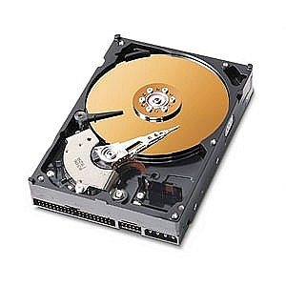
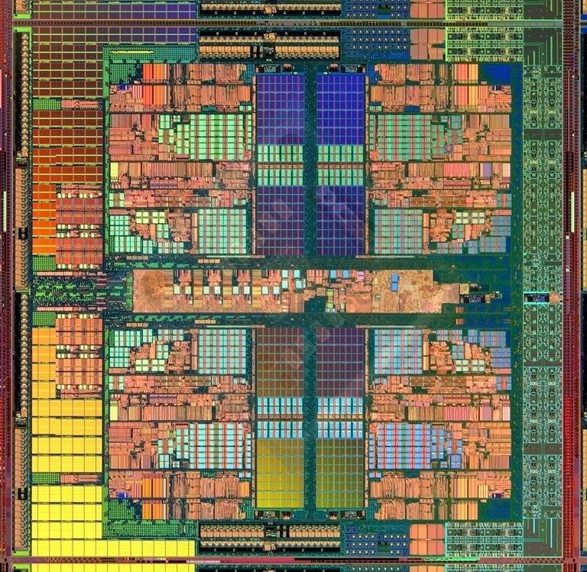
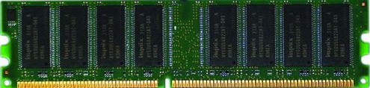
The Main Memory System
Main memory is a critical component of all computing systems: server, mobile, embedded, desktop, sensor
Main memory system must scale (in size, technology, efficiency, cost, and management algorithms) to maintain performance growth and technology scaling benefits
Processor
and caches
Main Memory
Storage (SSD/HDD)

Slide 11
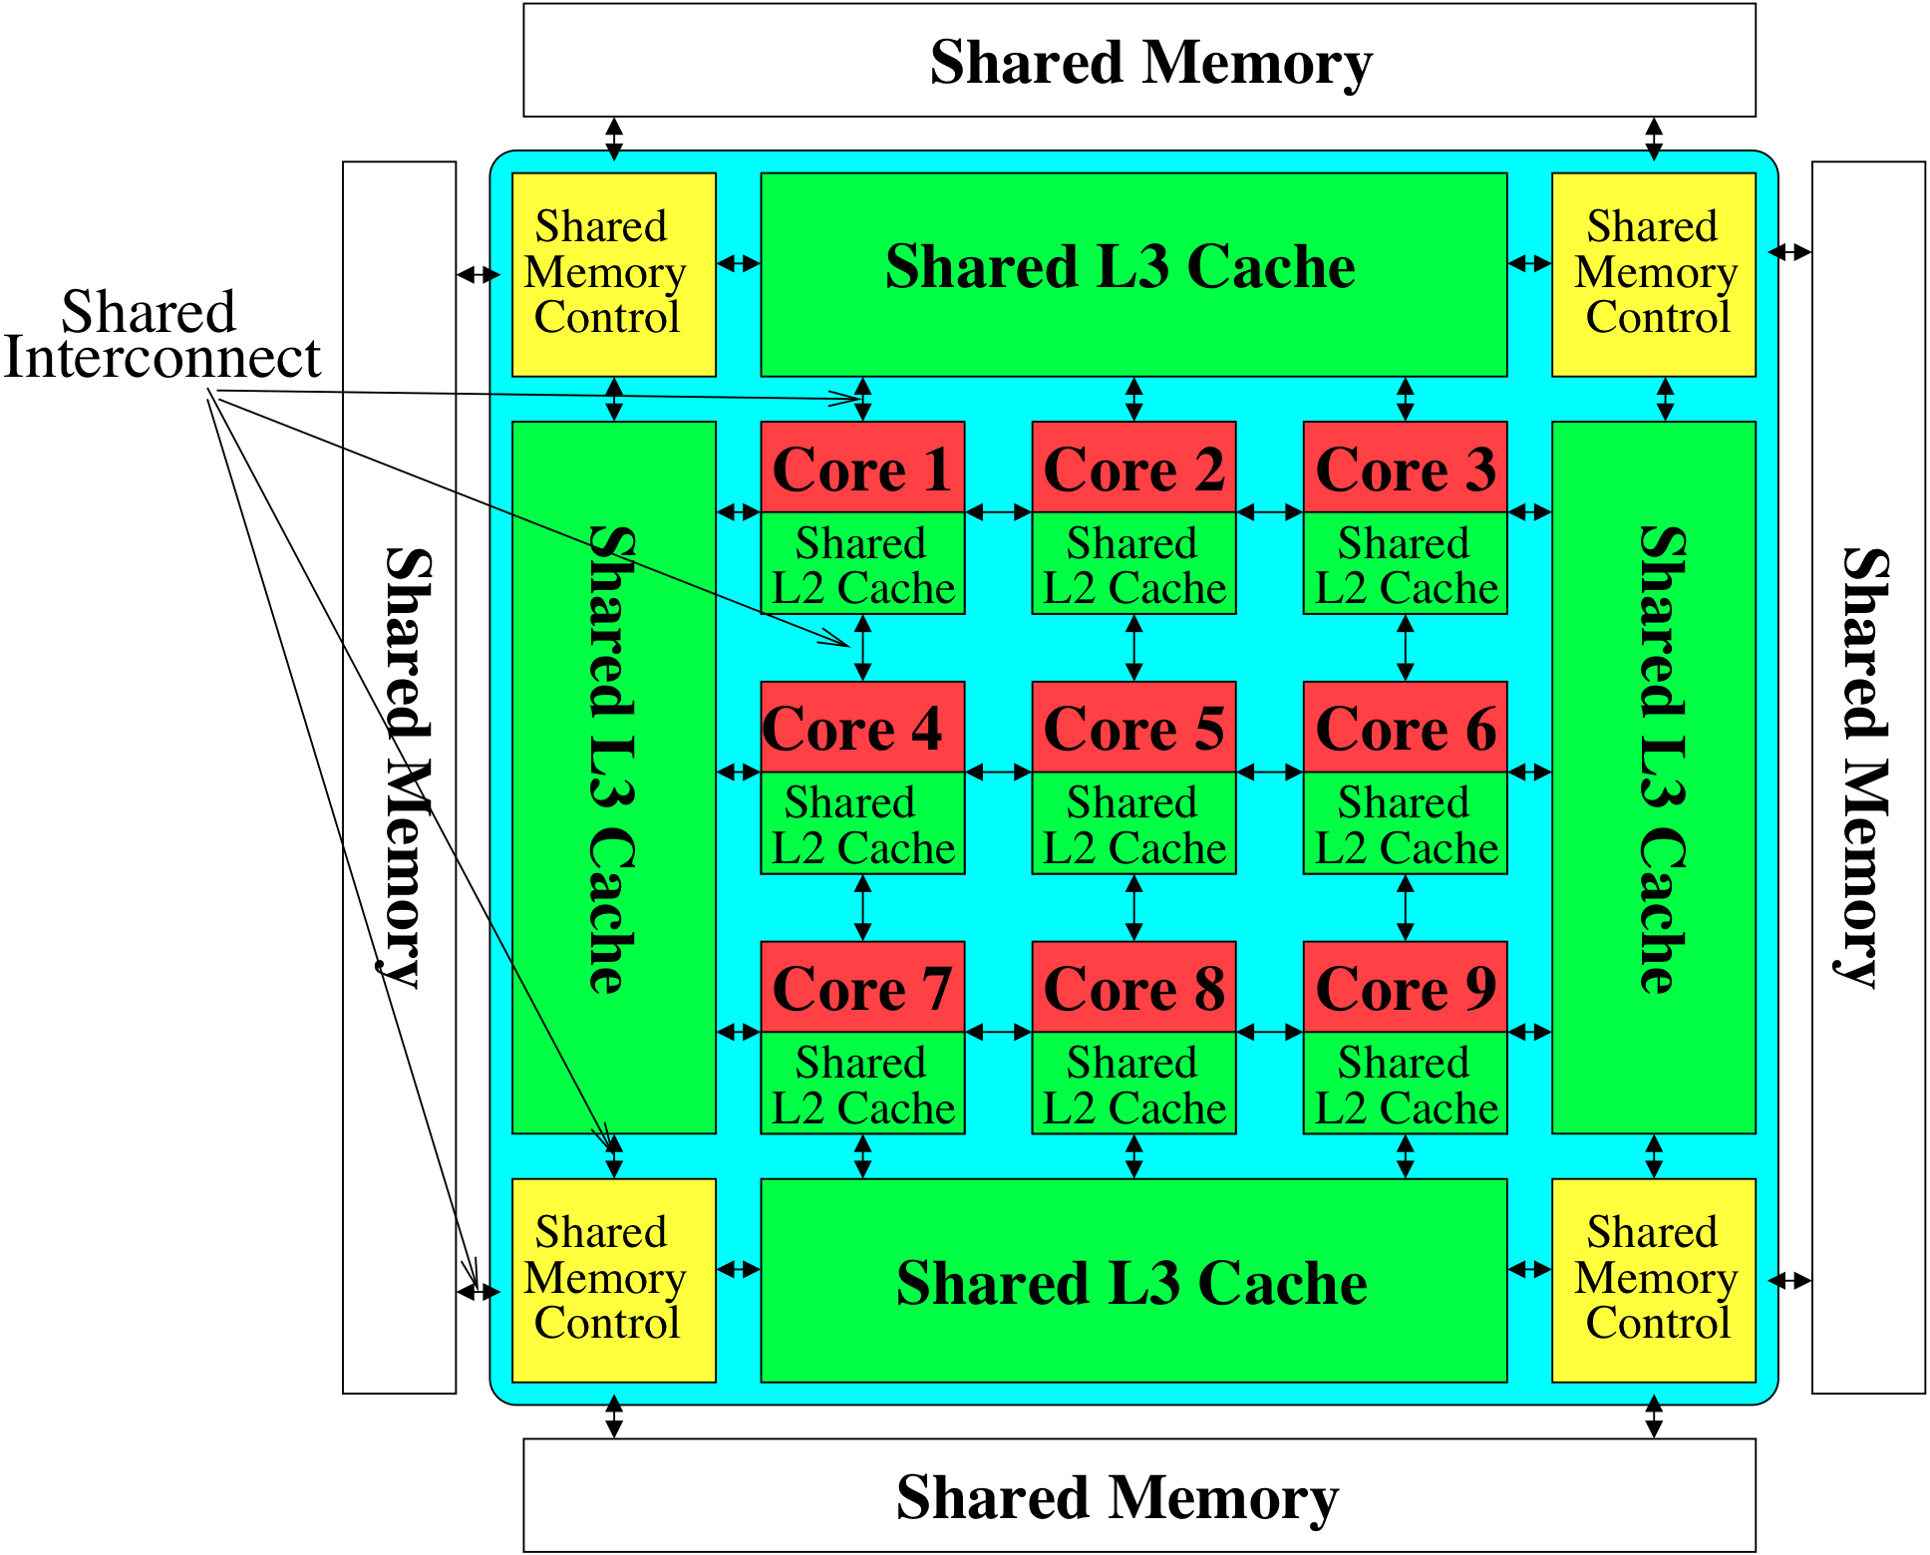
Memory System: A Shared Resource View
Storage

Slide 12
State of the Main Memory System
Recent technology, architecture, and application trends
  lead to new requirements
  exacerbate old requirements
DRAM and memory controllers, as we know them today, are (will be) unlikely to satisfy all requirements
Some emerging non-volatile memory technologies (e.g., PCM) enable new opportunities: memory+storage merging
We need to rethink the main memory system
  to fix DRAM issues and enable emerging technologies
  to satisfy all requirements

Slide 13
Agenda
Major Trends Affecting Main Memory
The Memory Scaling Problem and Solution Directions
  New Memory Architectures
  Enabling Emerging Technologies
How Can We Do Better?
Summary

Slide 14
Major Trends Affecting Main Memory (I)
Need for main memory capacity, bandwidth, QoS increasing
Main memory energy/power is a key system design concern
DRAM technology scaling is ending

Slide 15
Major Trends Affecting Main Memory (II)
Need for main memory capacity, bandwidth, QoS increasing
  Multi-core: increasing number of cores/agents
  Data-intensive applications: increasing demand/hunger for data
  Consolidation: cloud computing, GPUs, mobile, heterogeneity
Main memory energy/power is a key system design concern
DRAM technology scaling is ending

Slide 16
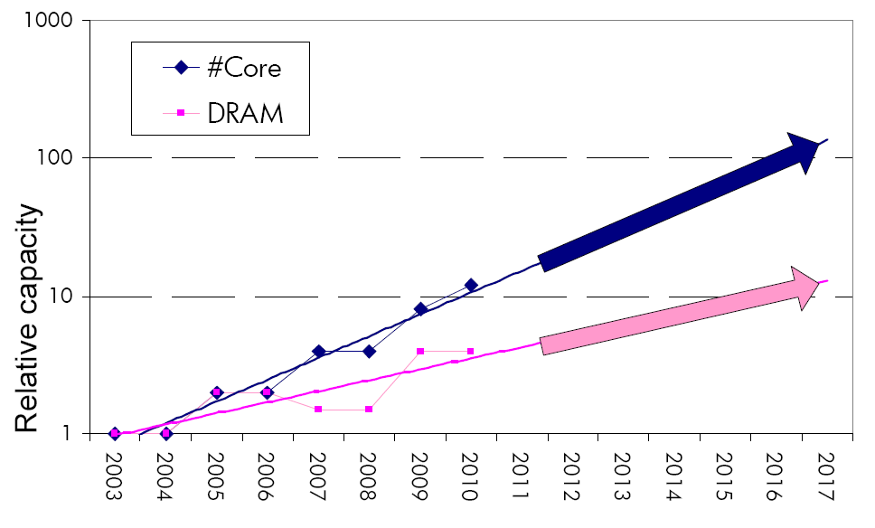
Example: The Memory Capacity Gap
Core count doubling ~ every 2 years
DRAM DIMM capacity doubling ~ every 3 years
Memory capacity per core expected to drop by 30% every two years
Trends worse for memory bandwidth per core!
Lim et al., ISCA 2009

Slide 17
Major Trends Affecting Main Memory (III)
Need for main memory capacity, bandwidth, QoS increasing
Main memory energy/power is a key system design concern
  ~40-50% energy spent in off-chip memory hierarchy [Lefurgy, IEEE Computer 2003]
  DRAM consumes power even when not used (periodic refresh)
DRAM technology scaling is ending

Slide 18
Major Trends Affecting Main Memory (IV)
Need for main memory capacity, bandwidth, QoS increasing
Main memory energy/power is a key system design concern
DRAM technology scaling is ending
  ITRS projects DRAM will not scale easily below X nm
  Scaling has provided many benefits:
    higher capacity (density), lower cost, lower energy

Slide 19
Agenda
Major Trends Affecting Main Memory
The Memory Scaling Problem and Solution Directions
  New Memory Architectures
  Enabling Emerging Technologies
How Can We Do Better?
Summary

Slide 20
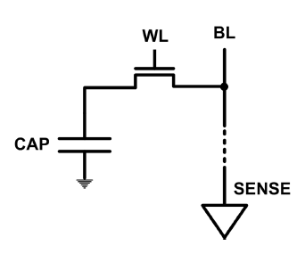
The DRAM Scaling Problem
DRAM stores charge in a capacitor (charge-based memory)
  Capacitor must be large enough for reliable sensing
  Access transistor should be large enough for low leakage and high retention time
  Scaling beyond 40-35nm (2013) is challenging [ITRS, 2009]
DRAM capacity, cost, and energy/power hard to scale

Slide 21
An Example of the DRAM Scaling Problem
Row of Cells
Wordline
Row
Victim Row
Row
Hammered Row
V_{LOW}
Opened
V_{HIGH}
Closed
Row
Victim Row
Row
Repeatedly opening and closing a row enough times within a refresh interval induces disturbance errors in adjacent rows in most real DRAM chips you can buy today
Flipping Bits in Memory Without Accessing Them: An Experimental Study of DRAM Disturbance Errors, (Kim et al., ISCA 2014)

Slide 22
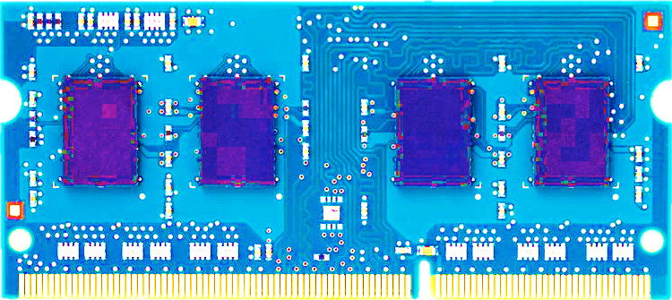
Most DRAM Modules Are at Risk
A company
B company
C company
86%
(37/43)
83%
(45/54)
88%
(28/32)
Up to
1.0×10⁷
errors
Up to
2.7×10⁶
errors
Up to
3.3×10⁵
errors
Flipping Bits in Memory Without Accessing Them: An Experimental Study of DRAM Disturbance Errors, (Kim et al., ISCA 2014)

Slide 23
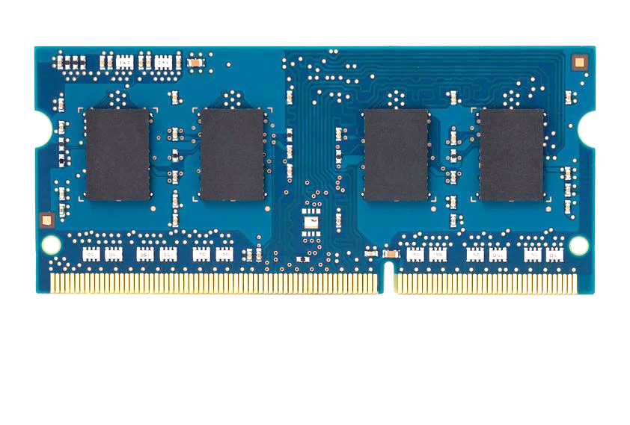
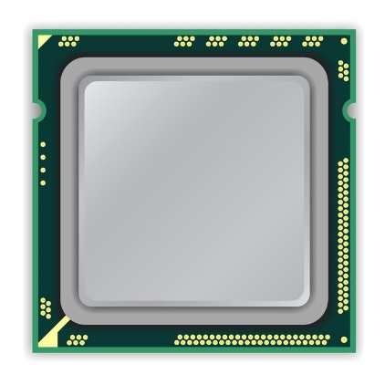
x86 CPU
DRAM Module
loop:
mov (X), %eax
mov (Y), %ebx
clflush (X)
clflush (Y)
mfence
jmp loop
X
Y
  https://github.com/CMU-SAFARI/rowhammer
Notes:
We demonstrate the errors on multiple x86 systems. Shown to the bottom-left is a “disturbance kernel”. When executed, it forces two rows to be opened and closed one after the other – over and over again. Consequently, it induces many errors in the module.

Slide 24
x86 CPU
DRAM Module
loop:
mov (X), %eax
mov (Y), %ebx
clflush (X)
clflush (Y)
mfence
jmp loop
X
Y
  https://github.com/CMU-SAFARI/rowhammer
Notes:
We demonstrate the errors on multiple x86 systems. Shown to the bottom-left is a “disturbance kernel”. When executed, it forces two rows to be opened and closed one after the other – over and over again. Consequently, it induces many errors in the module.

Slide 25
x86 CPU
DRAM Module
loop:
mov (X), %eax
mov (Y), %ebx
clflush (X)
clflush (Y)
mfence
jmp loop
X
Y
  https://github.com/CMU-SAFARI/rowhammer
Notes:
We demonstrate the errors on multiple x86 systems. Shown to the bottom-left is a “disturbance kernel”. When executed, it forces two rows to be opened and closed one after the other – over and over again. Consequently, it induces many errors in the module.

Slide 26
x86 CPU
DRAM Module
loop:
mov (X), %eax
mov (Y), %ebx
clflush (X)
clflush (Y)
mfence
jmp loop
X
Y
  https://github.com/CMU-SAFARI/rowhammer
Notes:
We demonstrate the errors on multiple x86 systems. Shown to the bottom-left is a “disturbance kernel”. When executed, it forces two rows to be opened and closed one after the other – over and over again. Consequently, it induces many errors in the module.

Slide 27
Observed Errors in Real Systems
A real reliability & security issue
In a more controlled environment, we can induce as many as ten million disturbance errors
CPU Architecture | Errors | Access-Rate
Intel Haswell (2013) | 22.9K | 12.3M/sec
Intel Ivy Bridge (2012) | 20.7K | 11.7M/sec
Intel Sandy Bridge (2011) | 16.1K | 11.6M/sec
AMD Piledriver (2012) | 59 | 6.1M/sec
Kim+, “Flipping Bits in Memory Without Accessing Them: An Experimental Study of DRAM Disturbance Errors,” ISCA 2014.
Notes:
When we executed the code on four different processors, all four of them yielded errors. Intel Haswell has the most errors, at 23 thousand, because it has the highest rate of accessing DRAM.
Later on, I’ll show that we can induce as many as ten million disturbance errors in a more controlled environment.
From this, we conclude that disturbance errors are a serious reliability issue.

Slide 28
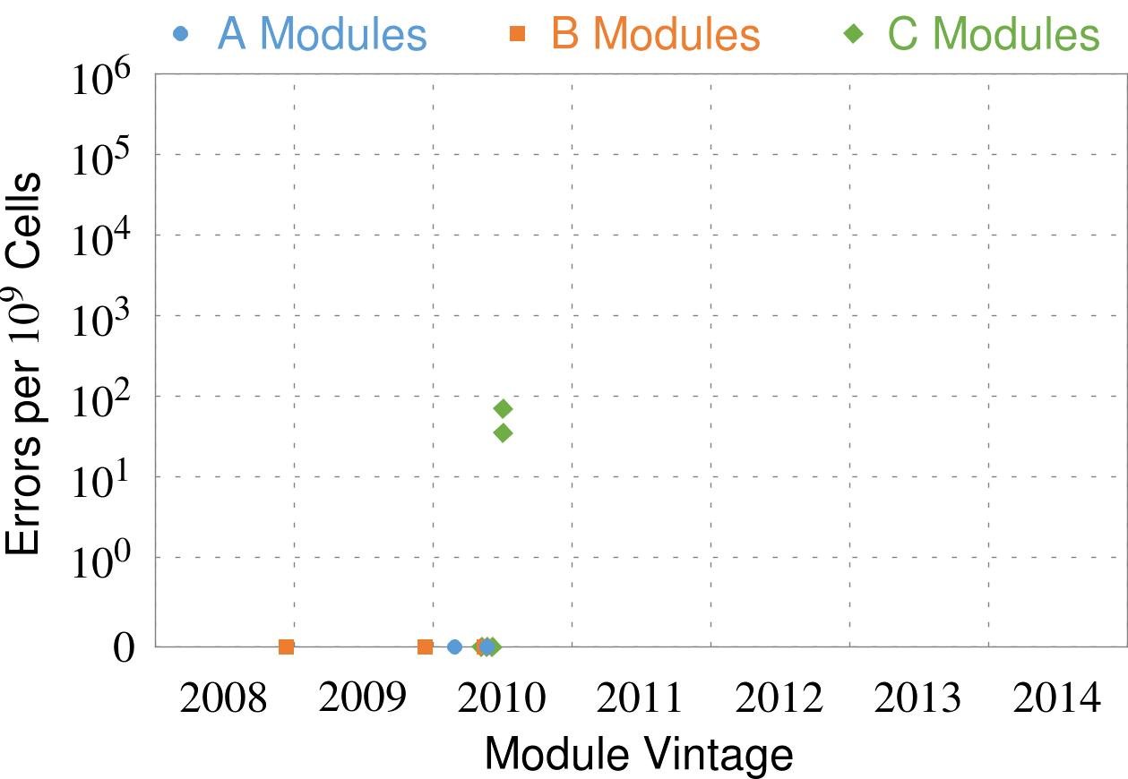
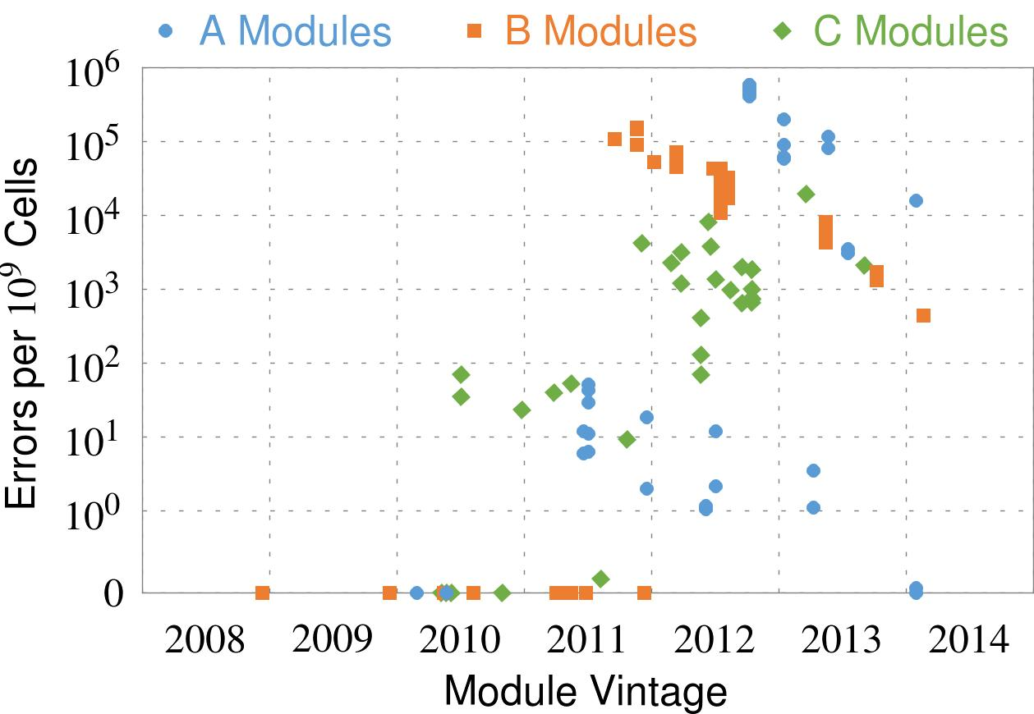
Errors vs. Vintage
First
Appearance
Notes:
In this figure, the x-axis is the module manufacture date. And the y-axis is the number of errors in a module, normalized to one billion cells. In 2008 and 2009, there are no errors. But, in 2010, we first start to see errors in C modules. After 2010, the errors start to proliferate. For A and B modules, we first start to see errors in 2011. In particular, all modules from 2012 and 2013 are vulnerable.

Slide 29
Errors vs. Vintage
First
Appearance
All modules from 2012–2013 are vulnerable
Notes:
In this figure, the x-axis is the module manufacture date. And the y-axis is the number of errors in a module, normalized to one billion cells. In 2008 and 2009, there are no errors. But, in 2010, we first start to see errors in C modules. After 2010, the errors start to proliferate. For A and B modules, we first start to see errors in 2011. In particular, all modules from 2012 and 2013 are vulnerable.

Slide 30
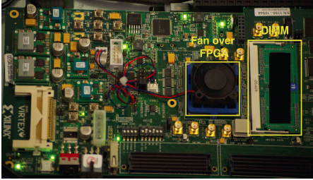
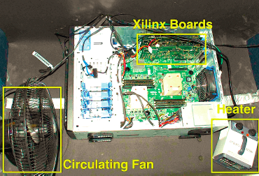
Experimental DRAM Testing Infrastructure
  An Experimental Study of Data Retention Behavior in Modern DRAM Devices: Implications for Retention Time Profiling Mechanisms (Liu et al., ISCA 2013)
  The Efficacy of Error Mitigation Techniques for DRAM Retention Failures: A Comparative Experimental Study
  (Khan et al., SIGMETRICS 2014)
  Flipping Bits in Memory Without Accessing Them: An Experimental Study of DRAM Disturbance Errors (Kim et al., ISCA 2014)
  Adaptive-Latency DRAM: Optimizing DRAM Timing for the Common-Case (Lee et al., HPCA 2015)
  AVATAR: A Variable-Retention-Time (VRT) Aware Refresh for DRAM Systems (Qureshi et al., DSN 2015)

Slide 31
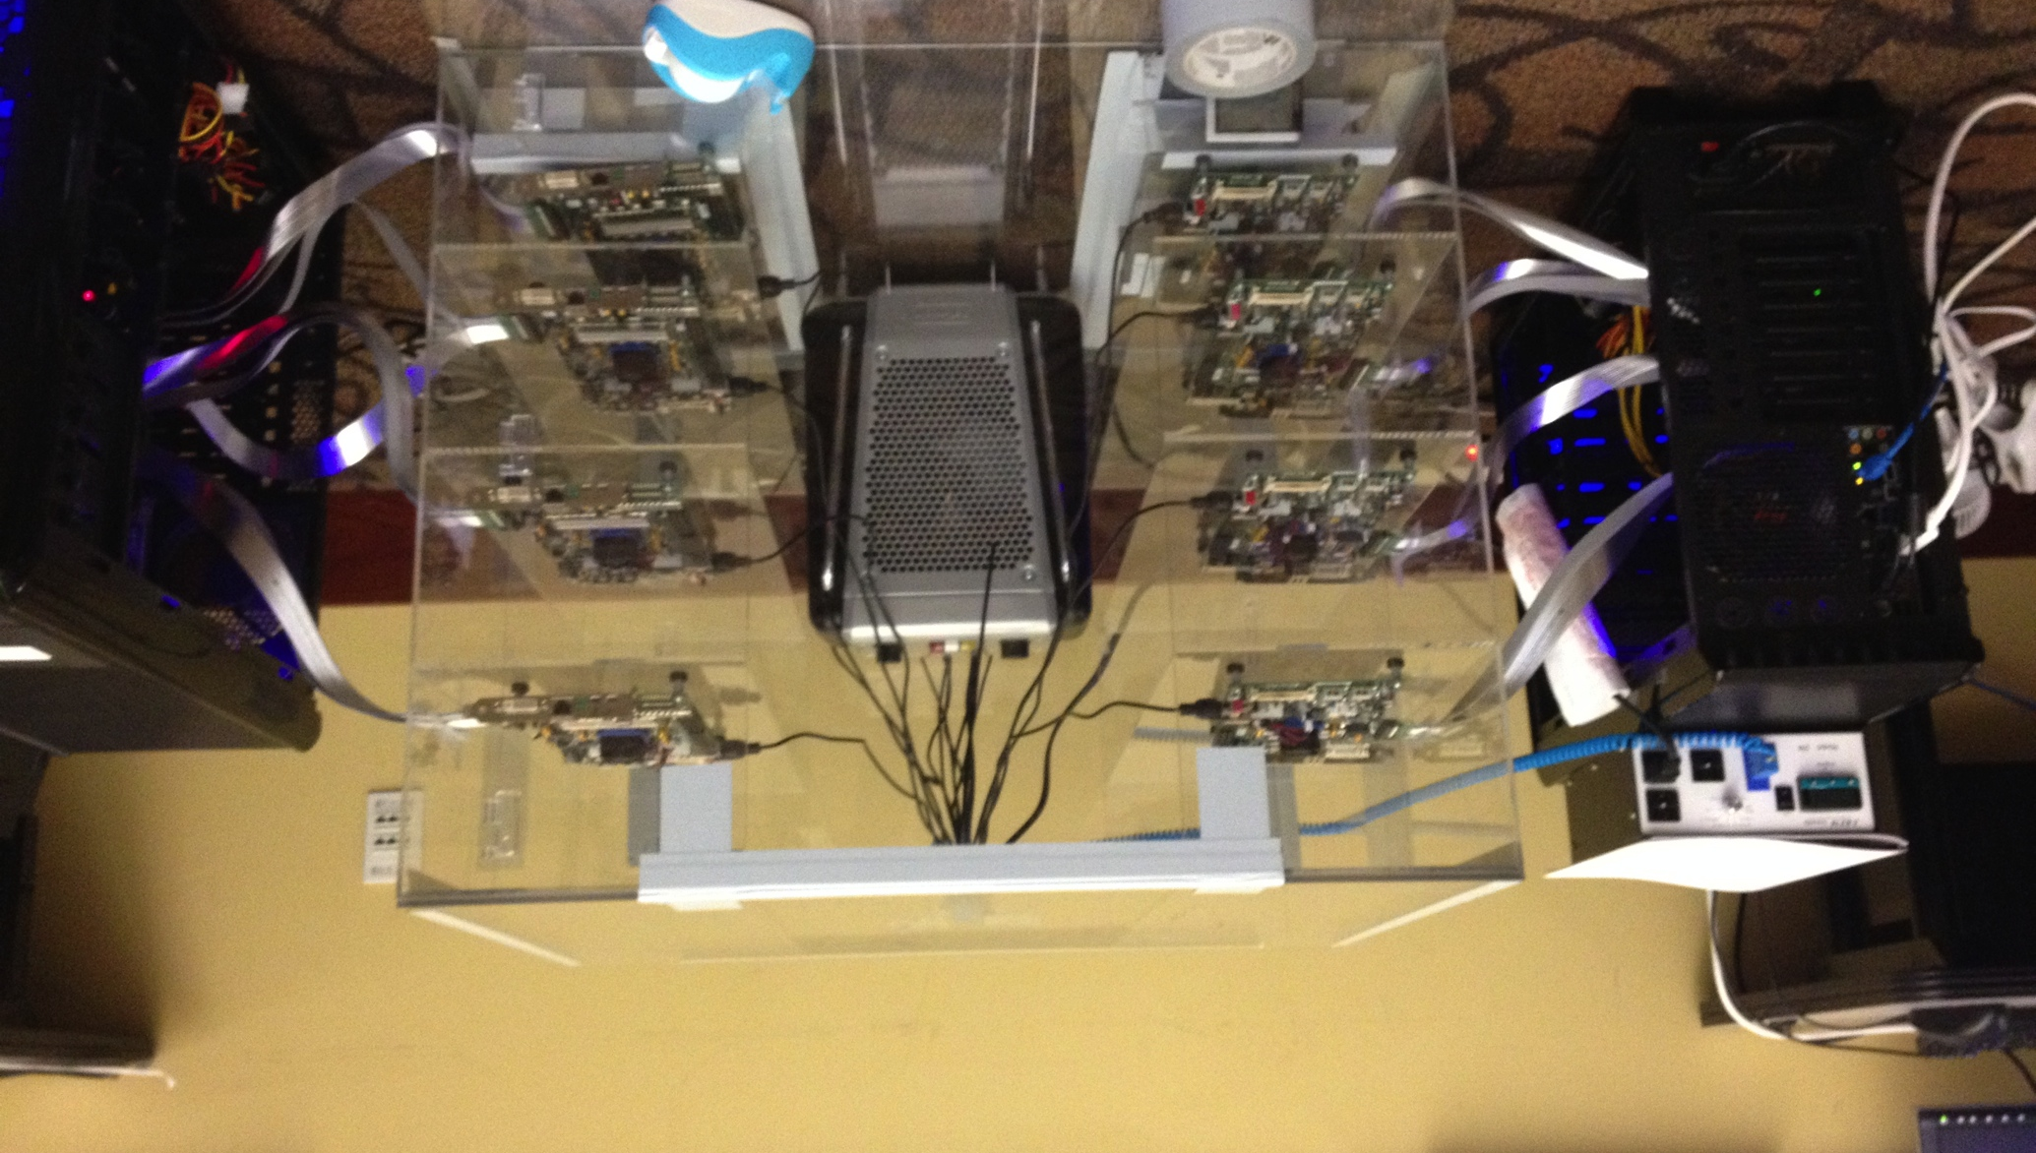
Experimental Infrastructure (DRAM)
Temperature
Controller
FPGAs
Heater
FPGAs
PC
  Kim+, “Flipping Bits in Memory Without Accessing Them: An Experimental Study of DRAM Disturbance Errors,” ISCA 2014.

Slide 32
RowHammer Characterization Results
Most Modules Are at Risk
Errors vs. Vintage
Error = Charge Loss
Adjacency: Aggressor & Victim
Sensitivity Studies
Other Results in Paper
Solution Space
Flipping Bits in Memory Without Accessing Them: An Experimental Study of DRAM Disturbance Errors, (Kim et al., ISCA 2014)
Notes:
Now I will present the characterization results, one-by-one.
First, I show that most modules are at risk. Second, I show the number of errors in a module as a function of the manufacture date. Third, I show that the errors are symptomatic of charge loss. Fourth, I show that an aggressor induces errors in adjacent rows. Fifth, I show several sensitivity studies. And, finally, I briefly describe other results in the paper.

Slide 33


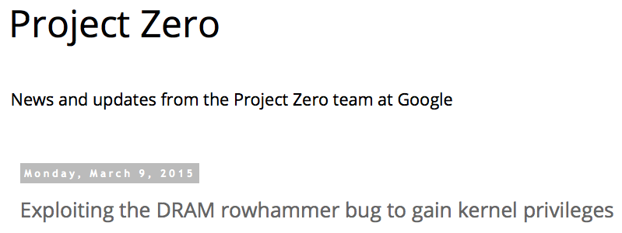
One Can Take Over an Otherwise-Secure System
Flipping Bits in Memory Without Accessing Them: An Experimental Study of DRAM Disturbance Errors (Kim et al., ISCA 2014)
Exploiting the DRAM rowhammer bug to gain kernel privileges (Seaborn, 2015)

Slide 34
RowHammer Security Attack Example
“Rowhammer” is a problem with some recent DRAM devices in which repeatedly accessing a row of memory can cause bit flips in adjacent rows (Kim et al., ISCA 2014).
  Flipping Bits in Memory Without Accessing Them: An Experimental Study of DRAM Disturbance Errors (Kim et al., ISCA 2014)
We tested a selection of laptops and found that a subset of them exhibited the problem.
We built two working privilege escalation exploits that use this effect.
  Exploiting the DRAM rowhammer bug to gain kernel privileges (Seaborn, 2015)
One exploit uses rowhammer-induced bit flips to gain kernel privileges on x86-64 Linux when run as an unprivileged userland process.
When run on a machine vulnerable to the rowhammer problem, the process was able to induce bit flips in page table entries (PTEs).
It was able to use this to gain write access to its own page table, and hence gain read-write access to all of physical memory.
Exploiting the DRAM rowhammer bug to gain kernel privileges (Seaborn, 2015)

Slide 35
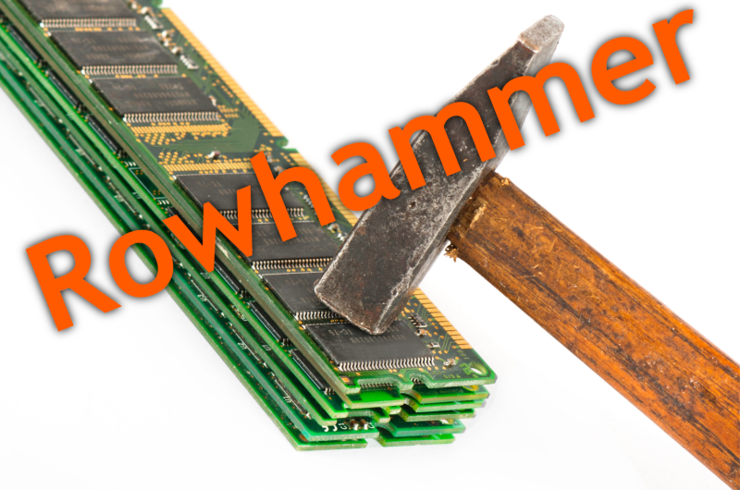

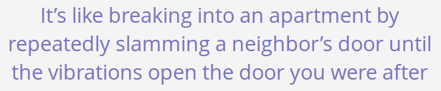
Security Implications
Notes:
Picture from the article:
http://thehackernews.com/2015/03/dram-rowhammer-vulnerability.html

Slide 36
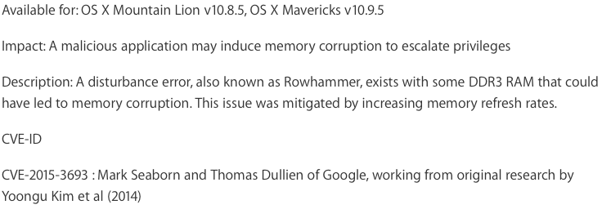
Apple’s Patch for RowHammer
https://support.apple.com/en-gb/HT204934

Slide 37
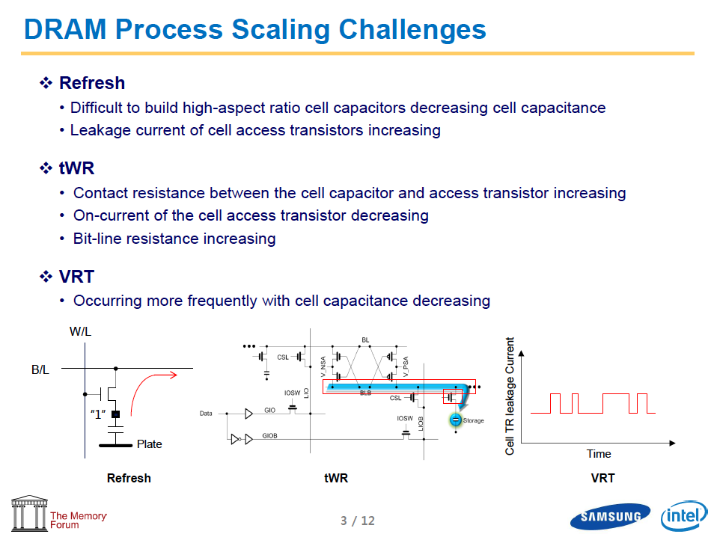
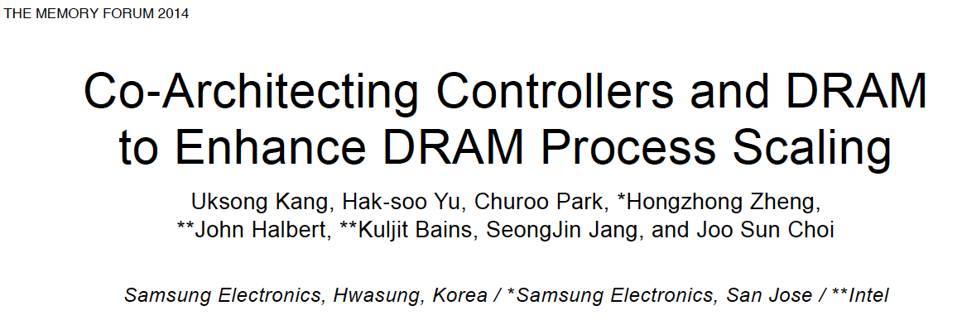
Recap: The DRAM Scaling Problem

Slide 38
How Do We Solve The Problem?
Fix it: Make DRAM and controllers more intelligent
  New interfaces, functions, architectures: system-DRAM codesign
Eliminate or minimize it: Replace or (more likely) augment DRAM with a different technology
  New technologies and system-wide rethinking of memory & storage
Embrace it: Design heterogeneous memories (none of which are perfect) and map data intelligently across them
  New models for data management and maybe usage
…
Problems
Algorithms
Programs
User
Runtime System
(VM, OS, MM)
ISA
Microarchitecture
Logic
Devices
Solutions (to memory scaling) require
software/hardware/device cooperation

Slide 39
Solution 1: Fix DRAM
Overcome DRAM shortcomings with
  System-DRAM co-design
  Novel DRAM architectures, interface, functions
  Better waste management (efficient utilization)
Key issues to tackle
  Enable reliability at low cost
  Reduce energy
  Improve latency and bandwidth
  Reduce waste (capacity, bandwidth, latency)
  Enable computation close to data

Slide 40
Solution 1: Fix DRAM
Liu+, “RAIDR: Retention-Aware Intelligent DRAM Refresh,” ISCA 2012.
Kim+, “A Case for Exploiting Subarray-Level Parallelism in DRAM,” ISCA 2012.
Lee+, “Tiered-Latency DRAM: A Low Latency and Low Cost DRAM Architecture,” HPCA 2013.
Liu+, “An Experimental Study of Data Retention Behavior in Modern DRAM Devices,” ISCA 2013.
Seshadri+, “RowClone: Fast and Efficient In-DRAM Copy and Initialization of Bulk Data,” MICRO 2013.
Pekhimenko+, “Linearly Compressed Pages: A Main Memory Compression Framework,” MICRO 2013.
Chang+, “Improving DRAM Performance by Parallelizing Refreshes with Accesses,” HPCA 2014.
Khan+, “The Efficacy of Error Mitigation Techniques for DRAM Retention Failures: A Comparative Experimental Study,” SIGMETRICS 2014.
Luo+, “Characterizing Application Memory Error Vulnerability to Optimize Data Center Cost,” DSN 2014.
Kim+, “Flipping Bits in Memory Without Accessing Them: An Experimental Study of DRAM Disturbance Errors,” ISCA 2014.
Lee+, “Adaptive-Latency DRAM: Optimizing DRAM Timing for the Common-Case,” HPCA 2015.
Qureshi+, “AVATAR: A Variable-Retention-Time (VRT) Aware Refresh for DRAM Systems,” DSN 2015.
Meza+, “Revisiting Memory Errors in Large-Scale Production Data Centers: Analysis and Modeling of New Trends from the Field,” DSN 2015.
Kim+, “Ramulator: A Fast and Extensible DRAM Simulator,” IEEE CAL 2015.
Seshadri+, “Fast Bulk Bitwise AND and OR in DRAM,” IEEE CAL 2015.
Ahn+, “A Scalable Processing-in-Memory Accelerator for Parallel Graph Processing,” ISCA 2015.
Ahn+, “PIM-Enabled Instructions: A Low-Overhead, Locality-Aware Processing-in-Memory Architecture,” ISCA 2015.
Lee+, “Decoupled Direct Memory Access: Isolating CPU and IO Traffic by Leveraging a Dual-Data-Port DRAM,” PACT 2015.
Seshadri+, “Gather-Scatter DRAM: In-DRAM Address Translation to Improve the Spatial Locality of Non-unit Strided Accesses,” MICRO 2015.
Avoid DRAM:
  Seshadri+, “The Evicted-Address Filter: A Unified Mechanism to Address Both Cache Pollution and Thrashing,” PACT 2012.
  Pekhimenko+, “Base-Delta-Immediate Compression: Practical Data Compression for On-Chip Caches,” PACT 2012.
  Seshadri+, “The Dirty-Block Index,” ISCA 2014.
  Pekhimenko+, “Exploiting Compressed Block Size as an Indicator of Future Reuse,” HPCA 2015.
  Vijaykumar+, “A Case for Core-Assisted Bottleneck Acceleration in GPUs: Enabling Flexible Data Compression with Assist Warps,” ISCA 2015.

Slide 41
Solution 2: Emerging Memory Technologies
Some emerging resistive memory technologies seem more scalable than DRAM (and they are non-volatile)
Example: Phase Change Memory
  Expected to scale to 9nm (2022 [ITRS])
  Expected to be denser than DRAM: can store multiple bits/cell
But, emerging technologies have shortcomings as well
  Can they be enabled to replace/augment/surpass DRAM?
Lee+, “Architecting Phase Change Memory as a Scalable DRAM Alternative,” ISCA’09, CACM’10, Micro’10.
Meza+, “Enabling Efficient and Scalable Hybrid Memories,” IEEE Comp. Arch. Letters 2012.
Yoon, Meza+, “Row Buffer Locality Aware Caching Policies for Hybrid Memories,” ICCD 2012.
Kultursay+, “Evaluating STT-RAM as an Energy-Efficient Main Memory Alternative,” ISPASS 2013.
Meza+, “A Case for Efficient Hardware-Software Cooperative Management of Storage and Memory,” WEED 2013.
Lu+, “Loose Ordering Consistency for Persistent Memory,” ICCD 2014.
Zhao+, “FIRM: Fair and High-Performance Memory Control for Persistent Memory Systems,” MICRO 2014.
Yoon, Meza+, “Efficient Data Mapping and Buffering Techniques for Multi-Level Cell Phase-Change Memories,” ACM TACO 2014.
Ren+, “ThyNVM: Enabling Software-Transparent Crash Consistency in Persistent Memory Systems,” MICRO 2015.
Notes:
Even if DRAM continues to scale there could be benefits to examining and enabling these new technologies.

Slide 42
Solution 3: Hybrid Memory Systems
CPU
Meza+, “Enabling Efficient and Scalable Hybrid Memories,” IEEE Comp. Arch. Letters, 2012.
Yoon, Meza et al., “Row Buffer Locality Aware Caching Policies for Hybrid Memories,” ICCD 2012 Best Paper Award.
DRAMCtrl
PCM Ctrl
DRAM
Technology X (e.g., PCM)
Fast, durable
Small,
leaky, volatile,
high-cost
Large, non-volatile, low-cost
Slow, wears out, high active energy
Hardware/software manage data allocation and movement
to achieve the best of multiple technologies

Slide 43
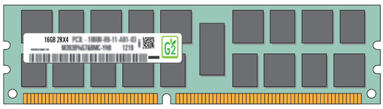
Exploiting Memory Error Tolerance with Hybrid Memory Systems
Heterogeneous-Reliability Memory [DSN 2014]
Vulnerable data
Vulnerable data
Tolerant data
Tolerant data
Reliable memory
Low-cost memory
Vulnerable data
  On Microsoft’s Web Search workload
  Reduces server hardware cost by 4.7 %
  Achieves single server availability target of 99.90 %
ECC protected
Well-tested chips
Tolerant data
NoECC or Parity
Less-tested chips
Notes:
As we have shown earlier, either across or within applications, our characterization can identify data that are vulnerable to memory errors and data that are tolerant to memory errors.
To exploit this observation, we would like to map these different data onto different memory modules according to their memory error tolerance.
As an example here, we map vulnerable data to reliable memory to improve reliability, and map tolerant data to low-cost less-reliable memory to exploit its tolerance and lower the cost. We call this mechanism heterogeneous-reliability memory, HRM.
Reliable memory consists of … Low cost memory consists of …
As we will show later, HRM allows us to use weaker error protection in memory, and enables the use of less-tested memory chips to lower the cost of the memory system, while still achieving reasonable single-server reliability target.

Slide 44
An Orthogonal Issue: Memory Interference
Main
Memory
Core
Core
Core
Core
Cores’ interfere with each other when accessing shared main memory
Notes:
In a multicore system, multiple applications running on the different cores share the main memory.
These applications interfere at the main memory. The result of this interference is unpredictable application slowdowns.

Slide 45
An Orthogonal Issue: Memory Interference
Problem: Memory interference between cores is uncontrolled
  → unfairness, starvation, low performance
  → uncontrollable, unpredictable, vulnerable system
Solution: QoS-Aware Memory Systems
  Hardware designed to provide a configurable fairness substrate
    Application-aware memory scheduling, partitioning, throttling
  Software designed to configure the resources to satisfy different QoS goals
QoS-aware memory systems can provide predictable performance and higher efficiency

Slide 46
Goal: Predictable Performance in Complex Systems
CPU
CPU
CPU
CPU
GPU
HWA
HWA
Shared Cache
DRAM and Hybrid Memory Controllers
DRAM and Hybrid Memories
Heterogeneous agents: CPUs, GPUs, and HWAs
Main memory interference between CPUs, GPUs, HWAs
How to allocate resources to heterogeneous agents
to mitigate interference and provide predictable performance?

Slide 47
Strong Memory Service Guarantees
Goal: Satisfy performance/SLA requirements in the presence of shared main memory, heterogeneous agents, and hybrid memory/storage
Approach:
  Develop techniques/models to accurately estimate the performance loss of an application/agent in the presence of resource sharing
  Develop mechanisms (hardware and software) to enable the resource partitioning/prioritization needed to achieve the required performance levels for all applications
  All the while providing high system performance
Subramanian et al., “MISE: Providing Performance Predictability and Improving Fairness in Shared Main Memory Systems,” HPCA 2013.
Subramanian et al., “The Application Slowdown Model,” MICRO 2015.

Slide 48
Challenge for Interconnects
QoS
and
Predictability

Slide 49
Some Promising Directions
New memory architectures
  Rethinking DRAM and flash memory
  A lot of hope in fixing DRAM
Enabling emerging NVM technologies
  Hybrid memory systems
  Single-level memory and storage
  A lot of hope in hybrid memory systems and single-level stores
System-level memory/storage QoS
  A lot of hope in designing a predictable system

Slide 50
Agenda
Major Trends Affecting Main Memory
The Memory Scaling Problem and Solution Directions
  New Memory Architectures
  Enabling Emerging Technologies
How Can We Do Better?
Summary

Slide 51
Rethinking DRAM
In-Memory Computation
Refresh
Reliability
Latency
Bandwidth
Energy
Memory Compression

Slide 52
Why In-Memory Computation Today?
Push from Technology
  DRAM Scaling at jeopardy
  → Controllers close to DRAM
  → Industry open to new memory architectures
Pull from Systems and Applications
  Data access is a major system and application bottleneck
  Systems are energy limited
  Data movement much more energy-hungry than computation

Slide 53
Two Approaches to In-Memory Processing
1. Minimally change DRAM to enable simple yet powerful computation primitives
  RowClone: Fast and Efficient In-DRAM Copy and Initialization of Bulk Data (Seshadri et al., MICRO 2013)
  Fast Bulk Bitwise AND and OR in DRAM (Seshadri et al., IEEE CAL 2015)
2. Exploit the control logic in 3D-stacked memory to enable more comprehensive computation near memory
  PIM-Enabled Instructions: A Low-Overhead, Locality-Aware Processing-in-Memory Architecture (Ahn et al., ISCA 2015)
  A Scalable Processing-in-Memory Accelerator for Parallel Graph Processing (Ahn et al., ISCA 2015)

Slide 54
Today’s Memory: Bulk Data Copy
1) High latency
Memory
3) Cache pollution
L3
CPU
L2
L1
MC
2) High bandwidth utilization
4) Unwanted data movement
1046ns, 3.6uJ (for 4KB page copy via DMA)

Slide 55
Future: RowClone (In-Memory Copy)
3) No cache pollution
1) Low latency
Memory
L3
CPU
L2
L1
MC
2) Low bandwidth utilization
4) No unwanted data movement
1046ns, 3.6uJ
90ns, 0.04uJ

Slide 56
DRAM Subarray Operation (load one byte)
4 Kbytes
Step 1: Activate row
Transfer row
DRAM subarray
Row Buffer (4 Kbytes)
Step 2: Read
Transfer byte onto bus
8 bits
Data Bus
Notes:
say you want a byte

Slide 57
RowClone: In-DRAM Row Copy
4 Kbytes
Step 1: Activate row A
Step 2: Activate row B
Transfer row
DRAM subarray
Transfer
row
Row Buffer (4 Kbytes)
8 bits
Data Bus
Notes:
copy

Slide 58
Generalized RowClone
0.01% area cost
Inter Subarray Copy
(Use Inter-Bank Copy Twice)
Subarray
Chip I/O
Bank
Bank I/O
Memory Channel
Inter Bank Copy
(Pipelined
Internal RD/WR)
Intra Subarray
Copy (2 ACTs)

Slide 59
RowClone: Latency and Energy Savings
11.6x
74x
Seshadri et al., “RowClone: Fast and Efficient In-DRAM Copy and Initialization of Bulk Data,” MICRO 2013.

Slide 60
RowClone: Application Performance

Slide 61
RowClone: Multi-Core Performance

Slide 62
End-to-End System Design
Application
How to communicate occurrences of bulk copy/initialization across layers?
Operating System
How to ensure cache coherence?
ISA
Microarchitecture
How to maximize latency and energy savings?
DRAM (RowClone)
How to handle data reuse?

Slide 63
Goal: Ultra-Efficient Processing Near Data
CPU
core
CPU
core
mini-CPU
core
GPU
(throughput)
core
GPU
(throughput)
core
video
core
GPU
(throughput)
core
GPU
(throughput)
core
CPU
core
CPU
core
Memory
imaging
core
LLC
Specialized
compute-capability
in memory
Memory Controller
Memory Bus
Memory similar to a “conventional” accelerator

Slide 64
Enabling In-Memory Search
What is a flexible and scalable memory interface?
What is the right partitioning of computation capability?
What is the right low-cost memory substrate?
What memory technologies are the best enablers?
How do we rethink/ease search algorithms/applications?
Memory
Processor
Core
Database
Graphs
Media
Cache
Query
Interconnect
Results

Slide 65
Challenge for Interconnects
Efficient
Data
Movement

Slide 66
Enabling In-Memory Computation
DRAM Support
Cache Coherence
Virtual Memory Support
RowClone
(MICRO 2013)
Dirty-Block Index
(ISCA 2014)
Page Overlays
(ISCA 2015)
In-DRAM Gather Scatter
(MICRO 2015)
Non-contiguous Cache lines
Gathered Pages
In-DRAM Bitwise Operations
(IEEE CAL 2015)
?
?

Slide 67
In-DRAM AND/OR: Triple Row Activation
½V_{DD}
½V_{DD}+δ
V_{DD}
A
Final State
AB + BC + AC
B
C
C(A + B) + ~C(AB)
dis
en
0
½V_{DD}
Seshadri+, “Fast Bulk Bitwise AND and OR in DRAM”, IEEE CAL 2015.

Slide 68
In-DRAM Bulk Bitwise AND/OR Operation
BULKAND A, B → C
Semantics: Perform a bitwise AND of two rows A and B and store the result in row C
R0 – reserved zero row, R1 – reserved one row
D1, D2, D3 – Designated rows for triple activation
1. RowClone A into D1
2. RowClone B into D2
3. RowClone R0 into D3
4. ACTIVATE D1,D2,D3
5. RowClone Result into C

Slide 69
In-DRAM AND/OR Results
20X improvement in AND/OR throughput vs. Intel AVX
50.5X reduction in memory energy consumption
At least 30% performance improvement in range queries
In-DRAM AND (2 banks)
Throughput of AND operations (GB/s)
In-DRAM AND (1 bank)
Intel AVX
Size of Vectors to be ANDed
Seshadri+, “Fast Bulk Bitwise AND and OR in DRAM”, IEEE CAL 2015.

Slide 70
Going Forward
A bulk computation model in memory
New memory & software interfaces to enable bulk in-memory computation
New programming models, algorithms, compilers, and system designs that can take advantage of the model
Problems
Algorithms
Programs
User
Runtime System
(VM, OS, MM)
ISA
Microarchitecture
Logic
Devices

Slide 71
Two Approaches to In-Memory Processing
1. Minimally change DRAM to enable simple yet powerful computation primitives
  RowClone: Fast and Efficient In-DRAM Copy and Initialization of Bulk Data (Seshadri et al., MICRO 2013)
  Fast Bulk Bitwise AND and OR in DRAM (Seshadri et al., IEEE CAL 2015)
2. Exploit the control logic in 3D-stacked memory to enable more comprehensive computation near memory
  PIM-Enabled Instructions: A Low-Overhead, Locality-Aware Processing-in-Memory Architecture (Ahn et al., ISCA 2015)
  A Scalable Processing-in-Memory Accelerator for Parallel Graph Processing (Ahn et al., ISCA 2015)

Slide 72
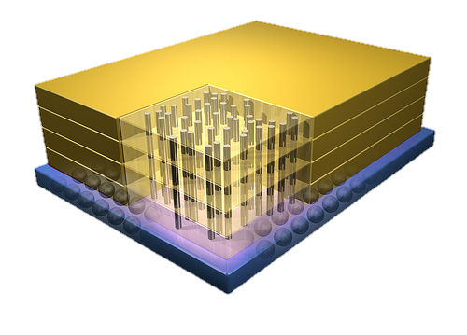
Tesseract System for Graph Processing
Host Processor
Memory-Mapped
Accelerator Interface
(Noncacheable, Physically Addressed)
In-Order Core
DRAM Controller
…
…
LP
PF Buffer
Crossbar Network
…
MTP
…
Message Queue
NI

Slide 73
Evaluated Systems
DDR3-OoO
HMC-OoO
HMC-MC
Tesseract
(with FDP)
(with FDP)
(32-entry MQ, 4KB PF Buffer)
32 Tesseract Cores
8 OoO
4GHz
8 OoO
4GHz
8 OoO
4GHz
8 OoO
4GHz
128
In-Order
2GHz
128
In-Order
2GHz
8 OoO
4GHz
8 OoO
4GHz
8 OoO
4GHz
8 OoO
4GHz
128
In-Order
2GHz
128
In-Order
2GHz
102.4GB/s
640GB/s
640GB/s
8TB/s

Slide 74
Workloads
Five graph processing algorithms
  Average teenage follower
  Conductance
  PageRank
  Single-source shortest path
  Vertex cover
Three real-world large graphs
  ljournal-2008 (social network)
  enwiki-2003 (Wikipedia)
  indochina-0024 (web graph)
  4~7M vertices, 79~194M edges

Slide 75
Tesseract Graph Processing Performance

Slide 76
Tesseract Graph Processing Performance

Slide 77
Memory Energy Consumption (Normalized)
-87%

Slide 78
Challenge for Interconnects
Interconnect Design
for
3D-stacked Memory

Slide 79
Rethinking DRAM
In-Memory Computation
Refresh
Reliability
Latency
Bandwidth
Energy
Memory Compression

Slide 80
DRAM Refresh
DRAM capacitor charge leaks over time
The memory controller needs to refresh each row periodically to restore charge
  Activate each row every N ms
  Typical N = 64 ms
Downsides of refresh
-- Energy consumption: Each refresh consumes energy
  -- Performance degradation: DRAM rank/bank unavailable while refreshed
  -- QoS/predictability impact: (Long) pause times during refresh
  -- Refresh rate limits DRAM capacity scaling

Slide 81
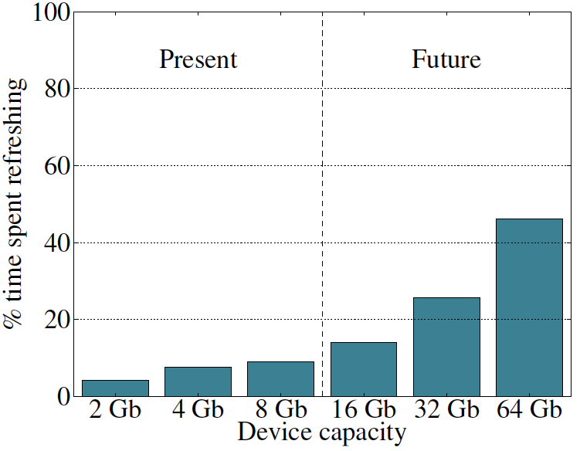
Refresh Overhead: Performance
46%
8%
Liu et al., “RAIDR: Retention-Aware Intelligent DRAM Refresh,” ISCA 2012.

Slide 82
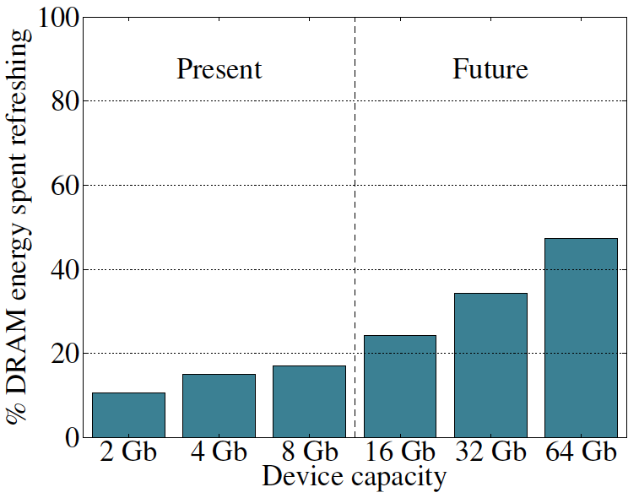
Refresh Overhead: Energy
47%
15%
Liu et al., “RAIDR: Retention-Aware Intelligent DRAM Refresh,” ISCA 2012.

Slide 83
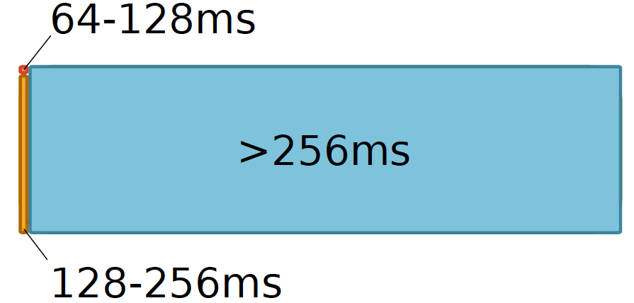
Retention Time Profile of DRAM

Slide 84
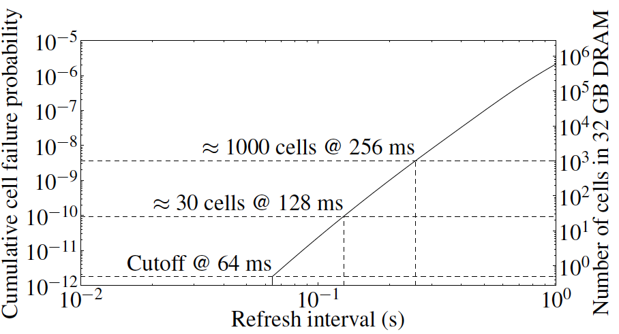
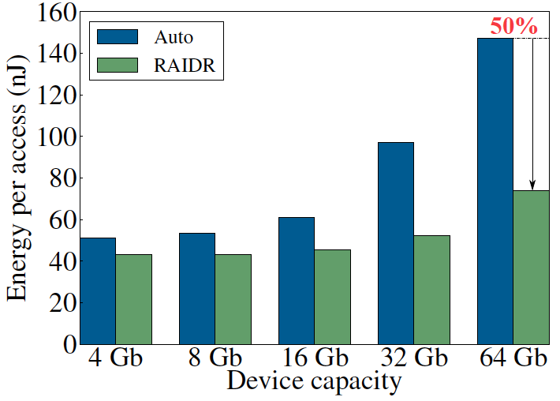
RAIDR: Eliminating Unnecessary Refreshes
Observation: Most DRAM rows can be refreshed much less often without losing data [Kim+, EDL’09][Liu+ ISCA’13]
Key idea: Refresh rows containing weak cells
more frequently, other rows less frequently
  1. Profiling: Profile retention time of all rows
  2. Binning: Store rows into bins by retention time in memory controller
  Efficient storage with Bloom Filters (only 1.25KB for 32GB memory)
  3. Refreshing: Memory controller refreshes rows in different bins at different rates
Results: 8-core, 32GB, SPEC, TPC-C, TPC-H
  74.6% refresh reduction @ 1.25KB storage
  ~16%/20% DRAM dynamic/idle power reduction
  ~9% performance improvement
  Benefits increase with DRAM capacity
Liu et al., “RAIDR: Retention-Aware Intelligent DRAM Refresh,” ISCA 2012.

Slide 85
Going Forward (for DRAM and Flash)
How to find out weak memory cells/rows
  Liu+, “An Experimental Study of Data Retention Behavior in Modern DRAM Devices: Implications for Retention Time Profiling Mechanisms”, ISCA 2013.
  Khan+, “The Efficacy of Error Mitigation Techniques for DRAM Retention Failures: A Comparative Experimental Study,” SIGMETRICS 2014.
Low-cost system-level tolerance of memory errors
  Luo+, “Characterizing Application Memory Error Vulnerability to Optimize Data Center Cost,” DSN 2014.
  Cai+, “Error Analysis and Retention-Aware Error Management for NAND Flash Memory,” Intel Technology Journal 2013.
  Cai+, “Neighbor-Cell Assisted Error Correction for MLC NAND Flash Memories,” SIGMETRICS 2014.
Tolerating cell-to-cell interference at the system level
  Kim+, “Flipping Bits in Memory Without Accessing Them: An Experimental Study of DRAM Disturbance Errors,” ISCA 2014.
  Cai+, “Program Interference in MLC NAND Flash Memory: Characterization, Modeling, and Mitigation,” ICCD 2013.

Slide 86
Experimental DRAM Testing Infrastructure
  An Experimental Study of Data Retention Behavior in Modern DRAM Devices: Implications for Retention Time Profiling Mechanisms (Liu et al., ISCA 2013)
  The Efficacy of Error Mitigation Techniques for DRAM Retention Failures: A Comparative Experimental Study
  (Khan et al., SIGMETRICS 2014)
  Flipping Bits in Memory Without Accessing Them: An Experimental Study of DRAM Disturbance Errors (Kim et al., ISCA 2014)
  Adaptive-Latency DRAM: Optimizing DRAM Timing for the Common-Case (Lee et al., HPCA 2015)
  AVATAR: A Variable-Retention-Time (VRT) Aware Refresh for DRAM Systems (Qureshi et al., DSN 2015)

Slide 87
Experimental Infrastructure (DRAM)
Temperature
Controller
FPGAs
Heater
FPGAs
PC
  Kim+, “Flipping Bits in Memory Without Accessing Them: An Experimental Study of DRAM Disturbance Errors,” ISCA 2014.

Slide 88
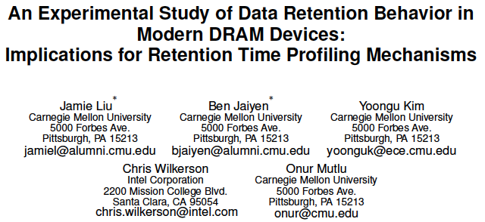
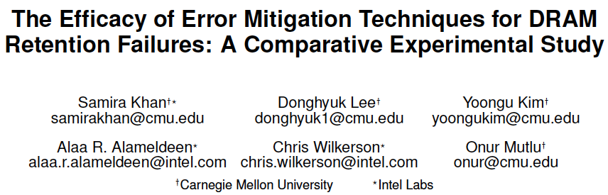
More Information [ISCA’13, SIGMETRICS’14]

Slide 89

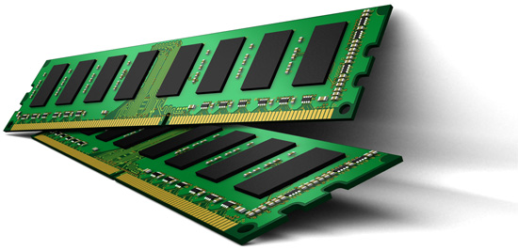
Online Profiling of DRAM In the Field
Initially protect DRAM
with ECC
Periodically test
parts of DRAM
1
2
Test
ECC
Test
Test
Adjust refresh rate and
reduce ECC
3
Optimize DRAM and mitigate errors online
without disturbing the system and applications
Notes:
Based on these observations, we propose that in an online profiling system,

Slide 90
Challenge for Interconnects
Fault Tolerance

Slide 91
Rethinking DRAM
In-Memory Computation
Refresh
Reliability
Latency
Bandwidth
Energy
Memory Compression

Slide 92
DRAM Latency-Capacity Trend
16X
-20%
DRAM latency continues to be a critical bottleneck, especially for response time-sensitive workloads
Notes:
The figure shows the historical trends of DRAM during the last 12-years, from 2000 to 2011.
We can see that, during this time, DRAM capacity has increased by 16 times.
On the other hand, during the same period of time, DRAM latency has reduced by only 20%.
As a result, the high DRAM latency continues to be a critical bottleneck for system performance.

Slide 93
What Causes the Long Latency?
DRAM Chip
DRAM Chip
cell array
subarray
Subarray
I/O
I/O
I/O
channel
channel
DRAM Latency = Subarray Latency + I/O Latency
DRAM Latency = Subarray Latency + I/O Latency
Dominant
Notes:
To understand what causes the long latency, let me take a look at the DRAM organization.
DRAM consists of two components, the cell array and the I/O circuitry. The cell array consists of multiple subarrays.
To read from a DRAM chip, the data is first accessed from the subarray and then the data is transferred over the channel by the I/O circuitry.
So, the DRAM latency is the sum of the subarray latency and the I/O latency.
We observed that the subarray latency is much higher than the I/O latency.
As a result, subarray is the dominant source of the DRAM latency as we explained in the paper.

Slide 94
Why is the Subarray So Slow?
Subarray
Cell
cell
wordline
bitline: 512 cells
access
row decoder
row decoder
transistor
capacitor
sense amplifier
bitline
sense amplifier
large sense amplifier
Long bitline
  Amortizes sense amplifier cost → Small area
  Large bitline capacitance → High latency & power
Notes:
The cell’s capacitor is small and can store only a small amount of charge.
That is why a subarray also has sense-amplifiers, which are specialized circuits that can detect the small amount of charge.
Unfortunately, a sense-amplifier size is about *100* times the cell size.
So, to amortize the area of the sense-amplifiers,
hundreds of cells share the same sense-amplifier through a long bitline.
However, a long bitline has a large capacitance that increases latency and power consumption.
Therefore, the long bitline is one of the dominant sources of high latency and high power consumption.
To understand why the subarray is so slow,
let me take a look at the subarray organization.

Slide 95
Trade-Off: Area (Die Size) vs. Latency
Long Bitline
Short Bitline
Faster
Smaller
Trade-Off: Area vs. Latency
Notes:
A naïve way to reduce the DRAM latency is to have short bitlines that have lower latency.
Unfortunately, short bitlines significantly increase the DRAM area.
Therefore, the bitline length exposes an important trade-off between area and latency.

Slide 96
Trade-Off: Area (Die Size) vs. Latency
32
Fancy DRAM
Short Bitline
Commodity DRAM
Long Bitline
64
Cheaper
128
256
512 cells/bitline
GOAL
Faster
Notes:
This figure shows the trade-off between DRAM area and latency as we change the bitline length.
Y-axis is the normalized DRAM area compared to a DRAM using 512 cells/bitline. A lower value is cheaper.
X-axis shows the latency in terms of tRC, an important DRAM timing constraint. A lower value is faster.
Commodity DRAM chips use long bitlines to minimize area cost. On the other hand, shorter bitlines achieve lower latency at higher cost.
Our goal is to achieve the best of both worlds: low latency and low area cost.

Slide 97
Approximating the Best of Both Worlds
Long Bitline
Long Bitline
Our Proposal
Short Bitline
Short Bitline
Small Area
Large Area
Small Area
High Latency
Low Latency
Low Latency
Need Isolation
Add Isolation Transistors
Short Bitline ➔ Fast
Notes:
To sum up, both long and short bitline do not achieve small area and low latency.
Long bitline has small area but has high latency while short bitline has low latency but has large area.
To achieve the best of both worlds, we first start from long bitline, which has small area.
After that, to achieve the low latency of short bitline, we divide the long bitline into two smaller segments.
The bitline length of the segment nearby the sense-amplifier is same as the length of short bitline.
Therefore, the latency of the segment is as low as the latency of the short bitline.
To isolate this fast segment from the other segment, we add isolation transistors that selectively connect the two segments.

Slide 98
Approximating the Best of Both Worlds
Long Bitline
Tiered-Latency DRAM
Our Proposal
Short Bitline
Long Bitline
Short Bitline
Small Area
Small Area
Large Area
High Latency
Low Latency
Low Latency
Small area using long bitline
Low Latency
Notes:
This way, our proposed approach achieves small area and low latency.
We call this new DRAM architecture as Tiered-Latency DRAM

Slide 99
Commodity DRAM vs. TL-DRAM [HPCA 2013]
DRAM Latency (tRC)
DRAM Power
  +49%
  +23%
  (52.5ns)
Latency
Power
  –56%
  –51%
  Near Far
  Near Far
  Commodity DRAM
  Commodity DRAM
  TL-DRAM
  TL-DRAM
DRAM Area Overhead
  ~3%: mainly due to the isolation transistors
Notes:
This figure compares the latency.
Y-axis is normalized latency.
Compared to commodity DRAM, TL-DRAM’s near segment has 56% lower latency, while the far segment has 23% higher latency.
The right figure compares the power.
Y-axis is normalized power.
Compared to commodity DRAM, TL-DRAM’s near segment has 51% lower power consumption and the far segment has 49% higher power consumption.
Lastly, mainly due to the isolation transistor, Tiered-latency DRAM increases the die-size by about 3%.

Slide 100
Trade-Off: Area (Die-Area) vs. Latency
32
64
Cheaper
128
256
512 cells/bitline
Near Segment
Far Segment
GOAL
Faster
Notes:
Again, the figure shows the trade-off between area and latency in existing DRAM.
Unlike existing DRAM, TL-DRAM achieves low latency using the near segment while increasing the area by only 3%.
Although the far segment has higher latency than commodity DRAM, we show that efficient use of the near segment enables TL-DRAM to achieve high system performance.

Slide 101
Leveraging Tiered-Latency DRAM
TL-DRAM is a substrate that can be leveraged by the hardware and/or software
Many potential uses
  Use near segment as hardware-managed inclusive cache to far segment
  Use near segment as hardware-managed exclusive cache to far segment
  Profile-based page mapping by operating system
  Simply replace DRAM with TL-DRAM
Lee+, “Tiered-Latency DRAM: A Low Latency and Low Cost DRAM Architecture,” HPCA 2013.
Notes:
There are multiple ways to leverage the TL-DRAM substrate by hardware or software.
In this slide, I describe many such ways.
First, the near segment can be used as a hardware-managed inclusive cache to the far segment.
Second, the near segment can be used as a hardware-managed exclusive cache to the far segment.
Third, the operating system can intelligently allocate frequently-accessed pages to the near segment.
Forth mechanism is to simple replace DRAM with TL-DRAM without any near segment handling
While our paper provides detailed explanations and evaluations of first three mechanism,
in this talk, we will focus on the first approach, which is to use the near segment as a hardware managed cache for the far segment.

Slide 102
Performance & Power Consumption
12.4%
11.5%
10.7%
–23%
–24%
–26%
Normalized Performance
Normalized Power
Core-Count (Channel)
Core-Count (Channel)
Using near segment as a cache improves performance and reduces power consumption
Lee+, “Tiered-Latency DRAM: A Low Latency and Low Cost DRAM Architecture,” HPCA 2013.
Notes:
This figure shows the IPC improvement of our three caching mechanisms over commodity DRAM.
All of them improve performance and benefit-based caching shows maximum performance improvement by 12.7%.
The right figure shows the normalized power reduction of our three caching mechanisms over commodity DRAM.
All of them reduce power consumption and benefit-based caching shows maximum power reduction by 23%.
Therefore, using near segment as a cache improves performance and reduces power consumption at the cost of 3% area overhead.

Slide 103
Challenge for Interconnects
Interconnect Design
for
Low-latency Memory

Slide 104
What Else Causes the Long DRAM Latency?
Conservative timing margins!
DRAM timing parameters are set to cover the worst case
Worst-case temperatures
  85 degrees vs. common-case
  to enable a wide range of operating conditions
Worst-case devices
  DRAM cell with smallest charge across any acceptable device
  to tolerate process variation at acceptable yield
This leads to large timing margins for the common case

Slide 105
Adaptive-Latency DRAM [HPCA 2015]
Idea: Optimize DRAM timing for the common case
  Current temperature
  Current DRAM module
Why would this reduce latency?
  A DRAM cell can store much more charge in the common case (low temperature, strong cell) than in the worst case
  More charge in a DRAM cell
  → Faster sensing, charge restoration, precharging
  → Faster access (read, write, refresh, …)
Lee+, “Adaptive-Latency DRAM: Optimizing DRAM Timing for the Common-Case,” HPCA 2015.

Slide 106
AL-DRAM
Key idea
  Optimize DRAM timing parameters online
Two components
  DRAM manufacturer provides multiple sets of reliable DRAM timing parameters at different temperatures for each DIMM
  System monitors DRAM temperature & uses appropriate DRAM timing parameters
reliable DRAM timing parameters
DRAM temperature
Lee+, “Adaptive-Latency DRAM: Optimizing DRAM Timing for the Common-Case,” HPCA 2015.

Slide 107
Latency Reduction Summary of 115 DIMMs
Latency reduction for read & write (55°C)
  Read Latency: 32.7%
  Write Latency: 55.1%
Latency reduction for each timing parameter (55°C)
  Sensing: 17.3%
  Restore: 37.3% (read), 54.8% (write)
  Precharge: 35.2%
Lee+, “Adaptive-Latency DRAM: Optimizing DRAM Timing for the Common-Case,” HPCA 2015.

Slide 108
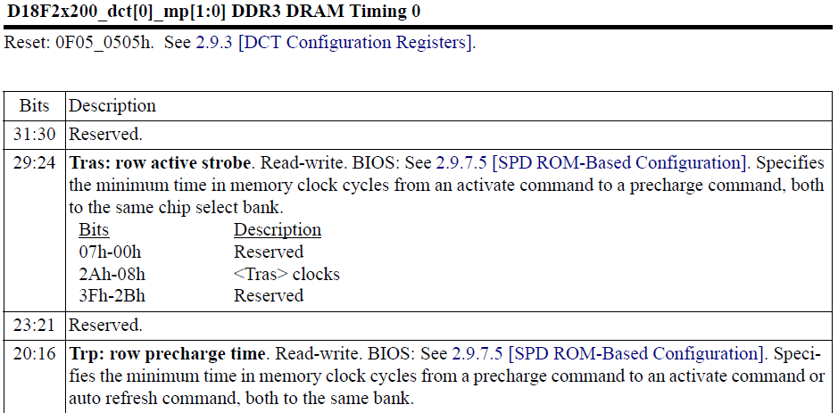
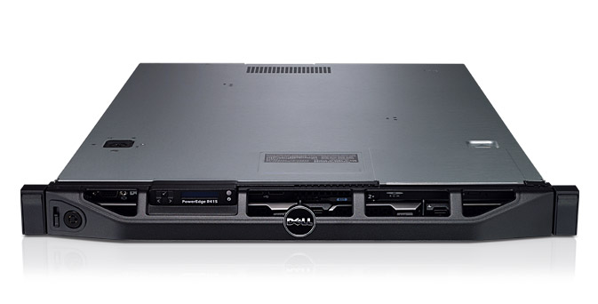
AL-DRAM: Real System Evaluation
System
  CPU: AMD 4386 ( 8 Cores, 3.1GHz, 8MB LLC)
  DRAM: 4GByte DDR3-1600 (800Mhz Clock)
  OS: Linux
  Storage: 128GByte SSD
Workload
  35 applications from SPEC, STREAM, Parsec, Memcached, Apache, GUPS

Slide 109
AL-DRAM: Single-Core Evaluation
Average
Improvement
6.7%
Performance Improvement
5.0%
1.4%
all-35-workload
AL-DRAM improves performance on a real system

Slide 110
AL-DRAM: Multi-Core Evaluation
Average
Improvement
14.0%
10.4%
Performance Improvement
2.9%
all-35-workload
AL-DRAM provides higher performance for
multi-programmed & multi-threaded workloads

Slide 111
Rethinking DRAM
In-Memory Computation
Refresh
Reliability
Latency
Bandwidth
Energy
Memory Compression

Slide 112
Agenda
Major Trends Affecting Main Memory
The Memory Scaling Problem and Solution Directions
  New Memory Architectures
  Enabling Emerging Technologies
How Can We Do Better?
Summary

Slide 113
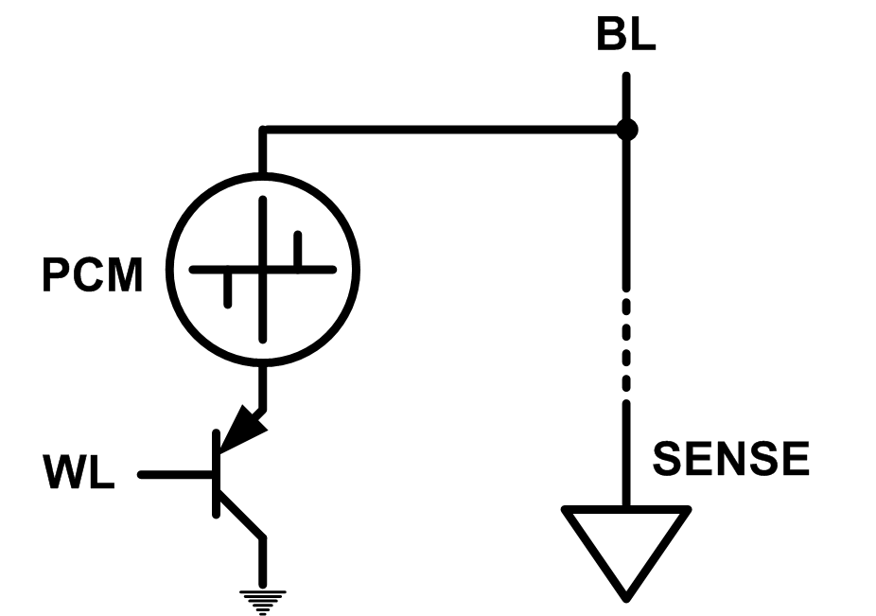
Solution 2: Emerging Memory Technologies
Some emerging resistive memory technologies seem more scalable than DRAM (and they are non-volatile)
Example: Phase Change Memory
  Data stored by changing phase of material
  Data read by detecting material’s resistance
  Expected to scale to 9nm (2022 [ITRS])
  Prototyped at 20nm (Raoux+, IBM JRD 2008)
  Expected to be denser than DRAM: can store multiple bits/cell
But, emerging technologies have (many) shortcomings
  Can they be enabled to replace/augment/surpass DRAM?
Notes:
Even if DRAM continues to scale there could be benefits to examining and enabling these new technologies.

Slide 114
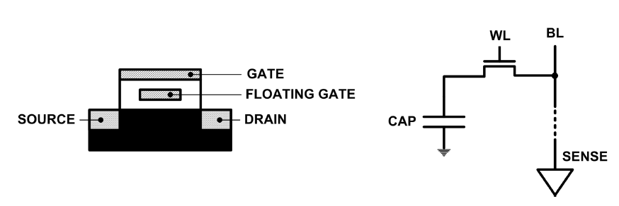
Limits of Charge Memory
Difficult charge placement and control
  Flash: floating gate charge
  DRAM: capacitor charge, transistor leakage
Reliable sensing becomes difficult as charge storage unit size reduces

Slide 115
Promising Resistive Memory Technologies
PCM
  Inject current to change material phase
  Resistance determined by phase
STT-MRAM
  Inject current to change magnet polarity
  Resistance determined by polarity
Memristors/RRAM/ReRAM
  Inject current to change atomic structure
  Resistance determined by atom distance

Slide 116
Phase Change Memory: Pros and Cons
Pros over DRAM
  Better technology scaling (capacity and cost)
  Non volatility
  Low idle power (no refresh)
Cons
  Higher latencies: ~4-15x DRAM (especially write)
  Higher active energy: ~2-50x DRAM (especially write)
  Lower endurance (a cell dies after ~10⁸ writes)
  Reliability issues (resistance drift)
Challenges in enabling PCM as DRAM replacement/helper:
  Mitigate PCM shortcomings
  Find the right way to place PCM in the system

Slide 117
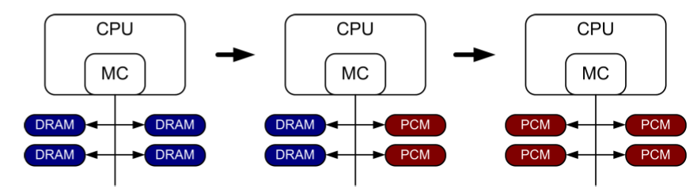
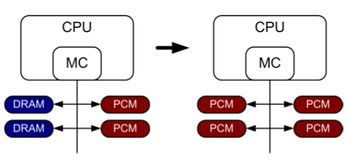
PCM-based Main Memory (I)
How should PCM-based (main) memory be organized?
Hybrid PCM+DRAM [Qureshi+ ISCA’09, Dhiman+ DAC’09]:
  How to partition/migrate data between PCM and DRAM

Slide 118
PCM-based Main Memory (II)
How should PCM-based (main) memory be organized?
Pure PCM main memory [Lee et al., ISCA’09, Top Picks’10]:
  How to redesign entire hierarchy (and cores) to overcome PCM shortcomings

Slide 119
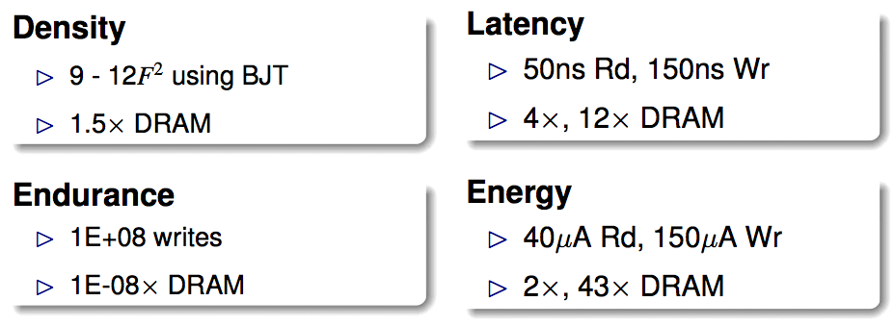
An Initial Study: Replace DRAM with PCM
Lee, Ipek, Mutlu, Burger, “Architecting Phase Change Memory as a Scalable DRAM Alternative,” ISCA 2009.
  Surveyed prototypes from 2003-2008 (e.g. IEDM, VLSI, ISSCC)
  Derived “average” PCM parameters for F=90nm

Slide 120
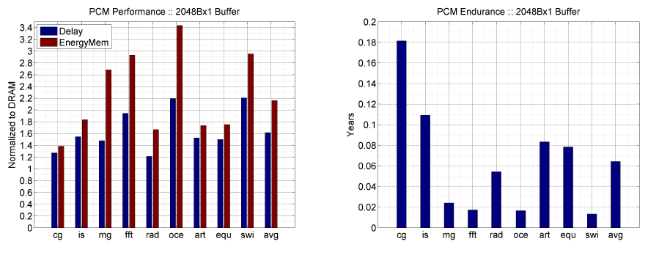
Results: Naïve Replacement of DRAM with PCM
Replace DRAM with PCM in a 4-core, 4MB L2 system
PCM organized the same as DRAM: row buffers, banks, peripherals
1.6x delay, 2.2x energy, 500-hour average lifetime
Lee, Ipek, Mutlu, Burger, “Architecting Phase Change Memory as a Scalable DRAM Alternative,” ISCA 2009.

Slide 121
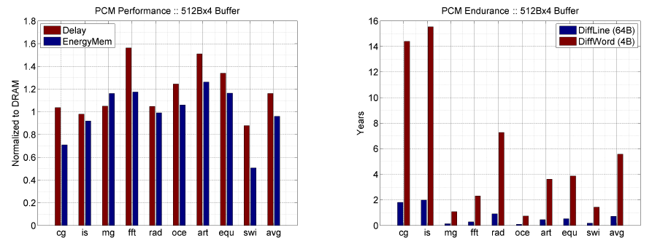
Results: Architected PCM as Main Memory
1.2x delay, 1.0x energy, 5.6-year average lifetime
Scaling improves energy, endurance, density
Caveat 1: Worst-case lifetime is much shorter (no guarantees)
Caveat 2: Intensive applications see large performance and energy hits
Caveat 3: Optimistic PCM parameters?

Slide 122
Solution 3: Hybrid Memory Systems
CPU
Meza+, “Enabling Efficient and Scalable Hybrid Memories,” IEEE Comp. Arch. Letters, 2012.
Yoon+, “Row Buffer Locality Aware Caching Policies for Hybrid Memories,” ICCD 2012 Best Paper Award.
DRAMCtrl
PCM Ctrl
DRAM
Phase Change Memory (or Tech. X)
Fast, durable
Small,
leaky, volatile,
high-cost
Large, non-volatile, low-cost
Slow, wears out, high active energy
Hardware/software manage data allocation and movement
to achieve the best of multiple technologies

Slide 123
Hybrid vs. All-PCM/DRAM [ICCD’12]
29%
31%
31% better performance than all PCM,
within 29% of all DRAM performance
Yoon+, “Row Buffer Locality-Aware Data Placement in Hybrid Memories,” ICCD 2012 Best Paper Award.
Notes:
Now let’s compare our mechanism to a homogeneous memory system.
Here the comparison points are a 16GB all-PCM and all-DRAM memory system.
Our mechanism achieves 31% better performance than the all-PCM memory system, and comes within 29% of the all-DRAM performance.
Note that we do not assume any capacity benefits of PCM over DRAM.
And yet, our mechanism bridges the performance gap between the two homogeneous memory systems.
If the capacity benefit of PCM was included, the hybrid memory system will perform even better.

Slide 124
Challenge for Interconnects
Efficient Data Movement
(across Multiple Memories)

Slide 125
STT-MRAM as Main Memory
Magnetic Tunnel Junction (MTJ) device
  Reference layer: Fixed magnetic orientation
  Free layer: Parallel or anti-parallel
Magnetic orientation of the free layer determines logical state of device
  High vs. low resistance
Write: Push large current through MTJ to change orientation of free layer
Read: Sense current flow
Kultursay et al., “Evaluating STT-RAM as an Energy-Efficient Main Memory Alternative,” ISPASS 2013.
Logical 0
Reference Layer
Barrier
Free Layer
Logical 1
Reference Layer
Barrier
Free Layer
Word Line
MTJ
Access
Transistor
Bit Line
Sense Line
Notes:
Moving from DRAM to STT-RAM, instead of a capacitor that stores charge, now we have a magnetic tunnel junction that has one reference layer with a fixed magnetic orientation, and a free layer that can be parallel or anti parallel to the reference layer; which determines the resistance, and in turn, the data stored in the MTJ. In addition to the MTJ, the cell, again, has an access transistor.
Reading requires a small voltage to be applied across the bitline and sense line; and the current is sensed. This current varies depending on the resistance of MTJ. To write data, we push a large current into the MTJ, which re-aligns the free layer. The direction of the current determines whether it becomes parallel or anti-parallel; i.e. logical 0 or 1.

Slide 126
STT-MRAM: Pros and Cons
Pros over DRAM
  Better technology scaling
  Non volatility
  Low idle power (no refresh)
Cons
  Higher write latency
  Higher write energy
  Reliability?
Another level of freedom
  Can trade off non-volatility for lower write latency/energy (by reducing the size of the MTJ)

Slide 127
Architected STT-MRAM as Main Memory
4-core, 4GB main memory, multiprogrammed workloads
~6% performance loss, ~60% energy savings vs. DRAM
Kultursay+, “Evaluating STT-RAM as an Energy-Efficient Main Memory Alternative,” ISPASS 2013.

Slide 128
Other Opportunities with Emerging Technologies
Merging of memory and storage
  e.g., a single interface to manage all data
New applications
  e.g., ultra-fast checkpoint and restore
More robust system design
  e.g., reducing data loss
Processing tightly-coupled with memory
  e.g., enabling efficient search and filtering

Slide 129
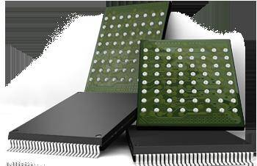
Coordinated Memory and Storage with NVM (I)
The traditional two-level storage model is a bottleneck with NVM
  Volatile data in memory → a load/store interface
  Persistent data in storage → a file system interface
  Problem: Operating system (OS) and file system (FS) code to locate, translate, buffer data become performance and energy bottlenecks with fast NVM stores
Two-Level Store
Load/Store
fopen, fread, fwrite, …
Virtual memory
Operating system
and file system
Processor
and caches
Address translation
Persistent (e.g., Phase-Change)
Memory
Main Memory
Storage (SSD/HDD)

Slide 130
Coordinated Memory and Storage with NVM (II)
Goal: Unify memory and storage management in a single unit to eliminate wasted work to locate, transfer, and translate data
  Improves both energy and performance
  Simplifies programming model as well
Unified Memory/Storage
Persistent Memory
Manager
Processor
and caches
Load/Store
Feedback
Persistent (e.g., Phase-Change) Memory
Meza+, “A Case for Efficient Hardware-Software Cooperative Management of Storage and Memory,” WEED 2013.

Slide 131
The Persistent Memory Manager (PMM)
Exposes a load/store interface to access persistent data
  Applications can directly access persistent memory → no conversion, translation, location overhead for persistent data
Manages data placement, location, persistence, security
  To get the best of multiple forms of storage
Manages metadata storage and retrieval
  This can lead to overheads that need to be managed
Exposes hooks and interfaces for system software
  To enable better data placement and management decisions
Meza+, “A Case for Efficient Hardware-Software Cooperative Management of Storage and Memory,” WEED 2013.
Notes:
Let’s take a closer look at the high-level design goals for a Persistent Memory Manager, or PMM.
[click] The most noticeable feature of the PMM – from the system software perspective – is the fact that it exposes a load/store interface to access all persistent data in the system. This means that applications can allocate portions of persistent memory, just as they would allocate portions of volatile DRAM memory in today’s systems.
[click] Of course, with a diverse array of devices managed by a persistent memory, it will be important for the PMM to leverage each of their strengths – and mitigate each of their weaknesses – as much as possible. To this end, the PMM is responsible for managing how volatile and persistent are placed among devices, to ensure data can be efficiently located, persistence guarantees met, and any security rules enforced.
[click] The PMM is also responsible for managing metadata storage and retrieval. We will later evaluate how such overheads affect system performance.
[click] In addition, to achieve the best performance and energy efficiency for the applications running on a system, it will be necessary for the system software to provide hints to the hardware to be used to make more efficient data placement decisions.

Slide 132
The Persistent Memory Manager (PMM)
Persistent objects
PMM uses access and hint information to allocate, locate, migrate and access data in the heterogeneous array of devices
Notes:
And to tie everything together, here is how a persistent memory would operate. Code allocates persistent objects and accesses them using loads and stores – no different than persistent memory in today’s machines. Optionally, the software can provide hints as to the types of access patterns or requirements of the software.
Then, a Persistent Memory Manager uses this access information and software hints to allocate, locate, migrate, and access data among the heterogeneous array of devices present on the system, attempting to strike a balance between application-level guarantees, like persistence and security, and performance and energy efficiency.

Slide 133
Performance Benefits of a Single-Level Store
~24X
~5X
Meza+, “A Case for Efficient Hardware-Software Cooperative Management of Storage and Memory,” WEED 2013.

Slide 134
Energy Benefits of a Single-Level Store
~16X
~5X
Meza+, “A Case for Efficient Hardware-Software Cooperative Management of Storage and Memory,” WEED 2013.

Slide 135
Challenge for Interconnects
Design for
Emerging Memories

Slide 136
Agenda
Major Trends Affecting Main Memory
The Memory Scaling Problem and Solution Directions
  New Memory Architectures
  Enabling Emerging Technologies
How Can We Do Better?
Summary

Slide 137
Principles (So Far)
Better cooperation between devices and the system
  Expose more information about devices to upper layers
  More flexible interfaces
Better-than-worst-case design
  Do not optimize for the worst case
  Worst case should not determine the common case
Heterogeneity in design (specialization, asymmetry)
  Enables a more efficient design (No one size fits all)
These principles are coupled

Slide 138
Agenda
Major Trends Affecting Main Memory
The Memory Scaling Problem and Solution Directions
  New Memory Architectures
  Enabling Emerging Technologies
How Can We Do Better?
Summary

Slide 139
Summary: Memory Scaling
Memory scaling problems are a critical bottleneck for system performance, efficiency, and usability
New memory architectures
  A lot of hope in fixing DRAM
Enabling emerging NVM technologies
  A lot of hope in hybrid memory systems and single-level stores
System-level memory/storage QoS
  A lot of hope in designing a predictable system
Three principles are essential for scaling
  Software/hardware/device cooperation
  Better-than-worst-case design
  Heterogeneity (specialization, asymmetry)

Slide 140
Takeaway for Interconnects
Memory-Centric
Interconnect
Design

Slide 141
Today

Slide 142
Future?

Slide 143
Better Future?

Slide 144
Acknowledgments
My current and past students and postdocs
  Rachata Ausavarungnirun, Abhishek Bhowmick, Amirali Boroumand, Rui Cai, Yu Cai, Kevin Chang, Saugata Ghose, Kevin Hsieh, Tyler Huberty, Ben Jaiyen, Samira Khan, Jeremie Kim, Yoongu Kim, Yang Li, Jamie Liu, Lavanya Subramanian, Donghyuk Lee, Yixin Luo, Justin Meza, Gennady Pekhimenko, Vivek Seshadri, Lavanya Subramanian, Nandita Vijaykumar, HanBin Yoon, Jishen Zhao, …
My collaborators at CMU
  Greg Ganger, Phil Gibbons, Mor Harchol-Balter, James Hoe, Mike Kozuch, Ken Mai, Todd Mowry, …
My collaborators elsewhere
  Can Alkan, Chita Das, Sriram Govindan, Norm Jouppi, Mahmut Kandemir, Konrad Lai, Yale Patt, Moinuddin Qureshi, Partha Ranganathan, Bikash Sharma, Kushagra Vaid, Chris Wilkerson, …

Slide 145
Funding Acknowledgments
NSF
GSRC
SRC
CyLab
AMD, Google, Facebook, HP Labs, Huawei, IBM, Intel, Microsoft, Nvidia, Oracle, Qualcomm, Rambus, Samsung, Seagate, VMware

Slide 146
Open Source Tools
Rowhammer
  https://github.com/CMU-SAFARI/rowhammer
Ramulator
  https://github.com/CMU-SAFARI/ramulator
MemSim
  https://github.com/CMU-SAFARI/memsim
NOCulator
  https://github.com/CMU-SAFARI/NOCulator
DRAM Error Model
  http://www.ece.cmu.edu/~safari/tools/memerr/index.html
Other open-source software from my group
  https://github.com/CMU-SAFARI/
  http://www.ece.cmu.edu/~safari/tools.html

Slide 147
Referenced Papers
All are available at
  http://users.ece.cmu.edu/~omutlu/projects.htm
  http://scholar.google.com/citations?user=7XyGUGkAAAAJ&hl=en
A detailed accompanying overview paper
  Onur Mutlu and Lavanya Subramanian,
  "Research Problems and Opportunities in Memory Systems"
  Invited Article in Supercomputing Frontiers and Innovations (SUPERFRI), 2015.

Slide 148
Related Videos and Course Materials
Undergraduate Computer Architecture Course Lecture Videos (2013, 2014, 2015)
Undergraduate Computer Architecture Course Materials (2013, 2014, 2015)
Graduate Computer Architecture Course Materials (Lecture Videos)
Parallel Computer Architecture Course Materials (Lecture Videos)
Memory Systems Short Course Materials
(Lecture Video on Main Memory and DRAM Basics)

Slide 149
Thank you.
onur@cmu.edu
http://users.ece.cmu.edu/~omutlu/

Slide 150
Rethinking Memory System Design
(along with Interconnects)
Onur Mutlu
onur@cmu.edu
http://users.ece.cmu.edu/~omutlu/
December 5, 2015
NoCArc 2015 Keynote

Slide 151
Backup Slides

Slide 152
Memory-Interconnect Examples

Slide 153
Some Examples
Application-awareness in the interconnect [Das+ MICRO’09, HPCA’13]
Focus on critical requests [Aergia, Das+ ISCA’10]
Quality of Service and predictability [Grot+ MICRO’09, ISCA’11]
Ultra-efficient data movement [BLESS ISCA’09, Chang+ HPCA’16]
Interconnect design for memory systems (DRAM, hybrid memory, NVM) [Lee+ HPCA’13, Chang+ HPCA’16]
…

Slide 154
Application-Aware Interconnect Design
Reetuparna Das, Onur Mutlu, Thomas Moscibroda, and Chita R. Das,
"Application-Aware Prioritization Mechanisms for On-Chip Networks"
Proceedings of the 42nd International Symposium on Microarchitecture (MICRO), pages 280-291, New York, NY, December 2009. Slides (pptx)
Reetuparna Das, Rachata Ausavarungnirun, Onur Mutlu, Akhilesh Kumar, and Mani Azimi,
"Application-to-Core Mapping Policies to Reduce Memory System Interference in Multi-Core Systems"
Proceedings of the 19th International Symposium on High-Performance Computer Architecture (HPCA), Shenzhen, China, February 2013. Slides (pptx)
Asit K. Mishra, Onur Mutlu, and Chita R. Das,
"A Heterogeneous Multiple Network-on-Chip Design: An Application-Aware Approach"
Proceedings of the 50th Design Automation Conference (DAC), Austin, TX, June 2013. Slides (pptx) Slides (pdf)

Slide 155
Focus on Criticality
Reetuparna Das, Onur Mutlu, Thomas Moscibroda, and Chita R. Das,
"Aergia: Exploiting Packet Latency Slack in On-Chip Networks"
Proceedings of the 37th International Symposium on Computer Architecture (ISCA), pages 106-116, Saint-Malo, France, June 2010. Slides (pptx)

Slide 156
QoS and Predictability
Boris Grot, Stephen W. Keckler, and Onur Mutlu,
"Preemptive Virtual Clock: A Flexible, Efficient, and Cost-effective QOS Scheme for Networks-on-Chip"
Proceedings of the 42nd International Symposium on Microarchitecture (MICRO), pages 268-279, New York, NY, December 2009. Slides (pdf)
Boris Grot, Joel Hestness, Stephen W. Keckler, and Onur Mutlu,
"Kilo-NOC: A Heterogeneous Network-on-Chip Architecture for Scalability and Service Guarantees"
Proceedings of the 38th International Symposium on Computer Architecture (ISCA), San Jose, CA, June 2011. Slides (pptx)

Slide 157
Efficient Data Movement: Bufferless (I)
Thomas Moscibroda and Onur Mutlu,
"A Case for Bufferless Routing in On-Chip Networks"
Proceedings of the 36th International Symposium on Computer Architecture (ISCA), pages 196-207, Austin, TX, June 2009. Slides (pptx)
Chris Fallin, Chris Craik, and Onur Mutlu,
"CHIPPER: A Low-Complexity Bufferless Deflection Router"
Proceedings of the 17th International Symposium on High-Performance Computer Architecture (HPCA), pages 144-155, San Antonio, TX, February 2011. Slides (pptx)
Chris Fallin, Greg Nazario, Xiangyao Yu, Kevin Chang, Rachata Ausavarungnirun, and Onur Mutlu,
"MinBD: Minimally-Buffered Deflection Routing for Energy-Efficient Interconnect"
Proceedings of the 6th ACM/IEEE International Symposium on Networks on Chip (NOCS), Lyngby, Denmark, May 2012. Slides (pptx) (pdf)
Rachata Ausavarungnirun, Chris Fallin, Xiangyao Yu, Kevin Chang, Greg Nazario, Reetuparna Das, Gabriel Loh, and Onur Mutlu,
"Design and Evaluation of Hierarchical Rings with Deflection Routing"
Proceedings of the 26th International Symposium on Computer Architecture and High Performance Computing (SBAC-PAD), Paris, France, October 2014. [Slides (pptx) (pdf)] [Source Code]

Slide 158
Efficient Data Movement: Bufferless (II)
George Nychis, Chris Fallin, Thomas Moscibroda, Onur Mutlu, and Srinivasan Seshan,
"On-Chip Networks from a Networking Perspective: Congestion and Scalability in Many-core Interconnects"
Proceedings of the 2012 ACM SIGCOMM Conference (SIGCOMM), Helsinki, Finland, August 2012. Slides (pptx)
George Nychis, Chris Fallin, Thomas Moscibroda, and Onur Mutlu,
"Next Generation On-Chip Networks: What Kind of Congestion Control Do We Need?"
Proceedings of the 9th ACM Workshop on Hot Topics in Networks (HOTNETS), Monterey, CA, October 2010. Slides (ppt) (key)
Kevin Chang, Rachata Ausavarungnirun, Chris Fallin, and Onur Mutlu,
"HAT: Heterogeneous Adaptive Throttling for On-Chip Networks"
Proceedings of the 24th International Symposium on Computer Architecture and High Performance Computing (SBAC-PAD), New York, NY, October 2012. Slides (pptx) (pdf)

Slide 159
Efficient Data Movement: Heterogeneous
Asit K. Mishra, Onur Mutlu, and Chita R. Das,
"A Heterogeneous Multiple Network-on-Chip Design: An Application-Aware Approach"
Proceedings of the 50th Design Automation Conference (DAC), Austin, TX, June 2013. Slides (pptx) Slides (pdf)

Slide 160
Interconnect Design for Memory
Kevin Chang et al., “Low-Cost Inter-Linked Subarrays (LISA): Enabling Fast Inter-Subarray Data Migration in DRAM,” HPCA 2016.
Donghyuk Lee, Yoongu Kim, Vivek Seshadri, Jamie Liu, Lavanya Subramanian, and Onur Mutlu,
"Tiered-Latency DRAM: A Low Latency and Low Cost DRAM Architecture"
Proceedings of the 19th International Symposium on High-Performance Computer Architecture (HPCA), Shenzhen, China, February 2013. Slides (pptx)

Slide 161
NAND Flash Memory Scaling

Slide 162
Another Talk: NAND Flash Scaling Challenges
Onur Mutlu,
"Error Analysis and Management for MLC NAND Flash Memory"
Technical talk at Flash Memory Summit 2014 (FMS), Santa Clara, CA, August 2014. Slides (ppt) (pdf)
Cai+, “Error Patterns in MLC NAND Flash Memory: Measurement, Characterization, and Analysis,” DATE 2012.
Cai+, “Flash Correct-and-Refresh: Retention-Aware Error Management for Increased Flash Memory Lifetime,” ICCD 2012.
Cai+, “Threshold Voltage Distribution in MLC NAND Flash Memory: Characterization, Analysis and Modeling,” DATE 2013.
Cai+, “Error Analysis and Retention-Aware Error Management for NAND Flash Memory,” Intel Technology Journal 2013.
Cai+, “Program Interference in MLC NAND Flash Memory: Characterization, Modeling, and Mitigation,” ICCD 2013.
Cai+, “Neighbor-Cell Assisted Error Correction for MLC NAND Flash Memories,” SIGMETRICS 2014.
Cai+,”Data Retention in MLC NAND Flash Memory: Characterization, Optimization and Recovery,” HPCA 2015.
Cai+, “Read Disturb Errors in MLC NAND Flash Memory: Characterization and Mitigation,” DSN 2015.
Luo+, “WARM: Improving NAND Flash Memory Lifetime with Write-hotness Aware Retention Management,” MSST 2015.
Meza+, “A Large-Scale Study of Flash Memory Errors in the Field,” SIGMETRICS 2015.

Slide 163
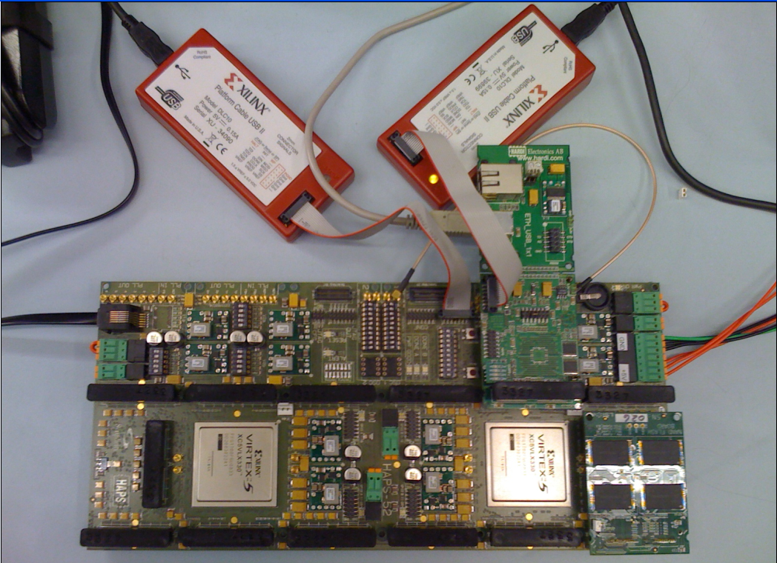
Experimental Infrastructure (Flash)
USB Daughter Board
USB Jack
HAPS-52 Mother Board
Virtex-II Pro
(USB controller)
3x-nm
NAND Flash
Virtex-V FPGA
(NAND Controller)
[Cai+, DATE 2012, ICCD 2012, DATE 2013, ITJ 2013, ICCD 2013, SIGMETRICS 2014, HPCA 2015, DSN 2015, MSST 2015]
NAND Daughter Board

Slide 164

Error Management in MLC NAND Flash
Problem: MLC NAND flash memory reliability/endurance is a key challenge for satisfying future storage systems’ requirements
Our Goals: (1) Build reliable error models for NAND flash memory via experimental characterization, (2) Develop efficient techniques to improve reliability and endurance
This talk provides a “flash” summary of our recent results published in the past 3 years:
  Experimental error and threshold voltage characterization [DATE’12&13]
  Retention-aware error management [ICCD’12]
  Program interference analysis and read reference V prediction [ICCD’13]
  Neighbor-assisted error correction [SIGMETRICS’14]

Slide 165
Ramulator: A Fast and Extensible DRAM Simulator
[IEEE Comp Arch Letters’15]

Slide 166
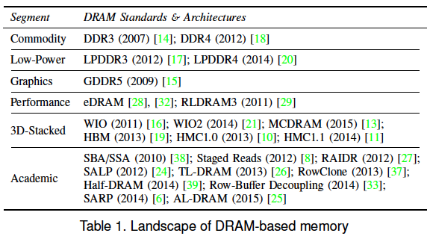
Ramulator Motivation
DRAM and Memory Controller landscape is changing
Many new and upcoming standards
Many new controller designs
A fast and easy-to-extend simulator is very much needed

Slide 167
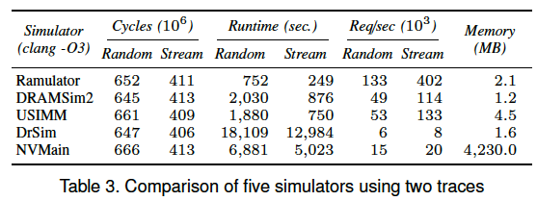
Ramulator
Provides out-of-the box support for many DRAM standards:
  DDR3/4, LPDDR3/4, GDDR5, WIO1/2, HBM, plus new proposals (SALP, AL-DRAM, TLDRAM, RowClone, and SARP)
~2.5X faster than fastest open-source simulator
Modular and extensible to different standards

Slide 168
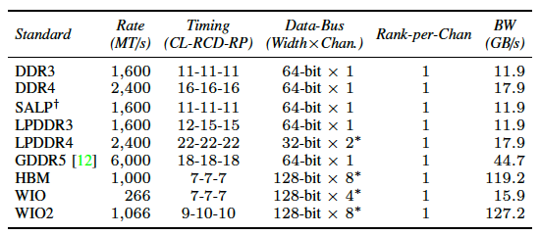
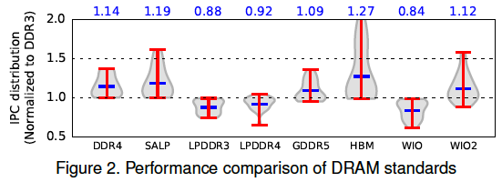
Case Study: Comparison of DRAM Standards
Across 22 workloads, simple CPU model

Slide 169
Ramulator Paper and Source Code
Yoongu Kim, Weikun Yang, and Onur Mutlu,
"Ramulator: A Fast and Extensible DRAM Simulator"
IEEE Computer Architecture Letters (CAL), March 2015.
[Source Code]
Source code is released under the liberal MIT License
  https://github.com/CMU-SAFARI/ramulator

Slide 170
DRAM Infrastructure

Slide 171
Experimental DRAM Testing Infrastructure
  An Experimental Study of Data Retention Behavior in Modern DRAM Devices: Implications for Retention Time Profiling Mechanisms (Liu et al., ISCA 2013)
  The Efficacy of Error Mitigation Techniques for DRAM Retention Failures: A Comparative Experimental Study
  (Khan et al., SIGMETRICS 2014)
  Flipping Bits in Memory Without Accessing Them: An Experimental Study of DRAM Disturbance Errors (Kim et al., ISCA 2014)
  Adaptive-Latency DRAM: Optimizing DRAM Timing for the Common-Case (Lee et al., HPCA 2015)
  AVATAR: A Variable-Retention-Time (VRT) Aware Refresh for DRAM Systems (Qureshi et al., DSN 2015)

Slide 172
Experimental Infrastructure (DRAM)
Temperature
Controller
FPGAs
Heater
FPGAs
PC
  Kim+, “Flipping Bits in Memory Without Accessing Them: An Experimental Study of DRAM Disturbance Errors,” ISCA 2014.

Slide 173
ThyNVM: Software-Transparent Crash Consistency in NVMs

Slide 174
ThyNVM: Transparent Hybrid NVM
Problem: How do you provide consistency and prevent data corruption in NVM upon a system crash?
Goal: Provide efficient programmer-transparent crash consistency in hybrid NVM
  Transparency: no library APIs or explicit interfaces to access NVM; just loads and stores
    Easier to support legacy code and hypervisors
    No programmer effort to adopt persistent memory
  Efficiency: use hybrid DRAM/NVM for high performance
Ren+, “ThyNVM: Enabling Software-Transparent Crash Consistency in Persistent Memory Systems,” MICRO 2015.

Slide 175
ThyNVM
Idea 1: Transparent periodic checkpointing of data
  Need to overlap checkpointing and execution
Idea 2: Differentiated checkpointing schemes for different types of updates
  Page Writeback: for sequential accesses (use DRAM)
  Address Remapping: for random accesses (use NVM/DRAM)
Idea 3: Coordination/switching between checkpointing schemes for high performance
Running
Checkpoint’g
Running
Checkpoint’g
time
time
Epoch 0
Epoch 1
Epoch 0
Epoch 1
Ren+, “ThyNVM: Enabling Software-Transparent Crash Consistency in Persistent Memory Systems,” MICRO 2015.

Slide 176
Checkpointing Tradeoffs in Hybrid Memory
 |  | Checkpointing granularity
 |  | Small (cache block) | Large (page)
Location of working copy | DRAM (based on writeback) | ❶ Inefficient ✘ Large metadata overhead ✘ Long checkpointing latency | ❷ Partially efficient ✔ Small metadata overhead ✘ Long checkpointing latency
 | NVM (based on remapping) | ❸ Partially efficient ✘ Large metadata overhead ✔ Short checkpointing latency ✔ Fast remapping | ❹ Inefficient ✔ Small metadata overhead ✔ Short checkpointing latency ✘ Slow remapping (on the critical path)
Ren+, “ThyNVM: Enabling Software-Transparent Crash Consistency in Persistent Memory Systems,” MICRO 2015.

Slide 177
ThyNVM: Dual-Scheme Checkpointing
Idea: Combine two types of checkpointing schemes to adapt to different types of access patterns
Sparse updates with low spatial locality → address remapping
→ block granularity checkpointing
→ working copy stored in NVM (for short ckpt latency)
Dense updates with high spatial locality → page writeback
→ page granularity checkpointing (small metadata)
→ working copy stored in DRAM for fast buffering; written back to NVM during ckpt.
Can switch between schemes when one is on critical path
Ren+, “ThyNVM: Enabling Software-Transparent Crash Consistency in Persistent Memory Systems,” MICRO 2015.

Slide 178
ThyNVM Performance (I)
In-memory storage workloads
  8.8%/29.9% higher throughput than journaling/shadow paging with a hash table based key-value store
Ren+, “ThyNVM: Enabling Software-Transparent Crash Consistency in Persistent Memory Systems,” MICRO 2015.

Slide 179
ThyNVM Performance (II)
Legacy compute-intensive workloads
  Within 3.4% of Ideal DRAM,
  2.7% higher performance than Ideal NVM.
Ren+, “ThyNVM: Enabling Software-Transparent Crash Consistency in Persistent Memory Systems,” MICRO 2015.

