Slide 1
Runahead Execution A Short Retrospective
Onur Mutlu, Jared Stark, Chris Wilkerson, Yale Patt
HPCA 2021 ToT Award Talk
2 March 2021

Slide 2
Agenda
Thanks
Runahead Execution
Looking to the Past
Looking to the Future

Slide 3
Runahead Execution [HPCA 2003]
Onur Mutlu, Jared Stark, Chris Wilkerson, and Yale N. Patt, "Runahead Execution: An Alternative to Very Large Instruction Windows for Out-of-order Processors" Proceedings of the 9th International Symposium on High-Performance Computer Architecture (HPCA), Anaheim, CA, February 2003. Slides (pdf) One of the 15 computer architecture papers of 2003 selected as Top Picks by IEEE Micro.

Slide 4
Small Windows: Full-Window Stalls
8-entry instruction window:
Oldest
LOAD R1 ← mem[R5]
L2 Miss! Takes 100s of cycles.
BEQ R1, R0, target
ADD R2 ← R2, 8
LOAD R3 ← mem[R2]
Independent of the L2 miss,
executed out of program order,
but cannot be retired.
MUL R4 ← R4, R3
ADD R4 ← R4, R5
STOR mem[R2] ← R4
ADD R2 ← R2, 64
Younger instructions cannot be executed
because there is no space in the instruction window.
LOAD R3 ← mem[R2]
The processor stalls until the L2 Miss is serviced.
Long-latency cache misses are responsible for most full-window stalls.

Slide 5
Impact of Long-Latency Cache Misses
L2 Misses
512KB L2 cache, 500-cycle DRAM latency, aggressive stream-based prefetcher
Data averaged over 147 memory-intensive benchmarks on a high-end x86 processor model

Slide 6
Impact of Long-Latency Cache Misses
L2 Misses
512KB L2 cache, 500-cycle DRAM latency, aggressive stream-based prefetcher
Data averaged over 147 memory-intensive benchmarks on a high-end x86 processor model

Slide 7
The Problem
Out-of-order execution requires large instruction windows to tolerate today’s main memory latencies.
As main memory latency increases, instruction window size should also increase to fully tolerate the memory latency.
Building a large instruction window is a challenging task if we would like to achieve
Low power/energy consumption (tag matching logic, load/store buffers)
Short cycle time (wakeup/select, regfile, bypass latencies)
Low design and verification complexity

Slide 8
Runahead Execution
A technique to obtain the memory-level parallelism benefits of a large instruction window
When the oldest instruction is a long-latency cache miss:
Checkpoint architectural state and enter runahead mode
In runahead mode:
Speculatively pre-execute instructions
The purpose of pre-execution is to generate prefetches
L2-miss dependent instructions are marked INV and dropped
When the original miss returns:
Restore checkpoint, flush pipeline, resume normal execution
Mutlu et al., “Runahead Execution: An Alternative to Very Large Instruction Windows for Out-of-order Processors,” HPCA 2003.

Slide 9
Runahead Example
Perfect Caches:
Load 1 Hit
Load 2 Hit
Compute
Compute
Small Window:
Load 1 Miss
Load 2 Miss
Compute
Stall
Compute
Stall
Miss 1
Miss 2
Runahead:
Load 1 Miss
Load 2 Miss
Load 1 Hit
Load 2 Hit
Compute
Runahead
Compute
Saved Cycles
Miss 1
Miss 2

Slide 10
Benefits of Runahead Execution
Instead of stalling during an L2 cache miss:
Pre-executed loads and stores independent of L2-miss instructions generate very accurate data prefetches:
For both regular and irregular access patterns
Instructions on the predicted program path are prefetched into the instruction/trace cache and L2.
Hardware prefetcher and branch predictor tables are trained using future access information.

Slide 11
Runahead Execution Pros and Cons
Advantages:
+ Very accurate prefetches for data/instructions (all cache levels)
+ Follows the program path
+ Simple to implement: most of the hardware is already built in
+ No waste of context: uses the main thread context for prefetching
+ No need to construct a pre-execution thread
Disadvantages/Limitations
-- Extra executed instructions
-- Limited by branch prediction accuracy
-- Cannot prefetch dependent cache misses
-- Effectiveness limited by available “memory-level parallelism” (MLP)
-- Prefetch distance (how far ahead to prefetch) limited by memory latency
Implemented in Sun ROCK, IBM POWER6, NVIDIA Denver

Slide 12
Performance of Runahead Execution

Slide 13
Runahead Execution vs. Large Windows

Slide 14
Runahead on In-order vs. Out-of-order

Slide 15
More on Runahead Execution
Onur Mutlu, Jared Stark, Chris Wilkerson, and Yale N. Patt, "Runahead Execution: An Alternative to Very Large Instruction Windows for Out-of-order Processors" Proceedings of the 9th International Symposium on High-Performance Computer Architecture (HPCA), Anaheim, CA, February 2003. Slides (pdf) One of the 15 computer architecture papers of 2003 selected as Top Picks by IEEE Micro.

Slide 16
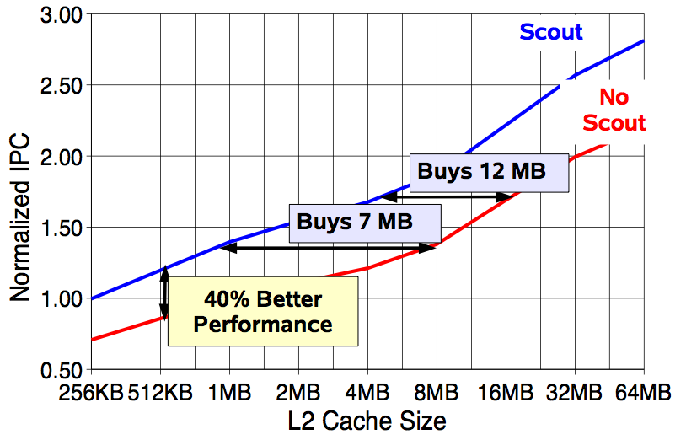
Effect of Runahead in Sun ROCK
Shailender Chaudhry talk, Aug 2008.

Slide 17
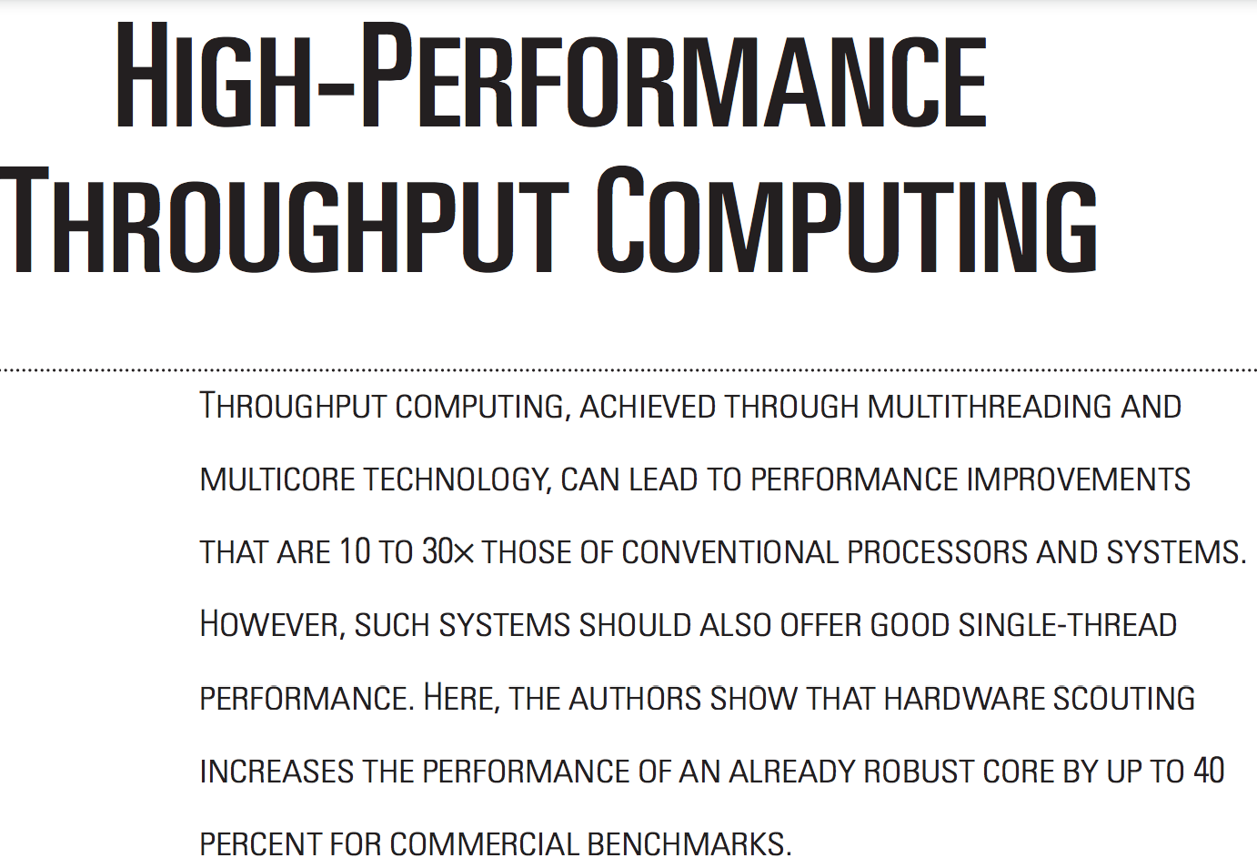
More on Runahead in Sun ROCK
Chaudhry+, “High-Performance Throughput Computing,” IEEE Micro 2005.

Slide 18
More on Runahead in Sun ROCK
Chaudhry+, “Simultaneous Speculative Threading,” ISCA 2009.

Slide 19
Runahead Execution in IBM POWER6
Cain+, “Runahead Execution vs. Conventional Data Prefetching
in the IBM POWER6 Microprocessor,” ISPASS 2010.

Slide 20
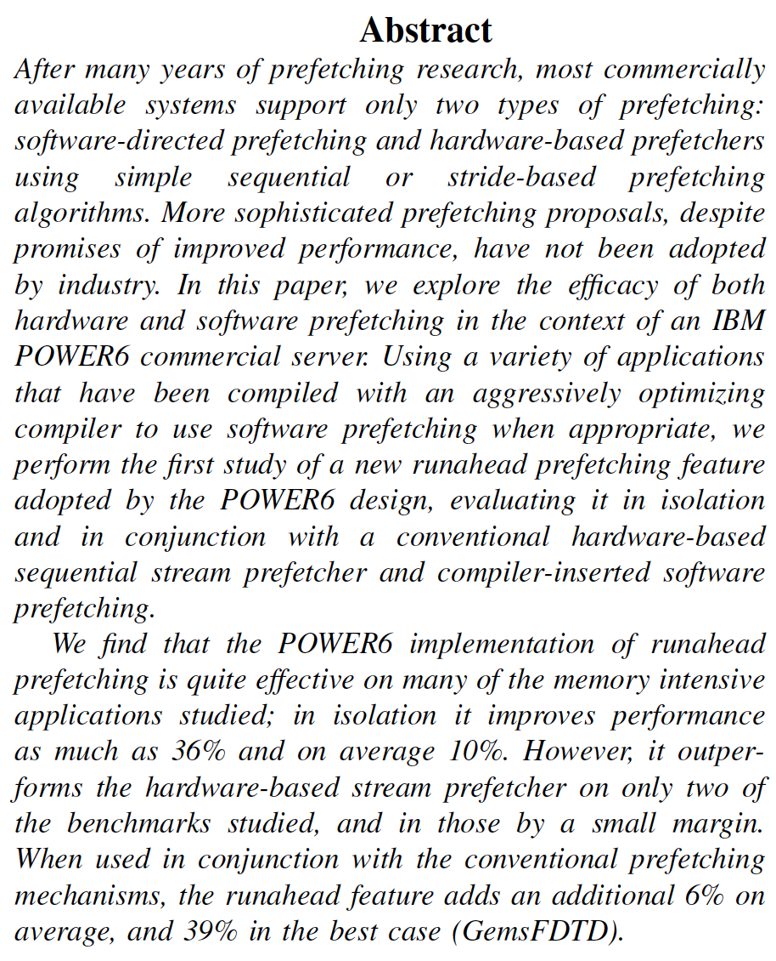
Runahead Execution in IBM POWER6

Slide 21
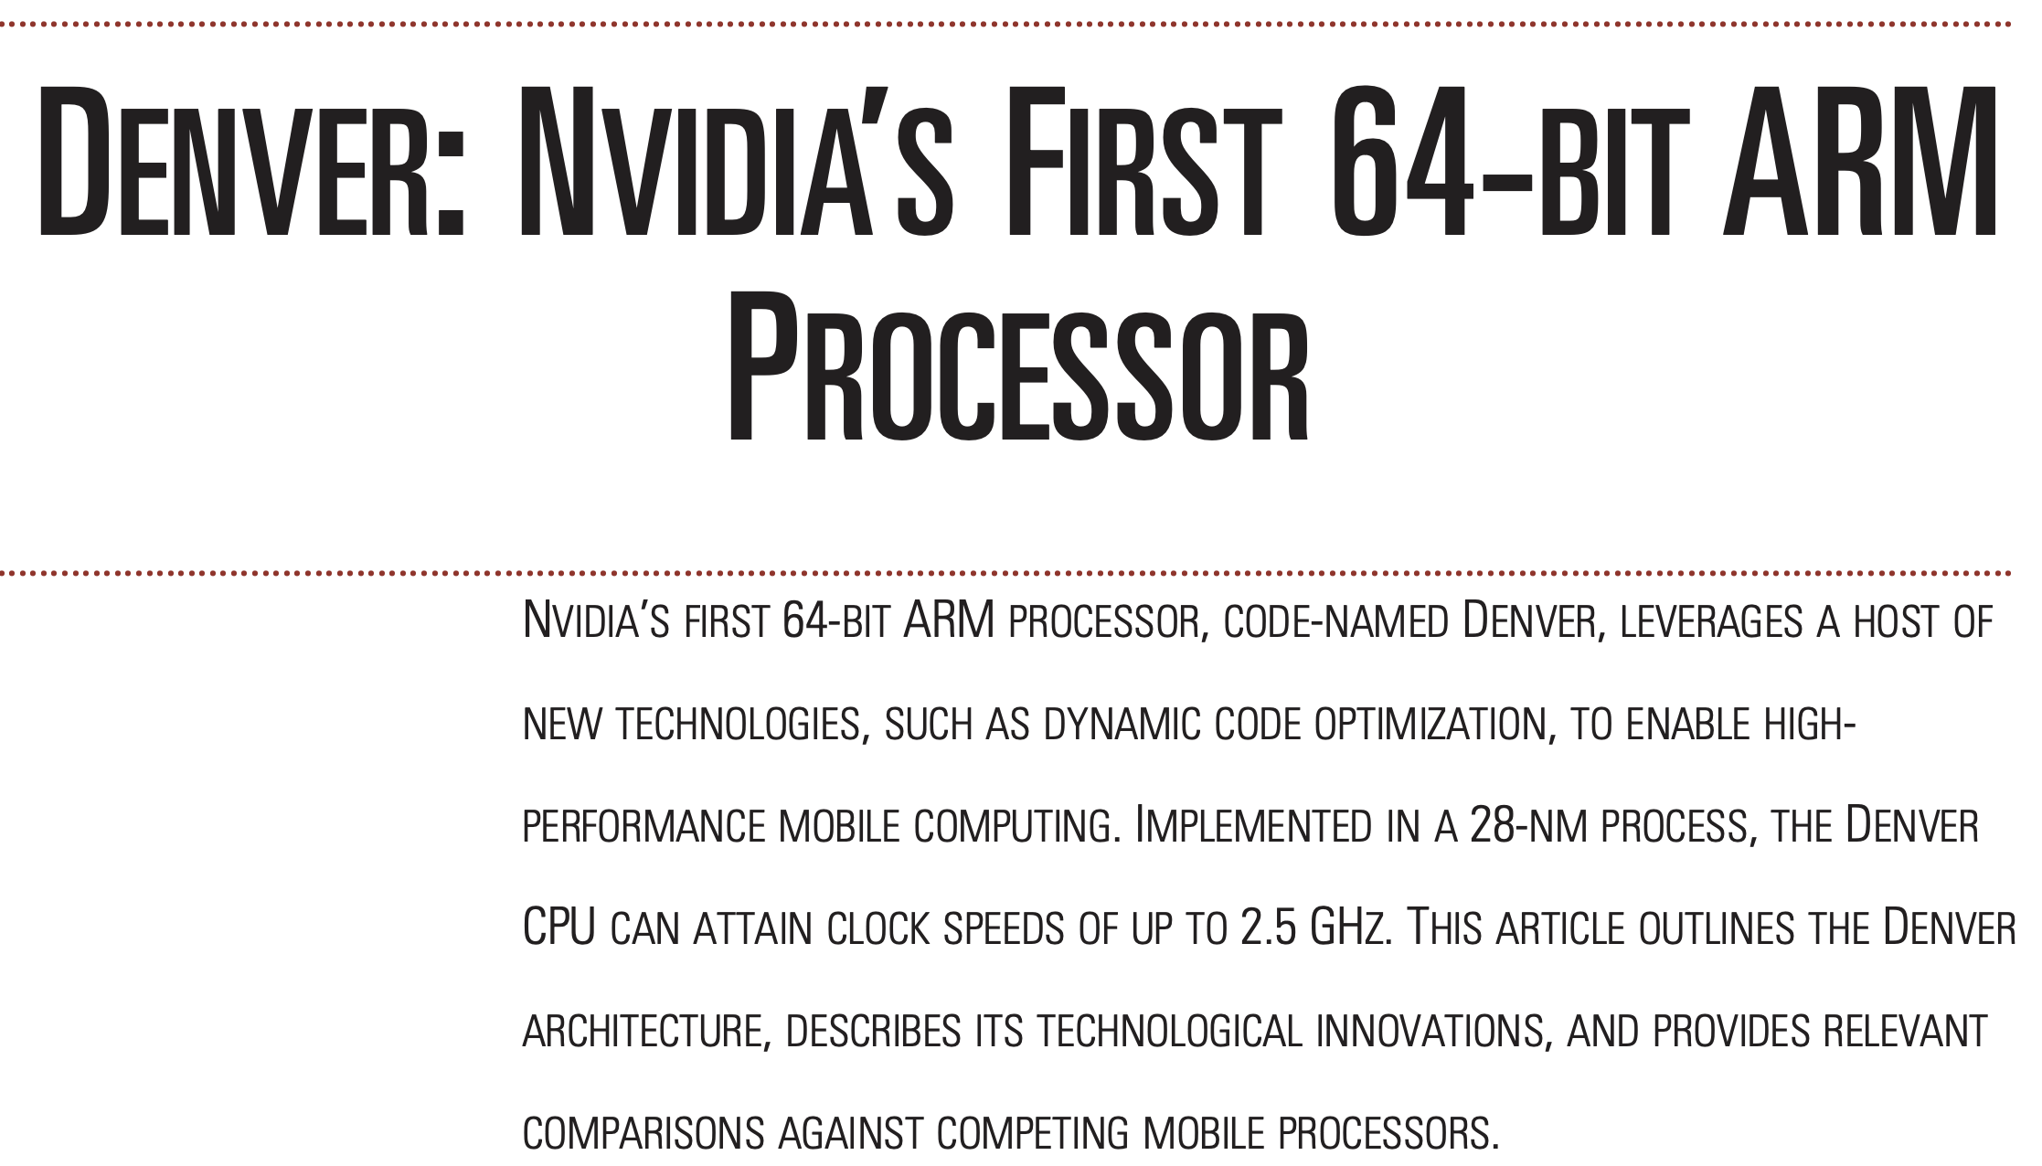
Runahead Execution in NVIDIA Denver
Boggs+, “Denver: NVIDIA’s First 64-Bit ARM Processor,” IEEE Micro 2015.

Slide 22
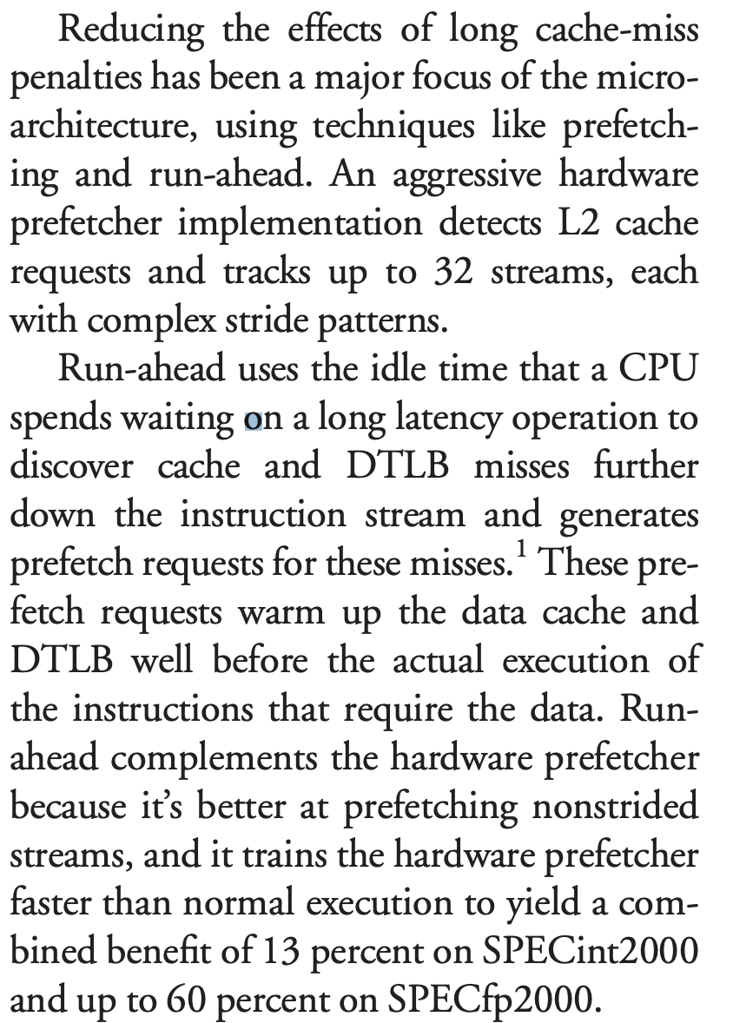
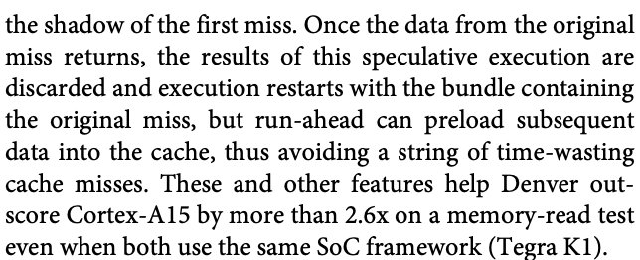
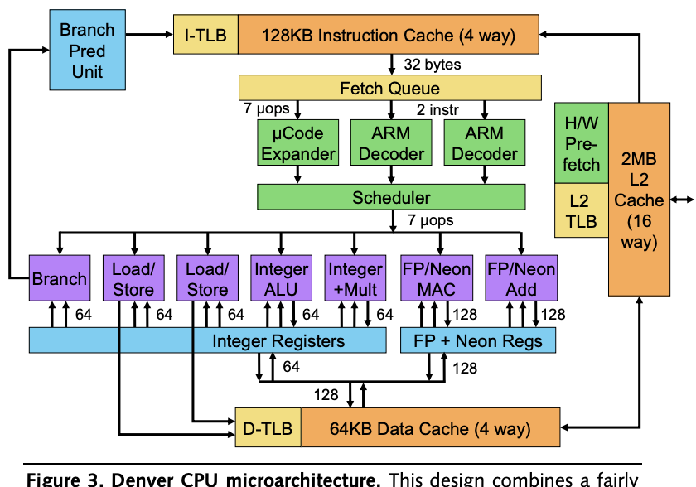
Runahead Execution in NVIDIA Denver
Boggs+, “Denver: NVIDIA’s First 64-Bit ARM Processor,” IEEE Micro 2015.
Gwennap, “NVIDIA’s First CPU is a Winner,” MPR 2014.

Slide 23
Runahead Enhancements

Slide 24
Runahead Enhancements
Mutlu et al., “Techniques for Efficient Processing in Runahead Execution Engines,” ISCA 2005, IEEE Micro Top Picks 2006.
Mutlu et al., “Address-Value Delta (AVD) Prediction,” MICRO 2005.
Armstrong et al., “Wrong Path Events,” MICRO 2004.
Mutlu et al., “An Analysis of the Performance Impact of Wrong-Path Memory References on Out-of-Order and Runahead Execution Processors,” IEEE TC 2005.

Slide 25
Limitations of the Baseline Runahead Mechanism
Energy Inefficiency
A large number of instructions are speculatively executed
Efficient Runahead Execution [ISCA’05, IEEE Micro Top Picks’06]
Ineffectiveness for pointer-intensive applications
Runahead cannot parallelize dependent L2 cache misses
Address-Value Delta (AVD) Prediction [MICRO’05]
Irresolvable branch mispredictions in runahead mode
Cannot recover from a mispredicted L2-miss dependent branch
Wrong Path Events [MICRO’04]
Wrong Path Memory Reference Analysis [IEEE TC’05]

Slide 26
More on Efficient Runahead Execution
Onur Mutlu, Hyesoon Kim, and Yale N. Patt, "Techniques for Efficient Processing in Runahead Execution Engines" Proceedings of the 32nd International Symposium on Computer Architecture (ISCA), pages 370-381, Madison, WI, June 2005. Slides (ppt) Slides (pdf) One of the 13 computer architecture papers of 2005 selected as Top Picks by IEEE Micro.

Slide 27
More on Efficient Runahead Execution
Onur Mutlu, Hyesoon Kim, and Yale N. Patt, "Efficient Runahead Execution: Power-Efficient Memory Latency Tolerance" IEEE Micro, Special Issue: Micro's Top Picks from Microarchitecture Conferences (MICRO TOP PICKS), Vol. 26, No. 1, pages 10-20, January/February 2006.

Slide 28
Agenda
Thanks
Runahead Execution
Looking to the Past
Looking to the Future

Slide 29
At the Time…
Large focus on increasing the size of the window…
And, designing bigger, more complicated machines
Runahead was a different way of thinking
Keep the OoO core simple and small
At the expense of non-MLP benefits
Use aggressive “automatic speculative execution” solely for prefetching
Synergistic with prefetching and branch prediction methods
A lot of interesting and innovative ideas ensued…

Slide 30
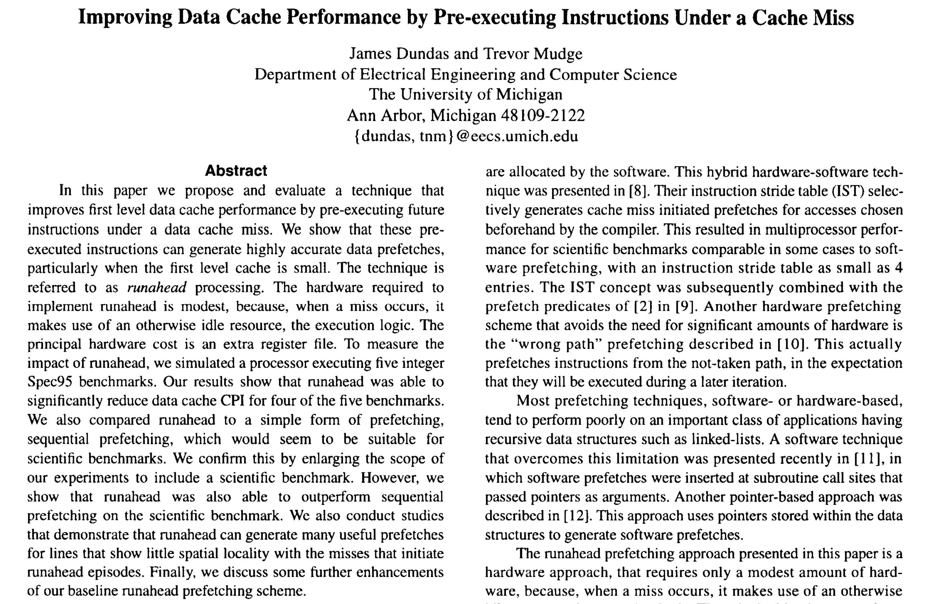
Important Precedent [Dundas & Mudge, ICS 1997]
Dundas+, “Improving Data Cache Performance by Pre-Executing Instructions Under a Cache Miss,” ICS 1997.

Slide 31
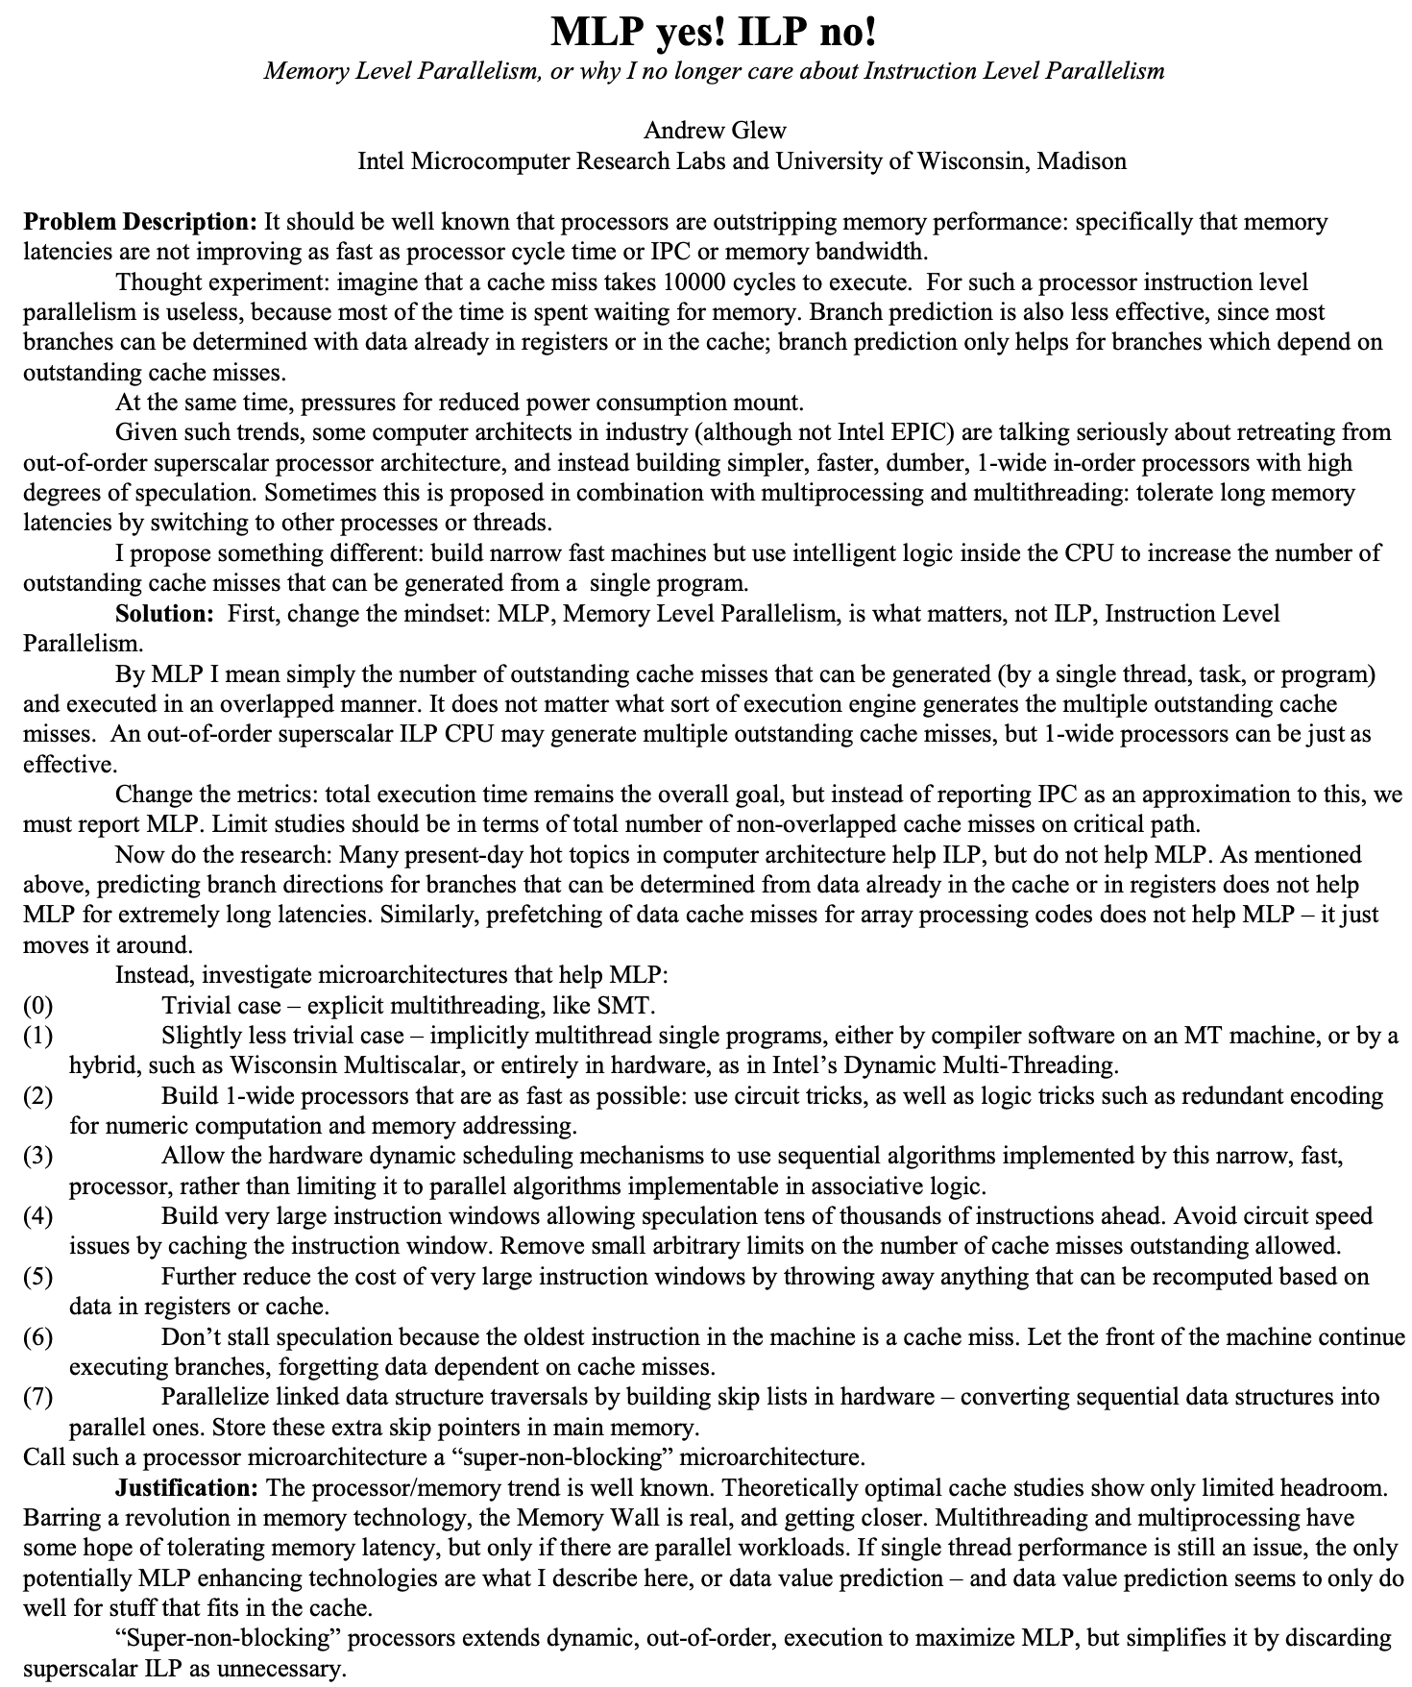
An Inspiration [Glew, ASPLOS-WACI 1998]
Glew, “MLP yes! ILP no!,” ASPLOS WACI 1998.

Slide 32
Agenda
Thanks
Runahead Execution
Looking to the Past
Looking to the Future

Slide 33
A Look into the Future…
Microarchitecture is still critically important
And, fun…
And, impactful…
Runahead is a great example of harmonious industry-academia collaboration
Fundamental problems will remain fundamental
And will require fundamental solutions

Slide 34
One Final Note
Our purpose was (and is) to advance the state of the art
That should be the sole purpose of any scientific effort
There is a dangerous tendency (especially today) that increasingly goes against the scientific purpose
In reviews & paper acceptance decisions
In paper formatting rules
In publication processes
In the bureaucracy academics have created
…
Conferences are not a competition → Let’s respect science

Slide 35
Suggestions to Reviewers
Be fair; you do not know it all
Be open-minded; you do not know it all
Be accepting of diverse research methods: there is no single way of doing research or writing a paper
Be constructive, not destructive
Enable heterogeneity, but not double standards
Do not block or delay scientific progress for non-reasons

Slide 36
Suggestion to Community
We Need to Fix the Reviewer Accountability Problem

Slide 37
Suggestion to Researchers: Principle: Passion
Follow Your Passion
(Do not get derailed
by naysayers)

Slide 38
Suggestion to Researchers: Principle: Resilience
Be Resilient

Slide 39
Principle: Learning and Scholarship
Focus on
learning and scholarship

Slide 40
Principle: Learning and Scholarship
The quality of your work defines your impact

Slide 41
Runahead Execution A Short Retrospective
Onur Mutlu, Jared Stark, Chris Wilkerson, Yale Patt
HPCA 2021 ToT Award Talk
2 March 2021

Slide 42
Backup Slides

Slide 43
Citation for the ToT Award
Runahead Execution is a pioneering paper that opened up new avenues in dynamic prefetching. The basic idea of run ahead execution effectively increases the instruction window very significantly, without having to increase physical resource size (e.g. the issue queue). This seminal paper spawned off a new area of ILP-enhancing microarchitecture research. This work has had strong industry impact as evidenced by IBM's POWER6 - Load Lookahead, NVIDIA Denver, and Sun ROCK's hardware scouting.

Slide 44
More on Runahead Execution
Lecture video from Fall 2020, Computer Architecture:
https://www.youtube.com/watch?v=zPewo6IaJ_8
Lecture video from Fall 2017, Computer Architecture:
https://www.youtube.com/watch?v=Kj3relihGF4
Onur Mutlu, "Efficient Runahead Execution Processors" Ph.D. Dissertation, HPS Technical Report, TR-HPS-2006-007, July 2006. Slides (ppt) Nominated for the ACM Doctoral Dissertation Award by the University of Texas at Austin.
https://www.youtube.com/onurmutlulectures

Slide 45
Runahead Execution Mechanism
Entry into runahead mode
Checkpoint architectural register state
Instruction processing in runahead mode
Exit from runahead mode
Restore architectural register state from checkpoint

Slide 46
Instruction Processing in Runahead Mode
Load 1 Miss
Compute
Runahead
Miss 1
Runahead mode processing is the same as normal instruction processing, EXCEPT:
It is purely speculative: Architectural (software-visible) register/memory state is NOT updated in runahead mode.
L2-miss dependent instructions are identified and treated specially.
They are quickly removed from the instruction window.
Their results are not trusted.

Slide 47
L2-Miss Dependent Instructions
Load 1 Miss
Compute
Runahead
Miss 1
Two types of results produced: INV and VALID
INV = Dependent on an L2 miss
INV results are marked using INV bits in the register file and store buffer.
INV values are not used for prefetching/branch resolution.

Slide 48
Removal of Instructions from Window
Load 1 Miss
Compute
Runahead
Miss 1
Oldest instruction is examined for pseudo-retirement
An INV instruction is removed from window immediately.
A VALID instruction is removed when it completes execution.
Pseudo-retired instructions free their allocated resources.
This allows the processing of later instructions.
Pseudo-retired stores communicate their data to dependent loads.
Notes:
Exceptions ignored. I/O operations that modify the state of the I/O devices are not performed. Uncacheable blocks are not fetched.

Slide 49
Store/Load Handling in Runahead Mode
Load 1 Miss
Compute
Runahead
Miss 1
A pseudo-retired store writes its data and INV status to a dedicated memory, called runahead cache.
Purpose: Data communication through memory in runahead mode.
A dependent load reads its data from the runahead cache.
Does not need to be always correct → Size of runahead cache is very small.

Slide 50
Branch Handling in Runahead Mode
Load 1 Miss
Compute
Runahead
Miss 1
INV branches cannot be resolved.
A mispredicted INV branch causes the processor to stay on the wrong program path until the end of runahead execution.
VALID branches are resolved and initiate recovery if mispredicted.

Slide 51
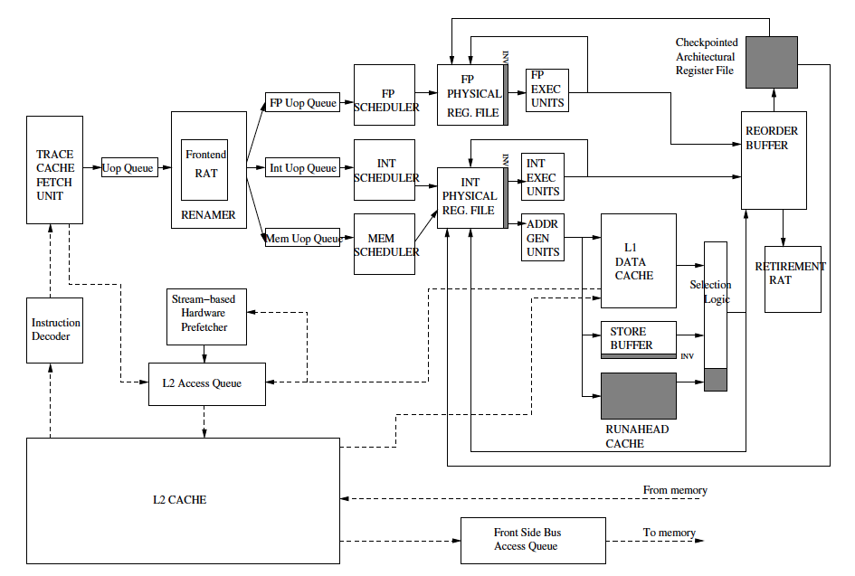
A Runahead Processor Diagram
Mutlu+, “Runahead Execution,”
HPCA 2003.

Slide 52
Limitations of the Baseline Runahead Mechanism
Energy Inefficiency
A large number of instructions are speculatively executed
Efficient Runahead Execution [ISCA’05, IEEE Micro Top Picks’06]
Ineffectiveness for pointer-intensive applications
Runahead cannot parallelize dependent L2 cache misses
Address-Value Delta (AVD) Prediction [MICRO’05]
Irresolvable branch mispredictions in runahead mode
Cannot recover from a mispredicted L2-miss dependent branch
Wrong Path Events [MICRO’04]
Wrong Path Memory Reference Analysis [IEEE TC’05]

Slide 53
The Efficiency Problem
22%
27%
Notes:
Mem latency 500
L2 cache 1 MB

Slide 54
Causes of Inefficiency
Short runahead periods
Overlapping runahead periods
Useless runahead periods
Mutlu et al., “Efficient Runahead Execution: Power-Efficient Memory Latency Tolerance,” ISCA 2005, IEEE Micro Top Picks 2006.

Slide 55
Short Runahead Periods
Processor can initiate runahead mode due to an already in-flight L2 miss generated by
the prefetcher, wrong-path, or a previous runahead period
Short periods
are less likely to generate useful L2 misses
have high overhead due to the flush penalty at runahead exit
Load 1 Miss
Load 2 Miss
Load 1 Hit
Load 2 Miss
Compute
Runahead
Miss 1
Miss 2

Slide 56
Overlapping Runahead Periods
Two runahead periods that execute the same instructions
Second period is inefficient
Load 1 Miss
Load 2 INV
Load 1 Hit
Load 2 Miss
Compute
OVERLAP
OVERLAP
Runahead
Miss 1
Miss 2

Slide 57
Useless Runahead Periods
Periods that do not result in prefetches for normal mode
They exist due to the lack of memory-level parallelism
Mechanism to eliminate useless periods:
Predict if a period will generate useful L2 misses
Estimate a period to be useful if it generated an L2 miss that cannot be captured by the instruction window
Useless period predictors are trained based on this estimation
Load 1 Miss
Load 1 Hit
Compute
Runahead
Miss 1

Slide 58
Overall Impact on Executed Instructions
26.5%
6.2%

Slide 59
Overall Impact on IPC
22.6%
22.1%

Slide 60
More on Efficient Runahead Execution
Onur Mutlu, Hyesoon Kim, and Yale N. Patt, "Techniques for Efficient Processing in Runahead Execution Engines" Proceedings of the 32nd International Symposium on Computer Architecture (ISCA), pages 370-381, Madison, WI, June 2005. Slides (ppt) Slides (pdf) One of the 13 computer architecture papers of 2005 selected as Top Picks by IEEE Micro.

Slide 61
More on Efficient Runahead Execution
Onur Mutlu, Hyesoon Kim, and Yale N. Patt, "Efficient Runahead Execution: Power-Efficient Memory Latency Tolerance" IEEE Micro, Special Issue: Micro's Top Picks from Microarchitecture Conferences (MICRO TOP PICKS), Vol. 26, No. 1, pages 10-20, January/February 2006.

Slide 62
Limitations of the Baseline Runahead Mechanism
Energy Inefficiency
A large number of instructions are speculatively executed
Efficient Runahead Execution [ISCA’05, IEEE Micro Top Picks’06]
Ineffectiveness for pointer-intensive applications
Runahead cannot parallelize dependent L2 cache misses
Address-Value Delta (AVD) Prediction [MICRO’05]
Irresolvable branch mispredictions in runahead mode
Cannot recover from a mispredicted L2-miss dependent branch
Wrong Path Events [MICRO’04]
Wrong Path Memory Reference Analysis [IEEE TC’05]

Slide 63
The Problem: Dependent Cache Misses
Runahead execution cannot parallelize dependent misses
wasted opportunity to improve performance
wasted energy (useless pre-execution)
Runahead performance would improve by 25% if this limitation were ideally overcome
Runahead: Load 2 is dependent on Load 1
Cannot Compute Its Address!
Load 1 Miss
Load 2
INV
Load 1 Hit
Load 2 Miss
Compute
Runahead
Miss 1
Miss 2

Slide 64
Parallelizing Dependent Cache Misses
Idea: Enable the parallelization of dependent L2 cache misses in runahead mode with a low-cost mechanism
How: Predict the values of L2-miss address (pointer) loads
Address load: loads an address into its destination register, which is later used to calculate the address of another load
as opposed to data load
Read:
Mutlu et al., “Address-Value Delta (AVD) Prediction,” MICRO 2005.

Slide 65
Parallelizing Dependent Cache Misses
Cannot Compute Its Address!
Load 1 Miss
Load 2 INV
Load 1 Hit
Load 2 Miss
Compute
Runahead
Miss 1
Miss 2
Value Predicted
Can Compute Its Address
Load 1 Miss
Load 2
Miss
Load 1 Hit
Load 2 Hit
Saved Speculative Instructions
Compute
Runahead
Saved Cycles
Miss 1
Miss 2
Notes:
As I showed before, traditional runahead execution cannot parallelize dependent cache misses due to load 1 and load 2, because load 2 cannot compute its address in runahead mode. However, if the value of Load 1 is predicted, Load 2 would be able to compute its address and it would generate its miss in runahead mode.

Slide 66
More on AVD Prediction
Onur Mutlu, Hyesoon Kim, and Yale N. Patt, "Address-Value Delta (AVD) Prediction: Increasing the Effectiveness of Runahead Execution by Exploiting Regular Memory Allocation Patterns" Proceedings of the 38th International Symposium on Microarchitecture (MICRO), pages 233-244, Barcelona, Spain, November 2005. Slides (ppt) Slides (pdf) One of the five papers nominated for the Best Paper Award by the Program Committee.

Slide 67
More on AVD Prediction (II)
Onur Mutlu, Hyesoon Kim, and Yale N. Patt, "Address-Value Delta (AVD) Prediction: A Hardware Technique for Efficiently Parallelizing Dependent Cache Misses" IEEE Transactions on Computers (TC), Vol. 55, No. 12, pages 1491-1508, December 2006.

Slide 68
Limitations of the Baseline Runahead Mechanism
Energy Inefficiency
A large number of instructions are speculatively executed
Efficient Runahead Execution [ISCA’05, IEEE Micro Top Picks’06]
Ineffectiveness for pointer-intensive applications
Runahead cannot parallelize dependent L2 cache misses
Address-Value Delta (AVD) Prediction [MICRO’05]
Irresolvable branch mispredictions in runahead mode
Cannot recover from a mispredicted L2-miss dependent branch
Wrong Path Events [MICRO’04]
Wrong Path Memory Reference Analysis [IEEE TC’05]

Slide 69
Wrong Path Events
David N. Armstrong, Hyesoon Kim, Onur Mutlu, and Yale N. Patt, "Wrong Path Events: Exploiting Unusual and Illegal Program Behavior for Early Misprediction Detection and Recovery" Proceeedings of the 37th International Symposium on Microarchitecture (MICRO), pages 119-128, Portland, OR, December 2004. Slides (pdf)Slides (ppt)

Slide 70
Effects of Wrong Path Execution (I)
Onur Mutlu, Hyesoon Kim, David N. Armstrong, and Yale N. Patt, "Understanding the Effects of Wrong-Path Memory References on Processor Performance" Proceedings of the 3rd Workshop on Memory Performance Issues (WMPI), pages 56-64, Munchen, Germany, June 2004. Slides (pdf)

Slide 71
Effects of Wrong Path Execution (II)
Onur Mutlu, Hyesoon Kim, David N. Armstrong, and Yale N. Patt, "An Analysis of the Performance Impact of Wrong-Path Memory References on Out-of-Order and Runahead Execution Processors" IEEE Transactions on Computers (TC), Vol. 54, No. 12, pages 1556-1571, December 2005.

