Slide 1


Architecting and Exploiting
Asymmetry in Multi-Core Architectures
Onur Mutlu
onur@cmu.edu
June 19, 2013
TUBITAK

Slide 2
Course Info: Who Am I?
Instructor: Prof. Onur Mutlu
  Carnegie Mellon University ECE/CS
  PhD from UT-Austin, worked at Microsoft Research, Intel, AMD
  http://www.ece.cmu.edu/~omutlu
  onur@cmu.edu (Best way to reach me)
  http://users.ece.cmu.edu/~omutlu/projects.htm
Research, Teaching, Consulting Interests
  Computer architecture, software/hardware interaction and co-design
  Many-core systems, heterogeneous systems
  Memory systems, interconnects
  Scalable, predictable and QoS-aware systems
  Fault tolerance and security
  Algorithms and architectures for genome analysis and important applications
  …
  1. developing efficient, high-performance, and scalable systems;
  2. solving difficult architectural problems at low cost & complexity

Slide 3
Overview of My Group’s Research
Heterogeneous systems, accelerating bottlenecks
Memory (and storage) systems
  Scalability, energy, latency, parallelism, performance
  Compute in/near memory
Predictable performance, QoS
Efficient interconnects
Bioinformatics algorithms and architectures
Acceleration of important applications, software/hardware co-design

Slide 4
Our Goals
Solve difficult platform and system (software and hardware) design problems to
  Enable more scalable system designs solving bigger problems or solving problems more efficiently
  Enable new applications
  Enable new usage models of computers

Slide 5
Three Key Problems in Future Systems
Memory system
  Many important existing and future applications are increasingly data intensive → require bandwidth and capacity
  Data storage and movement limits performance & efficiency
Efficiency (performance and energy) → scalability
  Enables scalable systems → new applications
  Enables better user experience → new usage models
Predictability and robustness
  Resource sharing and unreliable hardware causes QoS issues
  Predictable performance and QoS are first class constraints

Slide 6
Readings and Videos

Slide 7
Mini Course: Multi-Core Architectures
Lecture 1.1: Multi-Core System Design
  http://users.ece.cmu.edu/~omutlu/pub/onur-Bogazici-June-6-2013-lecture1-1-multicore-and-asymmetry-afterlecture.pptx
Lecture 1.2: Cache Design and Management
  http://users.ece.cmu.edu/~omutlu/pub/onur-Bogazici-June-7-2013-lecture1-2-cache-management-afterlecture.pptx
Lecture 1.3: Interconnect Design and Management
  http://users.ece.cmu.edu/~omutlu/pub/onur-Bogazici-June-10-2013-lecture1-3-interconnects-afterlecture.pptx

Slide 8
Mini Course: Memory Systems
Lecture 2.1: DRAM Basics and DRAM Scaling
  http://users.ece.cmu.edu/~omutlu/pub/onur-Bogazici-June-13-2013-lecture2-1-dram-basics-and-scaling-afterlecture.pptx
Lecture 2.2: Emerging Technologies and Hybrid Memories
  http://users.ece.cmu.edu/~omutlu/pub/onur-Bogazici-June-14-2013-lecture2-2-emerging-memory-afterlecture.pptx
Lecture 2.3: Memory QoS and Predictable Performance
  http://users.ece.cmu.edu/~omutlu/pub/onur-Bogazici-June-17-2013-lecture2-3-memory-qos-afterlecture.pptx

Slide 9
Readings for Today
Required – Symmetric and Asymmetric Multi-Core Systems
  Suleman et al., “Accelerating Critical Section Execution with Asymmetric Multi-Core Architectures,” ASPLOS 2009, IEEE Micro 2010.
  Suleman et al., “Data Marshaling for Multi-Core Architectures,” ISCA 2010, IEEE Micro 2011.
  Joao et al., “Bottleneck Identification and Scheduling for Multithreaded Applications,” ASPLOS 2012.
  Joao et al., “Utility-Based Acceleration of Multithreaded Applications on Asymmetric CMPs,” ISCA 2013.
Recommended
  Amdahl, “Validity of the single processor approach to achieving large scale computing capabilities,” AFIPS 1967.
  Olukotun et al., “The Case for a Single-Chip Multiprocessor,” ASPLOS 1996.
  Mutlu et al., “Runahead Execution: An Alternative to Very Large Instruction Windows for Out-of-order Processors,” HPCA 2003, IEEE Micro 2003.
  Mutlu et al., “Techniques for Efficient Processing in Runahead Execution Engines,” ISCA 2005, IEEE Micro 2006.

Slide 10
Videos for Today
Multiprocessors
  Basics:http://www.youtube.com/watch?v=7ozCK_Mgxfk&list=PL5PHm2jkkXmidJOd59REog9jDnPDTG6IJ&index=31
  Correctness and Coherence: http://www.youtube.com/watch?v=U-VZKMgItDM&list=PL5PHm2jkkXmidJOd59REog9jDnPDTG6IJ&index=32
  Heterogeneous Multi-Core: http://www.youtube.com/watch?v=r6r2NJxj3kI&list=PL5PHm2jkkXmidJOd59REog9jDnPDTG6IJ&index=34
Runahead Execution
  http://www.youtube.com/watch?v=z8YpjqXQJIA&list=PL5PHm2jkkXmidJOd59REog9jDnPDTG6IJ&index=28

Slide 11
Online Lectures and More Information
Online Computer Architecture Lectures
  http://www.youtube.com/playlist?list=PL5PHm2jkkXmidJOd59REog9jDnPDTG6IJ
Online Computer Architecture Courses
  Intro: http://www.ece.cmu.edu/~ece447/s13/doku.php
  Advanced: http://www.ece.cmu.edu/~ece740/f11/doku.php
  Advanced: http://www.ece.cmu.edu/~ece742/doku.php
Recent Research Papers
  http://users.ece.cmu.edu/~omutlu/projects.htm
  http://scholar.google.com/citations?user=7XyGUGkAAAAJ&hl=en

Slide 12
Architecting and Exploiting
Asymmetry in Multi-Core Architectures

Slide 13
Warning
This is an asymmetric talk
But, we do not need to cover all of it…
Component 1: A case for asymmetry everywhere
Component 2: A deep dive into mechanisms to exploit asymmetry in processing cores
Component 3: Asymmetry in memory controllers
Asymmetry = heterogeneity
  A way to enable specialization/customization

Slide 14
The Setting
Hardware resources are shared among many threads/apps in a many-core system
  Cores, caches, interconnects, memory, disks, power, lifetime, …
Management of these resources is a very difficult task
  When optimizing parallel/multiprogrammed workloads
  Threads interact unpredictably/unfairly in shared resources
Power/energy consumption is arguably the most valuable shared resource
  Main limiter to efficiency and performance

Slide 15
Shield the Programmer from Shared Resources
Writing even sequential software is hard enough
  Optimizing code for a complex shared-resource parallel system will be a nightmare for most programmers
Programmer should not worry about (hardware) resource management
  What should be executed where with what resources
Future computer architectures should be designed to
  Minimize programmer effort to optimize (parallel) programs
  Maximize runtime system’s effectiveness in automatic shared resource management

Slide 16
Shared Resource Management: Goals
Future many-core systems should manage power and performance automatically across threads/applications
Minimize energy/power consumption
While satisfying performance/SLA requirements
  Provide predictability and Quality of Service
Minimize programmer effort
  In creating optimized parallel programs
Asymmetry and configurability in system resources essential to achieve these goals

Slide 17
Asymmetry Enables Customization
Symmetric: One size fits all
  Energy and performance suboptimal for different phase behaviors
Asymmetric: Enables tradeoffs and customization
  Processing requirements vary across applications and phases
  Execute code on best-fit resources (minimal energy, adequate perf.)
C
C
C
C
C1
C2
C
C
C
C
C3
C
C
C
C
C4
C4
C4
C4
C
C
C
C
C5
C5
C5
C5
Symmetric
Asymmetric

Slide 18
Thought Experiment: Asymmetry Everywhere
Design each hardware resource with asymmetric, (re-)configurable, partitionable components
  Different power/performance/reliability characteristics
  To fit different computation/access/communication patterns

Slide 19
Thought Experiment: Asymmetry Everywhere
Design the runtime system (HW & SW) to automatically choose the best-fit components for each phase
  Satisfy performance/SLA with minimal energy
  Dynamically stitch together the “best-fit” chip for each phase
Phase 1
Phase 2
Phase 3

Slide 20
Thought Experiment: Asymmetry Everywhere
Morph software components to match asymmetric HW components
  Multiple versions for different resource characteristics
Version 1
Version 2
Version 3

Slide 21
Many Research and Design Questions
How to design asymmetric components?
  Fixed, partitionable, reconfigurable components?
  What types of asymmetry? Access patterns, technologies?
What monitoring to perform cooperatively in HW/SW?
  Automatically discover phase/task requirements
How to design feedback/control loop between components and runtime system software?
How to design the runtime to automatically manage resources?
  Track task behavior, pick “best-fit” components for the entire workload

Slide 22
Talk Outline
Problem and Motivation
How Do We Get There: Examples
Accelerated Critical Sections (ACS)
Bottleneck Identification and Scheduling (BIS)
Staged Execution and Data Marshaling
Thread Cluster Memory Scheduling (if time permits)
Ongoing/Future Work
Conclusions

Slide 23
Exploiting Asymmetry: Simple Examples
Serial
Parallel
Execute critical/serial sections on high-power, high-performance cores/resources [Suleman+ ASPLOS’09, ISCA’10, Top Picks’10’11, Joao+ ASPLOS’12]
  Programmer can write less optimized, but more likely correct programs

Slide 24
Exploiting Asymmetry: Simple Examples
Streaming
Random access
Execute streaming “memory phases” on streaming-optimized cores and memory hierarchies
  More efficient and higher performance than general purpose hierarchy

Slide 25
Exploiting Asymmetry: Simple Examples
Bandwidth sensitive
Latency sensitive
Partition memory controller and on-chip network bandwidth asymmetrically among threads [Kim+ HPCA 2010, MICRO 2010, Top Picks 2011] [Nychis+ HotNets 2010] [Das+ MICRO 2009, ISCA 2010, Top Picks 2011]
  Higher performance and energy-efficiency than symmetric/free-for-all

Slide 26
Exploiting Asymmetry: Simple Examples
Compute intensive
Memory intensive
Have multiple different memory scheduling policies apply them to different sets of threads based on thread behavior [Kim+ MICRO 2010, Top Picks 2011] [Ausavarungnirun, ISCA 2012]
  Higher performance and fairness than a homogeneous policy

Slide 27
Exploiting Asymmetry: Simple Examples
CPU
DRAMCtrl
PCM Ctrl
DRAM
Phase Change Memory (or Tech. X)
Fast, durable
Small,
leaky, volatile,
high-cost
Large, non-volatile, low-cost
Slow, wears out, high active energy
DRAM
Phase Change Memory
Build main memory with different technologies with different characteristics (energy, latency, wear, bandwidth) [Meza+ IEEE CAL’12]
  Map pages/applications to the best-fit memory resource
  Higher performance and energy-efficiency than single-level memory

Slide 28
Talk Outline
Problem and Motivation
How Do We Get There: Examples
Accelerated Critical Sections (ACS)
Bottleneck Identification and Scheduling (BIS)
Staged Execution and Data Marshaling
Thread Cluster Memory Scheduling (if time permits)
Ongoing/Future Work
Conclusions

Slide 29
Serialized Code Sections in Parallel Applications
Multithreaded applications:
  Programs split into threads
Threads execute concurrently on multiple cores
Many parallel programs cannot be parallelized completely
Serialized code sections:
  Reduce performance
  Limit scalability
  Waste energy

Slide 30
Causes of Serialized Code Sections
Sequential portions (Amdahl’s “serial part”)
Critical sections
Barriers
Limiter stages in pipelined programs

Slide 31
Bottlenecks in Multithreaded Applications
Definition: any code segment for which threads contend (i.e. wait)
Examples:
Amdahl’s serial portions
  Only one thread exists → on the critical path
Critical sections
  Ensure mutual exclusion → likely to be on the critical path if contended
Barriers
  Ensure all threads reach a point before continuing → the latest thread arriving is on the critical path
Pipeline stages
  Different stages of a loop iteration may execute on different threads,
  slowest stage makes other stages wait → on the critical path

Slide 32
Critical Sections
Threads are not allowed to update shared data concurrently
  For correctness (mutual exclusion principle)
Accesses to shared data are encapsulated inside
critical sections
Only one thread can execute a critical section at
a given time

Slide 33
Example from MySQL
Critical
Section
Access Open Tables Cache
Open database tables
Perform the operations
….
Parallel
Notes:
I show an example from the MySQL database. Each database thread first>>>
opens the database tables it requires, and >>>
then processes the transaction >>>
While independent transactions can proceed in parallel, opening the tables requires accessing a shared data structure called the Open Table Caches. The open tables cache is a 2-dimensional a linked data structure accesses to which are difficult to parallelize. >>>
Thus the accesses are encapsulated in a critical section.>>>

Slide 34
Contention for Critical Sections
12 iterations, 33% instructions inside the critical section
Critical Section
Parallel
Idle
P = 4
P = 3
P = 2
33% in critical section
P = 1
0
1
2
3
4
5
6
7
8
9
10
11
12
Notes:
For simplicity lets assume that when run as a single thread, each database transaction spends 33% of its time inside the critical section and 75% of its time executing the parallel portion. >>>
I show execution of 16 transactions on a single core. The red represent the critical sections and the grey represent the non-critical section code.>>>
With 2 cores, overall execution time is halved >>>
With 4 cores, the execution time is again halved however note that the critical section is being run at all times. Thus, performance has become critical section limited ..>>>
Further increasing the cores to 8, does not reduce execution time. >>>
Thus critical sections reduce performance and limit scalability.

Slide 35
Contention for Critical Sections
12 iterations, 33% instructions inside the critical section
Critical Section
Parallel
Idle
P = 4
Accelerating critical sections
increases performance and scalability
P = 3
Critical
Section
Accelerated by 2x
P = 2
P = 1
0
1
2
3
4
5
6
7
8
9
10
11
12
Notes:
However, I can accelerate the critical section. When we accelerate the critical section execution by 2x, the time inside the critical section reduces to half. I use blue to show the accelerated critical section. At one core, the overall execution time reduces. >>>
Similarly execution time also reduces at 2, 3, and 4 cores. >>>
Most notably, due to the shorter critical sections, performance no longer saturates at 4 cores. Instead, execution time continues to reduce until 4 cores.

Slide 36
Impact of Critical Sections on Scalability
Contention for critical sections leads to serial execution (serialization) of threads in the parallel program portion
Contention for critical sections increases with the number of threads and limits scalability
Speedup
Chip Area (cores)
MySQL (oltp-1)

Slide 37
Impact of Critical Sections on Scalability
Contention for critical sections leads to serial execution (serialization) of threads in the parallel program portion
Contention for critical sections increases with the number of threads and limits scalability
Asymmetric
Speedup
Today
Chip Area (cores)
MySQL (oltp-1)

Slide 38
A Case for Asymmetry
Execution time of sequential kernels, critical sections, and limiter stages must be short
It is difficult for the programmer to shorten these
serialized sections
  Insufficient domain-specific knowledge
  Variation in hardware platforms
  Limited resources
Goal: A mechanism to shorten serial bottlenecks without requiring programmer effort
Idea: Accelerate serialized code sections by shipping them to powerful cores in an asymmetric multi-core (ACMP)

Slide 39
ACMP
Provide one large core and many small cores
Execute parallel part on small cores for high throughput
Accelerate serialized sections using the large core
  Baseline: Amdahl’s serial part accelerated [Morad+ CAL 2006, Suleman+, UT-TR 2007]
Large
core
Small
core
Small
core
Small
core
Small
core
Small
core
Small
core
Small
core
Small
core
Small
core
Small
core
Small
core
Small
core
ACMP
Notes:
We use the Asymmetric Chip Multiprocessor or ACMP as our baseline. The ACMP was first proposed by Morad et al to handle the Amdahl’s serial part. ACMP provides one large core and many small cores. The small cores execute the parallel part at high throughput and the large core executes the Amdahl’s serial part of the program where ONLY a single thread exists. The ACMP uses locks to handle the critical sections similar to a conventional CMP. Let me show an example.

Slide 40
Conventional ACMP
EnterCS()
  PriorityQ.insert(…)
LeaveCS()
P2 encounters a Critical Section
Sends a request for the lock
Acquires the lock
Executes Critical Section
Releases the lock
P1
Core executing critical section
P2
P3
P4
On-chip Interconnect
Notes:
Consider an ACMP with one large core and 3 small cores, ALL executing parallel threads. Initially P3, shown in red is executing the critical section.
When P2 encounters a critical section.
It sends a request for the lock to P3, which is executing the critical section currently.
P2 is able to acquire the lock after P3 releases the lock.
P2 then executes the critical sections and
releases the lock at the end.

Slide 41
Accelerated Critical Sections (ACS)
Accelerate Amdahl’s serial part and critical sections using the large core
  Suleman et al., “Accelerating Critical Section Execution with Asymmetric Multi-Core Architectures,” ASPLOS 2009, IEEE Micro Top Picks 2010.
Large
core
Small
core
Small
core
Critical Section
Request Buffer (CSRB)
Small
core
Small
core
Small
core
Small
core
Small
core
Small
core
Small
core
Small
core
Small
core
Small
core
ACMP

Slide 42
Accelerated Critical Sections (ACS)
EnterCS()
  PriorityQ.insert(…)
LeaveCS()
1. P2 encounters a critical section (CSCALL)
2. P2 sends CSCALL Request to CSRB
3. P1 executes Critical Section
4. P1 sends CSDONE signal
P1
Core executing critical section
P2
P3
P4
Critical Section
Request Buffer (CSRB)
Onchip-Interconnect

Slide 43
ACS Architecture Overview
ISA extensions
  CSCALL LOCK_ADDR, TARGET_PC
  CSRET LOCK_ADDR
Compiler/Library inserts CSCALL/CSRET
On a CSCALL, the small core:
  Sends a CSCALL request to the large core
    Arguments: Lock address, Target PC, Stack Pointer, Core ID
  Stalls and waits for CSDONE
Large Core
  Critical Section Request Buffer (CSRB)
  Executes the critical section and sends CSDONE to the requesting core
Notes:
ACS requires support from the ISA, compiler, and the microarchitecture. We require two new instructions, CSCALL and CSRET. CSCALL has two arguments: the address of the lock protecting the critical section and the starting address of the critical section. CSRET takes the address of the lock as its only argument.
The compiler or the library inserts CSCALL and CSRET at the beginning and end of the critical section respectively.
When a small core encounters a CSCALL instruction, it sends the CSCALL request together with its stack pointer and core ID to the large core. AND waits for the CSDONE signal.
The large core buffers the request in the CSRB and executes the critical sections. It sends a CSDONE signal to the small core on completion.

Slide 44
Accelerated Critical Sections (ACS)
Small Core
Small Core
Large Core
A = compute()
A = compute()
LOCK X
result = CS(A)
UNLOCK X
print result
PUSH A
CSCALL X, Target PC
…
…
…
CSCALL Request
…
…
…
Send X, TPC, STACK_PTR, CORE_ID
Waiting in Critical Section Request Buffer (CSRB)
…
…
…
…
TPC:
Acquire X
POP A
result = CS(A)
PUSH result
Release X
CSRET X
CSDONE Response
POP result
print result

Slide 45
False Serialization
ACS can serialize independent critical sections
Selective Acceleration of Critical Sections (SEL)
  Saturating counters to track false serialization
To large core
4
CSCALL (A)
3
A
2
Critical Section Request Buffer
(CSRB)
4
CSCALL (A)
B
5
CSCALL (B)
From small cores
Notes:
While executing the critical sections on the large core accelerates their execution, ACS can serialize the execution of independent critical sections. Independent critical sections protect disjoint data and can execute concurrently in conventional systems. Since ACS sends all critical sections to the large core, their execution can get serialized. WE call this false serialization. To reduce the effect of false serialization,
we implement a mechanism to selectively disable the acceleration of critical sections which are experiencing false serialization. We call it SEL.
To implement SEL, we add a table of saturating counters to the CSRB which track false serialization. For simplicity, assume there is one counter for every independent critical section. A counter is incremented when the critical section experiences false serialization and decremented otherwise.
For example, consider a system with two critical sections A and B and an empty CSRB.
A CSCALL for critical section A arrives. Since there are no other entries, there is no false serialization, so
the counter corresponding to critical section A is decremented.
While the first call is still in progress, another CSCALL for A arrives. Again, there is NO false serialization since CSCALL for A would have waited for the first instance of critical section A even in the conventional system.
Thus counter for A is again decremented.
Now a CSCALL for B is enters the CSRB. Since B now has to wait for critical section A, which it should NOT. We say that B is experiencing false serialization and
increment its counter.
When a counter reaches its maximum value, acceleration for that critical section is disabled and conventional locking is used for its execution from there on.

Slide 46
ACS Performance Tradeoffs
Pluses
  + Faster critical section execution
  + Shared locks stay in one place: better lock locality
  + Shared data stays in large core’s (large) caches: better shared data locality, less ping-ponging
Minuses
  - Large core dedicated for critical sections: reduced parallel throughput
  - CSCALL and CSDONE control transfer overhead
  - Thread-private data needs to be transferred to large core: worse private data locality

Slide 47
ACS Performance Tradeoffs
Fewer parallel threads vs. accelerated critical sections
  Accelerating critical sections offsets loss in throughput
  As the number of cores (threads) on chip increase:
    Fractional loss in parallel performance decreases
    Increased contention for critical sections
    makes acceleration more beneficial
Overhead of CSCALL/CSDONE vs. better lock locality
  ACS avoids “ping-ponging” of locks among caches by keeping them at the large core
More cache misses for private data vs. fewer misses for shared data
Notes:
ACS dedicates the large core for execution of critical sections which could otherwise be used for executing additional threads. This reduces peak parallel throughput. However, we find that in critical section intensive workloads this is not a problem since the benefit obtained by accelerating of critical sections offsets the loss in peak parallel throughput.
Moreover, we observe that this problem will be further reduce as the number of cores on the chip increase for two reasons.
First, the fraction of throughput lost due to ACS decreases. For example, loosing 4 cores in a 64-core system will be a much smaller loss than loosing 4 cores in a 8-core system.
Second, contention for critical sections increases as the number of concurrent threads increase. When contention is high, accelerating the critical sections not only reduces the critical section execution time BUT also the waiting time for contending threads. Thereby making the acceleration even more beneficial.
ACS also incurs the overhead of sending CSCALL and CSDONE signals.
This overhead is similar to the conventional systems because in conventional systems lock acquire operations often generate a cache miss and the lock variable is brought from another core. In ACS, since all critical sections execute on one LARGE core, the lock variables stay resident in its cache which saves cache misses. Thus, overall, ACS has similar latency.
In ACS the input arguments to the critical section must be transferred from the cache of the small core to the cache of the large core. Let me explain this trade-off with an example.

Slide 48
Cache Misses for Private Data
PriorityHeap.insert(NewSubProblems)
Private Data: NewSubProblems
Shared Data:
The priority heap
Puzzle Benchmark
Notes:
Consider this critical section from the puzzle benchmark. This critical sections protects a priority heap. The input argument is the node to be inserted on the heap.
The priority heap is the Shared data which is data protected by the critical sections and private data is the incoming node to be inserted.
During execution, multiple nodes of the heap are touched to find the right place to insert the incoming private data. In conventional systems, the shared data usually moves from cache-to-cache as different cores modify it inside critical sections. The private data is usually available locally. In ACS, since all critical sections execute on the large core, the shared data stays resident AT the large and does not move from cache to cache. However, private data has to be brought in from the small requesting core to execute the critical section.

Slide 49
ACS Performance Tradeoffs
Fewer parallel threads vs. accelerated critical sections
  Accelerating critical sections offsets loss in throughput
  As the number of cores (threads) on chip increase:
    Fractional loss in parallel performance decreases
    Increased contention for critical sections
    makes acceleration more beneficial
Overhead of CSCALL/CSDONE vs. better lock locality
  ACS avoids “ping-ponging” of locks among caches by keeping them at the large core
More cache misses for private data vs. fewer misses for shared data
  Cache misses reduce if shared data > private data
We will get back to this

Slide 50
ACS Comparison Points
Small
core
Small
core
Small
core
Small
core
Large
core
Small
core
Small
core
Large
core
Small
core
Small
core
Small
core
Small
core
Small
core
Small
core
Small
core
Small
core
Small
core
Small
core
Small
core
Small
core
Small
core
Small
core
Small
core
Small
core
Small
core
Small
core
Small
core
Small
core
Small
core
Small
core
Small
core
Small
core
Small
core
Small
core
Small
core
Small
core
Small
core
Small
core
Small
core
Small
core
Small
core
Small
core
SCMP
ACMP
ACS
Conventional locking
Conventional locking
Large core executes Amdahl’s serial part
Large core executes Amdahl’s serial part and critical sections
Notes:
In our experiments we simulated three configurations.
First, A symmetric CMP or SCMP with all small cores. The numbers of cores is equal to the chip area and conventional locks are used for critical sections.
Second, an ACMP with one large core and remaining small cores. The large core takes the area of 4 small cores. The large core is used to execute Amdahl’s bottleneck. Critical Sections are executed using conventional locking.
Third, ACS, which is an ACMP with a CSRB and support for accelerating critical sections. In ACS, the Amdahl’s bottleneck as well as the critical sections execute on the large core.
The large core replceas four small cores. When chip area increases, we increase the number of small cores in all three confgiurations. At area 16, the SCMP has 16 small cores and the ACMP and ACS has 1 large core and 12 small cores. At area 32, the SCMP has 32 small cores and ACMP and ACS have 1 large core and 28 small cores.
We use the ACMP as our baseline.

Slide 51
Accelerated Critical Sections: Methodology
Workloads: 12 critical section intensive applications
  Data mining kernels, sorting, database, web, networking
Multi-core x86 simulator
  1 large and 28 small cores
  Aggressive stream prefetcher employed at each core
Details:
  Large core: 2GHz, out-of-order, 128-entry ROB, 4-wide, 12-stage
  Small core: 2GHz, in-order, 2-wide, 5-stage
  Private 32 KB L1, private 256KB L2, 8MB shared L3
  On-chip interconnect: Bi-directional ring, 5-cycle hop latency

Slide 52
ACS Performance
Chip Area = 32 small cores
SCMP = 32 small cores
ACMP = 1 large and 28 small cores
Equal-area comparison
Number of threads = Best threads
269 180 185
Coarse-grain locks
Fine-grain locks

Slide 53
Equal-Area Comparisons
------ SCMP
------ ACMP
------ ACS
Number of threads = No. of cores
(a) ep
(b) is
(c) pagemine
(d) puzzle
(e) qsort
(f) tsp
Speedup over a small core
(g) sqlite
(h) iplookup
(i) oltp-1
(i) oltp-2
(k) specjbb
(l) webcache
Chip Area (small cores)
Notes:
Now we will compare SCMP, ACMP, and ACS as the chip area increases. The X-axis is chip area and the Y-axis shows speedup over a SINGLE small core. The green line shows ACS, the red line shows the ACMP, and blue line shows the SCMP. Here we set the number of threads equal to the number of available cores.
As you can see, critical sections severely limit the scalability of some benchmarks. For example, performance of PageMine saturates at only 8 threads. Notice that the peak speedup of ACS is higher than both ACMP and SCMP and ACS does not saturate until 12 threads.
More importantly, In case of puzzle and oltp-1, while the ACMP and SCMP show poor scalability ACS significantly improves scalability as well as speedup.
In all, ACS improves scalability in 7 out of the 12 workloads.

Slide 54
ACS Summary
Critical sections reduce performance and limit scalability
Accelerate critical sections by executing them on a powerful core
ACS reduces average execution time by:
  34% compared to an equal-area SCMP
  23% compared to an equal-area ACMP
ACS improves scalability of 7 of the 12 workloads
Generalizing the idea: Accelerate all bottlenecks (“critical paths”) by executing them on a powerful core

Slide 55
Talk Outline
Problem and Motivation
How Do We Get There: Examples
Accelerated Critical Sections (ACS)
Bottleneck Identification and Scheduling (BIS)
Staged Execution and Data Marshaling
Thread Cluster Memory Scheduling (if time permits)
Ongoing/Future Work
Conclusions

Slide 56
BIS Summary
Problem: Performance and scalability of multithreaded applications
are limited by serializing bottlenecks
  different types: critical sections, barriers, slow pipeline stages
  importance (criticality) of a bottleneck can change over time
Our Goal: Dynamically identify the most important bottlenecks and
accelerate them
  How to identify the most critical bottlenecks
  How to efficiently accelerate them
Solution: Bottleneck Identification and Scheduling (BIS)
  Software: annotate bottlenecks (BottleneckCall, BottleneckReturn) and implement waiting for bottlenecks with a special instruction (BottleneckWait)
  Hardware: identify bottlenecks that cause the most thread waiting and accelerate those bottlenecks on large cores of an asymmetric multi-core system
Improves multithreaded application performance and scalability, outperforms previous work, and performance improves with more cores

Slide 57
Bottlenecks in Multithreaded Applications
Definition: any code segment for which threads contend (i.e. wait)
Examples:
Amdahl’s serial portions
  Only one thread exists → on the critical path
Critical sections
  Ensure mutual exclusion → likely to be on the critical path if contended
Barriers
  Ensure all threads reach a point before continuing → the latest thread arriving is on the critical path
Pipeline stages
  Different stages of a loop iteration may execute on different threads,
  slowest stage makes other stages wait → on the critical path

Slide 58
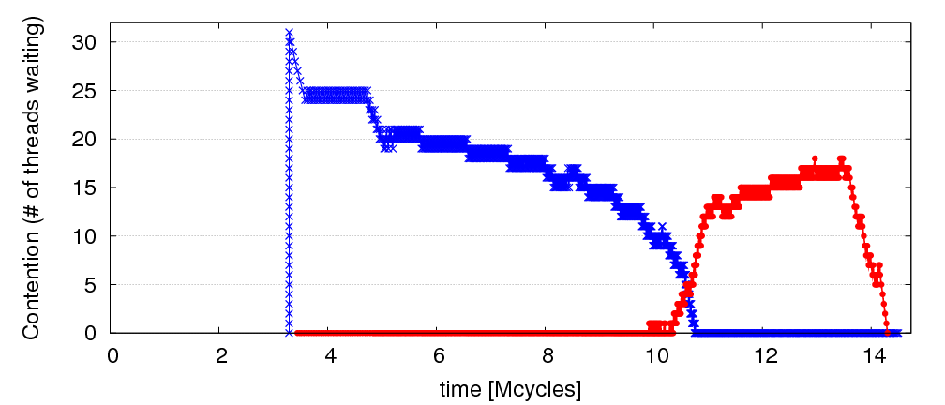
Observation: Limiting Bottlenecks Change Over Time
A=full linked list; B=empty linked list
repeat
Lock A
Traverse list A
Remove X from A
Unlock A
Compute on X
Lock B
Traverse list B
Insert X into B
Unlock B
until A is empty
32 threads
Lock B is limiter
Lock A is limiter

Slide 59
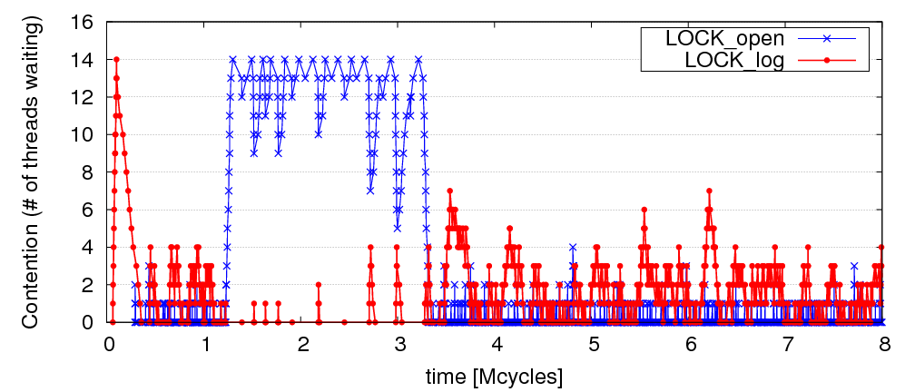
Limiting Bottlenecks Do Change on Real Applications
MySQL running Sysbench queries, 16 threads

Slide 60
Previous Work on Bottleneck Acceleration
Asymmetric CMP (ACMP) proposals [Annavaram+, ISCA’05]
[Morad+, Comp. Arch. Letters’06] [Suleman+, Tech. Report’07]
  Accelerate only the Amdahl’s bottleneck
Accelerated Critical Sections (ACS) [Suleman+, ASPLOS’09]
  Accelerate only critical sections
  Does not take into account importance of critical sections
Feedback-Directed Pipelining (FDP) [Suleman+, PACT’10 and PhD thesis’11]
  Accelerate only stages with lowest throughput
  Slow to adapt to phase changes (software based library)
No previous work can accelerate all three types of bottlenecks or
quickly adapts to fine-grain changes in the importance of bottlenecks
Our goal: general mechanism to identify performance-limiting bottlenecks of any type and accelerate them on an ACMP

Slide 61
Bottleneck Identification and Scheduling (BIS)
Key insight:
  Thread waiting reduces parallelism and
  is likely to reduce performance
  Code causing the most thread waiting → likely critical path
Key idea:
  Dynamically identify bottlenecks that cause
  the most thread waiting
  Accelerate them (using powerful cores in an ACMP)

Slide 62
Bottleneck Identification and Scheduling (BIS)
Compiler/Library/Programmer
Hardware
Annotate
bottleneck code
Implement waiting
for bottlenecks
Measure thread
waiting cycles (TWC)
for each bottleneck
Accelerate bottleneck(s)
with the highest TWC
Binary containing
BIS instructions

Slide 63
Critical Sections: Code Modifications
…
…
…
BottleneckCall bid, targetPC
…
targetPC: while cannot acquire lock
Wait loop for watch_addr
acquire lock
…
release lock
BottleneckReturn bid
while cannot acquire lock
Wait loop for watch_addr
acquire lock
…
release lock
BottleneckWait bid, watch_addr
Used to enable acceleration
Used to keep track of waiting cycles

Slide 64
Barriers: Code Modifications
…
BottleneckCall bid, targetPC
enter barrier
while not all threads in barrier
BottleneckWait bid, watch_addr
exit barrier
…
targetPC: code running for the barrier
…
BottleneckReturn bid

Slide 65
Pipeline Stages: Code Modifications
BottleneckCall bid, targetPC
…
targetPC: while not done
while empty queue
BottleneckWait prev_bid
dequeue work
do the work …
while full queue
BottleneckWait next_bid
enqueue next work
BottleneckReturn bid

Slide 66
Bottleneck Identification and Scheduling (BIS)
Compiler/Library/Programmer
Hardware
Annotate
bottleneck code
Implements waiting
for bottlenecks
Measure thread
waiting cycles (TWC)
for each bottleneck
Accelerate bottleneck(s)
with the highest TWC
Binary containing
BIS instructions

Slide 67
BIS: Hardware Overview
Performance-limiting bottleneck identification and acceleration are independent tasks
Acceleration can be accomplished in multiple ways
  Increasing core frequency/voltage
  Prioritization in shared resources [Ebrahimi+, MICRO’11]
  Migration to faster cores in an Asymmetric CMP
Small
core
Small
core
Large core
Small
core
Small
core
Small
core
Small
core
Small
core
Small
core
Small
core
Small
core
Small
core
Small
core

Slide 68
Bottleneck Identification and Scheduling (BIS)
Compiler/Library/Programmer
Hardware
Annotate
bottleneck code
Implements waiting
for bottlenecks
Measure thread
waiting cycles (TWC)
for each bottleneck
Accelerate bottleneck(s)
with the highest TWC
Binary containing
BIS instructions

Slide 69
Determining Thread Waiting Cycles for Each Bottleneck
Small Core 1
Large Core 0
BottleneckWait x4500
bid=x4500, waiters=0, twc = 11
bid=x4500, waiters=1, twc = 0
bid=x4500, waiters=1, twc = 1
bid=x4500, waiters=2, twc = 7
bid=x4500, waiters=1, twc = 10
bid=x4500, waiters=2, twc = 5
bid=x4500, waiters=1, twc = 9
bid=x4500, waiters=1, twc = 3
bid=x4500, waiters=1, twc = 4
bid=x4500, waiters=1, twc = 5
bid=x4500, waiters=1, twc = 2
bid=x4500, waiters=2, twc = 9
bid=x4500, waiters=1, twc = 11
Small Core 2
Bottleneck
Table (BT)
BottleneckWait x4500
…

Slide 70
Bottleneck Identification and Scheduling (BIS)
Compiler/Library/Programmer
Hardware
Annotate
bottleneck code
Implements waiting
for bottlenecks
Measure thread
waiting cycles (TWC)
for each bottleneck
Accelerate bottleneck(s)
with the highest TWC
Binary containing
BIS instructions

Slide 71
Bottleneck Acceleration
Small Core 1
Large Core 0
BottleneckCall x4700
BottleneckCall x4600
bid=x4700, pc, sp, core1
BottleneckReturn x4700
Execute locally
Execute remotely
Acceleration
Index Table (AIT)
bid=x4700, pc, sp, core1
bid=x4700 , large core 0
Execute remotely
Scheduling Buffer (SB)
Execute locally
bid=x4600, twc=100
← twc < Threshold
Small Core 2
bid=x4700, twc=10000
← twc > Threshold
Bottleneck
Table (BT)
AIT
bid=x4700 , large core 0
…

Slide 72
BIS Mechanisms
Basic mechanisms for BIS:
  Determining Thread Waiting Cycles ✓
  Accelerating Bottlenecks ✓
Mechanisms to improve performance and generality of BIS:
  Dealing with false serialization
  Preemptive acceleration
  Support for multiple large cores

Slide 73
False Serialization and Starvation
Observation: Bottlenecks are picked from Scheduling Buffer in Thread Waiting Cycles order
Problem: An independent bottleneck that is ready to execute
has to wait for another bottleneck that has higher thread waiting cycles → False serialization
Starvation: Extreme false serialization
Solution: Large core detects when a bottleneck is ready to execute in the Scheduling Buffer but it cannot → sends the bottleneck back to the small core

Slide 74
Preemptive Acceleration
Observation: A bottleneck executing on a small core can become the bottleneck with the highest thread waiting cycles
Problem: This bottleneck should really be accelerated (i.e., executed on the large core)
Solution: The Bottleneck Table detects the situation and
sends a preemption signal to the small core. Small core:
  saves register state on stack, ships the bottleneck to the large core
Main acceleration mechanism for barriers and pipeline stages

Slide 75
Support for Multiple Large Cores
Objective: to accelerate independent bottlenecks
Each large core has its own Scheduling Buffer
(shared by all of its SMT threads)
Bottleneck Table assigns each bottleneck to
a fixed large core context to
  preserve cache locality
  avoid busy waiting
Preemptive acceleration extended to send multiple instances of a bottleneck to different large core contexts

Slide 76
Hardware Cost
Main structures:
  Bottleneck Table (BT): global 32-entry associative cache, minimum-Thread-Waiting-Cycle replacement
  Scheduling Buffers (SB): one table per large core,
  as many entries as small cores
  Acceleration Index Tables (AIT): one 32-entry table
  per small core
Off the critical path
Total storage cost for 56-small-cores, 2-large-cores < 19 KB

Slide 77
BIS Performance Trade-offs
Faster bottleneck execution vs. fewer parallel threads
  Acceleration offsets loss of parallel throughput with large core counts
Better shared data locality vs. worse private data locality
  Shared data stays on large core (good)
  Private data migrates to large core (bad, but latency hidden with Data Marshaling [Suleman+, ISCA’10])
Benefit of acceleration vs. migration latency
  Migration latency usually hidden by waiting (good)
  Unless bottleneck not contended (bad, but likely not on critical path)

Slide 78
Methodology
Workloads: 8 critical section intensive, 2 barrier intensive and 2 pipeline-parallel applications
  Data mining kernels, scientific, database, web, networking, specjbb
Cycle-level multi-core x86 simulator
  8 to 64 small-core-equivalent area, 0 to 3 large cores, SMT
  1 large core is area-equivalent to 4 small cores
Details:
  Large core: 4GHz, out-of-order, 128-entry ROB, 4-wide, 12-stage
  Small core: 4GHz, in-order, 2-wide, 5-stage
  Private 32KB L1, private 256KB L2, shared 8MB L3
  On-chip interconnect: Bi-directional ring, 2-cycle hop latency

Slide 79
BIS Comparison Points (Area-Equivalent)
SCMP (Symmetric CMP)
  All small cores
  Results in the paper
ACMP (Asymmetric CMP)
  Accelerates only Amdahl’s serial portions
  Our baseline
ACS (Accelerated Critical Sections)
  Accelerates only critical sections and Amdahl’s serial portions
  Applicable to multithreaded workloads
  (iplookup, mysql, specjbb, sqlite, tsp, webcache, mg, ft)
FDP (Feedback-Directed Pipelining)
  Accelerates only slowest pipeline stages
  Applicable to pipeline-parallel workloads (rank, pagemine)

Slide 80
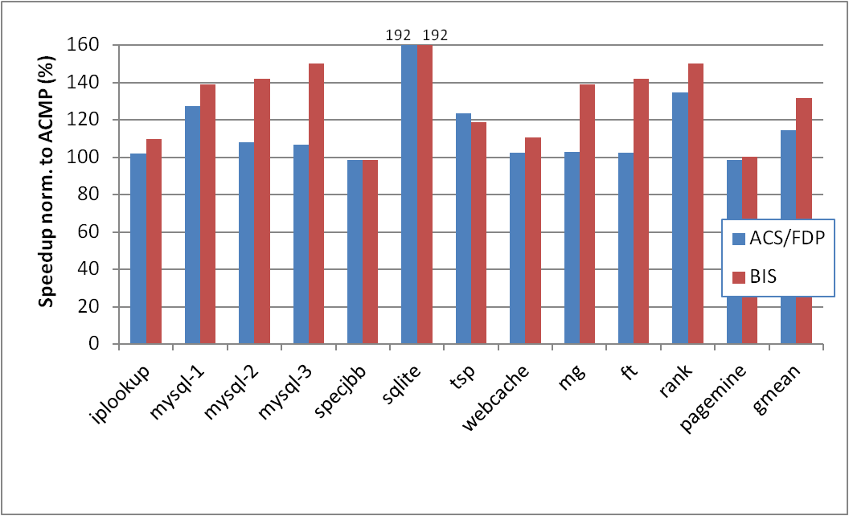
BIS Performance Improvement
Optimal number of threads, 28 small cores, 1 large core
limiting bottlenecks change over time
barriers, which ACS
cannot accelerate
BIS outperforms ACS/FDP by 15% and ACMP by 32%
BIS improves scalability on 4 of the benchmarks
ACS
FDP

Slide 81
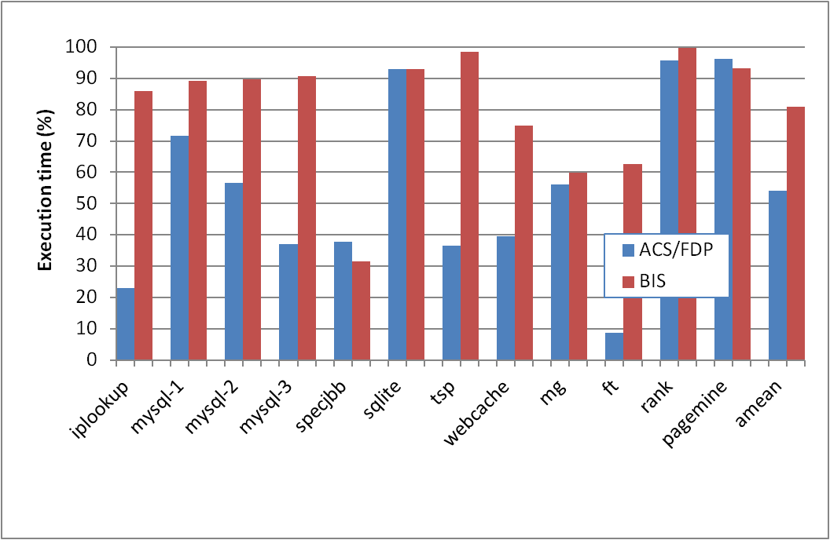
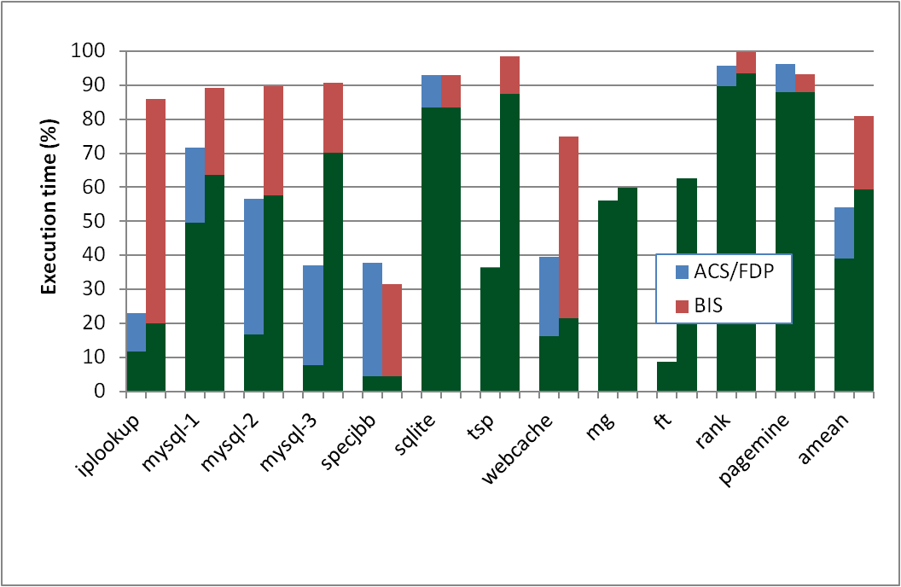
Why Does BIS Work?
Fraction of execution time spent on predicted-important bottlenecks
Actually critical
Coverage: fraction of program critical path that is actually identified as bottlenecks
  39% (ACS/FDP) to 59% (BIS)
Accuracy: identified bottlenecks on the critical path over total identified bottlenecks
  72% (ACS/FDP) to 73.5% (BIS)

Slide 82
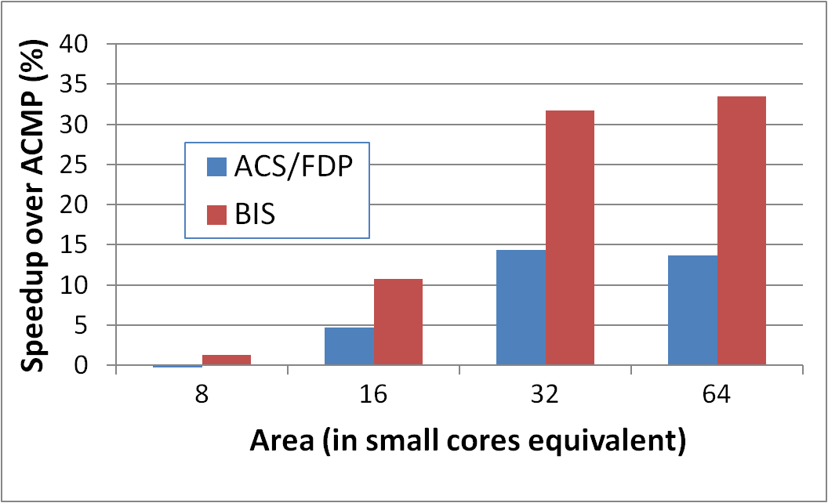
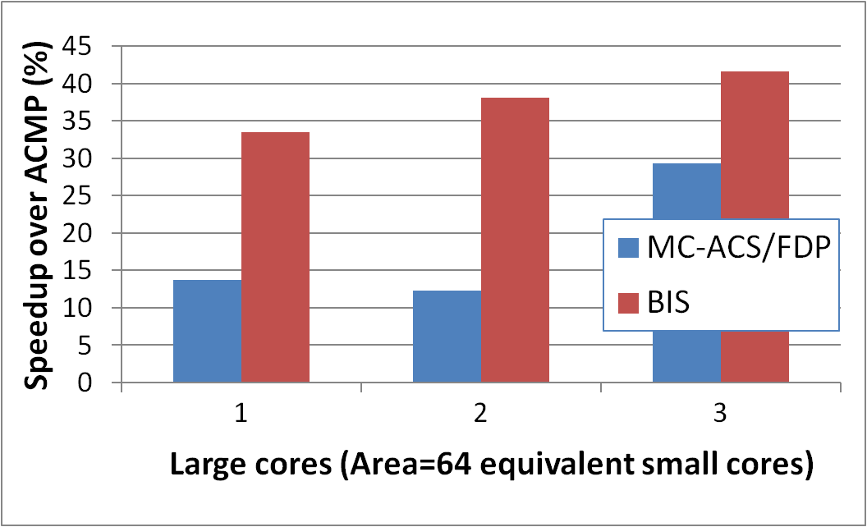
BIS Scaling Results
Performance increases with:
1) More small cores
  Contention due to bottlenecks increases
  Loss of parallel throughput due to large core reduces
2) More large cores
  Can accelerate
  independent bottlenecks
  Without reducing parallel throughput (enough cores)
15%
19%
6.2%
2.4%

Slide 83
BIS Summary
Serializing bottlenecks of different types limit performance of multithreaded applications: Importance changes over time
BIS is a hardware/software cooperative solution:
  Dynamically identifies bottlenecks that cause the most thread waiting and accelerates them on large cores of an ACMP
  Applicable to critical sections, barriers, pipeline stages
BIS improves application performance and scalability:
  15% speedup over ACS/FDP
  Can accelerate multiple independent critical bottlenecks
  Performance benefits increase with more cores
Provides comprehensive fine-grained bottleneck acceleration for future ACMPs with little or no programmer effort

Slide 84
Talk Outline
Problem and Motivation
How Do We Get There: Examples
Accelerated Critical Sections (ACS)
Bottleneck Identification and Scheduling (BIS)
Staged Execution and Data Marshaling
Thread Cluster Memory Scheduling (if time permits)
Ongoing/Future Work
Conclusions

Slide 85
Staged Execution Model (I)
Goal: speed up a program by dividing it up into pieces
Idea
  Split program code into segments
  Run each segment on the core best-suited to run it
  Each core assigned a work-queue, storing segments to be run
Benefits
  Accelerates segments/critical-paths using specialized/heterogeneous cores
  Exploits inter-segment parallelism
  Improves locality of within-segment data
Examples
  Accelerated critical sections, Bottleneck identification and scheduling
  Producer-consumer pipeline parallelism
  Task parallelism (Cilk, Intel TBB, Apple Grand Central Dispatch)
  Special-purpose cores and functional units
Notes:
Accelerate critical paths
Ship computation to data (A segmenting approach)

Slide 86
Staged Execution Model (II)
LOAD X
STORE Y
STORE Y
LOAD Y
….
STORE Z
LOAD Z
….
Notes:
Let me demonstrate the staged execution model pictorially. Assume that we have this contiguous chunk of code. I show only loads and stores since they are relevant to our work.

Slide 87
Staged Execution Model (III)
Split code into segments
Segment S0
LOAD X
STORE Y
STORE Y
Segment S1
LOAD Y
….
STORE Z
Segment S2
LOAD Z
….
Notes:
This figure shows the same chunk of code split into three segments, S0, S1, S2.
This split can be done statically and dynamically, and it is not the focus of our paper. However, I will soon show you two paradigms that split the code in different ways.

Slide 88
Staged Execution Model (IV)
Core 0
Core 1
Core 2
Work-queues
Instances
of S0
Instances
of S1
Instances
of S2
Notes:
Once the split is done, each segment is assigned to a different core (this assignment can be done statically or dynamically, and again has been covered in previous work).
The work queue of each core contains the segments to be executed in that core.
In this example, S0 is executed in core 0, S1 executed in core 1, and so on.
*** Usually, to preserve locality and take advantage of customization, a segment is executed in one core.
*** This also preserves the locality of data that is commonly touched by instances of S0, S1, and S2 (intra-segment data, or shared data among instances of the same segment).

Slide 89
Staged Execution Model: Segment Spawning
Core 0
Core 1
Core 2
LOAD X
STORE Y
STORE Y
S0
LOAD Y
….
STORE Z
S1
LOAD Z
….
S2
Notes:
A segment that is executing on one core spawns another segment on another core, which in turn can spawn another segment in another core. These segments may need to communicate with each other because a later segment may need the data produced by a previous segment.
Segment spawning:
OLD:
When these segment runs on three cores P0, P1 and P2, core>>>
P1 incurs a cache miss to fetch Y and >>>
P2 incurs a cache miss to fetch Z
We cnan avoid these misses by shipping the data required by a segment to the core where the segment will run.

Slide 90
Staged Execution Model: Two Examples
Accelerated Critical Sections [Suleman et al., ASPLOS 2009]
  Idea: Ship critical sections to a large core in an asymmetric CMP
    Segment 0: Non-critical section
    Segment 1: Critical section
  Benefit: Faster execution of critical section, reduced serialization, improved lock and shared data locality
Producer-Consumer Pipeline Parallelism
  Idea: Split a loop iteration into multiple “pipeline stages” where one stage consumes data produced by the next stage → each stage runs on a different core
    Segment N: Stage N
  Benefit: Stage-level parallelism, better locality → faster execution
Notes:
Let me give you two concrete examples of staged execution models. I will extensively use these examples to show the benefits of data marshaling.

Slide 91
Problem: Locality of Inter-segment Data
Core 0
Core 1
Core 2
LOAD X
STORE Y
STORE Y
S0
Transfer Y
Cache Miss
LOAD Y
….
STORE Z
S1
Transfer Z
Cache Miss
LOAD Z
….
S2
Notes:
The problem is that when segments execute on different cores, they may need data produced by previous segments.
In this example, when S1 is executing Load to address Y on Core 1, it will incur a cache miss on the cache block containing Y because Core 0 was the last writer to that block.
If there is an inter-segment cache miss, the core that executes the segment will stall (or progress more slowly).
These intra-segment communication misses reduce the performance potential of staged execution.

Slide 92
Problem: Locality of Inter-segment Data
Accelerated Critical Sections [Suleman et al., ASPLOS 2010]
  Idea: Ship critical sections to a large core in an ACMP
  Problem: Critical section incurs a cache miss when it touches data produced in the non-critical section (i.e., thread private data)
Producer-Consumer Pipeline Parallelism
  Idea: Split a loop iteration into multiple “pipeline stages” → each stage runs on a different core
  Problem: A stage incurs a cache miss when it touches data produced by the previous stage
Performance of Staged Execution limited by inter-segment cache misses
Notes:
Let’s quickly take a look at what these misses look like in the two models we have discussed.
Remember in ACS, the critical sections are shipped to a large core. This means that the thread-private data that is produced outside the critical section and consumed inside it needs to be transferred to the large core when the critical section needs this data.
Similarly, in pipeline parallelism, …
…
But what is the effect of such cache misses on overall performance?

Slide 93
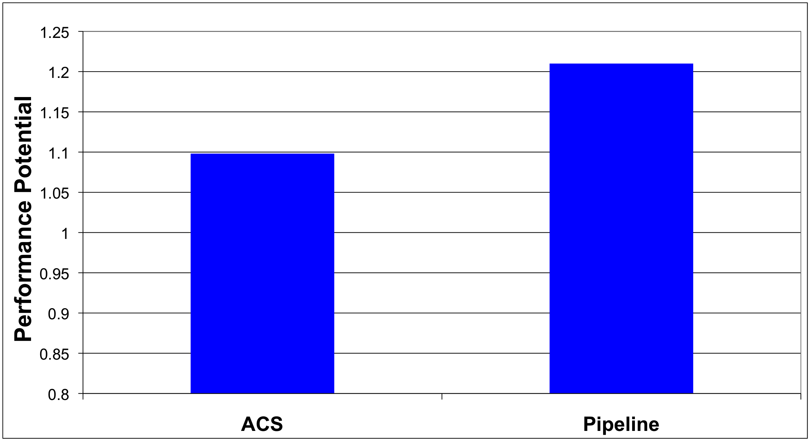
What if We Eliminated All Inter-segment Misses?

Slide 94
Talk Outline
Problem and Motivation
How Do We Get There: Examples
Accelerated Critical Sections (ACS)
Bottleneck Identification and Scheduling (BIS)
Staged Execution and Data Marshaling
Thread Cluster Memory Scheduling (if time permits)
Ongoing/Future Work
Conclusions

Slide 95
Terminology
Core 0
Core 1
Core 2
LOAD X
STORE Y
STORE Y
S0
Inter-segment data: Cache block written by one segment and consumed by the next segment
Transfer Y
LOAD Y
….
STORE Z
S1
Transfer Z
LOAD Z
….
Generator instruction:
The last instruction to write to an inter-segment cache block in a segment
S2
Notes:
Let me first introduce some terminology. >>>
We call the data which is written by one segment and read by the next segment, inter-segment data >>>
In our example, Y and Z are intersegment data. >>>
We call the last instruction to modify intersegment data in a segment a generator. >>>
For example, The instructions which store Y and Z are generator instructions. >>>

Slide 96
Key Observation and Idea
Observation: Set of generator instructions is stable over execution time and across input sets
Idea:
  Identify the generator instructions
  Record cache blocks produced by generator instructions
  Proactively send such cache blocks to the next segment’s core before initiating the next segment
Suleman et al., “Data Marshaling for Multi-Core Architectures,” ISCA 2010, IEEE Micro Top Picks 2011.
Notes:
We made a key observation that lead to the development of data marshaling. We found that across a wide variety of workloads …
Based on this observation, the basic idea is data marshaling is as follows:

Slide 97
Data Marshaling
Compiler/Profiler
Hardware
Identify generator
instructions
Insert marshal
instructions
Record generator-
produced addresses
Marshal recorded
blocks to next core
Binary containing
generator prefixes & marshal Instructions
Notes:
DM consists of two components: Compiler and Hardware.

Slide 98
Data Marshaling
Compiler/Profiler
Hardware
Identify generator
instructions
Insert marshal
instructions
Record generator-
produced addresses
Marshal recorded
blocks to next core
Binary containing
generator prefixes & marshal Instructions
Notes:
The job of the compiler is twofolds.

Slide 99
Profiling Algorithm
Inter-segment data
LOAD X
STORE Y
STORE Y
Mark as Generator Instruction
LOAD Y
….
STORE Z
LOAD Z
….
Notes:
The algorithm runs the program as a single thread and instruments all memory instructions.
Every time an instruction modifies a cache block, the algorithm stores the instruction’s IP as the last-writer of the cache block.
Every time a segment reads a cache block whose last writer is from previous segment, i.e., the data is inter-segment data, the last-writer is added to the generator set.
SPEND LESS TIME

Slide 100
Marshal Instructions
LOAD X
STORE Y
G: STORE Y
MARSHAL C1
When to send (Marshal)
Where to send (C1)
LOAD Y
….
G:STORE Z
MARSHAL C2
0x5: LOAD Z
….
Notes:
In addition to marking the generators, the compiler/library must also insert >>>
a Marshal instruction at the end of every segment.
The instruction informs the hardware that it is time to marshal the lines and the argument to the instruction tells it where the lines should be marshaled to.
(Inserted just before the point where the next segment is initiated)
If segments are not statically scheduled to the cores, the compiler would insert the segment id as argument to the MARSHAL instruction. This segment ID is later bound to a physical core ID via the runtime library or the hardware.
Marshal instructions can come free depending on SE model
SPEND LESS TIME
Binding between segment ID and core ID… accomplished by the runtime library or can be done with hardware dynamically as well if HW scheduling is employed.

Slide 101
DM Support/Cost
Profiler/Compiler: Generators, marshal instructions
ISA: Generator prefix, marshal instructions
Library/Hardware: Bind next segment ID to a physical core
Hardware
  Marshal Buffer
    Stores physical addresses of cache blocks to be marshaled
    16 entries enough for almost all workloads → 96 bytes per core
  Ability to execute generator prefixes and marshal instructions
  Ability to push data to another cache

Slide 102
DM: Advantages, Disadvantages
Advantages
  Timely data transfer: Push data to core before needed
  Can marshal any arbitrary sequence of lines: Identifies generators, not patterns
  Low hardware cost: Profiler marks generators, no need for hardware to find them
Disadvantages
  Requires profiler and ISA support
  Not always accurate (generator set is conservative): Pollution at remote core, wasted bandwidth on interconnect
    Not a large problem as number of inter-segment blocks is small
Notes:
Pollution at remote core

Slide 103
Accelerated Critical Sections with DM
Large Core
LOAD X
STORE Y
G: STORE Y
CSCALL
Small Core 0
Addr Y
LOAD Y
….
G:STORE Z
CSRET
Critical Section
L2
Cache
L2
Cache
Data Y
Marshal
Buffer
Cache Hit!
103
Notes:
103

Slide 104
Accelerated Critical Sections: Methodology
Workloads: 12 critical section intensive applications
  Data mining kernels, sorting, database, web, networking
  Different training and simulation input sets
Multi-core x86 simulator
  1 large and 28 small cores
  Aggressive stream prefetcher employed at each core
Details:
  Large core: 2GHz, out-of-order, 128-entry ROB, 4-wide, 12-stage
  Small core: 2GHz, in-order, 2-wide, 5-stage
  Private 32 KB L1, private 256KB L2, 8MB shared L3
  On-chip interconnect: Bi-directional ring, 5-cycle hop latency

Slide 105
DM on Accelerated Critical Sections: Results
168 170
8.7%
Notes:
I show the speedup of ACMP over SCMP where both of them employ data marshaling. DM improves performance by 8% for critical section-limited workloads and by 16% for pipeline workloads. In both cases, I also show an unrealistic ideal configuration where all misses to private and inter-stage data are artificially converted into hits. Notice that DM gets very close to this unrealistic ideal configuration.

Slide 106
Pipeline Parallelism
Cache Hit!
LOAD X
STORE Y
G: STORE Y
MARSHAL C1
Core 0
Core 1
S0
Addr Y
LOAD Y
….
G:STORE Z
MARSHAL C2
S1
L2
Cache
L2
Cache
Data Y
0x5: LOAD Z
….
Marshal
Buffer
S2
106
Notes:
106
To implement DM, Each core is augmented with a >>>
Marshal Buffer. The marshal buffer stores the addresses of the cache lines to be marshaled. >>>
Every time a core encounters a Generator instruction, it enqueues the address of the cache line being written by the instruction in the marshal buffer. >>>
When a core hits a critical section, it ships al the lines pointed to by the marshal buffer entries to the large core. The large core encounters hits when it needs to access this data.

Slide 107
Pipeline Parallelism: Methodology
Workloads: 9 applications with pipeline parallelism
  Financial, compression, multimedia, encoding/decoding
  Different training and simulation input sets
Multi-core x86 simulator
  32-core CMP: 2GHz, in-order, 2-wide, 5-stage
  Aggressive stream prefetcher employed at each core
  Private 32 KB L1, private 256KB L2, 8MB shared L3
  On-chip interconnect: Bi-directional ring, 5-cycle hop latency

Slide 108
DM on Pipeline Parallelism: Results
16%
Notes:
I show the speedup of ACMP over SCMP where both of them employ data marshaling. DM improves performance by 8% for critical section-limited workloads and by 16% for pipeline workloads. In both cases, I also show an unrealistic ideal configuration where all misses to private and inter-stage data are artificially converted into hits. Notice that DM gets very close to this unrealistic ideal configuration.

Slide 109
DM Coverage, Accuracy, Timeliness
High coverage of inter-segment misses in a timely manner
Medium accuracy does not impact performance
  Only 5.0 and 6.8 cache blocks marshaled for average segment

Slide 110
Scaling Results
DM performance improvement increases with
  More cores
  Higher interconnect latency
  Larger private L2 caches
Why? Inter-segment data misses become a larger bottleneck
  More cores → More communication
  Higher latency → Longer stalls due to communication
  Larger L2 cache → Communication misses remain
Notes:
Relative performance impact of inter-segment data cache misses increases with all three parameters

Slide 111
Other Applications of Data Marshaling
Can be applied to other Staged Execution models
  Task parallelism models
    Cilk, Intel TBB, Apple Grand Central Dispatch
  Special-purpose remote functional units
  Computation spreading [Chakraborty et al., ASPLOS’06]
  Thread motion/migration [e.g., Rangan et al., ISCA’09]
Can be an enabler for more aggressive SE models
  Lowers the cost of data migration
    an important overhead in remote execution of code segments
  Remote execution of finer-grained tasks can become more feasible → finer-grained parallelization in multi-cores

Slide 112
Data Marshaling Summary
Inter-segment data transfers between cores limit the benefit of promising Staged Execution (SE) models
Data Marshaling is a hardware/software cooperative solution: detect inter-segment data generator instructions and push their data to next segment’s core
  Significantly reduces cache misses for inter-segment data
  Low cost, high-coverage, timely for arbitrary address sequences
  Achieves most of the potential of eliminating such misses
Applicable to several existing Staged Execution models
  Accelerated Critical Sections: 9% performance benefit
  Pipeline Parallelism: 16% performance benefit
Can enable new models→ very fine-grained remote execution

Slide 113
Talk Outline
Problem and Motivation
How Do We Get There: Examples
Accelerated Critical Sections (ACS)
Bottleneck Identification and Scheduling (BIS)
Staged Execution and Data Marshaling
Thread Cluster Memory Scheduling (if time permits)
Ongoing/Future Work
Conclusions

Slide 114
Motivation
Memory is a shared resource
Threads’ requests contend for memory
  Degradation in single thread performance
  Can even lead to starvation
How to schedule memory requests to increase both system throughput and fairness?
Core
Core
Memory
Core
Core

Slide 115
Previous Scheduling Algorithms are Biased
Better fairness
System throughput
bias
Better system throughput
Fairness
bias
Ideal
No previous memory scheduling algorithm provides both the best fairness and system throughput

Slide 116
Why do Previous Algorithms Fail?
Throughput biased approach
Fairness biased approach
  Prioritize less memory-intensive threads
  Take turns accessing memory
  Good for throughput
  Does not starve
thread A
less memory
intensive
thread B
higher
priority
thread C
thread A
thread B
thread C
not prioritized ➔
reduced throughput
starvation ➔ unfairness
Single policy for all threads is insufficient

Slide 117

Insight: Achieving Best of Both Worlds
higher
priority
For Throughput
  Prioritize memory-non-intensive threads
thread
thread
thread
For Fairness
thread
  Unfairness caused by memory-intensive being prioritized over each other
    Shuffle threads
  Memory-intensive threads have
  different vulnerability to interference
    Shuffle asymmetrically
thread
thread
thread
thread
thread
thread
thread
thread

Slide 118
Overview: Thread Cluster Memory Scheduling
Group threads into two clusters
Prioritize non-intensive cluster
Different policies for each cluster
higher
priority
Memory-non-intensive
Non-intensive
cluster
thread
Throughput
thread
thread
thread
thread
thread
Prioritized
higher
priority
thread
thread
thread
thread
Threads in the system
Memory-intensive
Intensive cluster
Fairness

Slide 119
Non-Intensive Cluster
Prioritize threads according to MPKI
Increases system throughput
  Least intensive thread has the greatest potential for making progress in the processor
higher
priority
lowest MPKI
thread
thread
thread
thread
highest MPKI

Slide 120

Intensive Cluster
Periodically shuffle the priority of threads
Is treating all threads equally good enough?
BUT: Equal turns ≠ Same slowdown
higher
priority
  Most prioritized
thread
thread
thread
thread
  Increases fairness
thread
thread

Slide 121
Results: Fairness vs. Throughput
Averaged over 96 workloads
Better fairness
5%
Better system throughput
39%
5%
8%
TCM provides best fairness and system throughput

Slide 122
Results: Fairness-Throughput Tradeoff
When configuration parameter is varied…
Better fairness
FRFCFS
STFM
Better system throughput
ATLAS
PAR-BS
TCM
Adjusting ClusterThreshold
TCM allows robust fairness-throughput tradeoff

Slide 123
TCM Summary
No previous memory scheduling algorithm provides both high system throughput and fairness
  Problem: They use a single policy for all threads
TCM is a heterogeneous scheduling policy
  Prioritize non-intensive cluster ➔ throughput
  Shuffle priorities in intensive cluster ➔ fairness
  Shuffling should favor nice threads ➔ fairness
Heterogeneity in memory scheduling provides the best system throughput and fairness

Slide 124
More Details on TCM
Kim et al., “Thread Cluster Memory Scheduling: Exploiting Differences in Memory Access Behavior,” MICRO 2010, Top Picks 2011.

Slide 125
Memory Control in CPU-GPU Systems
Observation: Heterogeneous CPU-GPU systems require memory schedulers with large request buffers
Problem: Existing monolithic application-aware memory scheduler designs are hard to scale to large request buffer sizes
Solution: Staged Memory Scheduling (SMS)
  decomposes the memory controller into three simple stages:
  1) Batch formation: maintains row buffer locality
  2) Batch scheduler: reduces interference between applications
  3) DRAM command scheduler: issues requests to DRAM
Compared to state-of-the-art memory schedulers:
  SMS is significantly simpler and more scalable
  SMS provides higher performance and fairness
Ausavarungnirun et al., “Staged Memory Scheduling,” ISCA 2012.
Notes:
We observe that Heterogeneous CPU-GPU systems require memory schedulers with large request buffers and this becomes a problem for existing monolithic application-aware memory scheduler designs because they are hard to scale to large request buffer size
Our Solution, staged memory scheduling, decomposes MC into three simpler stages:
1) Batch formation: maintains row buffer locality by forming batches of row-hitting requests.
2) Batch scheduler: reduces interference between applications by picking the next batch to prioritize.
3) DRAM command scheduler: issues requests to DRAM
Compared to state-of-the-art memory schedulers:
SMS is significantly simpler and more scalable
SMS provides higher performance and fairness, especially in heterogeneous CPU-GPU systems.

Slide 126
Asymmetric Memory QoS in a Parallel Application
Threads in a multithreaded application are inter-dependent
Some threads can be on the critical path of execution due to synchronization; some threads are not
How do we schedule requests of inter-dependent threads to maximize multithreaded application performance?
  Idea: Estimate limiter threads likely to be on the critical path and prioritize their requests; shuffle priorities of non-limiter threads to reduce memory interference among them [Ebrahimi+, MICRO’11]
  Hardware/software cooperative limiter thread estimation:
    Thread executing the most contended critical section
    Thread that is falling behind the most in a parallel for loop
Ebrahimi et al., “Parallel Application Memory Scheduling,” MICRO 2011.

Slide 127
Talk Outline
Problem and Motivation
How Do We Get There: Examples
Accelerated Critical Sections (ACS)
Bottleneck Identification and Scheduling (BIS)
Staged Execution and Data Marshaling
Thread Cluster Memory Scheduling (if time permits)
Ongoing/Future Work
Conclusions

Slide 128
Related Ongoing/Future Work
Dynamically asymmetric cores
Memory system design for asymmetric cores
Asymmetric memory systems
  Phase Change Memory (or Technology X) + DRAM
  Hierarchies optimized for different access patterns
Asymmetric on-chip interconnects
  Interconnects optimized for different application requirements
Asymmetric resource management algorithms
  E.g., network congestion control
Interaction of multiprogrammed multithreaded workloads

Slide 129
Talk Outline
Problem and Motivation
How Do We Get There: Examples
Accelerated Critical Sections (ACS)
Bottleneck Identification and Scheduling (BIS)
Staged Execution and Data Marshaling
Thread Cluster Memory Scheduling (if time permits)
Ongoing/Future Work
Conclusions

Slide 130
Summary
Applications and phases have varying performance requirements
Designs evaluated on multiple metrics/constraints: energy, performance, reliability, fairness, …
One-size-fits-all design cannot satisfy all requirements and metrics: cannot get the best of all worlds
Asymmetry in design enables tradeoffs: can get the best of all worlds
  Asymmetry in core microarch. → Accelerated Critical Sections, BIS, DM → Good parallel performance + Good serialized performance
  Asymmetry in memory scheduling → Thread Cluster Memory Scheduling → Good throughput + good fairness
Simple asymmetric designs can be effective and low-cost

Slide 131
Thank You
Onur Mutlu
onur@cmu.edu
http://www.ece.cmu.edu/~omutlu
Email me with any questions and feedback!

Slide 132
Architecting and Exploiting
Asymmetry in Multi-Core Architectures
Onur Mutlu
onur@cmu.edu
June 19, 2013
TUBITAK

Slide 133
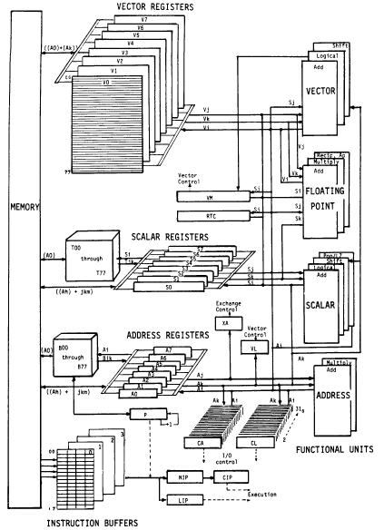
Vector Machine Organization (CRAY-1)
CRAY-1
Russell, “The CRAY-1 computer system,” CACM 1978.
Scalar and vector modes
8 64-element vector registers
64 bits per element
16 memory banks
8 64-bit scalar registers
8 24-bit address registers

Slide 134
Identifying and Accelerating
Resource Contention Bottlenecks

Slide 135
Thread Serialization
Three fundamental causes
1. Synchronization
2. Load imbalance
3. Resource contention

Slide 136
Memory Contention as a Bottleneck
Problem:
  Contended memory regions cause serialization of threads
  Threads accessing such regions can form the critical path
  Data-intensive workloads (MapReduce, GraphLab, Graph500) can be sped up by 1.5 to 4X by ideally removing contention
Idea:
  Identify contended regions dynamically
  Prioritize caching the data from threads which are slowed down the most by such regions in faster DRAM/eDRAM
Benefits:
  Reduces contention, serialization, critical path

Slide 137
Evaluation
Workloads: MapReduce, GraphLab, Graph500
Cycle-level x86 platform simulator
  CPU: 8 out-of-order cores, 32KB private L1, 512KB shared L2
  Hybrid Memory: DDR3 1066 MT/s, 32MB DRAM, 8GB PCM
Mechanisms
  Baseline: DRAM as a conventional cache to PCM
  CacheMiss: Prioritize caching data from threads with highest cache miss latency
  Region: Cache data from most contended memory regions
  ACTS: Prioritize caching data from threads most slowed down due to memory region contention

Slide 138
Caching Results

Slide 139
Heterogeneous Main Memory

Slide 140
Heterogeneous Memory Systems
CPU
Meza, Chang, Yoon, Mutlu, Ranganathan, “Enabling Efficient and Scalable Hybrid Memories,” IEEE Comp. Arch. Letters, 2012.
DRAMCtrl
PCM Ctrl
DRAM
Phase Change Memory (or Tech. X)
Fast, durable
Small,
leaky, volatile,
high-cost
Large, non-volatile, low-cost
Slow, wears out, high active energy
Hardware/software manage data allocation and movement
to achieve the best of multiple technologies

Slide 141
One Option: DRAM as a Cache for PCM
PCM is main memory; DRAM caches memory rows/blocks
  Benefits: Reduced latency on DRAM cache hit; write filtering
Memory controller hardware manages the DRAM cache
  Benefit: Eliminates system software overhead
Three issues:
  What data should be placed in DRAM versus kept in PCM?
  What is the granularity of data movement?
  How to design a low-cost hardware-managed DRAM cache?
Two idea directions:
  Locality-aware data placement [Yoon+ , CMU TR 2011]
  Cheap tag stores and dynamic granularity [Meza+, IEEE CAL 2012]

Slide 142
DRAM vs. PCM: An Observation
Row buffers are the same in DRAM and PCM
Row buffer hit latency same in DRAM and PCM
Row buffer miss latency small in DRAM, large in PCM
Accessing the row buffer in PCM is fast
What incurs high latency is the PCM array access → avoid this
CPU
Row buffer
DRAMCtrl
PCM Ctrl
DRAM Cache
PCM Main Memory
Bank
Bank
Bank
Bank
N ns row hit
Fast row miss
N ns row hit
Slow row miss

Slide 143
Row-Locality-Aware Data Placement
Idea: Cache in DRAM only those rows that
  Frequently cause row buffer conflicts → because row-conflict latency is smaller in DRAM
  Are reused many times → to reduce cache pollution and bandwidth waste
Simplified rule of thumb:
  Streaming accesses: Better to place in PCM
  Other accesses (with some reuse): Better to place in DRAM
Bridges half of the performance gap between all-DRAM and all-PCM memory on memory-intensive workloads
Yoon et al., “Row Buffer Locality-Aware Data Placement in Hybrid Memories,” CMU SAFARI Technical Report, 2011.

Slide 144
The Problem with Large DRAM Caches
A large DRAM cache requires a large metadata (tag + block-based information) store
How do we design an efficient DRAM cache?
CPU
LOAD X
Metadata:
X → DRAM
Mem
Ctlr
Mem
Ctlr
DRAM
PCM
X
(small, fast cache)
(high capacity)
Access X

Slide 145
Idea 1: Tags in Memory
Store tags in the same row as data in DRAM
  Store metadata in same row as their data
  Data and metadata can be accessed together
Benefit: No on-chip tag storage overhead
Downsides:
  Cache hit determined only after a DRAM access
  Cache hit requires two DRAM accesses
DRAM row
Cache block 0
Cache block 1
Cache block 2
Tag0
Tag1
Tag2

Slide 146
Idea 2: Cache Tags in SRAM
Recall Idea 1: Store all metadata in DRAM
  To reduce metadata storage overhead
Idea 2: Cache in on-chip SRAM frequently-accessed metadata
  Cache only a small amount to keep SRAM size small

Slide 147
Idea 3: Dynamic Data Transfer Granularity
Some applications benefit from caching more data
  They have good spatial locality
Others do not
  Large granularity wastes bandwidth and reduces cache utilization
Idea 3: Simple dynamic caching granularity policy
  Cost-benefit analysis to determine best DRAM cache block size
  Group main memory into sets of rows
  Some row sets follow a fixed caching granularity
  The rest of main memory follows the best granularity
    Cost–benefit analysis: access latency versus number of cachings
    Performed every quantum

Slide 148
Methodology
System: 8 out-of-order cores at 4 GHz
Memory: 512 MB direct-mapped DRAM, 8 GB PCM
  128B caching granularity
  DRAM row hit (miss): 200 cycles (400 cycles)
  PCM row hit (clean / dirty miss): 200 cycles (640 / 1840 cycles)
Evaluated metadata storage techniques
  All SRAM system (8MB of SRAM)
  Region metadata storage
  TIM metadata storage (same row as data)
  TIMBER, 64-entry direct-mapped (8KB of SRAM)

Slide 149
TIMBER Performance
-6%
Meza, Chang, Yoon, Mutlu, Ranganathan, “Enabling Efficient and Scalable Hybrid Memories,” IEEE Comp. Arch. Letters, 2012.

Slide 150
TIMBER Energy Efficiency
18%
Meza, Chang, Yoon, Mutlu, Ranganathan, “Enabling Efficient and Scalable Hybrid Memories,” IEEE Comp. Arch. Letters, 2012.

Slide 151
Summary
Applications and phases have varying performance requirements
Designs evaluated on multiple metrics/constraints: energy, performance, reliability, fairness, …
One-size-fits-all design cannot satisfy all requirements and metrics: cannot get the best of all worlds
Asymmetry in design enables tradeoffs: can get the best of all worlds
  Asymmetry in core microarch. → Accelerated Critical Sections, BIS, DM → Good parallel performance + Good serialized performance
  Asymmetry in main memory → Data Management for DRAM-PCM Hybrid Memory → Good performance + good efficiency
Simple asymmetric designs can be effective and low-cost

Slide 152
Overview of Research in the CMU SAFARI Research Group
Onur Mutlu
onur@cmu.edu
http://www.ece.cmu.edu/~omutlu
October 2012

Slide 153
A Bit About Me and My Research
Assistant Professor @ Carnegie Mellon University ECE/CS
http://www.ece.cmu.edu/~omutlu
onur@cmu.edu, 512-658-0891 (cell)
  Interested in fundamental techniques for efficient, high-performance, and scalable systems; solving difficult architectural problems at low cost & complexity
Research, teaching, consulting in:
  Computer architecture, hardware/software interaction and cooperation
  Multi-core systems, heterogeneous systems, new execution models
  Memory systems (memory controllers, caches, DRAM, emerging technologies)
  Interconnects
  Hardware/software interaction and co-design (PL, OS, Architecture)
  Predictable and QoS-aware systems
  Fault tolerance
  Bioinformatics algorithms and architectures

Slide 154
Goal: Scalable and Energy-Efficient Memory
Problem: Main memory is a large energy & performance bottleneck
Our goal: Rethink main memory design for efficiency and scalability
  1) Minimize waste and maximize parallelism in DRAM & controllers
  2) Enable emerging technologies for energy-efficient memory
Example recent solution ideas:
  Tiered latency DRAM: Low latency at low cost [Lee+ HPCA 2013]
  SALP: Subarray-level parallelism in DRAM [Kim+ ISCA 2012]
  RAIDR: Retention-aware DRAM refresh [Liu+ ISCA 2012]
  Staged memory controllers [Ausavarungnirun+ ISCA 2012]
  Hybrid PCM+DRAM main memory with efficient DRAM cache design, dynamic data transfer granularity, and intelligent data placement [Meza+ IEEE CAL 2012, Yoon+ ICCD 2012, Lee+ ISCA 2009]
  Low complexity cache/memory compression [Pekhimenko+ PACT 2012]
  Efficient caching with evicted address filters [Seshadri+ PACT 2012]

Slide 155
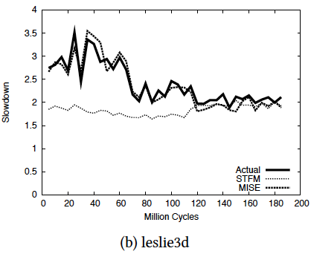
Goal: QoS-Aware, Predictable (Memory) Systems
Problem: Memory interference is uncontrolled today → uncontrollable, unpredictable, vulnerable system
Goal: We need to control it → Design a QoS-aware system
Solution: Hardware/software cooperative memory QoS
  Hardware designed to provide a configurable fairness substrate
    Application-aware memory scheduling, partitioning, throttling
  Software designed to configure the resources to satisfy different QoS goals, satisfy SLAs
  E.g., memory controllers and interconnects provide QoS and predictable performance
  [2007-2013, Top Picks’09,’11a,’11b,’12]
  New schedulers: STFM, ATLAS, PARBS, TCM, IMPS, SMS, MISE [Subramanian HPCA 2013]

Slide 156
Tiered Latency DRAM (TL-DRAM)
Long Bitline
Short Bitline
Tiered Bitline
+ Low Area Cost
- High Area Cost
+ Low Area Cost
- High Latency
+ Low Latency
+ Low Latency

Slide 157
My Research Group: SAFARI
14 PhD students
1 Postdoctoral researcher (1 more joining soon)
2 Undergraduate students
4 Visiting students
Research spanning:
  architecture, hardware/software interface
  circuit/architecture interface
  system/architecture interface
  algorithms
  bioinformatics
  …

Slide 158
This Set of Slides …
Describe the current major research areas/directions in my group (Slides 5-13)
Provide a partial list of papers with links to papers and talks (Slides 14-31)
Describe the Memory QoS research in some detail (Slides 32-56)
Describe the Heterogeneous Memory research in some detail (Slides 57-69)
Describe recent results in Scalable Memory Systems research (Slides 70-139)

Slide 159
Research Topics (I): Memory, Caches, Prefetching
How to provide QoS and predictability in memory and interconnect
  Novel memory controller, interconnect, cache designs
  A major effort in my group since 2006 [Top Picks’09,’11a,’11b,’12]
  Prefetch-aware shared resource management [MICRO’09, ISCA’11]
How to do effective cache/DRAM compression
  Base-delta-immediate compression [PACT’12]
How to efficiently utilize large caches
  Evicted-address filters [PACT’12]
How to tolerate long memory latencies
  Runahead execution [HPCA’03, ISCA’05, MICRO’05, Top Picks’03,’05]
  Prefetching in multi-core [HPCA’07,’09, MICRO’08’09, ISCA’11]

Slide 160
QoS-Aware, Predictable Memory Systems
Problem: Memory interference is uncontrolled → uncontrollable, unpredictable, vulnerable system
Goal: We need to control it → Design a QoS-aware system
Solution: Hardware/software cooperative memory QoS
  Hardware designed to provide a configurable fairness substrate
    Application-aware memory scheduling, partitioning, throttling
  Software designed to configure the resources to satisfy different QoS goals
  E.g., fair, programmable memory controllers and on-chip networks provide QoS and predictable performance
  [2007-2012, Top Picks’09,’11a,’11b,’12]

Slide 161
More on QoS-aware Memory Systems
Smart vs. dumb resources approaches
  Application-aware memory scheduling, partitioning, throttling
How to handle prefetch requests in a QoS-aware multi-core memory system?
  Prefetch-aware shared resource management, ISCA’11.
  Prefetch-aware memory controllers, MICRO’08, IEEE-TC’11.
  Coordinated control of multiple prefetchers, MICRO’09.
How to design QoS mechanisms in the interconnect?
  Topology-aware, scalable QoS, ISCA’11.
  Slack-based packet scheduling, ISCA’10.
  Efficient bandwidth guarantees, MICRO’09.
  Application-aware request prioritization, MICRO’09.
ISCA 2011 Talk
Micro 2008 Talk
Micro 2009 Talk

Slide 162
Research Topics (II): Acceleration
Bottleneck identification and acceleration
  BIS, ASPLOS 2012.
Heterogeneous multi-core systems with automatic resource management
  Accelerating critical section execution, ASPLOS’09.
Improving programmer productivity with better hardware support for parallel and safe programs
  Data Marshaling for Staged Execution, ISCA’10.
  HW Support for Safe Languages, ISCA’09, ASPLOS’08, ISCA’07.

Slide 163
Research Topics (III): Interconnects
  Very efficient interconnects
  Bufferless routers [ISCA’09, HotNets’10, HPCA’11, SIGCOMM’12]
  Minimally buffered deflection routing [NOCS’12]
  Congestion control [HotNets’10, SIGCOMM’12, Tech Report’11]
  Hierarchical rings with deflection routing [Tech Report’11]
  Multidrop express channels, HPCA’09.
QoS-aware interconnects
  Topology-aware scalable QoS, ISCA’11.
  Slack-based packet scheduling, ISCA’10.
  Efficient bandwidth guarantees, MICRO’09.
  Application-aware request prioritization, MICRO’09.
  Core, interconnect, memory co-design

Slide 164
Goal: Low Energy, High Performance Systems
Heterogeneous multi-core systems and accelerators
  Bottleneck identification and scheduling [ASPLOS’12]
  Accelerated critical sections [ASPLOS’09], Data Marshaling [ISCA’10]
  Acceleration of garbage collection [ISCA’09] and virtual functions [ASPLOS’08, ISCA’07]
  Very efficient interconnects
  Bufferless routers [ISCA’09, HotNets’10, HPCA’11, SIGCOMM’12]
  Minimally buffered deflection routing [NOCS’12]
  Congestion control [HotNets’10, SIGCOMM’12, SBAC-PAD’12]
  Hierarchical rings with deflection routing [CMU Tech Report’11]
  Multidrop express channels [HPCA’09]
Very efficient latency-tolerant core designs
  Runahead and beyond [HPCA’03, ISCA’05, MICRO’05, Top Picks’03,’05]
  Prefetching in multi-core [HPCA’07,’09, MICRO’08’09, ISCA’11]

Slide 165
Research Topics (IV): Fault Tolerance
Hard and soft error tolerance
  Online testing for wearout detection, MICRO’07, ICCAD’09, VTS’10.
  Soft error detection via re-execution, DSN’05.
  NVM/Flash error analysis and tolerance [DATE’12, ICCD’12]

Slide 166
Research Topics (V): Main Memory Scaling
Scaling DRAM into the future
  RAIDR: retention-aware DRAM refresh, ISCA’12.
  Eliminating bank conflicts via subarray-level parallelism, ISCA’12.
  Enabling emerging memory technologies as main memory
  PCM-based main memory, ISCA’09.
  Hybrid PCM-DRAM main memory, IEEE CAL’12.
  Locality-aware data placement in hybrid memory, CMU Tech Report’11. NVMW’12, ICCD’12.
  MLC PCM as main memory, NVMW’12, Submission’12.

Slide 167
Research Topics (VI): Core Design
Latency tolerant, energy efficient core designs
  Runahead execution [HPCA’03, ISCA’05, MICRO’05, Top Picks’03,’05]
  Prefetching in multi-core [HPCA’07,’09, MICRO’08’09, ISCA’11]
  New execution paradigms and hardware/software interfaces
  Efficient thread context management, multithreading, hardware based scheduling
  Specialization of cores to different functions, heterogeneous multi-core

Slide 168
Research Topics (VII): Bioinformatics
Algorithms for faster genome sequence analysis
  MrFAST, Nature Genetics 2009.
  FastHash, BMC Genomics 2013.
Architectures and accelerators for faster genome sequence analysis

Slide 169
Memory QoS

Slide 170

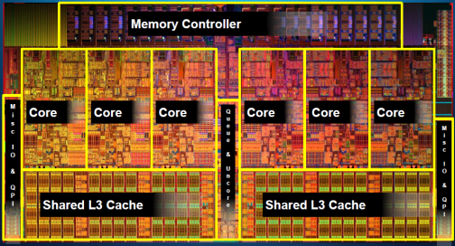
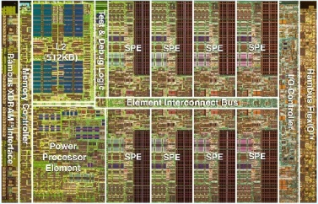
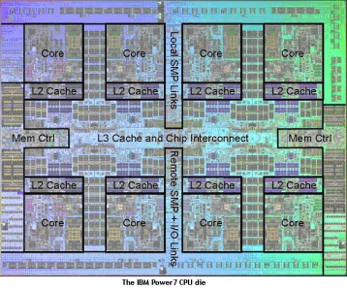
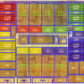
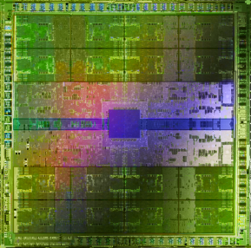
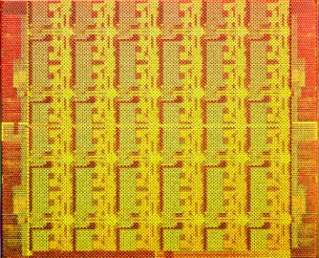
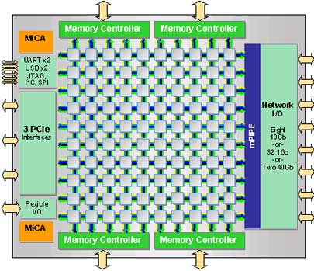
Trend: Many Cores on Chip
Simpler and lower power than a single large core
Large scale parallelism on chip
Intel Core i7
8 cores
IBM Cell BE
8+1 cores
IBM POWER7
8 cores
AMD Barcelona
4 cores
Nvidia Fermi
448 “cores”
Intel SCC
48 cores, networked
Tilera TILE Gx
100 cores, networked
Sun Niagara II
8 cores

Slide 171
Many Cores on Chip
What we want:
  N times the system performance with N times the cores
What do we get today?

Slide 172
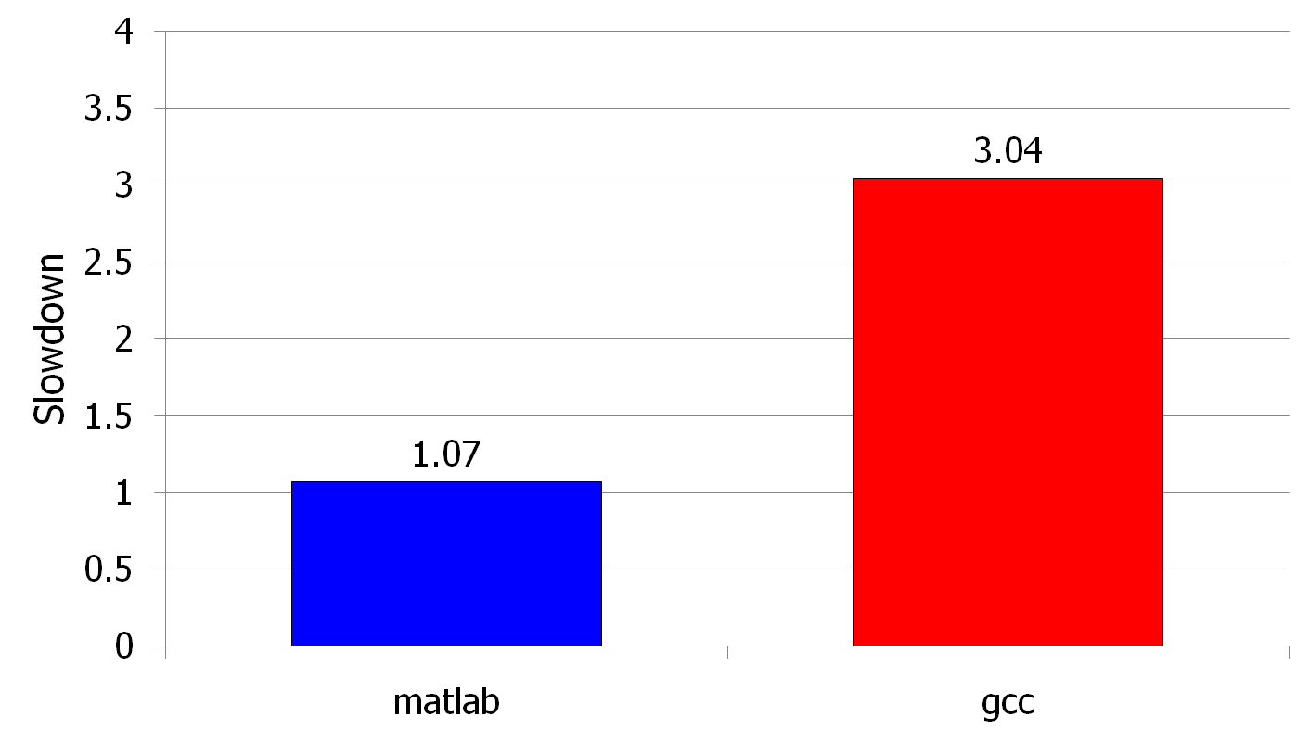
(Un)expected Slowdowns
High priority
Memory Performance Hog
Low priority
Attacker
(Core 1)
Movie player
(Core 2)
(Core 0)
(Core 1)
Moscibroda and Mutlu, “Memory performance attacks: Denial of memory service
in multi-core systems,” USENIX Security 2007.
Notes:
What kind of performance do we expect when we run two applications on a multi-core system? To answer this question, we performed an experiment. We took two applications we cared about, ran them together on different cores in a dual-core system, and measured their slowdown compared to when each is run alone on the same system. This graph shows the slowdown each app experienced. (DATA explanation…)
Why do we get such a large disparity in the slowdowns?
Is it the priorities? No. We went back and gave high priority to gcc and low priority to matlab. The slowdowns did not change at all. Neither the software or the hardware enforced the priorities.
Is it the contention in the disk? We checked for this possibility, but found that these applications did not have any disk accesses in the steady state. They both fit in the physical memory and therefore did not interfere in the disk.
What is it then? Why do we get such large disparity in slowdowns in a dual core system?
I will call such an application a “memory performance hog”
Now, let me tell you why this disparity in slowdowns happens.
Is it that there are other applications or the OS interfering with gcc, stealing its time quantums? No.

Slide 173
Why? Uncontrolled Memory Interference
CORE 1
movie player
Multi-Core
Chip
attacker
CORE 2
L2
CACHE
L2
CACHE
unfairness
INTERCONNECT
Shared DRAM
Memory System
DRAM MEMORY CONTROLLER
DRAM
Bank 0
DRAM
Bank 1
DRAM
Bank 2
DRAM
Bank 3
Notes:
-In a multi-core chip, different cores share some hardware resources. In particular, they share the DRAM memory system. The shared memory system consists of this and that.
When we run matlab on one core, and gcc on another core, both cores generate memory requests to access the DRAM banks. When these requests arrive at the DRAM controller, the controller favors matlab’s requests over gcc’s requests. As a result, matlab can make progress and continues generating memory requests. These requests are again favored by the DRAM controller over gcc’s requests. Therefore, gcc starves waiting for its requests to be serviced in DRAM whereas matlab makes very quick progress as if it were running alone.
Why does this happen? This is because the algorithms employed by the DRAM controller are unfair.
But, why are these algorithms unfair? Why do they unfairly prioritize matlab accesses?
To understand this, we need to understand how a DRAM bank operates.
Almost all systems today contain multi-core chips
Multi-core systems consist of multiple on-chip cores and caches
Cores share the DRAM memory system
DRAM memory system consists of
DRAM banks that store data (multiple banks to allow parallel accesses)
DRAM memory controller that mediates between cores and DRAM memory
It schedules memory operations generated by cores to DRAM
This talk is about exploiting the unfair algorithms in the memory controllers to perform denial of service to running threads
To understand how this happens, we need to know about how each DRAM bank operates

Slide 174
A Memory Performance Hog
// initialize large arrays A, B
for (j=0; j<N; j++) {
index = j*linesize;
A[index] = B[index];
…
}
// initialize large arrays A, B
for (j=0; j<N; j++) {
index = rand();
A[index] = B[index];
…
}
streaming
random
STREAM
RANDOM
Sequential memory access
Very high row buffer locality (96% hit rate)
Memory intensive
Random memory access
Very low row buffer locality (3% hit rate)
Similarly memory intensive
Moscibroda and Mutlu, “Memory Performance Attacks,” USENIX Security 2007.
Notes:
Streaming through memory by performing operations on two 1D arrays.
Sequential memory access
Each access is a cache miss (elements of array larger than a cache line size) → hence, very memory intensive
Link to the real code…

Slide 175
What Does the Memory Hog Do?
Row decoder
T0: Row 0
T0: Row 0
T0: Row 0
T0: Row 0
T0: Row 0
T0: Row 0
T0: Row 0
T1: Row 5
T1: Row 111
T0: Row 0
T1: Row 16
T0: Row 0
Memory Request Buffer
Row 0
Row Buffer
Row 0
Column mux
Row size: 8KB, cache block size: 64B
128 (8KB/64B) requests of T0 serviced before T1
T0: STREAM
T1: RANDOM
Data
Moscibroda and Mutlu, “Memory Performance Attacks,” USENIX Security 2007.
Notes:
Pictorially demonstrate how stream denies memory service to rdarray
Stream continuously accesses columns in row 0 in a streaming manner (streams through a row after opening it)
In other words almost all its requests are row-hits
RDarray’s requests are row-conflicts (no locality)
The DRAM controller reorders streams requests to the open row over other requests (even older ones) to maximize DRAM throughput
Hence, rdarray’s requests do not get serviced as long as stream is issuing requests at a fast-enough rate
In this example, the red thread’s request to another row will not get serviced until stream stops issuing a request to row 0
With those parameters, 128 requests of stream would be serviced before 1 from rdarray
As row-buffer size increases, which is the industry trend, this problem will become more severe
This is not the worst case, but it is easy to construct and understand
Stream falls off the row buffer at some point
I leave it to the listeners to construct a case worse than this (it is possible)

Slide 176
Effect of the Memory Performance Hog
2.82X slowdown
Slowdown
1.18X slowdown
Results on Intel Pentium D running Windows XP
(Similar results for Intel Core Duo and AMD Turion, and on Fedora Linux)
Moscibroda and Mutlu, “Memory Performance Attacks,” USENIX Security 2007.
Notes:
RANDOM was given higher OS priority in the experiments

Slide 177
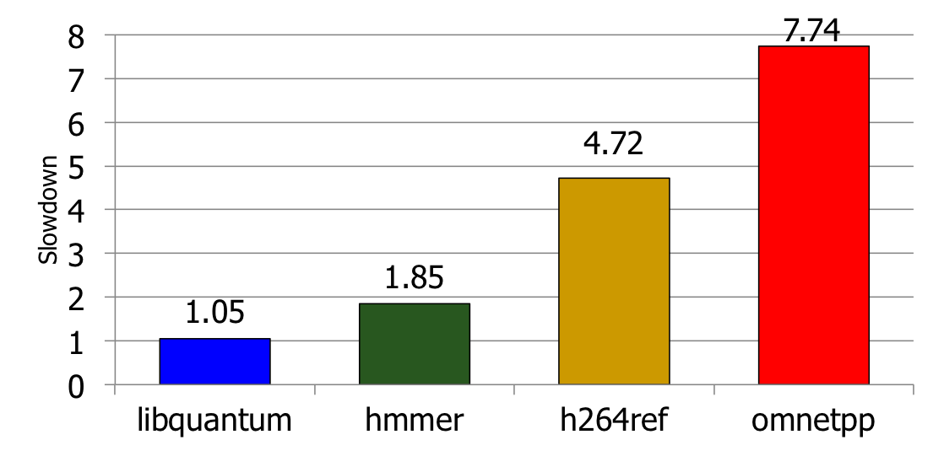
Greater Problem with More Cores
Vulnerable to denial of service (DoS) [Usenix Security’07]
Unable to enforce priorities or SLAs [MICRO’07,’10,’11, ISCA’08’11’12, ASPLOS’10]
Low system performance [IEEE Micro Top Picks ’09,’11a,’11b,’12]
Uncontrollable, unpredictable system

Slide 178
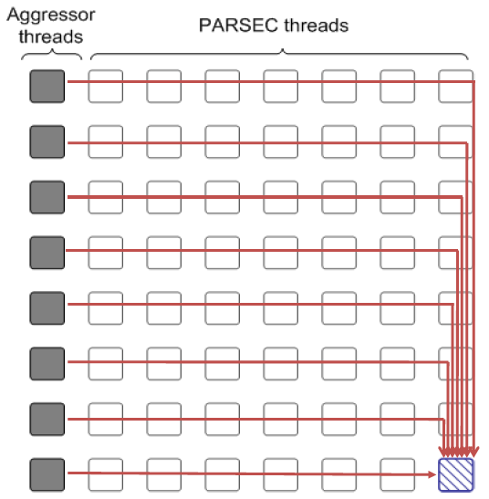
Distributed DoS in Networked Multi-Core Systems
Attackers
(Cores 1-8)
Stock option pricing application
(Cores 9-64)
Cores connected via
packet-switched
routers on chip
~5000X slowdown
Grot, Hestness, Keckler, Mutlu,
“Preemptive virtual clock: A Flexible,
Efficient, and Cost-effective QOS
Scheme for Networks-on-Chip,“
MICRO 2009.

Slide 179
Solution: QoS-Aware, Predictable Memory
Problem: Memory interference is uncontrolled → uncontrollable, unpredictable, vulnerable system
Goal: We need to control it → Design a QoS-aware system
Solution: Hardware/software cooperative memory QoS
  Hardware designed to provide a configurable fairness substrate
    Application-aware memory scheduling, partitioning, throttling
  Software designed to configure the resources to satisfy different QoS goals
  E.g., fair, programmable memory controllers and on-chip networks provide QoS and predictable performance
  [2007-2012, Top Picks’09,’11a,’11b,’12]

Slide 180
Designing QoS-Aware Memory Systems: Approaches
Smart resources: Design each shared resource to have a configurable interference control/reduction mechanism
  QoS-aware memory controllers [Mutlu+ MICRO’07] [Moscibroda+, Usenix Security’07] [Mutlu+ ISCA’08, Top Picks’09] [Kim+ HPCA’10] [Kim+ MICRO’10, Top Picks’11] [Ebrahimi+ ISCA’11, MICRO’11] [Ausavarungnirun+, ISCA’12]
  QoS-aware interconnects [Das+ MICRO’09, ISCA’10, Top Picks ’11] [Grot+ MICRO’09, ISCA’11, Top Picks ’12]
  QoS-aware caches
Dumb resources: Keep each resource free-for-all, but reduce/control interference by injection control or data mapping
  Source throttling to control access to memory system [Ebrahimi+ ASPLOS’10, ISCA’11, TOCS’12] [Ebrahimi+ MICRO’09] [Nychis+ HotNets’10]
  QoS-aware data mapping to memory controllers [Muralidhara+ MICRO’11]
  QoS-aware thread scheduling to cores

Slide 181
A Mechanism to Reduce Memory Interference
Memory Channel Partitioning
  Idea: System software maps badly-interfering applications’ pages to different channels [Muralidhara+, MICRO’11]
Separate data of low/high intensity and low/high row-locality applications
Especially effective in reducing interference of threads with “medium” and “heavy” memory intensity
  11% higher performance over existing systems (200 workloads)
Time Units
Time Units
Channel 0
Channel 0
5
4
3
2
1
5
4
3
2
1
Bank 0
Bank 0
Core 0
App A
Core 0
App A
Bank 1
Bank 1
Bank 0
Core 1
App B
Bank 0
Core 1
App B
Bank 1
Bank 1
Channel 1
Channel 1
Conventional Page Mapping
Channel Partitioning
MCP Micro 2011 Talk

Slide 182
Designing QoS-Aware Memory Systems: Approaches
Smart resources: Design each shared resource to have a configurable interference control/reduction mechanism
  QoS-aware memory controllers [Mutlu+ MICRO’07] [Moscibroda+, Usenix Security’07] [Mutlu+ ISCA’08, Top Picks’09] [Kim+ HPCA’10] [Kim+ MICRO’10, Top Picks’11] [Ebrahimi+ ISCA’11, MICRO’11] [Ausavarungnirun+, ISCA’12]
  QoS-aware interconnects [Das+ MICRO’09, ISCA’10, Top Picks ’11] [Grot+ MICRO’09, ISCA’11, Top Picks ’12]
  QoS-aware caches
Dumb resources: Keep each resource free-for-all, but reduce/control interference by injection control or data mapping
  Source throttling to control access to memory system [Ebrahimi+ ASPLOS’10, ISCA’11, TOCS’12] [Ebrahimi+ MICRO’09] [Nychis+ HotNets’10]
  QoS-aware data mapping to memory controllers [Muralidhara+ MICRO’11]
  QoS-aware thread scheduling to cores

Slide 183
QoS-Aware Memory Scheduling
Resolves memory contention by scheduling requests
How to schedule requests to provide
  High system performance
  High fairness to applications
  Configurability to system software
Memory controller needs to be aware of threads
Core
Core
Memory Controller
Memory
Core
Core

Slide 184
QoS-Aware Memory Scheduling: Evolution
Stall-time fair memory scheduling [Mutlu+ MICRO’07]
  Idea: Estimate and balance thread slowdowns
  Takeaway: Proportional thread progress improves performance, especially when threads are “heavy” (memory intensive)
Parallelism-aware batch scheduling [Mutlu+ ISCA’08, Top Picks’09]
  Idea: Rank threads and service in rank order (to preserve bank parallelism); batch requests to prevent starvation
  Takeaway: Preserving within-thread bank-parallelism improves performance; request batching improves fairness
ATLAS memory scheduler [Kim+ HPCA’10]
  Idea: Prioritize threads that have attained the least service from the memory scheduler
  Takeaway: Prioritizing “light” threads improves performance

Slide 185
Throughput vs. Fairness
Throughput biased approach
Fairness biased approach
  Prioritize less memory-intensive threads
  Take turns accessing memory
  Good for throughput
  Does not starve
thread A
less memory
intensive
thread B
higher
priority
thread C
thread A
thread B
thread C
not prioritized ➔
reduced throughput
starvation ➔ unfairness
Single policy for all threads is insufficient
Notes:
So why do previous algorithms fail?
On the one hand there is the throughput biased approach that prioritizes less memory-intensive threads.
Servicing memory requests from such threads allow them to make progress in the processor, increasing throughput.
However, the most memory-intensive thread, thread C, remains persistently deprioritized and and becomes prone to starvation causing large slowdowns and, ultimately, unfairness.
On the other hand there is the fairness biased approach where threads take turns accessing the memory.
In this case, the most memory-intensive thread does not starve.
However, the least memory-intensive thread, thread A, is not prioritized, leading to reduced throughput.
As you can see, a single policy applied to all threads is insufficient since different threads have different memory access needs.

Slide 186
Achieving the Best of Both Worlds
higher
priority
For Throughput
  Prioritize memory-non-intensive threads
thread
thread
thread
For Fairness
thread
  Unfairness caused by memory-intensive being prioritized over each other
    Shuffle thread ranking
  Memory-intensive threads have
  different vulnerability to interference
    Shuffle asymmetrically
thread
thread
thread
thread
thread
thread
thread
thread
Notes:
So how do we achieve the best of both worlds? Our algorithm is based on the following insights:
First, we would like to prioritize the memory-non-intensive threads to increase system throughput.
Doing so does not degrade unfairness, since memory-non-intensive threads are inherently “light” and rarely cause interference for the memory-intensive threads.
For fairness, we discovered that unfairness is usually caused when one memory-intensive thread is prioritized over another.
As we’ve seen, the most deprioritized thread can starve.
To address this problem, we would like to shuffle their priority so that no single thread is persistently prioritized over another thread.
However, memory-intensive threads are not created equal.
They have different vulnerability to memory interference.
To address their differences, shuffling should be performed in an asymmetric manner.

Slide 187
Thread Cluster Memory Scheduling [Kim+ MICRO’10]
Group threads into two clusters
Prioritize non-intensive cluster
Different policies for each cluster
higher
priority
Memory-non-intensive
Non-intensive
cluster
thread
Throughput
thread
thread
thread
thread
thread
Prioritized
higher
priority
thread
thread
thread
thread
Threads in the system
Memory-intensive
Intensive cluster
Fairness
Notes:
Our algorithm, Thread Cluster Memory Scheduling, first groups threads into two clusters.
Among the threads executing in the system, some are memory-non-intensive whereas some are memory-intensive.
We isolate the memory-non-intensive threads into the non-intensive cluster and the memory-intensive threads into the intensive cluster.
This is so that we can apply different policies for different threads.
Subsequently, we prioritize the non-intensive cluster over the intensive cluster since the non-intensive threads have greater potential for making progress IN THEIR CORES [ONUR].
Finally, we apply different policies within each cluster, one optimized for throughput and the other for fairness.

Slide 188
TCM: Throughput and Fairness
24 cores, 4 memory controllers, 96 workloads
Better fairness
Better system throughput
TCM, a heterogeneous scheduling policy,
provides best fairness and system throughput
Notes:
This figure shows the performance of the four previous scheduling algorithms in addition to TCM, averaged over 96 workloads.
FRFCFS has low system throughput and fairness.
STFM and PAR-BS is biased towards fairness, while ATLAS is biased towards system throughput.
TCM lies towards the lower right part of the figure and provides the best fairness and system throughput.
Compared to ATLAS, TCM provides approx 5% better throughput and 39% better fairness.
Compared to PAR-BS, TCM provides approx 5% better fairness and 8% better throughput.

Slide 189
TCM: Fairness-Throughput Tradeoff
When configuration parameter is varied…
Better fairness
FRFCFS
STFM
Better system throughput
ATLAS
PAR-BS
TCM
Adjusting ClusterThreshold
TCM allows robust fairness-throughput tradeoff

Slide 190
Memory Control in CPU-GPU Systems
Observation: Heterogeneous CPU-GPU systems require memory schedulers with large request buffers
Problem: Existing monolithic application-aware memory scheduler designs are hard to scale to large request buffer sizes
Solution: Staged Memory Scheduling (SMS)
  decomposes the memory controller into three simple stages:
  1) Batch formation: maintains row buffer locality
  2) Batch scheduler: reduces interference between applications
  3) DRAM command scheduler: issues requests to DRAM
Compared to state-of-the-art memory schedulers:
  SMS is significantly simpler and more scalable
  SMS provides higher performance and fairness
Ausavarungnirun et al., “Staged Memory Scheduling,” ISCA 2012.
Notes:
We observe that Heterogeneous CPU-GPU systems require memory schedulers with large request buffers and this becomes a problem for existing monolithic application-aware memory scheduler designs because they are hard to scale to large request buffer size
Our Solution, staged memory scheduling, decomposes MC into three simpler stages:
1) Batch formation: maintains row buffer locality by forming batches of row-hitting requests.
2) Batch scheduler: reduces interference between applications by picking the next batch to prioritize.
3) DRAM command scheduler: issues requests to DRAM
Compared to state-of-the-art memory schedulers:
SMS is significantly simpler and more scalable
SMS provides higher performance and fairness, especially in heterogeneous CPU-GPU systems.

Slide 191
Memory QoS in a Parallel Application
Threads in a multithreaded application are inter-dependent
Some threads can be on the critical path of execution due to synchronization; some threads are not
How do we schedule requests of inter-dependent threads to maximize multithreaded application performance?
  Idea: Estimate limiter threads likely to be on the critical path and prioritize their requests; shuffle priorities of non-limiter threads to reduce memory interference among them [Ebrahimi+, MICRO’11]
  Hardware/software cooperative limiter thread estimation:
    Thread executing the most contended critical section
    Thread that is falling behind the most in a parallel for loop
Ebrahimi et al., “Parallel Application Memory Scheduling,” MICRO 2011.

Slide 192
Some Related Past Work
That I could not cover…
How to handle prefetch requests in a QoS-aware multi-core memory system?
  Prefetch-aware shared resource management, ISCA’11.
  Prefetch-aware memory controllers, MICRO’08, IEEE-TC’11.
  Coordinated control of multiple prefetchers, MICRO’09.
How to design QoS mechanisms in the interconnect?
  Topology-aware, scalable QoS, ISCA’11.
  Slack-based packet scheduling, ISCA’10.
  Efficient bandwidth guarantees, MICRO’09.
  Application-aware request prioritization, MICRO’09.
ISCA 2011 Talk
Micro 2008 Talk
Micro 2009 Talk

Slide 193
Summary: Memory QoS Approaches and Techniques
Approaches: Smart vs. dumb resources
  Smart resources: QoS-aware memory scheduling
  Dumb resources: Source throttling; channel partitioning
  Both approaches are effective in reducing interference
  No single best approach for all workloads
Techniques: Request scheduling, source throttling, memory partitioning
  All approaches are effective in reducing interference
  Can be applied at different levels: hardware vs. software
  No single best technique for all workloads
Combined approaches and techniques are the most powerful
  Integrated Memory Channel Partitioning and Scheduling [MICRO’11]

Slide 194
Partial List of Referenced/Related Papers

Slide 195
Heterogeneous Cores
M. Aater Suleman, Onur Mutlu, Moinuddin K. Qureshi, and Yale N. Patt,
"Accelerating Critical Section Execution with Asymmetric Multi-Core Architectures"
Proceedings of the 14th International Conference on Architectural Support for Programming Languages and Operating Systems (ASPLOS), pages 253-264, Washington, DC, March 2009. Slides (ppt)
M. Aater Suleman, Onur Mutlu, Jose A. Joao, Khubaib, and Yale N. Patt,
"Data Marshaling for Multi-core Architectures"
Proceedings of the 37th International Symposium on Computer Architecture (ISCA), pages 441-450, Saint-Malo, France, June 2010. Slides (ppt)
Jose A. Joao, M. Aater Suleman, Onur Mutlu, and Yale N. Patt,
"Bottleneck Identification and Scheduling in Multithreaded Applications"
Proceedings of the 17th International Conference on Architectural Support for Programming Languages and Operating Systems (ASPLOS), London, UK, March 2012. Slides (ppt) (pdf)

Slide 196
QoS-Aware Memory Systems (I)
Rachata Ausavarungnirun, Kevin Chang, Lavanya Subramanian, Gabriel Loh, and Onur Mutlu,
"Staged Memory Scheduling: Achieving High Performance and Scalability in Heterogeneous Systems"
Proceedings of the 39th International Symposium on Computer Architecture (ISCA), Portland, OR, June 2012.
Sai Prashanth Muralidhara, Lavanya Subramanian, Onur Mutlu, Mahmut Kandemir, and Thomas Moscibroda,
"Reducing Memory Interference in Multicore Systems via Application-Aware Memory Channel Partitioning"
Proceedings of the 44th International Symposium on Microarchitecture (MICRO), Porto Alegre, Brazil, December 2011
Yoongu Kim, Michael Papamichael, Onur Mutlu, and Mor Harchol-Balter,
"Thread Cluster Memory Scheduling: Exploiting Differences in Memory Access Behavior"
Proceedings of the 43rd International Symposium on Microarchitecture (MICRO), pages 65-76, Atlanta, GA, December 2010. Slides (pptx) (pdf)
Eiman Ebrahimi, Chang Joo Lee, Onur Mutlu, and Yale N. Patt,
"Fairness via Source Throttling: A Configurable and High-Performance Fairness Substrate for Multi-Core Memory Systems"
ACM Transactions on Computer Systems (TOCS), April 2012.

Slide 197
QoS-Aware Memory Systems (II)
Onur Mutlu and Thomas Moscibroda,
"Parallelism-Aware Batch Scheduling: Enabling High-Performance and Fair Memory Controllers"
IEEE Micro, Special Issue: Micro's Top Picks from 2008 Computer Architecture Conferences (MICRO TOP PICKS), Vol. 29, No. 1, pages 22-32, January/February 2009.
Onur Mutlu and Thomas Moscibroda,
"Stall-Time Fair Memory Access Scheduling for Chip Multiprocessors"
Proceedings of the 40th International Symposium on Microarchitecture (MICRO), pages 146-158, Chicago, IL, December 2007. Slides (ppt)
Thomas Moscibroda and Onur Mutlu,
"Memory Performance Attacks: Denial of Memory Service in Multi-Core Systems"
Proceedings of the 16th USENIX Security Symposium (USENIX SECURITY), pages 257-274, Boston, MA, August 2007. Slides (ppt)

Slide 198
QoS-Aware Memory Systems (III)
Eiman Ebrahimi, Rustam Miftakhutdinov, Chris Fallin, Chang Joo Lee, Onur Mutlu, and Yale N. Patt,
"Parallel Application Memory Scheduling"
Proceedings of the 44th International Symposium on Microarchitecture (MICRO), Porto Alegre, Brazil, December 2011. Slides (pptx)
Boris Grot, Joel Hestness, Stephen W. Keckler, and Onur Mutlu,
"Kilo-NOC: A Heterogeneous Network-on-Chip Architecture for Scalability and Service Guarantees"
Proceedings of the 38th International Symposium on Computer Architecture (ISCA), San Jose, CA, June 2011. Slides (pptx)
Reetuparna Das, Onur Mutlu, Thomas Moscibroda, and Chita R. Das,
"Application-Aware Prioritization Mechanisms for On-Chip Networks"
Proceedings of the 42nd International Symposium on Microarchitecture (MICRO), pages 280-291, New York, NY, December 2009. Slides (pptx)

Slide 199
Heterogeneous Memory
Justin Meza, Jichuan Chang, HanBin Yoon, Onur Mutlu, and Parthasarathy Ranganathan,
"Enabling Efficient and Scalable Hybrid Memories Using Fine-Granularity DRAM Cache Management"
IEEE Computer Architecture Letters (CAL), May 2012.
HanBin Yoon, Justin Meza, Rachata Ausavarungnirun, Rachael Harding, and Onur Mutlu,
"Row Buffer Locality-Aware Data Placement in Hybrid Memories"
SAFARI Technical Report, TR-SAFARI-2011-005, Carnegie Mellon University, September 2011.
Benjamin C. Lee, Engin Ipek, Onur Mutlu, and Doug Burger,
"Architecting Phase Change Memory as a Scalable DRAM Alternative"
Proceedings of the 36th International Symposium on Computer Architecture (ISCA), pages 2-13, Austin, TX, June 2009. Slides (pdf)
Benjamin C. Lee, Ping Zhou, Jun Yang, Youtao Zhang, Bo Zhao, Engin Ipek, Onur Mutlu, and Doug Burger,
"Phase Change Technology and the Future of Main Memory"
IEEE Micro, Special Issue: Micro's Top Picks from 2009 Computer Architecture Conferences (MICRO TOP PICKS), Vol. 30, No. 1, pages 60-70, January/February 2010.

Slide 200
Flash Memory
Yu Cai, Eric F. Haratsch, Onur Mutlu, and Ken Mai,
"Error Patterns in MLC NAND Flash Memory: Measurement, Characterization, and Analysis"
Proceedings of the Design, Automation, and Test in Europe Conference (DATE), Dresden, Germany, March 2012. Slides (ppt)

Slide 201
Latency Tolerance
Onur Mutlu, Jared Stark, Chris Wilkerson, and Yale N. Patt,
"Runahead Execution: An Alternative to Very Large Instruction Windows for Out-of-order Processors"
Proceedings of the 9th International Symposium on High-Performance Computer Architecture (HPCA), pages 129-140, Anaheim, CA, February 2003. Slides (pdf)
Onur Mutlu, Hyesoon Kim, and Yale N. Patt,
"Techniques for Efficient Processing in Runahead Execution Engines"
Proceedings of the 32nd International Symposium on Computer Architecture (ISCA), pages 370-381, Madison, WI, June 2005. Slides (ppt) Slides (pdf)
Onur Mutlu, Hyesoon Kim, and Yale N. Patt,
"Address-Value Delta (AVD) Prediction: Increasing the Effectiveness of Runahead Execution by Exploiting Regular Memory Allocation Patterns"
Proceedings of the 38th International Symposium on Microarchitecture (MICRO), pages 233-244, Barcelona, Spain, November 2005. Slides (ppt) Slides (pdf)

Slide 202
Scaling DRAM: Refresh and Parallelism
Jamie Liu, Ben Jaiyen, Richard Veras, and Onur Mutlu,
"RAIDR: Retention-Aware Intelligent DRAM Refresh"
Proceedings of the 39th International Symposium on Computer Architecture (ISCA), Portland, OR, June 2012.
Yoongu Kim, Vivek Seshadri, Donghyuk Lee, Jamie Liu, and Onur Mutlu,
"A Case for Exploiting Subarray-Level Parallelism (SALP) in DRAM"
Proceedings of the 39th International Symposium on Computer Architecture (ISCA), Portland, OR, June 2012.

