Slide 1
Enabling and Exploiting
Partition-Level Parallelism (PALP) in Phase Change Memories
Presenter: Dr. Anup K. Das
Shihao Song, Anup Das, Drexel University
Onur Mutlu, ETH Zurich
Nagarajan Kandasamy, Drexel University
CASES 2019, New York

Slide 2
Executive Summary
Observations
  Memory bank conflicts reduce system performance by lowering bank utilization, causing CPU cores to stall
  A PCM bank’s peripheral structures allow to read and program 128 PCM cells in parallel, providing opportunity to resolve bank conflicts
Idea: PArtition-Level Parallelism (PALP) in PCM
  Introduce new mechanism to enable read-write parallelism in PCM banks with minimum changes to PCM interface and its timing
  Introduce simple circuit modifications to enable read-read parallelism in PCM banks
  Propose new access scheduling mechanism to exploit read-write and read-read parallelism in PCM banks
Design Updates: Analyze internal architecture of PCM banks
  New PCM commands
  New decoupled write driver design
Performance Evaluation
  Significant bank conflict reduction (28% average system performance improvement for SPEC CPU 2017 and MiBench workloads)

Slide 3
PCM Bank Conflicts
PCM can serve requests in parallel using multiple banks
Request to the same bank must be served serially
  Called Bank Conflicts
Bank conflicts reduce performance by lowering bank utilization, causing CPU cores to stall
Our goal: improve performance by resolving bank conflicts in PCM devices

Slide 4
Bank Conflict Related Key Observation
Bank conflicts are due to the high temporal and spatial access locality in workloads that lead to repeated access to multiple rows that map to the same bank

Slide 5
Bank Conflict Related Key Observations
Bank conflicts are due to the high temporal and spatial access locality in workloads that lead to repeated access to multiple rows that map to the same bank
On average, 43% of PCM requests in these workloads generate bank conflicts
Read-read bank conflicts outnumber read-write and write-write bank conflicts for all workloads (averaging 79% of all bank conflicts)

Slide 6
Bank Conflict Related Key Observations
Bank conflicts are due to the high temporal and spatial access locality in workloads that lead to repeated access to multiple rows that map to the same bank
Idea: Enable parallelism in PCM banks to resolve read-read bank conflicts first, and then other conflicts
(if possible)
On average, 43% of PCM requests in these workloads generate bank conflicts
Read-read bank conflicts outnumber read-write and write-write bank conflicts for all workloads (averaging 79% of all bank conflicts)

Slide 7
Bank Conflicts Resolution Techniques
Mechanism
Read-Read Conflicts
Read-Write Conflicts
Write-Write Conflicts
Baseline
No
No
No
MultPartition
No
Yes
No
SALP (DRAM)
Yes
Yes
Yes
PALP (PCM)
Yes
Yes
No
Baseline: Arjomand et al. “Boosting access parallelism to PCM-based main memory” in ISCA 2016
MultiPartition: Zhou et al., “An efficient parallel scheduling scheme on multi-partition PCM architecture” in ISLPED 2016
SALP: Kim et al., “A Case for Exploiting Subarray-Level Parallelism (SALP) in DRAM” in ISCA 2012

Slide 8
Outline
Introduction
Motivation
Background on PCM
Contribution 1: Enabling read-write parallelism
Contribution 2: Enabling read-read parallelism
Contribution 3: Exploiting parallelism
Evaluation
Conclusion

Slide 9
PCM Bank Structure
A PCM bank is implemented as a collection of partitions that operate mostly independently; sharing the sense amplifiers (to read) and the write drivers (to write)
Peripheral structures in PCM banks allow to read and program
128 PCM cells in parallel

Slide 10
Baseline PCM Commands
ACTIVATE(A): activate the wordline and enable the access device for the PCM cells to be accessed
READ(R)/WRITE(W): drive read or write current through the PCM cell. After this command executes, the data stored in the PCM cell is available at the output terminal of the sense amplifier, or the write data is programmed to the PCM cell
PRECHARGE(P): deactivate the wordline and bitline, and prepare the bank for the next access

Slide 11
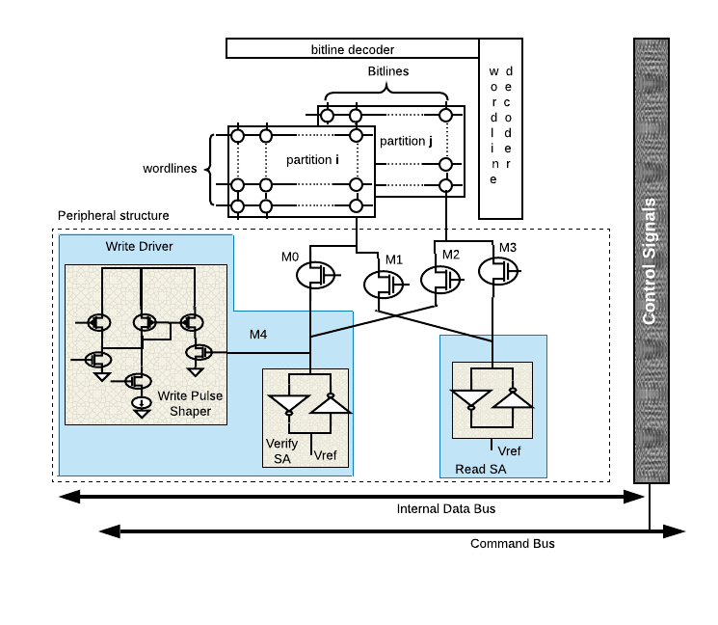
Internal Architecture of PCM Banks

Slide 12
Transistor Configuration for Read/Write

Slide 13
Transistor Configuration for Read/Write
Observation: Only one transistor ON at once for any given operation
Idea: Make two transistors ON to do parallel operations

Slide 14
Outline
Introduction
Motivation
Background on PCM
Contribution 1: Enabling read-write parallelism
Contribution 2: Enabling read-read parallelism
Contribution 3: Exploiting parallelism
Evaluation
Conclusion

Slide 15
Internal Architecture of PCM Banks

Slide 16
New Transistor Configuration
Potential to resolve read-write bank conflicts without additional hardware

Slide 17
PCM Interface Changes
New PCM command
READ-WITH-WRITE (RWW): connect the PCM bank’s sense amplifiers and write drivers to the two decoded partitions

Slide 18
PCM Interface Changes
New PCM command
READ-WITH-WRITE (RWW): connect the PCM bank’s sense amplifiers and write drivers to the two decoded partitions
Performance improvement 27%

Slide 19
PCM Commands: Baseline vs. New
To serve a write and a read request from two different partitions in a PCM bank

Slide 20
Outline
Introduction
Motivation
Background on PCM
Contribution 1: Enabling read-write parallelism
Contribution 2: Enabling read-read parallelism
Contribution 3: Exploiting parallelism
Evaluation
Conclusion

Slide 21
PCM bank Related Key Observation
Write drivers internally implement logic to verify the correctness of write operation
  Program & Verify Write Scheme in PCM

Slide 22
PCM bank Related Key Observation
Write drivers internally implement logic to verify the correctness of write operation
  Program & Verify Write Scheme in PCM
Idea: Decouple the verify logic and use it to serve a read request when needed

Slide 23
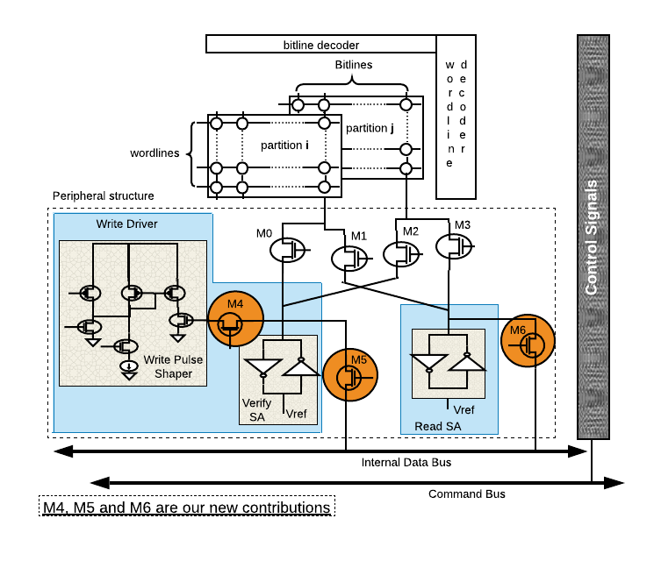
PCM bank Related Key Observation
Write drivers internally implement logic to verify the correctness of write operation
  Program & Verify Write Scheme in PCM

Slide 24
New Operating Modes for Write Driver
Introduce two operating modes for the write driver
In the decoupled mode, write driver can serve a read request and the sense amplifier can serve another read request
  Resolve read-read bank conflicts in PCM

Slide 25
PCM Interface Changes to Exploit Read-Read Parallelism
3 New PCM Commands
READ-WITH-READ (RWR): connect the sense amplifiers and verify logic of the write drivers to the two decoded partitions
DECOUPLE (D): set M4 = OFF, to enter in decoupled model
TRANSFER (T): sets M5 = ON and M6 = OFF to facilitate arbitration of the data bus to transfer two sets of data to the CPU

Slide 26
PCM Commands: Baseline vs. New
To serve two read requests from two different partitions in a PCM bank
Performance improvement 21%

Slide 27
PCM Commands: Baseline vs. New
To serve two read requests from two different partitions in a PCM bank

Slide 28
Outline
Introduction
Motivation
Background on PCM
Contribution 1: Enabling read-write parallelism
Contribution 2: Enabling read-read parallelism
Contribution 3: Exploiting parallelism
Evaluation
Conclusion

Slide 29
Summary of Changes and Impact
Design changes
  Four new PCM commands
  Three new transistors per peripheral structure
Impact
  Resolve read-write bank conflicts in PCM banks when using different partitions
  Resolve read-read bank conflicts in PCM banks when using different partitions
Contribution 3: Develop a new access scheduler to explicitly prioritize resolving bank conflicts

Slide 30
Exploiting Partition-Level Parallelism
Motivation

Slide 31
Exploiting Partition-Level Parallelism
Key considerations
  Ensures that no request is starved, i.e., backlogged excessively
    Starvation-freedom
  Ensure power consumption of the active partitions within the bank is not too high
    Running average power limit (RAPL)

Slide 32
Exploiting Partition-Level Parallelism
Algorithm

Slide 33
Outline
Introduction
Motivation
Background on PCM
Contribution 1: Enabling read-write parallelism
Contribution 2: Enabling read-read parallelism
Contribution 3: Exploiting parallelism
Evaluation
Conclusion

Slide 34
Evaluation Methodology
Gem5 frontend to simulate ARMv8-A (aarch64) with 8 cores
Hybrid DRAM-PCM memory system
In-house cycle-level PCM simulator for 8GB, 16GB, and 32GB PCM with DDR4 interface

Slide 35
Performance Comparison
Execution time (lower is better)

Slide 36
Performance Comparison
Execution time (lower is better)
51% lower execution time vs. MultiPartition and
28% lower execution time vs. Baseline

Slide 37
Power Consumption
Average Power (lower is better)
Peak Power (lower is better)

Slide 38
Power Consumption
Average Power (lower is better)
Peak Power (lower is better)
Both average and peak power within RAPL ratings

Slide 39
Design Overhead
On average, critical path delay increases by 25.3%
On average, power consumption increases by 17%

Slide 40
Performance Impact of PCM Capacity
8GB, 16GB, and 32GB PCM capacity

Slide 41
Performance Impact of PCM Capacity
8GB, 16GB, and 32GB PCM capacity
Most workloads have small working sets for which
8GB PCM is sufficient. No significant performance in increasing the PCM capacity from 8GB to 32GB

Slide 42
Outline
Introduction
Motivation
Background on PCM
Contribution 1: Enabling read-write parallelism
Contribution 2: Enabling read-read parallelism
Contribution 3: Exploiting parallelism
Evaluation
Conclusion

Slide 43
Conclusion
Observations
  Memory bank conflicts reduce system performance by lowering bank utilization, causing CPU cores to stall
  A PCM bank’s peripheral structures allow to read and program 128 PCM cells in parallel, providing opportunity to resolve bank conflicts
Idea: PArtition-Level Parallelism (PALP) in PCM
  Introduce new mechanism to enable read-write parallelism in PCM banks with minimum changes to PCM interface and its timing
  Introduce simple circuit modifications to enable read-read parallelism in PCM banks
  Propose new access scheduling mechanism to exploit read-write and read-read parallelism in PCM banks
Design Updates: Analyze internal architecture of PCM banks
  New PCM commands
  New decoupled write driver design
Performance Evaluation
  Significant bank conflict reduction (28% average system performance improvement for SPEC CPU 2017 and MiBench workloads)

Slide 44
Open-Source Tool
Open source tool
https://github.com/drexel-DISCO/PALP
Email: shihao.song@drexel.edu

Slide 45
Enabling and Exploiting
Partition-Level Parallelism (PALP) in Phase Change Memories
Presenter: Dr. Anup K. Das
Shihao Song, Anup Das, Drexel University
Onur Mutlu, ETH Zurich
Nagarajan Kandasamy, Drexel University
CASES 2019, New York

