Slide 1
Panthera: Holistic Memory Management for Big Data Processing over Hybrid Memories
Chenxi Wang
Huimin Cui
Ting Cao
John Zigman
Haris Volos
Onur Mutlu
Fang Lv
Xiaobing Feng
Guoqing Harry Xu
Notes:
My name is Chenxi Wang, a postdoctor in UCLA, CS department.
The title of my talk is : Panthera, Holistic memory management for big data processing over hybrid memories.
This work is done with Huimin Cui, Ting Cao, John Zigman, Haris Volos,
Onur Mutlu, Fang lv, Xiaobing Feng and Harry Xu.

Slide 2
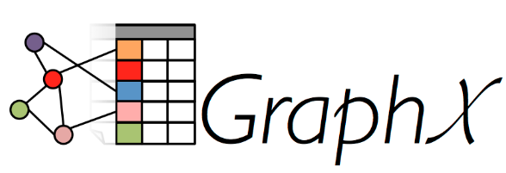
Big Data Workloads
Written in managed languages
MLlib
Current Memory : DRAM
40% of total energy consumption
Capacity starts to hit limit
Notes:
Lots of big data workloads, such as Spark and Hadoop, are written in managed languages.
They require higher and higher memory capacities. At the same time, we want to reduce the energy consumption of the servers.
However, DRAM accounts for up to 40% of the total energy consumption and continues growing.
Also, the DRAM capacity density is starting to hit the fundamental limit.

Slide 3
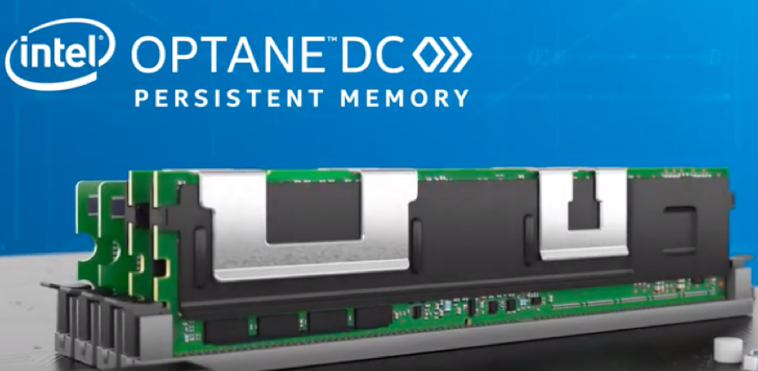
Non-Volatile Memory (NVM)
Byte addressable memory material
Pros
Higher memory capacity density
Lower price
Negligible background energy consumption
Cons
Increased read/write latency
Reduced bandwidth
Notes:
Non volatile memory is an emerging byte addressable memory technology.
Compared to DRAM, NVM has higher memory capacity, lower price and negligible background energy consumption.
However, its performance is worse than DRAM. It has increased memory access latency and reduced bandwidth.

Slide 4
Hybrid Memory : DRAM + Non-Volatile Memory (NVM)
Hot
Cache
Cache
DRAM
Warm
DRAM
Non Volatile Memory
Cold
SSD/HD
SSD/HD
Divide and place data into Hybrid Memory
Hybrid Memory Architecture
Current Memory Architecture
Notes:
In order to utilize the good performance of DRAM and lower energy consumption of NVM, integrate DRAM and NVM into a hybrid memory system is a promising way to satisfy big data applications’ requirements.
Because the performance of NVM is worse than DRAM,
the key challenge to use this new memory architecture is how to place data appropriately so that we can reduce energy consumption at a minimum time cost.

Slide 5
Hybrid memory management for big data
Opportunities & Challenges
Notes:
Next, I will introduce the opportunities and challenges of hybrid memory management for big data applications.
2 mins 30s,

Slide 6
Current Solution of Hybrid Memory Management
Divide Java heap into a DRAM and an NVM areas*
Frequently accessed object
Profile and migrate the frequently accessed objects to DRAM*
Java
Heap
Young Generation
Old
Generation
Significant online profiling overhead!
DRAM
NVM
[*] Write-rationing garbage collection for hybrid memories, Akram et al., PLDI’18
Notes:
A common approach to manage the hybrid memory in managed runtime is to divide the java heap into DRAM and NVM areas.
And then, profile the access frequency of objects and migrate the frequently accessed objects from NVM to DRAM space.
If the purpose is to optimize the durability of NVM, for example, the Write Rationing , it finds and migrates the write-intensive objects from NVM into DRAM. Because the write endurance of NVM is much worse than DRAM.
However, this approach is not suitable for big data applications running on cloud.
The big data applications have billions of objects.
Doing online profiling at object granularity will cause significant performance overhead.

Slide 7
Data Characteristics in Big Data Systems
Application-level memory subsystem
Coarse-grained granularity
Spark
Distributed data collection (RDD)
Different RDDs have different and clear access patterns
Temporary RDDs
Frequently used RDDs
Fault Tolerance RDDs
Execution Memory
Storage Memory
Off-Heap Memory
Spark Memory Management
Notes:
Big data systems, such as Spark, all have application-level memory subsystems, which can perform memory management at coarse-grained granularity.
For example, Spark manages its data and does computation at RDD granularity.
RDD is a distributed data collection defined in Spark. Different RDDs have different and clear access patterns.
For example, some RDDs are only used for fault tolerance, and some RDDs are frequently reused for computation.

Slide 8
Working with Big Data Characteristics
Use the characteristics of RDD to do coarse-grained data division
Objects within one RDD have the same access pattern and lifetime
=> Save lots of profiling overhead !
Java objects
RDD #1
RDD #2
❌ Runtime cannot see these
semantics of RDDs
Runtime
Notes:
The objects within one RDD all have the same access pattern and lifetime.
It’s a good opportunity to use the characteristics of RDD to do coarse-grained data division, which can save lots of online profiling overhead.
However, the problem is that runtime can not see the RDDs, except for a bunch of low-level java objects.
Therefore, we need to bridge the gap between the high level data structure and the low-level java objects.

Slide 9
Design
Notes:
Next, I introduce our solution, the Panthera.
5 mins,

Slide 10
Panthera - Holistic Memory Management System for Big Data Systems
RDD #1
RDD #2
Spark
Applications
Map Java heap space to physical NVM/DRAM
Data profiling :
Static inference
Coarse-grained dynamic analysis
Runtime
(OpenJDK)
Physical
Memory
DRAM
NVM
Notes:
Based on OpenJDK, we developed Panthera, the holistic hybrid memory management system for big data applications running on managed runtime, such as Spark.
Panthera manages hybrid memory in a holistic way:
First, it gets physical DRAM and NVM from OS and then maps Java heap spaces to the physical DRAM and NVM.
Second, it uses application-level semantics to divide objects into coarse-grained categories, and migrate objects by GC.
For the data profiling mechanism, Panthera provides both static inference and dynamic coarse-grained analysis.
Next, I will introduce the design details.

Slide 11
Static Inference of RDD Memory Tags
DRAM
Data intensive applications
Manage data in coarse-grained manner i.e., RDD
Data access pattern and lifetime are statically observed
var links = ctx.textFile..persist()
for ( i <- 1 to iters ){
.....
var contribs =
links.join(..)..persist()
.....
}
NVM
Infer the access frequency of RDD by def-use analysis
Mark Hot RDD with DRAM tag
Mark Cold RDD with NVM tag
PageRank
Notes:
As we have said, the data intensive applications manage data in coarse-grained manner, and the data access patterns and lifetime can be statically observed.
So, Panthera uses static analysis, the def-use analysis, to infer the access frequency of RDDs.
For example, the picture shows the code segment of Spark Pagerank.
RDD links is defined beyond the loop and frequently reused within the loop, so it should be marked with DRAM tag.
The RDD contribs, is defined in the loop, and each iteration will generate new data for this RDD. If programmer persist RDD contribs for tolerance, it should be marked as NVM tag.
Finally, we mark the RDD with different tags based on their access frequency.

Slide 12
Pass DRAM/NVM Tags via GC
Java Object
It’s not practical for a static analysis to find and mark all the objects within a RDD
Java Object with DRAM tag
RDD root object
GC traces all alive objects from root
Utilize GC to propagate the DRAM/NVM tags from RDD root objects to all reachable data objects
Zero online profiling overhead!
Notes:
However, each RDD consists a bunch of low-level java objects. All the objects within the RDD should be placed into DRAM or NVM according to RDD’s tag.
It’s not practical for a static analysis to mark all the objects of a RDD.
The Garbage Collection brings the opportunity to bridge the gap between the Application level data structure and Runtime objects.
During each GC, it needs to trace all the alive objects from the root.
We only need to tag the root object of a RDD, and then GC can propagate the tag to all the reachable data objects of this RDD.
Finally, Panthera can divide the objects according to the semantics of RDD.
The static analysis and tags propagation mechanisms incur zero online profiling overhead.

Slide 13
Dynamic Profiling of RDD Method Invocations
Low-overhead Dynamic Profiling mechanism
Monitor the number of function invocations on RDD root objects
Update the tags of the RDD root objects and propagate them to other objects during major GC
Notes:
Although static analysis is good enough for big data applications, Panthera also provides a low-overhead dynamic profiling mechanism, in case the static analysis isn’t that accurate.
Panthera monitors the number of function invocation, such as the RDD transformation operations, on RDD root objects, and write this value into the object headers.
During each Major GC, it updates the tags ,which were assigned by the static analysis, of the objects and migrates them according to their new tags.

Slide 14
Data Placement in Panthera
Based on DRAM/NVM tags
GC
Java Heap
Young Generation
Old
Generation
DRAM
NVM
Notes:
Data placement is done based on DRAM and NVM tags
Objects will be allocated according to their tags and whenever the tags are changed, they will be migrated by GC according to their new tags.

Slide 15
Runtime Optimizations
Utilize application-level semantics to do runtime optimizations
Eager promotion of RDD data objects
Big array optimization: alignment padding
Notes:
After getting application level semantics, Panthera have done some runtime level optimizations.
For example, for the “eager promotion”. All the tagged objects belong to persist RDDs, and they all have long-lifetime.
So, Panthera promotes these objects to old generation directly without waiting for that they survive several minor GC.
If you want to know more details about these optimizations, please read the paper.

Slide 16
Evaluation
Notes:
Next, we introduce the evaluation.
11 mins,

Slide 17
Our Hybrid Memory Emulator Supports Big Data Apps
Run Big Data applications
QuickPath Interconnect
Host CPU
Remote CPU
(QPI)
 | DRAM | NVM
Latency (ns) | 120 | 300
Bandwidth (GB/s) | 30 | 10
Thermal
Register
Local DRAM
Remote DRAM
DRAM
Emulated NVM
Hybrid Memory Emulator*
* Quartz: A Lightweight Performance Emulator for Persistent Memory Software, Volos et al., Middleware’15
Notes:
Existing NVM simulator can’t support commercial runtime well, such OpenJDK .
Based on NUMA architecture, we developed a Hybrid Memory emulator which can support Big Data applications.
We fix the application running on one CPU, and when it accesses the DRAM of another CPU, the QPI makes the memory access latency much longer.
Besides, inspired by the paper, Quartz, we use the thermal register to limit the bandwidth of remote memory.
Finally, compared to DRAM, the emulated NVM has a 2.5 times longer latency and 1/3 DRAM bandwidth. And these emulated parameters are consistent with NVM specifics.

Slide 18
Experiment Setup
Baseline
DRAM Only
Comparisons
Panthera
Unmanaged
Young generation: mapped on DRAM
Old generation: mapped on DRAM and NVM interleaved
At least as good as Write Rationing GC*
Old generation: DRAM and NVM Interleave at a specific ratio
(i.e., 1/3 DRAM ratio)
NVM
DRAM
NVM
DRAM
[*] Write-rationing garbage collection for hybrid memories, Akram et al., PLDI’18
Notes:
Applications running on DRAM only is used as the baseline.
And compare our work, Panthera, with the Unmanaged version.
For the Unmanaged version, we put its Young generation on DRAM, as Write Rationing GC does.
And its old generation is mapped to DRAM and NVM interleaved, as the picture shows. (The DRAM and NVM interleaves at 1/3 DRAM ratio.)
We use different DRAM ratio in our experiments.
The performance of Unmanaged version is at least as good as Write Rationing GC.

Slide 19
Overall Results – Performance Overhead
64 GB heap, DRAM/Memory = 1/3, Panthera has only 4% performance overhead
1.21
1.04
Average
Notes:
This slide shows the results of overall performance overhead. All the results are normalized to baseline, DRAM only.
The blue bars show the results of unmanaged. The orange bars show the results of Panthera.
Under this configuration, 64 GB heap, 1/3 DRAM ratio, Panthera only has 4% performance overhead.
And at the same time, unmanaged version has a 21% performance overhead.

Slide 20
Overall Results – Energy Consumption
64 GB heap, DRAM/Memory = 1/3, Panthera saves 32% energy consumption
0.73
Average
Notes:
This slide shows the overall results of energy consumption. All results are normalized to baseline, DRAM only.
Blue bars are unmanaged version, the orange bars are panthera.
With the same configuration, panthera saves 32% energy consumption.
We can get much more energy consumption benefits with larger memory size.
For example, under 120 GB java heap, Panthera saves 50% energy consumption.

Slide 21
GC Performance
64 GB heap, DRAM/Memory = 1/3, Panthera has 1% GC performance overhead
Unmanaged has 59% GC Performance overhead
Average
Notes:
This slide shows the results of GC performance, grey bars …
The unmanaged version has 60% GC performance overhead than DRAM only.
This is because GC is highly paralleled, and it is bound by both NVM latency and bandwidth heavily.
Panthera eliminates both the NVM latency and bandwidth bound by doing 2 things,
First, it moves frequently accessed, long-lifetime, data from NVM to DRAM.
Second, after getting the application level semantics, Panthera has done some runtime level optimizations to eliminate useless memory access.
Finally, Panthera only has a 1% GC performance overhead.

Slide 22
Mutator (Computation) Performance
64 GB heap, DRAM/Memory = 1/3, Panthera has 3% Mutator performance overhead
Unmanaged has 6% Mutator Performance overhead
Average
Notes:
This slide shows the results of mutator.
Although the mutators are also highly paralleled, they do much more computation than GC. And they don’t generate that high memory bandwidth.
Under the same configuration, 64 GB heap, 1/3 DRAM ratio.
Compared to baseline, unmanaged has 6% mutator performance overhead,
And after applying the optimization, Panthera only has 3% mutator performance overhead.

Slide 23
Conclusions
Panthera: a holistic memory management system for hybrid memory
Designed for big data applications
Use application-level semantics for coarse-grained data placement
Reduce energy consumption significantly at a small time cost

Slide 24
Thanks!
Q & A
Notes:
Possible Question:

