Slide 1
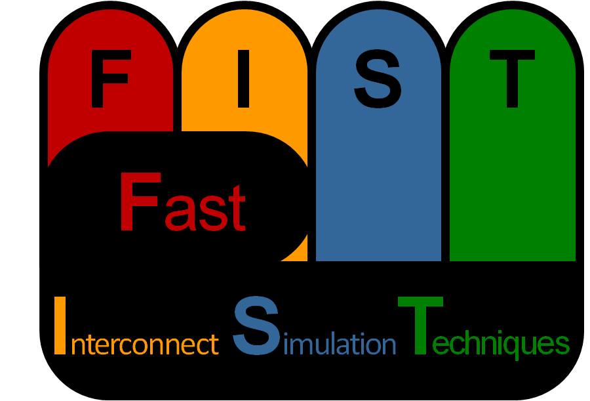

FIST: A Fast, Lightweight, FPGA-Friendly Packet Latency Estimator for NoC Modeling in Full-System Simulations
Michael K. Papamichael, James C. Hoe, Onur Mutlu
papamix@cs.cmu.edu, jhoe@ece.cmu.edu, onur@cmu.edu
Computer Architecture Lab at
Our work has been supported by NSF. We thank Xilinx and Bluespec for their FPGA and tool donations.
5/3/2011

Slide 2
Network-on-Chip Simulation
NoCs crucial component in chip multiprocessors
FIST project explores fast NoC simulation techniques
  Practical, FPGA-friendly approach for full-system simulations
R
R
P
L2
P
L2
L1
L1
R
R
P
L2
P
L2
L1
L1
Network model in a full-system simulator is simple
  Estimates packet latencies and delivers packets
2

Slide 3
FIST Network Simulation Goals
FPGA-friendly, but avoid implementing actual NoC
  Buffered NoC w/ multiple virtual channels complex
  Limited size of simulated network
Stay within acceptable error margin
Trade-off complexity vs. fidelity
Simulate variety of network topologies
Be fast to keep up with HW-based simulators
Datapath Width | 3x3 | 4x4 | 5x5 | 6x6 | 7x7 | 8x8
32-bit | 43% | 76% | 120% | 172% | 234% | 306%
64-bit | 63% | 112% | 175% | 253% | 344% | 449%
128-bit | 101% | 180% | 282% | 405% | 552% | 721%
256-bit | 177% | 315% | 493% | 709% | 965% | 1261%
LUT Requirements for a Mesh NoC on a modern FPGA*
32-bit Datapath
64-bit Datapath
FPGA
(Xilinx LX110T)
3x3
4x4
5x5
*
6x6
FPGA (Xilinx LX110T)
3x3
4x4
5x5
Mesh NoC LUT Usage on Xilinx LX110T FPGA*
*NoC Router RTL from http://nocs.stanford.edu/router.html
3
Notes:
Show results for LX155T?

Slide 4
What is a Network-on-Chip?
Abstract View of NoC
  Set of routers connected by links
  Buffers may exist at inputs/outputs
Mesh Example
R
R
R
R
R
R
R
R
R
N
N
N
R
R
R
R
N
N
N
N
R
R
R
N
N
N
4

Slide 5
Key Observation
Router has characteristic load-delay curves
Known curves for given configuration & traffic pattern
R
N
Inputs
Delay-Load Curve Example for Buffered Crossbar
Outputs
5
Notes:
Animate curve disposition as amount of buffering and traffic pattern changes

Slide 6
FIST Approach
Treat each hop as a load-delay curve
  Trade-off between model complexity and fidelity
  Keep track of load at each node
R
R
R
N
N
N
R
R
R
N
N
N
R
R
R
N
N
N
6

Slide 7
FIST in Action
Route packet from source to destination
  Determine routers that will be traversed
  Add up the delays for each traversed router
  Index load-delay curves using current load at each router
R
R
R
packet
delay
N
S
N
N
R
R
R
N
N
N
R
R
R
N
N
N
D
7

Slide 8
Outline
Introduction to FIST
Background
FIST-based Network Models
Applicability and Limitations
Evaluation
Related Work
Conclusions
Future Directions
Notes:
Have transition slide to prepare them for networking stuff (maybe mention fist here?)
Instrumentation components
Functional, no notion of timing. Trace-based.
In this talk, brief one-slide overview of BlueSPARC and talk about Network-on-Chip model.

Slide 9
Outline
Introduction to FIST
Background
FIST-based Network Models
Applicability and Limitations
Evaluation
Related Work
Conclusions
Future Directions
Notes:
Have transition slide to prepare them for networking stuff (maybe mention fist here?)
Instrumentation components
Functional, no notion of timing. Trace-based.
In this talk, brief one-slide overview of BlueSPARC and talk about Network-on-Chip model.

Slide 10

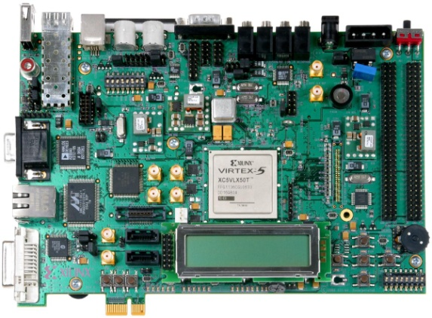
Simulation in Computer Architecture
Simulation indispensable tool
Slow for large-scale multiprocessor studies
  Full-system fidelity + many components
  Longer modern benchmarks
How can we make it faster?
Adjust trade-off between
  Speed, Accuracy, Flexibility
Speed
Full-system simulators often sacrifice
accuracy for speed and flexibility
Accuracy
Flexibility
Accelerate simulation using FPGAs
  Can provide orders of magnitude speedup
  Gaining more traction as FPGAs grow larger
10
Notes:
full-system simulation (run OS & commercial apps)
Longer benchmarks → trillions of instructions
Mention overheads?
2nd bullet: very hard to parallelize due to fine-grain communication

Slide 11
Anatomy of a Simulator
Collection of connected simulation components
  Each component models a different part of the system
  Example:
Cache Model
Network-on-Chip
Model
Simulation
Components
CMP
Model
Branch
Predictor Model
I/O Device
Models
FPGA-based simulators, can run components in parallel
  Each component can be mapped on a separate FPGA
  See ProtoFlex project for more info: www.ece.cmu.edu/~protoflex
11
Notes:
FIST model was designed to work in synergy (in tandem) with ProtoFlex
Instrumentation components
Functional, no notion of timing. Trace-based.
In this talk, brief one-slide overview of BlueSPARC and talk about Network-on-Chip model.

Slide 12
Outline
Introduction to FIST
Background
FIST-based Network Models
Applicability and Limitations
Evaluation
Related Work
Conclusions
Future Directions
Notes:
Have transition slide to prepare them for networking stuff (maybe mention fist here?)
Instrumentation components
Functional, no notion of timing. Trace-based.
In this talk, brief one-slide overview of BlueSPARC and talk about Network-on-Chip model.

Slide 13

Putting FIST Into Context
Detailed network models
  Cycle-accurate network simulators (e.g. BookSim)
  Analytical network models
  Typically study networks under synthetic traffic patterns
Updated Curves
Where does FIST fit in?
Train Curves
Use Curves
Feedback
Network models within full-system simulators
  Model network within a broader simulated system
  Assign delay to each packet traversing the network
  Traffic generated by real workloads
13
Notes:
Standalone (e.g. BookSim, SimGrid)

Slide 14
Online and Offline FIST
Offline FIST
  Detailed network simulator generates curves offline
  Can use synthetic or actual workload traffic
  Load curves into FIST and run experiment
Detailed
Network Model
Online FIST
  Initialization of curves same as offline
  Periodically run detailed network simulator on the side
  Compare accuracy and, if necessary, update curves
Provide feedback and receive updated curves
Detailed
Network Model
14

Slide 15
FIST Applicability and Limitations
“FIST-Friendly” Networks
  Exhibit stable, predictable behavior as load fluctuates
  Actual traffic similar training traffic
  Online FIST models can tolerate more “unpredictability”
FIST Limitations
  Depends on fidelity & representativeness of training models
  Higher loads and large buffers can limit FIST’s accuracy
    High network load → increased packet latency variance
    Large buffers → increased range of observed packet latencies
  Cannot capture fine-grain packet interactions
  Cannot replace cycle-accurate detailed network models
FIST only as good as its training data
15
Notes:
full-system simulation (run OS & commercial apps)
Longer benchmarks → trillions of instructions
Mention overheads?
2nd bullet: very hard to parallelize due to fine-grain communication

Slide 16
Using FIST to Model NoCs
NoCs affected by on-chip limitations and scarce resources
Employ simple routing algorithms
  Usually simple deterministic routing
Operate at low loads
  NoCs usually over-provisioned to handle worst-case
  Have been observed to operate at low injection rates
Small buffers
  On-chip abundance of wires reduces buffering requirements
  Amount of buffering in NoCs is limited or even eliminated
NoCs are “FIST-Friendly”
16

Slide 17
Outline
Introduction to FIST
Background
FIST-based Network Models
Applicability and Limitations
Evaluation
Related Work
Conclusions
Future Directions
Notes:
Have transition slide to prepare them for networking stuff (maybe mention fist here?)
Instrumentation components
Functional, no notion of timing. Trace-based.
In this talk, brief one-slide overview of BlueSPARC and talk about Network-on-Chip model.

Slide 18
FIST Implementations
Software Implementation of FIST (written in C++)
  Implements online and offline FIST models
Hardware Implementation (written in Bluespec)
  Precisely replicates software-based FIST
  Block diagram of architecture:
Packet Descriptors
Router Elements
Routing Logic
Src
Dest
Size
Pick
routers
Tree of
Adders
Packet
Delays
Load Tracker
Curve
Partial Delays
BRAM
18

Slide 19
Methodology
Examined online and offline FIST models
  Replaced cycle-accurate NoC model in tiled CMP Ysimulator
Network and system configuration
  4x4, 8x8, 16x16 wormhole-routed mesh with 4 virtual channels
  Each network node hosts core+coherent L1 and a slice of L2
Multiprogrammed and multithreaded workloads
  26 SPEC CPU2006 benchmarks of varying network intensity
  8 SPLASH-2 and 2 PARSEC workloads
Traffic generated by cache misses
  Single-flit control packets for data requests and coherence
  8-flit data packets for cache-block transfers
Offline and Online FIST models with two curves per router
  Curves represent injection and traversal latency at each router
  Offline model trained using uniform random synthetic traffic
Please see paper for more details!
19
Notes:
This is too dense…

Slide 20
Accuracy Results
8x8 mesh using FIST offline model
  Average Latency and Aggregate IPC Error
0.15
Latency Error
IPC Error
0.1
IPC Error < 4%
0.05
Latency/IPC Error
0
-
0.05
-
0.1
Latency Error < 8%
-
0.15
MP (Low)
MP (Med)
MP (High)
MT (SPL/PAR)
20

Slide 21
Accuracy Results
8x8 mesh using FIST online model
  Average Latency and Aggregate IPC Error
Latency/IPC Error
MP (Low)
MP (Med)
MP (High)
MT (SPL/PAR)
Both Latency and IPC Error below 3%
21

Slide 22
Performance Results
Getting a Sense of Performance
100M
HW FIST
10M
1M
Speed (packets/sec)
SW FIST
100K
10K
SW NoC Sims
(e.g. BookSim)
1K
Complexity / Level of Detail
Software-based speedup results for 16x16 mesh
  Offline FIST: 43x
  Online FIST: 18x
Hardware-based speedup: ~3-4 orders of magnitude
22

Slide 23
Hardware Implementation Results
FPGA resource usage & post-synthesis clock frequency
  Xilinx Virtex-5 LX155T (medium size FPGA)
  Xilinx Virtex-6 LX760 (large FPGA)
 | Virtex-5 LX155T |  |  | Virtex-6 LX760
Size | BRAMs | LUTs | Freq. | BRAMs | LUTs | Freq.
4x4 | 8 | 1% | 380 MHz | 8 | 0% | 448 MHz
8x8 | 32 | 5% | 263 MHz | 32 | 1% | 443 MHz
12x12 | 72 | 11% | 250 MHz | 72 | 2% | 375 MHz
16x16 | 128 | 20% | 214 MHz | 129 | 5% | 375 MHz
20x20 | 200 | 32% | 200 MHz | 201 | 8% | 319 MHz
24x24 | - | - | - | 289 | 12% | 312 MHz
Notes:
24*24 → 576 routers

Slide 24
Outline
Introduction to FIST
Background
FIST-based Network Models
Applicability and Limitations
Evaluation
Related Work
Conclusions
Future Directions
Notes:
Have transition slide to prepare them for networking stuff (maybe mention fist here?)
Instrumentation components
Functional, no notion of timing. Trace-based.
In this talk, brief one-slide overview of BlueSPARC and talk about Network-on-Chip model.

Slide 25
Related Work
Vast body of work on network modeling
  Analytical models, hardware prototyping, etc.
Abstract network modeling
  Previous work has studied the performance-accuracy vs. performance
  Comparing five
FPGAs for network modeling
  Cycle-accurate fidelity at the cost of limited scalability
  Virtualization techniques can help with scalability
  but can still suffer from high implementation complexity

Slide 26
Conclusions & Future Directions
Conclusions
Full-system simulators can tolerate small inaccuracies
FIST can provide fast SW- or HW-based NoC models
  SW model provides 18x-43x average speedup w/ <2% error
  HW model can scale to 100s routers with >1000x speedup
Not all networks are “FIST-friendly”
  But NoCs are good candidates for FIST-based modeling
Future Directions
Simple cycle-accurate, FPGA-friendly network models
Configurable flexible NoC generation
Notes:
Mention new networking work (e.g. network generation tool, multi-abstract NoC modeling)

Slide 27
Thanks!
Questions?

