Slide 1
AN EFFICIENT SYSTEM-LEVEL TECHNIQUE TO DETECT DATA-DEPENDENT FAILURES IN DRAM
PARBOR
Samira Khan
Donghyuk Lee
Onur Mutlu

Slide 2
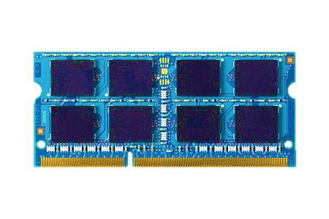
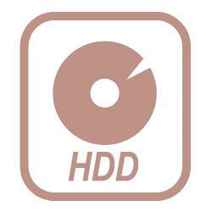
MEMORY IN TODAY’S SYSTEM
Processor
DRAM
Memory
Storage
DRAM is a critical for performance

Slide 3
MAIN MEMORY CAPACITY
Gigabytes of DRAM
Increasing demand for high capacity
1. More cores
2. Data-intensive applications
How did we get more capacity?

Slide 4
DRAM SCALING
Technology
Scaling
DRAM Cells
DRAM Cells
DRAM scaling enabled high capacity

Slide 5
DRAM SCALING TREND
Scaling places cells in close proximity,
increasing cell-to-cell interference
Technology
Scaling
DRAM Cells
DRAM Cells
More interference results in
more failures

Slide 6
How can we enable DRAM scaling
without sacrificing reliability?

Slide 7
SYSTEM-LEVEL DETECTION AND MITIGATION
Manufacturers can make cells smaller
without mitigating all failures
Detect
and
Mitigate
Unreliable
DRAM Cells
Reliable System
Detect and mitigate failures after
the system has become operational

Slide 8
SYSTEM-LEVEL DETECTION AND MITIGATION
Enables scalability [SIGMETRICS’14, DSN’14, DSN’15]
Lets vendors manufacture smaller, unreliable cells
Improves reliability [ISCA’13, ISCA’14, DSN’14, DSN’15]
Can detect failures that escape the manufacturing tests
Improves latency [HPCA’15, HPCA’16, SIGMETRICS’16]
Reduces latency for cells that do not fail at lower latency
Enables refresh optimizations [ASPLOS’11, ISCA’12, DSN’15]
Reduces refresh operations by using low refresh rate for robust cells

Slide 9
CHALLENGE
System-level detection and mitigation
faces a major challenge due to
a specific type of failure:
DATA-DEPENDENT FAILURES

Slide 10
DATA-DEPENDENT FAILURES
Data-dependent failure is a major type
of cell-to-cell interference failure
NO
FAILURE
INTERFERENCE
FAILURE
0
0
0
1
1
Some cells can fail depending on the
data stored in neighboring cells
JSSC’88, MDTD’02
Notes:
Y. Nakagome, … Kiyoo Itoh, The Impact of Data-Line Interference Noise on DRAM Scaling, IJSSC’88
M. Redeker, B. F. Cockburn, and D. G. Elliott. An investigation into crosstalk noise in DRAM structures. MTDT, 2002 (Memory Technology, Design and Testing)
J. Liu et al. An experimental study of data retention behavior in modern DRAM devices: Implications for retention time profiling mechanisms, ISCA 2012

Slide 11
CHALLENGE IN DETECTING DATA-DEPENDENT FAILURES
Detect failures by writing specific patterns
in the neighboring cell addresses
L
0
R
D
0
1
LINEAR
ADDRESS
X-1
X
X+1
0
0
1
0
0
1
SCRAMBLED
ADDRESS
X-1
X-4
X
X+2
X+1
PROBLEM: Scrambled address is not
visible to system (e.g. memory controller)

Slide 12
CAN WE DETERMINE THE LOCATION OF PHYSICALLY ADJACENT CELLS?
L
D
R
SCRAMBLED
ADDRESS
X-?
X
X+?
NAÏVE SOLUTION
For a given failure X,
test every combination of two bit addresses in the row
O(n²)
8192*8192 tests, 49 days for a row with 8K cells
Not feasible in a real system

Slide 13
OUR APPROACH: PARBOR
Goal:
A fast and efficient way to determine the locations of neighboring cells

Slide 14
PARBOR: Summary
A new technique to determine
the locations of neighboring DRAM cells
Reduces test time using two key ideas:
Exploits heterogeneity in cell interference to reduce test time by detecting only one neighbor
Exploits DRAM regularity and parallelism to detect all neighbor locations by running parallel tests in multiple rows
Detects neighboring locations
within 60-99 tests in 144 real DRAM chips,
a 745,654X reduction compared to naïve tests

Slide 15
OUTLINE
Data-Dependent Failures
Challenges in System-Level Detection
Our Mechanism: PARBOR
Experimental Results from Real Chips
Use Cases

Slide 16
A DRAM cell
A DRAM CELL
Transistor
Capacitor
Bitline
Bitline
Contact
Capacitor
Transistor
LOGICAL VIEW
VERTICAL CROSS SECTION

Slide 17
DATA-DEPENDENT FAILURES
Indirect path
Coupled Cells
0
1
0
Indirect path
Failures depend on the data content
in neighboring cells
Notes:
Due to coupling effect in DRAM, neighboring cells provide an indirect path that can interfere with the charge stored in cells. AS a result cells can fail based on the content in the neighboring cells.
For example, here when the neighboring cells are storing 010, the middle cell can lose charge due to coupling between cells and can result in a failure.

Slide 18
DETECTING DATA-DEPENDENT FAILURES
L
0
R
D
0
1
X-1
X
X+1
To test cell at address X, write 1 at address X and 0s at address X+1 and X-1
Need to write specific data patterns
in neighboring addresses

Slide 19
OUTLINE
Data-Dependent Failures
Challenges in System-Level Detection
Our Mechanism: PARBOR
Experimental Results from Real Chips
Use Cases

Slide 20
CHALLENGE: SCRAMBLED ADDRESS SPACE
0
0
1
0
0
1
SCRAMBLED
ADDRESS
X-1
X-4
X
X+2
X+1
0
1
0
SCRAMBLED
ADDRESS
X-?
X
X+?
Scrambled address not visible to system
Cannot detect failures without the address mapping information

Slide 21
CHALLENGE: SCRAMBLED ADDRESS SPACE
0
0
1
0
0
1
Vendor A
SCRAMBLED
ADDRESS
X-4
X
X+2
0
1
0
Vendor B
SCRAMBLED
ADDRESS
X-2
X
X+5
Different for each generation and vendor
Need a dynamic way to detect address mapping information in the system

Slide 22
NAIVE SOLUTION
L
D
R
SCRAMBLED
ADDRESS
X-?
X
X+?
Determine the location of neighboring cells
NAÏVE SOLUTION: O(n²)
For a given failure X, test every combination of two bit addresses in the row
Address bits: (0, 0), (0, 1), … (X-1, X), (X, X+1) ... (n-1, n)
For vendor A
X will fail only when X-4, X+2 tested
8192*8192 tests, 49 days for a row with 8K cells
Not feasible in a real system

Slide 23
GOAL
A fast and efficient way
to determine
the locations of neighboring cells

Slide 24
OUTLINE
Data-Dependent Failures
Challenges in System-Level Detection
Our Mechanism: PARBOR
Experimental Results from Real Chips
Use Cases

Slide 25
PARBOR: KEY OBSERVATIONS
Reduces test time based on two key observations:
Key observation 1:
Data-dependent failures depend on the heterogeneity in coupled cells
Some cells are strongly coupled and fail based on the data content in just one neighbor
Reduce test time by detecting only one neighbor
CHALLENGE: Detecting failures with only one neighbor information cannot find all failures

Slide 26
PARBOR: KEY OBSERVATIONS
Reduces test time based on two key observations:
Key observation 2:
DRAM exhibits regularity and parallelism
Neighbors are located at the same distance in different rows of DRAM
Detect all neighbor locations by running parallel tests in multiple rows

Slide 27
KEY OBSERVATION 1: STRONGLY VS. WEAKLY COUPLED CELLS
STRONGLY COUPLED CELL
Fails even if only one neighbor’s data changes
WEAKLY COUPLED CELL
Fails if both neighbors’ data change

Slide 28
KEY IDEA 1: EXPLOITING STRONGLY COUPLED CELLS
L
A
R
SCRAMBLED
ADDRESS
X-?
X
Instead of detecting both neighbors, reduce test time by detecting only one neighbor location in strongly coupled cells
Does not need to detect every two bit addresses
Linearly tests every bit address
0, 1, … , X, X+1, X+2, … n
ADVANTAGES
Reduces test time to linear O(n)
Can reduce test time further by applying recursive tests to linear tests

Slide 29
RECURSIVE TEST
L
A
X-4
X
SCRAMBLED
ADDRESS
2
6
LINEAR
TESTING
0 1 2 3 4 5 6 7
RECURSIVE
TESTING
0, 1, 2, 3
4, 5, 6, 7
0, 1
2, 3
4, 5
6, 7
0
1
2
3
4
5
6
7
Recursive test reduces test time
compared to linear testing

Slide 30
CHALLENGE:
Detecting failures with
only one neighbor information cannot find
*all* data-dependent failures

Slide 31
PARBOR: KEY OBSERVATIONS
Reduces test time based on two key observations:
Key observation 1:
Data-dependent failures depend on the heterogeneity in coupled cells
Some cells are strongly coupled and fail based on the data content in just one neighbor
Reduce test time by detecting only one neighbor
Key observation 2:
DRAM exhibits regularity and parallelism
Neighbors are located at the same distance in different rows of DRAM
Detect all neighbor locations by running parallel tests in multiple rows

Slide 32
KEY OBSERVATION 2: REGULARITY AND PARALLELISM IN DRAM
DRAM is internally organized as a 2D array of similar and repetitive tiles.
+1
A
+5
+1
B
+5
+1
C
+5
+1
D
+5
DRAM Bank
DRAM Tile
This regularity results in
regularity in address mapping

Slide 33
KEY OBSERVATION 2: REGULARITY AND PARALLELISM IN DRAM
DRAM Tile
SYSTEM
ADDRESS
1 0 5 4 9 8 3 2 7 6 11 10
±1 ±5 ±1 ±5 ±1 ±1 ±5 ±1 ±5 ±1
Due to regularity in tiles, neighbors can occur only in fixed distances

Slide 34
KEY OBSERVATION 2: REGULARITY AND PARALLELISM IN DRAM
+1
A
+5
-5
B
-1
DRAM Tile
-5
C
-1
+1
D
+5
SYSTEM
ADDRESS
1 0 5 4 9 8 3 2 7 6 11 10
±1 ±5 ±1 ±5 ±1 ±1 ±5 ±1 ±5 ±1
A, B, C, D provide all neighbor distances
{+1, -5, +5, -1}

Slide 35
KEY IDEA 2: PARALLEL TESTS IN MULTIPLE ROWS
Due to regularity in mapping, it is possible to determine the neighbor locations from different rows
Run parallel tests in multiple rows
Detect the neighbors’ distances in these rows
Aggregate the locations from different rows
Provides the neighbor distances for all cells

Slide 36
KEY IDEA 2: PARALLEL TESTS IN MULTIPLE ROWS
A+1
+1
B-5
A
C-1
-5
B
DRAM Tile
D+5
-1
C
D
+5
SYSTEM
ADDRESS
1 0 5 4 9 8 3 2 7 6 11 10
±1 ±5 ±1 ±5 ±1 ±1 ±5 ±1 ±5 ±1
Aggregated neighbor locations {+1, -5, +5, -1}

Slide 37
OUTLINE
Data-Dependent Failures
Challenges in System-Level Detection
Our Mechanism: PARBOR
Experimental Results from Real Chips
Use Cases

Slide 38
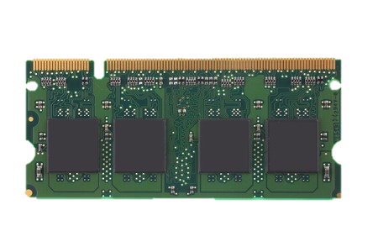
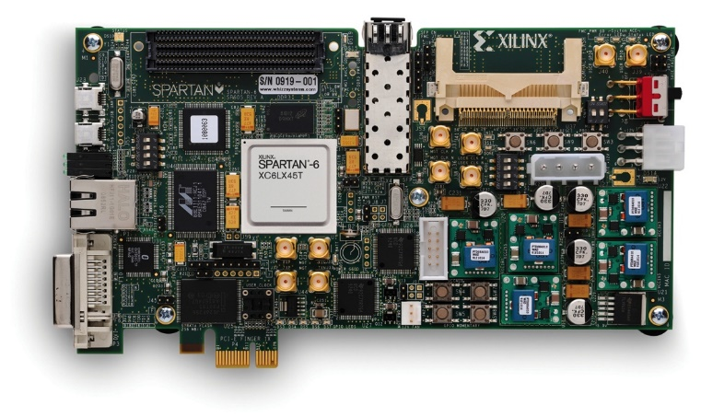
METHODOLOGY
An FPGA-based testing infrastructure
[ISCA’13, SIGMETRICS’14, ISCA’14, HPCA’15, DSN’15, SIGMETRICS’16]
Evaluated 144 chips from three major vendors

Slide 39
PARBOR: TEST CHARACTERISTICS
A
B
C
NUM TEST
REDUCED
745654X
1016800X
745654X
Can detect neighbor locations
in 66-90 tests

Slide 40
PARBOR: TEST CHARACTERISTICS
A
B
C
NUM TEST
REDUCED
745654X
1016800X
745654X
NEIGHBOR LOCATIONS
±8, ±16, ±48
±1, ±64
±16, ±33, ±49
Can detect different address mapping in different chips

Slide 41
OUTLINE
Data-Dependent Failures
Challenges in System-Level Detection
Our Mechanism: PARBOR
Experimental Results from Real Chips
Use Cases

Slide 42
USE CASES
USE CASE: PHYSICAL NEIGHBOR AWARE TEST
Use neighbor information to efficiently detect all data-dependent failures
USE CASE: DATA-CONTENT BASED REFRESH
Use neighbor information and program content to reduce refresh count

Slide 43
USE CASE: PHYSICAL NEIGHBOR-AWARE TEST
Use neighbor information to efficiently detect all data-dependent failures
Use PARBOR to detect neighbor locations
Neighbor locations at {±1 ±5}
Can test every 11 bits in parallel
Reduces test time, needs only 11 tests
At each test, write data pattern at the neighboring cells of each address
X-5, X+1, X, X-1, X+5 --> 0, 0, 1, 0, 0

Slide 44
USE CASE: PHYSICAL NEIGHBOR-AWARE TEST
A
B
C
NUM TESTS
32
32
16
EXTRA FAILURES
DETECTED
42%
7%
18%
Detects more failures
with small number of tests
leveraging neighboring information

Slide 45
USE CASES
USE CASE: PHYSICAL NEIGHBOR AWARE TEST
Use neighbor information to efficiently detect all data-dependent failures
USE CASE: DATA-CONTENT BASED REFRESH
Use neighbor information and program content to reduce refresh count

Slide 46
PROBLEM WITH TRADITIONAL REFRESH OPTIMIZATION
Lo-REF
Hi-REF
Lo-REF
Lo-REF
Traditional refresh optimization: [RAIDR ISCA’12]
High refresh rate with rows with failures
Low refresh rate for rows with no failure
Does not take into account that
failures occur only with specific content

Slide 47
A NEW USE CASE: DATA-CONTENT AWARE REFRESH
Lo-REF
0
1
0
Hi-REF only when contains 010
Lo-REF
Lo-REF
DC-REF optimization:
Builds on top of PARBOR to track locations of data-dependent failures and data patterns that cause the failures
High refresh rate for rows whose data content exhibits failures
Low refresh rate for rows with no failure

Slide 48
DATA-CONTENT AWARE REFRESH: Fraction of Rows with High Refresh Rate
16.4%
2.7%
DC-REF significantly reduces
the number of high refresh operations

Slide 49
DATA-CONTENT AWARE REFRESH: PREFORMANCE IMPACT
DC-REF improves performance by reducing refresh operations

Slide 50
PARBOR: Summary
A new technique to determine
the locations of neighboring DRAM cells
Exploits heterogeneity in data-dependent cells to reduce test time by detecting only one neighbor
Exploits DRAM regularity and parallelism to aggregate neighbor locations from multiple rows to identify all neighbor locations
Enables new uses cases to improve performance, reliability, and energy efficiency
Physical neighbor-aware test
Data-content aware refresh

Slide 51
AN EFFICIENT SYSTEM-LEVEL TECHNIQUE TO DETECT DATA-DEPENDENT FAILURES IN DRAM
PARBOR
Samira Khan
Donghyuk Lee
Onur Mutlu

Slide 52
USE CASE: PHYSICAL NEIGHBOR-AWARE TEST
A
B
C
A significant fraction of failures
can be detected only by PARBOR (20-30%)

