Slide 1

Ramulator 2
Presenter: Haocong Luo
PhD Student, ETH Zurich
SAFARI Research Group
Notes:
Hi everyone, I am Haocong, and I will be presenting our work on the experimental characterization of combined RH RP RD in modern DRAM chips

Slide 2
Motivation
Robustness issues in DRAM
  Data retention
  Read disturbance (RowHammer, RowPress, etc.)
  …
Performance issues in main memory system
  Performance overhead analysis of read disturbance mitigation techniques
  Processing-in-Memory architectures
  Emerging memory technologies
  …
DRAM simulation infrastructures is needed to understand, characterize, and evaluate the
robustness and performance of DRAM
Notes:
DRAM is the main stream technology for main memory today, but unfortunately, DRAM suffers from read disturbance

Slide 3
Executive Summary
Ramulator 2.0: Modern, modular, and extensible
DRAM & memory system simulator
  Fine-grained modeling of DRAM operation (cycle-level)
  Unified functional and timing modeling of DRAM based on hierarchical state-machines
  Modular and extensible software architecture
  Models a wide range of DRAM standards and memory controller functionalities
  Used in a wide range of research works
Notes:
ADD LINKS

Slide 4
Outline
1. Motivation
2. Ramulator 2.0
2.1 Simulator Design & Key Features
2.2 Case Studies
2.2.1 Cross-Sectional Study of RowHammer Mitigations
2.2.2 Evaluating the Performance of PRAC
2.2.3 BreakHammer: Throttling Suspect Threads
3. Conclusion & Future Work
Notes:
Here is the outline of my talk.

Slide 5
Outline
1. Motivation
2. Ramulator 2.0
2.1 Simulator Design & Key Features
2.2 Case Studies
2.2.1 Cross-Sectional Study of RowHammer Mitigations
2.2.2 Evaluating the Performance of PRAC
2.2.3 BreakHammer: Throttling Suspect Threads
3. Conclusion & Future Work
Notes:
Add motivation

Slide 6
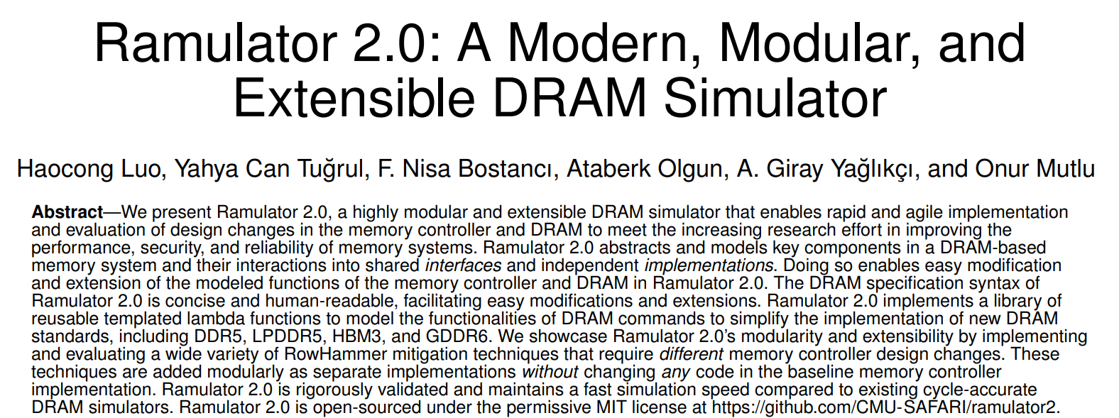


Ramulator 2.0
IEEE CAL Paper
Open-source version Github repo:
CMU-SAFARI/ramulator2

Slide 7
Outline
1. Motivation
2. Ramulator 2.0
2.1 Simulator Design & Key Features
2.2 Case Studies
2.2.1 Cross-Sectional Study of RowHammer Mitigations
2.2.2 Evaluating the Performance of PRAC
2.2.3 BreakHammer: Throttling Suspect Threads
3. Conclusion & Future Work
Notes:
Add motivation

Slide 8
Ramulator 2.0 Design and Features (I)
Hierarchical state-machine based modeling of DRAM
Level: “Channel”
Id: 0
State: …
State of a DRAM node:
Current state: open, close, activating, etc.
Timing constraints: Earliest time in the future that each DRAM command is allowed to be issued
Energy & power: Time spent in each state and the number of DRAM commands served (DRAMPower model)
Can be extended to include more
Parent
Level: “Rank”
Id: 0
State: …
Sibling
Level: “Rank”
Id: 1
State: …
Children
Level: “BankGroup”
Id: 0
State: …
Level: “BankGroup”
Id: 1
State: …

Slide 9
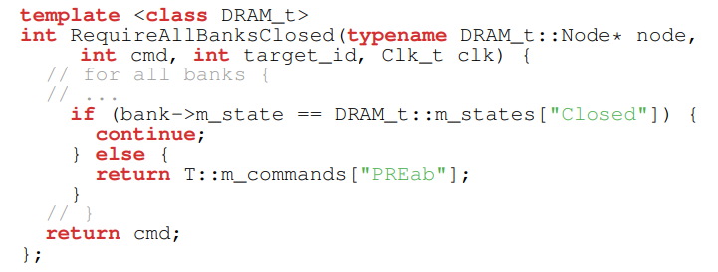
Ramulator 2.0 Design and Features (II)
DRAM commands implemented as lambda functions that hierarchically traverses and updates the states of the nodes
  Checks the current states of the nodes to decode
  which DRAM command to issue
  Programmatically apply state changes
  Updates the timing constraints, power metrics, etc.
Templated library of generalized DRAM command lambda functions allow reuse of command implementations across different DRAM standards
Applicable to:
DDR3, DDR4, DDR5
LPDDR4, LPDDR5
HBM (1/2/3), GDDR6
Example DRAM Command Decode Function

Slide 10
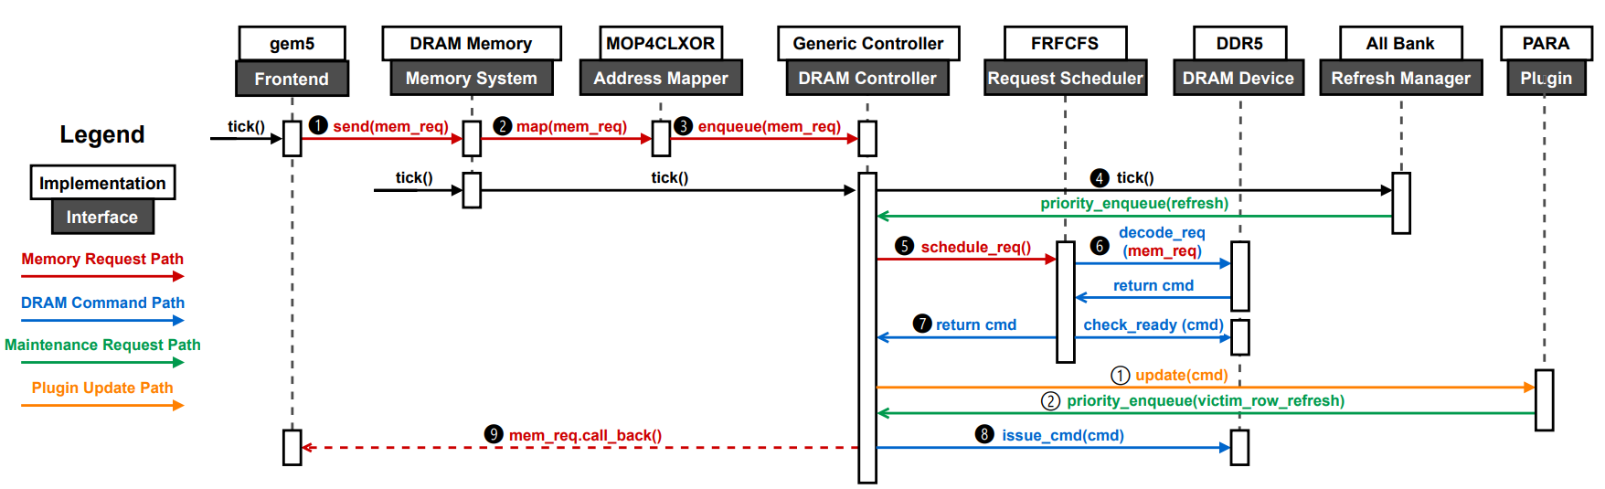
Ramulator 2.0 Design and Features (III)
Modular and extensible software architecture
  All components in the memory system modeled with the same interface and different implementations
  Example: The memory controller include:
    Address Mapper, Request Scheduler, Refresh Controller, Row Policy, etc.
    Each can be flexibly changed without hardcoding other parts

Slide 11
Ramulator 2.0 Design and Features (IV)
Modular and extensible software architecture
  All components in the memory system modeled with the same interface and different implementations
  Example: The memory controller include:
    Address Mapper, Request Scheduler, Refresh Controller, Row Policy, etc.
    Each can be flexibly changed without hardcoding other parts
Example: Memory Controller Plugins

Slide 12
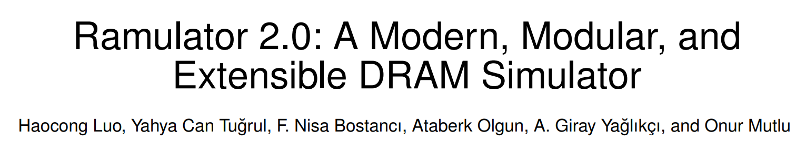
Ramulator 2.0 Design and Features (V)
More in the paper
  More detailed explanation of modeling methodology
  Authoring of DRAM specifications (organization, timings, etc.)
  Memory controller plugin & RowHammer mitigations
  Performance comparison with other DRAM simulators
  …
IEEE CAL Paper
Open-source version Github repo:
CMU-SAFARI/ramulator2

Slide 13
Outline
1. Motivation
2. Ramulator 2.0
2.1 Simulator Design & Key Features
2.2 Case Studies
2.2.1 Cross-Sectional Study of RowHammer Mitigations
2.2.2 Evaluating the Performance of PRAC
2.2.3 BreakHammer: Throttling Suspect Threads
3. Conclusion & Future Work

Slide 14
Outline
1. Motivation
2. Ramulator 2.0
2.1 Simulator Design & Key Features
2.2 Case Studies
2.2.1 Cross-Sectional Study of RowHammer Mitigations
2.2.2 Evaluating the Performance of PRAC
2.2.3 BreakHammer: Throttling Suspect Threads
3. Conclusion & Future Work

Slide 15
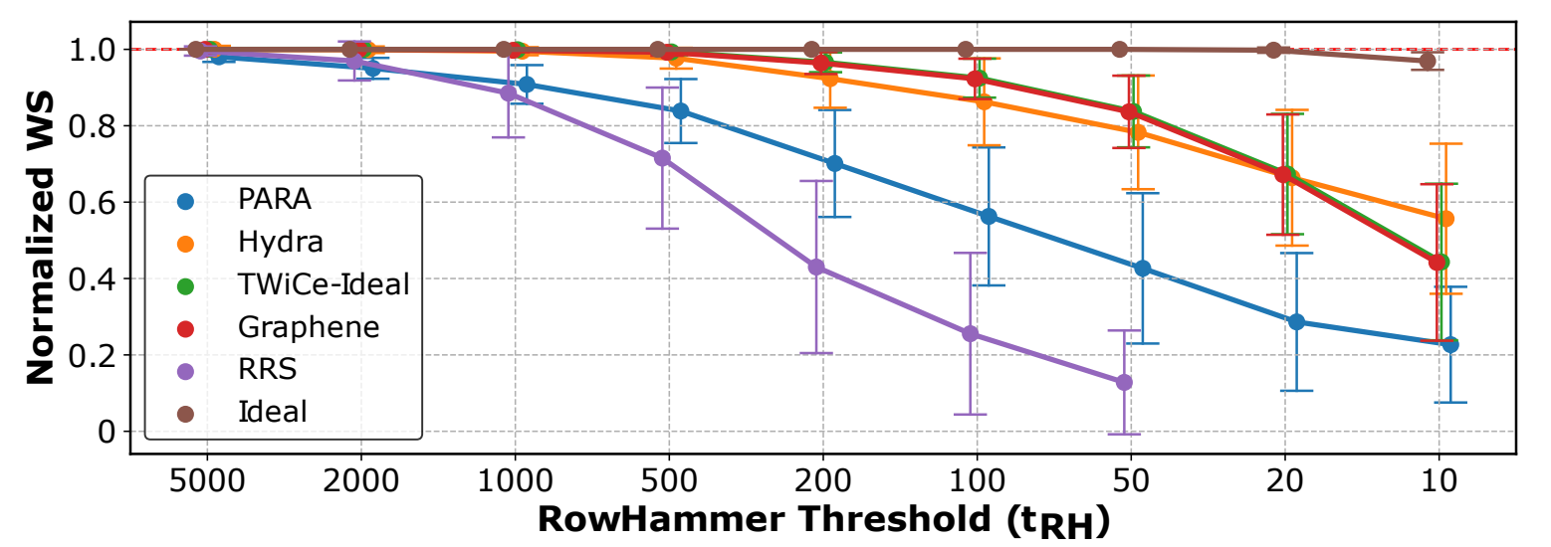
Ramulator 2.0 Case Studies (I)
Cross-section performance overhead evaluation of different RowHammer mitigation techniques
[Luo+, IEEE CAL 2023]
  Six different RowHammer mitigation techniques all implemented as plugins to the same memory controller implementation

Slide 16
Outline
1. Motivation
2. Ramulator 2.0
2.1 Simulator Design & Key Features
2.2 Case Studies
2.2.1 Cross-Sectional Study of RowHammer Mitigations
2.2.2 Evaluating the Performance of PRAC
2.2.3 BreakHammer: Throttling Suspect Threads
3. Conclusion & Future Work

Slide 17
Ramulator 2.0 Case Studies (II)
New Read Disturbance Mitigation Features in DDR5
  RFM Command: New DRAM command that gives the memory controller a longer time window so that the DRAM can refresh potential victim rows
  Per Row Activation Counting (PRAC): In-DRAM per-row activation counter (implemented as extra columns of cells)
PRAC Workflow
  Row activations increment the PRAC counters
  If the counter value reaches a critical threshold, the DRAM send a back-off signal to the memory controller
  Upon receiving the back-off signal, the memory controller send RFM commands to refresh the potential victim rows

Slide 18
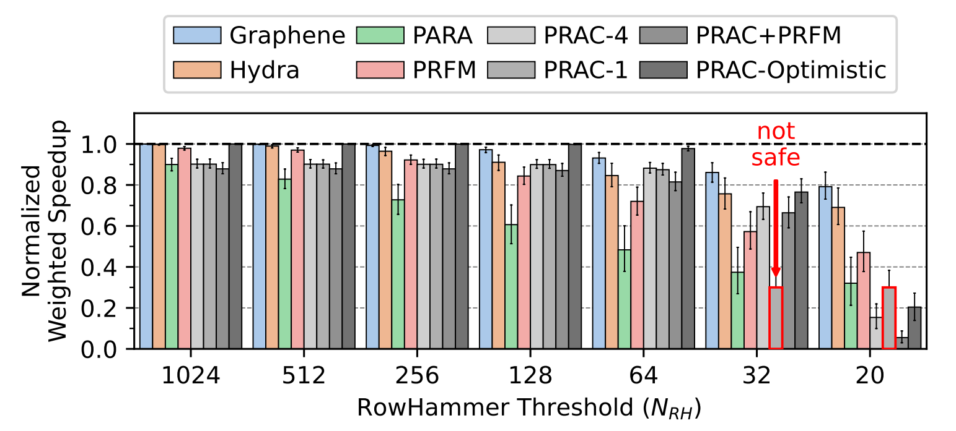
Ramulator 2.0 Case Studies (III)
Performance evaluation of DDR5 Per Row Activation Counting (PRAC) [Canpolat+, DRAMsec’24]
  Memory controller implementation extended with support for per-row activation count tracking and back-off signal

Slide 19
Outline
1. Motivation
2. Ramulator 2.0
2.1 Simulator Design & Key Features
2.2 Case Studies
2.2.1 Cross-Sectional Study of RowHammer Mitigations
2.2.2 Evaluating the Performance of PRAC
2.2.3 BreakHammer: Throttling Suspect Threads
3. Conclusion & Future Work

Slide 20
Ramulator 2.0 Case Studies (IV)
BreakHammer: Enhancing RowHammer Mitigations by Carefully Throttling Suspect Threads
[Canpolat+, MICRO’24]
  Goal: Reduce the performance overhead of RowHammer mitigation mechanisms by carefully reducing the number of performed RowHammer-preventive actions without compromising system robustness
  Key Idea: Limit the dynamic memory request count of a hardware thread based on how frequently the thread triggers RowHammer-preventive actions

Slide 21
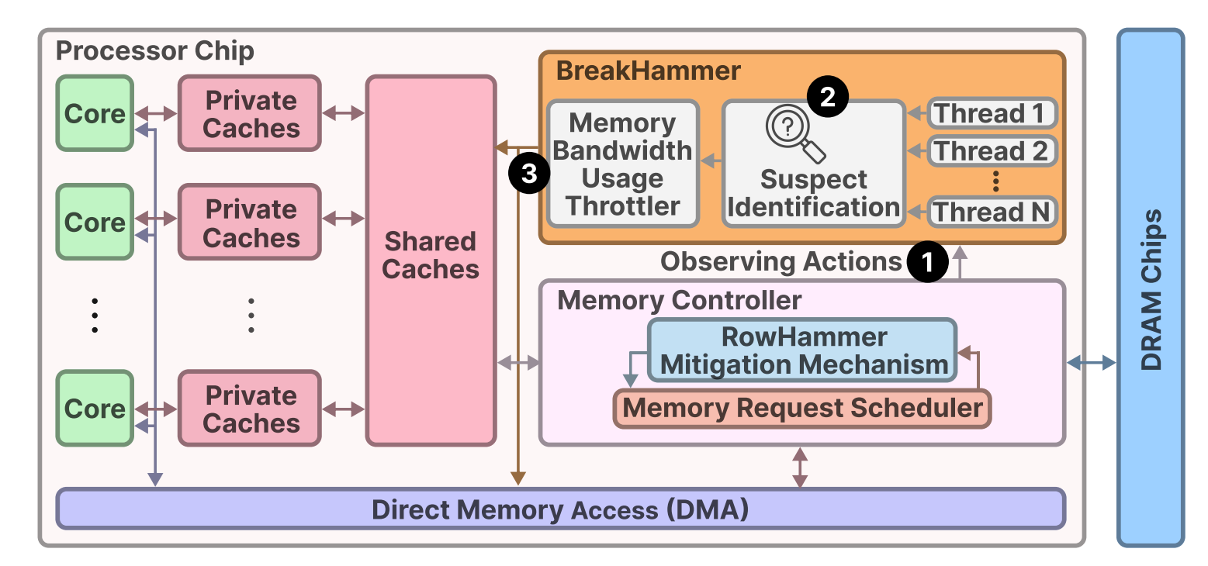
Ramulator 2.0 Case Studies (V)
BreakHammer: Enhancing RowHammer Mitigations by Carefully Throttling Suspect Threads
[Canpolat+, MICRO’24]
  Key Mechanism: 1) Observe the triggered RowHammer preventive actions, 2) identify suspect threads, and 3) reduce the request count of the suspect threads

Slide 22
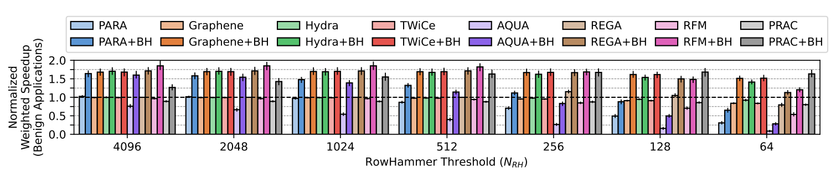
Ramulator 2.0 Case Studies (VI)
BreakHammer: Enhancing RowHammer Mitigations by Carefully Throttling Suspect Threads
[Canpolat+, MICRO’24]
  BreakHammer’s performance scaling for existin RowHammer mitigation mechanisms with an attacker present

Slide 23
Outline
1. Motivation
2. Ramulator 2.0
2.1 Simulator Design & Key Features
2.2 Case Studies
2.2.1 Cross-Sectional Study of RowHammer Mitigations
2.2.2 Evaluating the Performance of PRAC
2.2.3 BreakHammer: Throttling Suspect Threads
3. Conclusion & Future Work

Slide 24
Conclusion & Future Work
Ramulator 2.0: Modern, modular, and extensible
DRAM & memory system simulator
  Fine-grained modeling of DRAM operation (cycle-level)
  Models a wide range of DRAM standards and memory controller functionalities
  Used in a wide range of research works
Ongoing & Future Works
  Unit & regression test coverage
  More DRAM standards and emerging technologies
  More detailed memory controller modeling (i.e., pipelined scheduler and gear ratio)
  Generalizable modeling for PuM/PnM architectures
  …

Slide 25
DRAM Simulation and Testing Infrastructures
Presenter: Haocong Luo
Github repo:
CMU-SAFARI/ramulator2
Ramulator 2
Paper
Notes:
Hi everyone, I am Haocong, and I will be presenting our work on the experimental characterization of combined RH RP RD in modern DRAM chips

