Slide 1
Computer Architecture
Lecture 26b: RawHash
Can Firtina
ETH Zurich
Fall 2024
13 December 2024

Slide 2

Brief Self Introduction
Can Firtina
  Senior researcher in the SAFARI Research Group
  and a lecturer at ETH Zurich (PhD thesis defended in November 2024)
Research interests: Bioinformatics & Computer Architecture
  Real-time genome analysis
  Similarity search in a large space of genomic data
  Hardware-Algorithm co-design to accelerate genome analysis
  Genome editing
  Error correction
Get to know our group and our research: https://safari.ethz.ch
  Contact me: canfirtina@gmail.com
  Website: https://canfirtina.com
  Twitter (aka X): https://twitter.com/FirtinaC
  Bluesky: https://bsky.app/profile/firtinac.bsky.social

Slide 3




Recall: Key Applications of Genome Analysis
Uncovering and treating diseases
linked to genomic variations
Altering genomes to solve
fundamental challenges of life
Detecting pathogens
in the environment
Rapid surveillance of
disease outbreaks
Notes:
Let's start by looking at some key applications in genome analysis.
[CLICK] For example, we can uncover, …
To enable many of these applications, we need to analyze the genomic data.

Slide 4
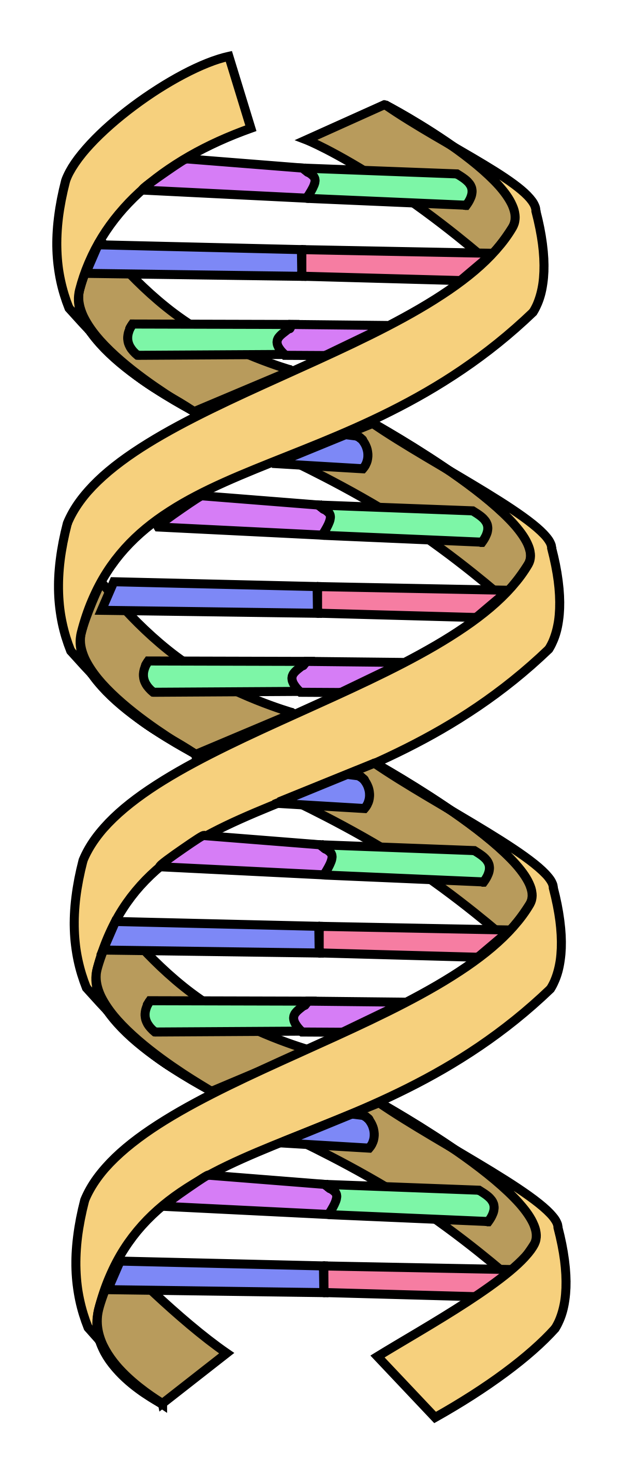
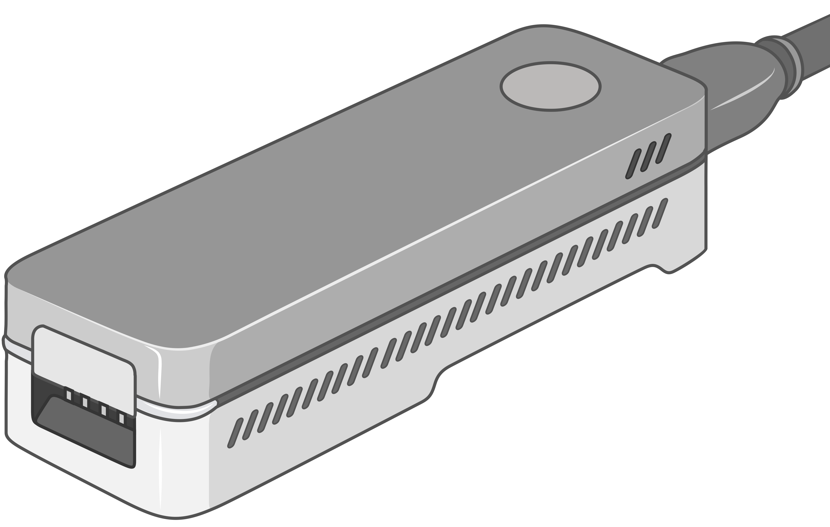


Recall: Genome Sequencing Data Generation
Sequencing process converts biological molecules
into digital nucleotide sequences called reads
Sequencing Device
AAGCTTCCATGG
AAATGGGCTTTC
GCTTCCAGAATG
GCCCAAATGGTT
Biological Molecule (e.g., DNA)
Sequencing Data
(Reads)
?
Challenge: Unknown origins
Challenge: Large volume of data to analyze
Notes:
The analysis of genomic data starts by converting the biological molecules
[CLICK] into digital nucleotide sequences that we call reads
However, there are certain challenges to analyzing genomic data.
[CLICK] First, the genomic origins of these reads are lost after sequencing.
[CLICK] Second, we need to analyze a large volume of data.

Slide 5



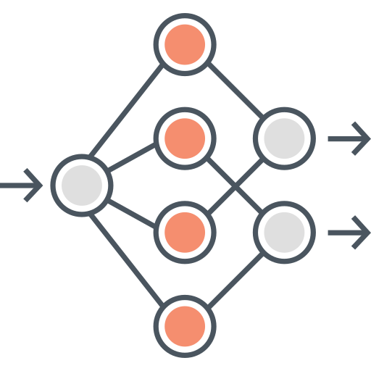



Recall: A Common Genome Analysis Pipeline
DNA
Molecule
Library Preparation
Sequencing
Raw
Sequencing Data
Sequencing Data Generation
TATGG
TGGTA
GCCTA
AAGCC
TATAT
Basecalling
Basecalled Sequencing Data
Denoised Raw Sequencing Data
Denoising
Translating
AAGCCTATATGGTAGTC
-2.1,0.3,2.3,-1.4
Preprocessing
Indexing
Seeding
Chaining
Alignment
Target Sequence
Hash Table
Query Sequence
Target Seq.
Target
Sequencing Data (Query):
AAGCCTATATGGTAGTC
0x00
2,64,…
Sketching
0x01
1,101,…
Sketching
Identifying the origin
Query
Query
Read Mapping
Store
…
Query Seq.
0xFF
13,21
Hash
Positions
Reference Genome (Target):
...
AAGCCTATATGCGTAATCAGATAGGATCGTCACGACTGT
...
Alignment Matrix
Hash
0x01
0x00
Hash
Seed Matches
Assembly
Variant Calling
Metagenomics
Downstream Analysis
Notes:
Generating the genomic data is usually the first step in a common genome analysis pipeline.
[CLICK] And initially these sequencing devices produce raw sequencing data
[CLICK] Which either needs to be translated into nucleotide sequences with a process called basecalling
[CLICK] Or preprocessed to reduce the inherent noise in raw sequencing data before further analysis
[CLICK] To identify the origin of sequencing data
[CLICK] we compare it with a representative sequence of a species, called a reference genome.
This process is known as read mapping and involves several steps.
[CLICK] First, we build an index, a hash table from the subsequences of a reference genome as a target sequence
[CLICK] Second, we extract subsequences, called seeds, from the sequencing data and query the index to find seed matches in the seeding step
[CLICK] Third, we identify nearby seed matches, called chains, to locate potential genomic regions of origin
[CLICK] Fourth, we optionally find exact matches and differences within the chaining region.
[CLICK] The information we generate from read mapping can be used for several purposes in downstream analysis, such as genome assembly, variant calling, and metagenomics.

Slide 6
Agenda for Today
Real-Time and Raw Sequencing Data Analysis
  RawHash [in ISMB/ECCB 2023]
  RawHash2 [Bioinformatics 2024]
  Rawsamble [arXiv 2024]

Slide 7



RawHash
Enabling Fast and Accurate Real-Time Analysis
of Raw Nanopore Signals for Large Genomes
Can Firtina
Nika Mansouri Ghiasi |  | Joel Lindegger |  | Gagandeep Singh
Meryem Banu Cavlak |  | Haiyu Mao |  | Onur Mutlu
RawHash
RawHash2
Code

Slide 8
Outline
Background
RawHash
RawHash2
Evaluation
Conclusion

Slide 9
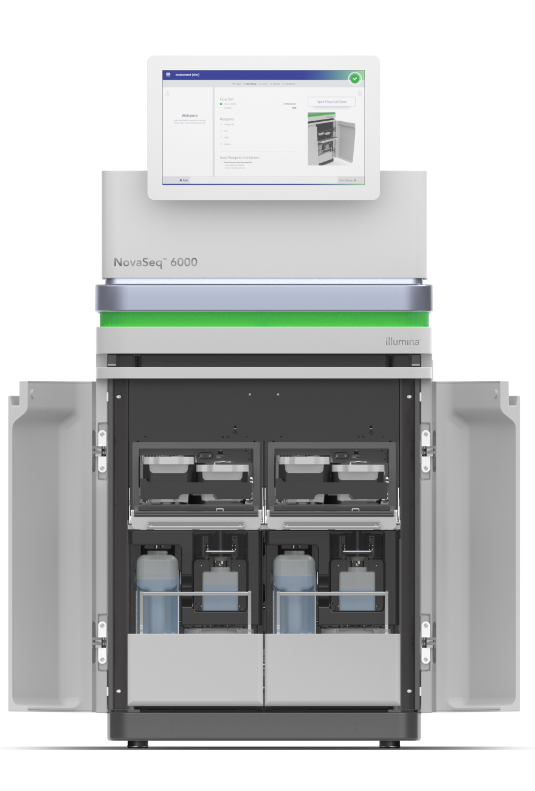
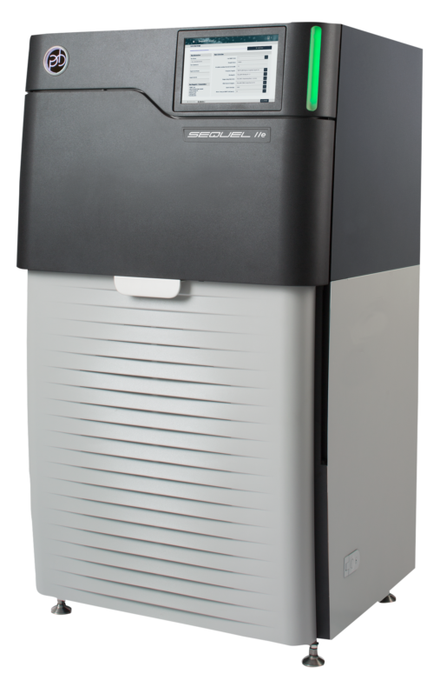
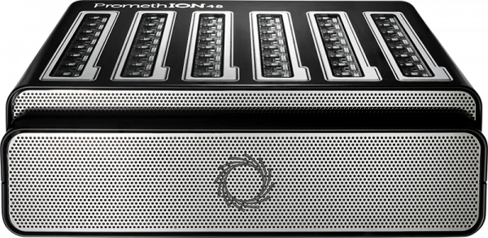
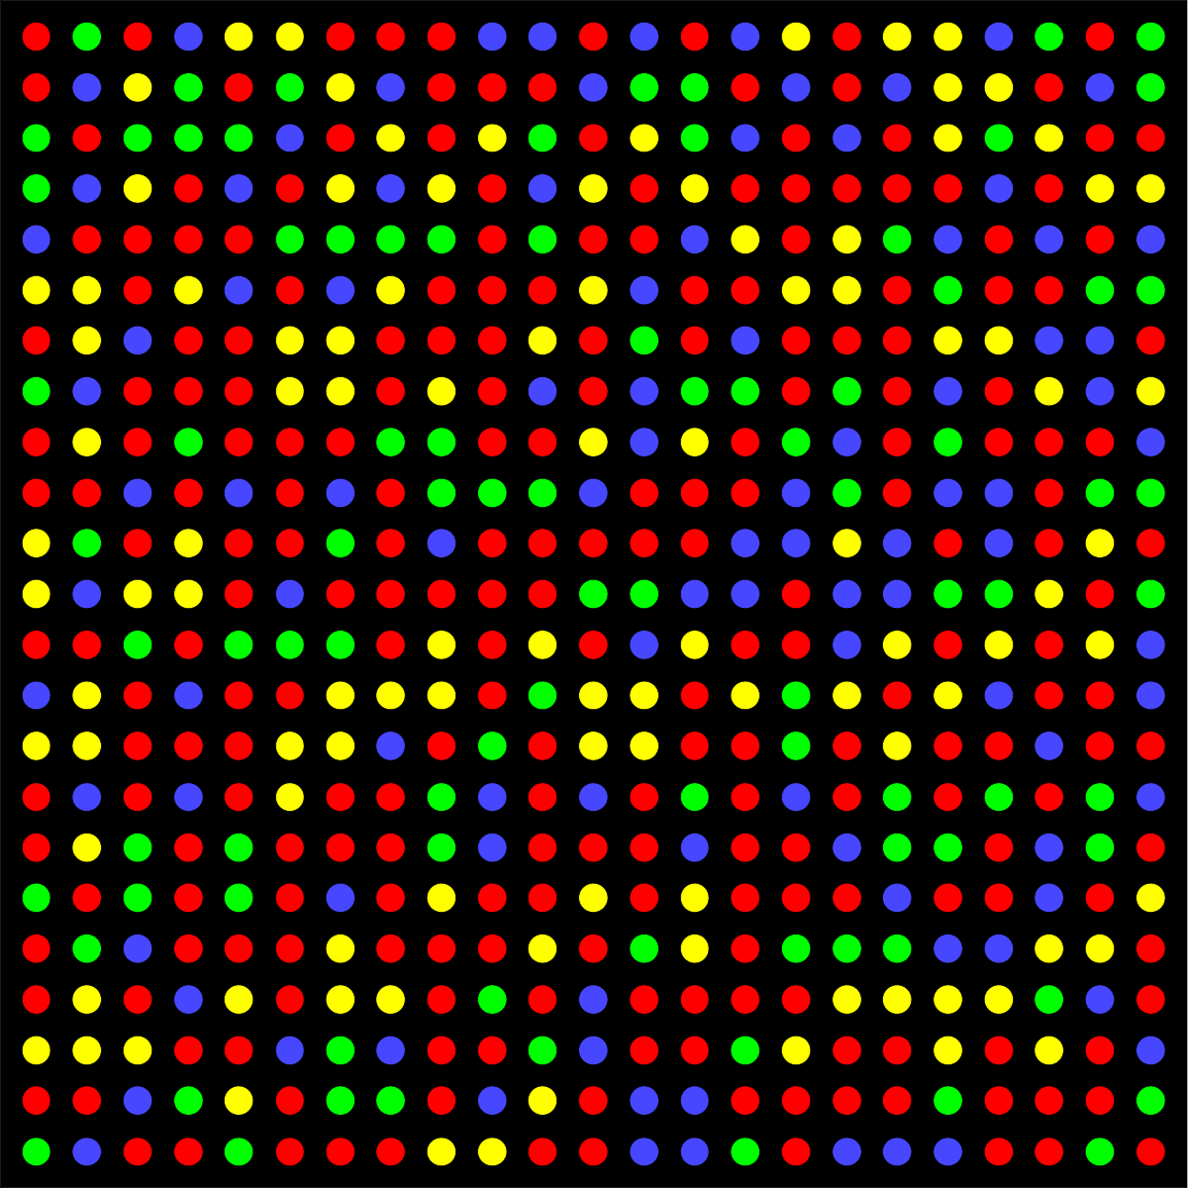


Recall: Different Raw Sequencing Data
Illumina
Nanopore
PacBio
Multiple images
Electrical Signal
30-hour movie
.BCL/.CBCL
.POD5
.BAM

Slide 10
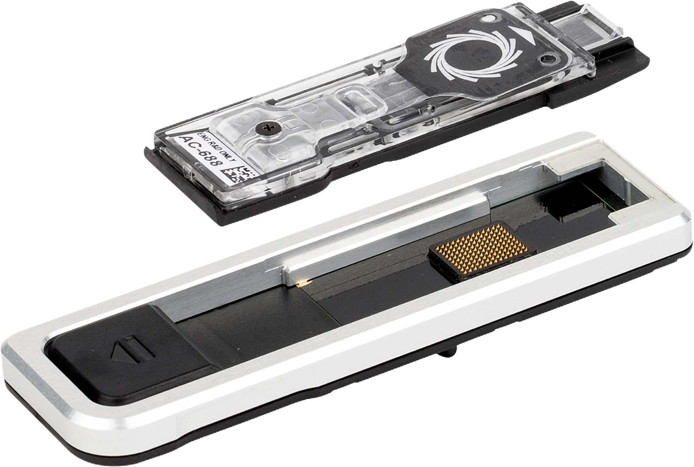

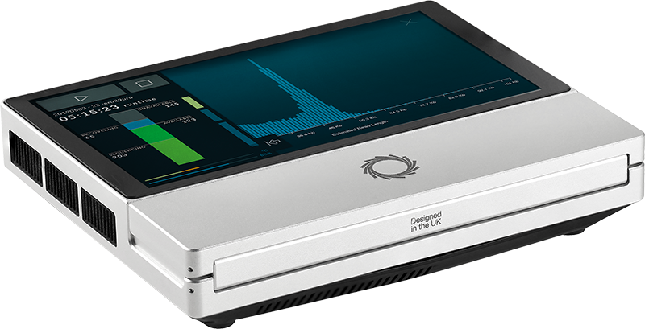
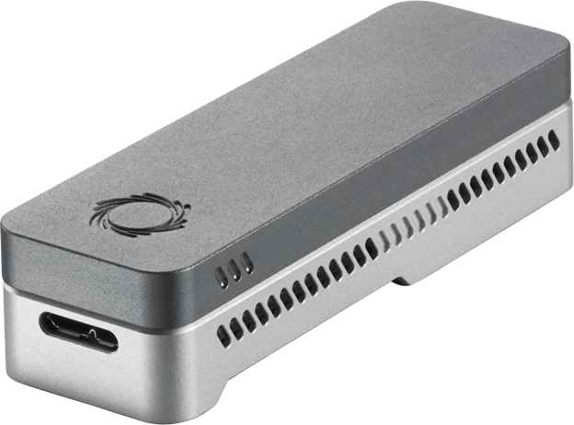
Nanopore Sequencing
Nanopore Sequencing: a widely used sequencing technology
  Can sequence large fragments of nucleic acid molecules
  Offers high throughput
  Cost-effective
  Enables real-time and portable genome analysis

Slide 11
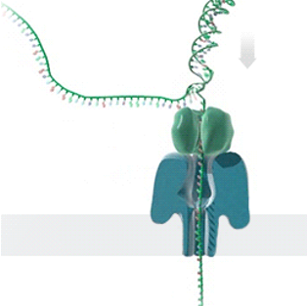
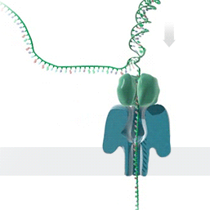



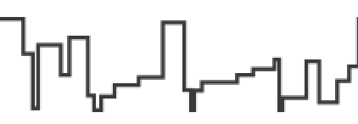


Nanopore Sequencing – How it Works
Single Nanopore
Nanopore Sequencer
Raw Signals
(~5000 signals/sec)
(Real-Time)
Analysis
Raw Signals: Ionic current measurements generated at a certain throughput
(Real-Time) Analysis: Analyzing raw signals instantly as they are generated
Real-Time Decisions: Stopping sequencing early based on real-time analysis
https://nanoporetech.com/platform/technology/basecalling
https://blogs.ed.ac.uk/institute-genetics-cancer/2020/04/08/nanopore-sequencing-controversial-world-records-and-whale-watching/
Notes:
Let's look at how nanopore sequencing works. This is a nanopore sequencer that contains many tiny pores, called nanopores.
[CLICK] As a nucleic acid molecule passes through a single nanopore from the negatively charged side to the positively charged side,
[CLICK] we can measure the ionic current disruptions that are distinctive to identify each nucleotide passing through. These disruptions are generated
as raw electrical signals
at a certain throughput.
[CLICK] We can analyze these raw signals instantly
as they are generated, which we call real-time analysis.
[CLICK] Based on the real-time analysis, we can stop sequencing a read or the entire sequencing run.

Slide 12
Benefits of Real-Time Analysis
✓
Reducing latency by overlapping analysis with sequencing
Time
Sequencing
Analysis
Reduced Latency
Sequencing & Real-Time Analysis
✓
Reducing sequencing time and cost by stopping sequencing early
Sequenced Bases
Completely Sequenced Read
Reduced Sequencing Time (and Cost)
Partially Sequenced Read
Sequencing is stopped early with a real-time decision
Notes:
There are two main benefits of real-time analysis.
First, we can reduce latency
[CLICK] by overlapping analysis with sequencing
[CLICK] Second, we can reduce sequencing time and cost
[CLICK] by stopping the sequencing early.

Slide 13




Challenges in Real-Time Analysis
Rapid analysis to match the nanopore sequencer throughput
Timely decisions to stop sequencing as early as possible
Accurate analysis from noisy raw signal data
Power-efficient computation for scalability and portability

Slide 14
Outline
Background
RawHash
RawHash2
Evaluation
Conclusion

Slide 15
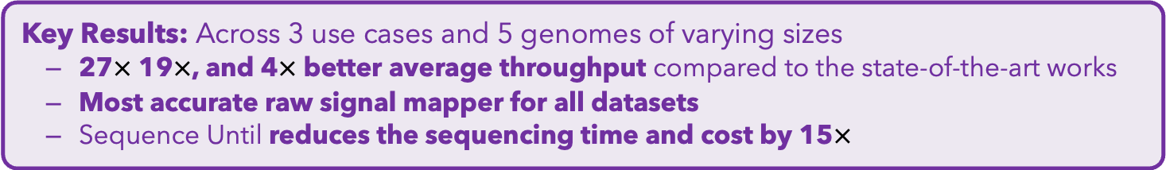
Executive Summary
Problem: Real-time analysis of nanopore raw signals is inaccurate and inefficient for large genomes
Goal: Enable fast and accurate real-time analysis of raw nanopore signals
Key Contributions:
1) The first hash-based mechanism for mapping raw nanopore signals
2) The novel Sequence Until technique can accurately and dynamically stop
the entire sequencing of all reads at once if further sequencing is not necessary
Key Results: Across 3 use cases and 5 genomes of varying sizes
  27$×$ 19$×$, and 4$×$ better average throughput compared to the state-of-the-art works
  Most accurate raw signal mapper for all datasets
  Sequence Until reduces the sequencing time and cost by 15$×$

Slide 16
Analyzing Raw Nanopore Signals
Traditional: Translating (basecalling) signals to bases before analysis
Recent Works: Directly analyzing signals without basecalling
Raw Signals
Basecalling
Read Mapping
Raw Signals
Raw Signal Mapping
A
T
G
G
✓
Basecalled sequences are
less noisy than raw signals
✓
Efficient analysis with better scalability and portability
✓
Many analysis tools use basecalled sequences
✓
Raw signals retain more information than just bases
✕
Costly and power-hungry
computational requirements

Slide 17
The Problem with Raw Signal Mapping
Raw Signal
Small Reference Genome
Large Reference Genome (Human)
Fewer candidate regions in small genomes
Substantially larger number of regions to check per read as the genome size increases
Problem: Probabilistic mechanisms
on many regions ➔ inaccurate mapping
Accurate mapping
Problem: Distance calculation
on many regions ➔ reduced throughput
High throughput

Slide 18
The Problem with Raw Signal Mapping
Raw Signal
Existing solutions are
inaccurate or inefficient
for large genomes
Small Reference Genome
Large Reference Genome (Human)
Fewer candidate regions in small genomes
Substantially larger number of regions to check per read as the genome size increases
Problem: Probabilistic mechanisms
on many regions ➔ inaccurate mapping
Accurate mapping
Problem: Distance calculation
on many regions ➔ reduced throughput
High throughput

Slide 19
Goal
Enable fast and accurate real-time analysis
of raw nanopore signals for large genomes

Slide 20
RawHash
The first hash-based search mechanism
to quickly and accurately map raw nanopore signals
to reference genomes
Sequence Until can accurately and dynamically stop the entire sequencing run at once
if further sequencing is unnecessary

Slide 21
RawHash
The first hash-based search mechanism
to quickly and accurately map raw nanopore signals
to reference genomes
Sequence Until can accurately and dynamically stop the entire sequencing run at once
if further sequencing is unnecessary

Slide 22
RawHash – Key Idea
Key Observation: Identical nucleotides generate similar raw signals
Raw Signal #1
Distance Calculation
Raw Signal #2
Hash
Hash
Fast Match
0x01
0x01
Challenge #1: Generating the same hash value for similar enough signals
Challenge #2: Accurately finding as few similar regions as possible

Slide 23

RawHash Overview
Reference Genome
Raw Nanopore Signals
...CTGCGTAG...
Offline Indexing
Signal Conversion
Signal Processing
Hash Table
(Index)
Quantization
Quantization
Store
Query
Real-Time Mapping
Hashing
Hashing
Matching Regions
Chaining & Mapping
Mapping positions
Notes:
Effective noise reduction enables us to perform accurate and real-time analysis in several steps.
[CLICK] First, we store the hash values we construct from the reference genome and use them as an index. This is an offline, one-time task.
[CLICK] Second, in real time, we query the hash values we generate from streaming raw signal data, which identifies matching regions between the reference genome and a read based on hash matches.
[CLICK] Third, we use the classical chaining and mapping process to determine if a read is mapped based on the chaining information we have so far.
[CLICK] If we need to sequence more to answer this question, we retrieve the next chunk of streaming data and perform similar computations in real time.
[CLICK] If not, we can stop sequencing, reducing sequencing time and cost.

Slide 24
RawHash Overview
Reference Genome
Raw Nanopore Signals
...CTGCGTAG...
Signal Conversion
Signal Processing
Notes:
Effective noise reduction enables us to perform accurate and real-time analysis in several steps.
[CLICK] First, we store the hash values we construct from the reference genome and use them as an index. This is an offline, one-time task.
[CLICK] Second, in real time, we query the hash values we generate from streaming raw signal data, which identifies matching regions between the reference genome and a read based on hash matches.
[CLICK] Third, we use the classical chaining and mapping process to determine if a read is mapped based on the chaining information we have so far.
[CLICK] If we need to sequence more to answer this question, we retrieve the next chunk of streaming data and perform similar computations in real time.
[CLICK] If not, we can stop sequencing, reducing sequencing time and cost.

Slide 25
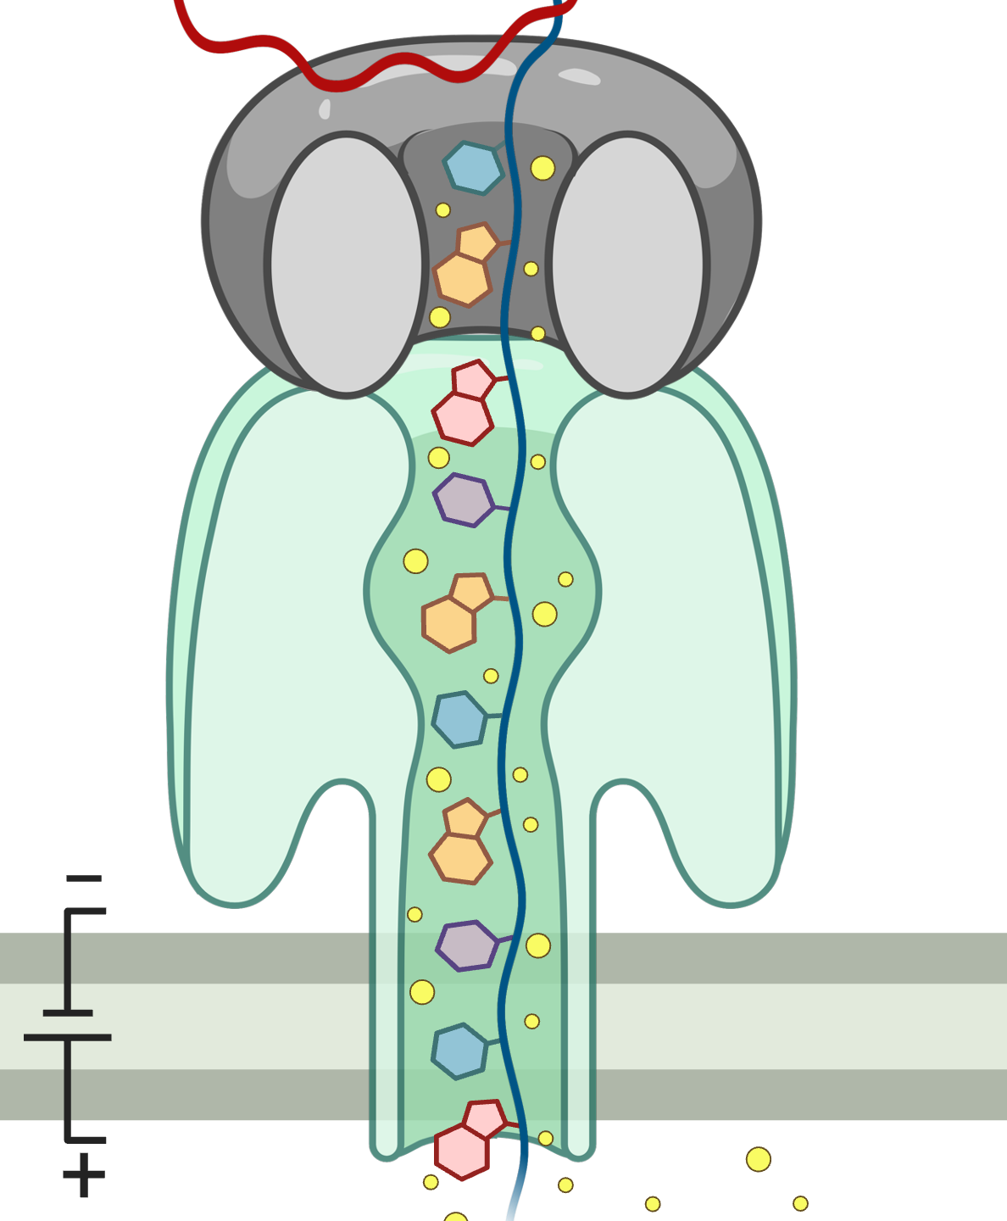
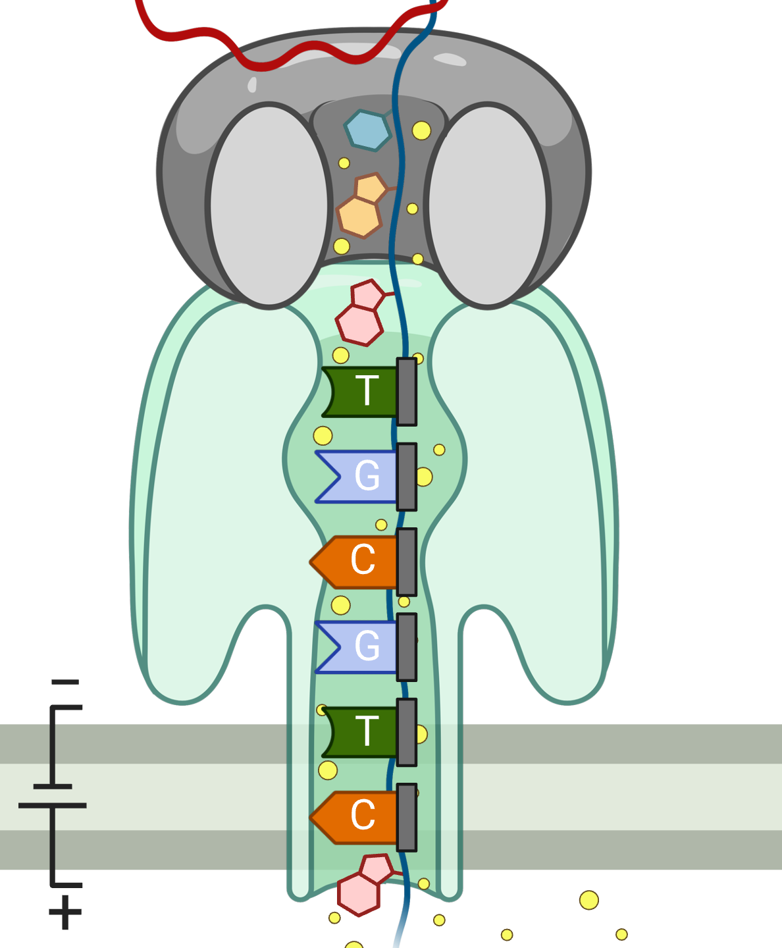
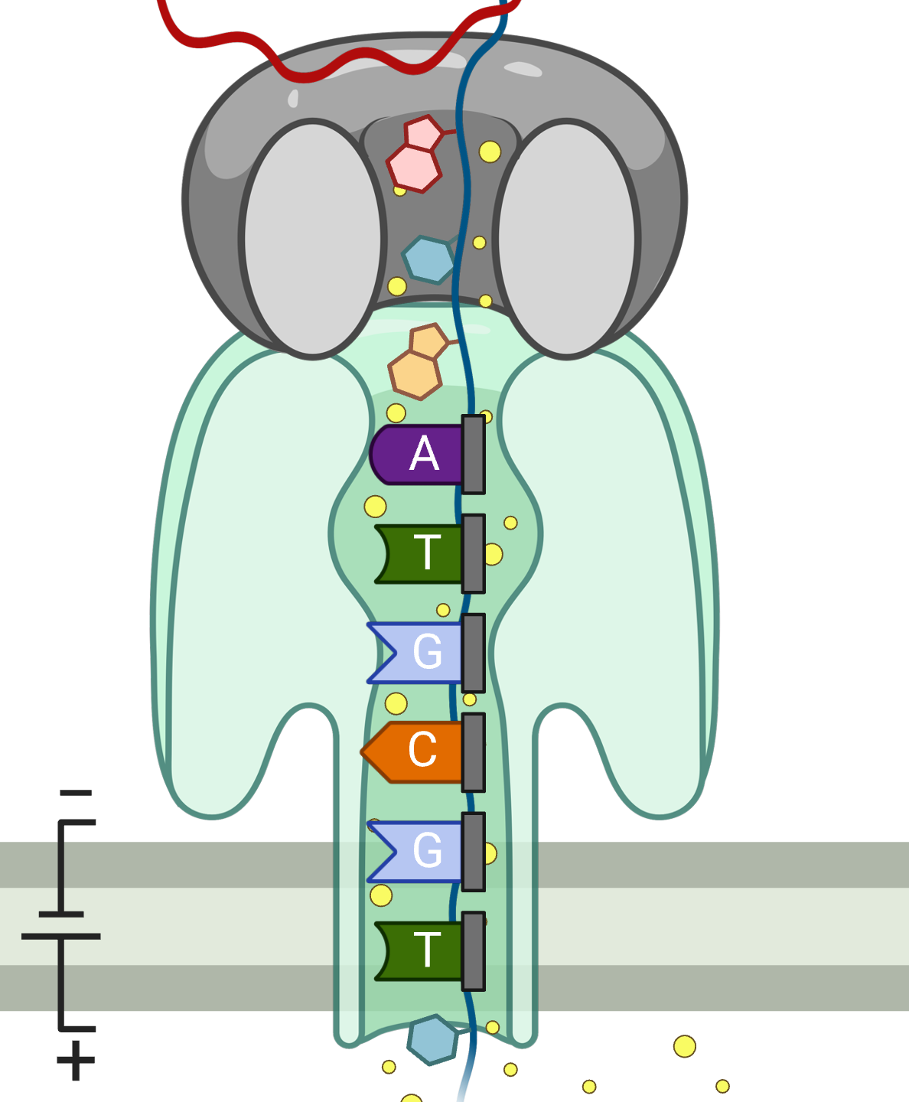

Processing Raw Nanopore Signals
K many nucleotides (k-mers) sequenced at a time
Observation: Abrupt change in the signal as DNA moves
inside a nanopore (e.g., when sequencing a new k-mer)
Goal: Identify raw signal segments corresponding each sequenced k-mer
  Event: A raw signal segment corresponding to a particular k-mer
  Statistical tests (segmentation) to find these events by identifying abrupt changes
Event
…
…
pAmpere
Segment
…
…
Time
-0.06
-0.22
TGCGTC
ATGCGT
6-mer

Slide 26
Reference-to-Signal Conversion
Goal: Enable direct comparison to raw signals by converting reference genome into its synthetic signal (one-time task)
K-mer model: Provides expected signal values for every possible k-mer
  A lookup table preconstructed based on nanopore’s characteristics
Use the k-mer model to convert all k-mers of a reference genome
to their expected signal values
Reference Genome
Reference Signals
...
...
...
...
CTGCGTAGCAGCGTAATAG
-0.06,0.24,-0.74,
CTGCGT
K-mer model
K-mer model
-0.06
AAAAAA
-0.29
TGCGTA
K-mer model
0.24
…
…
GCGTAG
TTTTTT
0.04
K-mer model
-0.74
K-mer
Signal
Expected Signal

Slide 27
Reference-to-Signal Conversion
Goal: Enable direct comparison to raw signals by converting reference genome into its synthetic signal (one-time task)
K-mer model: Provides expected signal values for every possible k-mer
  A lookup table preconstructed based on nanopore’s characteristics
Use the k-mer model to convert all k-mers of a reference genome
to their expected signal values
Can we directly match signals to each other?
Reference Genome
Reference Signals
...
...
...
...
CTGCGTAGCAGCGTAATAG
-0.06,0.24,-0.74,
CTGCGT
K-mer model
K-mer model
-0.06
AAAAAA
-0.29
TGCGTA
K-mer model
0.24
…
…
GCGTAG
TTTTTT
0.04
K-mer model
-0.74
K-mer
Signal
Expected Signal

Slide 28
RawHash Overview
Reference Genome
Raw Nanopore Signals
...CTGCGTAG...
Signal Conversion
Signal Processing
Quantization
Quantization
Notes:
Effective noise reduction enables us to perform accurate and real-time analysis in several steps.
[CLICK] First, we store the hash values we construct from the reference genome and use them as an index. This is an offline, one-time task.
[CLICK] Second, in real time, we query the hash values we generate from streaming raw signal data, which identifies matching regions between the reference genome and a read based on hash matches.
[CLICK] Third, we use the classical chaining and mapping process to determine if a read is mapped based on the chaining information we have so far.
[CLICK] If we need to sequence more to answer this question, we retrieve the next chunk of streaming data and perform similar computations in real time.
[CLICK] If not, we can stop sequencing, reducing sequencing time and cost.

Slide 29


Noise in Raw Signal Analysis
Sequencing CTGCGT with Different Nanopores
Raw
Signals:
-0.05
-0.07
-0.06
-0.05
-0.06
✕
Noise causes slight differences in raw signals from the same k-mer
Challenge: Directly matching raw signals is not feasible
Challenge: A single k-mer is too short for accurate matching
Notes:
However, raw signal analysis is noisy. Let's look at why.
[CLICK] Ionic current disruptions are caused by the presence
of a certain small number of nucleotides inside the nanopore, called a k-mer.
[CLICK] It is possible to sequence this short k-mer at different times or in different nanopores.
[CLICK] Each will report ionic current disruptions as an electrical signal measurement.
[CLICK] However, noise ...
[CLICK] This means we cannot directly match raw signals, as this is not feasible.
[CLICK] And even if we could, a single k-mer is too short and likely to appear in many places in a reference genome.

Slide 30
RawHash Key Idea – Quantization
Sequenced k-mer:
CTGCGT
-0.05
-0.07
-0.06
-0.05
-0.06
Quantize
Quantize
Quantize
Quantize
Quantize
Bucket #
0
1
2
3
4
5
6
7
8
9
10
11
12
13
14
15
-3.00
Range of signal values (normalized)
+3.00
✓
Reducing noise by quantizing raw signals into equal-width buckets
✓
Enables matching raw signals by eliminating slight differences
Notes:
To enable assigning the same values to similar raw signals
[CLICK] The key idea in RawHash is to perform quantization in two steps.
[CLICK] First, the quantization step creates a certain number of equal-width buckets across the entire raw signal range.
[CLICK] Second, we assign similar raw signals within the same signal range to the same bucket.
[CLICK] This reduces noise by quantizing raw signals into equal-width buckets
[CLICK] By doing so, RawHash enables ...

Slide 31
RawHash Overview
Reference Genome
Raw Nanopore Signals
...CTGCGTAG...
Signal Conversion
Signal Processing
Hash Table
(Index)
Quantization
Quantization
Store
Query
Hashing
Hashing
Notes:
Effective noise reduction enables us to perform accurate and real-time analysis in several steps.
[CLICK] First, we store the hash values we construct from the reference genome and use them as an index. This is an offline, one-time task.
[CLICK] Second, in real time, we query the hash values we generate from streaming raw signal data, which identifies matching regions between the reference genome and a read based on hash matches.
[CLICK] Third, we use the classical chaining and mapping process to determine if a read is mapped based on the chaining information we have so far.
[CLICK] If we need to sequence more to answer this question, we retrieve the next chunk of streaming data and perform similar computations in real time.
[CLICK] If not, we can stop sequencing, reducing sequencing time and cost.

Slide 32
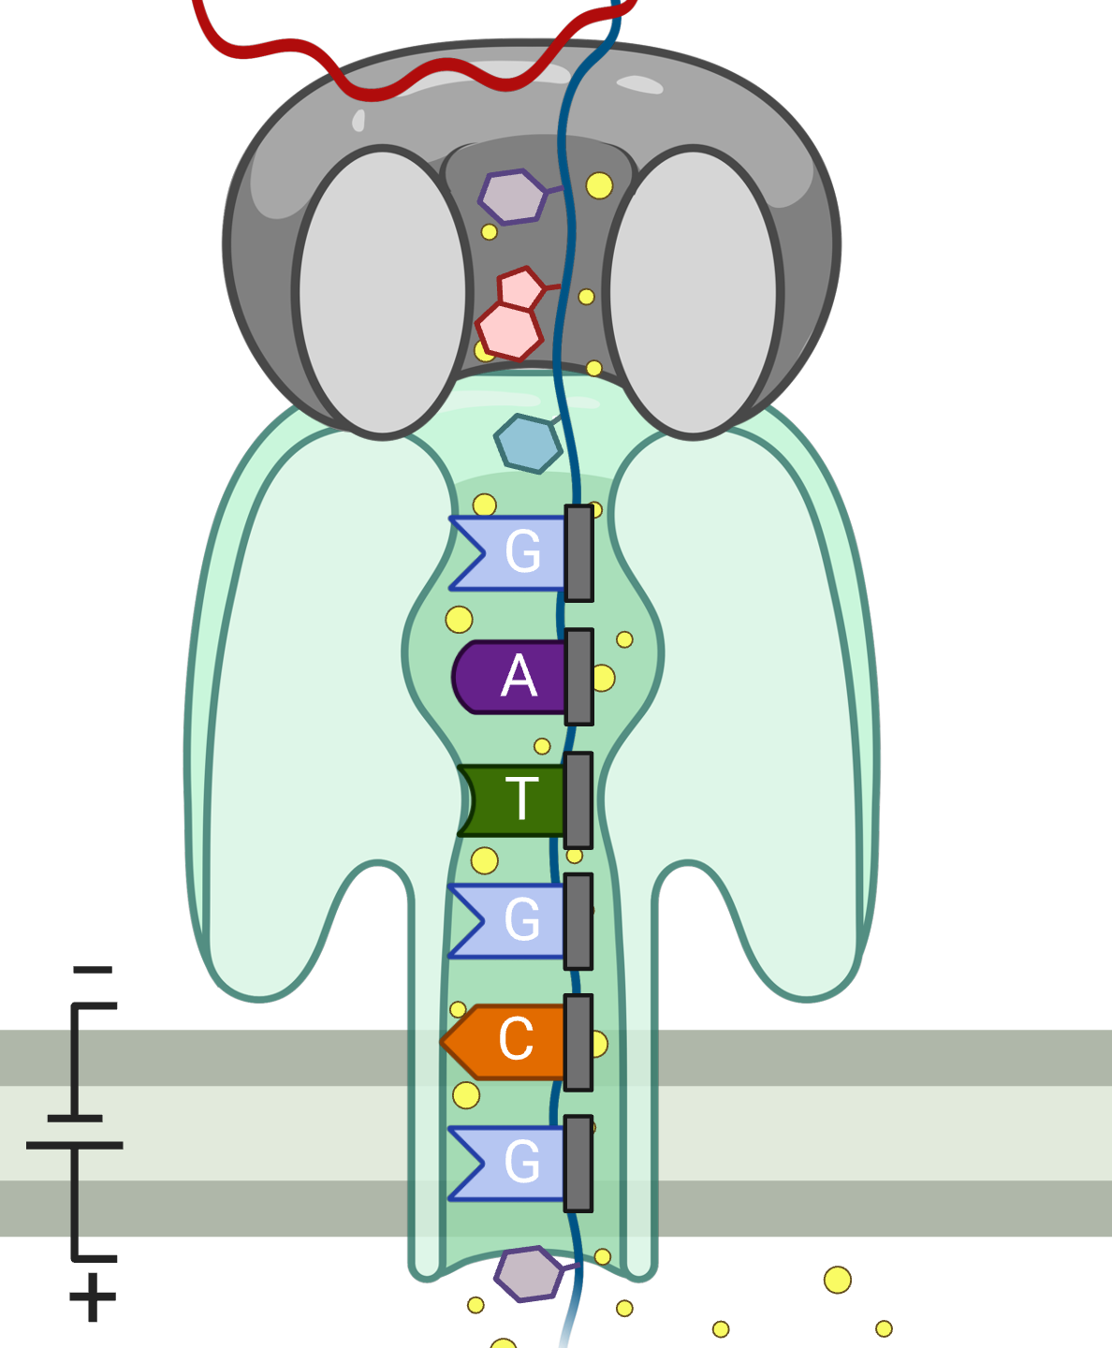
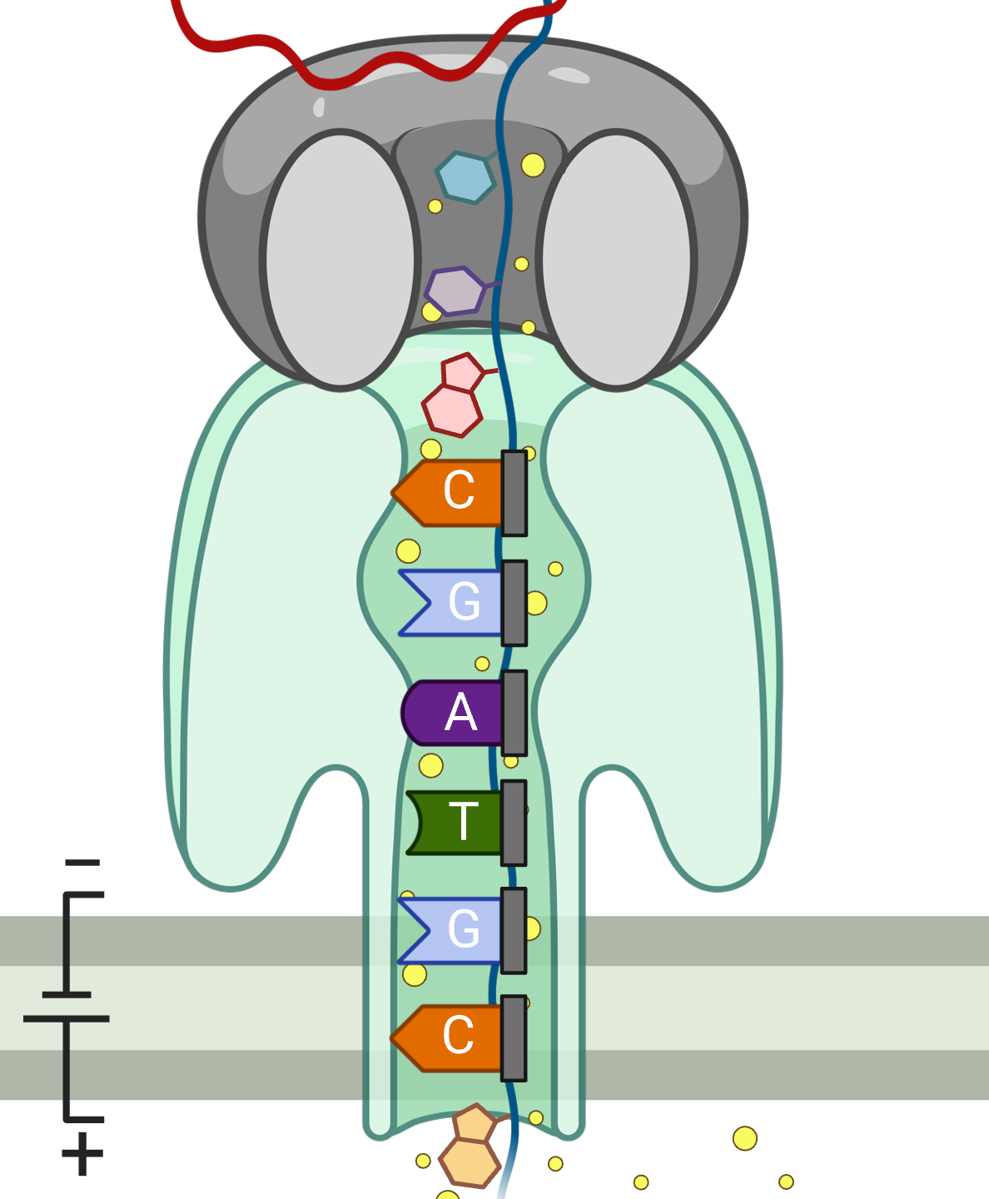
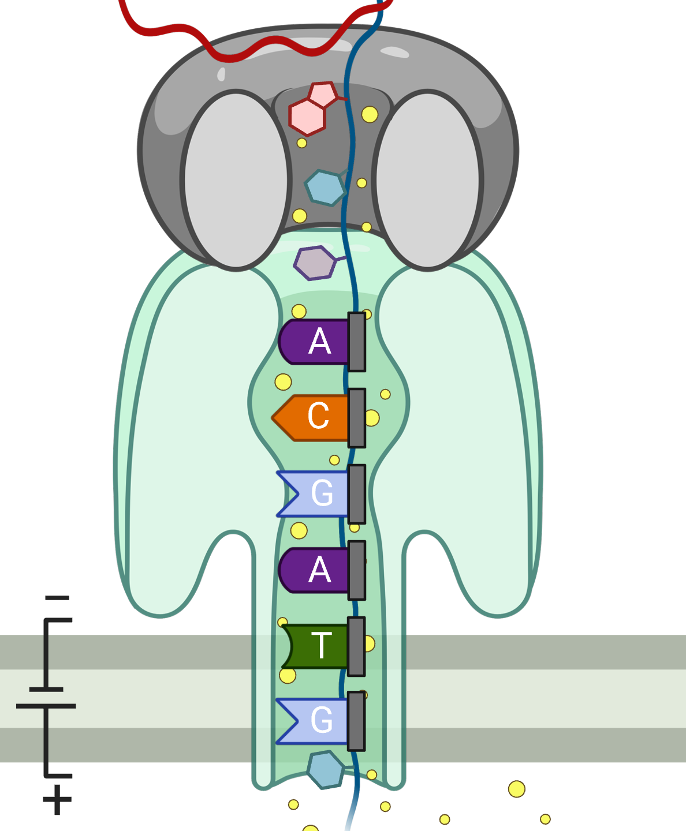
RawHash Key Idea – Hash-based Seeding
Sequencing CTGCGTAGCA
-0.06
-0.22
-0.75
0.96
-0.49
Quantize
Quantize
Quantize
Quantize
Quantize
0b0111
0b0111
0b0110
0b1011
0b0110
Pack
0b01110111011010110110
Hash
0x77db
Seeding, Chaining & Mapping
✓
Packing enables directly matching fewer
and more accurate k-mers
Notes:
Although we are limited by the length of k-mers we can sequence at a time, we can still increase the k-mer length used for hash-based seeding.
[MULTI CLICKS] To do this, we use multiple raw signals generated when sequencing a longer sequence segment from consecutive overlapping k-mers.
These quantized values shown in binary
[CLICK] can be packed together using simple bitwise operations and hashed.
Our packing strategy captures both the content and order of multiple consecutive k-mers, providing more detailed information than a single quantized value.
[CLICK] We can reliably use the hash value after packing to find fewer
and more accurate matches in the genome
[CLICK] by following the regular steps in hash-based read mapping, including seeding, chaining, and mapping.

Slide 33
RawHash Overview
Reference Genome
Raw Nanopore Signals
...CTGCGTAG...
Offline Indexing
Signal Conversion
Signal Processing
Hash Table
(Index)
Quantization
Quantization
Store
Query
Real-Time Mapping
Hashing
Hashing
Matching Regions
Chaining & Mapping
Mapping positions
Notes:
Effective noise reduction enables us to perform accurate and real-time analysis in several steps.
[CLICK] First, we store the hash values we construct from the reference genome and use them as an index. This is an offline, one-time task.
[CLICK] Second, in real time, we query the hash values we generate from streaming raw signal data, which identifies matching regions between the reference genome and a read based on hash matches.
[CLICK] Third, we use the classical chaining and mapping process to determine if a read is mapped based on the chaining information we have so far.
[CLICK] If we need to sequence more to answer this question, we retrieve the next chunk of streaming data and perform similar computations in real time.
[CLICK] If not, we can stop sequencing, reducing sequencing time and cost.

Slide 34
Real-Time Mapping with RawHash
Reference Genome (Converted to Signals)
Raw Signals
(~5000 signals/sec)
Reference Signals
Offline Indexing
Hash Table
(Index)
Quantize
Quantize
Store
Query
Hash
Hash
Real-Time Mapping
Yes: Analyze the next chunk
Matching Regions
Chaining & Mapping
Continue Mapping?
No: Stop
Sequencing
Notes:
Effective noise reduction enables us to perform accurate and real-time analysis in several steps.
[CLICK] First, we store the hash values we construct from the reference genome and use them as an index. This is an offline, one-time task.
[CLICK] Second, in real time, we query the hash values we generate from streaming raw signal data, which identifies matching regions between the reference genome and a read based on hash matches.
[CLICK] Third, we use the classical chaining and mapping process to determine if a read is mapped based on the chaining information we have so far.
[CLICK] If we need to sequence more to answer this question, we retrieve the next chunk of streaming data and perform similar computations in real time.
[CLICK] If not, we can stop sequencing, reducing sequencing time and cost.

Slide 35
RawHash
The first hash-based search mechanism
to quickly and accurately map raw nanopore signals
to reference genomes
Sequence Until can accurately and dynamically stop the entire sequencing run at once
if further sequencing is unnecessary

Slide 36
RawHash
The first hash-based search mechanism
to quickly and accurately map raw nanopore signals
to reference genomes
Sequence Until can accurately and dynamically stop the entire sequencing run at once
if further sequencing is unnecessary

Slide 37
The Sequence Until Mechanism
Problem:
  Unnecessary sequencing waste time, power and money
Key Idea:
  Dynamically decide if further sequencing of the entire sample is necessary to achieve high accuracy
  Stop sequencing early without sacrificing accuracy
Potential Benefits:
  Significant reduction in sequencing time and cost
Example real-time genome analysis use case:
  Relative abundance estimation

Slide 38





The Sequence Until Mechanism
Key Steps:
  Continuously generate relative abundance estimation after every $n$ reads
  Keep the last $t$ estimation results
  Detect outliers in the results via cross-correlation of the recent $t$ results
  Absence of outliers indicates consistent results
  Further sequencing is likely to generate consistent results ➔ Stop the sequencing
Relative Abundance Estimation
Keep Sequencing
$n$ Reads Sequenced
Estimation #1
Yes
Relative Abundance Estimation
$2n$ Reads Sequenced
Estimation #2
Outlier?
…
…
…
No
Relative Abundance Estimation
$t×n$ Reads Sequenced
Estimation #$t$
Stop Sequencing

Slide 39
Outline
Background
RawHash
RawHash2
Evaluation
Conclusion

Slide 40
Computer Architecture
Lecture 26b: RawHash
Can Firtina
ETH Zurich
Fall 2024
13 December 2024

Slide 41
Sequencing Data Analysis
Heuristic Algorithms
Data Structures
Filters
TATGG
AAGCC
TATAT
TGGTA
GCCTA
AGATA
TGCAC
CCTGG
✓
Quick, accurate, and energy-efficient analysis
Distributed
Computing
Imperfections in sequencing data
impacts design choices
Hardware Accelerators
✕
Notes:
Since we need to analyze a large volume of sequencing data, there are many types of optimizations to make the genome analysis practical

Slide 42
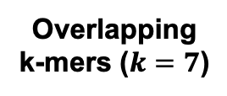
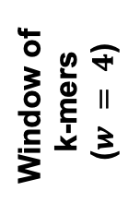
Minimizer Sketching
GCTATTACCT
GCTATTA
Hash
0xA1
Find
Minimum
Window of
k-mers
($w = 4$)
CTATTAC
Hash
0x02
Hash Table
0x02
TATTACC
Hash
0xFC
ATTACCT
Hash
0x45
CTATTAC
Overlapping
k-mers ($k=7$)
Sampled
k-mer (Minimizer)

Slide 43
Spaced Seeding
GCTATTA
Pattern
GXTAXTA
Hash
0xA1
GATACTA
Pattern
GXTAXTA
Hash
0xA1
GACACTA
Pattern
GXCAXTA
Hash
0xFC
Spaced Seeds

Slide 44
Strobemer Sketches
GCTATTACCTTAATGTGATGGAC
Link
GCTATTAATGGA
Hash
0xA1
GCTATCCCCTTAATGGGATGGAC
Link
GCTATTAATGGA
Hash
0xA1
GCCCTCCCCTTAAAGGGAATGGA
Link
CCTCTAAATGGA
Hash
0xFC
Selected k-mers (e.g., minimizers)
Strobemers

Slide 45
Hash-Based Sketching and Seed Matching
Target Sequence
Query Sequence
GCTATTACCTTAATGTGATGGACGA
CAGGCTATAACCCTAATGTTGC
Sketching
Sketching
GCTA
TAAT
GACG
GCTA
ATGT
Hash
Hash
Hash
Hash
Hash
0x01
0xA4
0x41
0x01
0xFE
Store
Store
Store
Query
Query
<List of Positional Information>
Match
0x01
0xA4
0x41
Hash Table
No Match
Notes:
hashing.pdf

Slide 46

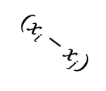










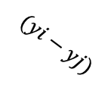
Chaining (Two Points)
$$xj$$
$$xi$$
Chaining
Target Seq.
Target Seq.
$$aj$$
$$ai$$
Anchor
(Seed match)
$$wi$$
$$(xi−xj)$$
$$aj$$
$$yj$$
$$yi$$
Query Seq.
Query Seq.
$$aj$$
$$ai$$
$$(yi−yj)$$
$$wi$$

Slide 47
Chaining (Multiple Points)
Exact hash value matches: Needed for finding matching regions between a reference genome and a read
What if there are mutations or errors?
  No hash (seed) match will occur in such positions
The chaining algorithm links exact matches in a proximity even though there are gaps (no seed matches) between them

Slide 48
Sequence Alignment

Slide 49
Nanopore Sequencing
Notes:
Nanopore technology consists of a nanometre-sized pore in an insulating membrane that separates two electrolyte-filled wells
DNA/RNA: negatively charged due to their phosphate-sugar backbones, which contain phosphate groups that carry negative charges.

Slide 50
Source of Noise in Nanopore Sequencing
Stochastic thermal fluctuations in the ionic current
  Random ionic movement due to inherent thermal energy (Brownian motion)
Variations in the translocation speed
  Mainly due to the motor protein
Environmental factors
  Temperature: Affecting enzymes including the motor protein
  pH levels: Affecting charge and the shape of molecules
Maybe: Aging & material-related noise between nanopores
  Their effects potentially can be minimized with normalization techniques
Notes:
Thermal fluctuations: Stochastic thermal fluctuations refer to random, small-scale variations in “ion movement” due to inherent thermal energy at the molecular level. These fluctuations occur at any temperature above absolute zero.
Brownian motion and even at quantum levels
Variations: due to the design of motor protein -> can be affected by environmental factors like temperature (below)
Temperature: can alter enzyme performance, leading to signal inconsistencies. -> higher temperatures may speedup translocation. Increases molecular Kinetic energy

Slide 51
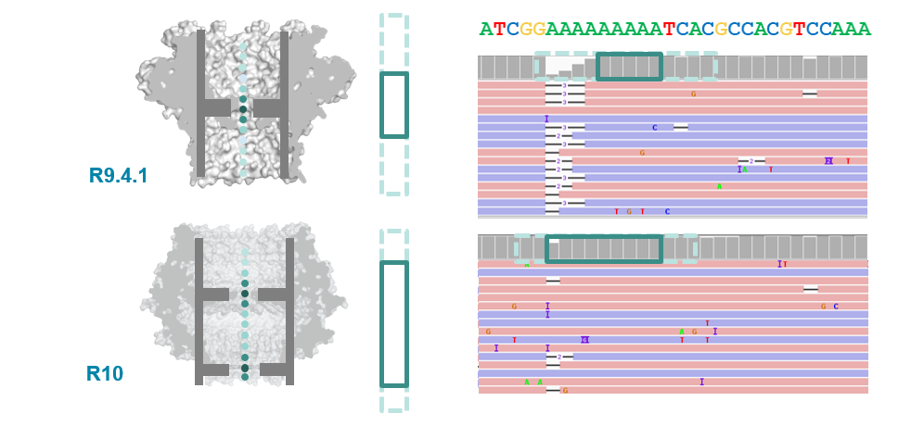
R9 vs. R10 Chemistries
Dual reader head
Motor protein with more consistent translocation speed in R10
Duplex sequencing in R10

Slide 52
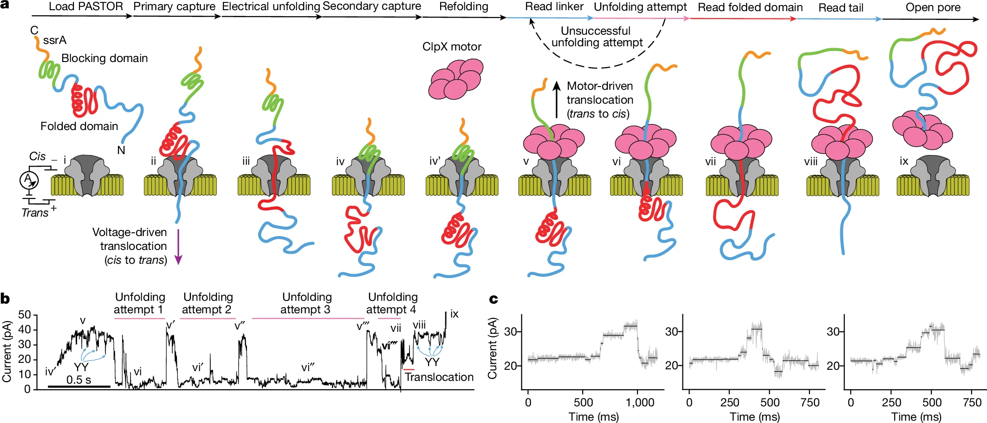
Proteomics with Nanopores
Motone+, “Multi-pass, single-molecule nanopore reading of long protein strands”, Nature 2024.
Notes:
PTMs: post-translational modifications, PTM code: unique and specific roles in driving biological processes
Peptide vs protein
Challenge: neutrally charged polypeptide backbone (lacking a consistent charge distribution): complicates the application of techniques that rely on charge-based separation or detection
Challenge: varying charge states of amino acid side chains: 20 different amino acids, each with unique side chains that can carry positive, negative, or neutral charges depending on the pH and local environment. Canceling out behavior?
Challenge: Rigid/Stable 3D protein structures. Challenging to sequence full length molecule
Control pH to control the movement of the protein

Slide 53
Applications of Read Until
Depletion: Reads mapping to a particular reference genome is ejected
Microbiome studies by removing host DNA
Eliminating known residual DNA or RNA (e.g., mitochondrial DNA)
High abundance genome removal
Enrichment: Reads not mapping to a particular reference genome is ejected
Removing contaminated organisms
Targeted sequencing (e.g., to a particular region of interest in the genome)
Low abundance genome enrichment

Slide 54
Applications of Run Until & Sequence Until
Run Until: Stopping the entire sequencing run
Stopping when reads reach to a particular depth of coverage
Stopping when the abundance of all genomes reach a particular threshold
Sequence Until: Run Until with accuracy-aware decision making
Stopping when relative abundance estimations do not change substantially (for high-abundance genomes)
Stopping when finding that the sample is contaminated with a particular set of genomes
…

Slide 55
In Vitro (e.g., PCR) vs. In Silico
Polymerase Chain Reaction (PCR) as a way of in vitro “analysis”
  Can increase the quantity of DNA in a sample
  Non-dynamic targeted sequencing (e.g., low abundance known targets)
  Requires additional resources: Time and money for preparation and execution of PCR
Adaptive sampling as a way of in silico (i.e., computational) analysis
  Cannot increase the existing quantity of DNA in a sample
  Dynamic targeted sequencing: Decisions can be made based on real-time analysis (e.g., Sequence Until)
  Minimal additional resources
    Almost no additional resources for preparation and execution
    Simultaneous enrichment and depletion is possible
    Better suited for rapid whole genome sequencing
  Beauty of computational analysis (e.g., high flexibility – no need for primers)
PCR and adaptive sampling can be combined depending on the analysis type

Slide 56
Finding Mapping Positions
Useful for any application that requires exact genomic position
  Variant calling in downstream analysis
  Specifically: Identifying rare variants in cancer genomics
  Methylation profiling
Accurate and flexible depth of coverage estimation
  Alternative: DNA quantification (without computational analysis)
    DNA quantification is challenging for metagenomics analysis
  Computational method: We can map to almost entire set of known reference genomes to accurately estimate the coverage of a metagenomics sample
Transcriptome analysis
  Accurately quantifying expression levels & alternative splicing
Better resolution (i.e., more sensitive analysis) for any other application that does not specifically require mapping positions

Slide 57

Reference-to-Event Conversion
K-mer model: Provides expected event values for each k-mer
  Preconstructed based on nanopore sequencer characteristics
Use the k-mer model to convert all k-mers
of a reference genome to their expected event values
Reference Genome
Expected Event Values
Normalized Event Values
GCTATTACC
GCTATT
K-mer Model
(Lookup Table)
105.757390
Normalize
2.21
CTATTA
81.740642
-0.09
k-mers ($k=6$)
TATTAC
103.170091
1.15
ATTACC
101.082485
1.11

Slide 58
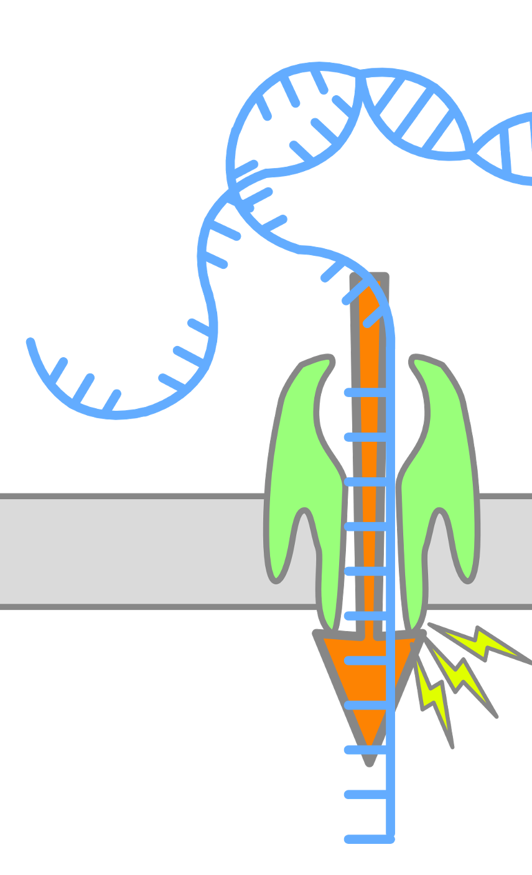
Enabling Analysis From Electrical Signals
K many nucleotides (k-mers) sequenced at a time
Event: A segment of the raw signal
  Corresponds to a particular k-mer
Observation: Event values generated after sequencing the same k-mer are similar in value (not necessarily the same)
Event
Event Value
Raw Nanopore Signal
Normalize
ACTTGG
pAmpere
Segment
Calculate
Means
2.21
Time
k-mer
ACTTGG

Slide 59
Quantization -- RawHash

Slide 60
Packing and Hashing
Consecutive k-mers
Consecutive events
CTATTA
-0.09
Quantize
1
1
0
0
1
TATTAC
1.15
Quantize
0
0
1
1
0
…
…
…
…
Pack
ATTACC
1.11
Quantize
0
0
1
0
1
1
1
0
0
1
0
0
1
1
0
…
0
1
0
0
1
Hash value of consecutive events
0x400D70A4
Hash

Slide 61
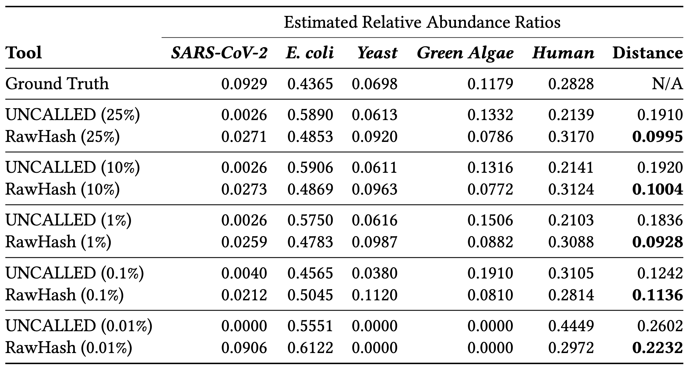
Sequence Until – RawHash & UNCALLED

Slide 62
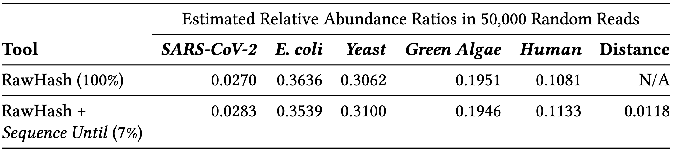
Sequence Until – RawHash

Slide 63
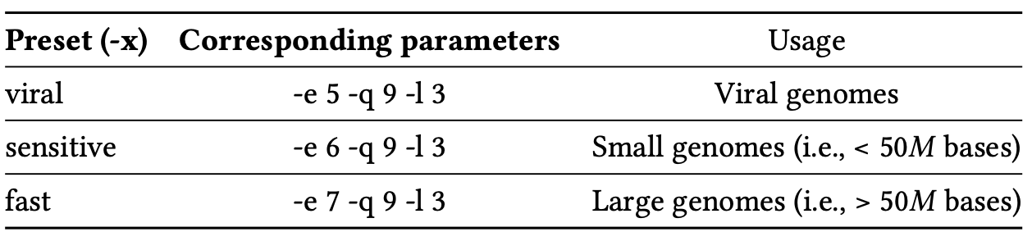
Presets

Slide 64
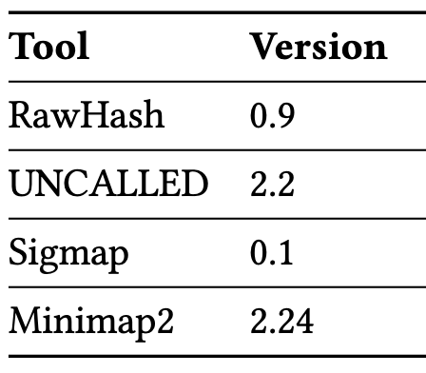
Versions – RawHash

