Slide 1
Computer Architecture
Lecture 26c: RawHash2
Can Firtina
ETH Zurich
Fall 2024
13 December 2024

Slide 2
Key Contributions in RawHash2
A new adaptive quantization that better fits
the expected nanopore signal pattern to achieve high accuracy
Weighted decision making for more robust mapping
Frequency filter and minimizer sketching
to reduce seed matches for faster and space-efficient mapping
Improved chaining algorithm with sensitive penalty scores

Slide 3
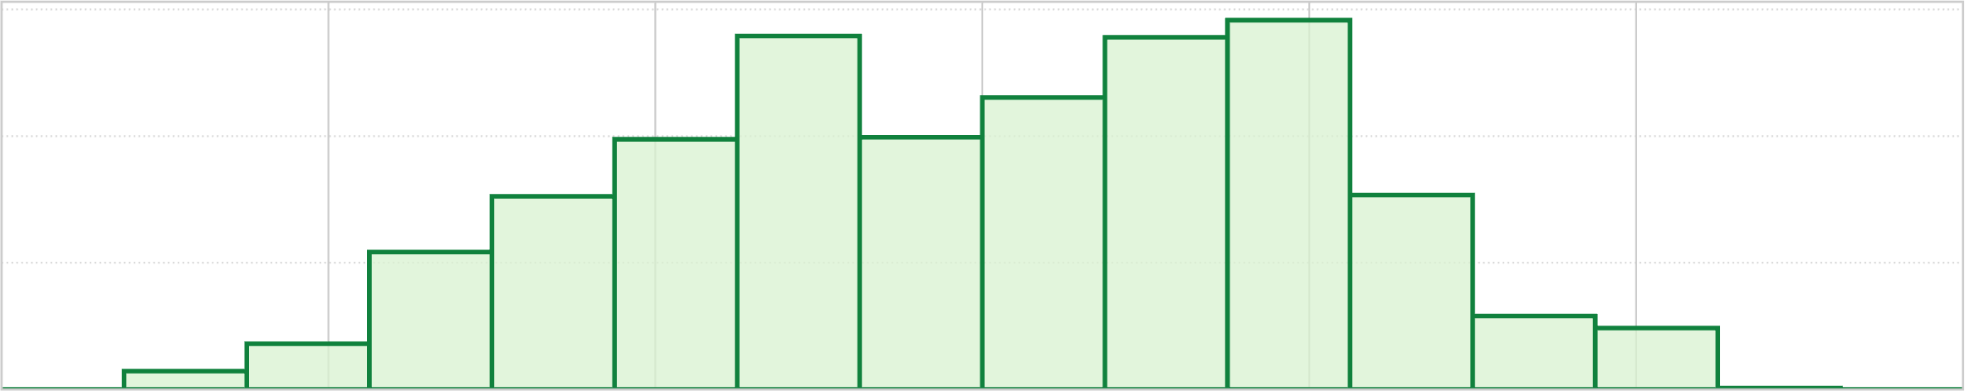
Better Understanding of Noise
Bucket #
0
1
2
3
4
5
6
7
8
9
10
11
12
13
14
15
-3.00
Range of raw signals (normalized)
+3.00
✕
Equal-width buckets leads to unbalanced loading
600
400
K-mer count
200
0
1
2
3
4
5
6
7
8
9
10
11
12
13
14
15
-3.00
+3.00
✕
More false hash matches due to reduced uniqueness
Notes:
Although constructing equal-width buckets enables noise reduction in RawHash,
[CLICK] we find that ...
[CLICK] which can cause more false hash matches due to reduced uniqueness, impacting several parameters related to accuracy and performance.

Slide 4
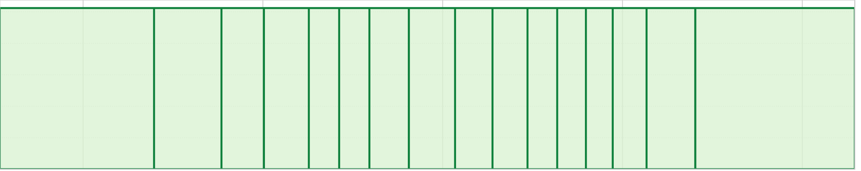
Adaptive Quantization
Key Idea: Quantizing raw signals with non-equal bucket widths
to maximize load balancing
K-mer count
-3.00
3.00
Goal: Ideal Load Balance
K-mer count
-3.00
3.00
✓
Adaptive quantization reduces collisions caused due to
skewed raw signal distributions
Notes:
The key idea in RawHash2 is to generate buckets with varying sizes
[CLICK] with the goal of balancing the amount of raw signals placed in each bucket, which we call adaptive quantization.
[CLICK] By doing so, we can reduce collisions caused by skewed raw signal distributions.

Slide 5
Other Key Improvements in RawHash2
Weighted mapping decisions
Sampling strategies for reduced storage and computation overheads
  Frequency filter and minimizer sketching
Improved chaining algorithm
  More sensitive scoring functions
Feature
List
Chaining
Score
Mapping
Quality
Number of
Seed Matches
…
w₂
w₃
w₄
w₁
+
>
Map
Frequency Filter
Do not Use Matching Regions
Matching Regions
True
Number of matching regions >
Threshold
False
Use
Matching Regions
Notes:
RawHash2 provides three other key improvements over RawHash.
[CLICK] First, rather than using a simple chaining score threshold, we generate multiple features to collectively decide if mapping should continue.
[CLICK] We assign weights to these features and update the weights to optimize mapping accuracy and performance.
We believe this idea should not be limited to raw signal mapping, but should be utilized in general read mappers.
[CLICK] Second, we use sampling strategies to reduce the amount of raw signal data we process
with frequency filtering and minimizer sketching.
[CLICK] For example, the frequency filter excludes matching regions if the number of matches from a hash value is above a certain threshold.
[CLICK] Otherwise, these matching regions proceed to steps such as chaining.
[CLICK] Third, we improve the chaining algorithm with more sensitive scoring functions.

Slide 6
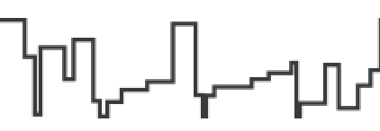

Real-Time Mapping with RawHash2
Reference Genome (Converted to Signals)
Raw Signals
(~5000 signals/sec)
Reference Signals
Offline Indexing
Adaptive
Quantization
Adaptive
Quantization
Hash Table
(Index)
Hash
Hash
Real-Time Mapping
Store
Query
Yes: Analyze the next chunk
Sketching
Sketching
Matching Regions
Chaining & Mapping
Continue Mapping?
Filtering
RawHash
RawHash2
No: Stop
Sequencing
Notes:
We modify the earlier RawHash pipeline by integrating adaptive quantization
[CLICK] followed by the same hashing technique from RawHash and the new sketching step
[CLICK] We use the hash values after sketching to construct the index and query the index as before.
[CLICK] Matching regions we receive after querying are filtered with a frequency filter
[CLICK] followed by a more sensitive chaining mechanism
[CLICK] and we decide on the mapping based on a weighted mapping strategy.

Slide 7
Outline
Background
RawHash
RawHash2
Evaluation
Conclusion

Slide 8
Evaluation Methodology
Two settings for RawHash2:
  RawHash2: All hash values without sampling
  RawHash2-Minimizer: Minimizer sketching
Compared to UNCALLED [Kovaka+, Nat. Biotech.'21],
Sigmap [Zhang+, ISMB/ECCB'21], and RawHash [Firtina+, ISMB/ECCB'23]
Use cases for real-time genome analysis:
  Read mapping
  Relative abundance estimation
  Contamination analysis
Notes:
We evaluate two different versions of RawHash2: first, the default case without any sketching technique, and second, RawHash2 with the minimizer sketching technique.
[CLICK] We compare RawHash2 with ...
[CLICK] We evaluate based on three different use cases, including read mapping.

Slide 9
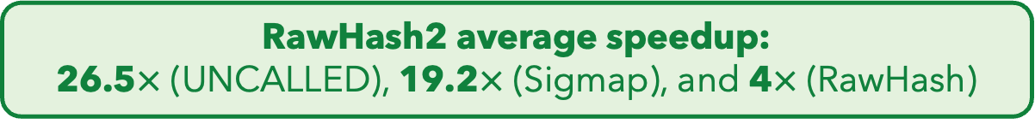
Key Results – Throughput
Data generation throughput of a single nanopore: ~450 bp/sec
  A single nanopore device contains roughly 512 to 2500 nanopores
Computation throughput of a single CPU thread: bases processed/sec
  Scalability: The number of nanopores that a single CPU thread can process
RawHash2 average speedup:
26.5$×$ (UNCALLED), 19.2$×$ (Sigmap), and 4$×$ (RawHash)
RawHash2-Minimizer average speedup: 2.5$×$ (RawHash2)
Notes:
Let’s first look at the throughput comparisons. A single nanopore generates roughly 4 to 5000 signals per second, corresponding to around 450 bases per second.
A single nanopore device contains around 500 to 2500 of these nanopores.
[CLICK] We define computational throughput as the number of bases a tool can process per second per CPU thread.
A tool's scalability is based on how many nanopores it can process with a single CPU thread.
[CLICK] First, we show the throughput results for UNCALLED and Sigmap,
with different datasets on the x-axis
and throughput on the y-axis.
The number of nanopores they can process with a single CPU thread is shown inside the bars.
Sigmap falls short of real-time analysis, as its throughput is below the data generation speed of a single nanopore for human genomes.
[CLICK] RawHash achieves significant speedup due to its fast hash-based search,
[CLICK] while RawHash2 and RawHash2-Minimizer further improve throughput with effective sampling strategies.
[CLICK] RawHash2 provides an average speedup of 26 times, 19 times, and 4 times compared to UNCALLED, Sigmap, and RawHash
[CLICK] RawHash2-Minimizer further increases throughput by 2.5x compared to RawHash2.

Slide 10
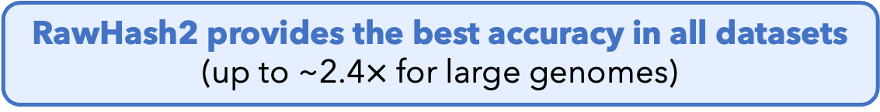
Key Results – Mapping Accuracy
Accuracy of mapping positions (F1 score)
  Ground truth: Mapping positions of basecalled sequences using minimap2
RawHash2 provides the best accuracy in all datasets
(up to ~2.4$×$ for large genomes)
RawHash2-Minimizer provides mapping accuracy comparable to RawHash2
Notes:
Next, we look at the mapping accuracy by identifying the correct mapping positions that each tool reports
based on the ground truth mapping positions
and calculating their F1 scores accordingly.
[CLICK] This figure shows the mapping accuracy results on the y-axis
using the datasets on the x-axis.
The accuracies of UNCALLED and Sigmap significantly drop for the human genome.
[CLICK] RawHash provides comparable accuracy on smaller genomes and substantially better accuracy for the human genome,
[CLICK] while RawHash2 and RawHash2-Minimizer substantially improve accuracy with the new and effective quantization and chaining mechanisms.
[CLICK] We find that RawHash2 ...
[CLICK] And ...

Slide 11
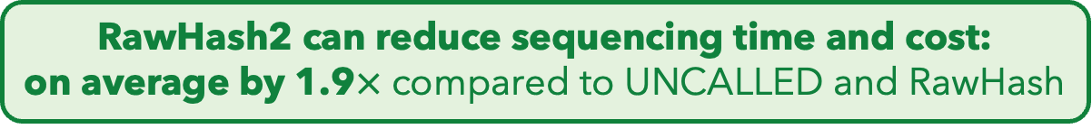
Average Sequenced Length
Fewer bases to sequence ➔ Less unnecessary sequencing
Lower is better
RawHash2 can reduce sequencing time and cost:
on average by 1.9$×$ compared to UNCALLED and RawHash

Slide 12
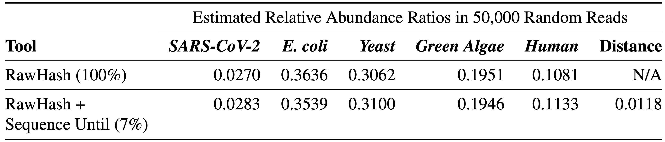
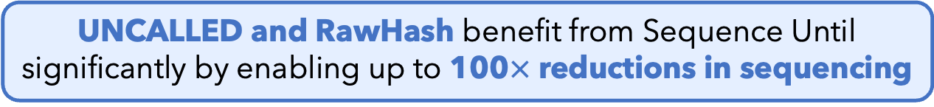
Benefits of Sequence Until
Running RawHash with and without Sequence Until
Sequence Until enables sequencing only 7%
of the entire sample while providing high accuracy
UNCALLED and RawHash benefit from Sequence Until
significantly by enabling up to 100$×$ reductions in sequencing

Slide 13
Outline
Background
RawHash
RawHash2
Evaluation
Conclusion

Slide 14
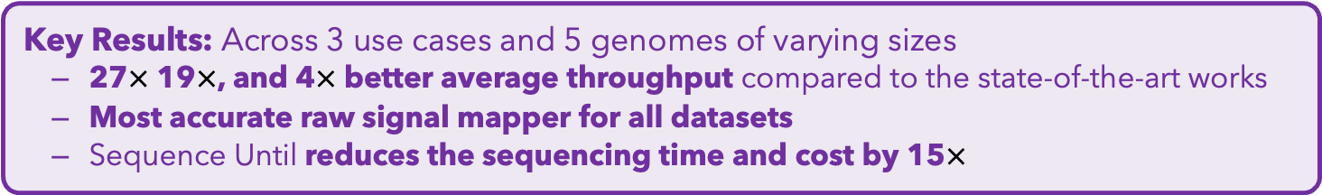
Conclusion
Key Contributions:
1) The first hash-based mechanism for mapping raw nanopore signals
2) The novel Sequence Until technique can accurately and dynamically stop
the entire sequencing of all reads at once if further sequencing is not necessary
Key Results: Across 3 use cases and 5 genomes of varying sizes
  27$×$ 19$×$, and 4$×$ better average throughput compared to the state-of-the-art works
  Most accurate raw signal mapper for all datasets
  Sequence Until reduces the sequencing time and cost by 15$×$
Many opportunities for analyzing raw nanopore signals in real-time:
  Many hash-based sketching techniques can now be used for raw signals
  Indexing is very cheap: Many future use cases with the on-the-fly index construction
  We should rethink the algorithms to fully perform downstream analysis with raw signals
Notes:
Let’s first look at the throughput comparisons. A single nanopore generates roughly 4 to 5000 signals per second, corresponding to around 450 bases per second.
A single nanopore device contains around 500 to 2500 of these nanopores.
[CLICK] We define computational throughput as the number of bases a tool can process per second per CPU thread.
A tool's scalability is based on how many nanopores it can process with a single CPU thread.
[CLICK] First, we show the throughput results for UNCALLED and Sigmap,
with different datasets on the x-axis
and throughput on the y-axis.
The number of nanopores they can process with a single CPU thread is shown inside the bars.
Sigmap falls short of real-time analysis, as its throughput is below the data generation speed of a single nanopore for human genomes.
[CLICK] RawHash achieves significant speedup due to its fast hash-based search,
[CLICK] while RawHash2 and RawHash2-Minimizer further improve throughput with effective sampling strategies.
[CLICK] RawHash2 provides an average speedup of 26 times, 19 times, and 4 times compared to UNCALLED, Sigmap, and RawHash
[CLICK] RawHash2-Minimizer further increases throughput by 2.5x compared to RawHash2.

Slide 15
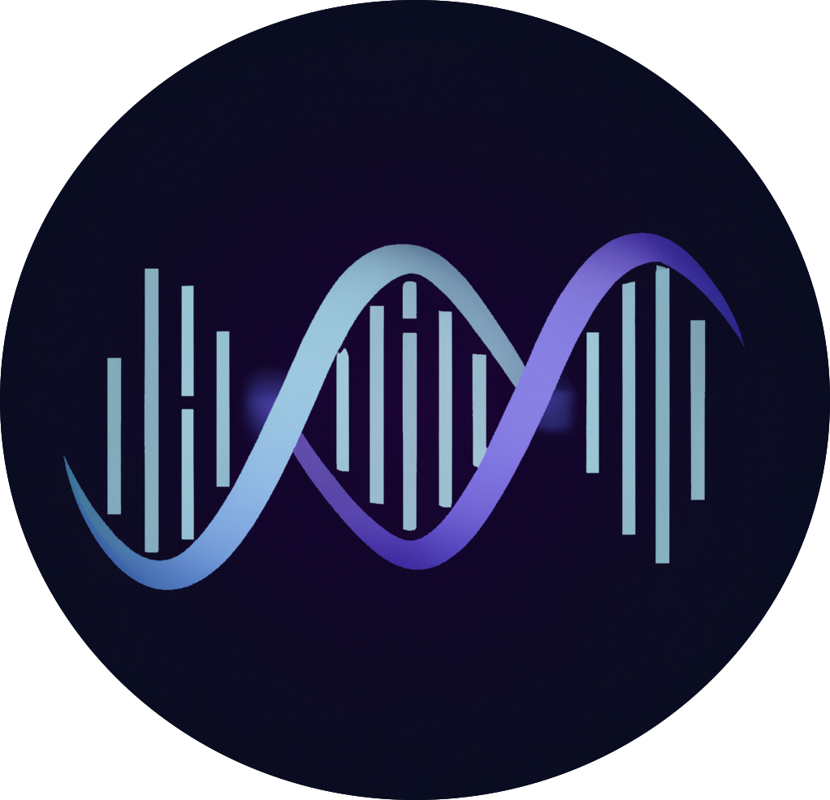


RawHash
Enabling Fast and Accurate Real-Time Analysis
of Raw Nanopore Signals for Large Genomes
Can Firtina
Nika Mansouri Ghiasi |  | Joel Lindegger |  | Gagandeep Singh
Meryem Banu Cavlak |  | Haiyu Mao |  | Onur Mutlu
RawHash
RawHash2
Code

Slide 16
Computer Architecture
Lecture 26c: RawHash2
Can Firtina
ETH Zurich
Fall 2024
13 December 2024

Slide 17

Sequencing Data Analysis
Heuristic Algorithms
Data Structures
Filters
TATGG
AAGCC
TATAT
TGGTA
GCCTA
AGATA
TGCAC
CCTGG
✓
Quick, accurate, and energy-efficient analysis
Distributed
Computing
Imperfections in sequencing data
impacts design choices
Hardware Accelerators
✕
Notes:
Since we need to analyze a large volume of sequencing data, there are many types of optimizations to make the genome analysis practical

Slide 18
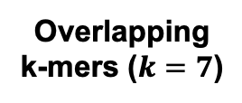
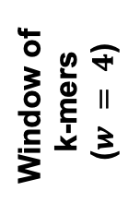
Minimizer Sketching
GCTATTACCT
GCTATTA
Hash
0xA1
Find
Minimum
Window of
k-mers
($w = 4$)
CTATTAC
Hash
0x02
Hash Table
0x02
TATTACC
Hash
0xFC
ATTACCT
Hash
0x45
CTATTAC
Overlapping
k-mers ($k=7$)
Sampled
k-mer (Minimizer)

Slide 19
Spaced Seeding
GCTATTA
Pattern
GXTAXTA
Hash
0xA1
GATACTA
Pattern
GXTAXTA
Hash
0xA1
GACACTA
Pattern
GXCAXTA
Hash
0xFC
Spaced Seeds

Slide 20
Strobemer Sketches
GCTATTACCTTAATGTGATGGAC
Link
GCTATTAATGGA
Hash
0xA1
GCTATCCCCTTAATGGGATGGAC
Link
GCTATTAATGGA
Hash
0xA1
GCCCTCCCCTTAAAGGGAATGGA
Link
CCTCTAAATGGA
Hash
0xFC
Selected k-mers (e.g., minimizers)
Strobemers

Slide 21
Hash-Based Sketching and Seed Matching
Target Sequence
Query Sequence
GCTATTACCTTAATGTGATGGACGA
CAGGCTATAACCCTAATGTTGC
Sketching
Sketching
GCTA
TAAT
GACG
GCTA
ATGT
Hash
Hash
Hash
Hash
Hash
0x01
0xA4
0x41
0x01
0xFE
Store
Store
Store
Query
Query
<List of Positional Information>
Match
0x01
0xA4
0x41
Hash Table
No Match
Notes:
hashing.pdf

Slide 22

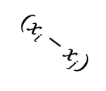










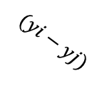
Chaining (Two Points)
$$xj$$
$$xi$$
Chaining
Target Seq.
Target Seq.
$$aj$$
$$ai$$
Anchor
(Seed match)
$$wi$$
$$(xi−xj)$$
$$aj$$
$$yj$$
$$yi$$
Query Seq.
Query Seq.
$$aj$$
$$ai$$
$$(yi−yj)$$
$$wi$$

Slide 23
Chaining (Multiple Points)
Exact hash value matches: Needed for finding matching regions between a reference genome and a read
What if there are mutations or errors?
  No hash (seed) match will occur in such positions
The chaining algorithm links exact matches in a proximity even though there are gaps (no seed matches) between them

Slide 24
Sequence Alignment

Slide 25
Nanopore Sequencing
Notes:
Nanopore technology consists of a nanometre-sized pore in an insulating membrane that separates two electrolyte-filled wells
DNA/RNA: negatively charged due to their phosphate-sugar backbones, which contain phosphate groups that carry negative charges.

Slide 26
Source of Noise in Nanopore Sequencing
Stochastic thermal fluctuations in the ionic current
  Random ionic movement due to inherent thermal energy (Brownian motion)
Variations in the translocation speed
  Mainly due to the motor protein
Environmental factors
  Temperature: Affecting enzymes including the motor protein
  pH levels: Affecting charge and the shape of molecules
Maybe: Aging & material-related noise between nanopores
  Their effects potentially can be minimized with normalization techniques
Notes:
Thermal fluctuations: Stochastic thermal fluctuations refer to random, small-scale variations in “ion movement” due to inherent thermal energy at the molecular level. These fluctuations occur at any temperature above absolute zero.
Brownian motion and even at quantum levels
Variations: due to the design of motor protein -> can be affected by environmental factors like temperature (below)
Temperature: can alter enzyme performance, leading to signal inconsistencies. -> higher temperatures may speedup translocation. Increases molecular Kinetic energy

Slide 27
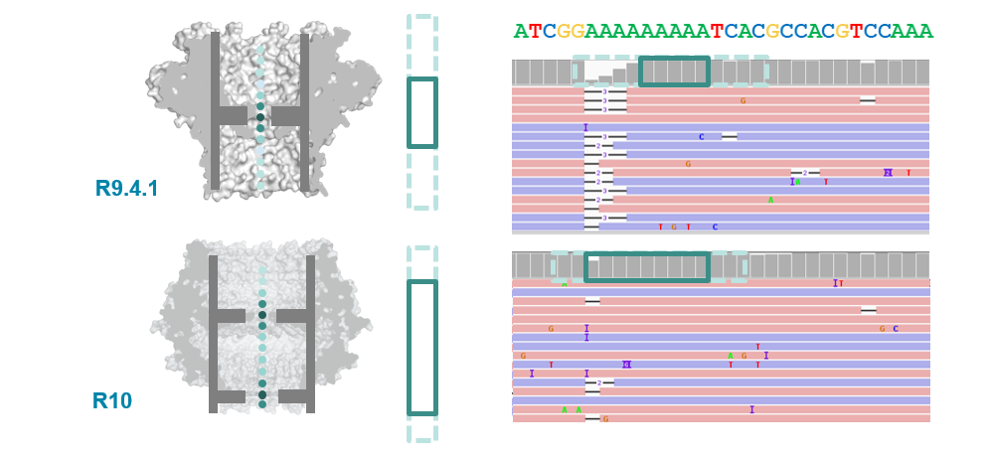
R9 vs. R10 Chemistries
Dual reader head
Motor protein with more consistent translocation speed in R10
Duplex sequencing in R10

Slide 28
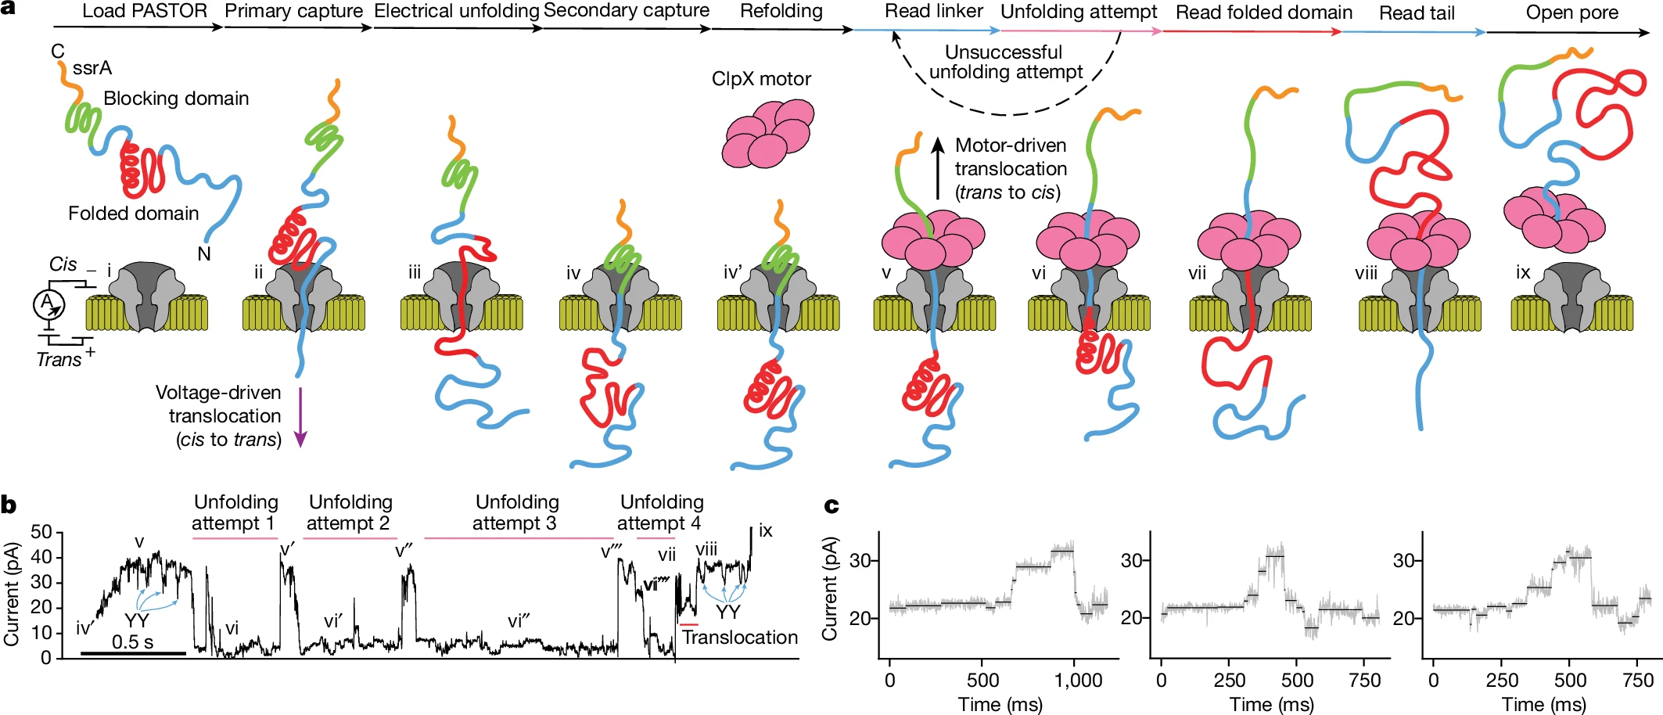
Proteomics with Nanopores
Motone+, “Multi-pass, single-molecule nanopore reading of long protein strands”, Nature 2024.
Notes:
PTMs: post-translational modifications, PTM code: unique and specific roles in driving biological processes
Peptide vs protein
Challenge: neutrally charged polypeptide backbone (lacking a consistent charge distribution): complicates the application of techniques that rely on charge-based separation or detection
Challenge: varying charge states of amino acid side chains: 20 different amino acids, each with unique side chains that can carry positive, negative, or neutral charges depending on the pH and local environment. Canceling out behavior?
Challenge: Rigid/Stable 3D protein structures. Challenging to sequence full length molecule
Control pH to control the movement of the protein

Slide 29
Applications of Read Until
Depletion: Reads mapping to a particular reference genome is ejected
Microbiome studies by removing host DNA
Eliminating known residual DNA or RNA (e.g., mitochondrial DNA)
High abundance genome removal
Enrichment: Reads not mapping to a particular reference genome is ejected
Removing contaminated organisms
Targeted sequencing (e.g., to a particular region of interest in the genome)
Low abundance genome enrichment

Slide 30
Applications of Run Until & Sequence Until
Run Until: Stopping the entire sequencing run
Stopping when reads reach to a particular depth of coverage
Stopping when the abundance of all genomes reach a particular threshold
Sequence Until: Run Until with accuracy-aware decision making
Stopping when relative abundance estimations do not change substantially (for high-abundance genomes)
Stopping when finding that the sample is contaminated with a particular set of genomes
…

Slide 31
In Vitro (e.g., PCR) vs. In Silico
Polymerase Chain Reaction (PCR) as a way of in vitro “analysis”
  Can increase the quantity of DNA in a sample
  Non-dynamic targeted sequencing (e.g., low abundance known targets)
  Requires additional resources: Time and money for preparation and execution of PCR
Adaptive sampling as a way of in silico (i.e., computational) analysis
  Cannot increase the existing quantity of DNA in a sample
  Dynamic targeted sequencing: Decisions can be made based on real-time analysis (e.g., Sequence Until)
  Minimal additional resources
    Almost no additional resources for preparation and execution
    Simultaneous enrichment and depletion is possible
    Better suited for rapid whole genome sequencing
  Beauty of computational analysis (e.g., high flexibility – no need for primers)
PCR and adaptive sampling can be combined depending on the analysis type

Slide 32
Finding Mapping Positions
Useful for any application that requires exact genomic position
  Variant calling in downstream analysis
  Specifically: Identifying rare variants in cancer genomics
  Methylation profiling
Accurate and flexible depth of coverage estimation
  Alternative: DNA quantification (without computational analysis)
    DNA quantification is challenging for metagenomics analysis
  Computational method: We can map to almost entire set of known reference genomes to accurately estimate the coverage of a metagenomics sample
Transcriptome analysis
  Accurately quantifying expression levels & alternative splicing
Better resolution (i.e., more sensitive analysis) for any other application that does not specifically require mapping positions

Slide 33

Reference-to-Event Conversion
K-mer model: Provides expected event values for each k-mer
  Preconstructed based on nanopore sequencer characteristics
Use the k-mer model to convert all k-mers
of a reference genome to their expected event values
Reference Genome
Expected Event Values
Normalized Event Values
GCTATTACC
GCTATT
K-mer Model
(Lookup Table)
105.757390
Normalize
2.21
CTATTA
81.740642
-0.09
k-mers ($k=6$)
TATTAC
103.170091
1.15
ATTACC
101.082485
1.11

Slide 34
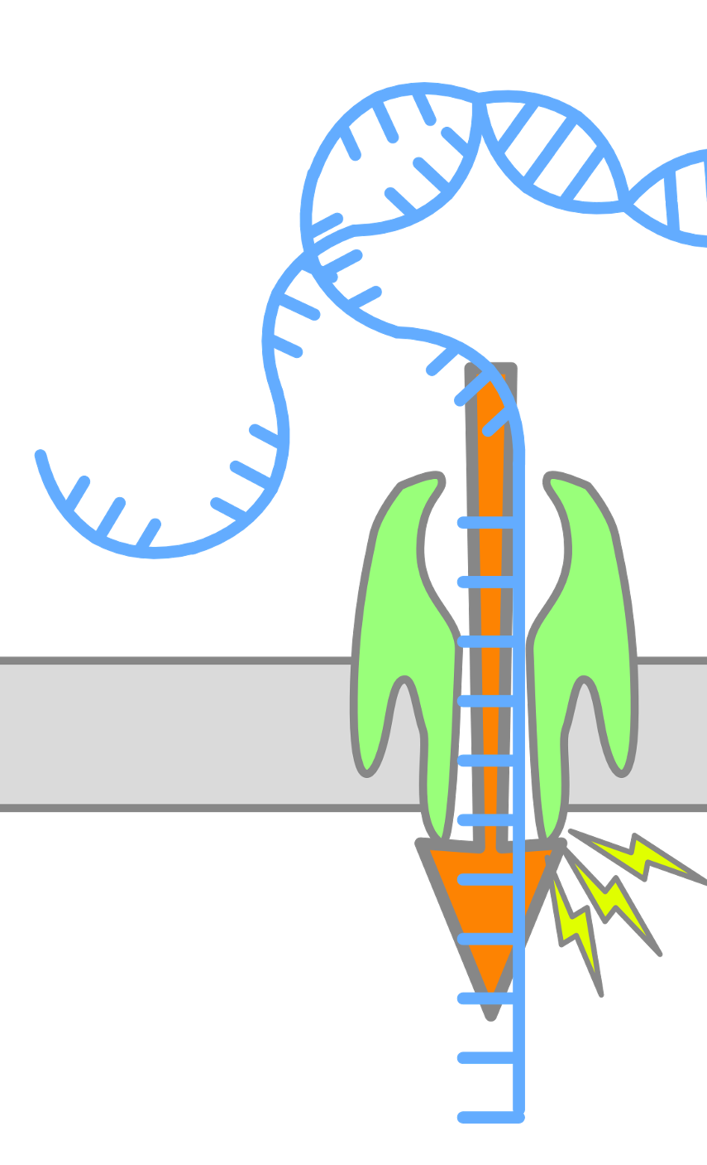
Enabling Analysis From Electrical Signals
K many nucleotides (k-mers) sequenced at a time
Event: A segment of the raw signal
  Corresponds to a particular k-mer
Observation: Event values generated after sequencing the same k-mer are similar in value (not necessarily the same)
Event
Event Value
Raw Nanopore Signal
Normalize
ACTTGG
pAmpere
Segment
Calculate
Means
2.21
Time
k-mer
ACTTGG

Slide 35
Quantization -- RawHash

Slide 36
Packing and Hashing
Consecutive k-mers
Consecutive events
CTATTA
-0.09
Quantize
1
1
0
0
1
TATTAC
1.15
Quantize
0
0
1
1
0
…
…
…
…
Pack
ATTACC
1.11
Quantize
0
0
1
0
1
1
1
0
0
1
0
0
1
1
0
…
0
1
0
0
1
Hash value of consecutive events
0x400D70A4
Hash

Slide 37
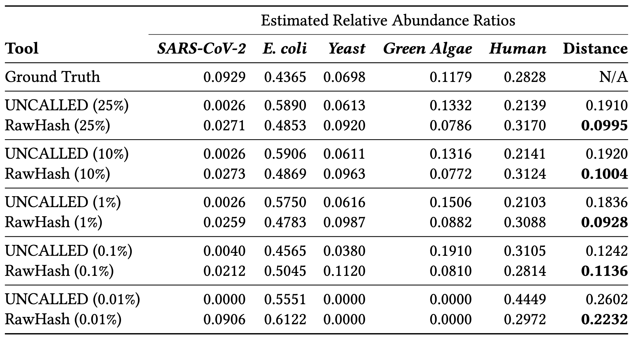
Sequence Until – RawHash & UNCALLED

Slide 38

Sequence Until – RawHash

Slide 39
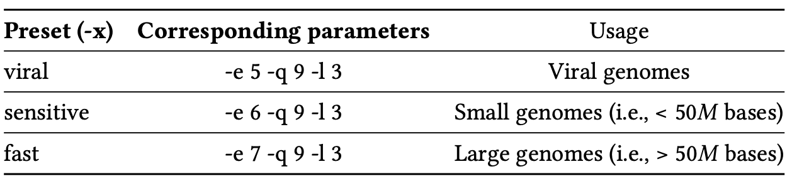
Presets

Slide 40
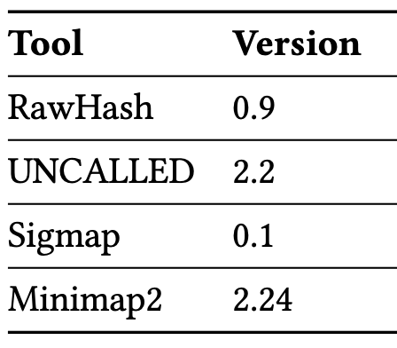
Versions – RawHash

Slide 41
Related Works
Basecalled real-time analysis
  ReadFish, ReadBouncer, RUBRIC: Basecalled read mapping
  SPUMONI, SPUMONI 2: Basecalled binary classification using r-index
  Coriolis: Basecalled metagenomics classification
  baseLess: k-mer calling for classification
Raw signal analysis without basecalling
  SquiggleNet, DeepSelectNet, RawMap: Target/non-target classification
  Sigmoni: Target/non-target classification using r-index
  UNCALLED, Sigmap, RawHash: Read mapping
Notes:
UNCALLED: Searching with ambiguity in FM-index. Find all possible k-mers that a event can represent. Query all in FM-index, then start a node from each match, and edge to the next ”event” where the next event can also represent multiple k-mers. Keep doing this until you uniquely reach a region. Forest of trees.

Slide 42
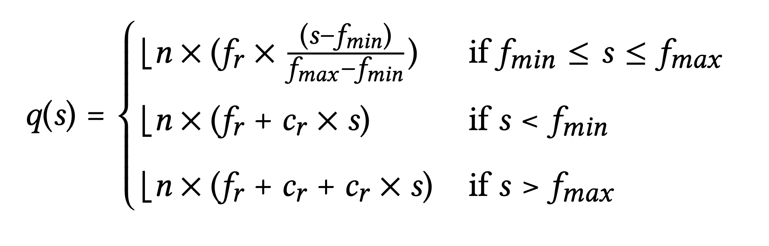
Adaptive Quantization

Slide 43
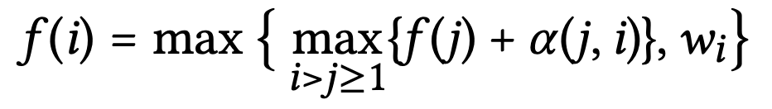
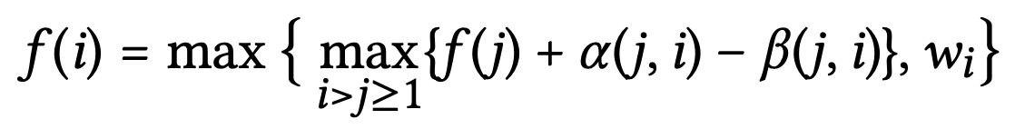

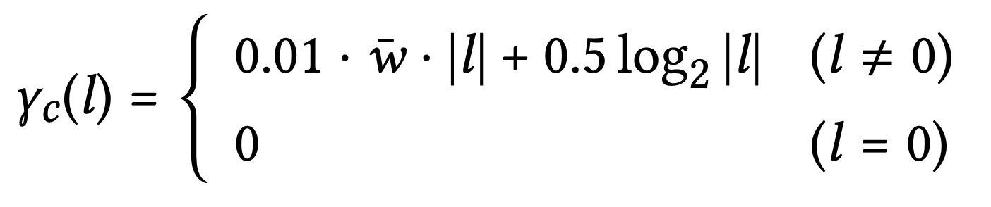
Chaining Scores – RawHash vs RawHash2
RawHash Chaining
RawHash2 Chaining

Slide 44
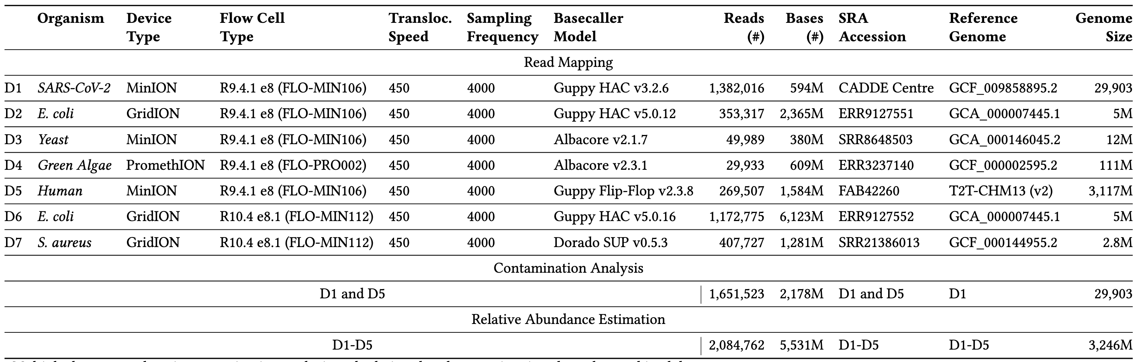
Datasets
Notes:
Staphylococcus aureus

Slide 45
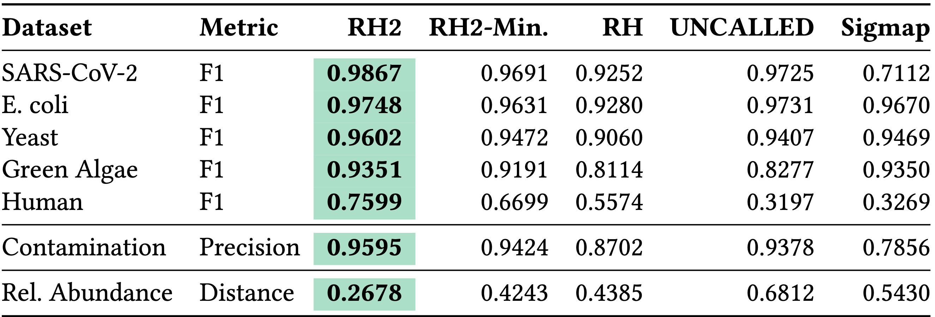
Accuracy

Slide 46
Mapping Accuracy – Radar
Notes:
Focus on larger genomes.

Slide 47
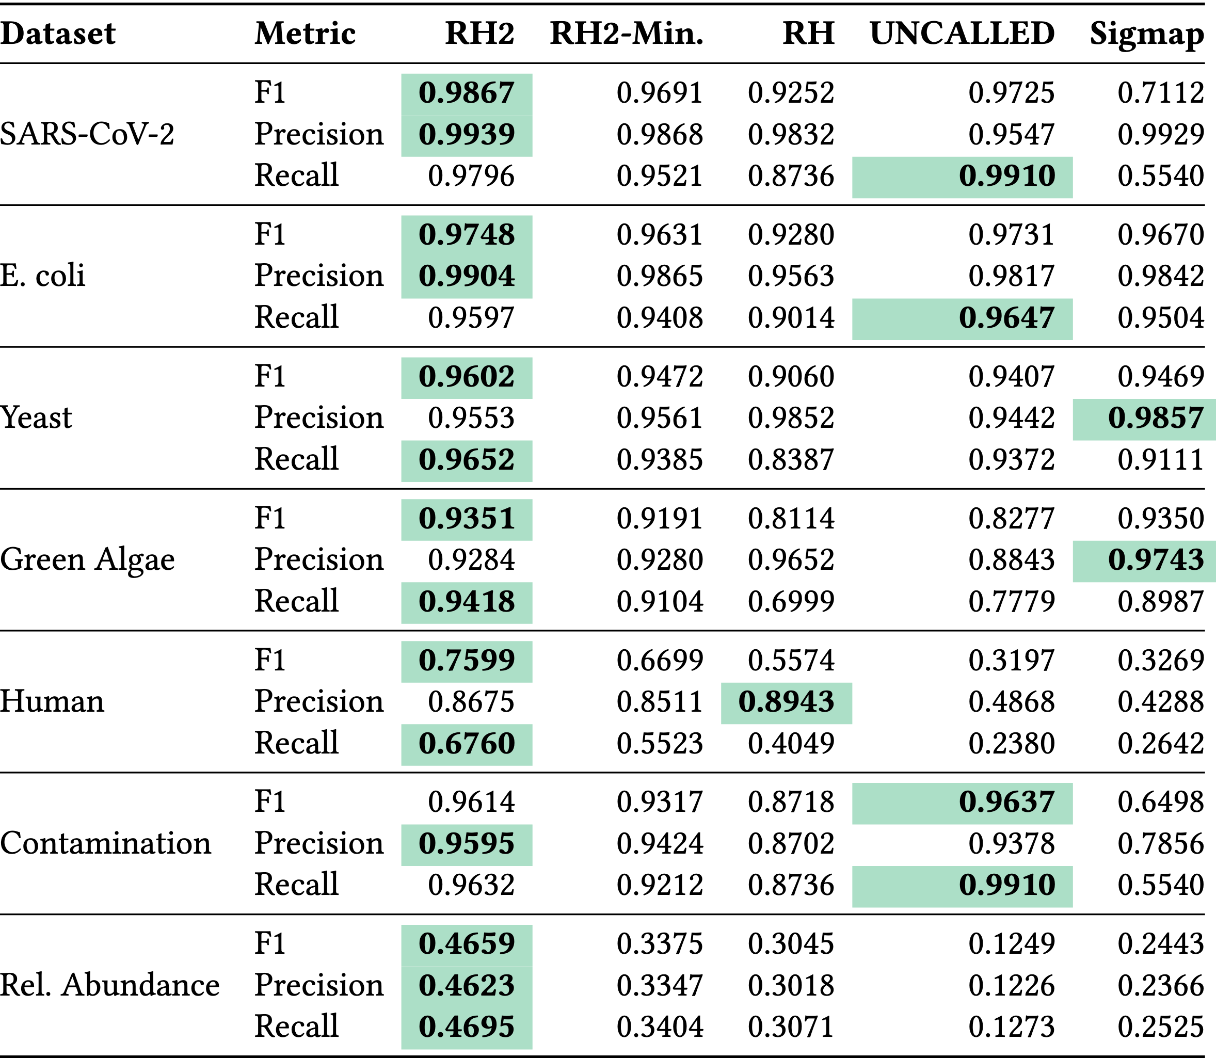
Mapping Accuracy – All Metrics

Slide 48
Combined Benefits – Radar
Notes:
Focus on larger genomes.

Slide 49
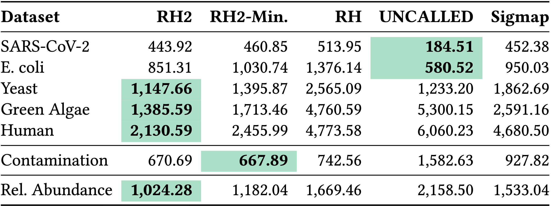
Sequenced Length

Slide 50
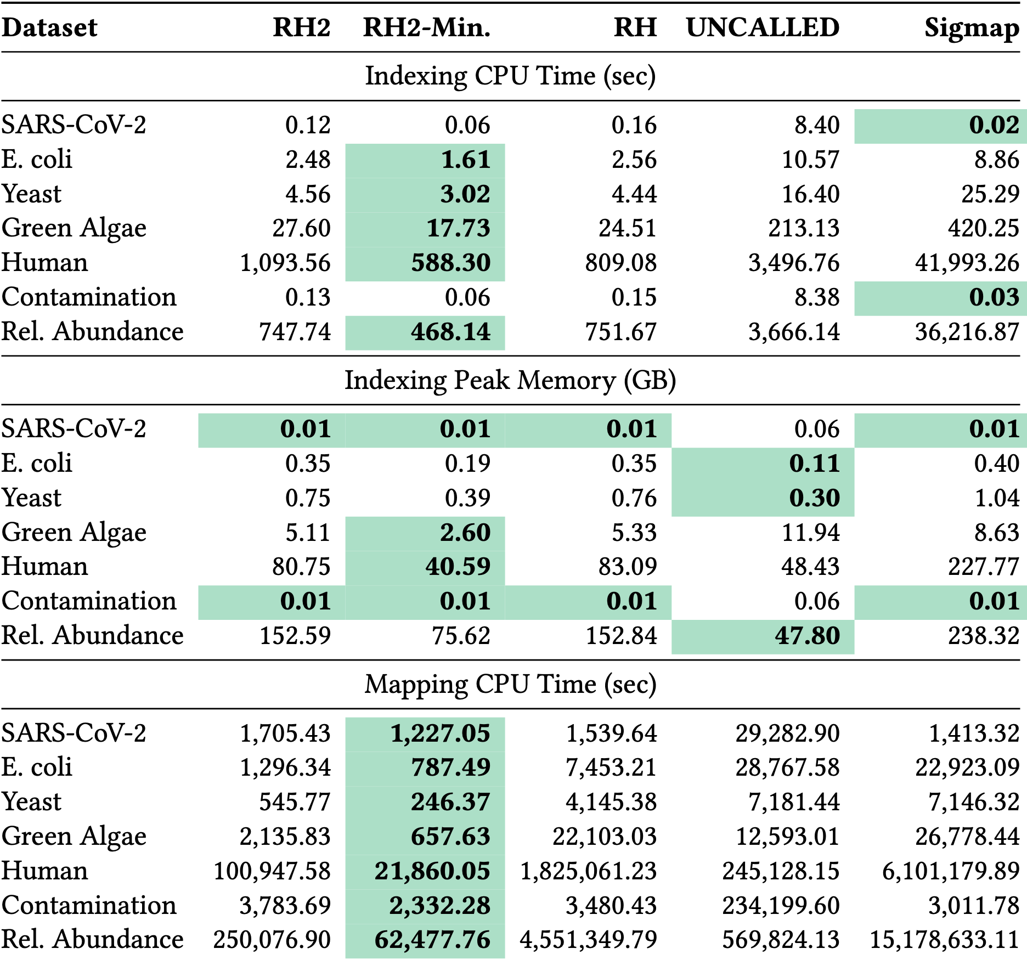
Computational Resources #1

Slide 51
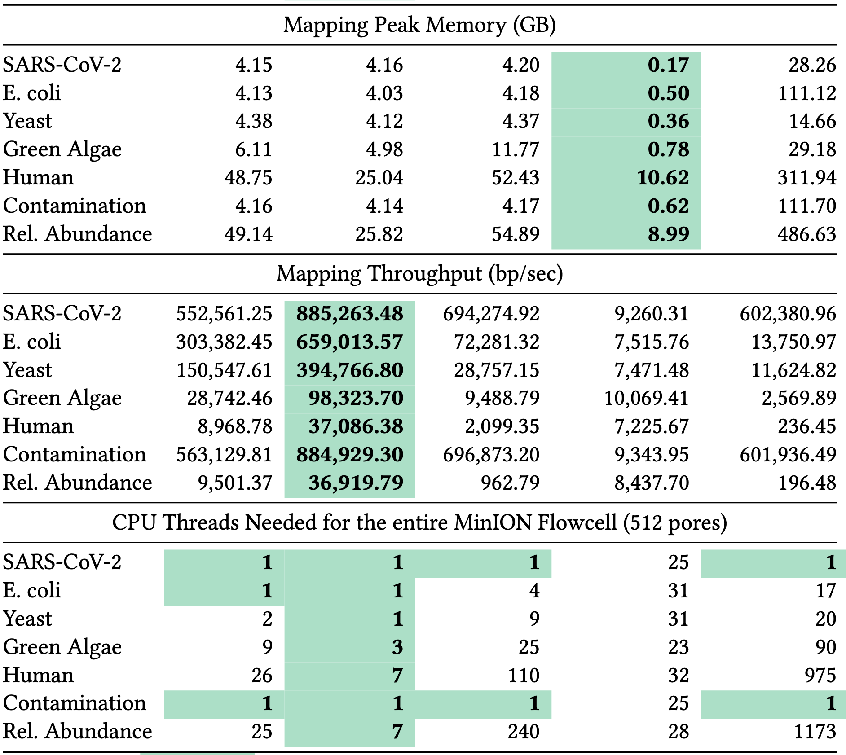
Computational Resources #2

Slide 52
Average Time Spent per Read
Notes:
This does not show how many bases they sequence. Not a great metric. If they were sequencing the same amount, would be good.
That’s why throughput + sequenced bases is better.
RawHash2/RawHash2-Minimizer is still better because of lower sequenced bases and higher throughput.

Slide 53
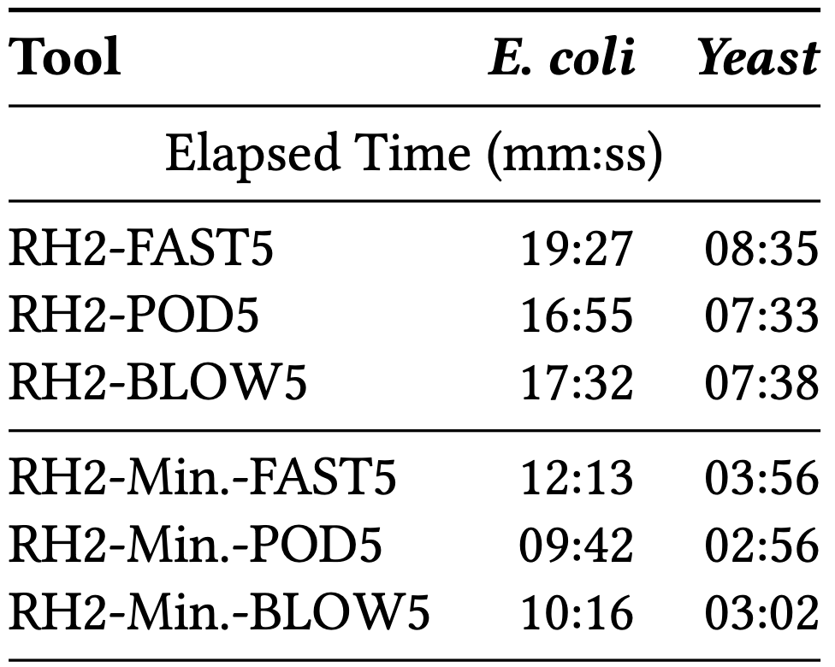
FAST5 vs. POD5. vs S/BLOW5
Notes:
FAST5 supports zlib and vbz (zstd+streamvbyte) as compression methods.
Default used to be zlib which ONT at once point made vbz the default.
BLOW5 also has zlib and vbz and the default is zlib.
POD5 only has vbz (actually an SIMD accelerated version of vbz).
zlib is much more CPU-intensive than zstd.

Slide 54
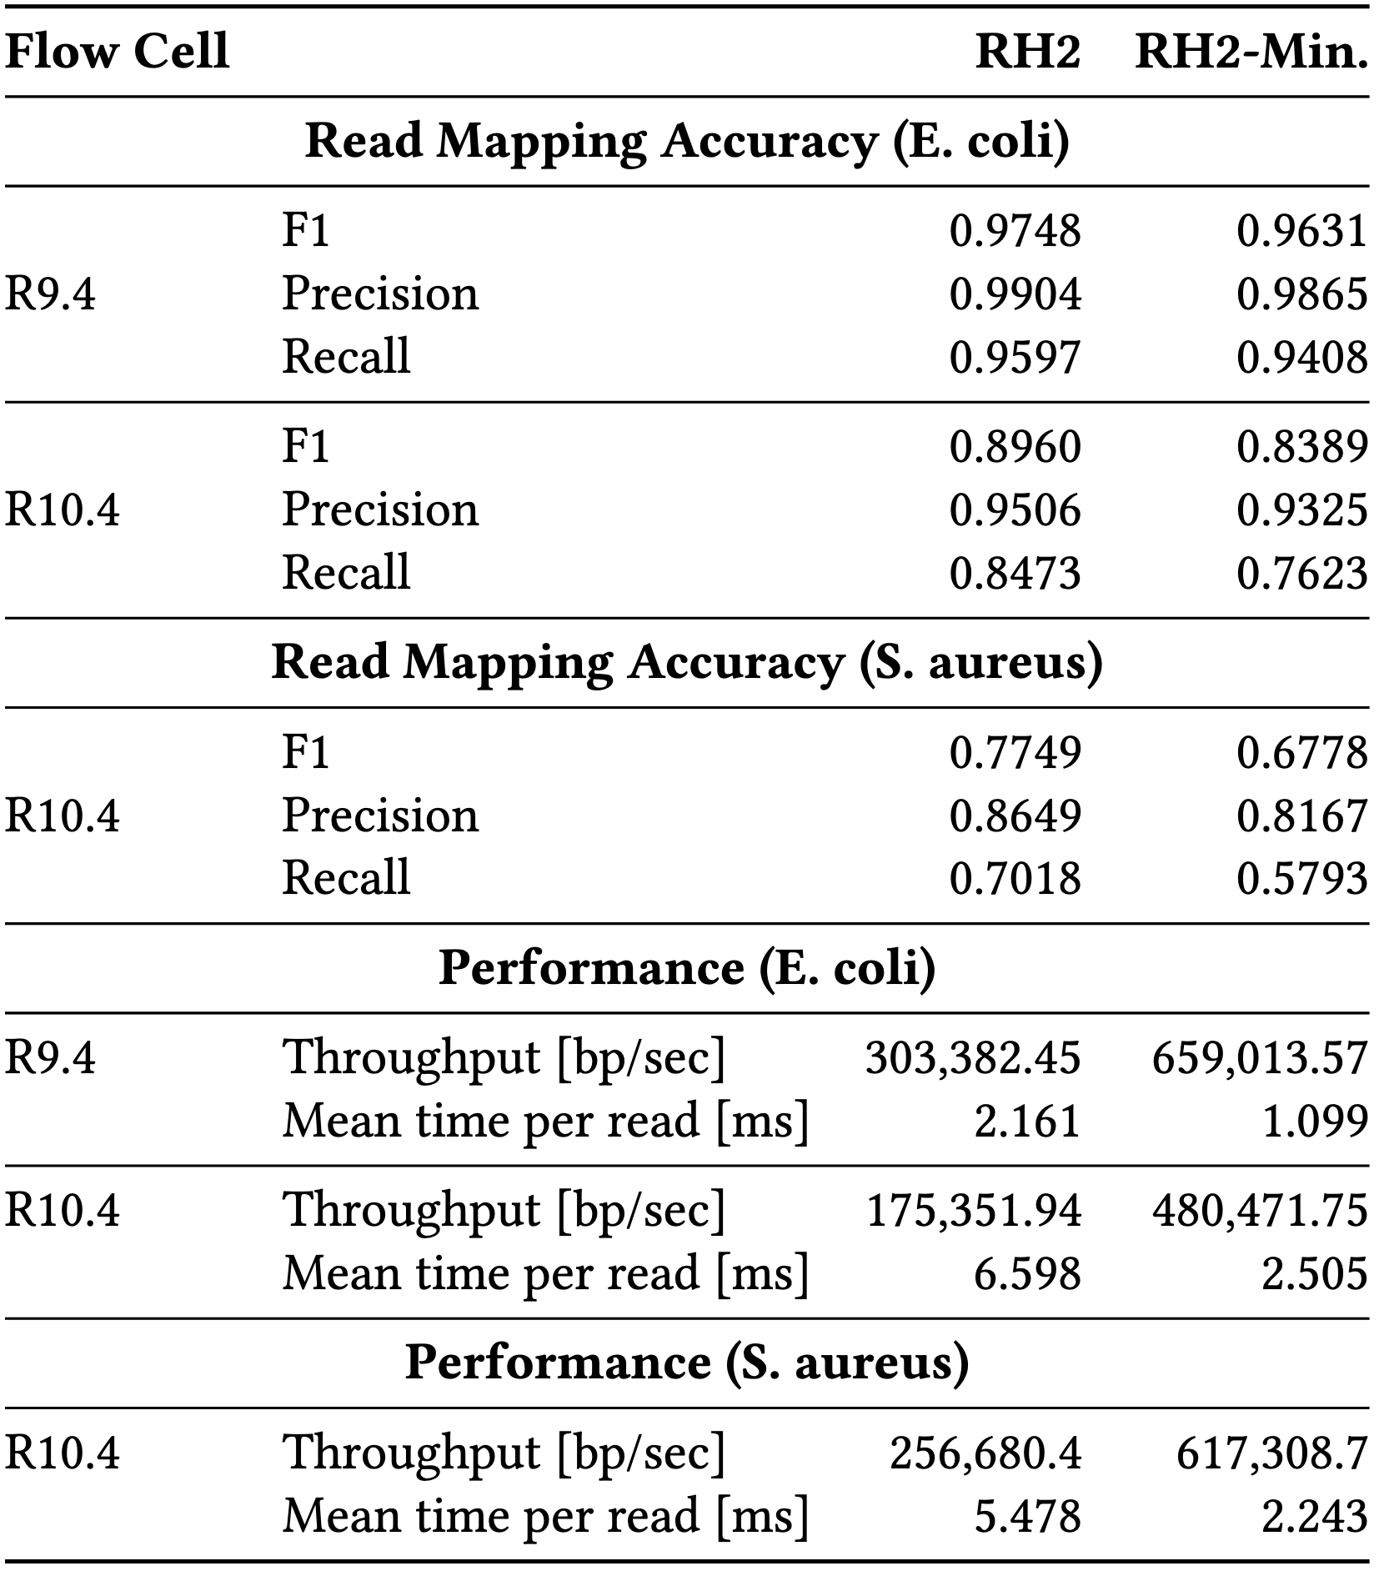
Flow Cell Types R9 vs R10.4
Notes:
Two reasons: 1) Better basecalled mapping, so we are further away from ground truth -> significant drop in recall
2) Worse segmentation. -> still some drop in precision (this can be explained by 1 too)

Slide 55
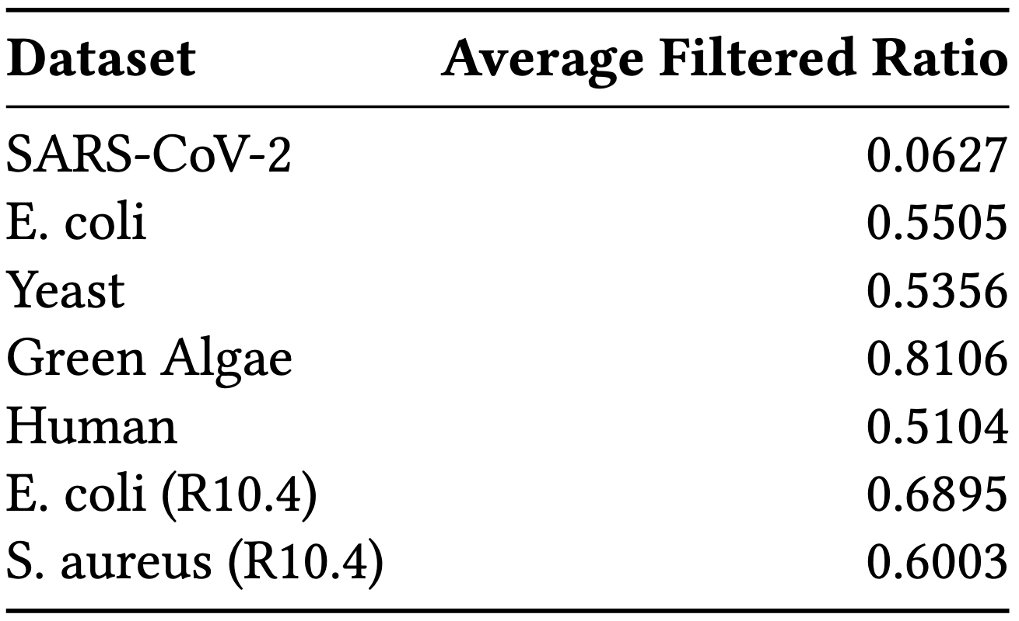
Ratio of Filtered Seed Hits
Notes:
Filtering: finding mid point index, min and max values for number of positions in the mid points. If within min,max range use the value we find. If not, use either min or max depending on where the actual mid value is.
Using this for filtering.

Slide 56
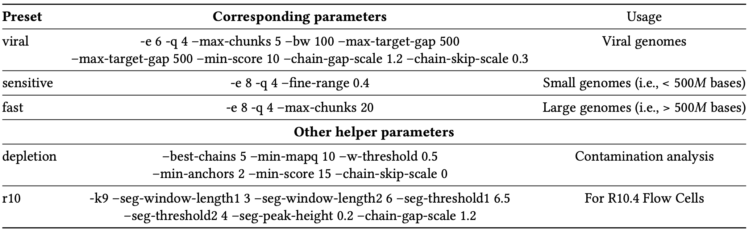
Presets

Slide 57
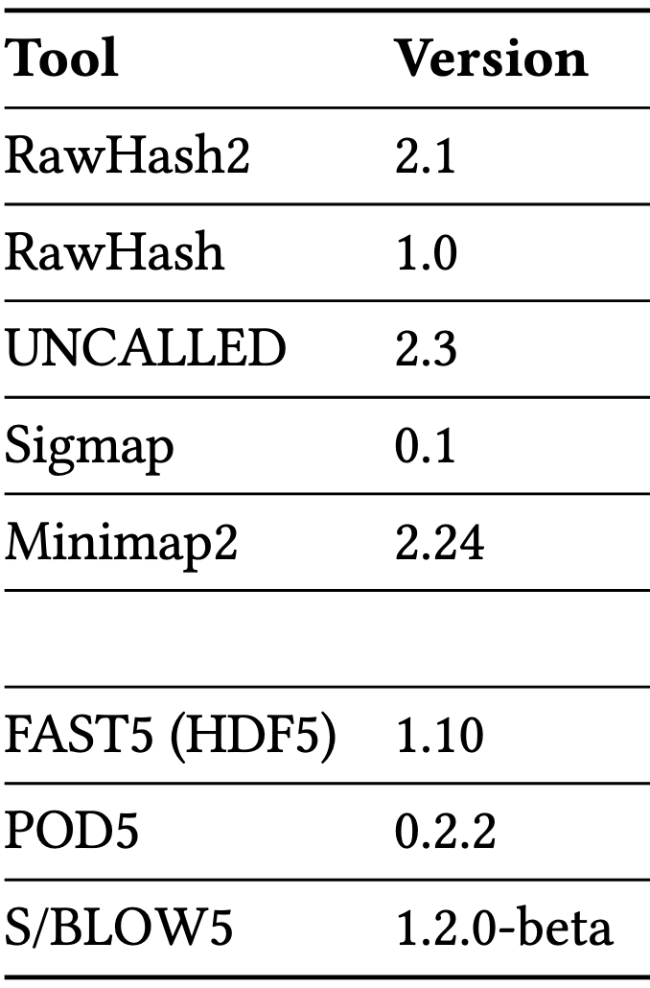
Versions

