Slide 1
The Reach Profiler (REAPER): Enabling the Mitigation of DRAM Retention Failures via Profiling at Aggressive Conditions
Minesh Patel Jeremie S. Kim
Onur Mutlu
Notes:
Hi I’m Minesh Patel from ETH Zurich
Today I’m going to talk about the Reach Profiler, a new methodology for DRAM retention failure profiling.
This work was done by researchers from the SAFARI group at ETH Zurich and Carnegie Mellon University.
[END]

Slide 2
Executive Summary
Motivation: DRAM refresh energy/performance overhead is high
Problem: DRAM retention failure profiling is hard
Complicated by cells changing retention times dynamically
Current profiling methods are unreliable or too slow
Goals:
Thoroughly analyze tradeoffs in retention failure profiling
Develop a fast and reliable profiling mechanism
Key Contributions:
First detailed characterization of 368 LPDDR4 DRAM chips
Reach profiling: Profile at an longer refresh interval and/or higher temperature, where cells are more likely to fail
Evaluation:
2.5x faster profiling with 99% coverage and 50% false positives
Enables longer refresh intervals that were previously unreasonable
2/36
Notes:
First, I’ll give a high level summary of the talk.
The high level motivation for this work is that DRAM refresh is a major impediment to scaling, especially in terms of energy.
The specific problem that we focus on is that DRAM retention failure profiling is hard.
This is due to a number of effects that cause cell retention times to change dynamically, and current profiling methods are either unreliable or are just too slow.
Our goals in this work are twofold. First, we would like to thoroughly characterize the tradeoff space surrounding retention failure profiling.
Second, we would like to use what we learn to develop a fast, reliable profiling mechanism.
We make a number of key contributions in this work.
First, we perform the first detailed retention failure characterization of 368 LPDDR4 DRAM chips
Second, we use what we learn to introduce the reach profiler, which profiles for failures at a longer refresh interval and/or a higher temperature, where cells are more likely to fail.
Through our evaluations, we find that reach profiling increases profiling performance by an average of 2.5x and enables longer refresh intervals that were previously unreasonable due to profiling overhead.
[END]

Slide 3
REAPER Outline
1. DRAM Refresh Background
2. Failure Profiling Challenges
3. Current Approaches
4. LPDDR4 Characterization
5. Reach Profiling
6. End-to-end Evaluation
3/36
Notes:
First I’ll give a high level overview of DRAM refresh
[END]

Slide 4
DRAM Cell Leakage
DRAM encodes information in leaky capacitors
wordline
access
transistor
charge
leakage
paths
capacitor
bitline
Stored data is corrupted if too much charge leaks (i.e., the capacitor voltage degrades too far)
4/36
Notes:
DRAM encodes data in fundamentally leaky capacitors
[CLICK]
Here is a simplified diagram of a DRAM cell.
Data is encoded in the capacitor as either charged or uncharged, and the access transistor is used to read from or write to the cell.
[CLICK]
There are a number of leakage paths by which charge can enter or exit the capacitor.
[CLICK]
The important thing to note is that stored data can be corrupted if too much charge leaks
Which is the same as saying if the capacitor voltage degrades too far
[END]

Slide 5
DRAM Cell Retention
100%
Retention Success
Vmin
Retention Failure
Capacitor voltage (Vdd)
0%
Retention time
time
Retention failure – when leakage corrupts stored data
Retention time – how long a cell holds its value
5/36
Notes:
Here, we have a simplified diagram of the capacitor voltage over time
We see that the voltage decreases over time in an exponential decay.
[CLICK]
We define a voltage, vmin, after which we can no longer tell what data was originally stored in the cell.
[CLICK]
As long as the voltage remains above this line, we consider this a retention success.
[CLICK]
However, as soon as the voltage drops below vmin, we consider this a retention failure
[CLICK]
We can define a term called ‘retention time’, which says how much time elapses before a retention failure occurs
[END]

Slide 6
DRAM is Much More Than Just One Cell!
Row Decoder
wordline
access
transistor
capacitor
Row Buffer
bitline
8GB DRAM = 6.4e10 cells
6/36
Notes:
However, we have to keep in mind that DRAM is much more than just one cell.
[CLICK]
In fact, DRAM can be composed of hundreds of billions of cells.
[CLICK]
For example, an 8 gigabyte DRAM is composed of 64 billion cells, none of which must experience a retention failure
[END]

Slide 7
DRAM Refresh
DRAM refresh periodically restores leaked charge
Every cell every refresh interval (default = 64ms)
Significant system performance/energy overhead
7/36
Notes:
To this end, we use a process called DRAM refresh, which periodically restores the charge in all DRAM cells
For current devices, every cell is restored every 64ms, which is known as the refresh interval.
This has a significant impact on system performance and energy.
[CLICK]
Here is some data from our evaluations. The Y-axis shows average system performance overhead for different DRAM chip sizes.
We see that the performance penalty is significant, especially for large DRAM chip sizes, which we may expect to see in the future.
[END]

Slide 8
Decreasing Refresh Overhead
Most cells do not fail at a longer refresh interval
< 100 failures
8/36
Notes:
However, we don’t have to refresh so often.
In fact, most cells can handle a longer refresh interval!
[CLICK]
Here is some empirical data we gathered from a representative chip at 45C.
The Y-axis shows the number of failing cells at 45C for different refresh intervals on the X axis. Note that the Y-axis is a log axis.
[CLICK]
We see that for a modest increase in refresh interval past 64ms, we have only a small number of failures!
[END]

Slide 9
Retention Failure Mitigation
Prior works handle these few failures to allow reliable operation at a longer refresh interval
RAIDR [Liu+, ISCA’12]
SECRET [Lin+, ICCD’12]
ArchShield [Nair+, ISCA’13]
DTail [Cui+, SC’14]
AVATAR [Qureshi+, DSN’15]
…
However, they assume they can perfectly identify the set of failing cells to handle
9/36
Notes:
Prior work has proposed many ways to mitigate retention failures so that we can operate DRAM safely at a longer refresh interval.
[CLICK]
However, they require a way to reliably identify failures
[CLICK]
This means we need a fast and reliable profiling mechanism to find failures
[END]

Slide 10
Retention Failure Mitigation
Prior works handle these few failures to allow reliable operation at a longer refresh interval
RAIDR [Liu+, ISCA’12]
SECRET [Lin+, ICCD’12]
ArchShield [Nair+, ISCA’13]
DTail [Cui+, SC’14]
AVATAR [Qureshi+, DSN’15]
…
However, they assume they can perfectly identify the set of failing cells to handle
Need a fast and reliable
profiling mechanism
to find the set of retention failures!
9/36
Notes:
Prior work has proposed many ways to mitigate retention failures so that we can operate DRAM safely at a longer refresh interval.
[CLICK]
However, they require a way to reliably identify failures
[CLICK]
This means we need a fast and reliable profiling mechanism to find failures
[END]

Slide 11
REAPER Outline
1. DRAM Refresh Background
2. Failure Profiling Challenges
3. Current Approaches
4. LPDDR4 Characterization
5. Reach Profiling
6. End-to-end Evaluation
10/36
Notes:
Now, let’s talk about some of the challenges surrounding retention failure profiling.
[END]

Slide 12
Idealized DRAM Refresh Operation
Row Decoder
Refresh Counter
64ms
SA
SA
SA
SA
SA
11/36
Notes:
Here is a diagram showing an idealized DRAM refresh operation.
We have a number of cells shown in green, and a refresh counter that counts down the time until the next refresh operation.
[CLICK]
We see that the charge in each cell decreases over time, but is restored every 64 milliseconds by a refresh operation.
[CLICK]
This is an idealized picture because the cells have identical retention times, so each cell is refreshed just before it fails.
In this case, there is no need for profiling since we’re already operating at the ideal refresh interval for these cells.
[CLICK]
However, real DRAM cells are not so ideal and exhibit variation in their retention times.
[END]

Slide 13
Idealized DRAM Refresh Operation
Row Decoder
Refresh Counter
64ms
SA
SA
SA
SA
SA
11/36
Notes:
Here is a diagram showing an idealized DRAM refresh operation.
We have a number of cells shown in green, and a refresh counter that counts down the time until the next refresh operation.
[CLICK]
We see that the charge in each cell decreases over time, but is restored every 64 milliseconds by a refresh operation.
[CLICK]
This is an idealized picture because the cells have identical retention times, so each cell is refreshed just before it fails.
In this case, there is no need for profiling since we’re already operating at the ideal refresh interval for these cells.
[CLICK]
However, real DRAM cells are not so ideal and exhibit variation in their retention times.
[END]

Slide 14
Idealized DRAM Refresh Operation
Row Decoder
Refresh Counter
64ms
SA
SA
SA
SA
SA
Here, all cells have identical retention times
All cells require the same short refresh interval
11/36
Notes:
Here is a diagram showing an idealized DRAM refresh operation.
We have a number of cells shown in green, and a refresh counter that counts down the time until the next refresh operation.
[CLICK]
We see that the charge in each cell decreases over time, but is restored every 64 milliseconds by a refresh operation.
[CLICK]
This is an idealized picture because the cells have identical retention times, so each cell is refreshed just before it fails.
In this case, there is no need for profiling since we’re already operating at the ideal refresh interval for these cells.
[CLICK]
However, real DRAM cells are not so ideal and exhibit variation in their retention times.
[END]

Slide 15
Idealized DRAM Refresh Operation
Row Decoder
Refresh Counter
64ms
However, real DRAM cells
exhibit variation in retention times
SA
SA
SA
SA
SA
Here, all cells have identical retention times
All cells require the same short refresh interval
11/36
Notes:
Here is a diagram showing an idealized DRAM refresh operation.
We have a number of cells shown in green, and a refresh counter that counts down the time until the next refresh operation.
[CLICK]
We see that the charge in each cell decreases over time, but is restored every 64 milliseconds by a refresh operation.
[CLICK]
This is an idealized picture because the cells have identical retention times, so each cell is refreshed just before it fails.
In this case, there is no need for profiling since we’re already operating at the ideal refresh interval for these cells.
[CLICK]
However, real DRAM cells are not so ideal and exhibit variation in their retention times.
[END]

Slide 16
Sources of Retention Time Variation
Process/voltage/temperature
Data pattern dependence (DPD)
Retention times change with data in cells/neighbors
e.g., all 1’s vs. all 0’s
Variable retention time (VRT)
Retention time changes randomly (unpredictably)
Due to a combination of various circuit effects
12/36
Notes:
Let’s take a look at some of the sources of this variation.
[CLICK]
First, cell retention times depend on process variation and vary dynamically with changes in voltage and temeperature.
[CLICK]
Second, data pattern dependence effects mean that the retention time of a cell depends on the value programmed into the cell and its neighbors.
For example, a DRAM containing all 1’s would have a different set of failures than if it contained all 0’s
[CLICK]
Third, variable retention time effects mean that the retention times of cells change randomly, and more importantly, unpredictably, over time
This is due to a combination of various circuit level effects
And prior work has shown that VRT effects make ECC necessary to operate at a longer refresh interval.
[END]

Slide 17
Heterogeneous Retention Times
Row Decoder
Long
Moderate
Short
SA
SA
SA
SA
SA
13/36
Notes:
Given these sources of variation, let’s take a look at a more realistic picture of DRAM refresh.
Here we have cells with different retention times
The green cells have a long retention time and the red cells have a short retention time
[CLICK]
We see that the red cells with short retention times come much closer to failure than do the green cells with short retention times.
[CLICK]
This means that the cells with short retention times require a short refresh interval [CLICK] and the cells with a long retention time can handle a longer refresh interval.
Now, let’s look at what happens when we use a longer refresh interval for all cells
[END]

Slide 18
Heterogeneous Retention Times
Row Decoder
Long
Moderate
Short
SA
SA
SA
SA
SA
13/36
Notes:
Given these sources of variation, let’s take a look at a more realistic picture of DRAM refresh.
Here we have cells with different retention times
The green cells have a long retention time and the red cells have a short retention time
[CLICK]
We see that the red cells with short retention times come much closer to failure than do the green cells with short retention times.
[CLICK]
This means that the cells with short retention times require a short refresh interval [CLICK] and the cells with a long retention time can handle a longer refresh interval.
Now, let’s look at what happens when we use a longer refresh interval for all cells
[END]

Slide 19
Heterogeneous Retention Times
Row Decoder
Long
Moderate
Short
Requires short refresh interval
SA
SA
SA
SA
SA
13/36
Notes:
Given these sources of variation, let’s take a look at a more realistic picture of DRAM refresh.
Here we have cells with different retention times
The green cells have a long retention time and the red cells have a short retention time
[CLICK]
We see that the red cells with short retention times come much closer to failure than do the green cells with short retention times.
[CLICK]
This means that the cells with short retention times require a short refresh interval [CLICK] and the cells with a long retention time can handle a longer refresh interval.
Now, let’s look at what happens when we use a longer refresh interval for all cells
[END]

Slide 20
Heterogeneous Retention Times
Row Decoder
Long
Moderate
Short
Can handle a longer refresh interval
Requires short refresh interval
SA
SA
SA
SA
SA
13/36
Notes:
Given these sources of variation, let’s take a look at a more realistic picture of DRAM refresh.
Here we have cells with different retention times
The green cells have a long retention time and the red cells have a short retention time
[CLICK]
We see that the red cells with short retention times come much closer to failure than do the green cells with short retention times.
[CLICK]
This means that the cells with short retention times require a short refresh interval [CLICK] and the cells with a long retention time can handle a longer refresh interval.
Now, let’s look at what happens when we use a longer refresh interval for all cells
[END]

Slide 21
Extended Refresh Interval (128ms)
Row Decoder
SA
SA
SA
SA
SA
Long
Moderate
Short
14/36
Notes:
Here, we operate with an extended refresh interval which is twice the default refresh interval of 64 milliseconds.
[CLICK]
We see that the red cells with short retention times actually end up failing, and we have three retention failures.
[CLICK]
The problem we want to solve is how can we quickly and reliably determine which cells will fail at a given refresh interval T
[END]

Slide 22
Extended Refresh Interval (128ms)
Row Decoder
3 retention failures
SA
SA
SA
SA
SA
Long
Moderate
Short
14/36
Notes:
Here, we operate with an extended refresh interval which is twice the default refresh interval of 64 milliseconds.
[CLICK]
We see that the red cells with short retention times actually end up failing, and we have three retention failures.
[CLICK]
The problem we want to solve is how can we quickly and reliably determine which cells will fail at a given refresh interval T
[END]

Slide 23
Extended Refresh Interval (128ms)
Row Decoder
How can we quickly and reliably determine the failing cells
at an increased refresh interval T?
3 retention failures
SA
SA
SA
SA
SA
Moderate
Short
Long
Moderate
Short
Long
14/36
Notes:
Here, we operate with an extended refresh interval which is twice the default refresh interval of 64 milliseconds.
[CLICK]
We see that the red cells with short retention times actually end up failing, and we have three retention failures.
[CLICK]
The problem we want to solve is how can we quickly and reliably determine which cells will fail at a given refresh interval T
[END]

Slide 24
REAPER Outline
1. DRAM Refresh Background
2. Failure Profiling Challenges
3. Current Approaches
4. Individual Bit Failures
5. Reach Profiling
6. End-to-end Evaluation
15/36
Notes:
Let’s take a look at some current approaches to retention failure profiling
[END]

Slide 25
Solution #1: ECC-Scrubbing
Key idea: leverage error-correcting codes (ECC) by periodically accessing all ECC words to continuously detect new failures
(e.g., AVATAR [Qureshi+, DSN’15])
Pros
Simple: read accesses to all DRAM locations
Low overhead: DRAM is available during scrubs
Cons
Unreliable: does not account for changes in data pattern, which changes cell retention times
Can potentially miss failures between scrubs
16/36
Notes:
The first approach we consider is called ‘ECC scrubbing’
[CLICK]
The key idea is to leverage error-correcting codes, or ECC, by periodically accessing all ECC words in order to continuously detect any new failures that appear
[CLICK]
The pros of this approach are that it’s simple, because we’re just doing a bunch of read accesses
This means that it’s also relatively low overhead since DRAM is still available for operation during scrubs
[CLICK]
However, it’s also unreliable, because it does not account for changes in data pattern, which could cause changes in cell retention times
This means that ECC scrubbing can potentially miss many failures in between scrubs due to changing data patterns
[END]

Slide 26
Solution #2: Brute-force Profiling
Key idea: for {N data patterns} * {M test rounds}:
1) Write data pattern to DRAM
2) Wait for the refresh interval
3) Check for errors
(e.g., RAPID [Venkatesan+, HPCA’06], RAIDR [Liu+, ISCA’12])
Pros
More reliable: finds a higher percentage of all possible failures using many different data patterns
Cons
Slow: many test rounds required for reliability
High overhead: DRAM is unavailable for a long time
17/36
Notes:
The second solution we consider is what we call Brute-Force Profiling
[CLICK]
The key idea is that for N data patterns over M test rounds, we first write the data pattern to DRAM, wait for the refresh interval we are interested in, and check for any errors that occur
[CLICK]
The pros are that it’s more reliable since it finds a higher percentage of all possible failures by using many different data patterns
[CLICK]
However, we find that many testing rounds are required to provide high reliability, and thus it is high overhead since DRAM is unavailable for a long time
[CLICK]
Our goals in this work are to study the tradeoffs surrounding profiling, and use what we learn to develop a fast and reliable profiling mechanism
[END]

Slide 27
Solution #2: Brute-force Profiling
Key idea: for {N data patterns} * {M test rounds}:
1) Write data pattern to DRAM
2) Wait for the refresh interval
3) Check for errors
(e.g., RAPID [Venkatesan+, HPCA’06], RAIDR [Liu+, ISCA’12])
Our goals:
1) study profiling tradeoffs
2) develop a fast and reliable profiling mechanism
Pros
More reliable: finds a higher percentage of all possible failures using many different data patterns
Cons
Slow: many test rounds required for reliability
High overhead: DRAM is unavailable for a long time
17/36
Notes:
The second solution we consider is what we call Brute-Force Profiling
[CLICK]
The key idea is that for N data patterns over M test rounds, we first write the data pattern to DRAM, wait for the refresh interval we are interested in, and check for any errors that occur
[CLICK]
The pros are that it’s more reliable since it finds a higher percentage of all possible failures by using many different data patterns
[CLICK]
However, we find that many testing rounds are required to provide high reliability, and thus it is high overhead since DRAM is unavailable for a long time
[CLICK]
Our goals in this work are to study the tradeoffs surrounding profiling, and use what we learn to develop a fast and reliable profiling mechanism
[END]

Slide 28
REAPER Outline
1. DRAM Refresh Background
2. Failure Profiling Challenges
3. Current Approaches
4. LPDDR4 Characterization
5. Reach Profiling
6. End-to-end Evaluation
18/36
Notes:
To this end, we perform an extensive characterization of LPDDR4 DRAM chips
[END]

Slide 29
Experimental Infrastructure
368 2y-nm LPDDR4 DRAM chips
4Gb chip size
From 3 major DRAM vendors
Thermally controlled testing chamber
Ambient temperature range: {40°C – 55°C} ± 0.25°C
DRAM temperature is held at 15°C above ambient
19/36
Notes:
The infrastructure we developed can test 368 state-of-the-art LPDDR4 DRAM chips.
Each chip is 4 gigaBITS in size, and we have chips from across three major DRAM vendors.
[CLICK]
We test within a thermally controlled chamber with an ambient temperature range of 40 to 55 degrees C with a tolerance of 0.25 degrees.
DRAM temperature is always held at 15 degrees C above ambient using a local heat source
[END]

Slide 30
LPDDR4 Studies
Temperature
Data Pattern Dependence
Retention Time Distributions
Variable Retention Time
Individual Cell Characterization
20/36
Notes:
Here are the studies that we did using our infrastructure.
We find that the first three, temperature, data pattern dependence, and retention time distributions, show results similar to those in prior work using DDR3 DRAM.
[CLICK]
Therefore, in this talk I’m going to focus on 4 and 5, variable retention time, and individual cell characterization, which show new results that help motivate our mechanism.
[END]

Slide 31
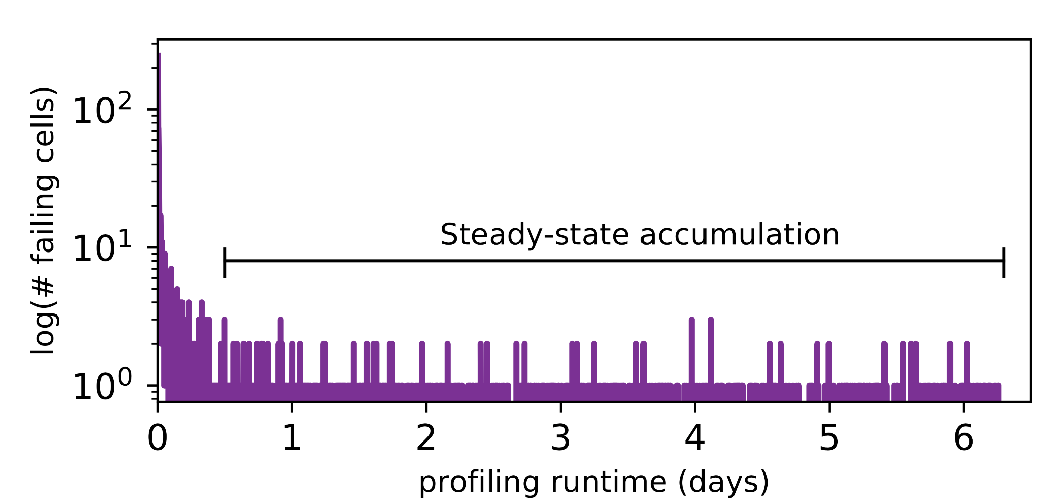
Long-term Continuous Profiling
Representative chip from Vendor B, 2048ms, 45°C
# New Failing Cells
Time (days)
New failing cells continue to appear over time
Attributed to variable retention time (VRT)
The set of failing cells changes over time
21/36
Notes:
Here is some data we collected from a representative chip at a fixed refresh interval of 2048ms.
We show the number of new failing cells discovered by continuously profiling over 6 days.
[CLICK]
We see that new failing cells continue to appear over time.
We attribute these to variable retention time effects, which mean that cells can randomly change retention times at any point.
[CLICK]
This shows that the set of failing cells we find at 2048ms changes over time
[CLICK]
This means that error correction codes and online profiling are necessary to manage new failing cells that continue to appear
[END]

Slide 32
Long-term Continuous Profiling
Representative chip from Vendor B, 2048ms, 45°C
# New Failing Cells
Error correction codes (ECC)
and online profiling are necessary
to manage new failing cells
Time (days)
New failing cells continue to appear over time
Attributed to variable retention time (VRT)
The set of failing cells changes over time
21/36
Notes:
Here is some data we collected from a representative chip at a fixed refresh interval of 2048ms.
We show the number of new failing cells discovered by continuously profiling over 6 days.
[CLICK]
We see that new failing cells continue to appear over time.
We attribute these to variable retention time effects, which mean that cells can randomly change retention times at any point.
[CLICK]
This shows that the set of failing cells we find at 2048ms changes over time
[CLICK]
This means that error correction codes and online profiling are necessary to manage new failing cells that continue to appear
[END]

Slide 33
Single-cell Failure Probability (Cartoon)
idealized cell
(retention time = 3s)
22/36
Notes:
In another study, we analyzed the failure probability of individual cells.
Here we show the probability of read failure for a single cell over different refresh intervals
We show an idealized cell, with never fails below 3.5 seconds, but always fails above 3.5s
We can say that this cell has a retention time of 3.5s.
[CLICK]
However, we find that real cells look more like the blue cartoon, which follows a normal distribution with a mean at 3.5s.
Note that even below 3.5s, there is a nonzero probability of the cell failing.
[END]

Slide 34
Single-cell Failure Probability (Cartoon)
idealized cell
(retention time = 3s)
actual cell
N(μ, σ) | μ = 3s
22/36
Notes:
In another study, we analyzed the failure probability of individual cells.
Here we show the probability of read failure for a single cell over different refresh intervals
We show an idealized cell, with never fails below 3.5 seconds, but always fails above 3.5s
We can say that this cell has a retention time of 3.5s.
[CLICK]
However, we find that real cells look more like the blue cartoon, which follows a normal distribution with a mean at 3.5s.
Note that even below 3.5s, there is a nonzero probability of the cell failing.
[END]

Slide 35
Single-cell Failure Probability (Real)
22/36
Notes:
TEMPERATURE TEMPERATURE TEMPERATURE TEMPERATURE TEMPERATURE TEMPERATURE TEMPERATURE
Here we show real data from a real chip, [CLICK] which we collected by testing how often the cell failed out of 16 trials for different refresh intervals.
[CLICK]
We now show 8 different cells from the same chip.
[CLICK]
Suppose we are interested in operating at a refresh interval of 1.7 seconds.
[CLICK]
We will find 6 cells with a non-negligible probability of failing
[CLICK]
However, the bottom two cells will be hard to find since they have a low probability of failure at this refresh interval
[CLICK]
Instead, if we profile at an increased refresh interval, [CLICK] the same cells will be much easier to find since they will have a high probability of failure.
[CLICK]
However, we will also identify some additional cells as failing, which can end up being false positives.
[CLICK]
We repeat the same analysis for temperature variation and find that cells behave similarly. We show details of this analysis in the paper.
[CLICK]
The takeaway here is that any given cell is more likely to fail at a longer refresh interval or a higher temperature.
[END]

Slide 36
Single-cell Failure Probability (Real)
failed 9 times out of 16 trials
22/36
Notes:
TEMPERATURE TEMPERATURE TEMPERATURE TEMPERATURE TEMPERATURE TEMPERATURE TEMPERATURE
Here we show real data from a real chip, [CLICK] which we collected by testing how often the cell failed out of 16 trials for different refresh intervals.
[CLICK]
We now show 8 different cells from the same chip.
[CLICK]
Suppose we are interested in operating at a refresh interval of 1.7 seconds.
[CLICK]
We will find 6 cells with a non-negligible probability of failing
[CLICK]
However, the bottom two cells will be hard to find since they have a low probability of failure at this refresh interval
[CLICK]
Instead, if we profile at an increased refresh interval, [CLICK] the same cells will be much easier to find since they will have a high probability of failure.
[CLICK]
However, we will also identify some additional cells as failing, which can end up being false positives.
[CLICK]
We repeat the same analysis for temperature variation and find that cells behave similarly. We show details of this analysis in the paper.
[CLICK]
The takeaway here is that any given cell is more likely to fail at a longer refresh interval or a higher temperature.
[END]

Slide 37
Single-cell Failure Probability (Real)
22/36
Notes:
TEMPERATURE TEMPERATURE TEMPERATURE TEMPERATURE TEMPERATURE TEMPERATURE TEMPERATURE
Here we show real data from a real chip, [CLICK] which we collected by testing how often the cell failed out of 16 trials for different refresh intervals.
[CLICK]
We now show 8 different cells from the same chip.
[CLICK]
Suppose we are interested in operating at a refresh interval of 1.7 seconds.
[CLICK]
We will find 6 cells with a non-negligible probability of failing
[CLICK]
However, the bottom two cells will be hard to find since they have a low probability of failure at this refresh interval
[CLICK]
Instead, if we profile at an increased refresh interval, [CLICK] the same cells will be much easier to find since they will have a high probability of failure.
[CLICK]
However, we will also identify some additional cells as failing, which can end up being false positives.
[CLICK]
We repeat the same analysis for temperature variation and find that cells behave similarly. We show details of this analysis in the paper.
[CLICK]
The takeaway here is that any given cell is more likely to fail at a longer refresh interval or a higher temperature.
[END]

Slide 38
Single-cell Failure Probability (Real)
22/36
Notes:
TEMPERATURE TEMPERATURE TEMPERATURE TEMPERATURE TEMPERATURE TEMPERATURE TEMPERATURE
Here we show real data from a real chip, [CLICK] which we collected by testing how often the cell failed out of 16 trials for different refresh intervals.
[CLICK]
We now show 8 different cells from the same chip.
[CLICK]
Suppose we are interested in operating at a refresh interval of 1.7 seconds.
[CLICK]
We will find 6 cells with a non-negligible probability of failing
[CLICK]
However, the bottom two cells will be hard to find since they have a low probability of failure at this refresh interval
[CLICK]
Instead, if we profile at an increased refresh interval, [CLICK] the same cells will be much easier to find since they will have a high probability of failure.
[CLICK]
However, we will also identify some additional cells as failing, which can end up being false positives.
[CLICK]
We repeat the same analysis for temperature variation and find that cells behave similarly. We show details of this analysis in the paper.
[CLICK]
The takeaway here is that any given cell is more likely to fail at a longer refresh interval or a higher temperature.
[END]

Slide 39
Single-cell Failure Probability (Real)
operate here
22/36
Notes:
TEMPERATURE TEMPERATURE TEMPERATURE TEMPERATURE TEMPERATURE TEMPERATURE TEMPERATURE
Here we show real data from a real chip, [CLICK] which we collected by testing how often the cell failed out of 16 trials for different refresh intervals.
[CLICK]
We now show 8 different cells from the same chip.
[CLICK]
Suppose we are interested in operating at a refresh interval of 1.7 seconds.
[CLICK]
We will find 6 cells with a non-negligible probability of failing
[CLICK]
However, the bottom two cells will be hard to find since they have a low probability of failure at this refresh interval
[CLICK]
Instead, if we profile at an increased refresh interval, [CLICK] the same cells will be much easier to find since they will have a high probability of failure.
[CLICK]
However, we will also identify some additional cells as failing, which can end up being false positives.
[CLICK]
We repeat the same analysis for temperature variation and find that cells behave similarly. We show details of this analysis in the paper.
[CLICK]
The takeaway here is that any given cell is more likely to fail at a longer refresh interval or a higher temperature.
[END]

Slide 40
Single-cell Failure Probability (Real)
operate here
22/36
Notes:
TEMPERATURE TEMPERATURE TEMPERATURE TEMPERATURE TEMPERATURE TEMPERATURE TEMPERATURE
Here we show real data from a real chip, [CLICK] which we collected by testing how often the cell failed out of 16 trials for different refresh intervals.
[CLICK]
We now show 8 different cells from the same chip.
[CLICK]
Suppose we are interested in operating at a refresh interval of 1.7 seconds.
[CLICK]
We will find 6 cells with a non-negligible probability of failing
[CLICK]
However, the bottom two cells will be hard to find since they have a low probability of failure at this refresh interval
[CLICK]
Instead, if we profile at an increased refresh interval, [CLICK] the same cells will be much easier to find since they will have a high probability of failure.
[CLICK]
However, we will also identify some additional cells as failing, which can end up being false positives.
[CLICK]
We repeat the same analysis for temperature variation and find that cells behave similarly. We show details of this analysis in the paper.
[CLICK]
The takeaway here is that any given cell is more likely to fail at a longer refresh interval or a higher temperature.
[END]

Slide 41
Single-cell Failure Probability (Real)
operate here
hard
to find
22/36
Notes:
TEMPERATURE TEMPERATURE TEMPERATURE TEMPERATURE TEMPERATURE TEMPERATURE TEMPERATURE
Here we show real data from a real chip, [CLICK] which we collected by testing how often the cell failed out of 16 trials for different refresh intervals.
[CLICK]
We now show 8 different cells from the same chip.
[CLICK]
Suppose we are interested in operating at a refresh interval of 1.7 seconds.
[CLICK]
We will find 6 cells with a non-negligible probability of failing
[CLICK]
However, the bottom two cells will be hard to find since they have a low probability of failure at this refresh interval
[CLICK]
Instead, if we profile at an increased refresh interval, [CLICK] the same cells will be much easier to find since they will have a high probability of failure.
[CLICK]
However, we will also identify some additional cells as failing, which can end up being false positives.
[CLICK]
We repeat the same analysis for temperature variation and find that cells behave similarly. We show details of this analysis in the paper.
[CLICK]
The takeaway here is that any given cell is more likely to fail at a longer refresh interval or a higher temperature.
[END]

Slide 42
Single-cell Failure Probability (Real)
operate here
profile here
hard
to find
22/36
Notes:
TEMPERATURE TEMPERATURE TEMPERATURE TEMPERATURE TEMPERATURE TEMPERATURE TEMPERATURE
Here we show real data from a real chip, [CLICK] which we collected by testing how often the cell failed out of 16 trials for different refresh intervals.
[CLICK]
We now show 8 different cells from the same chip.
[CLICK]
Suppose we are interested in operating at a refresh interval of 1.7 seconds.
[CLICK]
We will find 6 cells with a non-negligible probability of failing
[CLICK]
However, the bottom two cells will be hard to find since they have a low probability of failure at this refresh interval
[CLICK]
Instead, if we profile at an increased refresh interval, [CLICK] the same cells will be much easier to find since they will have a high probability of failure.
[CLICK]
However, we will also identify some additional cells as failing, which can end up being false positives.
[CLICK]
We repeat the same analysis for temperature variation and find that cells behave similarly. We show details of this analysis in the paper.
[CLICK]
The takeaway here is that any given cell is more likely to fail at a longer refresh interval or a higher temperature.
[END]

Slide 43
Single-cell Failure Probability (Real)
operate here
profile here
easy
to find
hard
to find
22/36
Notes:
TEMPERATURE TEMPERATURE TEMPERATURE TEMPERATURE TEMPERATURE TEMPERATURE TEMPERATURE
Here we show real data from a real chip, [CLICK] which we collected by testing how often the cell failed out of 16 trials for different refresh intervals.
[CLICK]
We now show 8 different cells from the same chip.
[CLICK]
Suppose we are interested in operating at a refresh interval of 1.7 seconds.
[CLICK]
We will find 6 cells with a non-negligible probability of failing
[CLICK]
However, the bottom two cells will be hard to find since they have a low probability of failure at this refresh interval
[CLICK]
Instead, if we profile at an increased refresh interval, [CLICK] the same cells will be much easier to find since they will have a high probability of failure.
[CLICK]
However, we will also identify some additional cells as failing, which can end up being false positives.
[CLICK]
We repeat the same analysis for temperature variation and find that cells behave similarly. We show details of this analysis in the paper.
[CLICK]
The takeaway here is that any given cell is more likely to fail at a longer refresh interval or a higher temperature.
[END]

Slide 44
Single-cell Failure Probability (Real)
operate here
profile here
easy
to find
hard
false
to find
positives
22/36
Notes:
TEMPERATURE TEMPERATURE TEMPERATURE TEMPERATURE TEMPERATURE TEMPERATURE TEMPERATURE
Here we show real data from a real chip, [CLICK] which we collected by testing how often the cell failed out of 16 trials for different refresh intervals.
[CLICK]
We now show 8 different cells from the same chip.
[CLICK]
Suppose we are interested in operating at a refresh interval of 1.7 seconds.
[CLICK]
We will find 6 cells with a non-negligible probability of failing
[CLICK]
However, the bottom two cells will be hard to find since they have a low probability of failure at this refresh interval
[CLICK]
Instead, if we profile at an increased refresh interval, [CLICK] the same cells will be much easier to find since they will have a high probability of failure.
[CLICK]
However, we will also identify some additional cells as failing, which can end up being false positives.
[CLICK]
We repeat the same analysis for temperature variation and find that cells behave similarly. We show details of this analysis in the paper.
[CLICK]
The takeaway here is that any given cell is more likely to fail at a longer refresh interval or a higher temperature.
[END]

Slide 45
Single-cell Failure Probability (Real)
operate here
profile here
easy
Any cell is more likely to fail
at a longer refresh interval
OR a higher temperature
to find
hard
false
to find
positives
22/36
Notes:
TEMPERATURE TEMPERATURE TEMPERATURE TEMPERATURE TEMPERATURE TEMPERATURE TEMPERATURE
Here we show real data from a real chip, [CLICK] which we collected by testing how often the cell failed out of 16 trials for different refresh intervals.
[CLICK]
We now show 8 different cells from the same chip.
[CLICK]
Suppose we are interested in operating at a refresh interval of 1.7 seconds.
[CLICK]
We will find 6 cells with a non-negligible probability of failing
[CLICK]
However, the bottom two cells will be hard to find since they have a low probability of failure at this refresh interval
[CLICK]
Instead, if we profile at an increased refresh interval, [CLICK] the same cells will be much easier to find since they will have a high probability of failure.
[CLICK]
However, we will also identify some additional cells as failing, which can end up being false positives.
[CLICK]
We repeat the same analysis for temperature variation and find that cells behave similarly. We show details of this analysis in the paper.
[CLICK]
The takeaway here is that any given cell is more likely to fail at a longer refresh interval or a higher temperature.
[END]

Slide 46
REAPER Outline
1. DRAM Refresh Background
2. Failure Profiling Challenges
3. Current Approaches
4. LPDDR4 Characterization
5. Reach Profiling
6. End-to-end Evaluation
23/36
Notes:
This leads us into the key idea of reach profiling
[END]

Slide 47
Reach Profiling
Key idea: profile at a longer refresh interval and/or a higher temperature
temperature
operate
here
refresh interval
24/36
Notes:
…which is to profile NOT at the desired operating conditions, but rather at a longer refresh interval and/or a higher tempereature
[CLICK]
The pros of this approach are that it’s faster and more reliable since we are profiling for failures where they are most likely to occur
[CLICK]
However, we may also identify false positives, which fail under profiling conditions but not under operating conditions
[END]

Slide 48
Reach Profiling
Key idea: profile at a longer refresh interval and/or a higher temperature
profile
here
temperature
operate
here
refresh interval
24/36
Notes:
…which is to profile NOT at the desired operating conditions, but rather at a longer refresh interval and/or a higher tempereature
[CLICK]
The pros of this approach are that it’s faster and more reliable since we are profiling for failures where they are most likely to occur
[CLICK]
However, we may also identify false positives, which fail under profiling conditions but not under operating conditions
[END]

Slide 49
Reach Profiling
Key idea: profile at a longer refresh interval and/or a higher temperature
Pros
Fast + Reliable: reach profiling searches for cells where they are most likely to fail
Cons
False Positives: profiler may identify cells that fail under profiling conditions, but not under operating conditions
25/36
Notes:
…which is to profile NOT at the desired operating conditions, but rather at a longer refresh interval and/or a higher tempereature
[CLICK]
The pros of this approach are that it’s faster and more reliable since we are profiling for failures where they are most likely to occur
[CLICK]
However, we may also identify false positives, which fail under profiling conditions but not under operating conditions
[END]

Slide 50
Towards an Implementation
Reach profiling is a general methodology
3 key questions for an implementation:
What are desirable profiling conditions?
How often should the system profile?
What information does the profiler need?
26/36
Notes:
Reach profiling as shown is a general methodology.
[CLICK]
In order to turn it into a concrete implementation, we need to answer three key questions
[CLICK]
First, what are the desirable profiling conditions?
[CLICK]
Second, how often must we reprofile?
[CLICK]
Third, what information does the profiler need in order to figure all of this out?
[END]

Slide 51
Three Key Profiling Metrics
Runtime: how long profiling takes
Coverage: portion of all possible failures discovered by profiling
False positives: number of cells observed to fail during profiling but never during actual operation
27/36
Notes:
To this end, we identify three key metrics we can use to characterize any retention failure profiling mechanism.
[CLICK]
Runtime represents how long profiling actually takes
[CLICK]
Coverage represents the portion of all possible failures that are discovered by the profiling mechanism
[CLICK]
False positives represent the number of cells that are observed to fail during profiling, but never during actual operation
[CLICK]
We then perform a detailed exploration of how these three metrics change under many different profiling conditions.
[END]

Slide 52
Three Key Profiling Metrics
Runtime: how long profiling takes
Coverage: portion of all possible failures discovered by profiling
False positives: number of cells observed to fail during profiling but never during actual operation
We explore how these three metrics
change under many different
profiling conditions
27/36
Notes:
To this end, we identify three key metrics we can use to characterize any retention failure profiling mechanism.
[CLICK]
Runtime represents how long profiling actually takes
[CLICK]
Coverage represents the portion of all possible failures that are discovered by the profiling mechanism
[CLICK]
False positives represent the number of cells that are observed to fail during profiling, but never during actual operation
[CLICK]
We then perform a detailed exploration of how these three metrics change under many different profiling conditions.
[END]

Slide 53
Q1: Desirable Profiling Conditions
Similar trends across chips and vendors!
For 99% coverage, we find on average:
2.5x speedup by profiling at +250ms at a cost of a 50% false positive rate
>3.5x speedup by profiling at + >500ms at a cost of a >75% false positive rate
More examples and detail in the paper
28/36
Notes:
The first question we need to answer is what are desirable profiling conditions.
[CLICK]
Through our characterization, we find that there are very similar trends across both chips and vendors
[CLICK]
We find that on average, to maintain 99% coverage of failures, we can obtain a 2.5x speedup by profiling at +250ms, and over a 3.5x speedup by profiling at +500ms.
However, increasing the speedup also increases the number of false positives that we observe.
[CLICK]
We have more examples and much more detail in the paper
[END]

Slide 54
Q2: How Often to Profile
Estimation using a probabilistic model
Can use our empirical data for estimates
Details are in the paper
e.g., Need to reprofile every 2.3 days for a:
2GB ECC DRAM
1024ms refresh interval at 45°C
Profiling with 99% coverage
29/36
Notes:
The second question we want to answer is how often do we have to re-profile?
[CLICK]
We can actually estimate this using a probabilistic model, which uses our empirical data to provide estimates
The details of this model and how we use it are in the paper
[CLICK]
For example, based on our experimental characterization, we find that we need to reprofile every 2.3 days for a 2 gigabyte ECC DRAM under the assumptions listed
[END]

Slide 55
Q3: Information Necessary for Profiling
The cost of handling identified failures
Determines how many errors we can mitigate
e.g., error-correction codes (ECC)
Empirical per-chip characterization data
Used to reliably estimate profiling parameters
Details are in the paper
30/36
Notes:
The third question we need to answer is what do we need to know in order to profile?
[CLICK]
First, we need to know the failure mitigation mechanism that we’re using
This determines how many errors we can actually mitigate, and thus how aggressively we can profile
[CLICK]
Second, we need some sort of empirical per-chip characterization data in order to reliably make estimates of the different profiling parameters
This helps us find a good point in the tradeoff space at which to profile
We provide more detail about exactly what data we need in the paper
[END]

Slide 56
REAPER Outline
1. DRAM Refresh Background
2. Failure Profiling Challenges
3. Current Approaches
4. LPDDR4 Characterization
5. Reach Profiling
6. End-to-end Evaluation
31/36
Notes:
Finally, let’s discuss our end-to-end evaluations
[END]

Slide 57
Our Mechanism: REAPER
Simple implementation of reach profiling
Pessimistic assumptions
Whole system pauses during profiling
Firmware executes profiling routine
Exclusive DRAM access
Only manipulates refresh interval, not temperature
32/36
Notes:
We evaluate REAPER, which is our simple implementation of reach profiling
[CLICK]
REAPER makes a number of pessimistic assumptions
First, the whole system pauses while profiling
This means that the profiler has exclusive access to DRAM while profiling
Second, REAPER can only manipulate refresh interval and not temperature. We believe that this is a reasonable assumption for devices in the field.
[END]

Slide 58
Evaluation Methodology
Simulators
Performance: Ramulator [Kim+, CAL’15]
Energy: DRAMPower [Chandrasekar+, DSD’11]
Configuration
4-core (4GHz), 8MB LLC
LPDDR4-3200, 4 channels, 1 rank/channel
Workloads
20 random 4-core benchmark mixes
SPEC CPU2006 benchmark suite
33/36
Notes:
We evaluate REAPER using Ramulator for performance and DRAMPower for DRAM energy.
We model a 4-core system using 4 channels of LPDDR4 DRAM
[CLICK]
We measure performance and energy across 20 random 4-core benchmark mixes drawn from the SPEC CPU2006 benchmark suite
[END]

Slide 59
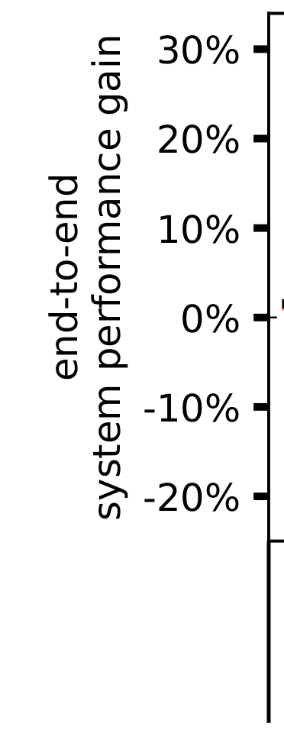
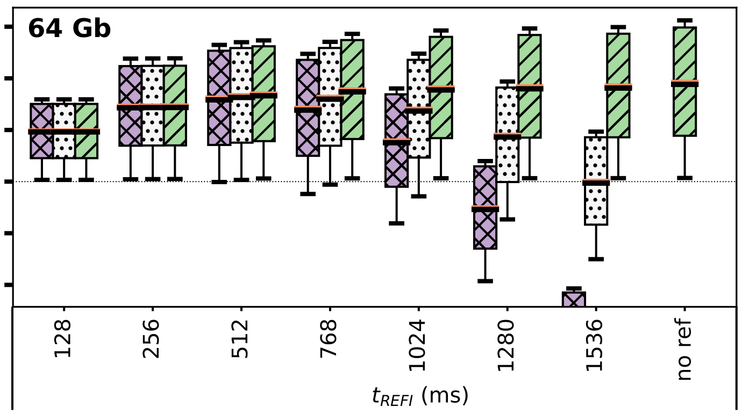
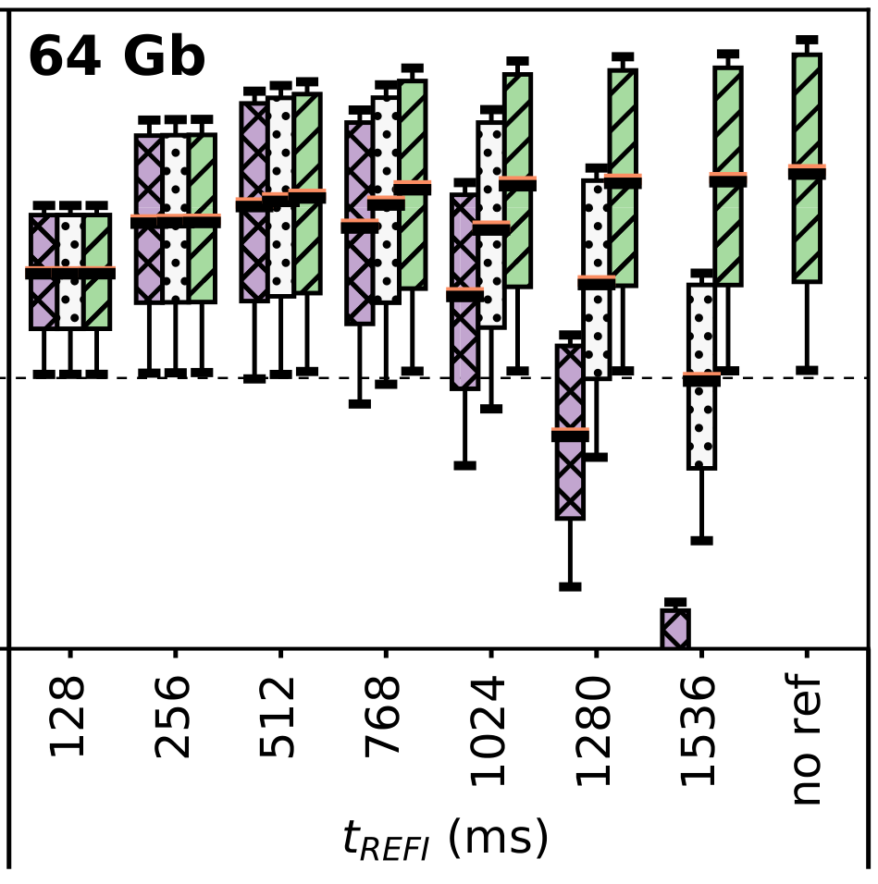
Simulated End-to-end Performance
refresh interval (ms)
34/36
Notes:
Here is a plot of our simulated end-to-end performance gain for operating at different refresh intervals.
The boxplots show the distribution of benchmark performance for brute-force profiling, REAPER, and the ideal profiling mechanism with no overhead.
[CLICK]
We see that for short refresh intervals, where we reprofile rarely, profiling overhead is not significant and both profiling mechanisms come close to ideal.
[CLICK]
However, for long refresh intervals where we reprofile often, profiling overhead is highly significant and actually begins to cause system performance degradation.
[CLICK]
We see that at 1024 and 1280 milliseconds, visibly REAPER outperforms brute-force profiling, maintaining more of the ideal profiler’s benefit than brute-force profiling is able to.
[CLICK]
Overall, we find that REAPER enables a best-case 16.3% system performance improvement and a 36.4% DRAM power reduction, which is shown in the paper.
[CLICK]
Furthermore, REAPER enables the 1280ms refresh interval, which is unreasonable with brute-force profiling due to profiling overhead.
[END]

Slide 60
Simulated End-to-end Performance
refresh interval (ms)
Reprofile rarely
Reprofile often
34/36
Notes:
Here is a plot of our simulated end-to-end performance gain for operating at different refresh intervals.
The boxplots show the distribution of benchmark performance for brute-force profiling, REAPER, and the ideal profiling mechanism with no overhead.
[CLICK]
We see that for short refresh intervals, where we reprofile rarely, profiling overhead is not significant and both profiling mechanisms come close to ideal.
[CLICK]
However, for long refresh intervals where we reprofile often, profiling overhead is highly significant and actually begins to cause system performance degradation.
[CLICK]
We see that at 1024 and 1280 milliseconds, visibly REAPER outperforms brute-force profiling, maintaining more of the ideal profiler’s benefit than brute-force profiling is able to.
[CLICK]
Overall, we find that REAPER enables a best-case 16.3% system performance improvement and a 36.4% DRAM power reduction, which is shown in the paper.
[CLICK]
Furthermore, REAPER enables the 1280ms refresh interval, which is unreasonable with brute-force profiling due to profiling overhead.
[END]

Slide 61
Simulated End-to-end Performance
refresh interval (ms)
Reprofile rarely
Reprofile often
34/36
Notes:
Here is a plot of our simulated end-to-end performance gain for operating at different refresh intervals.
The boxplots show the distribution of benchmark performance for brute-force profiling, REAPER, and the ideal profiling mechanism with no overhead.
[CLICK]
We see that for short refresh intervals, where we reprofile rarely, profiling overhead is not significant and both profiling mechanisms come close to ideal.
[CLICK]
However, for long refresh intervals where we reprofile often, profiling overhead is highly significant and actually begins to cause system performance degradation.
[CLICK]
We see that at 1024 and 1280 milliseconds, visibly REAPER outperforms brute-force profiling, maintaining more of the ideal profiler’s benefit than brute-force profiling is able to.
[CLICK]
Overall, we find that REAPER enables a best-case 16.3% system performance improvement and a 36.4% DRAM power reduction, which is shown in the paper.
[CLICK]
Furthermore, REAPER enables the 1280ms refresh interval, which is unreasonable with brute-force profiling due to profiling overhead.
[END]

Slide 62
Simulated End-to-end Performance
On average, REAPER enables:
16.3% system performance improvement
36.4% DRAM power reduction
REAPER enables longer refresh intervals, which are unreasonable
using brute-force profiling
refresh interval (ms)
Reprofile rarely
Reprofile often
34/36
Notes:
Here is a plot of our simulated end-to-end performance gain for operating at different refresh intervals.
The boxplots show the distribution of benchmark performance for brute-force profiling, REAPER, and the ideal profiling mechanism with no overhead.
[CLICK]
We see that for short refresh intervals, where we reprofile rarely, profiling overhead is not significant and both profiling mechanisms come close to ideal.
[CLICK]
However, for long refresh intervals where we reprofile often, profiling overhead is highly significant and actually begins to cause system performance degradation.
[CLICK]
We see that at 1024 and 1280 milliseconds, visibly REAPER outperforms brute-force profiling, maintaining more of the ideal profiler’s benefit than brute-force profiling is able to.
[CLICK]
Overall, we find that REAPER enables a best-case 16.3% system performance improvement and a 36.4% DRAM power reduction, which is shown in the paper.
[CLICK]
Furthermore, REAPER enables the 1280ms refresh interval, which is unreasonable with brute-force profiling due to profiling overhead.
[END]

Slide 63
Other Analyses in the Paper
Detailed LPDDR4 characterization data
Temperature dependence effects
Retention time distributions
Data pattern dependence
Variable retention time
Individual cell failure distributions
Profiling tradeoff space characterization
Runtime, coverage, and false positive rate
Temperature and refresh interval
Probabilistic model for tolerable failure rates
Detailed results for end-to-end evaluations
35/36
Notes:
The paper contains many other analyses that we didn’t have time to cover here today.
[CLICK]
These include a much more detailed characterization of LPDDR4 DRAM chips, including results and takeaways
[CLICK]
A much more in-depth analysis of the tradeoff space surrounding profiling
[CLICK]
A detailed analysis of the probabilistic model we use to compute how often we need to reprofile
[CLICK]
And detailed results for our end-to-end evaluations, including both performance and energy
[END]

Slide 64
Summary
Problem:
DRAM refresh performance and energy overhead is high
Current approaches to retention failure profiling are slow or unreliable
Goals:
Thoroughly analyze profiling tradeoffs
Develop a fast and reliable profiling mechanism
Key Contributions:
First detailed characterization of 368 LPDDR4 DRAM chips
Reach profiling: Profile at a longer refresh interval or higher temperature than target conditions, where cells are more likely to fail
Evaluation:
2.5x faster profiling with 99% coverage and 50% false positives
REAPER enables 16.3% system performance improvement and 36.4% DRAM power reduction
Enables longer refresh intervals that were previously unreasonable
36/36
Notes:
To conclude, I’ll go over a summary of the talk.
The high level motivation for this work is that DRAM refresh is a major impediment to scaling, especially in terms of energy.
The specific problem that we focus on is that DRAM retention failure profiling is hard.
Our goals in this work are twofold. First, we would like to thoroughly analyze retention failure profiling tradeoffs
Second, we would like to use what we learn to develop a fast, reliable profiling mechanism.
We make two key contributions in this work.
First, we perform the first detailed retention failure characterization of 368 LPDDR4 DRAM chips
Second, we use what we learn to introduce the reach profiler, which profiles for failures at a longer refresh interval and/or a higher temperature, where cells are more likely to fail.
Through our evaluations, we find that reach profiling increases profiling performance by an average of 2.5x while maintaining high coverage and a moderate false positive rate.
Our implementation of reach profiling, called REAPER, enables significant system performance improvement and DRAM power reduction.
Finally, reach profiling enables longer refresh intervals that were previously unreasonable due to profiling overhead.
[END]

Slide 65
The Reach Profiler (REAPER): Enabling the Mitigation of DRAM Retention Failures via Profiling at Aggressive Conditions
Minesh Patel Jeremie S. Kim
Onur Mutlu
Notes:
Thank you for your time, and I’m happy to take any questions
[END]

Slide 66
Temperature Relationship
Well-fitting exponential relationship:
E.g., 10°C ~ 10x more failures
38
Notes:
Experimentally determined temperature relationship

Slide 67
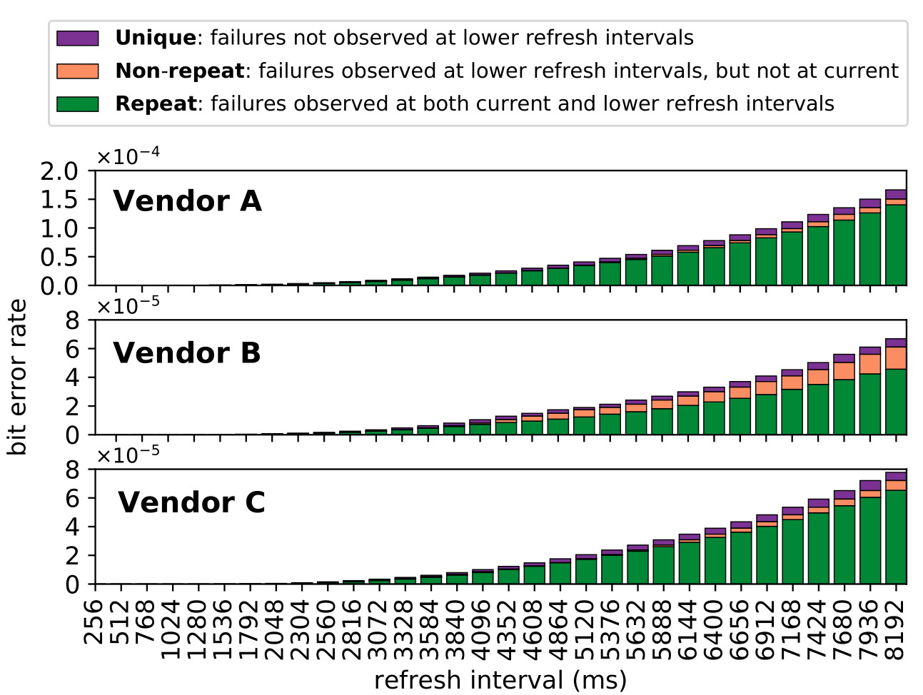
Retention Failures @ 45°C
39
Notes:
Number of retention failures vs. time for chips from our vendors

Slide 68
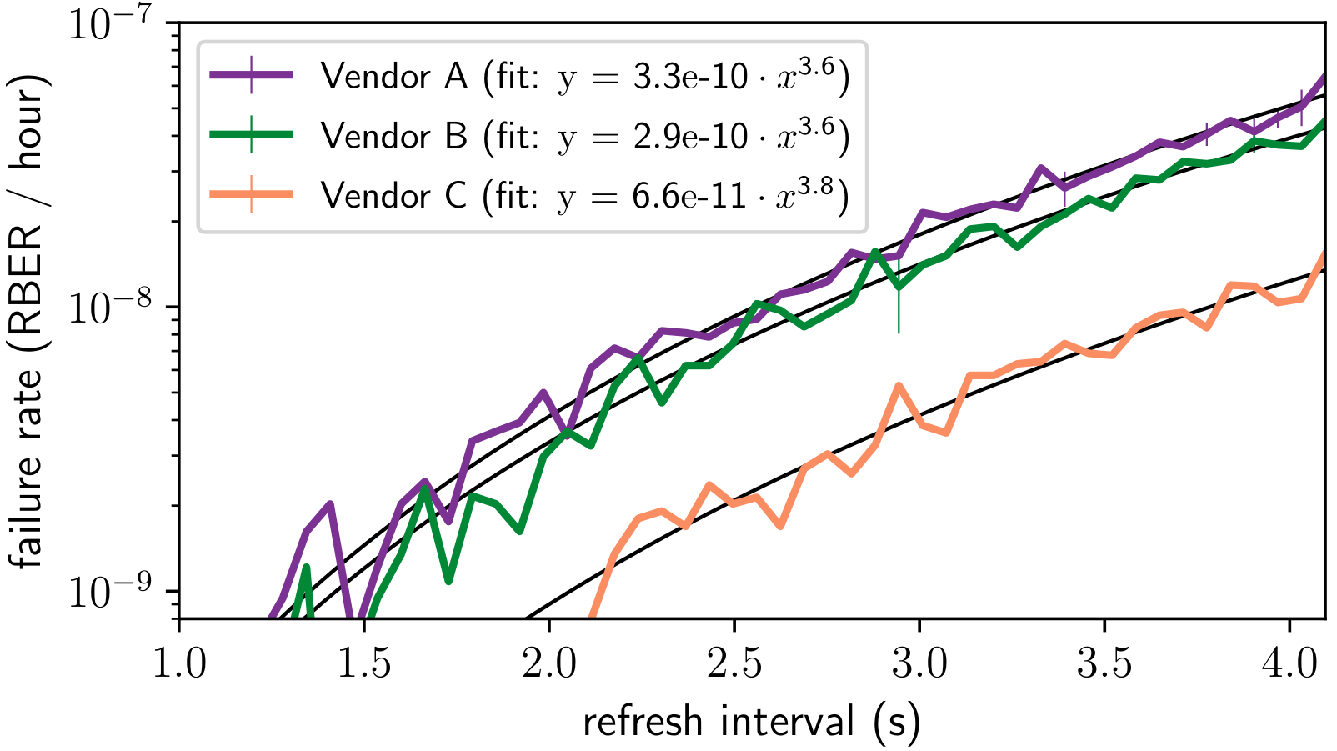
VRT Failure Accumulation Rate
40
Notes:
Rate of steady-state VRT failure accumulation as defined in Slide 21 across all of our chips from all three different vendors

Slide 69
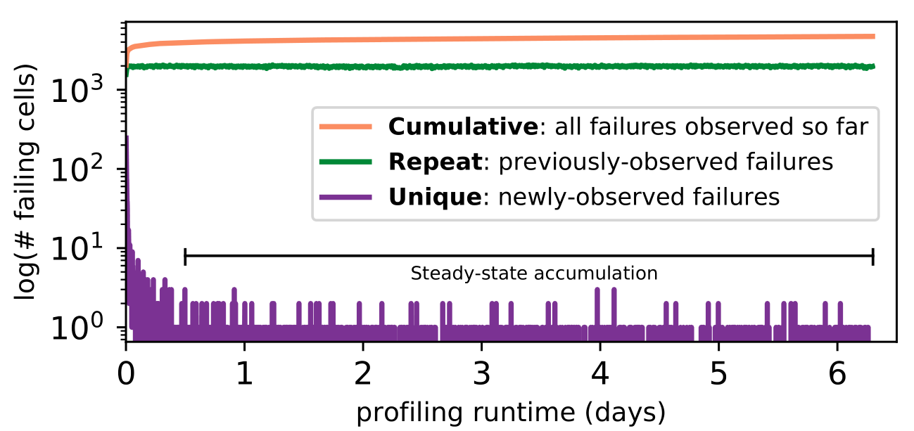
800 Rounds of Profiling @ 2048ms, 45°C
41
Notes:
Failures discovered by continuous profiling at a fixed refresh interval of 2048ms for 6.5 days at 45C. Data is taken from a representative chip from Vendor B

Slide 70
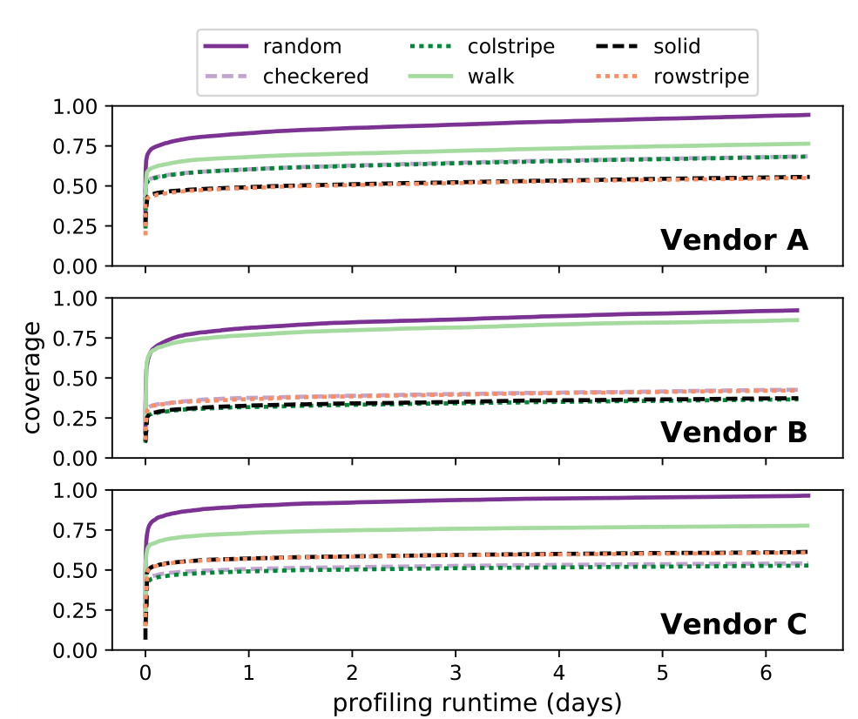
800 Rounds of Profiling @ 2048ms, 45°C
42
Notes:
Failures discovered by continuous profiling using different data patterns at a fixed refresh interval of 2048ms for 6.5 days at 45C. Data is taken from a representative chip from Vendor B

Slide 71
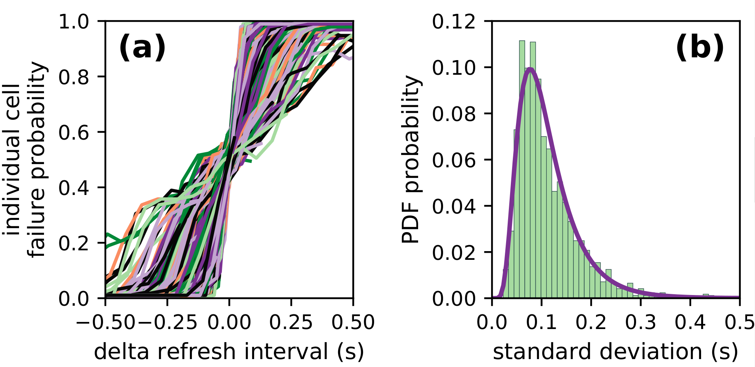
Individual Cell Failure Probabilities
Single representative chip of Vendor B at 40° C
Refresh intervals ranging from 64ms to 4096ms
43

Slide 72
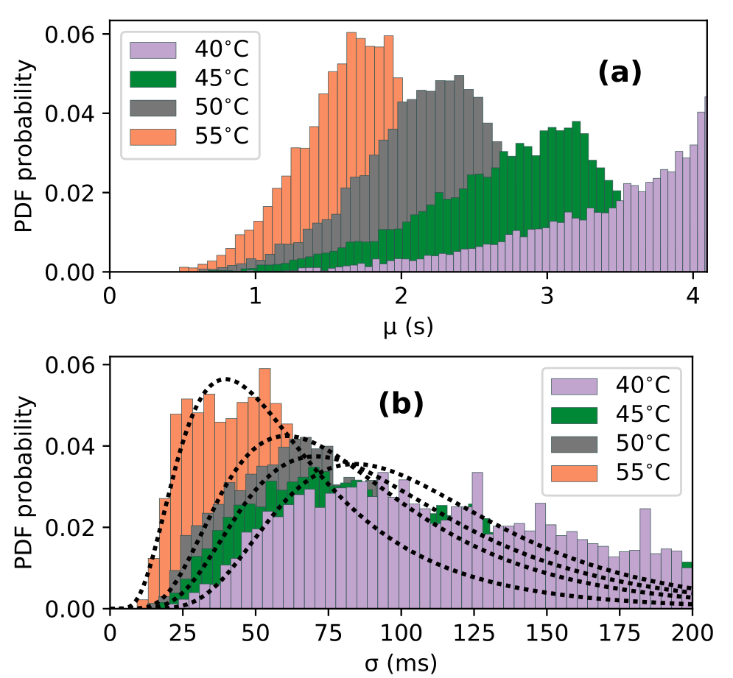
Individual Cell Failure Distributions
44
Notes:
Distributions of the mean/stv of different cells from a representative chip of Vendor B across different temperatures.

Slide 73
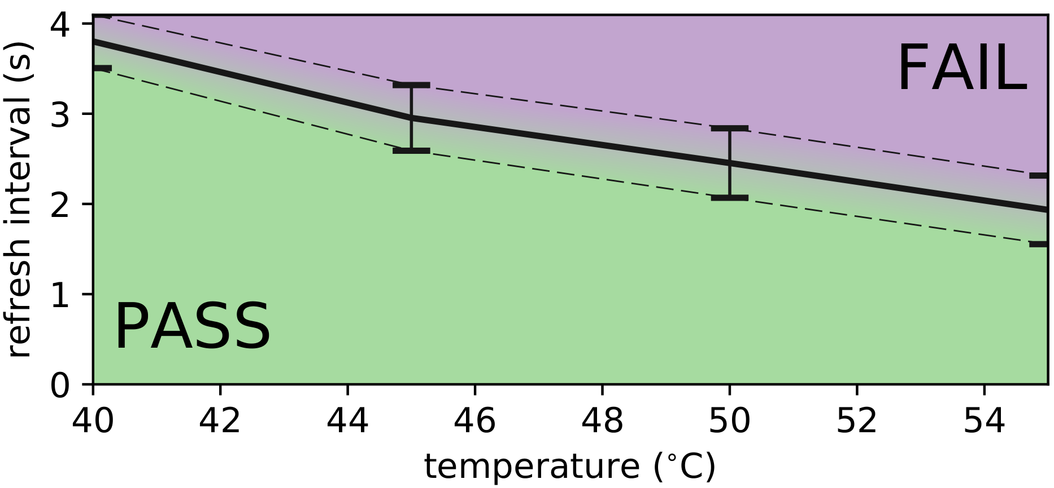
Single-cell Failures With Temperature
Single representative chip of Vendor B
{mean, std} for cells between 64ms and 4096ms
45
Notes:
Failure probability of a single cell encoded as 0 == PASS and 1 == FAIL. Probability is shown for a distribution of cells failing between 64ms and 4096ms, with the solid line representing the mean and the dashed line the standard distribution.

Slide 74
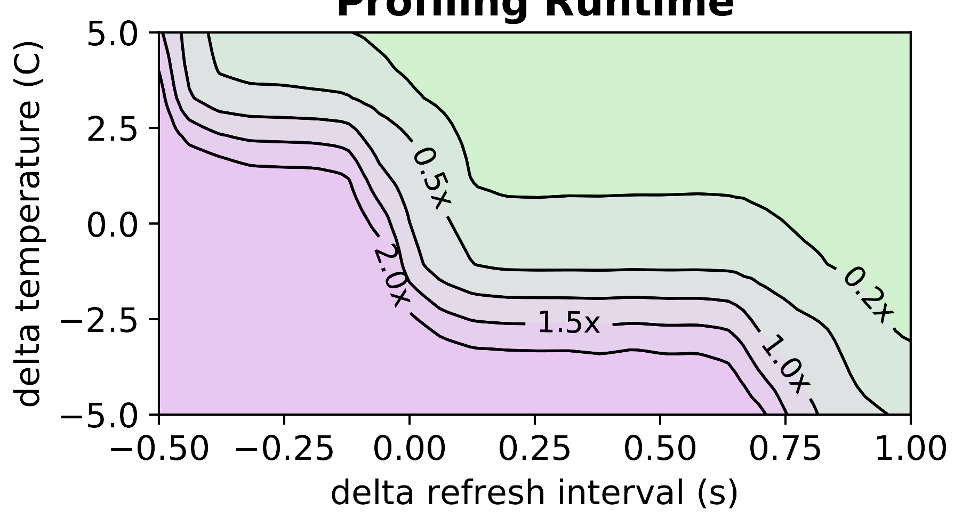
Example experimental analysis
Runtime for 95% coverage of {2048ms, 50C}
REACH
{+125ms, +1.0C}
5x speedup
{+0ms, +0C}
46
Notes:
Example analysis of profiling runtime, shown in contours ranging from 2.0x to 0.2x relative to 1.0x (representing brute-force profiling). We observe that by profiling at (+125ms, 1.0C), we can obtain a 5x speedup relative to brute-force profiling.

Slide 75
Q2: How often must we re-profile?
Raw Bit Error Rate (RBER) – ratio of actual failing DRAM cells
Uncorrectable Bit Error Rate (UBER) – error rate observed by the system
We can compute the maximum tolerable RBER for a given UBER and ECC strength
 | No ECC | SECDED | ECC-2
Max RBER for UBER = 10⁻¹⁵ | 1e-15 | 3.8e-9 | 6.9e-7
Equivalent # bits in 2GB DRAM | < 1 | 65 | 12,000
Without ECC, we can’t tolerate even one failure!
47

Slide 76
Probabilistic Failure Model
k = ECC strength (e.g., SECDED = 1)
w = ECC word size (e.g., SECDED 64/72 word = 72 bits)
48

Slide 77
Probabilistic Failure Model
k = ECC strength (e.g., SECDED = 1)
w = ECC word size (e.g., SECDED 64/72 word = 72 bits)
Binomial distribution of errors in an n-bit word:
49

Slide 78
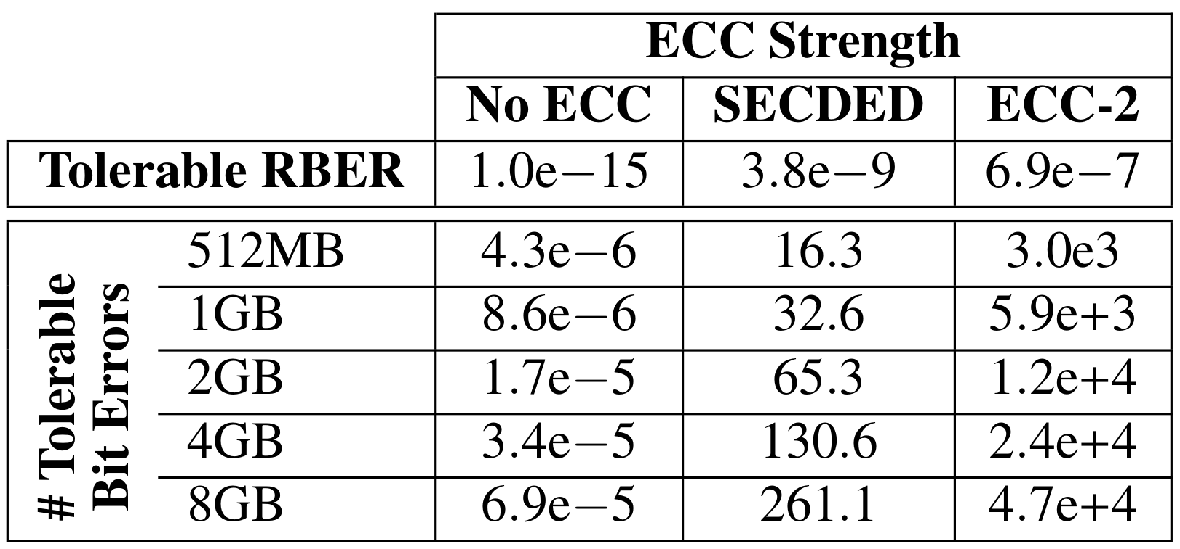
Allowable Errors
Tolerable RBER and tolerable number of bit errors for UBER = 10⁻¹⁵ across different ECC strengths for selected DRAM sizes
50

Slide 79
Tradeoff Space Exploration
We explore:
368 LPDDR4 chips
Refresh intervals from 64ms – 4096ms
Temperatures from 40C – 55C
51

Slide 80
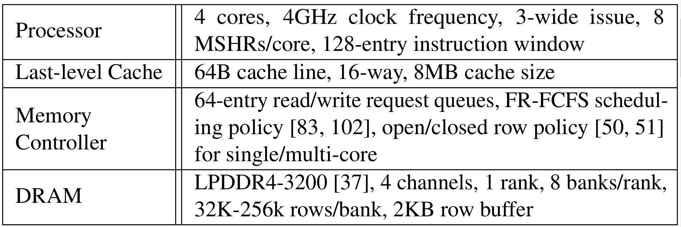
Evaluation Configuration Details
52

Slide 81
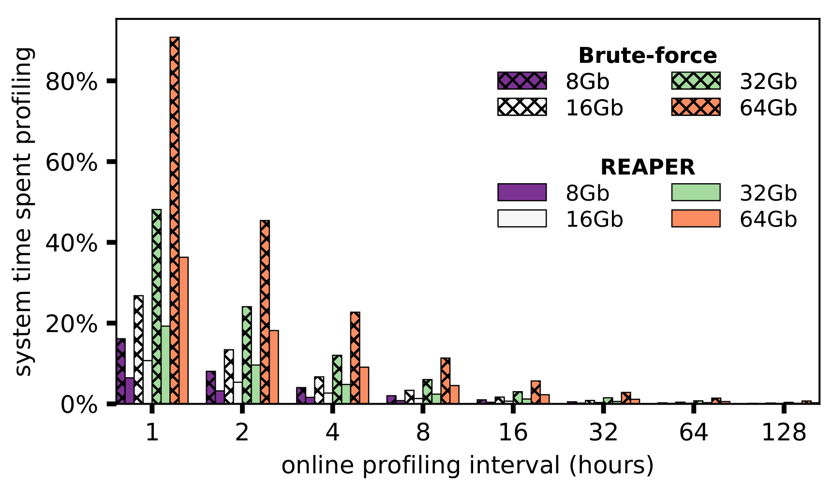
Profiling Performance Overhead
53
Notes:
Here we show the raw performance overhead of profiling for various different online profiling intervals.
The Y-axis shows the percentage of total system time spent profiling, and the X axis shows different online profiling intervals in hours.
The different bars represent different DRAM chip sizes for both the baseline brute-force approach and REAPER
[CLICK]
We see that for short profiling intervals, the system overhead is prohibitively high. However, we see that REAPER significantly improves profiling performance for all DRAM sizes.
[CLICK]
For long profiling intervals, the overhead is rather low, and even in this case we see that REAPER improves profiling performance.
[CLICK]
We conclude that overall, REAPER significantly improves performance relative to brute-force profiling for any profiling interval or DRAM size
[END]

Slide 82
Profiling Performance Overhead
REAPER significantly improves
profiling performance
for any profiling interval/DRAM size
53
Notes:
Here we show the raw performance overhead of profiling for various different online profiling intervals.
The Y-axis shows the percentage of total system time spent profiling, and the X axis shows different online profiling intervals in hours.
The different bars represent different DRAM chip sizes for both the baseline brute-force approach and REAPER
[CLICK]
We see that for short profiling intervals, the system overhead is prohibitively high. However, we see that REAPER significantly improves profiling performance for all DRAM sizes.
[CLICK]
For long profiling intervals, the overhead is rather low, and even in this case we see that REAPER improves profiling performance.
[CLICK]
We conclude that overall, REAPER significantly improves performance relative to brute-force profiling for any profiling interval or DRAM size
[END]

Slide 83
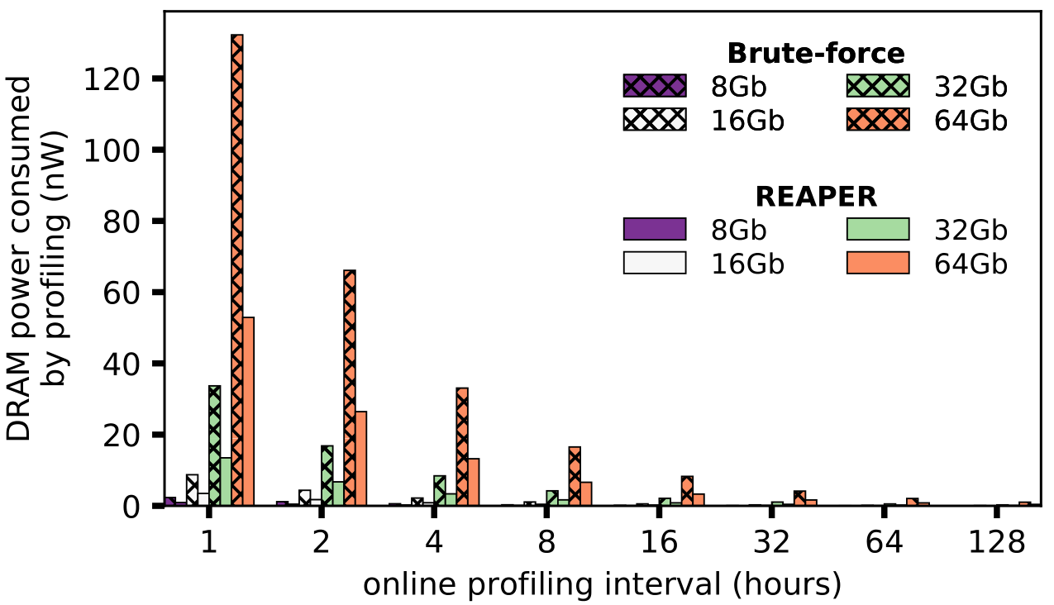
Profiling Energy Overhead
54
Notes:
Here we show the raw performance overhead of profiling for various different online profiling intervals.
The Y-axis shows the percentage of total system time spent profiling, and the X axis shows different online profiling intervals in hours.
The different bars represent different DRAM chip sizes for both the baseline brute-force approach and REAPER
[CLICK]
We see that for short profiling intervals, the system overhead is prohibitively high. However, we see that REAPER significantly improves profiling performance for all DRAM sizes.
[CLICK]
For long profiling intervals, the overhead is rather low, and even in this case we see that REAPER improves profiling performance.
[CLICK]
We conclude that overall, REAPER significantly improves performance relative to brute-force profiling for any profiling interval or DRAM size
[END]

Slide 84
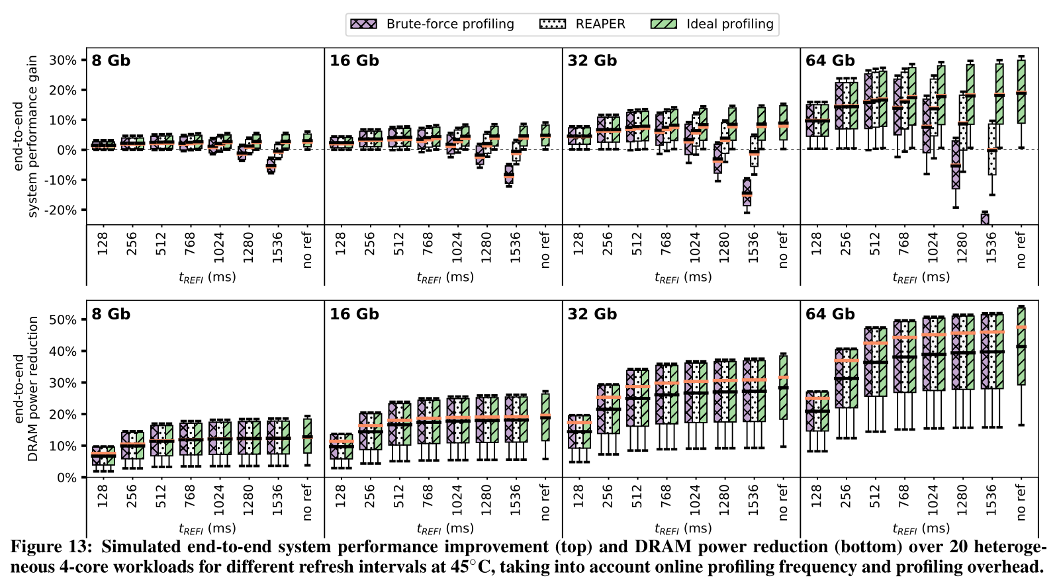
End-to-end Performance/Energy
55

Slide 85
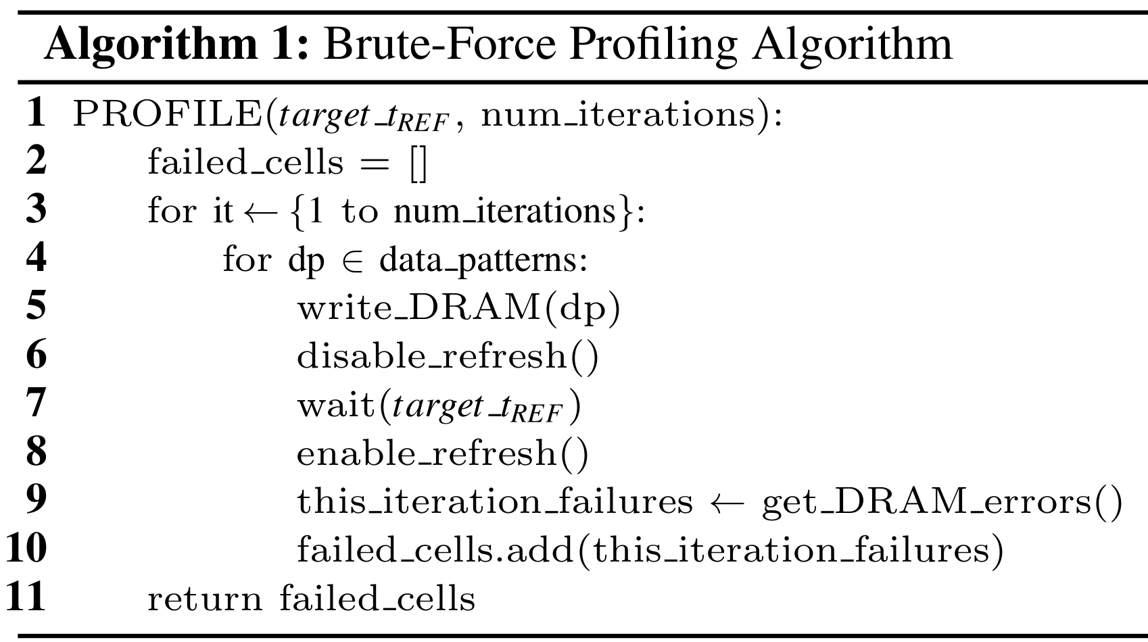
56

