Slide 1
An Experimental Study of Reduced-Voltage Operation in Modern FPGAs for Neural Network Acceleration
Behzad Salami | Baturay Onural | Ismail Yuksel
Fahrettin Koc | Oguz Ergin | Adrian Cristal
Osman Unsal | Hamid Sarbazi-Azad | Onur Mutlu
50th IEEE/IFIP International Conference on Dependable Systems and Networks (DSN), 30th June, 2020
Notes:
Hello, my name is Behzad. In this lightening talk I will be presenting An Experimental Study of Reduced-Voltage Operation in Modern FPGAs for Neural Network Acceleration.

Slide 2
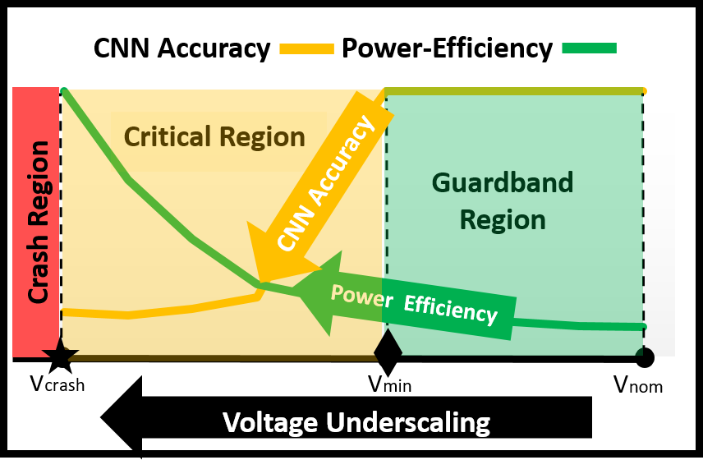
Executive Summary
Goal: Improve the power-efficiency of FPGA-based neural networks by:
Undervolting (i.e., underscaling supply voltage) below nominal level
Evaluation Setup
5 Image classification workloads
3 Xilinx UltraScale+ ZCU102 platforms
Main Results
Large voltage guardband (i.e., 33%)
>3X power-efficiency gain
In the Main Talk
Characterization of FPGA voltage behavior and its impact on the power-reliability
Frequency underscaling
Environmental temperature
Notes:
[CLICK] Our goal is to improve the power-efficiency of FPGA-based neural networks by
[CLICK] Undervolting FPGAs below the nominal level that is set by vendor
[CLICK] Our experiments are based on
[CLICK] 5 image classification workloads and also
[CLICK] 3 Xilinx UltraScale+ platforms
[CLICK] Among main results, the overall voltage behavior is shown in this figure.
[CLICK] As seen, there is a large voltage guardband, 33% of the nominal level. By eliminating this guardband and undervolting further
[CLICK] we achieve more than 3 times power-efficiency gain.
[CLICK] In the main talk, we
[CLICK] will elaborate on the power-reliability trade-off.
[CLICK] Also, we will discuss our frequency underscaling technique to prevent the accuracy loss below guardband.
[CLICK] Finally, we will discuss the effect of environmental temperature.

Slide 3
An Experimental Study of Reduced-Voltage Operation in Modern FPGAs for Neural Network Acceleration
Behzad Salami | Baturay Onural | Ismail Yuksel
Fahrettin Koc | Oguz Ergin | Adrian Cristal
Osman Unsal | Hamid Sarbazi-Azad | Onur Mutlu
50th IEEE/IFIP International Conference on Dependable Systems and Networks (DSN), 30th June, 2020
Notes:
Thanks for your attention.

