Slide 1
An Experimental Study of Reduced-Voltage Operation in Modern FPGAs for Neural Network Acceleration
Behzad Salami | Baturay Onural | Ismail Yuksel
Fahrettin Koc | Oguz Ergin | Adrian Cristal
Osman Unsal | Hamid Sarbazi-Azad | Onur Mutlu
50th IEEE/IFIP International Conference on Dependable Systems and Networks (DSN), 30th June, 2020
Notes:
10 minutes talk + 5 minutes questions
Hi, Welcome to this talk. My name is Behzad and I would like to present this paper, titled An Experimental Study of Reduced-Voltage Operation in Modern FPGAs for Neural Network Acceleration.

Slide 2
Executive Summary
Motivation: Power consumption of neural networks is a main concern
Hardware acceleration: GPUs, FPGAs, and ASICs
Problem: FPGAs are at least 10X less power-efficient than equivalent ASICs
Goal: Bridge the power-efficiency gap between ASIC- and FPGA-based neural networks by Undervolting below nominal level
Evaluation Setup
5 Image classification workloads
3 Xilinx UltraScale+ ZCU102 platforms
2 On-chip voltage rails
Main Results
Large voltage guardband (i.e., 33%)
>3X power-efficiency gain
Notes:
To begin, I will give a brief overview.
[CLICK] Our motivation is that the power consumption of Neural Networks is a first class concern in state-of-the-art applications, due to the massive amount of data movement and computational power.
[CLICK] To alleviate this issue, hardware acceleration using GPUs, FPGAs, and ASICS is a promising solution. Among them, FPGAs are getting popular, since, they deliver higher throughput than GPUs and provide better flexibility than ASICs.
[CLICK] But the problem is that the power-efficiency of FPGAs is at least 10X less than equivalent ASICs.
[CLICK] Our goal is to alleviate this issue by undervolting off-the-shelf FPGAs running Neural Network applications. Undervolting means supply voltage underscaling below default level that is set by FPGA vendor.
[CLICK] Our study is based on
[CLICK] 5 image classification workloads
[CLICK] 3 real Xilinx ZCU102 devices which is based on Zynq architecture,
[CLICK] and 2 on-chip voltage rails
[CLICK] Among the main results,
[CLICK] we discover a large voltage guardband of 33% of the nominal voltage level. This guardband is set by vendor to ensure the correct functionality in the worst-case conditions. Eliminating this guardband does not incur any performance or reliability overhead. By undervolting,
[CLICK] by applying this techinque, we achieve more than 3X power-efficiency.

Slide 3
Outline
Motivation and Background
Our Goal
Methodology
Results
Overall Voltage Behavior
Power-Reliability Trade-off
Frequency Underscaling
Environmental Temperature
Prior Works
Summary, Conclusion, and Future Works
Notes:
Here is the outline for the talk.

Slide 4
Outline
Motivation and Background
Our Goal
Methodology
Results
Overall Voltage Behavior
Power-Reliability Trade-off
Frequency Underscaling
Environmental Temperature
Prior Works
Summary, Conclusion, and Future Works
Notes:
I will first discuss the motivation behind the work and also will briefly provide the necessary background.

Slide 5
Motivation and Background
Motivation
Power consumption of neural networks is a main concern
Hardware acceleration: GPUs, FPGAs, and ASICs
FPGAs: Getting popular but less power-efficient than equivalent ASICs
Large voltage guardbands (12-35%) for CPUs, GPUs, DRAMs
Any potential of “Undervolting FPGAs” for power-efficiency of neural networks?
Background
Neural Networks: Widely deployed with an inherent resilience to errors
FPGAs: Higher throughput than GPUs and better flexibility than ASICs
Undervolting: Reduces power cons., may incur reliability or performance issues
Notes:
[CLICK] First, motivation
[CLICK] The main motivation behind this work is the increasing interest for neural network that are limited to their high power consumption drawback.
[CLICK] Using efficient accelerators usually deliver better power-efficiency than general purpose processors.
[CLICK] Among accelerator frameworks, FPGAs are getting popular thanks to their less time to market; however, their power efficiency is at least 10 times less than ASIC-based neural networks.
[CLICK] as a hardware level technique, Undervolting has been recently studied for off-the-shelf CPUs, GPUs, and DRAMs. They have shown significant potential of this technique since vendors usually add large guardbands below the nominal level. This guardband is usually unnecessary for many real-world applications and eliminating it delivers power-efficieny without compromising performance or reliability.
[CLICK] In this work, we aim to experimentally study the potential of undervolting of real FPGA devices for neural networks.
[CLICK] now I will give a brief background about
[CLICK] Neural networks first. Neural networks are getting popular since they have shown a significant potential to classify unseen objects. They have an inherent resiliency to errors.
[CLICK] fpgas second. FPGAs have reconfigurable, massively parallel, and deeply pipelined architectures. They have advantage of both GPUs and ASICs in terms of flexibility and efficiency.
[CLICK] finally undervolting. We refer undervolting as supply voltage underscaling below the nominal level that is set by vendor. We apply undervolting until the underlying FPGA device stops operating. The direct advantage is the power saving, however, it may have performance or reliability overhead. This trade-off is experimentally studied in this work.

Slide 6
Outline
Motivation and Background
Our Goal
Methodology
Results
Overall Voltage Behavior
Power-Reliability Trade-off
Frequency Underscaling
Environmental Temperature
Prior Works
Summary, Conclusion, and Future Works
Notes:
Let me elaborate on our main goals of this work.

Slide 7
Our Goal
Primary Goal
Bridge the power-efficiency gap between ASIC- and FPGA-based neural networks by:
Undervolting (i.e., underscaling voltage below nominal level)
Secondary Goals
Study the voltage behavior of real FPGAs (e.g., guardband)
Study the power-efficiency gain of undervolting for neural networks
Study the reliability overhead
Study the frequency underscaling to prevent the accuracy loss
Study the effect of environmental temperature
Notes:
[CLICK] Our primary goal is to
[CLICK] Bridge the power-efficiency gap between ASIC- and FPGA-based neural networks by:
[CLICK] Voltage underscaling of real FPGAs below the nominal level
[CLICK] Beside that, we aim to
[CLICK] Study the voltage behavior of real FPGAs such as voltage guardbands
[CLICK] Study the power-efficiency gain of undervolting for neural networks
[CLICK] Study the reliability overhead
[CLICK] Study the frequency underscaling to prevent the accuracy loss below guardband
[CLICK] and finally, study the effect of environmental temperature

Slide 8
Outline
Motivation and Background
Our Goal
Methodology
Results
Overall Voltage Behavior
Power-Reliability Trade-off
Frequency Underscaling
Environmental Temperature
Prior Works
Summary, Conclusion, and Future Works
Notes:
I will briefly explain the experimental methodology next.

Slide 9
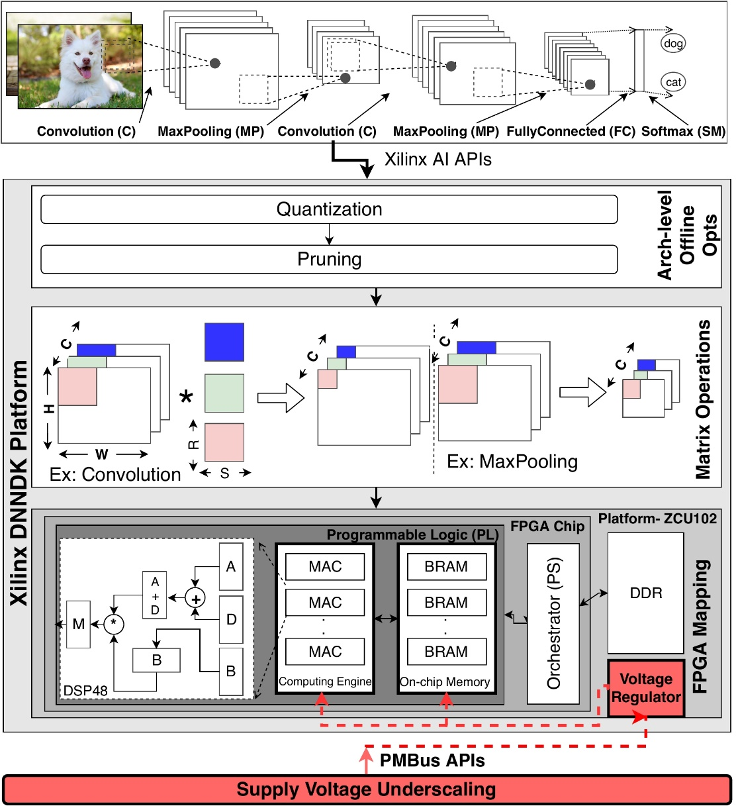
Overall Methodology
5 CNN image classification workloads, i.e., VGGNet, GoogleNet, AlexNet, ResNet50, Inception.
Xilinx DNNDK to map CNN into FPGA
By default optimized for INT8
3 identical samples of Xilinx ZCU102
ZYNQ Ultrscale+ architecture
Hard-core ARM for data orchestration
FPGA for CNN acceleration
2 on-chip voltage rails, via PMBus
$V_{CCINT}$: DSPs, LUTs, buffers, …
$V_{CCBRAM}$: BRAMs
$V_{nom}$= 850mV (set by manufacturer)
Vast majority (>99.9%) of the power is dissipated on $V_{CCINT}$
Notes:
[CLICK] our experimental methodology is summarized in this figure. Our focus is the classification phase of convolutional neural networks so we start with a pre-trained model.
[CLICK] We selected 5 state-of-the-art image classification benchmarks as listed here. They have different number of layers, neurons, and models sizes from a few KBs to hundreds of MBs.
[CLICK] For mapping CNN models into FPGA, we use a tool from Xilinx, called DNNDK. By using this tool, we make sure that our study is general-enough and not specified for a specifiec design.
[CLICK] DNNDK support several Xilinx FPGAs. We perform our experiments on 3 identical samples of Xilinx ZCU102. This architecture is composed of ARM and fpga. The DNN computations are performed in FPGA part and the ARM processor is used to orchestrate the data movement.
[CLICK] Lastly, we access the voltage rails on the FPGA platform using the PMBus. Among different voltage rails, we focus on on-chip ones including VCCINT and VCCBRAM. VCCINT is used in share by DSPs, LUTs, buffers, and routing resources, and VCCBRAM is individually used by on-chip memories. Note that this is hard setup of the platform set by vendor. The default voltage level for both these rails is 850mv.
[CLICK] Among these voltage rails, we measure the power consumption at the nominal level and observed that the BRAMs power is negligible. This can be the result of the efficient on-chip memory design in Xilinx Ultrascale+ family. Hence, we focus on undervolting VCCINT.

Slide 10
Outline
Motivation and Background
Our Goal
Methodology
Results
Overall Voltage Behavior
Power-Reliability Trade-off
Frequency Underscaling
Environmental Temperature
Prior Works
Summary, Conclusion, and Future Works
Notes:
I will now discuss the experimental results.

Slide 11
Outline
Motivation and Background
Our Goal
Methodology
Results
Overall Voltage Behavior
Power-Reliability Trade-off
Frequency Underscaling
Environmental Temperature
Prior Works
Summary, Conclusion, and Future Works
Notes:
I will start with presenting and discussing the voltage behavior we experimentally observed for FPGAs.

Slide 12
Overall Voltage Behavior
Guardband: Large region below nominal level ($V_{nom}=850mV$)
Critical: Narrower region below guardband ($V_{min}=570mV$)
Crash: FPGA crashes below critical region ($V_{crash}=540mV$)
Guard
band
No performance or reliability loss
Added by the vendor to ensure the worst-case conditions
Large guardband, average of 33%
Critical
A narrow voltage region
Neural network accuracy collapse
Crash
FPGA stops operating
Slight variation of voltage behavior across platforms and benchmarks
Notes:
Here, we show the overall voltage behavior.
[CLICK] Undervolting below the nominal level, we observe three voltage region: guardband, critical, and crash.
[CLICK] Guardband is added by vendor to ensure the correct functionality in the worst-case conditions. We measured it an average of 33%. There is no reliability or performance loss in this region. So eliminating it can deliver significant power saving in normal conditions.
[CLICK] Below guardband, there is a narrower region at which FPGA operates but with the CNN accuracy loss. We call it critical region. A minimum safe voltage level or Vmin separates the guardband and critical regions.
[CLICK] Finally below the critical regions and at Vcrach FPGA does not operate. Vcrash is measured to be average of 540mV.
[CLICK] Note that there is a slight variation of voltage behavior across 3 platforms and 5 benchmarks studied.

Slide 13
Outline
Motivation and Background
Our Goal
Methodology
Results
Overall Voltage Behavior
Power-Reliability Trade-off
Frequency Underscaling
Environmental Temperature
Prior Works
Summary, Conclusion, and Future Works
Notes:
I will discuss now the effect of the reduced-voltage operations on the power consumption and DNN accuracy trade-off according to the voltage behavior discussed.

Slide 14
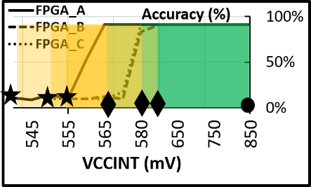
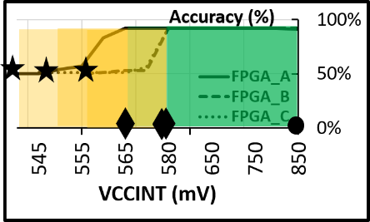
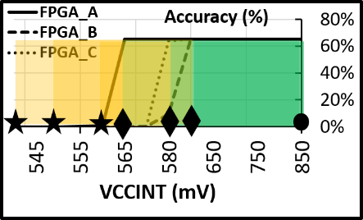
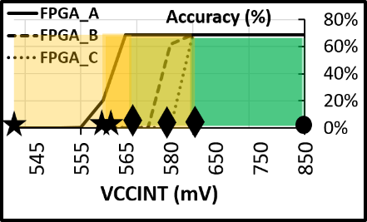
Power-Reliability Trade-off
Power-efficiency (GOPs/W) gain
>3X power saving (2.6X by eliminating guardband and further 43% in critical region)
Slight variation across 3 platforms and 5 workloads
43%
2.6X
Reliability overhead (i.e., CNN accuracy loss)
No accuracy loss in the guardband, accuracy collapse in the critical region
Slight variation across 3 platforms and 5 workloads
VGGNet GoogleNet AlexNet ResNet Inception
Notes:
[CLICK] First power. There is a total of more than 3X gain in power-efficiency when undervolting from nominal level to the crash point. 2.6X of this is achieved by eliminating the guardband and a further 43% is as the result of undervolting in the critical region which has the cost of accuracy loss.
[CLICK] there is a slight variation across 3 benchmarks and 5 platforms.
[CLICK] the CNN accuracy is substantially reduced in the critical region.
[click] and there is an accuracy collapse for all benchmarks. [click]As it can be seen, with a slight variation across 3 benchmarks and 5 platforms.

Slide 15
Outline
Motivation and Background
Our Goal
Methodology
Results
Overall Voltage Behavior
Power-Reliability Trade-off
Frequency Underscaling
Environmental Temperature
Prior Works
Summary, Conclusion, and Future Works
Notes:
To improve the reliability of the accelerator in the reduced voltage regions, we proposed a frequency underscaling technique that I will discuss it now.

Slide 16
Frequency Underscaling
Simultaneous frequency underscaling to prevent CNN accuracy collapse in the critical voltage region
For each voltage level below $V_{min}$, we found the $F_{max}$, the maximum operating frequency at which there is no accuracy loss
Leads to performance and energy-efficiency loss
Best setting for High-performance and Energy-efficiency
Best setting for Power-efficiency
VCCINT (mV) | Fmax (Mhz) | GOPs (Norm) | Power (W) Norm) | GOPs/W (Norm) | GOPs/J (Norm)
570 | 333 | 1 | 1 | 1 | 1
565 | 300 | 0.94 | 0.97 | 0.97 | 0.87
560 | 250 | 0.83 | 0.84 | 0.99 | 0.75
555 | 250 | 0.83 | 0.78 | 1.06 | 0.8
550 | 250 | 0.83 | 0.75 | 1.1 | 0.83
545 | 250 | 0.83 | 0.74 | 1.12 | 0.84
540 | 200 | 0.7 | 0.56 | 1.25 | 0.75
(Voltage steps= 5mV, Frequency steps= 50Mhz)- shown for GoogleNet
Notes:
[CLICK] Our aim is to simultaneous frequency underscaling with undervolting.
[CLICK] To this end, for each supply voltage setting below Vmin, we aim to identify the maximum frequency value Fmax with which the system does not have any accuracy loss.
[CLICK] As expected, the performance and energy-efficiency of the accelerator reduces when the frequency is underscaled, however, the accuracy loss disappears.
[CLICK] We summarize the detail results for an example pair of platform and workload, in this table. As it can be seen, the first two columns are the voltage levels below Vmin and associated Fmax settings and the rest four columns represents the perofmance, power, power-efficiency, and energy-effiency parameters, normalized to the default setting at Vmin.
[CLICK] The best setting for each parameter is highlighted.
[CLICK] We found that Vmin with a default frequency of 333Mhz is the best setting to achieve high-performance and energy-efficient design. Since by frequency underscaling, the performance and energy-efficiency reduces gradually up to 30% and 25%, respectively.
[CLICK] However, due to reduced frequency, the power-efficiency improves up to 25% at Vcrash versus Vmin. There is also 44% of power consumption reduction at Vcrash versus Vmin, due to the voltage and frequency underscaled.

Slide 17
Outline
Motivation and Background
Our Goal
Methodology
Results
Overall Voltage Behavior
Power-Reliability Trade-off
Frequency Underscaling
Environmental Temperature
Prior Works
Summary, Conclusion, and Future Works
Notes:
Lastly, I will present our experimental analysis about the effect of the environmental temperature in the power-reliability trade-off.

Slide 18
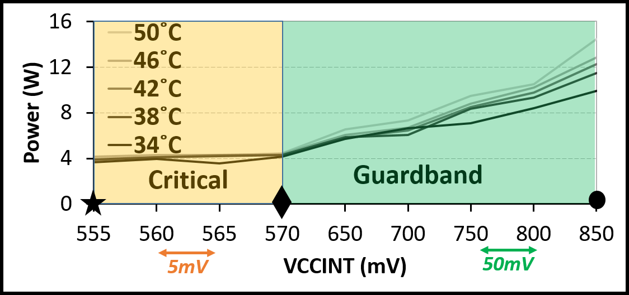
Environmental Temperature
Effects of environmental temperature on power-reliability
Use fan speed to test temperature in [34 $℃$, 50 $℃$]
On-board temperature monitored by PMBus
Temperature effects on power consumption
$↓Temp → ↓Power$ (direct relation of power and temp)
By undervolting, the impact of temperature on power consumption reduces.
Temperature effects on reliability
$↓Temp → ↑Accuracy loss$ (indirect relation of reliability and temp)
In our temperature range, $V_{min}$ and $V_{crash}$do not change significantly.
GoogleNet
Notes:
Temperature has significant impact on the power consumption as well as on the reliability.
[CLICK] We studied its impact while undervolting $V_{CCINT}$. [CLICK] In our tests, we use the speed of the FPGA fan that can generate the temperature in the range of [34 $℃$, 50 $℃$]. Wealso use PMBus to monitor the on-chip temperature.
[CLICK] First power: as can be seen in this figure, temperature directly impacts the power consumption, meaning that lowering the temperature leads to lower power consumption. This is mainly due to the reduction of static power.
[CLICK] However, by undervolting further, the impact of temperature on the power consumption reduces and as you can see, in the critical voltage region there is a negligible impact. This can be explained by noting that by undervolting, the static power also gradually reduces. As the result, the temperature which also impacts the static power does now show much effect on it.
[CLICK] On the other side, temperature has an indirect impact on the reliability, meaning that reducing the temperature the reliability improves or the accuracy loss reduces.
[CLICK] Also, we observe a negligible change in the voltage regions by temperature changes. Although, in wider ranges we may observe differences. This needs further experiments and equipment.

Slide 19
Outline
Motivation and Background
Our Goal
Methodology
Results
Overall Voltage Behavior
Power-Reliability Trade-off
Frequency Underscaling
Environmental Temperature
Prior Works
Summary, Conclusion, and Future Works
Notes:
I will now discuss the existing prior work on undervolting specially those studied techniques for DNNs.

Slide 20
Prior Works
Undervolting
Studies for off-the-shelf real CPUs, GPUs, ASICs, DRAMs
Large voltage guardband (from 12% to 35%) for many devices
This work extends such studies for off-the-shelf FPGAs especially for neural network acceleration and confirms large guardbands (i.e., 33%)
Power-Efficient Neural Networks
Studies on architectural-, hardware-, and software-level techniques
Undervolting in neural network ASIC accelerator (e.g., GreenTPU-DAC’19)
This work proposes a hardware-level undervolting for further power-saving (>3X) in FPGAs.
Reliability in Neural Networks
Analytical and simulation-based studies (e.g., Thundervolt-DAC’18)
Some studies on real hardware (e.g., EDEN-MICRO’19)
This work studies the reliability of neural networks on real FPGAs when operating at reduced voltage levels.
Notes:
I will briefly mention the related works in three categories including undervolting, power-efficiency, and reliability studies in CNNs.
[CLICK] First undervolting. [CLICK] In real experiments, this technique has been studied for off-the-shelf CPUs, GPUs, ASICs, DRAMs. There are also works on the simulators, which may not produce precise results. [CLICK] They have studied multiple aspects of this technique. For example. A large voltage guardband is observed for many devices. [CLICK] This work extends such studies for off-the-shelf FPGAs specially and confirm large voltage guardband as well.
[CLICK] Next power-efficient CNNs [CLICK] There are many approaches to improve the power-efficiency of CNNs in different levels like architectural, hardware, and software. [CLICK] Also, undervolting has been in part studied for CNN accelerators but mostly on ASICs like GreenTPU. [CLICK] This work proposes hardware-level undervolting technique for further power-saving in FPGA-based accelerators.
[CLICK] Last, reliability studies on CNNs. [CLICK] Analytical reliability studies as well as simulation-based random fault injection are the most common ways to study reliability in CNNs. Clearly, their accuracy might be an a question also their validation on real hardware. [CLICK] On real faults, there are some works mostly on soft errors also on the reliability of CNNs on undervolted DRAMs. [CLICK] This work did an experimentally CNN reliability studies on real FPGAs under reduced voltage operations.

Slide 21
Outline
Motivation and Background
Our Goal
Methodology
Results
Overall Voltage Behavior
Power-Reliability Trade-off
Frequency Underscaling
Environmental Temperature
Prior Works
Summary, Conclusion, and Future Works
Notes:
Now let me conclude by giving the summary.

Slide 22
Summary, Conclusion, and Future Works
Summary
We improve the power-efficiency (>3X) of off-the-shelf FPGAs via undervolting for neural network accelerators:
2.6X by eliminating the guardband (i.e., 33%) without any cost
43% by further undervolting below the guardband with the cost of
either accuracy loss, when the frequency is not underscaled
or performance loss, when the frequency is underscaled
Conclusion
Undervolting is an effective way to achieve significant power-saving for FPGA-based neural network accelerators
Future Works
HW & SW extension of our undervolting for FPGA clusters and other neural network models and tools
Notes:
[CLICK] In summary. [CLICK] We achieve more than 3X power-efficiency for FPGA-based CNN accelerator by undervolting real FPGAs below the nominal level. [CLICK] 2.6X of the gain is achieved by eliminating the guardband (i.e., 33%) without any cost. [CLICK] and the rest 43% is achieved by further undervolting below the guardband. [CLICK] This gain has the cost of either accuracy loss when frequency is set to maximum or [CLICK] performance loss when the frequency is simultaneously underscaled.
[CLICK] We conclude that. [CLICK] Undervolting is an effective way to achieve significant power-saving for FPGA-based neural network accelerators. [CLICK] And as ongoing work, we will be extending our experiments in both hardware and software. We will repeat our experiments in FPGA clusters to accommodate the effect of process variation. Also, we will evaluate non-CNN applications under reduced voltage operation in FPGAs.

Slide 23
An Experimental Study of Reduced-Voltage Operation in Modern FPGAs for Neural Network Acceleration
Behzad Salami | Baturay Onural | Ismail Yuksel
Fahrettin Koc | Oguz Ergin | Adrian Cristal
Osman Unsal | Hamid Sarbazi-Azad | Onur Mutlu
50th IEEE/IFIP International Conference on Dependable Systems and Networks (DSN), 30th June, 2020
Notes:
Thank you.

