Slide 1
TRRespass: Exploiting the Many Sides of Target Row Refresh
Pietro Frigo¹ Emanuele Vannacci¹ Hasan Hassan² Victor Van der Veen³ Onur Mutlu² Herbert Bos¹ Cristiano Giuffrida¹ Kaveh Razavi¹
¹Vrije Universiteit Amsterdam ²ETH Zürich ³Qualcomm Technologies Inc.

Slide 2
Teaser
Memory vendors advertise RowHammer-free devices
What is Target Row Refresh (TRR)? Not a single mitigation!
Reverse-engineering of in-DRAM mitigations
  The Many-sided RowHammer
  Hammering up to 20 aggressor rows
3 major vendors all vulnerable: Samsung, Micron, SK Hynix
  Currently representing over 95% of the DRAM market

Slide 3
Memory request flow
DIMMs
DRAM
CPU
Memory Controller
DRAM commands

Slide 4
DRAM Refresh
DRAM is dynamic because data must be refresh periodically
  Retention time (i.e., 64ms)
The MC issues a REFRESH command every 7.8µs
  Only a small portion of memory is refreshed with a command
  8192 refreshes within a 64ms interval

Slide 5
Memory array
1
1
1
1
Row 0
0
1
1
0
Row 1
1
1
1
1
Row 2
0
1
0
1
Row 3
Row buffer

Slide 6
Read operation: Row 1
1
1
1
1
Row 0
-
-
-
-
Row 1
1
1
1
1
Row 2
0
1
0
1
Row 3
0
1
1
0
ACTIVATE Row 1

Slide 7
Read operation: Row 3
1
1
1
1
Row 0
0
1
1
0
Row 1
1
1
1
1
Row 2
0
1
0
1
Row 3
-
-
-
-
PRECHARGE Row 1

Slide 8
Read operation: Row 3
1
1
1
1
Row 0
0
1
1
0
Row 1
1
1
1
1
Row 2
-
-
-
-
Row 3
0
1
0
1
ACTIVATE Row 3

Slide 9
RowHammer
1
1
1
1
Row 0
0
1
1
0
Row 1
1
0
1
1
Row 2
0
1
0
1
Row 3
-
-
-
-
Bit flip!

Slide 10
Double-sided RowHammer
1
Row 0
1
1
1
1
1
1
1
0
1
1
0
Row 1
Aggressor row
1
0
1
1
Row 2
Victim row
0
1
0
1
Row 3
Aggressor row
-
-
-
-
Bit flip!

Slide 11
Hardware mitigations
Error-correcting code (ECC) [1]
Refreshing a row restores the cells electric charge: it prevents flips.
Double refresh
Target Row Refresh (TRR)
[1] L. Cojocaret al., “Exploiting Correcting Codes: On the Effectiveness of ECC Memory Against Rowhammer Attacks,” in S&P, 2019.

Slide 12
Target Row Refresh
TRR-like mitigations track rows activations and refresh victim rows
  Many possible implementations in practice
  Security through obscurity
Pseudo TRR (pTRR)
  Memory controller implementation
In-DRAM TRR
  Embedded in the DRAM circuitry

Slide 13
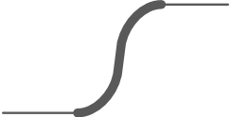

Timeline
pTRR DDR3
In-DRAM TRR
Intel reports pTRR on DDR3 server systems
Earliest manufacturing date of RH-free DRAM modules
'12
'13
'14
'15
'16
'17
'18
'19
Last generation DIMMs we focus on
pTRR DDR4
First DDR4 generation is pTRR protected

Slide 14
Goals
Reverse engineer TRR to demystify in-DRAM mitigations
Memory device assessment
  A Novel hammering pattern: The Many-sided RowHammer
  Hammering up to 20 aggressor rows allows to bypass TRR
Automatically test memory devices: TRRespass
  Automate hammering patterns generation

Slide 15
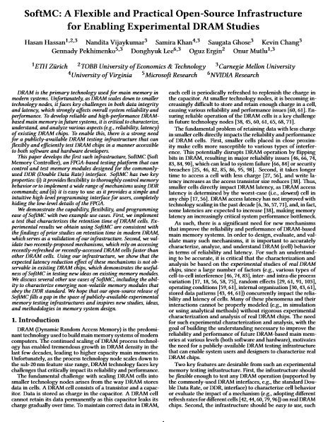
Challenges
Analysis from the CPU side not possible
  No timing side-channels
FPGA-based memory controller [1,2]
[1] H. Hassan et al., “SoftMC: A Flexible and Practical Open-Source Infrastructure for Enabling Experimental DRAM Studies,” in HPCA, 2017
[2] SAFARI Research Group, “SoftMC — GitHub Repository,” https:// github.com/CMU-SAFARI/SoftMC.

Slide 16
Building blocks
Abstractions:
Sampler
  Track aggressor rows activations
  Keep a set of rows
Inhibitor
  Prevent bit flips
  Refresh victims

Slide 17
Case study: Vendor C
How big is the sampler?
Pick N aggressor rows
Perform a series of hammers (activations of aggressors)
  8K activations
After each series of hammers, issue R refreshes
10 Rounds
Activations
Refreshes
Activations
Refreshes
Round

Slide 18
Case study: Vendor C

Slide 19
Case study: Vendor C

Slide 20
Case study: Vendor C

Slide 21
Case study: Observations
The TRR mitigation acts on every refresh command

Slide 22
Case study: Vendor C

Slide 23
Case study: Vendor C

Slide 24
Case study: Observations
The TRR mitigation acts on every refresh command
The mitigation can sample more than one aggressor per refresh interval
The mitigation can refresh only a single victim within a refresh operation

Slide 25
Case study: Vendor C

Slide 26
Case study: Vendor C

Slide 27
Case study: Observations
The TRR mitigation acts on every refresh command
The mitigation can sample more than one aggressor per refresh interval
The mitigation can refresh only a single victim within a refresh operation
Sweeping the number of refresh operations and aggressor rows while hammering reveals the sampler size

Slide 28
Case study: Vendor C
with tREFi == 7.8μs
Notes:
Discuss the sampler address dependency here, explaining that we've made further studies on other DIMMs, and we have additional observations.
Maybe add a slide after this one to summarize the key observations.

Slide 29
Case study: Observations
The TRR mitigation acts on every refresh command
The mitigation can sample more than one aggressor per refresh interval
The mitigation can refresh only a single victim within a refresh operation
Sweeping the number of refresh operations and aggressor rows while hammering reveals the sampler size
The sampling mechanism is affected by the addresses of aggressor rows

Slide 30
TRRespass: The RowFuzzer
Black-box fuzzing for RowHammer
  Ignore the MC optimizations
  Scalable approach for testing
The sampler can track a limited number of aggressor rows
  # Aggressors
The sampler design may be row address dependent
  Aggressor Location

Slide 31
TRRespass: Results
42 DIMMS from 3 of the major vendors: Samsung, Micron, SK Hynix
  95% of the market
Testing 256MB of contiguous memory against the best pattern
13 DIMMs with bit flips
  Multiple effective patterns for each of them
Bit flips with double refresh
Fuzzing is effective.
  How to Improve? Parameter selection.

Slide 32
Exploitation
Memory templating
  Find the right hammering pattern
  Locations of aggressors not always fundamental
Bit flips are repeatable
  Spurious flips
We demonstrate the feasibility of 3 example attacks:
  Privilege escalation [1]
  Access to co-hosted VM via RSA key corruption [2]
  Sudo exploit: opcode flipping [3]
[1] M. Seaborn and T. Dullien, “Exploiting the DRAM Rowhammer Bug to Gain Kernel Privileges,” in Black Hat USA, 2015
[2] K. Razavi et al., “Flip Feng Shui: Hammering a Needle in the Software Stack,” in USENIX Sec., 2016
[3] D. Gruss et al., “Another Flip in the Wall of Rowhammer Defenses,” in S&P, 2018.

Slide 33
Conclusion
Bit flips with more than 20 aggressor rows!
  DDR4 devices are much more vulnerable than DDR3
  Bit flips with less than 50K activations
Fuzzing can help in memory testing
  Reverse engineering to find meaningful parameters
RowHammer is still a serious problem
No prompt mitigations available

Slide 34
Questions!

