Slide 1
Are We Susceptible to Rowhammer? An End-to-End Methodology for Cloud Providers
Lucian Cojocar, Jeremie Kim§†, Minesh Patel§, Lillian Tsai‡,
Stefan Saroiu, Alec Wolman, and Onur Mutlu§†
Microsoft Research, §ETH Zurich, †CMU, ‡MIT

Slide 2
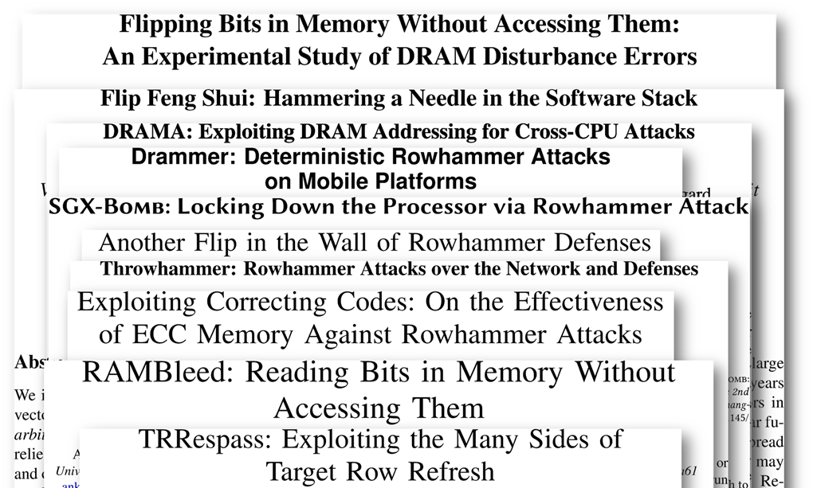
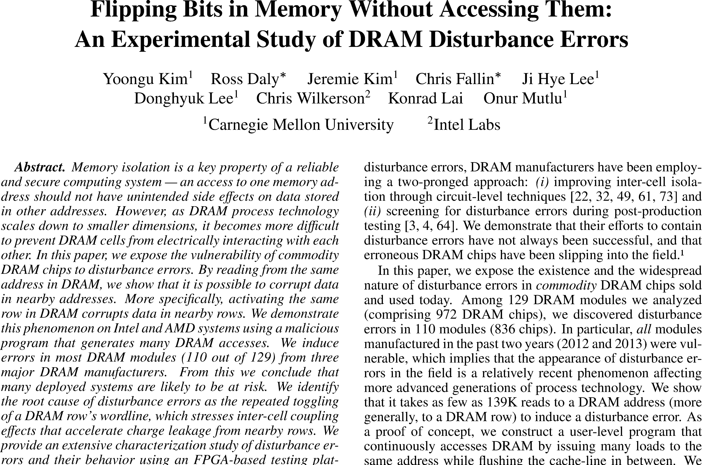
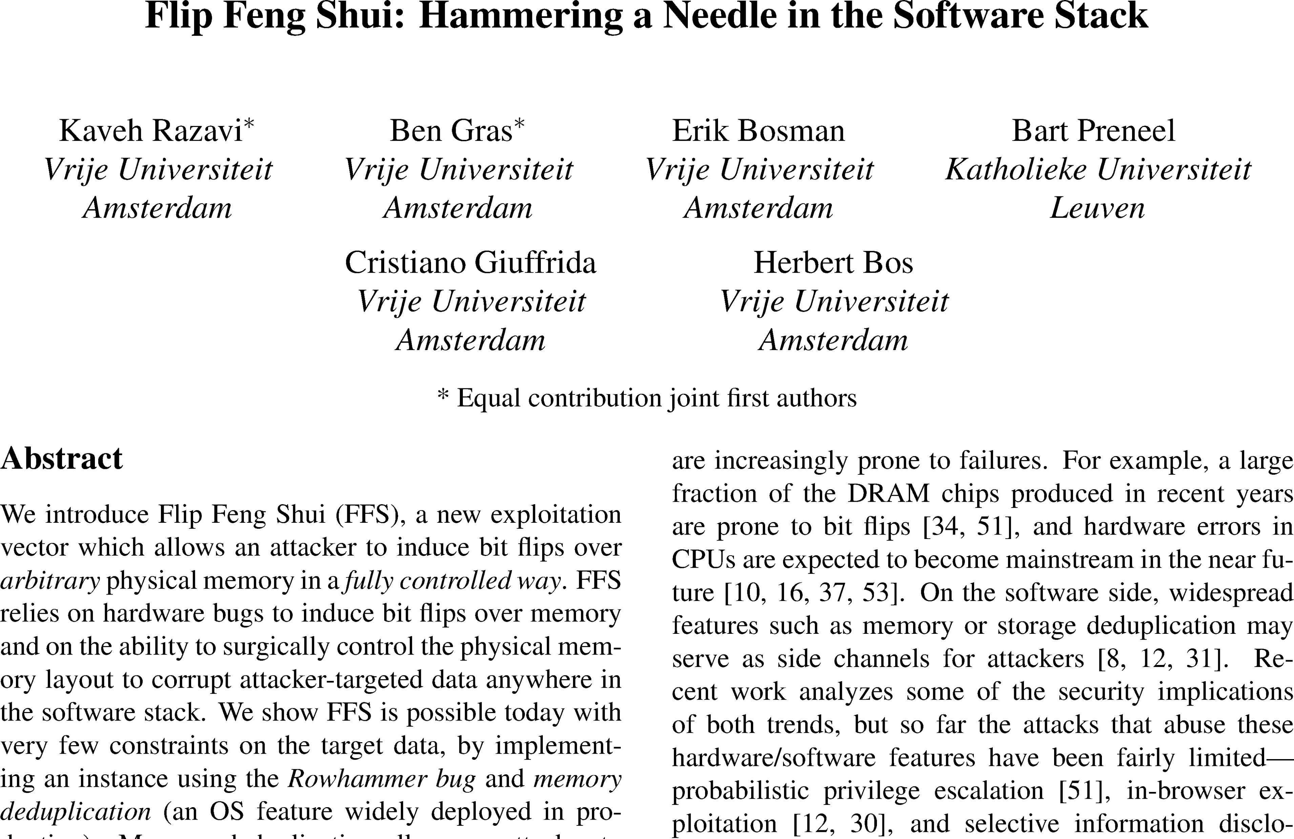
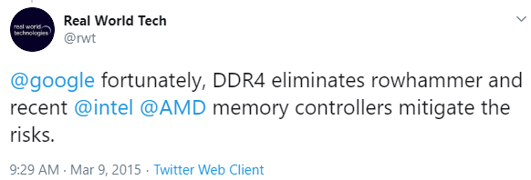
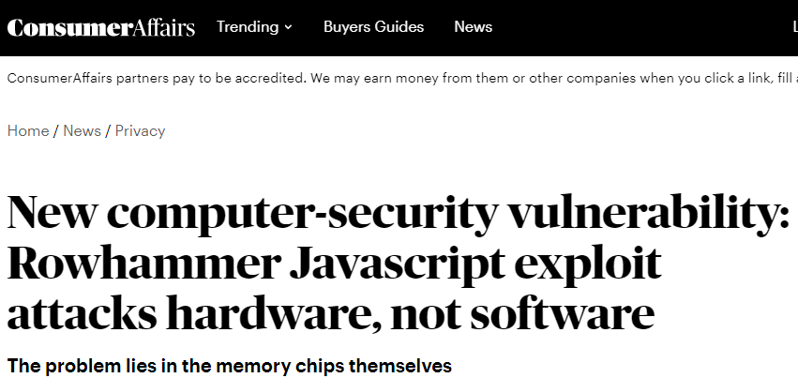
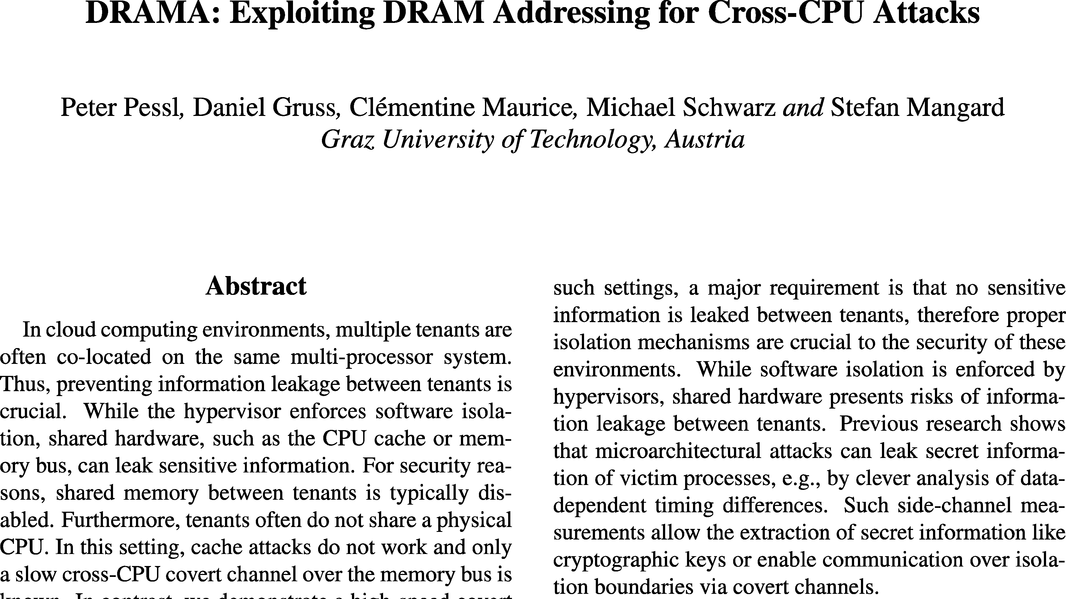
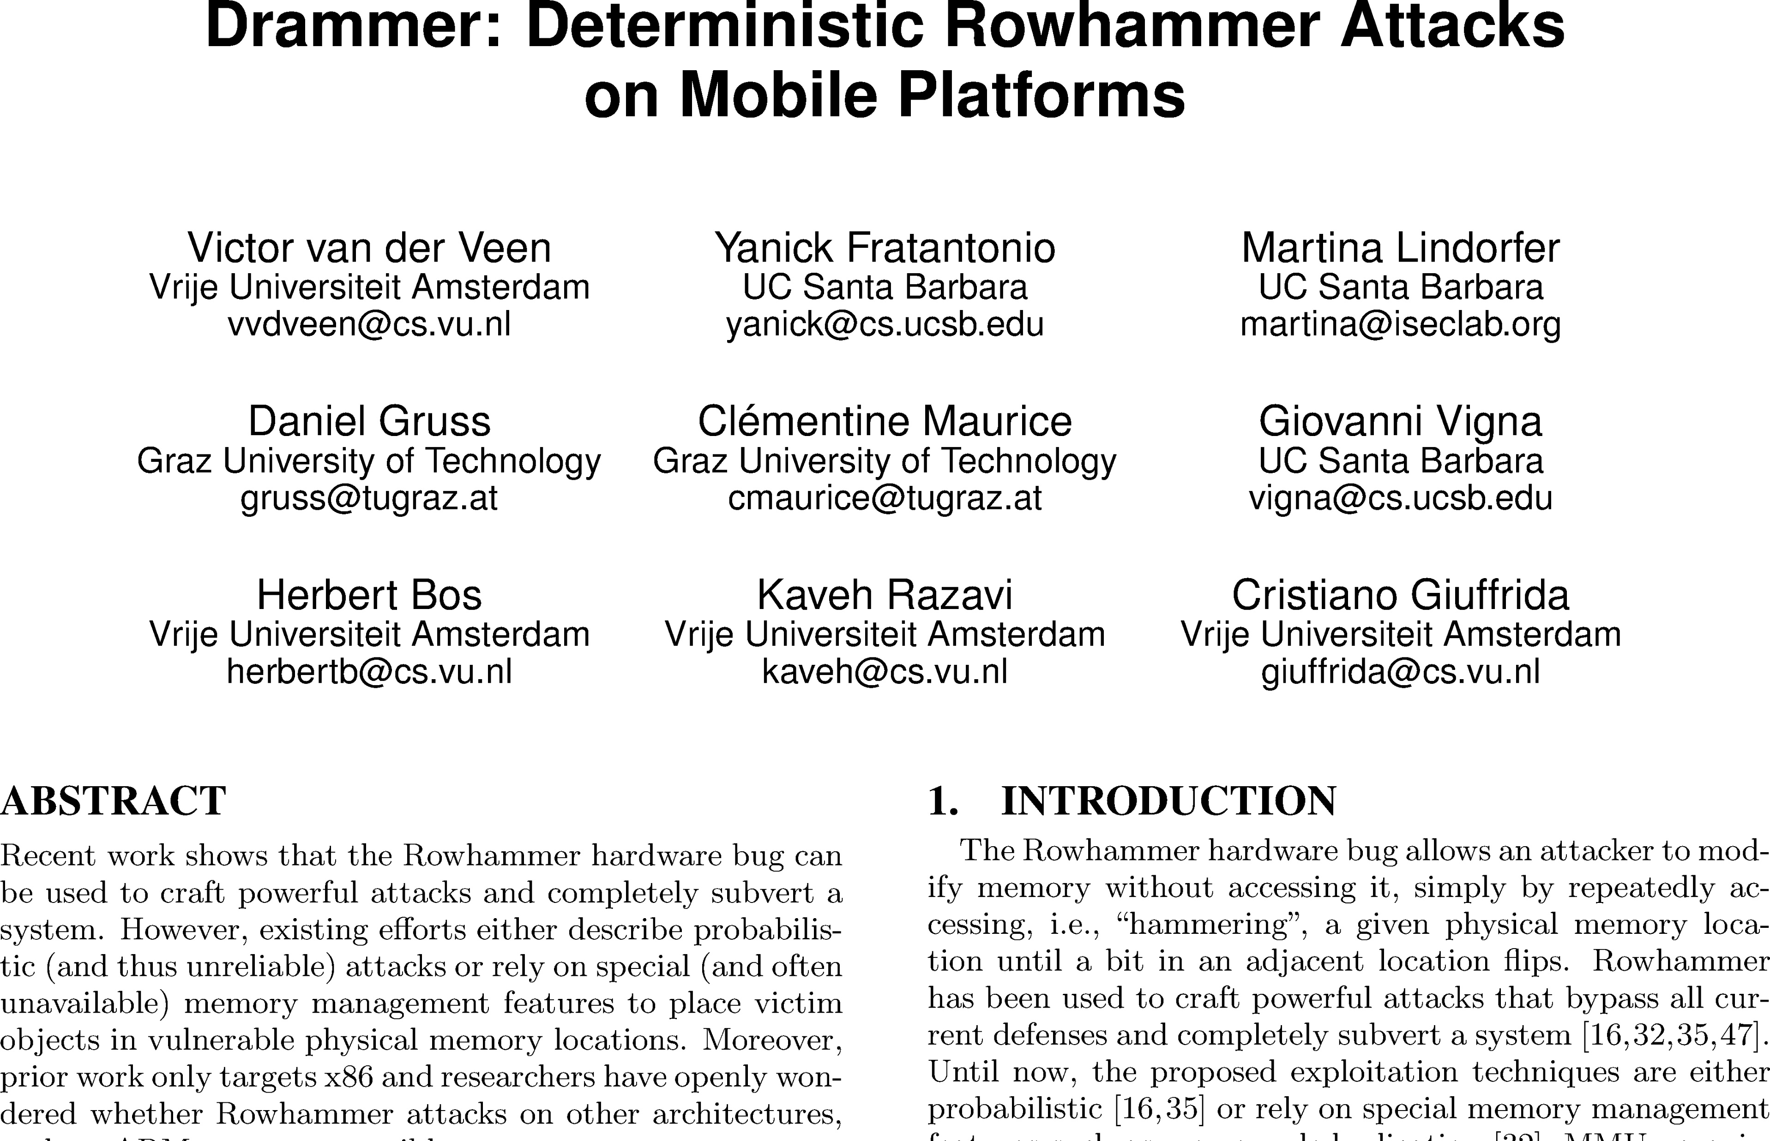
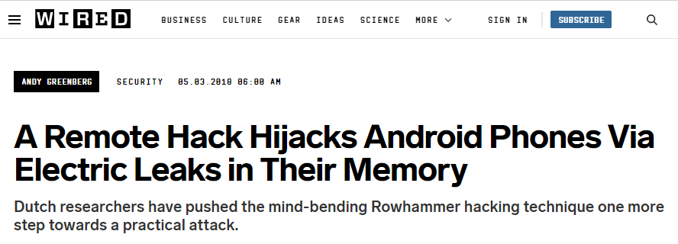
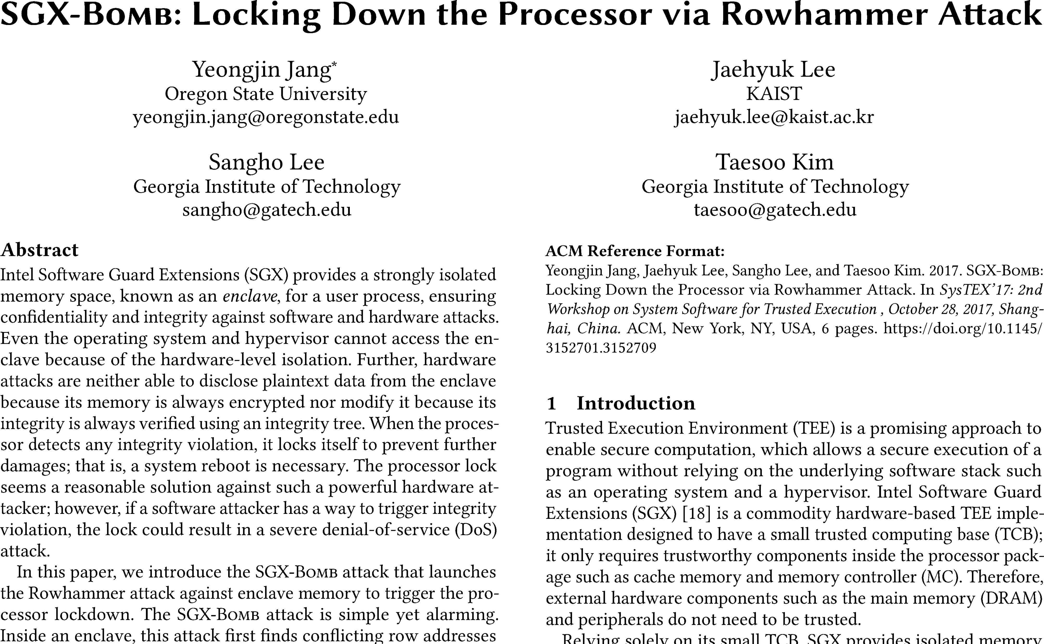
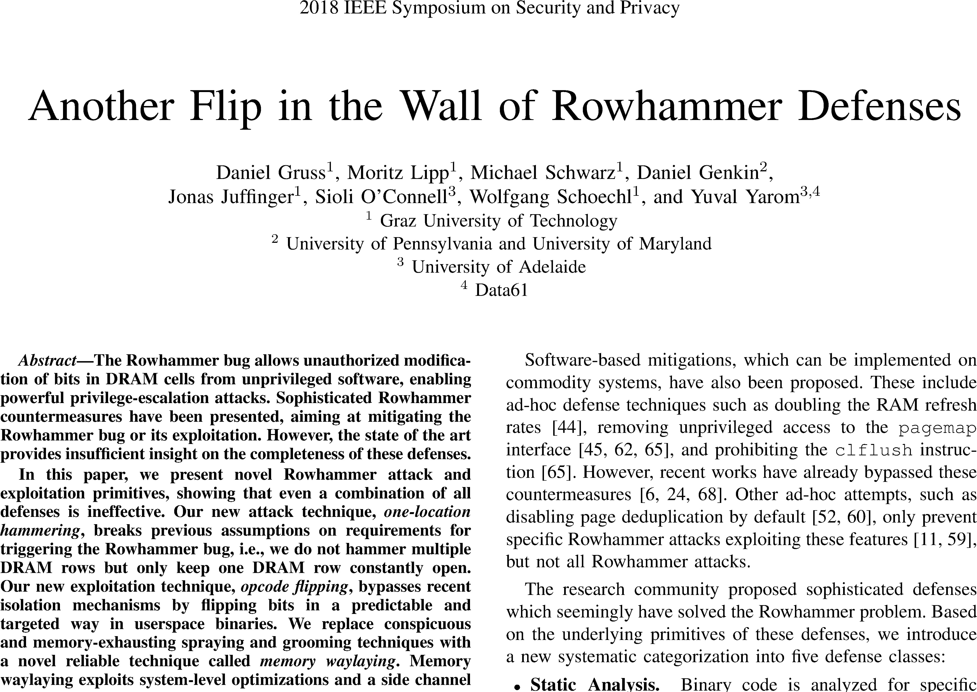
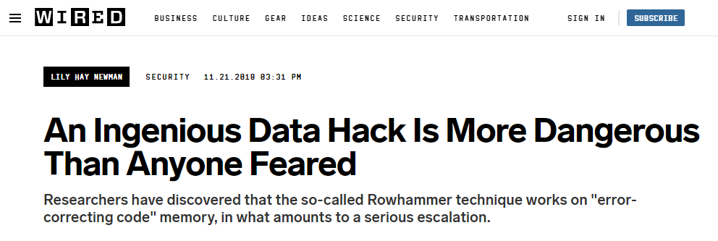
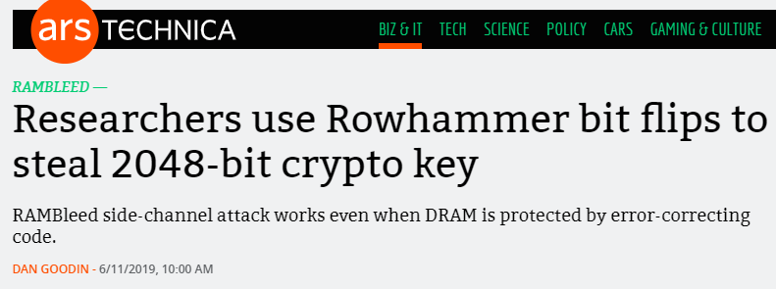
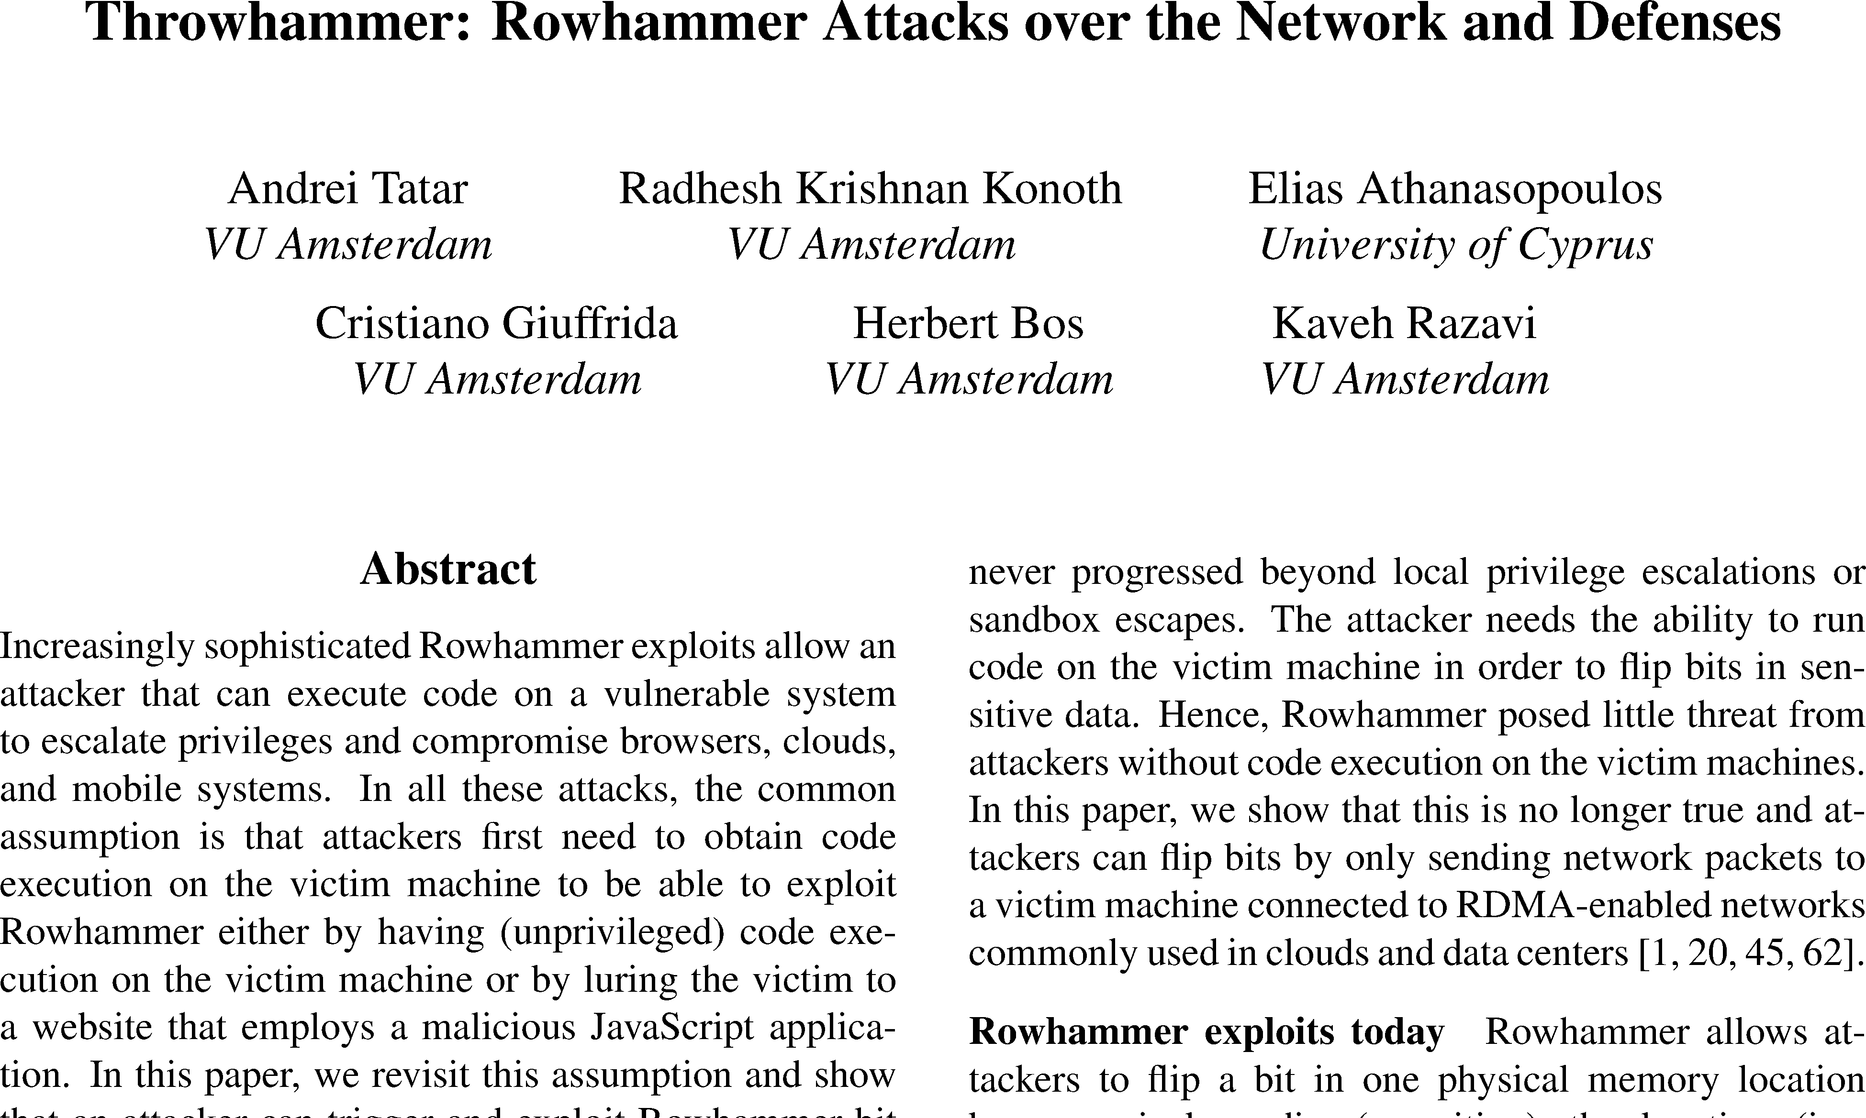
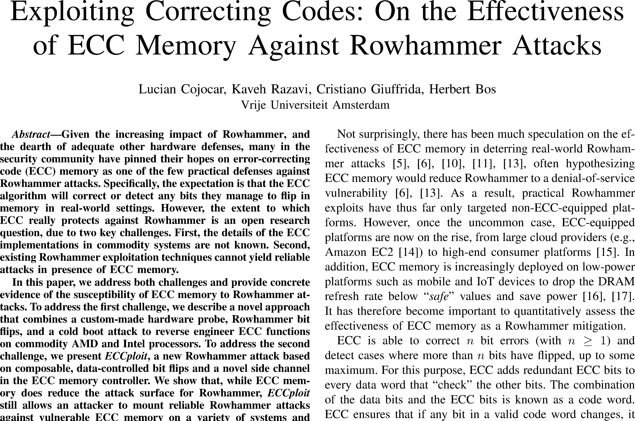
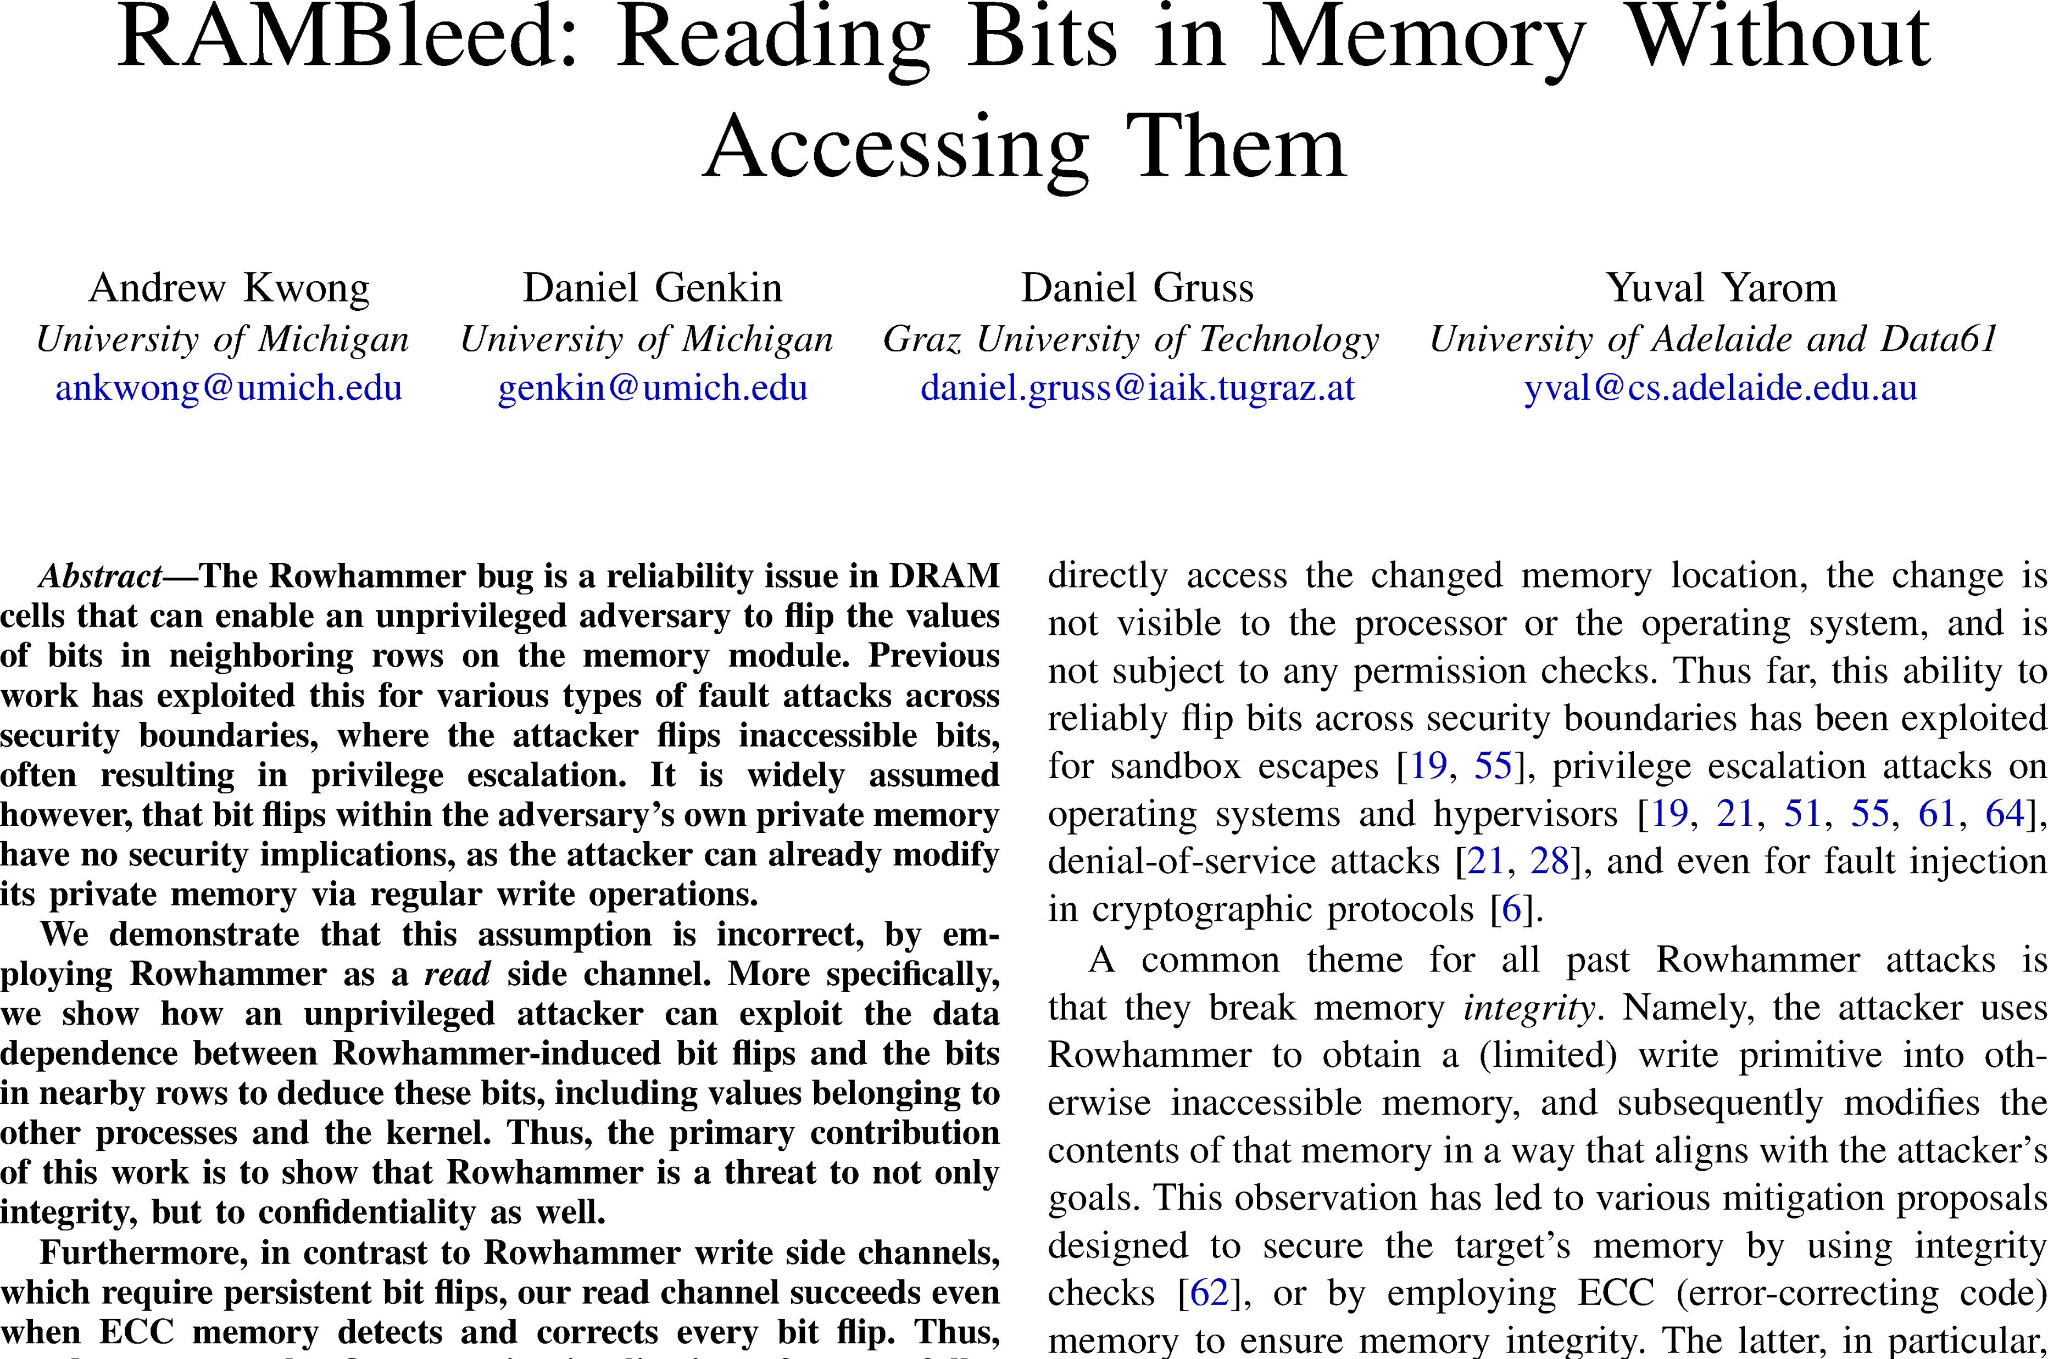
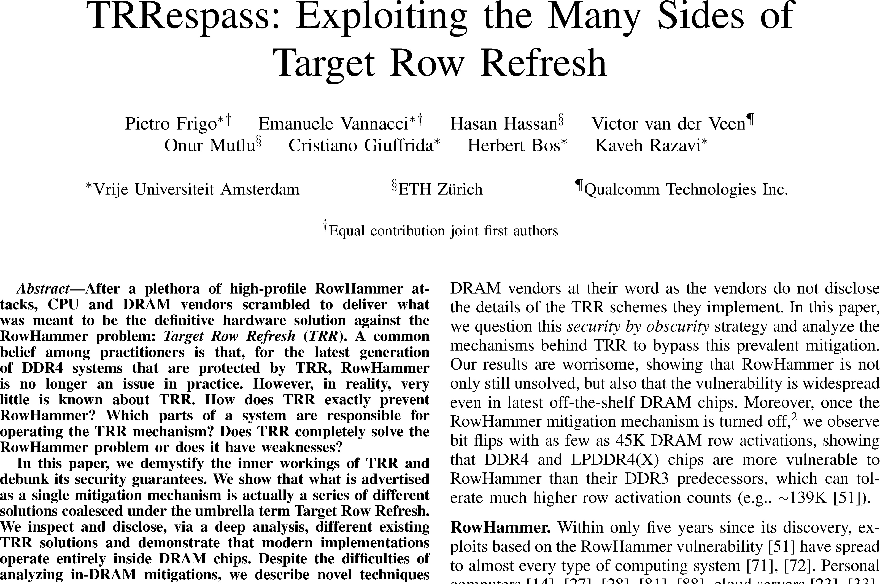
Landscape of Rowhammer
Research Community
Media Coverage
Memory Vendors
Rowhammer is very serious!
Are my servers susceptible?"
Cloud Providers

Slide 3
Our Work
Develop an end-to-end methodology to test if any cloud server is susceptible to Rowhammer
Must overcome two major technical challenges:
Develop instruction sequence to optimally hammer DRAM
Develop a strategy to map row adjacency inside DIMMs
Apply methodology on three generations of Intel servers:
Broadwell, Skylake, Cascade Lake

Slide 4
Rowhammer Primer
“Flipping Bits in Memory Without Accessing Them:
An Experimental Study of DRAM Disturbance Errors”
Kim et al., ISCA ‘14
Col 1
Col 2
Col 3
Col 4
loop:
load A // Row 1
load B // Row 3
clflush A
clflush B
Row 1
0
0
0
1
ACT 1
PC
1
1
1
Row 2
0
1
PC
Row 3
0
1
1
0
ACT 3
ACT 1
ACT 3
ACT 3
ACT 1
ACT 1
ACT 3
ACT 3
ACT 1
ACT 1
ACT 3
ACT 3
ACT 1
ACT 1
CPU
ACT 3
DRAM

Slide 5
Two Key Requirements for Rowhammer Testing
To be successful, methodology must create worst-case testing conditions for DIMMs
Must generate highest rate of ACTs on a cloud server
Must hammer rows whose cells are adjacent inside DRAM

Slide 6
Challenges in Generating Highest Rate of ACTs
How to measure rate of ACTs of instruction sequences?
We used a DDR bus analyzer
Effectiveness of instruction sequence subject to many factors:
Out of order execution
Cache hierarchy
Memory controller’s DRAM scheduling
Memory traffic interference from OS and processes
ACT 3
CPU
ACT 1
ACT 3
ACT 1
ACT 3
ACT 1
ACT 3
ACT 1
DIMM
DIMM & Bus Analyzer

Slide 7
Typical Rowhammer Instruction Sequence
Dozens of variations found in dozens of papers:
loop: movzx rax, BYTE PTR [rcx] movzx rax, BYTE PTR [rdx]
clflush{opt} BYTE PTR [rcx] clflush{opt} BYTE PTR [rdx]
{m|l|s|no}-fence

Slide 8
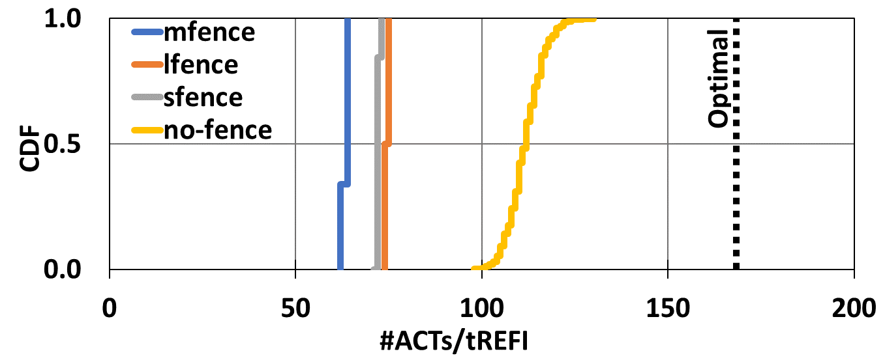
Rate of ACTs from Previous Instruction Sequences
Rate of ACTs of Previous Instruction Sequences
33%
Far from optimal

Slide 9
Our Near-Optimal Instruction Sequence on Skylake
while (1) { clflushopt A
clflushopt B
}
Instruction sequence leverages micro-architectural side-effects

Slide 10
Two Key Requirements for Rowhammer Testing
To be successful, methodology must create worst-case testing conditions for DIMMs
Must generate highest rate of ACTs on a cloud server
Must hammer rows whose cells are adjacent inside DRAM

Slide 11
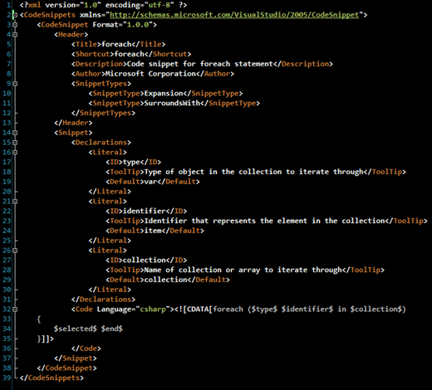
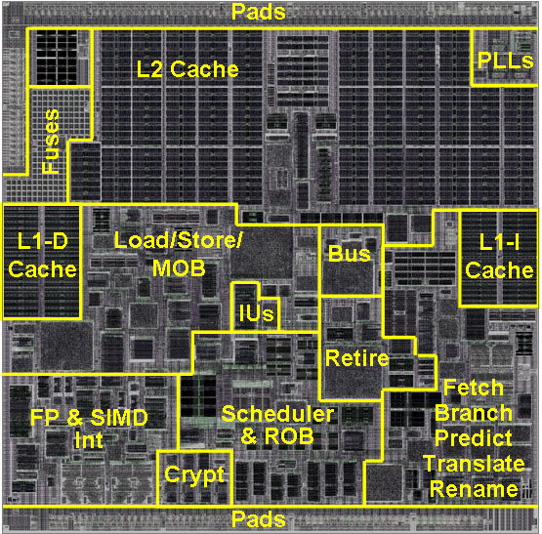
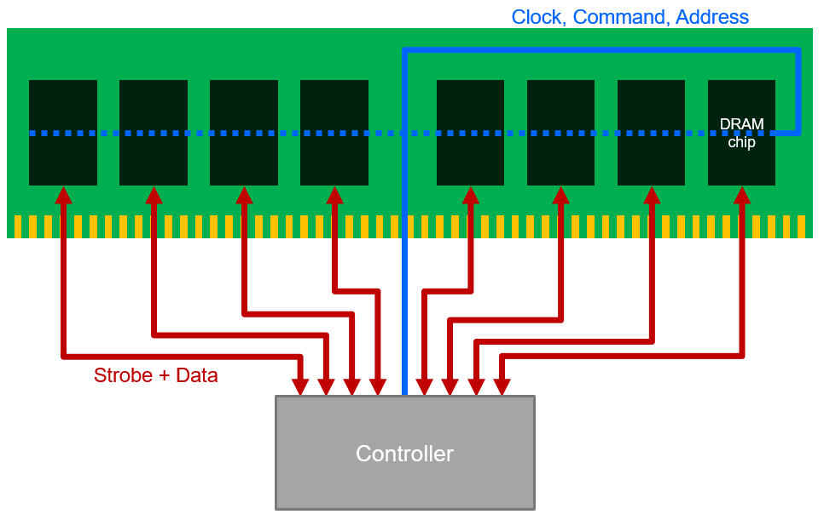
Determining Physically Adjacent Rows
System
Virtual
Address
System
Physical Address
DDR Bus Address
DRAM Internal Address
KNOWN
KNOWN
REVERSE-ENGINEERED
UNKNOWN
Chipset-specific,
Underspecified documentation
DIMM-specific,
Trade secret
Straightforward

Slide 12
Previous Reverse-Engineering Methodology Relies on Rowhammer
Hammering one row yields many bit flips in adjacent rows
Fewer bits flipped as the distance from the hammered row increases
Technique works only for DIMMs that succumb to Rowhammer
Instance of chicken-and-egg problem
K-4
0
K-3
0
K-2
4
memory cell
K-1
11
aggressor
K
bit flip
K+1
12
K+2
3
K+3
0
K+4
0

Slide 13
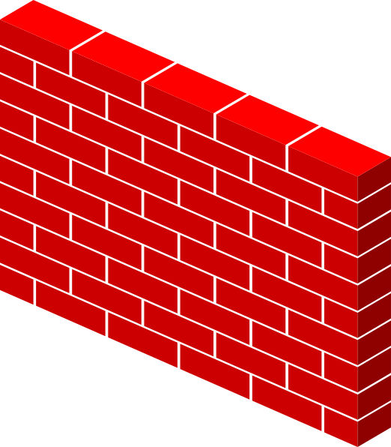
Mount a Devastating Rowhammer by Masking Refreshes (REF)
In the absence of REFs, any DIMM easily succumbs to Rowhammer
ACT 1
ACT 1
REF
REF
ACT 3
ACT 3
REF
REF
ACT 1
ACT 1
REF
ACT 3
ACT 3
REF
ACT 1
CPU
ACT 1
DIMM
Design a device to mask REFs but allow Rowhammer traffic

Slide 14
Fault Injector that Masks Refresh Commands
Fault the A14 signal to mask refreshes

Slide 15
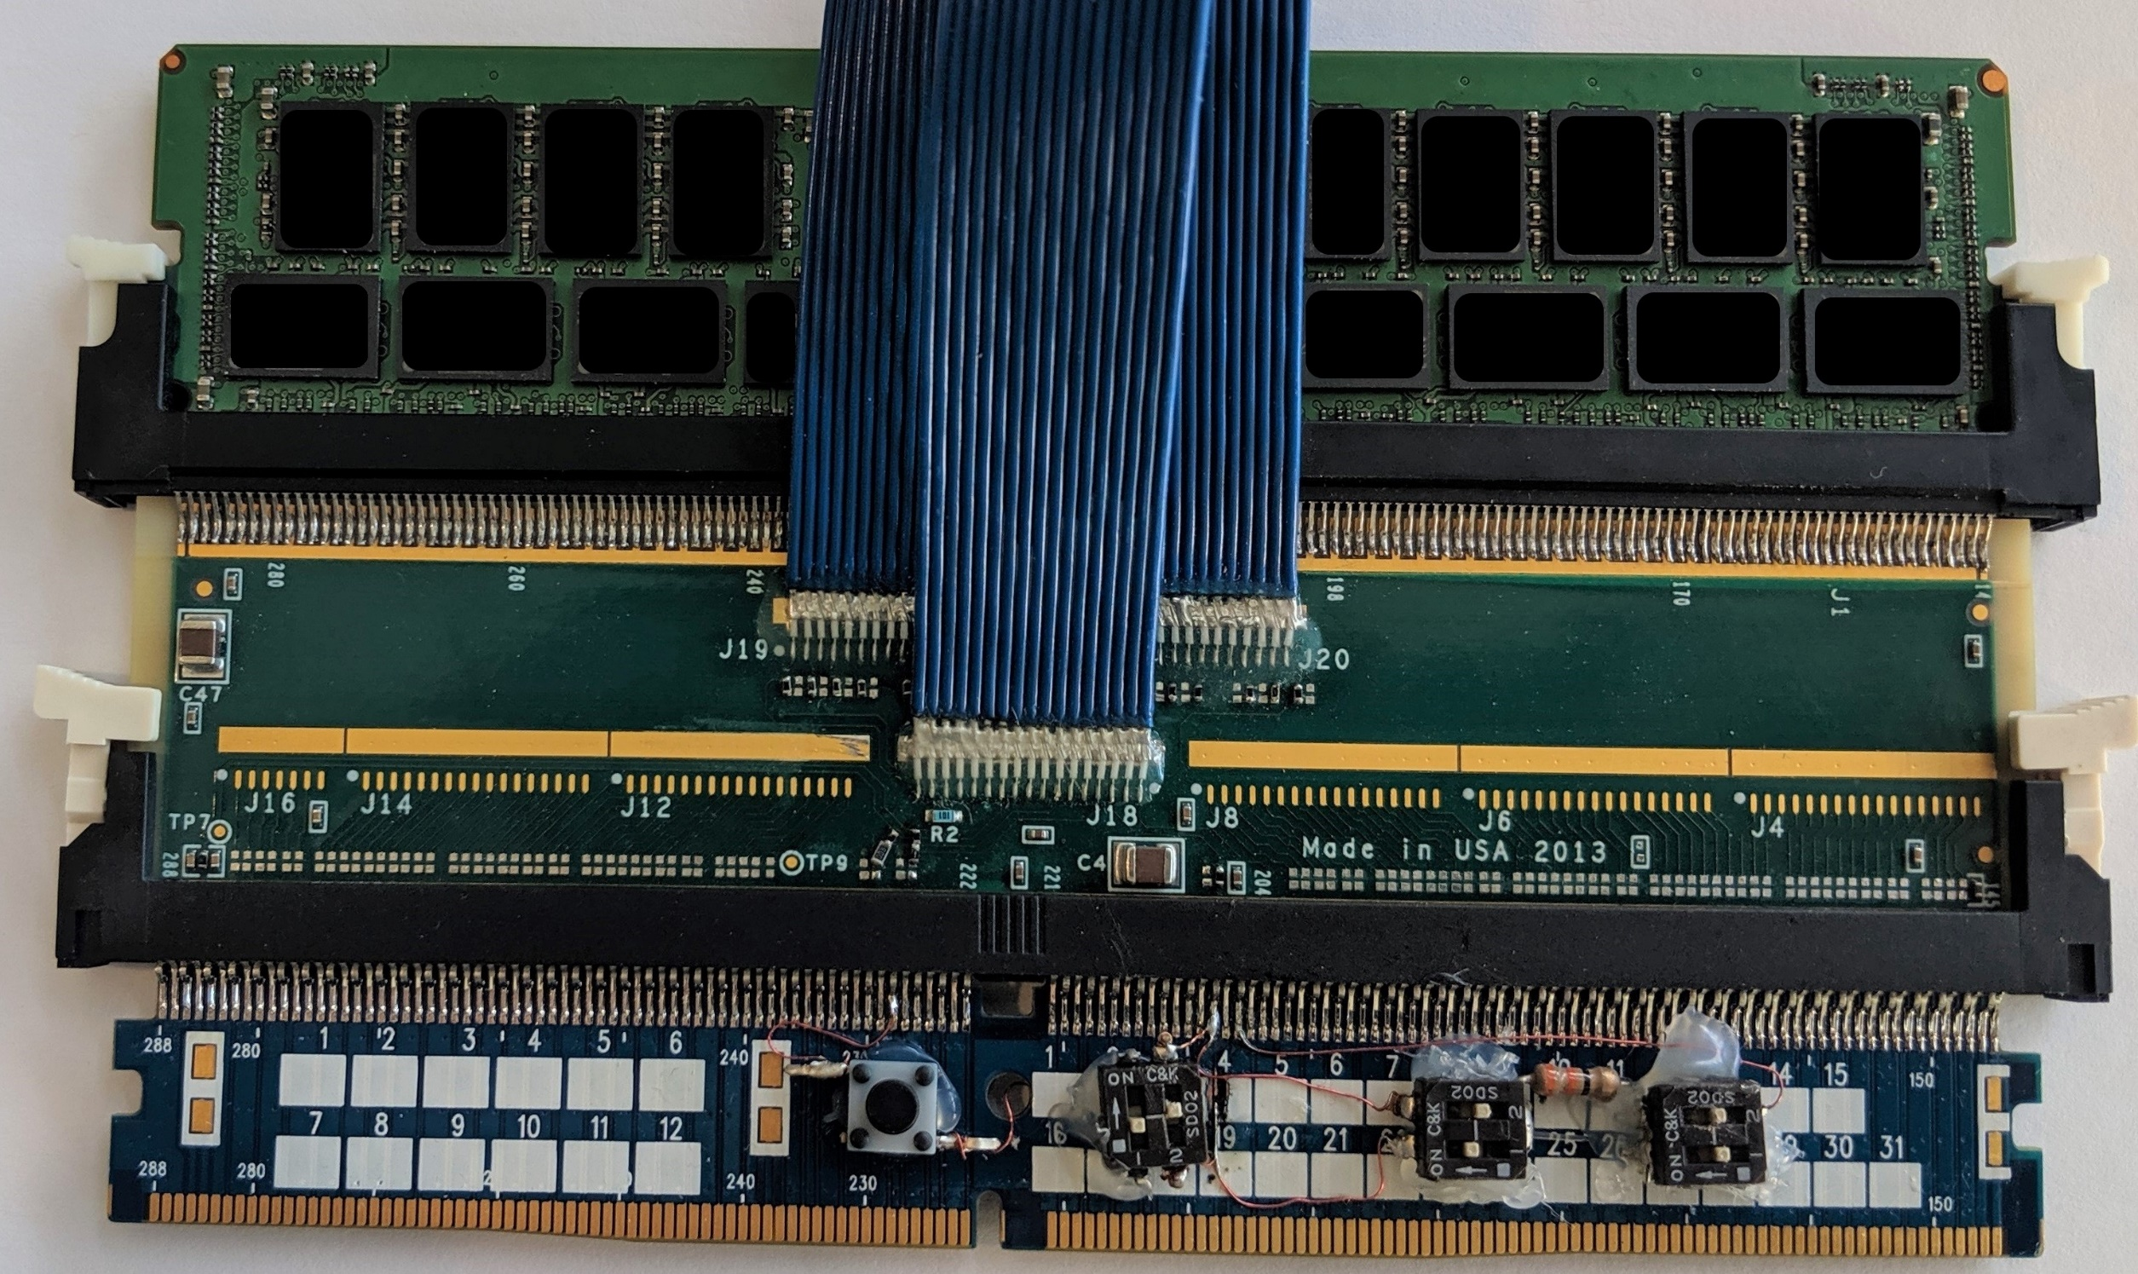
Our Complete Hardware Stack

Slide 16
Row Adjacency Map
0
1
2
29
30
31
32
33
34
61
62
0
1
2
29
30
31
32
63
33
34
61
62
63
0
1
2
29
30
31
32
33
34
61
62
0
1
2
29
30
31
32
63
33
34
61
62
63
…00
0x11400
…00
0x11400
0
1
0
1
0
0
1
1
0
1
1
0
0
1
0
1
0
0
1
1
0
1
1
0
…01
0x11401
…01
0x11401
0
1
0
1
0
0
1
1
0
1
1
0
0
1
0
1
0
0
1
1
0
1
1
0
…02
0x11402
…02
0x11402
0
1
0
1
0
0
1
1
0
1
1
0
0
1
0
1
0
0
1
1
0
1
1
0
…03
“Half” row
…03
0x11403
0
1
0
1
0
1
0
1
0
1
1
0
0x11403
0
1
0
1
0
1
0
1
0
1
1
0
…04
0x11404
…04
0x11404
0
1
0
1
0
0
1
1
0
1
1
0
0
1
0
1
0
0
1
1
0
1
1
0
…05
0x11405
…05
0x11405
0
1
1
1
0
0
1
1
0
1
1
0
0
1
1
1
0
0
1
1
0
1
1
0
…06
0x11406
…06
0x11406
0
1
0
1
0
0
1
1
0
1
1
0
0
1
0
1
0
0
1
1
0
1
1
0
…07
0x11407
…07
0x11407
0
1
0
1
0
0
1
1
0
1
1
0
0
1
0
1
0
0
1
1
0
1
1
0
…08
0x11408
…08
0x11408
0
0
0
1
0
0
0
1
0
1
1
0
0
0
0
1
0
0
0
1
0
1
1
0
…09
0x11409
…09
0x11409
0
1
0
1
0
0
1
1
0
1
1
0
0
1
0
1
0
0
1
1
0
1
1
0
…0A
0x1140A
…0A
0x1140A
0
1
0
1
0
0
1
1
0
1
1
0
0
1
0
1
0
0
1
1
0
1
1
0
…0B
“Full” row
…0B
…0B
0x1140B
0x1140B
0
1
0
1
0
0
1
1
0
1
1
0
0
1
0
1
0
0
1
1
0
1
1
0
…0C
0x1140C
…0C
0x1140C
0
1
0
1
0
0
1
1
0
1
1
0
0
1
0
1
0
0
1
1
0
1
1
0
…0D
0x1140D
…0D
0x1140D
0
1
0
1
0
0
1
1
0
1
1
0
0
1
0
1
0
0
1
1
0
1
1
0
…0E
0x1140E
…0E
0x1140E
0
1
0
1
0
0
1
1
0
1
1
0
0
1
0
1
0
0
1
1
0
1
1
0
…0F
0x1140F
…0F
0x1140F
0
1
0
1
0
0
0
1
0
1
1
0
0
1
0
1
0
0
0
1
0
1
1
0
…10
0x11410
…10
0x11410
0
1
0
1
0
0
1
1
0
1
1
0
0
1
0
1
0
0
1
1
0
1
1
0
Adjacency for row 0x1140F in one DIMM from Vendor 1
Adjacency for row 0x1140B in one DIMM from Vendor 1
Adjacency for row 0x1140F in one DIMM from Vendor 2

Slide 17
Key Takeaways
Logical rows do not always map linearly inside DRAM devices
Words in half-rows flip fewer bits than words in whole-rows
All bits in the whole-rows are equally susceptible
Some (but not all) bits in half-rows are equally susceptible
Most, but not all, bits flip from 1 to 0
Adjacency map differs from one vendor to another
DIMMs sourced from different vendors have different # of bit flips

Slide 18
An end-to-end methodology to test if any cloud server is susceptible to Rowhammer
An instruction sequence to optimally hammer DRAM
All previous sequences have sub-optimal ACT rates
Two clflushopt instructions hammers at near-optimal rate
A strategy to map row adjacency inside DIMMs
A DDR4 fault injector that masks refresh commands
Logical rows do not always map linearly
Applied the methodology to three generations of Intel servers
Broadwell, Skylake, Cascade Lake

