Slide 1


The DRAM RowHammer Problem and its Reliability and Security Implications
Onur Mutlu
onur@cmu.edu
http://users.ece.cmu.edu/~omutlu/
July 27, 2015

Slide 2
Modern DRAM is Prone to Disturbance Errors
Row of Cells
Wordline
Row
Victim Row
Row
Hammered Row
V_{LOW}
Opened
V_{HIGH}
Closed
Row
Victim Row
Row
Repeatedly opening and closing a row enough times within a refresh interval induces disturbance errors in adjacent rows in most real DRAM chips you can buy today
Flipping Bits in Memory Without Accessing Them: An Experimental Study of DRAM Disturbance Errors, (Kim et al., ISCA 2014)

Slide 3
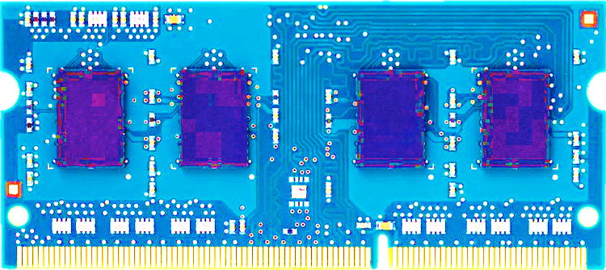
Most DRAM Modules Are at Risk
A company
B company
C company
86%
(37/43)
83%
(45/54)
88%
(28/32)
Up to
1.0×10⁷
errors
Up to
2.7×10⁶
errors
Up to
3.3×10⁵
errors
Flipping Bits in Memory Without Accessing Them: An Experimental Study of DRAM Disturbance Errors, (Kim et al., ISCA 2014)

Slide 4

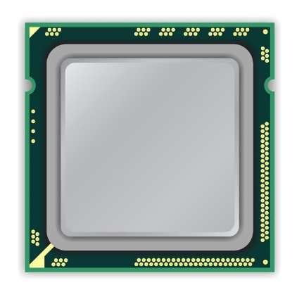
A Simple Program Can Induce Many Errors
CPU
DRAM Module
loop:
mov (X), %eax
mov (Y), %ebx
clflush (X)
clflush (Y)
mfence
jmp loop
X
Y
  Download from: https://github.com/CMU-SAFARI/rowhammer
Notes:
We demonstrate the errors on multiple x86 systems. Shown to the bottom-left is a “disturbance kernel”. When executed, it forces two rows to be opened and closed one after the other – over and over again. Consequently, it induces many errors in the module.

Slide 5


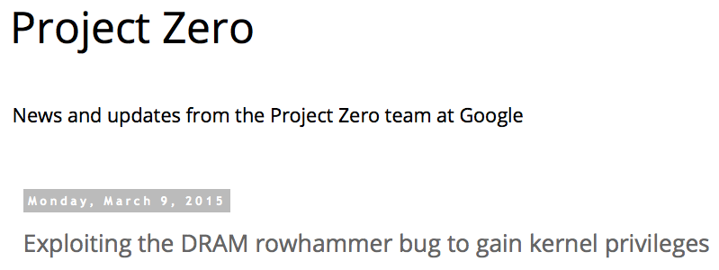
One Can Take Over an Otherwise-Secure System
Flipping Bits in Memory Without Accessing Them: An Experimental Study of DRAM Disturbance Errors (Kim et al., ISCA 2014)
Exploiting the DRAM rowhammer bug to gain kernel privileges (Seaborn, 2015)

Slide 6
RowHammer Security Attack Example
“Rowhammer” is a problem with some recent DRAM devices in which repeatedly accessing a row of memory can cause bit flips in adjacent rows (Kim et al., ISCA 2014).
  Flipping Bits in Memory Without Accessing Them: An Experimental Study of DRAM Disturbance Errors (Kim et al., ISCA 2014)
We tested a selection of laptops and found that a subset of them exhibited the problem.
We built two working privilege escalation exploits that use this effect.
  Exploiting the DRAM rowhammer bug to gain kernel privileges (Seaborn, 2015)
One exploit uses rowhammer-induced bit flips to gain kernel privileges on x86-64 Linux when run as an unprivileged userland process.
When run on a machine vulnerable to the rowhammer problem, the process was able to induce bit flips in page table entries (PTEs).
It was able to use this to gain write access to its own page table, and hence gain read-write access to all of physical memory.
Exploiting the DRAM rowhammer bug to gain kernel privileges (Seaborn, 2015)

Slide 7
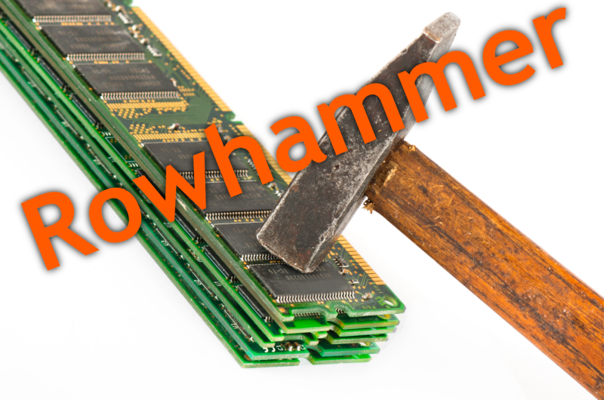
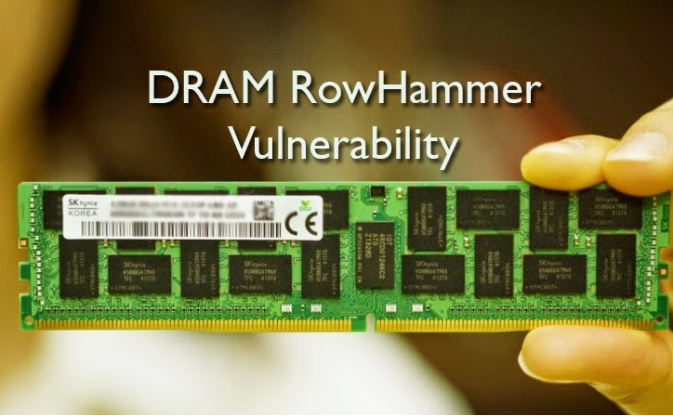
Security Implications
Notes:
Picture from the article:
http://thehackernews.com/2015/03/dram-rowhammer-vulnerability.html

Slide 8
The DRAM RowHammer Problem and its Reliability and Security Implications
Onur Mutlu
onur@cmu.edu
http://users.ece.cmu.edu/~omutlu/
July 27, 2015

Slide 9
More Detailed Slides

Slide 10
Observed Errors in Real Systems
A real reliability & security issue
In a more controlled environment, we can induce as many as ten million disturbance errors
CPU Architecture | Errors | Access-Rate
Intel Haswell (2013) | 22.9K | 12.3M/sec
Intel Ivy Bridge (2012) | 20.7K | 11.7M/sec
Intel Sandy Bridge (2011) | 16.1K | 11.6M/sec
AMD Piledriver (2012) | 59 | 6.1M/sec
Flipping Bits in Memory Without Accessing Them: An Experimental Study of DRAM Disturbance Errors, (Kim et al., ISCA 2014)
Notes:
When we executed the code on four different processors, all four of them yielded errors. Intel Haswell has the most errors, at 23 thousand, because it has the highest rate of accessing DRAM.
Later on, I’ll show that we can induce as many as ten million disturbance errors in a more controlled environment.
From this, we conclude that disturbance errors are a serious reliability issue.

Slide 11
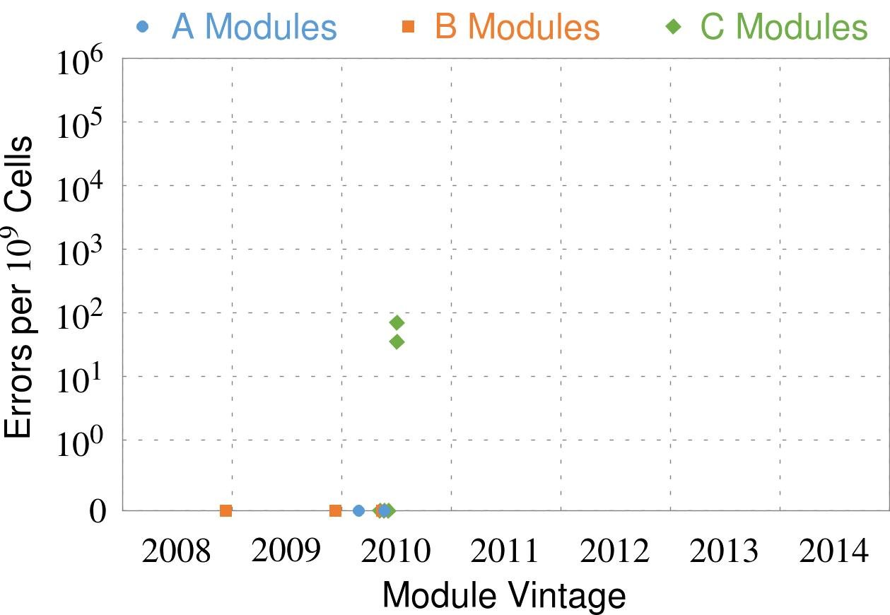
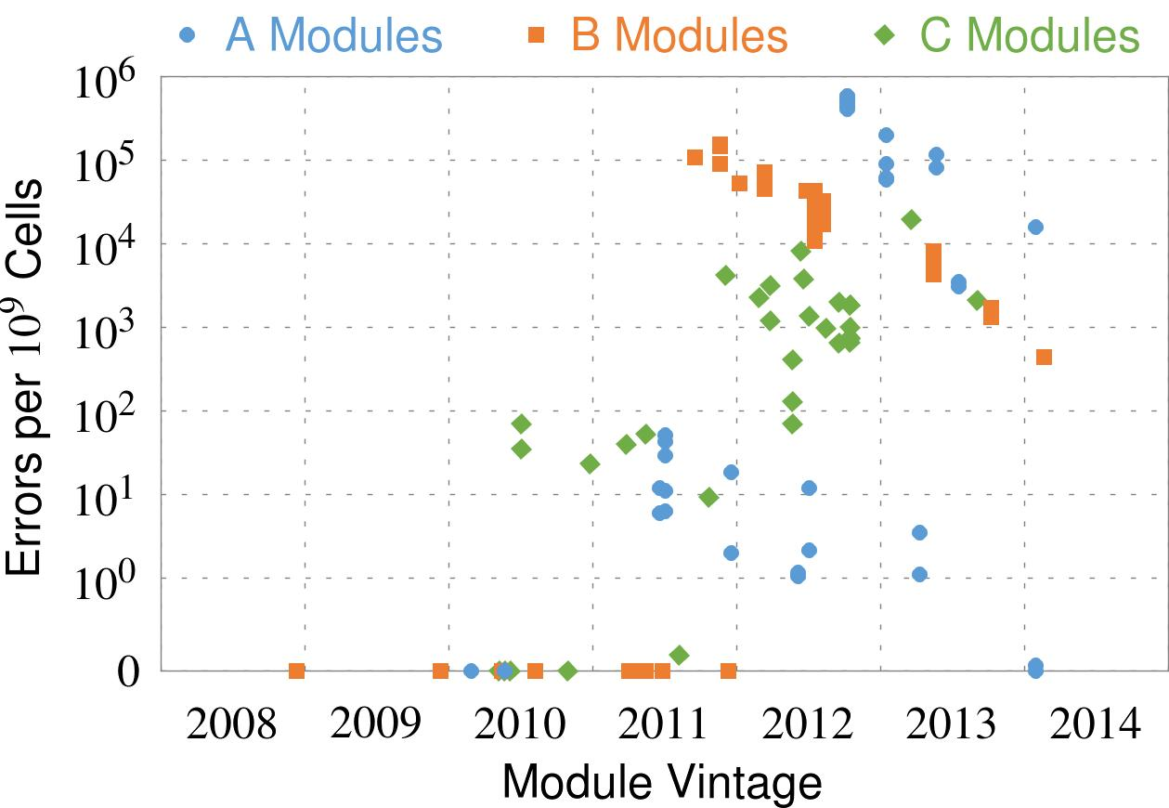
Errors vs. Vintage
First
Appearance
All modules from 2012–2013 are vulnerable
Flipping Bits in Memory Without Accessing Them: An Experimental Study of DRAM Disturbance Errors, (Kim et al., ISCA 2014)
Notes:
In this figure, the x-axis is the module manufacture date. And the y-axis is the number of errors in a module, normalized to one billion cells. In 2008 and 2009, there are no errors. But, in 2010, we first start to see errors in C modules. After 2010, the errors start to proliferate. For A and B modules, we first start to see errors in 2011. In particular, all modules from 2012 and 2013 are vulnerable.

Slide 12
How Do We Solve The Problem?
Fix it: Make DRAM and controllers more intelligent
  New interfaces, functions, architectures: system-DRAM codesign
Eliminate or minimize it: Replace or (more likely) augment DRAM with a different technology
  New technologies and system-wide rethinking of memory & storage
Embrace it: Design heterogeneous memories (none of which are perfect) and map data intelligently across them
  New models for data management and maybe usage
…
Problems
Algorithms
Programs
User
Runtime System
(VM, OS, MM)
ISA
Microarchitecture
Logic
Devices
Solutions (to memory scaling) require
software/hardware/device cooperation

Slide 13
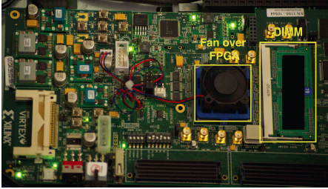
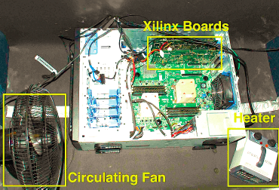
Experimental DRAM Testing Infrastructure
  An Experimental Study of Data Retention Behavior in Modern DRAM Devices: Implications for Retention Time Profiling Mechanisms (Liu et al., ISCA 2013)
  The Efficacy of Error Mitigation Techniques for DRAM Retention Failures: A Comparative Experimental Study
  (Khan et al., SIGMETRICS 2014)
  Flipping Bits in Memory Without Accessing Them: An Experimental Study of DRAM Disturbance Errors (Kim et al., ISCA 2014)
  Adaptive-Latency DRAM: Optimizing DRAM Timing for the Common-Case (Lee et al., HPCA 2015)
  AVATAR: A Variable-Retention-Time (VRT) Aware Refresh for DRAM Systems (Qureshi et al., DSN 2015)

Slide 14

Experimental DRAM Testing Infrastructure
Temperature
Controller
FPGAs
Heater
FPGAs
PC
  Kim+, “Flipping Bits in Memory Without Accessing Them: An Experimental Study of DRAM Disturbance Errors,” ISCA 2014.

Slide 15
RowHammer Characterization Results
Most Modules Are at Risk
Errors vs. Vintage
Error = Charge Loss
Adjacency: Aggressor & Victim
Sensitivity Studies
Other Results in Paper
Solution Space
Flipping Bits in Memory Without Accessing Them: An Experimental Study of DRAM Disturbance Errors, (Kim et al., ISCA 2014)
Notes:
Now I will present the characterization results, one-by-one.
First, I show that most modules are at risk. Second, I show the number of errors in a module as a function of the manufacture date. Third, I show that the errors are symptomatic of charge loss. Fourth, I show that an aggressor induces errors in adjacent rows. Fifth, I show several sensitivity studies. And, finally, I briefly describe other results in the paper.

Slide 16
Selected Readings on RowHammer
Our first detailed study: Rowhammer analysis and solutions
  Yoongu Kim, Ross Daly, Jeremie Kim, Chris Fallin, Ji Hye Lee, Donghyuk Lee, Chris Wilkerson, Konrad Lai, and Onur Mutlu,
  "Flipping Bits in Memory Without Accessing Them: An Experimental Study of DRAM Disturbance Errors"
  Proceedings of the 41st International Symposium on Computer Architecture (ISCA), Minneapolis, MN, June 2014. [Slides (pptx) (pdf)] [Lightning Session Slides (pptx) (pdf)] [Source Code and Data]
Our Source Code to Induce Errors in Modern DRAM Chips
  https://github.com/CMU-SAFARI/rowhammer
Google’s Security Attack to Take Over a System
  Exploiting the DRAM rowhammer bug to gain kernel privileges (Seaborn, 2015)
  https://github.com/google/rowhammer-test

Slide 17
RowHammer in Popular Sites and Press
https://en.wikipedia.org/wiki/Row_hammer
https://twitter.com/hashtag/rowhammer?f=realtime
http://www.rowhammer.com/
http://www.zdnet.com/article/flipping-dram-bits-maliciously/
http://www.infoworld.com/article/2894497/security/rowhammer-hardware-bug-threatens-to-smashnotebook-
http://www.zdnet.com/article/rowhammer-dram-flaw-could-be-widespread-says-google/
http://arstechnica.com/security/2015/03/cutting-edge-hack-gives-super-user-status-by-exploiting-dramweakness/
https://www.youtube.com/watch?v=H63dUfGBpxE
http://www.wired.com/2015/03/google-hack-dram-memory-electric-leaks/
https://www.grc.com/sn/sn-498-notes.pdf
…

Slide 18
For More Information
DRAM Basics Lecture Video
  https://www.youtube.com/watch?v=ZLCy3pG7Rc0
Related Issues in Memory Systems
  Onur Mutlu and Lavanya Subramanian,
  "Research Problems and Opportunities in Memory Systems"
  Invited Article in Supercomputing Frontiers and Innovations (SUPERFRI), 2015.

Slide 19
Open Source Tools
Rowhammer
  https://github.com/CMU-SAFARI/rowhammer
Ramulator
  https://github.com/CMU-SAFARI/ramulator
MemSim
  https://github.com/CMU-SAFARI/memsim
NOCulator
  https://github.com/CMU-SAFARI/NOCulator
DRAM Error Model
  http://www.ece.cmu.edu/~safari/tools/memerr/index.html
Other open-source software from my group
  https://github.com/CMU-SAFARI/
  http://www.ece.cmu.edu/~safari/tools.html

Slide 20
Related Videos and Course Materials
Undergraduate Computer Architecture Course Lecture Videos (2013, 2014, 2015)
Undergraduate Computer Architecture Course Materials (2013, 2014, 2015)
Graduate Computer Architecture Course Materials (Lecture Videos)
Parallel Computer Architecture Course Materials (Lecture Videos)
Memory Systems Short Course Materials
(Lecture Video on Main Memory and DRAM Basics)

