Slide 1



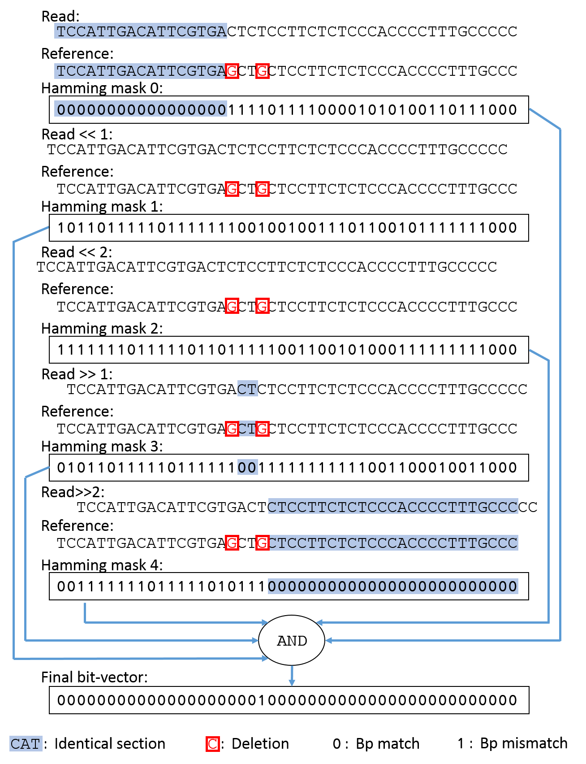
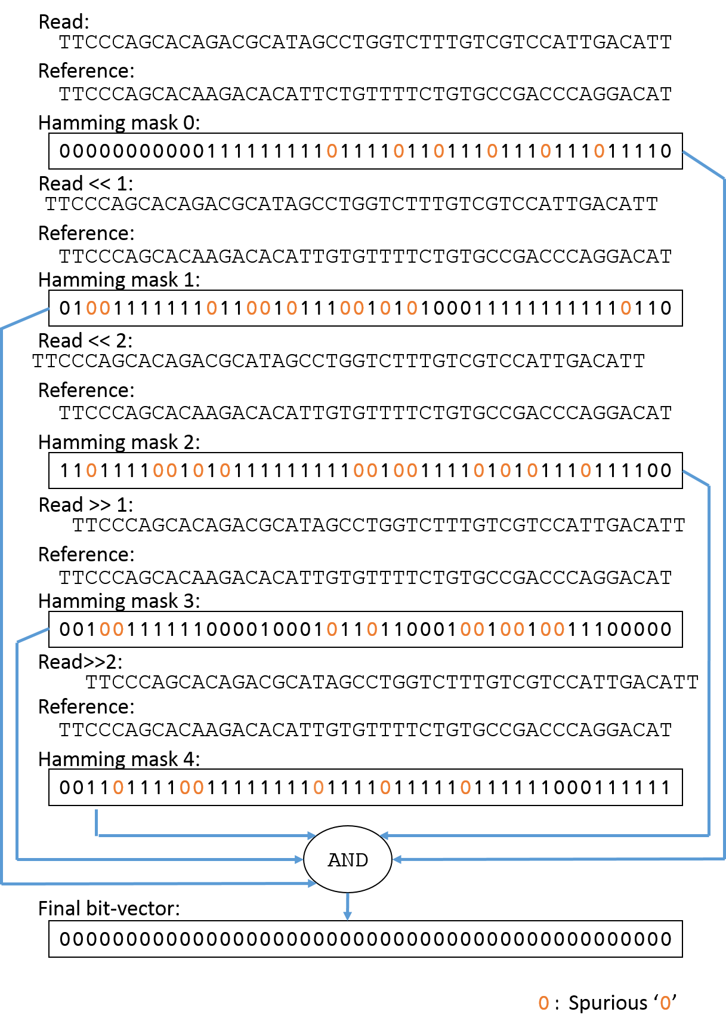
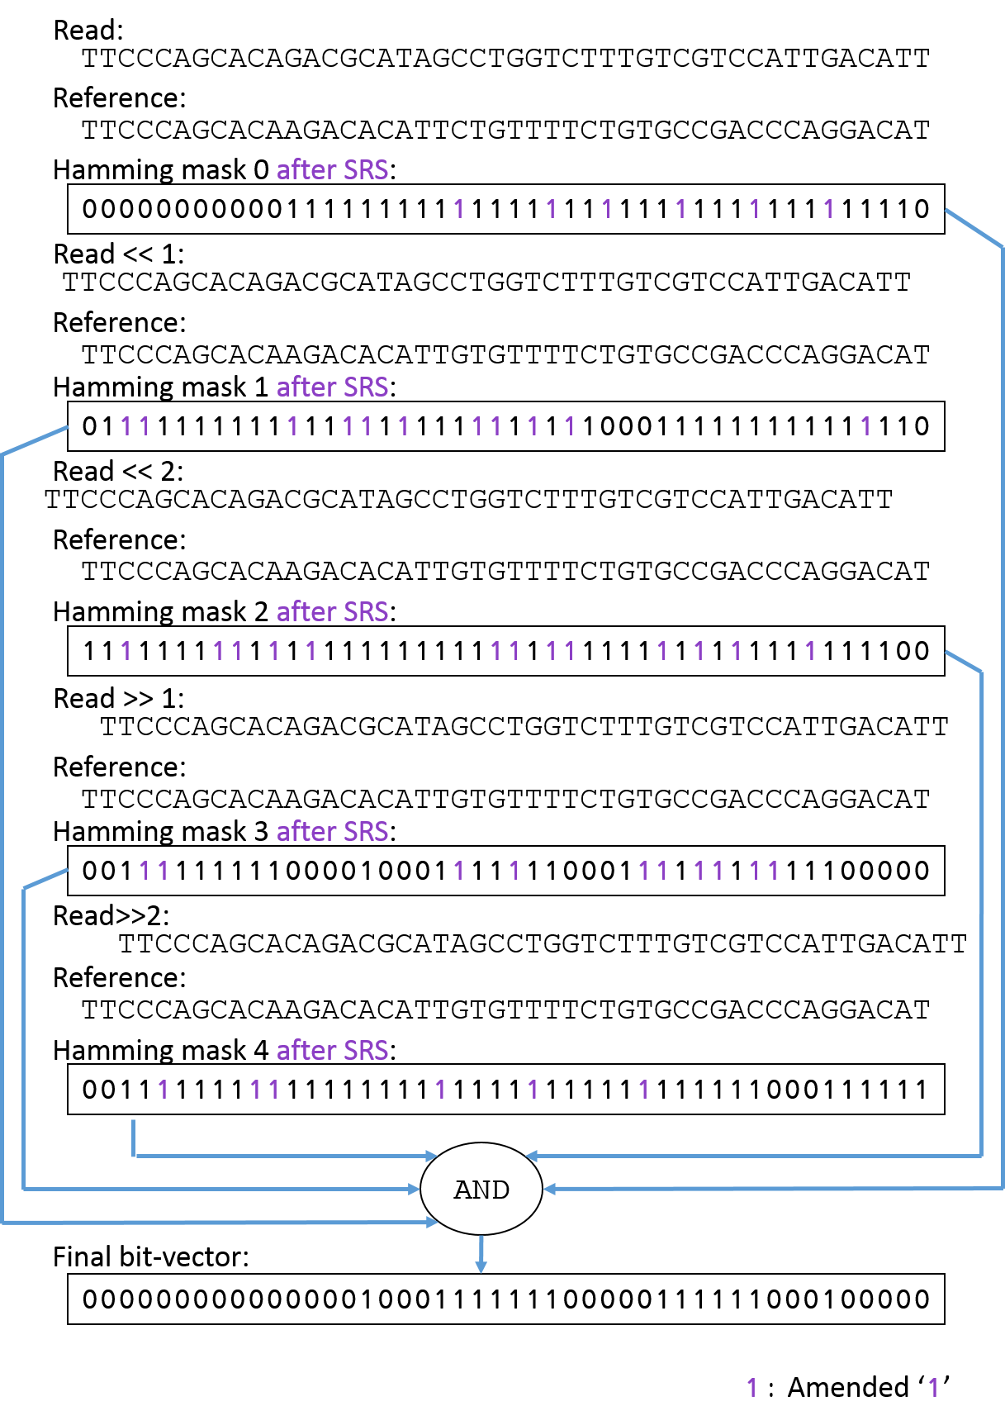
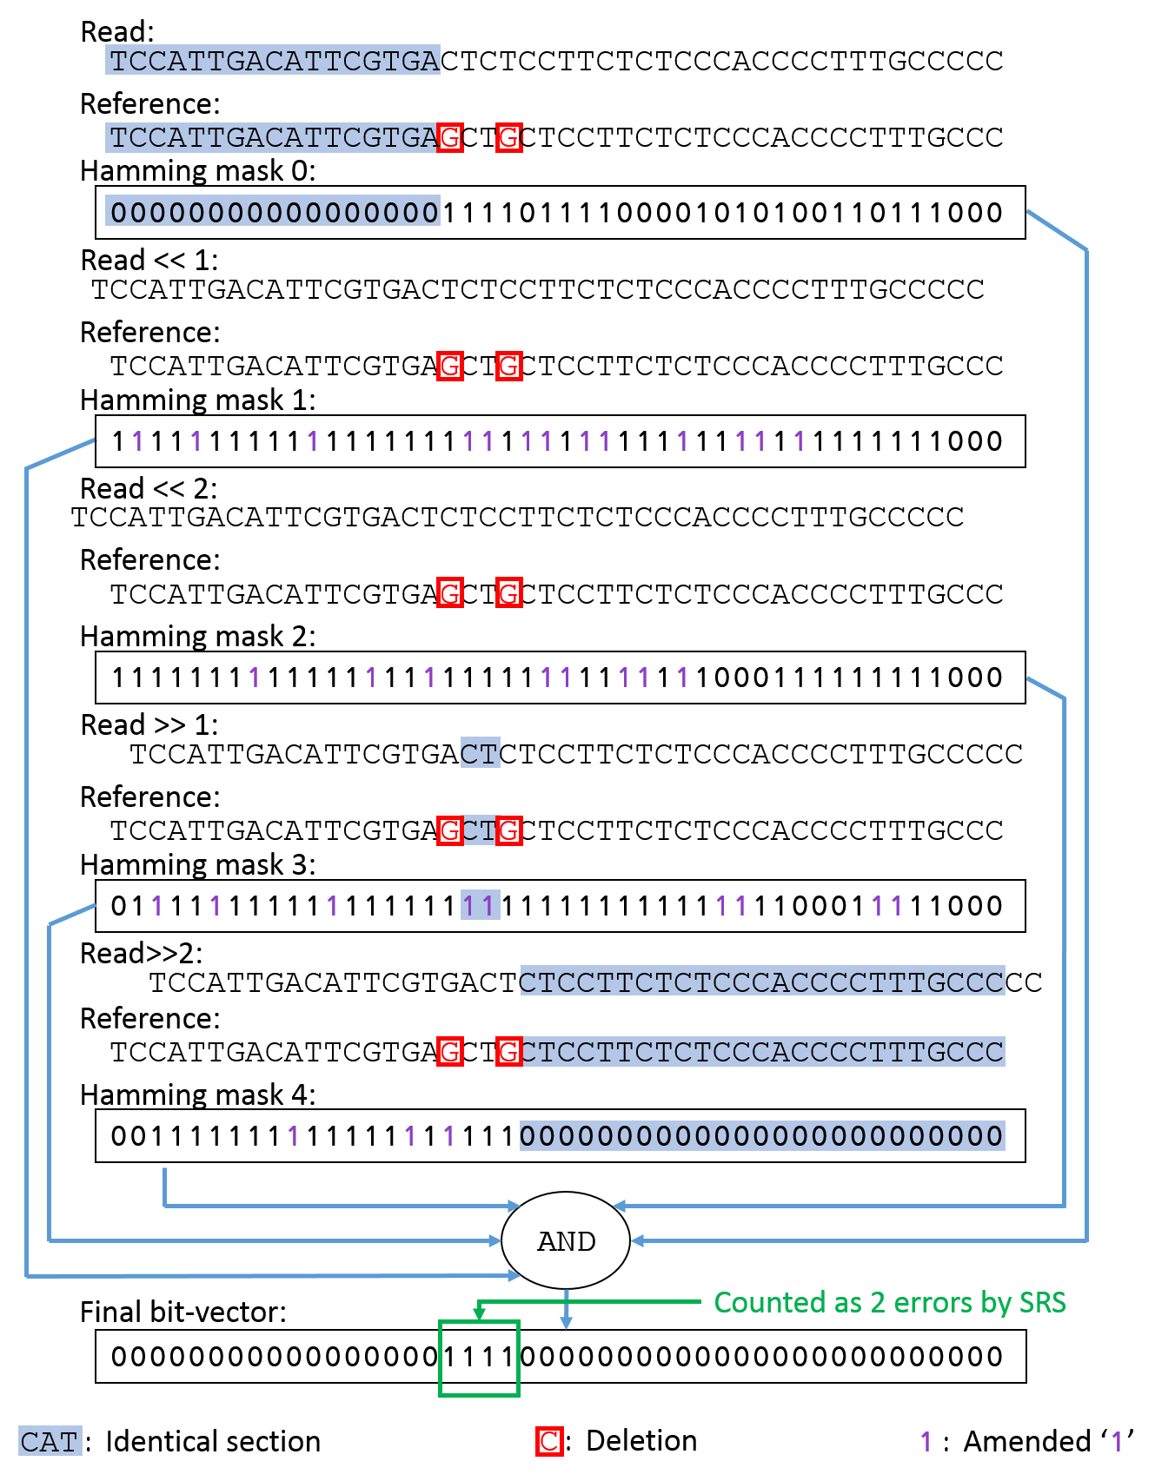
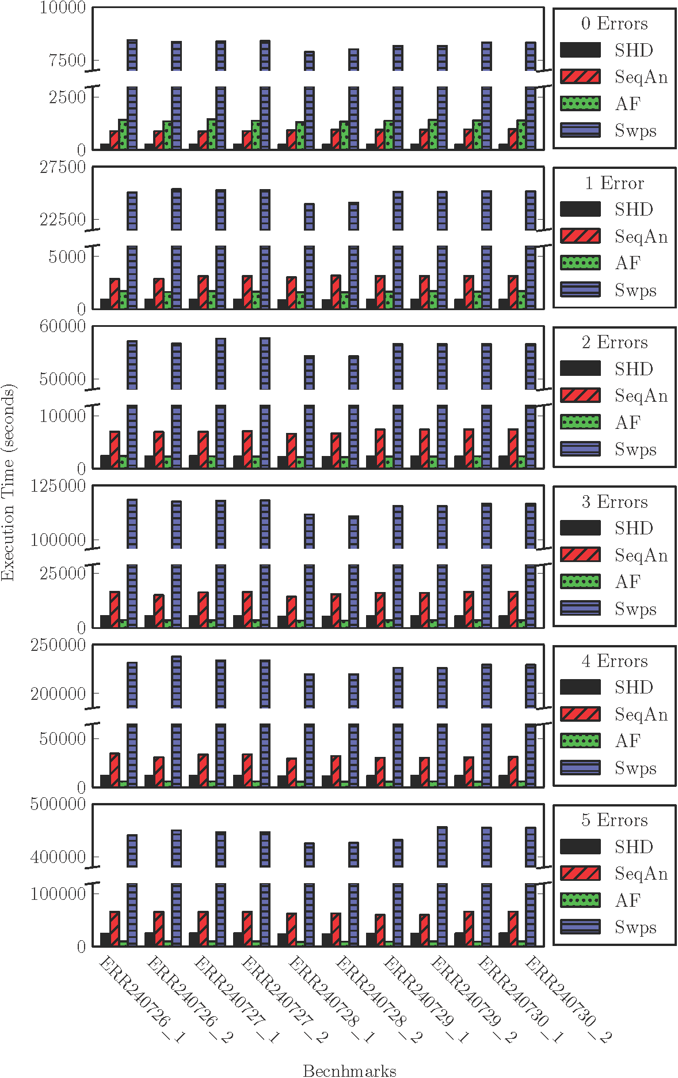
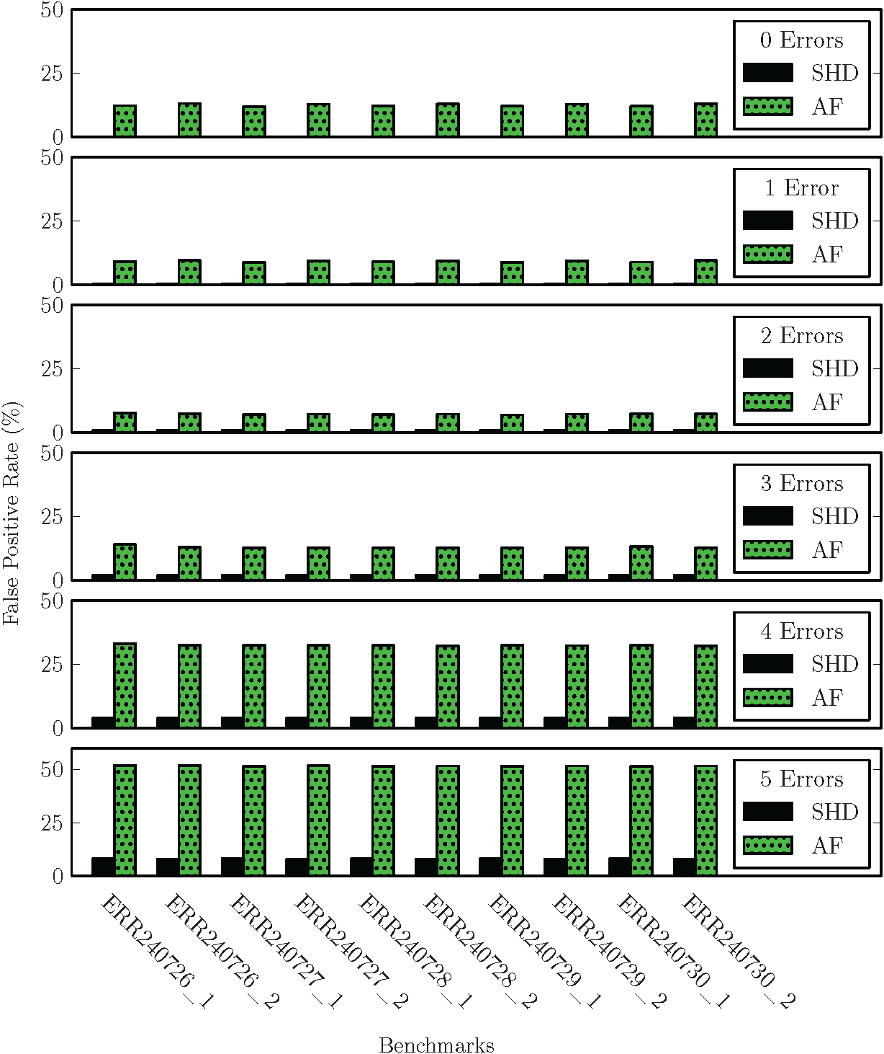
Shifted Hamming Distance (SHD): A Fast and Accurate SIMD-Friendly Filter
for Local Alignment in Read Mapping
Hongyi Xin¹, John Greth¹, John Emmons¹, Gennady Pekhimenko¹, Carl Kingsford¹, Can Alkan², Onur Mutlu¹
¹ Departments of Computer Science and Electrical and Computer Engineering, Carnegie Mellon University, Pittsburgh, PA, USA
² Dept. of Computer Engineering, Bilkent University, Ankara, Turkey
Problem:
Shifted Hamming Distance (SHD):
1
Identifying all matching bps of a correct mapping with SHM (e=2)
NGS mappers can be divided into two categories: Suffix-array based and seed-and-extend based
Suffix-array based mappers (i.e. bwa, bowtie2, SOAP3) find the best mappings fast but lose high-error mappings
Seed-and-extend based mappers (i.e., mrfast, shrimp, RazerS3) find all mappings but waste resources on rejecting incorrect mappings
Our goal: Provide an effective filter to efficiently filter out incorrect mappings
Key idea: use simple bit-parallel and SIMD operations to quickly filter out incorrect mappings
Key observations:
If two strings differ by ≤e errors, then every non-erroneous bp can be aligned in at most e shifts
If two strings differ by ≤e errors, then they share at most (e+1) identical sections (Pigeonhole Principle)
SHD consist of two parts: shifted Hamming mask-set (SHM) and speculative removal of short-matches (SRS)
1
2
Shifted Hamming Mask-set (SHM):
3
4
Speculative Removal of Short-matches (SRS):
Key idea: SHM identifies matching by incrementally shifting the read against the reference
Mechanism: Use bit-wise XOR to find all matching bps. Then use bit-wise AND to merge them together (Fig 1)
Mappings that contain more than e ‘1’s in the final bit-vector must contain more than e errors
Cons: SHD may let incorrect mappings pass through (Fig 2) because all ‘0’s “survive” the AND operations
Key idea: SRS refines SHM by removing short stretches of matches (<3 bps) identified in the Hamming masks (Fig 3)
Key observations:
Identical sections tend to be long (≥ 3 bps)
Short stretches of matches (streaks of ‘0’ <3 bps) are likely to be random matches of bps (generate spurious ‘0’s)
Mechanism: Amend short streak of ‘0’s into ‘1’s while count errors conservatively in the final bit-vector (Fig 4)
2
SHM fails to identify an incorrect mapping due to random matches (e=2)
3
SRS removes short random matches from the Hamming masks (e=2)
Only 1 error. Pass!
4
SRS counts errors conservatively to preserve correctness
Refined by SRS
No errors? Pass… Oops!
More than 2 errors. Filter!
Pass!
5
Results and Conclusion:
Performance results:
SHM and SRS are implemented using bit-parallel and SIMD operations (with Intel SSE, details in upcoming paper)
The threshold of SRS is platform dependent (3 bps at maximum on Intel platforms)
We compare SHD against:
SeqAn: Gene Myers’ bit-vector algorithm
Swps: A SIMD implementation of Smith-Waterman algorithm
AF: A k-mer locality based filter, FastHASH
We used mrFast to retrieve all potential mappings (read-reference pairs) from ten real read sets from 1000 Genomes Project
The false positive rate of SHD increases with larger error thresholds. SHD is effective with up to 5% error rate
Key Conclusion: SHD is 3x faster than the best previous implementation of edit-distance calculation, while having a false positive rate of only 7% (e = 5)
False positive results:

