Slide 1


SoftMC
A Flexible and Practical
Open-Source Infrastructure for Enabling Experimental DRAM Studies
Hasan Hassan,
Nandita Vijaykumar, Samira Khan,
Saugata Ghose, Kevin Chang,
Gennady Pekhimenko, Donghyuk Lee,
Oguz Ergin, Onur Mutlu
Notes:
Hello everyone.
My name is Hasan and as the last talk of the last session today, I will present SoftMC, which is an infrastructure for testing DRAM.

Slide 2
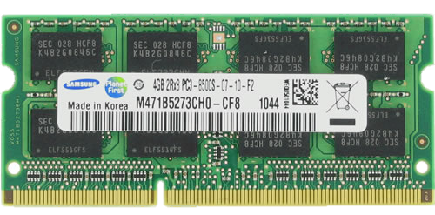
DRAM
Reliability
Performance
Characterize, analyze, and understand DRAM behavior
Notes:
Reliability and Performance are two important problems of DRAM technology today. They may be even more important in the future, as it is becoming increasingly difficult to scale DRAM cells into smaller technology nodes.
In fact, a new reliability issue, RowHammer, has been recently discovered, which exists only on new generation DRAM chips that are manufactured at small technology nodes.
So, there is a significant need for new mechanisms that could improve DRAM reliability and performance
To design, evaluate, and validate such mechanisms, it is important to accurately characterize, analyze and understand DRAM cell behavior.

Slide 3
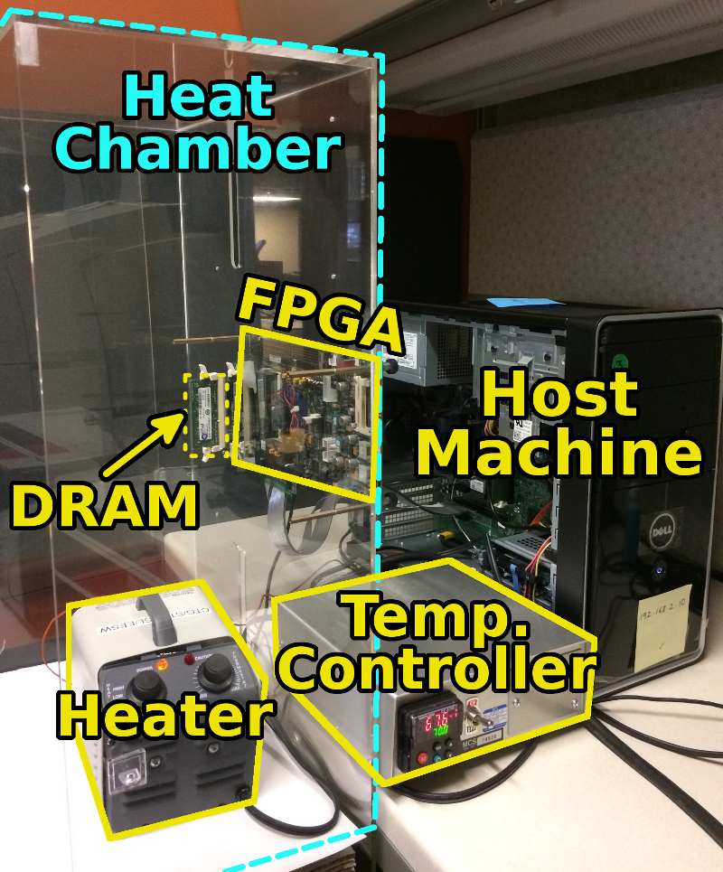
SoftMC
  Flexible
  Easy to Use (C++ API)
  Open-source
Example Use Cases
1
Retention Time Distribution Study
Evaluating Two Recently-Proposed Latency Reduction Mechanisms
2
github.com/CMU-SAFARI/SoftMC
Notes:
To this end, we propose SoftMC, an FPGA-based memory characterization infrastructure.
It is flexible, so it can support testing of any DRAM operation, and easy to use thanks to the high-level programming language (C++) API that we provide.
We release SoftMC as an open-source tool. SoftMC is available in our github repository.
In my talk, later today, I will show you the two use cases that we implemented using SoftMC.
First, we implement a Retention Time Distribution Study, using which we find the charge-retaining capability of the DRAM cells. This study serves as a validation of the correctness of SoftMC.
Second, we evaluate two recently-proposed latency reduction mechanisms.
From the results we obtain using SoftMC, we do not observe the expected latency reduction effect of these two mechanisms.
That study shows the effectiveness of SoftMC on validating or refuting ideas that reduce DRAM latency.

