Slide 1


SoftMC
A Flexible and Practical
Open-Source Infrastructure for Enabling Experimental DRAM Studies
Hasan Hassan,
Nandita Vijaykumar, Samira Khan,
Saugata Ghose, Kevin Chang,
Gennady Pekhimenko, Donghyuk Lee,
Oguz Ergin, Onur Mutlu
Notes:
Hello everyone.
My name is Hasan and today, I will talk about our work named SoftMC, which is an open-source infrastructure for testing DRAM.
This work is done in collaboration with co-authors from ETH Zurich, Carnegie Mellon University, and
TOBB University of Economics and Technology

Slide 2
Executive Summary
Two critical problems of DRAM: Reliability and Performance
  Recently-discovered bug: RowHammer
Characterize, analyze, and understand DRAM cell behavior
We design and implement SoftMC, an FPGA-based DRAM testing infrastructure
  Flexible and Easy to Use (C++ API)
  Open-source (github.com/CMU-SAFARI/SoftMC)
We implement two use cases
  A retention time distribution test
  An experiment to validate two latency reduction mechanisms
SoftMC enables a wide range of studies
Notes:
I would like to start with a quick summary of our work.
[CLICK]
Reliability and Performance are two important problems of DRAM technology today. They may be even more important in the future, as it is becoming increasingly difficult to scale DRAM cells into smaller technology nodes. Manufacturers try hard to tackle these problems, but still
a new reliability issue, RowHammer, has been recently discovered, which exists only on new generation DRAM chips that are manufactured at small technology nodes.
[CLICK]
So, there is a significant need for new mechanisms that could improve DRAM reliability and performance. To design, evaluate, and validate such mechanisms, it is important to accurately characterize, analyze and understand DRAM cell behavior.
[CLICK]
To this end, we design and implement SoftMC, an FPGA-based DRAM testing infrastructure that enables various studies on DRAM. Our infrastructure is flexible and easy to use. A prototype implementation of SoftMC is available as open-source code, which can be accessed from our github repository.
[CLICK]
We evaluate SoftMC and demonstrate its potential and ease of use by implementing two use cases. First, we show how simple is to implement a retention time distribution test, to characterize the retention time behavior of the DRAM cells.
[CLICK]
Second, we demonstrate the flexibility and capability of SoftMC by validating two recently-proposed DRAM latency reduction mechanisms. This experiment demonstrates the importance of experimentally characterizing real DRAM chips to understand the behavior of DRAM cells, and the effectiveness of SoftMC in validating or refuting new ideas on existing memory modules.
We believe that SoftMC would enable a wide range of studies to improve DRAM reliability and performance.

Slide 3
Outline
DRAM Basics & Motivation
SoftMC
Use Cases
  Retention Time Distribution Study
  Evaluating Recently-Proposed Ideas
Future Research Directions
Conclusion
Notes:
Here is the outline of the rest of my talk.
First, I would like to start with explaining basic DRAM operations and building motivation for an infrastructure to characterize real DRAM chips.

Slide 4
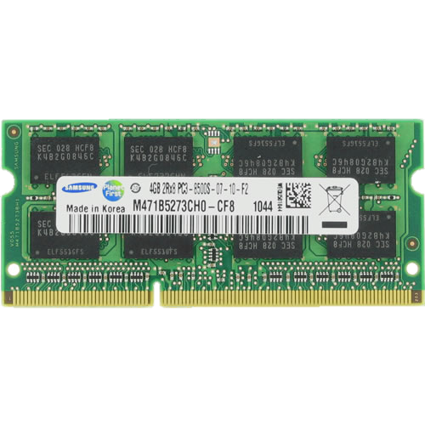
DRAM Operations
DRAM Cell
DRAM Row
Memory
Bus
CPU
Memory Controller
Precharge
Read
Activate
Sense Amplifier
Notes:
A typical system consists of CPU, and a DRAM module, which is accessed by the Memory Controller.
The memory module is composed of several DRAM chips. Inside each chip, we have a 2D array of DRAM cells, each of them storing a single bit of information as electrical charge. The cells are vertically connected to sense amplifiers, which can read the data from the cells and update it if needed. Each of horizontally distributed lines of cells are organized as DRAM rows.
Lets look at DRAM commands that the memory controller issues to access a particular DRAM cell.
[CLICK]
When the memory controller sends an activate command to the DRAM, first, the row to be accessed is being selected. [CLICK] Then, the cells of the selected rows transfer their charge to the sense amplifiers. Based on the charge amount received, the sense amplifiers determines the value that each cell store and then [CLICK] they restore the charge of the cells back to its initial amount.
[CLICK]
Next, the memory controller issues a read or write command to the DRAM. I show the read command here. With that command, we access the sense amplifiers from which we want to read data from [CLICK], and transfer that data over the memory bus to the CPU.
[CLICK]
So, although we completed a particular access, we still need to perform one more operation to prepare the DRAM for the next access, if that targets a row different than the one we have activated. We prepare the DRAM for an access to a new row using the precharge operation. [CLICK] Precharge, turns both the row and the sense amplifiers back to their initial states.
These are the key DRAM operations that enable accesses. Something that I didn’t mention in this slide in the latency of each of these operations.

Slide 5
DRAM Latency
0 (refresh)
64 ms
DRAM
Cell
Sense Amplifier
time
Activate
Read
Precharge
Activate
Ready-to-access
Latency
Retention Time: The interval during which the data
is retained correctly in the DRAM cell without accessing it
Precharge
Latency
Activation Latency
Notes:
In this slide, I would like to show the status of a DRAM cell and a sense amplifier prior to performing the key DRAM operations and on a completion of them.
When the cell is not yet activated, in other words when a row is closed, DRAM cells leak their charge gradually. The interval during which the data is retained correctly in a DRAM cell without accessing it is called Retention Time. DRAM cells are typically refreshed at 64 ms refresh period, to ensure DRAM stores the correct data continuously. Now, lets look at how DRAM commands change the status of the DRAM cell and the Sense Amplifier.
At the point where we just issue the Activate, the DRAM cell is fully charged, and the sense amplifier is idle. After a time interval, which we call ready-to-access latency, the memory controller could issue a read or write command. Later, when the cell is fully restored, after the activation latency, the memory controller is free to issue a precharge command to prepare the DRAM to an access to a new row. During the precharge operation, the sense amplifier gradually turns back into its idle state. We call the time associated with the precharge operation, precharge latency.
What if the memory controller does not obey these latencies?
Can we reduce DRAM access latency that way?

Slide 6
Latency vs. Reliability
DRAM
Cell
Sense Amplifier
time
Activate
Read
Precharge
Activate
Violating latencies negatively affects DRAM reliability
Ready-to-access
Latency
Precharge
Latency
Activation Latency
Notes:
If the memory controller issues the read command earlier in time, the DRAM will try to serve the data from a sense amplifier that may not have been properly sensed the data. That may lead to reading corrupted data.
[CLICK]
Similarly, if the memory controller issues the Precharge command earlier, the DRAM will start precharging without fully restoring the cell. Which may result in read error during the next access to the cell.
[CLICK]
Last, if the memory controller does not wait for the precharge operation to complete, and issues an activate command to a new row, then the activate operation will begin when the sense amplifier has some amount of charge (which means it is not completely in idle state). That may again result in reading incorrect data.
So, reducing the timing intervals between the commands to improve DRAM performance may negatively affect DRAM reliability. To develop such mechanisms, the exact characteristics of real DRAM cells need to be studied.
Reducing DRAM latency is just one factor that needs to be studied, but there are also other factors that affect DRAM reliability.

Slide 7
Other Factors Affecting Reliability and Latency
Temperature
Voltage
Inter-cell Interference
Manufacturing Process
Retention Time
…
To develop new mechanisms
improving reliability and latency,
we need to better understand
the effects of these factors
Notes:
There are also other factors affecting DRAM reliability and latency.
Such as, temperature, voltage, …
I would be happy to discuss these during the poster session.
To design more reliable and faster DRAM, we need to better understand the effects of such factors.

Slide 8
Characterizing DRAM
Many of the factors
affecting DRAM reliability and latency
cannot be properly modeled
We need to perform experimental studies
of real DRAM chips
Notes:
Many of the factors affecting DRAM reliability and latency cannot be properly modeled in simulation or analytically
To design, evaluate, and validate mechanisms that could improve reliability and performance,
We need to characterize, analyze and understand the behavior of real DRAM chips in terms of reliability and performance

Slide 9
Outline
DRAM Basics & Motivation
SoftMC
Use Cases
  Retention Time Distribution Study
  Evaluating Recently-Proposed Ideas
Future Research Directions
Conclusion
Notes:
Now, I will tell about SoftMC, the infrastructure we designed to perform DRAM characterization studies

Slide 10
Goals of a DRAM Testing Infrastructure
Flexibility
  Ability to test any DRAM operation
  Ability to test any combination of DRAM operations and custom timing parameters
Ease of use
  Simple programming interface (C++)
  Minimal programming effort and time
  Accessible to a wide range of users
    who may lack experience in hardware design
Notes:
Before showing you the design of SoftMC, I would like to explain the two goals that we believe a memory characterization infrastructure should achieve.
First, a memory testing infrastructure should be flexible so that it can support testing any DRAM operation. A testing infrastructure should enable issuing the DRAM command in any order, with adjustable and precise timing between these commands.
[CLICK]
Second, the infrastructure should be easy to use. It should have simple and intuitive programming interface that minimizes programming effort and time. It also should be accessible to wide-range of users. Even users that lack experience of hardware design should be able to perform DRAM tests.
We designed our infrastructure to achieve these goals.

Slide 11
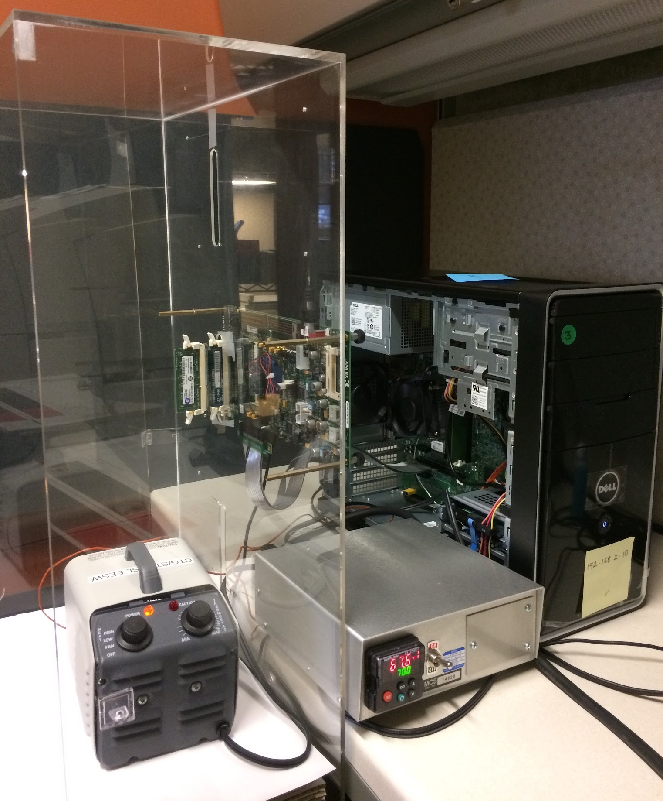
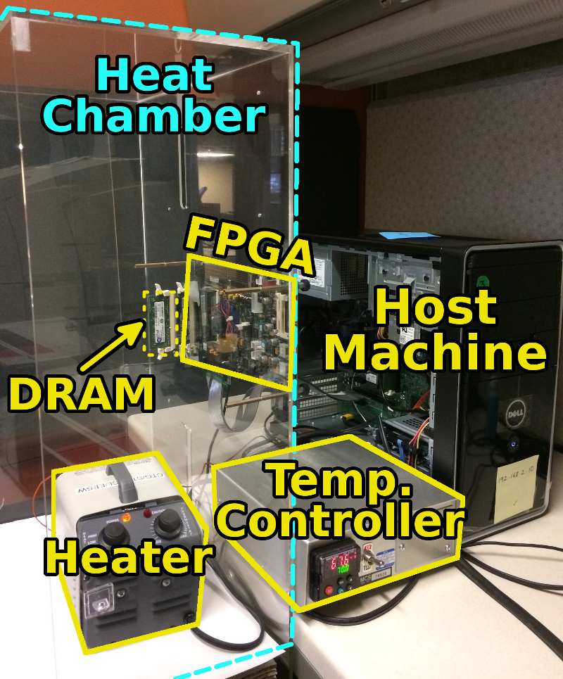
SoftMC: High-level View
FPGA-based
memory characterization infrastructure
Prototype using Xilinx ML605
Easily programmable using the C++ API
Notes:
SoftMC, Soft Memory Controller is an FPGA-based memory characterization infrastructure and achieves both flexibility and ease of use goals.
On the right-hand side, you can see our entire platform. We have a host machine, where we define DRAM tests, an FPGA, which has a DDR3 module mounted on. The FPGA is connected to the Host machine via PCIe interface.
To adjust the temperature in controlled manner, we enclose the DRAM module with a Heat Chamber. Inside the heat chamber, we have a heater to increase the environmental temperature. The Temperature Controller helps us keep the temperature at fixed point.
We develop a prototype of SoftMC on Xilinx ML605 FPGA board.
We also provide an API implemented in C++ to make developing test routines easier.

Slide 12
SoftMC: Key Components
1. SoftMC API
2. PCIe Driver
3. SoftMC Hardware
Notes:
There are 3 key components of SoftMC. The API, the PCIe driver, and the hardware, which is implemented on FPGA.
I will explain these components in more detail.
Let’s first take a look on the SoftMC API.

Slide 13
SoftMC API
Writing data to DRAM:
InstructionSequence iseq;
iseq.insert(genACT(bank, row));
iseq.insert(genWAIT(tRCD));
iseq.insert(genWR(bank, col, data));
iseq.insert(genWAIT(tCL + tBL + tWR));
iseq.insert(genPRE(bank));
iseq.insert(genWAIT(tRP));
iseq.insert(genEND());
iseq.execute(fpga);
Instruction generator functions
Notes:
In the SoftMC API, we provide a set of C++ functions and structures that would minimize the programmer’s effort. In this presentation, I won’t go over the API in detail, instead I will demonstrate how the API is used by a simple code example. For more details, please refer to our paper or the source code.
The API provides a set of instruction generator functions. Programmers use these functions to generate instructions that tells the hardware to perform specific operations. For example, genACT generates an instruction to activate a given row from a given bank. genWAIT generates an instruction to tell the hardware to wait for the given number of cycles before executing the next instruction. We also provide functions for generating DRAM write and precharge commands. For more details, please see our paper or our source code documentation
We provide another abstraction, InstructionSequence, a data structure that’s keeps the generates instructions in order, and provides a function to easily send them to the SoftMC hardware. The programmer inserts the instructions to the InstructionSequence, and sends them to the hardware using the execute function.
So, these are the key parts of the API that we offer. Please see our paper for more details.

Slide 14
SoftMC: Key Components
1. SoftMC API
2. PCIe Driver*
Communicates raw data with the FPGA
3. SoftMC Hardware
* Jacobsen, Matthew, et al. "RIFFA 2.1: A reusable integration framework for FPGA accelerators." TRETS, 2015
Notes:
The PCIe driver is only responsible of transferring raw data between the host machine and FPGA. The data can be the instructions generated in the host machine, or data read from DRAM which is sent back to the host machine.
Let me move to the details of SoftMC Hardware

Slide 15

SoftMC Hardware
Read
Activate
Wait (Ready-to-access Latency)
Instruction Receiver
DDR PHY
Instructions
DRAM
Instruction Dispatcher
Instruction Queue
PCIe Controller
Auto-refresh Controller
Calibration Controller
Host
Machine
Read Capture
Data
SoftMC Hardware (FPGA)
Notes:
This slide depicts the host machine, the DRAM module, and the FPGA that implements the SoftMC hardware.
I would like to show how the hardware operates by an example.
On the host machine, using the SoftMC API that I presented in the previous slide, the programmer generates a set of SoftMC instructions. Then the driver sends these instructions over the PCIe bus to the SoftMC hardware. In the SoftMC hardware, the instructions are buffered in the Instruction Queue. After receiving the entire Instruction Sequence, the Instruction Dispatcher fetches instructions from the queue and executes them.
Let’s assume the first one is an activate instructions, using which we will open a row from the DRAM. For that instruction, the dispatcher creates a corresponding DRAM command, which the DDR PHY unit sends to the DRAM module via the DDR bus. The dispatcher fetches the next instruction. It is a wait instructions that only tells the dispatcher to not fetch any instructions for the next couple of cycles. So this instruction doesn’t send anything to the DRAM. Last, the dispatcher executes a READ instruction, for which a DDR command is sent to the DRAM. In return, the DRAM module sends data back to the DDR PHY. DDR PHY forwards the data to the Read Capture module, which forwards the data further to the Host Machine. This was a demonstration of how the hardware operate in case of reading data from DRAM.
We also have Auto-refresh controller, which the user can set to automatically refresh the DRAM and Calibration Controller which performs task to ensure data integrity of the DDR bus.
That was in high-level a demonstration of our SoftMM design. For more details, please check our paper.

Slide 16
Outline
DRAM Basics & Motivation
SoftMC
Use Cases
  Retention Time Distribution Study
  Evaluating Recently-Proposed Ideas
Future Research Directions
Conclusion
Notes:
Using SoftMC, we implement two use cases.
First, we perform a retention time distribution study, in order to validate the correctness of our infrastructure.

Slide 17
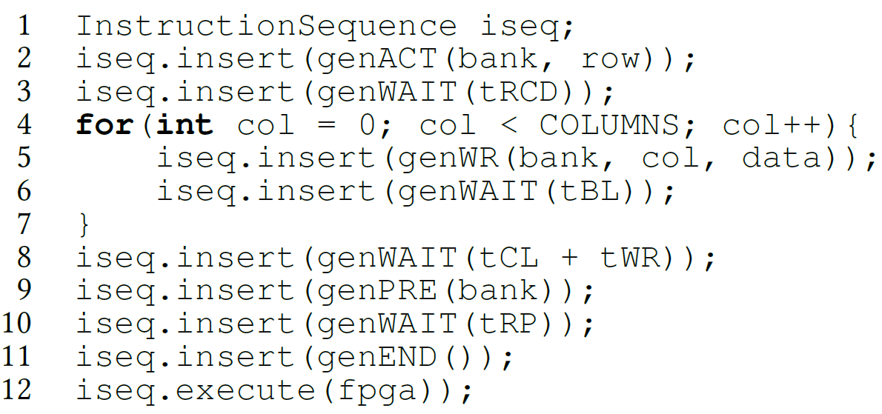
Retention Time Distribution Study
Write Reference Data to a Row
Wait
(Refresh Interval)
Read Back
Observe Errors
Increase the refresh interval
Can be implemented with just ~100 lines of code
Notes:
Retention Time of a DRAM cell is defined as the interval during which the cell can correctly store the data.
In this test, we experimentally analyze the retention time distribution in three DRAM modules from three different vendors.
Now I will show you how we perform that test using SoftMC. First, we write data reference data pattern to a DRAM row. Then, we wait for some time, which in fact specifies the refresh interval. After that refresh interval, we read the data back from the row, and check it if it still stores the reference data that we previously wrote. Then we repeat the test by increasing the refresh interval. We perform the test on every row in the DRAM module. This entire test could be implemented with about 100 lines of code using SoftMC API.
Now let me show you the results that we obtained from that experiment.

Slide 18
Retention Time Test: Results
@ ~20⁰C (room temperature)
Module A
Module B
Validates the correctness of the SoftMC Infrastructure
Module C
Notes:
Our results match the retention time results reported by prior work. This study validates the correctness of our testing infrastructure.

Slide 19
Outline
DRAM Basics & Motivation
SoftMC
Use Cases
  Retention Time Distribution Study
  Evaluating Recently-Proposed Ideas
Future Research Directions
Conclusion
Notes:
Now let me move to our second use case.
In this use case, we evaluate two recently proposed latency reduction mechanisms and show the effectiveness of SoftMC in validating or refuting recently proposed ideas

Slide 20
Accessing Highly-charged Cells Faster
NUAT
^{(Shin+, HPCA 2014)}
ChargeCache
^{(Hassan+, HPCA 2016)}
A highly-charged cell can be accessed with low latency
Notes:
Two mechanisms, ChargeCache and Non Uniform Access Time Memory Controller (NUAT) exploit the same key observation to reduce DRAM access latency.
A Highly-charged DRAM cell can be accessed faster, with lower latency. ChargeCache combines this observation with that recently-accessed DRAM cells are in highly-charged state. This is because, when we access a cell, it gets restored as I showed in the first slides. On the other hand, NUAT is based on the observation that recently-refreshed DRAM cells have high amount of charge.
Let me show in the next slide what I mean by highly-charged cell and why it can be accessed with low latency.

Slide 21
How a Highly-Charged Cell Is Accessed Faster?
0 (refresh)
64 ms
DRAM
Cell
Sense Amplifier
time
Activate
Read
Precharge
Activate
Ready-to-access
Latency
Precharge
Latency
Activation Latency
Notes:
Recall that prior to activate, the DRAM cell is leaking its charge. The two studies we evaluate observe that if the activate is issued when the DRAM cell is highly-charged, which means it is accessed just after the refresh, the access latency can be reduced. Specifically, their mechanisms can reduce Ready to access latency and Activation Latency. Note that, current memory controllers do not have a notion of charge available in the cells and hence they cannot exploit this observation. Their mechanisms extend the memory controller with such ability.
Although we perform separate experiment using SoftMC, to measure the headroom for reduction on these latencies,
In this talk I will only explain the experiment we performed for ready to access latency. I would be happy to discuss our other experiment offline.

Slide 22
Ready-to-access Latency Test
Longer wait
Lower cell charge
Shorter wait
Higher cell charge
Write Reference Data
Wait for the
Wait Interval
Read Back
Observe Errors
Change
the Wait Interval
With custom ready-to-access latency parameter
Can be implemented with just ~150 lines of code
Notes:
Here is our methodology for the ready to access latency test.
We start the test similar to retention time distribution study, by writing a reference data. Next, we wait for some time interval. We use this interval to adjust the charge amount stored in the cell. If we wait longer, the cell will leak more charge, and at the end the cell will contain lower charge. If we wait shorter, the cell will contain higher charge.
Next, the read back data from the same location in DRAM that we wrote the reference data to. We perform this read with low ready-to-access latency. Which means, after issuing the activate command, we wait less prior to issuing the read command. Then we compare the data we read with the reference data, and we count the number of errors. We repeat the test through the entire DRAM with different wait intervals.

Slide 23
Ready-to-access Latency: Results
Expected Curves
Real Curves
@ 80⁰C temperature
We do not observe
the expected
latency reduction effect
in existing DRAM chips
Notes:
First, I would like to show you what the results should look like based on the idea that highly-charged cells can be accessed faster.
In the x-axis of the figure, we have the wait interval, which you can think as the charge amount of the cell. Going to the left the cell has more charge, going to the right the cell has less charge. On the y-axis we have the number of bytes with at least one bit-flip. The lines represent the number of errors for different ready-to-access latencies, from 6 cycles to just 3 cycles.
If we look at this point, we can see that when a cell has leaked significant portion of its charge, the correct data can be read from the DRAM cell using default ready-to-access latency, which is 6. But, the data cannot be read correctly with low latency. On the other hand, when the cell contains higher amount of charge, it can be accessed correctly also with low latency without any errors.
OK, lets look at our results that we obtained by testing real DRAM chips.
As you see, there is not a considerable distinction among the curves for 6, 5, and 4 cycles of latency, which conflicts with our expectation.
With 3 cycles latency, we have error even when working with very small wait interval. We believe that is because with such a low latency, some of the cells cannot correctly operate regardless of their charge amount.
Based on our experiments using SoftMC, we do not observe the expected latency reduction effect in existing DRAM chips.

Slide 24
Why Don’t We See the Latency Reduction Effect?
The memory controller cannot externally control when a sense amplifier gets enabled in existing DRAM chips
Ready to Access
Ready to Access
Charge Level
Cell
Data 1
charge
Potential Reduction
Enabling the Sense Amplifier
Sense Amp
Data 0
Fixed Latency!
time
ACT
R/W
Notes:
But, what is the reason behind that? Why don’t we see the latency reduction effect?
Based on our discussion with DRAM manufacturers, we found out that there is a critical timing parameter which cannot be externally controlled my the memory controller. This is the interval between the Activate command, until the sense amplifier gets enabled. Let me explain that with the following example.
Initially, the cell has charge in region of Data 1. With the activate command, the cell shared a portion of its charge with the wire connected to the sense amplifier. This sharing continues until the sense amplifier gets enabled and starts charging the cell back to fully charged state. This time, from the issuing of activate command to the enabling of the sense amplifier is fixed in the DRAM circuit. When the sense amplifier is enabled it brings the cell to highly charged state. And at the time where the cell reaches ready to access charge level, the memory controller can issue the read or write command. And the entire latency from ACT to Read or Write is ready-to-access-latency as I explained in the start of my talk.
Let’s see what happens when we start with initially fully charged cell. Since, the latency to enable the sense amplifier is fixed, after charge sharing, the cell charge reaches almost the same point, and we do not get any room for reduction of ready-to-access latency. However, if we look at the point where the charge sharing gets to the point where the blue line reaches just before enabling the sense amplifier, we see that we have a significant potential for latency reduction.
Using SoftMC, we show that the expected latency reduction effect is not observable in existing DRAM chips.

Slide 25
Outline
DRAM Basics & Motivation
SoftMC
Use Cases
  Retention Time Distribution Study
  Evaluating Recently-Proposed Ideas
Future Research Directions
Conclusion
Notes:
I presented you two examples that SoftMC enables. Now, I will talk about more future research directions that SoftMC can enable

Slide 26
Future Research Directions
More Characterization of DRAM
  How are the cell characteristics changing with different generations of technology nodes?
  What types of usage accelerate aging?
Characterization of Non-volatile Memory
Extensions
  Memory Scheduling
  Workload Analysis
  Testbed for in-memory Computation
Notes:
First of all, SoftMC will enable more DRAM characterization studies. SoftMC can help to answer questions such as:
…
Second, by some minor changes, SoftMC can be used for characterization of emerging Non-volatile memories. When such chips become available, it will be critical to characterize and analyze them in order to understand, exploit, and correct their behavior.
Thirds, SoftMC could also be extended to enable studies on areas such as memory scheduling and power management. SoftMC could also be adapted to run real workloads on it.
We believe, SoftMC will help to develop mechanisms and architectures that improve reliability and performance of future memory systems.

Slide 27
Outline
DRAM Basics & Motivation
SoftMC
Use Cases
  Retention Time Distribution Study
  Evaluating Recently-Proposed Ideas
Future Research Directions
Conclusion
Notes:
Now, let me conclude

Slide 28
Conclusion
SoftMC: First publicly-available FPGA-based DRAM testing infrastructure
Flexible and Easy to Use
Implemented two use cases
  Retention Time Distribution Study
  Evaluation of two recently-proposed latency reduction mechanisms
SoftMC can enable many other studies, ideas, and methodologies in the design of future memory systems
Download our first prototype
github.com/CMU-SAFARI/SoftMC
Notes:
So now, let me quickly conclude.
We designed and implemented the first publicly-available FPGA-based DRAM testing infrastructure. SoftMC has two properties, Flexibility and Ease of Use, which enable wide-range of studies on DRAM to be performed by a wide-range of researchers.
We show the capabilities of SoftMC by implementing two use cases. The results of our Retention Time Distribution study match with previously reported results, validating the correctness of SoftMC.
In the second use case, using SoftMC, we show that the expected latency reduction effect of two recently-proposed mechanisms is not observable in existing DRAM chips. That study shows the capability of SoftMC in validating or refuting new mechanisms on DRAM.
We believe that SoftMC will be widely used to evaluate and validate studies, ideas, and methodologies in the design of future memory systems.

Slide 29
SoftMC
A Flexible and Practical
Open-Source Infrastructure for Enabling Experimental DRAM Studies
Hasan Hassan,
Nandita Vijaykumar, Samira Khan,
Saugata Ghose, Kevin Chang,
Gennady Pekhimenko, Donghyuk Lee,
Oguz Ergin, Onur Mutlu

Slide 30
Backup Slides

Slide 31
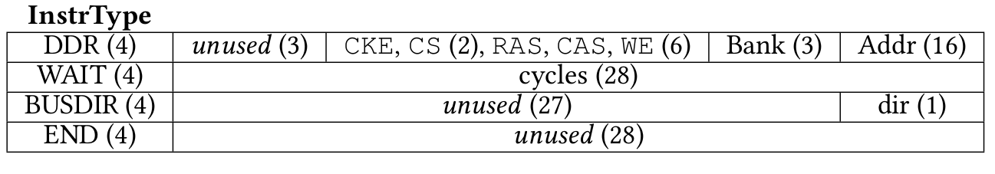
Key SoftMC Instructions

Slide 32
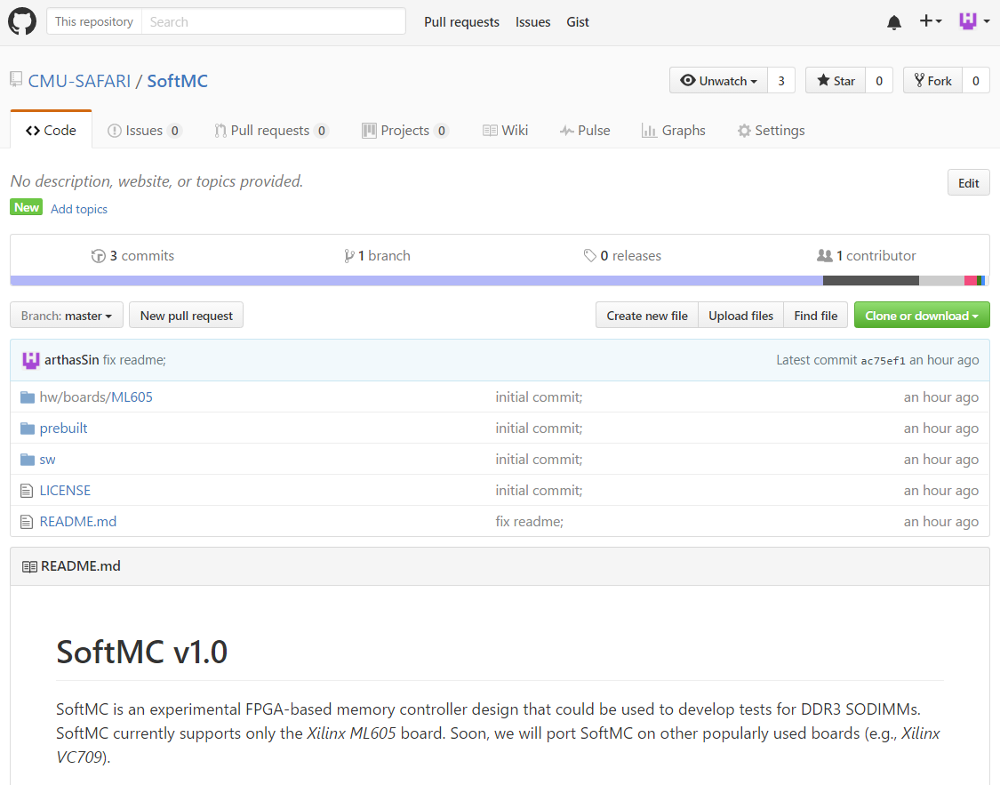
SoftMC @ Github

Slide 33
Ready-to-Access Latency Test Results
Module B
Module A
Module C

Slide 34
Activation Latency Test
With low activation latency parameter
Write Reference Data
Wait for the
Wait Interval
ACT-PRE
Change
the wait interval
Observe Errors
Read Back
Wait for the
Wait Interval
Notes:
Here is our methodology for the ready to access latency test.
We start the test similar to retention time distribution study, by writing a reference data. Next, we wait for some time interval. We use this interval to adjust the charge amount stored in the cell. If we wait longer, the cell will leak more charge, and at the end the cell will contain lower charge. If we wait shorter, the cell will contain higher charge.
Next, the read back data from the same location in DRAM that we wrote the reference data to. We perform this read with low ready-to-access latency. Which means, after issuing the activate command, we wait less prior to issuing the read command. Then we compare the data we read with the reference data, and we count the number of errors. We repeat the test through the entire DRAM with different wait intervals.

Slide 35
Activation Latency Test Results
Module B
Module A
Module C

