Slide 1



SysScale: Exploiting Multi-domain
Dynamic Voltage and Frequency Scaling
for Energy Efficient Mobile Processors
Jawad Haj-Yahya¹
Mohammed Alser¹ Jeremie Kim¹ A. Giray Yaglıkçı¹
Nandita Vijaykumar^{1,2,3} Efraim Rotem² Onur Mutlu¹
1
1
2
3
Notes:
Hello, my name is Jawad Haj-Yahya and I will present our work SysScale: Exploiting Multi-domain Dynamic Voltage and Frequency Scaling for Energy Efficient Mobile Processors

Slide 2
Executive Summary
Problem: A modern thermally-constrained mobile SoC has three domains: compute, IO, and memory. The SoC allocates a fixed power budget to these domains unfairly based on their worst-case performance demands even if they are underutilized.
Goal: Increase the energy efficiency and performance of mobile SoCs by dynamically orchestrating the distribution of the SoC power budget across the three domains based on their actual performance demands.
Mechanism: SysScale, a new multi-domain power management technique that introduces
  A new DVFS (dynamic voltage and frequency scaling) mechanism to distribute the SoC power to each domain based on its predicted performance demand
  An accurate algorithm to predict each domain’s performance demand
  Domain-specialized techniques to optimize the energy efficiency of each domain at different operating points
Evaluation: We implement SysScale on the Intel Skylake SoC for mobile devices. SysScale:
  Improves the performance of SPEC CPU2006 and 3DMark workloads by up to 16% and 8.9% (9.2% and 7.9% on average), providing larger benefits at lower power budgets
  Reduces the average power consumption of battery life workloads by up to 10.7% (8.5% on average)
Notes:
First, I’ll give a high level overview of the talk [CLICK]
A modern thermally-constrained mobile SoC has three domains: compute, IO, and memory. The SoC allocates a fixed power budget to these domains unfairly based on their worst-case performance demands even if they are underutilized. [CLICK]
Our goals is to Increase the energy efficiency and performance of mobile SoCs by dynamically orchestrating the distribution of the SoC power budget across the three domains based on their actual performance demands. [CLICK]
To this end we propose SysScale, a new multi-domain power management technique that introduces three mechanisms [CLICK]
First, A new DVFS mechanism to distribute the SoC power to each domain based on its predicted performance demand [CLICK]
Secondly, An accurate algorithm to predict each domain’s performance demand [CLICK]
Finally, Domain-specialized techniques to optimize the energy efficiency of each domain at different operating points [CLICK]
We implement SysScale on the Intel Skylake SoC for mobile devices [CLICK]
SysScale Improves the performance of SPEC CPU2006 and 3DMark workloads by up to 16% and 8.9% while providing larger benefits at lower power budgets [CLICK]
SysScale Reduces the average power consumption of battery life workloads by up to 10.7%
[END]

Slide 3
Presentation Outline
Overview of a Modern SoC
Motivation and Goal
SysScale
  Power Management Flow
  Demand Prediction Mechanism
  Holistic Power Management Algorithm
Evaluation
Conclusion
Notes:
Here is the outline for the talk today
[END]

Slide 4
Presentation Outline
Overview of a Modern SoC
Motivation and Goal
SysScale
  Power Management Flow
  Demand Prediction Mechanism
  Holistic Power Management Algorithm
Evaluation
Conclusion
Notes:
I will begin with a brief overview on mobile SoC
[END]

Slide 5
Overview of a Modern SoC Architecture
3 domains in modern thermally-constrained mobile SoC: Compute, Memory, IO
Several voltage sources exist, and some of them are shared between domains
IO controllers and engines, IO interconnect, memory controller, and DDRIO typically each has an independent clock
IO peripherals
V_SA
V_IO
VDDQ
IO Engines/
Controllers
Memory
Controller
DRAM
DDRIO Digital
IO Interconnect
DDRIO Analog
IO Domain
Memory Domain
System On Chip
CPU Cores
Last Level
Cache
Graphics
Engines
Compute Domain
V_C
V_G
Notes:
[CLICK]
There are three domains in modern thermally-constrained mobile SoC:
[CLICK]
Compute [CLICK]
Memory [CLICK]
and IO [CLICK]
Several voltage sources exists, and some of them are shared between domains. For example VDDQ [CLICK]
V_IO [CLICK]
V_SA [CLICK]
V_Core [CLICK]
and V_Graphics
[CLICK]
Many components in the SoC normally have their own clock, for example IO controllers and engines, IO interconnect, memory controller, and DDRIO typically each has an independent clock
[END]

Slide 6
Overview of a Modern SoC Architecture
3 domains in modern thermally-constrained mobile SoC: Compute, Memory, IO
Several voltage sources exist, and some of them are shared between domains
IO controllers/engines, IO interconnect, memory controller, and DDRIO typically each has an independent clock
IO peripherals
V_SA
V_IO
VDDQ
IO Engines/
Controllers
Compute domain supports dynamic
voltage and frequency scaling (DVFS).
IO and memory domains have fixed
clock frequencies and voltages.
Memory
Controller
DRAM
DDRIO Digital
IO Interconnect
DDRIO Analog
IO Domain
Memory Domain
System On Chip
CPU Cores
Last Level
Cache
Graphics
Engines
Compute Domain
V_C
V_G
Notes:
Compute domain supports dynamic voltage and frequency scaling (DVFS).
While IO and memory domains have fixed clock frequencies and voltages.
[END]

Slide 7
Presentation Outline
Overview of a Modern SoC
Motivation and Goal
SysScale
  Power Management Flow
  Demand Prediction Mechanism
  Holistic Power Management Algorithm
Evaluation
Conclusion
Notes:
I will now discuss the motivation and the goal of our work
[END]

Slide 8
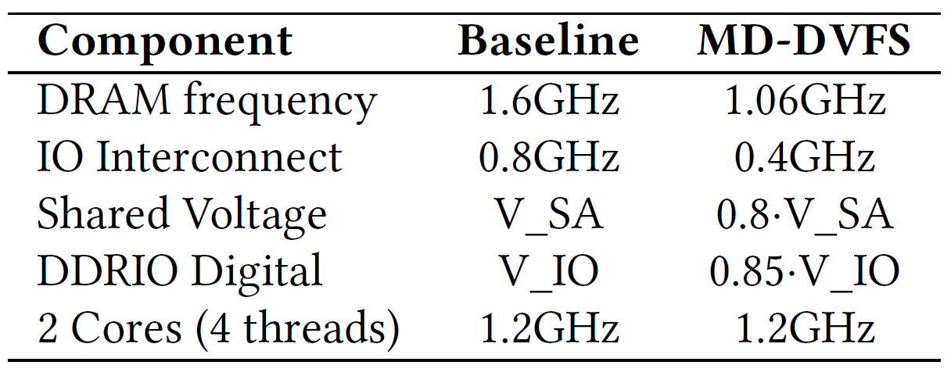
Motivational Experiment
We evaluate the potential benefits of employing DVFS across the three SoC domains
We carry out an experiment on the Intel Broadwell processor under two setups
  Baseline
  Multi-Domain DVFS (MD-DVFS)
We use multiple workloads from SPEC CPU2006 and 3DMark, and a workload that exercises the peak memory bandwidth of DRAM
Notes:
[CLICK]
To motivate our work We evaluate the potential benefits of employing DVFS across the three SoC domains [CLICK]
We carry out an experiment on the Intel Broadwell processor under two setups [CLICK]
Baseline setup [CLICK]
Multi-Domain DVFS setup, MD-DVFS in short. In the MD-DVFS we reduce the frequencies of the DRAM and IO interconnect.
We also reduce the shared voltage and the DDRIO Digital voltage [CLICK]
We use multiple workloads from SPEC CPU2006 and 3DMark, and a workload that exercises the peak memory bandwidth of DRAM
We make four observations from our motivational experiment. I will describe them one by one.
[END]

Slide 9
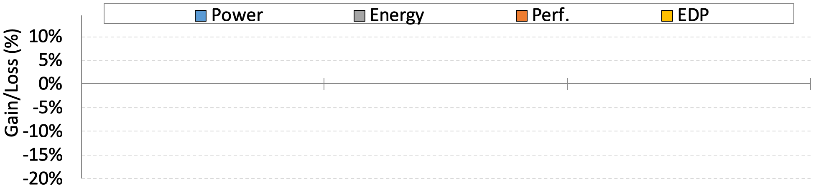
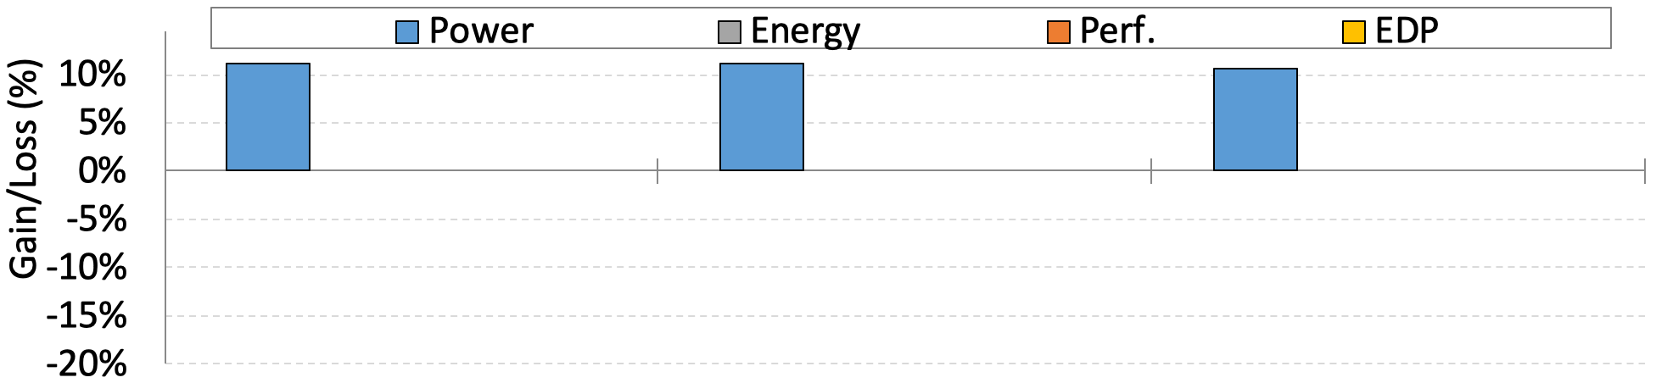
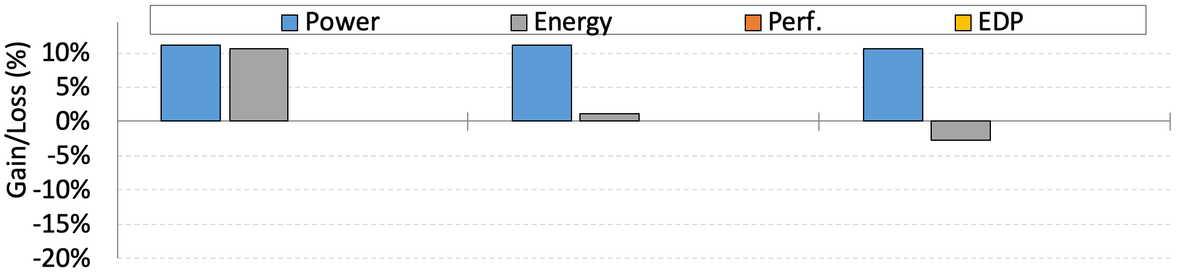
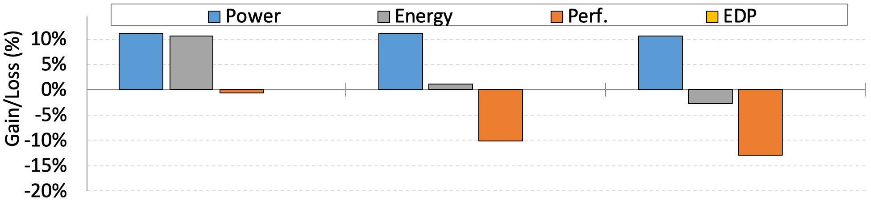
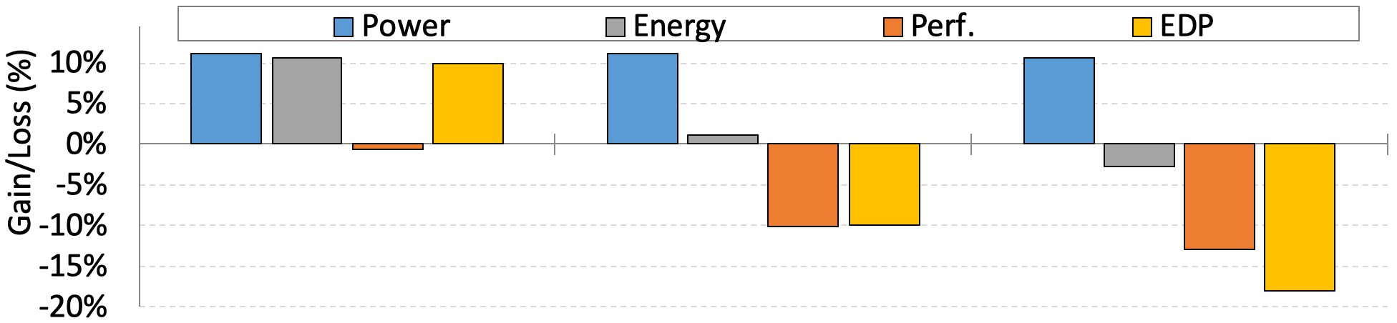
Observation 1: SoC Multi-Domain Scaling
The SoC power budget management algorithm (PBM) assigns a fixed power budget to the IO and memory domains
The power budget corresponds to the worst-case performance demands (bandwidth/latency)
Running three SPEC CPU2006 workloads using baseline and MD-DVFS
400.perlbench 436.cactusADM 470.lbm
Notes:
Our first observation is about the importance of SoC Multi-Domain Scaling [CLICK]
We observe that the SoC power budget management algorithm (PBM) assigns a fixed power budget to the IO and memory domains [CLICK]
The power budget corresponds to the worst-case performance demands [CLICK]
When running three SPEC CPU2006 workloads using baseline and MD-DVFS setups [CLICK]
We observe that the power of the three workloads is reduced by about 10% [CLICK]
The energy of the 1st workloads was reduced by 10% while for the other workloads it was decreased slightly or increased [CLICK]
The performance of the 1st workloads was slightly degraded while the other workloads experienced more than 10% performance degradation [CLICK]
Moreover, the EDP of the 1st workload was improved by about 10% while the other workloads experienced significant degradation in EDP
[END]

Slide 10
Observation 1: SoC Multi-Domain Scaling
The SoC power budget management algorithm (PBM) assigns a fixed power budget to the IO and memory domains
The power budget corresponds to the worst-case performance demands (bandwidth/latency)
Running three SPEC CPU2006 workloads using baseline and MD-DVFS
400.perlbench 436.cactusADM 470.lbm
The effect on energy efficiency (EDP) varies widely across workloads.
Notes:
The effect on energy efficiency, varies widely across workloads. [CLICK]

Slide 11
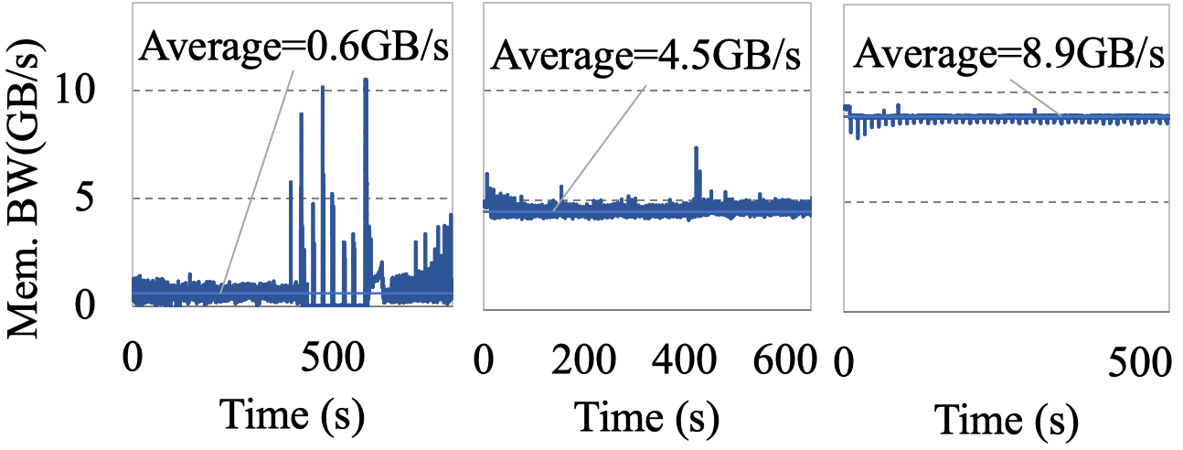
Observation 1: SoC Multi-Domain Scaling
The SoC power budget management algorithm (PBM) assigns a fixed power budget to the IO and memory domains
The power budget corresponds to the worst-case performance demands (bandwidth/latency)
Running three SPEC CPU2006 workloads using baseline and MD-DVFS
The workloads have different memory bandwidth demands
400.perlbench 436.cactusADM 470.lbm
400.perlbench 436.cactusADM 470.lbm
Notes:
Close look into the bandwidth demand of the three workloads [CLICK] show that The workloads have different memory bandwidth demands [CLICK]
[END]

Slide 12
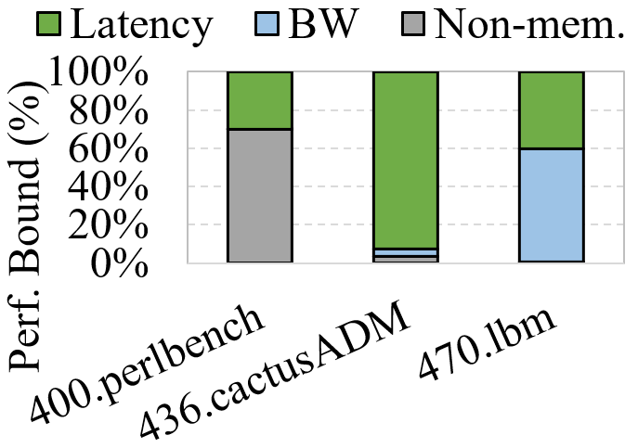
Observation 1: SoC Multi-Domain Scaling
The SoC power budget management algorithm (PBM) assigns a fixed power budget to the IO and memory domains
The power budget corresponds to the worst-case performance demands (bandwidth/latency)
Running three SPEC CPU2006 workloads using baseline and MD-DVFS
436.cactusADM is highly bottlenecked by memory latency
400.perlbench 436.cactusADM 470.lbm
400.perlbench 436.cactusADM 470.lbm
Notes:
Close look into the latency demand reveals that the second workload is highly bottlenecked by memory latency
[END]

Slide 13
Observation 1: SoC Multi-Domain Scaling
The SoC power budget management algorithm (PBM) assigns a fixed power budget to the IO and memory domains
The power budget corresponds to the worst-case performance demands (bandwidth/latency)
Running three SPEC CPU2006 workloads using baseline and MD-DVFS
DVFS in IO and memory can reduce power and energy
with minimal performance impact,
for workloads that are not bottlenecked by memory
400.perlbench 436.cactusADM 470.lbm
400.perlbench 436.cactusADM 470.lbm
Notes:
We conclude that DVFS in IO and memory can reduce power and energy with minimal performance impact, for workloads that are not bottlenecked by memory
[END]

Slide 14
Observation 2: Power Budget Redistribution
PBM (Power Budget Management Algorithm) employs a power budget redistribution mechanism between components within a domain
  E.g., between cores and graphics engines
Current PBMs do not support dynamic power redistribution across different domains
We evaluate the impact of increasing CPU cores’ frequency of the MD-DVFS setup from 1.2GHz to 1.3GHz (redistribute power budget)
Notes:
Our second observation is about the importance of Power Budget Redistribution across domains [CLICK]
PBM (Power Budget Management Algorithm) employs a power budget redistribution mechanism between components within a domain
E.g., between cores and graphics engines within the compute domain [CLICK]
Current PBMs do not support dynamic power redistribution across different domains [CLICK]
We evaluate the impact of increasing CPU cores’ frequency of the MD-DVFS setup from 1.2GHz to 1.3GHz when utilizing the redistributed power budget [CLICK]
We can see that the compared to baseline without MD-DVFS, the performance of the 1st workload was improved by 8%
and the performance for 2nd and 3rd workloads was degraded by 5% and 10%.
[END]

Slide 15
Observation 2: Power Budget Redistribution
PBM (Power Budget Management Algorithm) employs a power budget redistribution mechanism between components within a domain
  E.g., between cores and graphics engines
Current PBMs do not support dynamic power redistribution across different domains
We evaluate the impact of increasing CPU cores’ frequency of the MD-DVFS setup from 1.2GHz to 1.3GHz (redistribute power budget)
Applying DVFS in IO and memory domains and
redistributing the saved power budget between domains
can improve performance in compute-bound workloads.
Notes:
We conclude that Applying DVFS in IO and memory domains and redistributing the saved power budget between domains can improve performance in compute-bound workloads.
[END]

Slide 16
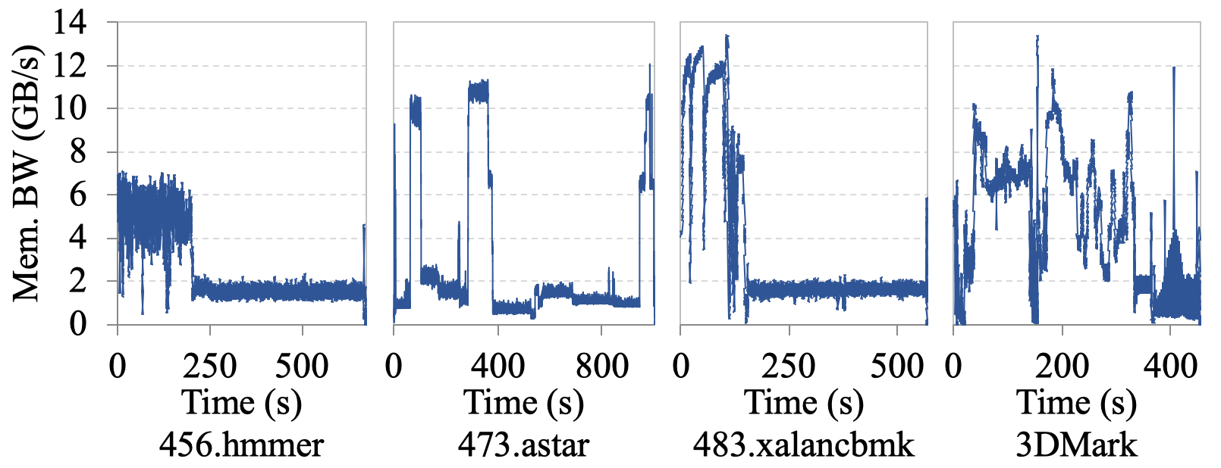
Observation 3: Memory Bandwidth Demands
Multiple components in the IO and compute domains have widely-varying main memory bandwidth demands across different workloads.
For example, memory bandwidth demands of some SPEC CPU2006 and 3DMark workloads over time look like:
Notes:
Our third observation is about the Memory Bandwidth Demands in mobile SoC [CLICK]
Multiple components in the IO and compute domains have widely-varying main memory bandwidth demands across different workloads [CLICK]
For example, memory bandwidth demands of some SPEC CPU2006 and 3DMark workloads over time look like this [CLICK]
Several intervals have low bandwidth demand, for example below 5GBytes/s

Slide 17
Observation 3: Memory Bandwidth Demands
Multiple components in the IO and compute domains have widely-varying main memory bandwidth demands across different workloads.
Memory bandwidth demand of different SoC engines:
Notes:
In addition, memory bandwidth demand of different SoC engines looks like this [CLICK]
Several SoC engines have low bandwidth demand, for example below 5GB/s, under some configurations and workloads
[END]

Slide 18
Observation 3: Memory Bandwidth Demands
Multiple components in the IO and compute domains have widely-varying main memory bandwidth demands across different workloads.
Memory bandwidth demand of different SoC engines:
Typical workloads have modest memory demands.
Yet, the SoC IO and memory domains are provisioned high.
This makes existing mobile SoCs inefficient for typical workloads.
Notes:
We conclude that typical workloads have modest memory demands. Yet, the SoC IO and memory domains are provisioned high.
This makes existing mobile SoCs inefficient for typical workloads.
[END]

Slide 19
Observation 4: Optimizing DRAM Configuration
Memory reference code (MRC) training is part of the BIOS code that manages system memory initialization
The purpose of MRC training is to:
  Detect the DIMMs and their capabilities
  Configure the configuration registers (CRs) of the memory controller (MC), DDRIO, and DIMMs
Compared to using optimized MRC values for a given frequency, unoptimized MRC values can greatly degrade:
  Average power (by 22%)
  Performance (by 10%)
Notes:
Our fourth and final observation is about the importance of optimizing DRAM configuration [CLICK]
Memory reference code (MRC) training is part of the BIOS code that manages system memory initialization [CLICK]
The purpose of MRC training is [CLICK]
To Detect the DIMMs and their capabilities[CLICK]
And to Configure the configuration registers (CRs) of the memory controller (MC), DDRIO, and DIMMs[CLICK]
Compared to using optimized MRC values for a given frequency, unoptimized MRC values can greatly degrade: [CLICK]
Average power by 22% [CLICK]
And the Performance by 10%. Both results measured on real Broadwell system using a workload that exercises peak memory bandwidth
[END]

Slide 20
Observation 4: Optimizing DRAM Configuration
Memory reference code (MRC) training is part of the BIOS code that manages system memory initialization
The purpose of MRC training is to:
  Detect the DIMMs and their capabilities
  Configure the configuration registers (CRs) of the memory controller (MC), DDRIO, and DIMMs
Compared to using optimized MRC values, unoptimized MRC values can greatly degrade:
  Average power (by 22%)
  Performance (by 10%).
Optimizing the DRAM configuration for each frequency
is very important for
multi-domain DVFS energy efficiency
Notes:
We conclude that Optimizing the DRAM configuration for each frequency is very important for multi-domain DVFS energy efficiency
[END]

Slide 21
Our Goal: Holistic SoC Power Management
We conclude that a holistic power management approach is needed to mitigate the power management inefficiencies in current mobile SoCs
Our goal is to provide such an efficient multi-domain power management approach
  by dynamically orchestrating the distribution of the SoC power budget across the three domains based on their actual performance demands
Notes:
Based on our four key observations [CLICK] We conclude that a holistic power management approach is needed to mitigate the power management inefficiencies in current mobile SoCs [CLICK]
Our goal is to provide such an efficient multi-domain power management approach [CLICK]
by dynamically orchestrating the distribution of the SoC power budget across the three domains based on their actual performance demands
[END]

Slide 22
Presentation Outline
Overview of a Modern SoC
Motivation and Goal
SysScale
  Power Management Flow
  Demand Prediction Mechanism
  Holistic Power Management Algorithm
Evaluation
Conclusion
Notes:
Now I will explain the technique to achieve our goal
[END]

Slide 23
SysScale
SysScale is a new multi-domain power management technique to improve the energy efficiency of mobile SoCs
SysScale is based on three key ideas:
  A new DVFS (dynamic voltage and frequency scaling) mechanism to distribute the SoC power to each domain based on its predicted performance demand
  An accurate algorithm to predict each domain’s performance demand
  Domain-specialized techniques to optimize the energy efficiency of each domain at different operating points
Notes:
We propose SysScale [CLICK] SysScale is a new multi-domain power management technique to improve the energy efficiency of mobile SoCs [CLICK]
SysScale is based on three key ideas: [CLICK]
First, A new DVFS mechanism to distribute the SoC power to each domain based on its predicted performance demand [CLICK]
Secondly, An accurate algorithm to predict each domain’s performance demand [CLICK]
And finally, Domain-specialized techniques to optimize the energy efficiency of each domain at different operating points.
[END]

Slide 24
SysScale Architecture
SysScale has three key components:
  A power management flow that is responsible for the DVFS process and reconfiguring DRAM with optimized MRC values
  A demand prediction mechanism that predicts the performance demands from each SoC domain
  A holistic power management algorithm that is responsible for DVFS of the SoC domains to meet the system’s dynamic performance demand and redistributing the power budget across domains
Notes:
[CLICK] SysScale architecture has three key components [CLICK]
The first components is A power management flow that is responsible for the DVFS process and reconfiguring DRAM with optimized MRC values [CLICK]
The second components is A demand prediction mechanism that predicts the performance demands from each SoC domain [CLICK]
And the final components is A holistic power management algorithm that is responsible for DVFS of the SoC domains to meet the system’s dynamic performance demand and redistributing the power budget across domains.
[END]

Slide 25
Presentation Outline
Overview on Mobile SoC
Motivation and Goal
SysScale
  Power Management Flow
  Demand Prediction Mechanism
  Holistic Power Management Algorithm
Evaluation
Conclusion
Notes:
Now I will explain each of the 3 SysScale components.
[END]

Slide 26
Power Management Flow
The SysScale power management flow is responsible for adjusting the frequencies and voltages of the IO interconnect and memory subsystem. The flow steps are:
  A demand prediction mechanism decides on target operating point
    Evaluated every 30ms (configurable, tuned post-silicon)
  Adjust voltages depending on the DVFS direction
  Block and drain IO and memory domains
  Enter DRAM into self refresh
  Load optimized MRC (Memory reference code) values for the new operating point
  Adjust clock frequencies
  Resume SoC operation
Notes:
[CLICK] The first component is the SysScale power management flow which is responsible for adjusting the frequencies and voltages of the IO interconnect and memory subsystem. Let me go through the steps of the flow [CLICK]
First, A demand prediction mechanism, which is evaluated every 30ms, decides on target operating point [CLICK]
Secondly, we Adjust voltages depending on the DVFS direction [CLICK]
Next step is a Block and drain of IO and memory domains [CLICK]
Forth, we place DRAM into self refresh mode[CLICK]
Then we Load optimized MRC values for the new operating point [CLICK]
Next, we Adjust clock frequencies [CLICK]
Finally, we Resume the SoC operation.
[END]

Slide 27
Demand Prediction Mechanism
Demand prediction mechanism predicts the performance demands using:
  Peripheral configuration registers
  Performance counters
Peripheral configuration registers indicate the active devices and their configuration:
  For example, number of active displays or cameras and frame rates
We use 4 performance counters with thresholds corresponding to each counter:
  The performance counter indicates the bandwidth/latency demand of CPU cores, graphics engines and IO devices
Notes:
The second component is a Demand Prediction Mechanism [CLICK]
Demand prediction mechanism predicts the performance demands using: [CLICK]
Peripheral configuration registers [CLICK]
Performance counters [CLICK]
Peripheral configuration registers indicate the active devices and their configuration: [CLICK]
For example, number of active displays or cameras and frame rates [CLICK]
We use 4 performance counters with thresholds corresponding to each counter: [CLICK]
The performance counter indicates the bandwidth/latency demand of CPU cores, graphics engines and IO devices.
[END]

Slide 28
Holistic Power Management Algorithm
SysScale implements a power distribution algorithm in the power management unit (PMU) firmware
The system moves the IO and memory domains to a high- or low-performance operating point based on the decision of the demand prediction mechanism
  The system redistributes the power budget across SoC domains when changing the operating point
For example, when the SoC moves to a low-performance operating point, the PMU:
  Reduces the power budgets of the IO and memory domains and
  Increases the power budget of the compute domain
Notes:
The last component is Holistic Power Management Algorithm [CLICK]
SysScale implements a power distribution algorithm in the power management unit firmware [CLICK]
The system moves the IO and memory domains to a high- or low-performance operating point based on the decision of the demand prediction mechanism [CLICK]
The system redistributes the power budget across SoC domains when changing the operating point [CLICK]
For example, when the SoC moves to a low-performance operating point, the PMU [CLICK]
Reduces the power budgets of the IO and memory domains and [CLICK]
Increases the power budget of the compute domain.
[END]

Slide 29
Presentation Outline
Overview on Mobile SoC
Motivation and Goal
SysScale
  Power Management Flow
  Demand Prediction Mechanism
  Holistic Power Management Algorithm
Evaluation
Conclusion
Notes:
I will next present our evaluation of SysScale
[END]

Slide 30
Methodology
System: We implement SysScale on a real Intel Skylake system
  For our baseline measurements, we disable SysScale
  We use an SoC with 4.5W thermal design power (TDP)
Power Measurements: We use National Instruments data acquisition device for power measurement
Workloads: We evaluate SysScale with three classes of workloads
  CPU: SPEC CPU2006 benchmarks
  Graphics: 3DMARK benchmarks
  Battery life: web browsing, light gaming, video conferencing, and video playback benchmarks
Comparison Points: We compare SysScale to the two most relevant prior works, MemScale [Deng+, ASPLOS 2011] and CoScale [Deng+, MICRO 2012]:
  MemScale applies DVFS only for memory subsystem
  CoScale coordinates CPU cores and memory subsystem DVFS
Notes:
First, I will present our methodology [CLICK]
We implement SysScale on a real Intel Skylake system [CLICK]
For our baseline measurements, we disable SysScale [CLICK]
We use an SoC with 4.5W thermal design power (TDP) [CLICK]
We use National Instruments data acquisition device for power measurement [CLICK]
We evaluate SysScale with three classes of workloads [CLICK]
For CPU: we use SPEC CPU2006 benchmarks [CLICK]
For Graphics: we use 3DMARK benchmarks [CLICK]
For Battery life: we use web browsing, light gaming, video conferencing, and video playback benchmarks [CLICK]
Comparison Points: We compare SysScale to the two most relevant prior works, MemScale and CoScale [CLICK]
Basically, MemScale applies DVFS only for memory subsystem [CLICK]
While CoScale coordinates CPU cores and memory subsystem DVFS.
[END]

Slide 31
Results – CPU Workloads
SysScale improves real system performance by 9.2% on average
SysScale provides 5.4×/2.4× the performance improvement of MemScale/CoScale, because:
  SysScale is holistic, taking into account all SoC domains
  Unlike the other mechanisms, SysScale optimizes the DRAM interface
The performance benefit of SysScale correlates with the performance scalability of the running workload with CPU frequency
Notes:
Let me start with showing the result for the CPU workloads [CLICK]
[CLICK]
SysScale improves real system performance by 9.2% on average [CLICK]
SysScale provides 5.4 and 2.4 times the performance improvement of MemScale and CoScale [CLICK]
This because SysScale is holistic, taking into account all SoC domains [CLICK]
And Unlike the other mechanisms, SysScale optimizes the DRAM interface [CLICK]
The performance benefit of SysScale correlates with the performance scalability of the running workload with CPU frequency.
[END]

Slide 32
Results – CPU Workloads
SysScale significantly improves CPU core performance
by holistically applying DVFS to SoC domains
and redistributing power budget
SysScale improves real system performance by 9.2% on average
SysScale provides 5.4×/2.4× the performance improvement of MemScale/CoScale, because:
  SysScale is holistic, taking into account all SoC domains
  Unlike the other mechanisms, SysScale optimizes the DRAM interface
The performance benefit of SysScale correlates with the performance scalability of the running workload with CPU frequency.
Notes:
We conclude that SysScale significantly improves CPU core performance by holistically applying DVFS to SoC domains and redistributing power budget.
[END]

Slide 33
Results – Graphics Workloads
SysScale improves real system performance (6.7%-8.9%) because it boosts the graphics engines’ frequency by redistributing the power budget across the three domains
SysScale provides approximately 5× the performance improvement of MemScale and CoScale
MemScale and CoScale have similar performance improvements because their average power savings are identical.
  In graphics workloads, CPU cores run at the lowest possible frequency
  CoScale cannot further scale down the CPU frequency
Notes:
Now let us see the result for the Graphics workloads [CLICK]
[CLICK]
SysScale improves real system performance between 6.7% and 8.9% because SysScale boosts the graphics engines’ frequency by redistributing the power budget across the three domains [CLICK]
SysScale provides approximately 5 times the performance improvement of MemScale and CoScale [CLICK]
MemScale and CoScale have similar performance improvements because their average power savings are identical [CLICK]
This is because In graphics workloads, CPU cores run at the lowest possible frequency [CLICK]
Therefore CoScale cannot further scale down the CPU frequency.
[END]

Slide 34
Results – Graphics Workloads
SysScale improves performance because it boosts the graphics engines’ frequency by redistributing the power budget across the three domains
SysScale provides approximately 5× the performance improvement of MemScale and CoScale
MemScale and CoScale have similar performance improvements because their average power savings are identical.
  In graphics workloads, CPU cores run at the lowest possible frequency
  CoScale cannot further scale down the CPU frequency.
SysScale significantly improves the graphics performance using
the saved power budget from IO and memory domains
Notes:
We conclude that SysScale significantly improves the graphics performance using
the saved power budget from IO and memory domains.
[END]

Slide 35
Results – Battery Life Workloads
Battery life workloads have fixed performance requirements
SysScale reduces average power (6.4%-10.7%) on a real system and workloads
SysScale provides approximately 5× the power reduction of MemScale and CoScale
MemScale and CoScale have similar average power reduction
  In battery life workloads, CPU cores run at the lowest possible frequency
  CoScale cannot further scale down the CPU frequency
Notes:
Now I will present the results for Battery Life Workloads [CLICK]
[CLICK]
Battery life workloads normally have fixed performance requirements [CLICK]
SysScale reduces average power (6.4%-10.7%) on a real system and workloads [CLICK]
SysScale provides approximately 5× the power reduction of MemScale and CoScale [CLICK]
MemScale and CoScale have similar average power reduction
This is because In battery life workloads, CPU cores run at the lowest possible frequency
Therefore, CoScale cannot further scale down the CPU frequency.
[END]

Slide 36
Results – Battery Life Workloads
SysScale significantly reduces
the SoC average power consumption
Battery life workloads have fixed performance requirements
SysScale reduces average power (6.4%-10.7%) on a real system and workloads
SysScale provides approximately 5× the power reduction of MemScale and CoScale
MemScale and CoScale have similar average power reduction
  In battery life workloads CPU cores run at the lowest possible frequency
  CoScale cannot further scale down the CPU frequency.
Notes:
We conclude that SysScale significantly reduces the SoC average power consumption.
[END]

Slide 37
Other Results in the Paper
SysScale performance and average power consumption sensitivity to:
System Thermal Design Power (TDP)
  SysScale's performance benefit increases as TDP decreases
  SysScale improves energy consumption across the entire TDP range (3.5W–91W)
Different DRAM frequencies and types
Notes:
We have more results in the paper. For example [CLICK]
SysScale performance and average power consumption sensitivity to [CLICK]
System TDP [CLICK]
SysScale's performance benefit increases as TDP decreases [CLICK]
SysScale improves energy consumption across the entire TDP range [CLICK]
We also have Results for Different DRAM frequencies and types
[END]

Slide 38
Presentation Outline
Overview of a Modern SoC
Motivation and Goal
SysScale
  Power Management Flow
  Demand Prediction Mechanism
  Holistic Power Management Algorithm
Evaluation
Conclusion
Notes:
Let me quickly conclude my talk.
[END]

Slide 39
Conclusion
SysScale is the first work to enable coordinated and highly-efficient DVFS across all SoC domains to increase energy efficiency
SysScale optimizes and efficiently redistributes the total power budget across all SoC domains based on the performance demands of each domain
We implemented SysScale on the Intel Skylake SoC for mobile devices
  SysScale improves the performance of real CPU and graphics workloads (by up to 16% and 8.9%, respectively, for 4.5W TDP)
  SysScale reduces the average power consumption of battery life workloads (by up to 10.7%) across all TDPs of the Intel Skylake system
We conclude that SysScale is an effective approach to balance power consumption and performance demands across all SoC domains
Notes:
[CLICK]
SysScale is the first work to enable coordinated and highly-efficient DVFS across all SoC domains to increase energy efficiency [CLICK]
SysScale optimizes and efficiently redistributes the total power budget across all SoC domains -- based on the performance demands of each domain [CLICK]
We implemented SysScale on the Intel Skylake SoC for mobile devices [CLICK]
SysScale improves the performance of real CPU and graphics workloads by up to 16% and 8.9% - respectively - for 4.5W Thermal Design Power SoC [CLICK]
SysScale reduces the average power consumption of battery life workloads by up to 10.7% ---
across all TDPs of the Intel Skylake system [CLICK]
We conclude that SysScale is an effective approach to balance power consumption and performance demands across all SoC domains

Slide 40
SysScale: Exploiting Multi-domain
Dynamic Voltage and Frequency Scaling
for Energy Efficient Mobile Processors
Jawad Haj-Yahya¹
Mohammed Alser¹ Jeremie Kim¹ A. Giray Yaglıkçı¹
Nandita Vijaykumar^{1,2,3} Efraim Rotem² Onur Mutlu¹
1
1
2
3
Notes:
Thank you for your attention. For many more details, I invite you to read our ISCA 2020 paper.
[END]

