Slide 1

throttLL’eM
Predictive GPU Throttling for Energy Efficient LLM Inference Serving
Andreas K. Kakolyris Dimosthenis Masouros
Petros Vavaroutsos Sotirios Xydis Dimitrios Soudris
Notes:
Hi everyone. I am Andreas and I am happy to present our work, throttLL’eM:
Predictive GPU Throttling for Energy Efficient LLM Inference serving

Slide 2
Executive Summary
Problem: LLM inference consumes significant energy.
Energy consumption is predicted to increase with further adoption
Static optimization policies violate Service Level Objectives (SLOs)
Goal: Reduce the energy consumption of LLM inference serving without violating SLOs
Key Idea: Predict the future state of the serving system to find the minimum performance level required to achieve SLOs.
Key Mechanism: throttLL’eM
Models the token generation latency based on system metrics.
Predicts how these system metrics will evolve over time.
Adjusts the parameters of the system to minimize energy consumption while meeting SLOs.
Key Result: throttLL’eM can reduce the energy consumption of LLM serving by 42%.
Notes:
Here is a summary of this work
[CLICK] What we want to tackle is the high energy consumption of LLM inference
This problem is expected to get worse as adoption increases, and as models get larger
We also know that Static optimization approaches such as power capping may violate Service Level Objectives
[CLICK] Our goal is to reduce the energy consumption of LLM inference serving, without violating the Service Level Objectives of the Application
[CLICK] The key idea behind throttLL’em is to predict the future state of the inference serving system in order to find the minimum performance level that is required to achieve the SLOs.
[CLICK] throttLL’eM works by
i) accurately modelling the token generation latency based on system metrics
ii) Predicting how these system metrics will evolve over time and finally,
uses these insights in order to adjust various aspects of the system and minimize energy consumption while meeting SLOs.
[CLICK] The key result of throttLL’eM is that it achieves 42% lower energy consumption compared to the baseline system on a real-world inference trace.

Slide 3
Outline
Background
Motivation
throttLL’eM: Mechanism
Evaluation
Conclusion
Notes:
So here is an outline of this presentation

Slide 4
Outline
Background
Motivation
throttLL’eM: Mechanism
Evaluation
Conclusion
Notes:
First, I am going to start by giving some background on LLM inference

Slide 5
Background on LLM inference
“Can you explain how LLMs work?”
9544
1231
8321
590
9210
113
30
1. Prompt Tokenization
Convert input (sub-)words to a unique representation (tokens)
Notes:
Let’s see at a very high level how an LLM works
When a request is received, it is converted into a sequence of numerical values, which are called tokens

Slide 6
Background on LLM inference
“Can you explain how LLMs work?”
9544
1231
8321
590
9210
113
30
K
LLM
V
120
2. Prefill (Prompt) Phase
Generate the first token of the answer
Generate KV cache
Compute bound
“An”
Notes:
This sequence of tokens is given to the LLM
, which among other operations computes and caches [CLICK] the Key and Value matrices.
This initial forward pass of the LLM will generate the first token and this phase is known to be compute bound.

Slide 7
Background on LLM inference
“Can you explain how LLMs work?”
9544
1231
8321
590
9210
113
30
K
LLM
V
“An”
Notes:
[Click]

Slide 8
Background on LLM inference
“Can you explain how LLMs work?”
9544
1231
8321
590
9210
113
30
K
LLM
V
9210
3. Generation (Decode) Phase
Generate rest of response tokens
Update KV cache
Memory bound
“LLM”
Notes:
Since LLMs are autoregressive, generating one token at a time, this process repeats
with the previously cached KV representations are read during each iteration.
Additionally, new representations also computed and appended to the KV cache.
Overall, this autoregressive generation process is known to be memory bound.

Slide 9
Background on LLM inference
“Can you explain how LLMs work?”
9544
1231
8321
590
9210
113
30
K
LLM
V
3. Generation (Decode) Phase
Generate rest of response tokens
Update KV cache
Memory bound
“LLM”
Notes:
This process repeats again [CLICK]

Slide 10
Background on LLM inference
“Can you explain how LLMs work?”
9544
1231
8321
590
9210
113
30
K
LLM
V
114
“works”
3. Generation (Decode) Phase
Generate rest of response tokens
Update KV cache
Memory bound
Notes:
And again [click]

Slide 11
Background on LLM inference
“Can you explain how LLMs work?”
9544
1231
8321
590
9210
113
30
K
LLM
V
“works”
3. Generation (Decode) Phase
Generate rest of response tokens
Update KV cache
Memory bound
Notes:
And again [click]

Slide 12
Background on LLM inference
“Can you explain how LLMs work?”
9544
1231
8321
590
9210
113
30
K
…
LLM
V
…
9821
4. Generation Termination
EOS token generated
max_tokens generated
“<EOS>”
…
Notes:
Until at some point, either
[click] a special End-Of-Sequence token is generated OR
[click] a predefined threshold regarding the number of generated tokens is reached.

Slide 13
Challenges of LLM inference
“Can you explain how LLMs work?”
9544
1231
8321
590
9210
113
30
K
…
LLM
V
…
9821
“<EOS>”
Autoregressive Token Generation ➔ Unpredictability
…
Notes:
Overall, this unique autoregressive nature of LLMs,
compared to previous neural network architectures, makes modelling performance unpredictable

Slide 14
Challenges of LLM inference
“Can you explain how LLMs work?”
9544
1231
8321
590
9210
113
30
K
…
LLM
V
…
9821
“<EOS>”
Autoregressive Token Generation ➔ Unpredictability
…
Variable Memory Footprint ➔ Performance Variability
Notes:
Additionally, their dynamic memory footprint and the nature of the attention mechanism introduce performance variability

Slide 15
Challenges of LLM inference
“Can you explain how LLMs work?”
9544
1231
8321
590
9210
113
30
K
…
LLM
V
…
9821
“<EOS>”
Autoregressive Token Generation ➔ Unpredictability
…
Variable Memory Footprint ➔ Performance Variability
Inflight Batching [Yu+, OSDI’22] ➔ Additional Performance Variability
Notes:
And finally,
the existence of mechanisms such as iteration level batching add additional performance variability,
as batch size can change unpredictably between LLM iterations.

Slide 16
Outline
Background
Motivation
throttLL’eM: Mechanism
Evaluation
Conclusion
Notes:
Moving on to the motivation

Slide 17
Motivation:
Performance-Energy Tradeoffs in LLM inference
Lower frequencies increase the
Time-Between-Tokens
Performance degradation decreases when using larger batch sizes
GPU power draw only depends on the frequency used
Notes:
In this slide we describe some of the performance and energy tradeoffs in LLM inference
[click] As can be seen from the figure, using lower GPU frequencies, increases the latency, in this case the Time-between-tokens (or TBT).
[click] However this performance degradation is actually not really severe, especially when using larger batch sizes.
[click ] At the same time, power consumption solely depends on the GPU frequency
which is demonstrated
[click] by the uniformity in color across the vertical axis of the heatmap.

Slide 18
Motivation:
System Level Performance-Efficiency Tradeoffs
Throughput depends on Batch size
Performance gains diminish when using increasingly higher frequencies
Energy Efficiency also increases with batch size
Highest energy efficiency in the middle of the frequency range
High efficiency is possible with minimal performance loss
Notes:
So if we zoom out and take a look at the bigger picture view of the entire LLM inference system
[click] We see that system throughput, which we measure in tokens per second mainly depends on batch size and not as much on frequency,
[click] especially above a certain frequency threshold.
[click] At the same time, energy efficiency, which we measure as the number of tokens generated per unit of energy, improves as batch size increases [click] and peaks around the middle of the range of frequencies.
[click] The key point from this is that high efficiency can be achieved with minimal performance loss

Slide 19
Motivation:
Modeling LLM performance
Inference slows down as context length increases
KV cache size is an accurate proxy for performance
Constant Batch size
Pearson Correlation of 0.92
Notes:
Frequency and batch size are not the only factors that affect the performance of LLM inference.
Due to how the attention mechanism operates inference slows down as the context length increases.
In our experiments we see that one metric whic correlates well with this degradation is the number of blocks used to store the KV cache of the model.
In fact when frequency and batch size are kept constant, the relationship between time between tokens and the number of KV blocks used appears almost linear. [click]
[CLICK] In a different experiment where we artificially keep batch size constant,
we measured a Pearson Correlation of 0.92 between the number of KV blocks used
and the Time between tokens.
As a result, [CLICK]
KV cache size can become a good proxy for performance when other parameters are kept constant.

Slide 20
Motivation: Energy Efficient LLM serving
Goal
Reduce energy consumption while meetings SLOs
Idea
Model performance at the iteration level to enable fine-grained energy efficiency optimization
Notes:
So to reiterate:
[CLIK] Our goal is to reduce the energy consumption while meeting SLOs,
which we are going to achieve by exploiting the previously mentioned tradeoffs.
[CLICK] The key idea behind throttLL’eM is to model the performance of LLM inference at the iteration level and use this modelling to make fine grained request scheduling decisions and energy efficiency optimizations.

Slide 21
Outline
Background
Motivation
throttLL’eM: Mechanism
Evaluation
Conclusion
Notes:
I will now move on to describing the Mechanism behind throttLL’eM which is split into
An OFFLINE and an ONLINE stage

Slide 22
throttLL’eM
Modelling System Performance
throttLL’eM sweeps batch size, logs KV cache size and performance using randomly chosen frequencies
The gathered samples cover the entire system state space
Notes:
The first step in our implementation is an offline profiling step, during which throttLL’eM monitors the throughput of LLM inference.
To achieve this, throttLL’eM sweeps the batch size and logs the size of the KV cache.
For each gathered sample, a new frequency is randomly chosen.
[CLICK] This way, the gathered samples cover the entire state space of the system .

Slide 23
throttLL’eM
Modelling System Performance
throttLL’eM trains a Machine Learning model that predicts performance using the gathered samples
Notes:
Using these samples, throttLL’eM trains a Machine Learning model, that predicts performance.
This covers the offline stage of throttLL’eM and I will now move on to the online stage

Slide 24
throttLL’eM: Online Stage
1)
Predicting future states
2)
Validate SLOs
3)
Adjust System Performance
Notes:
As was mentioned earlier, throttLL’eM works by making accurate fine-grained predictions about the performance of the system

Slide 25
throttLL’eM
Predicting future states
throttLL’eM employs a generation length prediction model to predict how many tokens a query will generate
throttLL’eM uses these predictions to forecast batch size and KV cache size at each future iteration
Notes:
First, throttLL’eM employs a generation length predictor, which previous works have described, in order to predict how many tokens - how many LLM iterations – a request will take to generate.
We use these to predict:
[CLICK] the batch size
AND
[CLICK] the size of the KV cache at each future iteration

Slide 26
throttLL’eM: Online Stage
1)
Predicting future states
2)
Validate SLOs
3)
Adjust System Performance
Notes:
Using these predictions,
throttLL’eM estimates the future performance of the system to assess if the SLOs will be achieved

Slide 27
throttLL’eM
Validating SLOs
Before scheduling a request, throttLL’eM predicts its impact on the future performance of the system
Notes:
When a new request arrives, throttLL’eM initially places it in a request queue.
Before scheduling the request, throttLL’eM evaluates how its admission will impact
Batch size and KV cache size and then uses the performance prediction models to estimate the iteration level performance in the future.
This is done under maximum frequency to model the peak performance of the system.

Slide 28
throttLL’eM
Validating SLOs
throttLL’eM uses the performance predictions to check if the SLOs of running requests can be attained if the request is scheduled
Notes:
throttLL’eM uses these performance prediction to validate different SLOs such as TBT and E2E latency.
If the scheduling of the request is predicted to cause SLO violations, then the request remains in the request queue.

Slide 29
throttLL’eM
Validating SLOs
throttLL’eM uses the performance predictions to check if the SLOs of running requests can be attained if the request is scheduled
Notes:
Otherwise, if all SLOs can be met, the request is scheduled.
This covers the request scheduling process.

Slide 30
throttLL’eM: Online Stage
1)
Predicting future states
2)
Validate SLOs
3)
Adjust System Performance
Notes:
The next step is to attempt to optimize the energy efficiency of the system.

Slide 31
throttLL’eM
Adjusting System Performance
throttLL’eM performs a binary search of the Frequency search space to find the minimum frequency that satisfies all SLOs
Notes:
This is performed each time a request is scheduled, and is very similar to what was already described for the SLO validation process.
However, instead of validating for the maximum available frequency,
we perform a binary search over the frequency search space, to find the minimum frequency that satisfies the SLOs.
Since the SLOs where previously validated using the maximum frequency, the existence of at least one frequency that can satisfy all SLOs is guaranteed.

Slide 32
throttLL’eM
Adjusting System Performance
throttLL’eM periodically checks and scales the capacity of the system using predetermined load thresholds
Notes:
throttLL’eM also has an autoscaling component, which I will not cover in detail.
This component periodically checks and adjust the capacity of the system using predetermined load thresholds.

Slide 33


throttLL’eM: Overview
“Can you explain how LLMs work?”
1
Token generation length prediction
2
3
4
KV Cache & Batch projection
Query Scheduler
ML Model
Throttling Controller
$$\hat{B}$$
$$\hat{KV}$$
SLO violation check
Total KV
Cache
Running
Batch
Inference Backend
5
K
LLM
Autoscaling Mechanism
GPU
GPU
GPU
GPU
V
…
GPU
GPU
GPU
GPU
Notes:
So when we combine all of these components, we end up with something that looks like this

Slide 34
Outline
Background
Motivation
throttLL’eM: Mechanism
Evaluation
Conclusion
Notes:
I will now move on to the evaluation

Slide 35
Evaluation Methodology
System Configuration: NVIDIA DGX-A100
  Processor 2x AMD EPYC 7742
  DRAM 1TB DDR4
  GPUs 8x NVIDIA A100-SXM4-40GB
  Software NVIDIA Triton + TensorRT-LLM backend
Evaluated LLMs: LLaMa family of models
  LLaMa3 8B TP1 configuration
  LLaMa2 13B TP1, TP2 and TP4 configurations
  LLaMa3 70B TP8 configuration
LLM Inference Trace:
  Inference trace from Azure
  Contains query input and generation lengths
  Time-scaled to match the peak performance of the evaluated system
Notes:
We deploy throttLL’eM on an NVIDIA DGX system with the following configuration. The main highlight of this system are are the eight - A100 GPUs
For the sofware stack we use NVIDIA’s triton inference server, using the TensorRT LLM inference backend.
We mainly use models form the LLaMa family
And we use LLM conversation inference trace from azure, which contains the inputs and generation lengths of real user queries

Slide 36
Evaluation Results
1)
Performance Modeling Evaluation
2)
Frequency Scaling Evaluation
3)
End-to-End throttLL’eM evaluation
Notes:
We break down our evaluation into three subsections, starting with our performance modelling methodology.

Slide 37
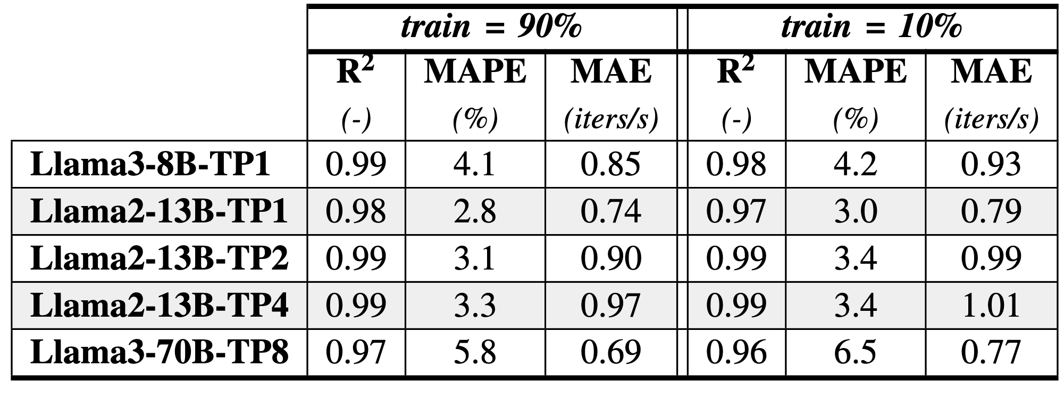
Performance Modeling Evaluation
R² score, MAPE and MAE for different train-test splits and model configurations
Distribution of accumulated drift per elapsed iteration
The performance prediction model achieves high performance,
even with sparse datasets
throttLL’eM accumulates a relatively small average drift of 0.43ms per iteration
Notes:
First,
[CLICK] throttLL’eMs performance prediction model achieves high R-squared scores, above 0.97.
This is also true for sparse datasets, featuring R-squared scores above 0.96 even at a 10% train-test split.
[CLICK] In a different experiment, we then measure the difference between the actual the expected time at which we will arrive at a given LLM iteration, which we call “drift”.
[CLICK] throttLL’eM accumulates very little drift, 0.43 ms per iteration on average, showing that it can accurately model performance.

Slide 38
Evaluation Results
1)
Performance Modeling Evaluation
2)
Frequency Scaling Evaluation
3)
End-to-End throttLL’eM evaluation
Notes:
To evaluate the energy gains stemming from frequency scaling, we deploy throttLL’eM without autoscaling on the previously mentioned LLM inference trace.

Slide 39
Frequency Scaling Evaluation
Distribution of a) Time-between-Tokens, b) End-to-End latency and c) Power consumption for the default implementation and throttLL’eM at 0%, 15% and 30% error levels for LLaMa2-13B-TP2
As the error level increases, throttLL’eM becomes more conservative, leading to lower energy efficiency
throttLL’eM significantly increases energy efficiency even at 30% prediction error level
Notes:
In this slide, we only analyze the results from throttLL’em running LLaMa2-13B on 2 GPUs, without autoscaling
We set the TBT SLO to an average latency of 200 ms per token.
We also define an End-to-End latency SLO of a 99th percentile value of 30 seconds,
which corresponds to the same value of the underlying system at the point of saturation.
We show the distribution of TBT, End to End latency, and total power draw.
The grey distributions correspond to the baseline system running at maximum frequency, with the other bars corresponding to throttLL’eM at 0,15 and 30% error levels of the generation length prediction model.
We can see, that throttLL’eM easily achieves the TBT SLO.
[Click] A more interesting insight is that throttLL’em can aggressively approach, without violating the E2E latency SLO.
As the error of the predictor increases, [click] we have designed throttLL’eM to become increasingly conservative , selecting higher frequencies as a safety margin, which
1: Limits how aggressively we can approach the E2E SLO
2: Increases the average power
And
3: reduces the energy efficiency of the system by reducing the number of tokens produced by unit of energy.
However, even in the case of 30% predictor error level, throttLL’eM can still increase energy efficiency significantly, featuring 37% higher energy efficiency compared to the baseline system.

Slide 40
Frequency Scaling Evaluation
Distribution of
Time-between-Tokens for different models and configurations
Distribution of
End-to-End latency for different models and configurations
Distribution of
Power draw for different models and configurations
Notes:
At this point I will mention that the paper features data for many more models and configurations

Slide 41
Frequency Scaling Evaluation
Time-to-First-Token for different models and configurations
Queueing time for different models and configurations
Average Frequency for different models and configurations
Notes:
As well as data regarding other metrics such as time to first token,
queuing times and
selected frequencies.

Slide 42
Evaluation Results
1)
Performance Modeling Evaluation
2)
Frequency Scaling Evaluation
3)
End-to-End throttLL’eM evaluation
Notes:
We now deploy throttLL’eM with instance scaling also enabled.

Slide 43
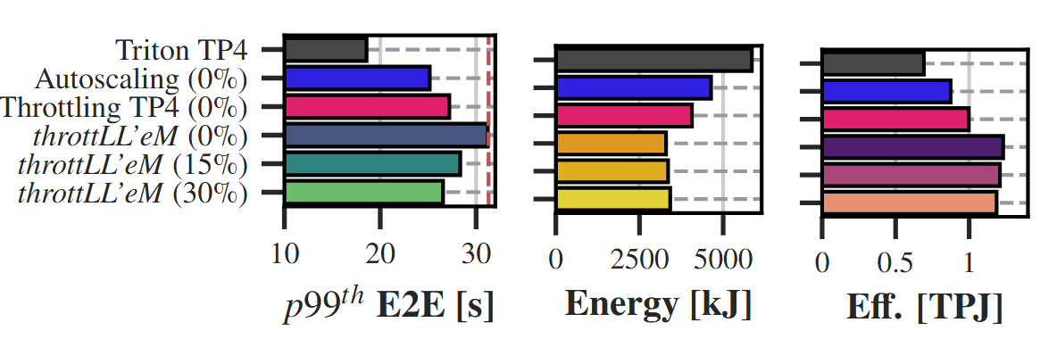
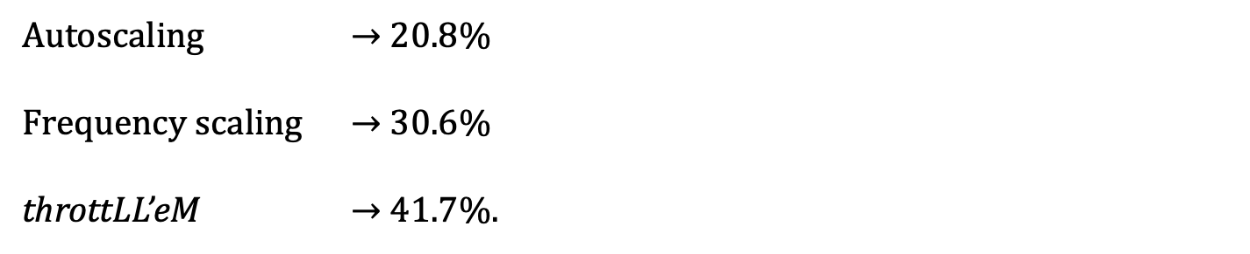
Ablation Study
throttLL’eM significantly increases energy efficiency by using both instance and frequency scaling
Energy Reduction by:
Autoscaling $→$ 20.8%
Frequency scaling $→$ 30.6%
throttLL’eM $→$ 41.7%.
Notes:
To quantify the energy efficiency gains of throttLL’eM we compare it to the following implementations
First - Triton, which is the baseline configuration comprised of 4 GPUs in a tensor parallel configuration running at maximum frequency
Second - An implementation that ONLY performs autoscaling
And Third - An implementation that ONLY performs frequency scaling
In this case throttLL’eM at 30% predictor error level, improves energy efficiency by 42% compared to the baseline,
While autoscaling and frequency scaling only achieve 21 and 31% respectively
[CLICK] The takeaway here is that both instance and frequency scaling are required to achieve maximum energy savings

Slide 44
Result Interpretation
By increasing the latency of individual LLM iterations:
Increases the average batch size
Reduces the number of performed forward passes
throttLL’eM performs fewer LLM inferences by using a larger batch size, increasing efficiency
Notes:
Finally, I would like to give a brief interpretation regarding the sources of our energy gains.
There is something interesting regarding frequency scaling.
By reducing frequency, throttLL’eM increases the latency of the forward pass during LLM inference.
Due to this, and the inflight batching mechanism the batch size is artificially increased, resulting in an about 25% increase on average compared to the implementation that performs autoscaling only.
As a result of this, ThrottLL’eM also performs about 24% fewer forward passes using a larger batch size, increasing efficiency.

Slide 45
Motivation (again):
System Level Performance-Efficiency Tradeoffs
Notes:
So in fact, we manage to not only move [CLICK] in this direction
as I hinted at in the motivation section, but also in this [CLICK] direction, further increasing efficiency.
At the same time we compensate for the reduced [CLICK] request level performance by increasing [CLICK] batch level parallelism and system throughput

Slide 46
Outline
Background
Motivation
throttLL’eM: Mechanism
Evaluation
Conclusion
Notes:
So to conclude

Slide 47
Conclusion
throttLL’eM
Accurately models LLM performance
Predicts how the state of the system evolves over time
Accordingly scales the frequency and the capacity of the system to reduce the energy consumption while meeting SLOs
Key Results:
R² > 0.97
Small per iteration performance modelling drift of 0.43ms
Energy efficiency savings of upwards of 41%
Notes:
This was throttLL’eM, a framework for energy efficieny LLM inference
throttLL’eM accurately models, predicts and adjusts the performance of the system to meet SLOs with reduced energy consumption.
With our performance modelling methodology we achieve high R-squared scores
We experience a very small performance deviation between the actual and the predicted times of arrival at different LLM iterations.
Finally, we demonstrated energy savings upwards of 41%, while respecting the same SLOs as the baseline system.

Slide 48
throttLL’eM
Predictive GPU Throttling for Energy Efficient LLM Inference Serving
Andreas K. Kakolyris Dimosthenis Masouros
Petros Vavaroutsos Sotirios Xydis Dimitrios Soudris
Notes:
This was my presentation and I will be happy to answer any questions.

Slide 49
throttLL’eM
Predictive GPU Throttling for Energy Efficient LLM Inference Serving
Backup Slides
Andreas K. Kakolyris Dimosthenis Masouros
Petros Vavaroutsos Sotirios Xydis Dimitrios Soudris
Notes:
Hello everyone. I am Andreas and I am happy to present throttLL’eM: Predictive GPU Throttling for Energy Efficient LLM Inference serving

Slide 50
Motivation:
Modeling LLM performance
Tensor Parallelism exhibits the highest throughput
Tensor Parallelism exhibits the highest energy efficiency
Minimizing the number of GPUs used is necessary for optimal energy efficiency
Notes:
Another knob that can be used

Slide 51
Analysis on the trace
Transient E2E violations due to load increment while shadow instancing
Aggressive Frequency reduction when an instance cannot be downscaled
Autoscaling provides coarse-grained throughput adjustments Frequency scaling provides finer control
Notes:
In this case, we deploy throttLL’eM on the trace, scaling the peak request rate to match the serving capacity offered by the largest configuration which spans 4 GPUs. In this case, autoscaling is used to make coarse grained adjustments to serving throughput, while frequency scaling is used to make finer grained adjustments.
This figure displays some interesting points which we highlight using stars.
First, the red star indicates a situation in which rapid upscaling is required but the request cannot be met, due to the significant provisioning latency associated with starting a new instance.
Second, with a yellow star, we indicate a period of time during which downscaling cannot be performed as load still exceeds the capacity of the load configuration. In this case aggressive frequency downscaling is used to reduce power until load is reduced even further.
The insight here is that Frequency scaling can be used to provide finer grained control over LLM inference when coarse grained adjustments with authoscaling cannot be performed.

Slide 52
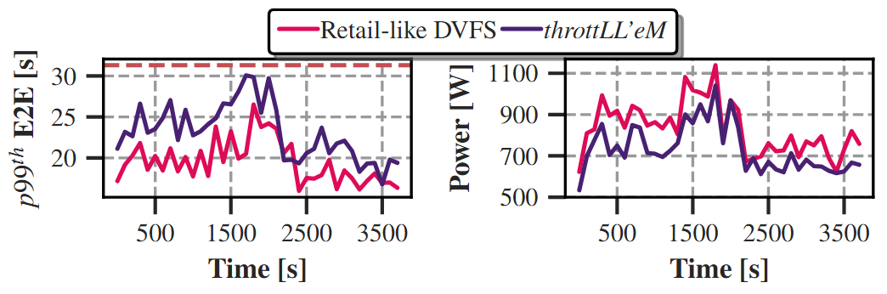
Ablation study and Comparison
Autoscaling reduces energy consumption by 20.8%
Frequency scaling reduces energy consumption by 30.6%
throttLL’eM reduces energy consumption by 41.7% over the baseline.
Compared against a Retail-like DVFS inspired implementation, throttLL’eM achieves XXX lower power consumption on average and approach the SLO deadline more aggressively.
Notes:
To quantify the gains that stem from autoscaling alone, we repeat the same experiment with different configurations.
Triton TP4 refers to the the baseline implementation comprised of 4 GPUs in a tensor parallel configuration.
We also deploy an implementation that only performs autoscaling as well as an implementation that only performs frequency scaling
In this case throttLL’eM at 30% predictor error level, reduces improves energy efficiency by XXX compared to autoscaling only, YY compared to only frequency scaling and provides a XXX improvement over the baseline configuration.
Finally, to highlight the energy gains against existing solutions, we compare throttLL’eM against a Retail-inspired solution. Compared to this implementation, throttLL’eM is able to approach the SLO deadline with greater precision, featuring consuming 12% less energy during the execution of the trace.

