Slide 1
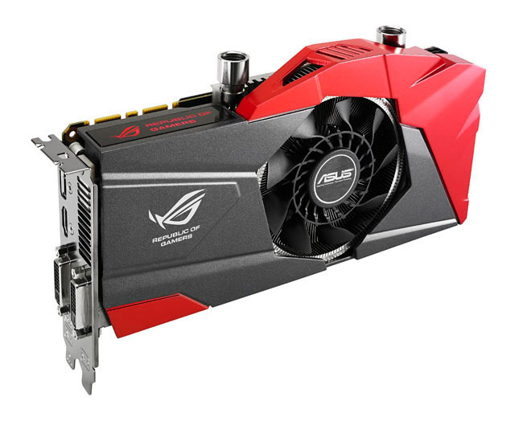



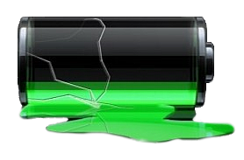

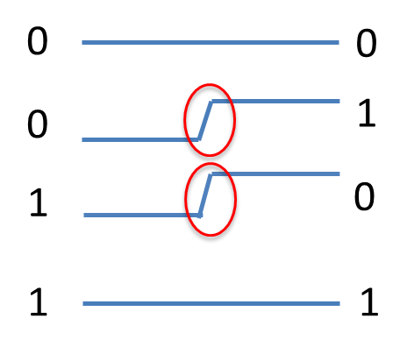

Energy-Efficient Data Compression for GPU Memory Systems
Gennady Pekhimenko (Advisors: Todd C. Mowry and Onur Mutlu) – Carnegie Mellon University
High Performance Computing is Everywhere
Potential for HW-Based Data Compression
Multiple simple patterns: zeros, repeated values, narrow values, pointers (low dynamic range)
Energy efficiency is key across the board
Different Compression Algorithms:
  BΔI [PACT’12] is based on Base-Delta Encoding
  Frequent Pattern Compression (FPC) [ISCA’04]
  C-Pack [Trans. on VLSI’12]
  Statistical Compression (SC²) [ISCA’14]
Applications today are data-intensive
Memory systems are bandwidth constrained
Data Compression is a promising technique to address these challenges
These algorithms improve performance
But there are challenges…
Energy Efficiency: What is a Bit “Toggle”?
Excessive Bit Toggles with Data Compression
How energy is spent in data transfers:
Uncompressed Cache Line
Compressed Cache Line (FPC)
Previous data:
0011
New data:
0101
0x00003A00
0x8001D000
0x00003A01
0x8001D008
0x5 0x3A00
0x7 8001D000
0x5 0x3A01
0x7 8001D008
0x00003A00
0x8001D000
Flit 0
5 3A00 7 8001D000 5 1D
Flit 0
Metadata
Toggles are expensive
XOR
Flit 1
XOR
Flit 1
0x00003A01
0x8001D008
1 01 7 8001D008 5 3A02 1
Energy = CV² + Fixed
..0000001…00001000
# Toggles = 2
001001111…10100011000
# Toggles = 31
Toggle-Aware Energy-Efficient Data Compression
Optimization: Metadata Consolidation (MC)
Problem:
+ 1.53X effective compression ratio
- 2.19X increase in toggle count
Goal:
Find the optimal tradeoff between
toggle count and compression ratio
Key Idea – Energy Control (EC):
Determine toggle count
Use a heuristic (Energy X Delay and
Energy X Delay² metrics)
Throttle compression when needed
Energy Control (EC)
Compressed Cache Line (FPC)
…
0x5 0x3A00 0x5 0x3A01
0x5 0x3A02 0x5 0x3A03
Metadata Consolidation (MC)
0x3A00 0x3A01
0x3A02 0x3A03
0x5 0x5 … 0x5
MC
Consolidated
Metadata
# Toggles = 18
# Toggles = 2
EC efficiently trades compressibility with toggles
MC reduces toggles & preserves compression ratio
Initial Results: Compression Ratio and Toggle Rate
Applications from NVIDIA: Mobile GPU – 54 in total, Discrete GPU – 167 in total
MC Results:
3.2%/2.9% reduction in toggles for FPC/C-Pack
Future Work:
Detailed Power/Energy model
Effect on different layers in memory hierarchy (DRAM and NoCs)
EC significantly reduces the number of toggles
EC preserves most of the compression benefits

