Slide 1





Understanding Latency Variation in Modern DRAM Chips
Experimental Characterization, Analysis, and Optimization
Kevin Chang
Abhijith Kashyap, Hasan Hassan, Saugata Ghose, Kevin Hsieh,
Donghyuk Lee, Tianshi Li, Gennady Pekhimenko, Samira Khan, Onur Mutlu
v1.3

Slide 2
Main Memory Latency Lags Behind
64x
16x
1.2x
Long DRAM latency → performance bottleneck
In-memory DB, Spark, JVM, … [Clapp+ (Intel), IISWC’15]
Google warehouse-scale workloads [Kanev+ (Google), ISCA’15]

Slide 3

Why is Latency High?
DRAM latency: Delay as specified in DRAM standards
  Doesn’t reflect true DRAM device latency
Imperfect manufacturing process → latency variation
High standard latency chosen to increase yield
DRAM A
DRAM B
DRAM C
Standard
Latency
Manufacturing
Variation
Low
High
DRAM Latency

Slide 4
Goals
1
1 Understand and characterize latency variation in modern DRAM chips
2
2 Develop a mechanism that exploits latency variation to reduce DRAM latency

Slide 5
Outline
Motivation and Goals
DRAM Background
Experimental Methodology
Characterization Results
Mechanism: Flexible-Latency DRAM
Conclusion

Slide 6
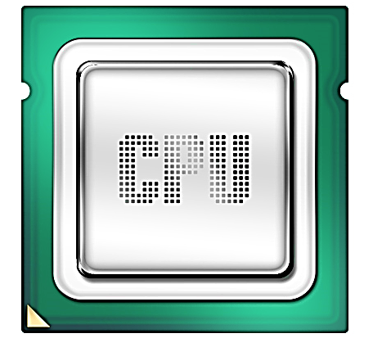
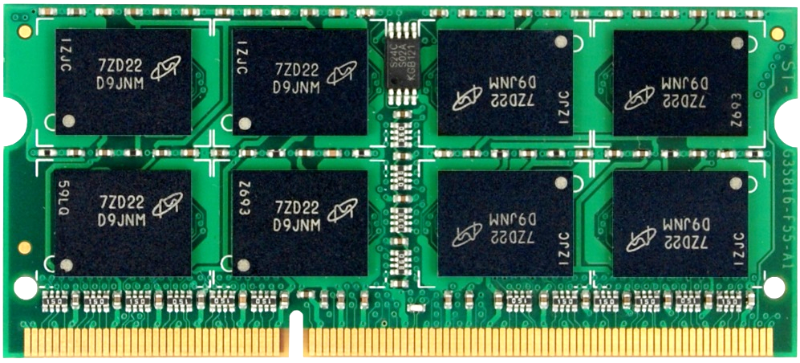
High-Level DRAM Organization
DRAM
chip
DRAM
Channel
DIMM
(Dual in-line memory module)

Slide 7
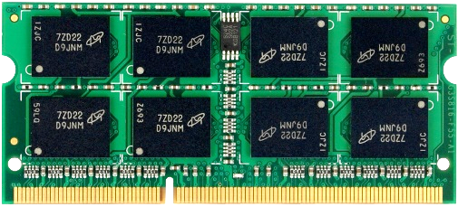
DRAM Chip Internals
…
DRAM Cell
…
…
Row Buffer
8KB (128 cache lines)

Slide 8
DRAM Operations
1
ACTIVATE: Store the row
into the row buffer
1
1
1
1
2
READ: Select the target
cache line and drive to CPU
3
PRECHARGE: Prepare the array for a new ACTIVATE
to CPU

Slide 9
DRAM Timing Parameters
1
Activation latency: tRCD
(13ns / 50 cycles)
2
Precharge latency: tRP
(13ns / 50 cycles)
Command
ACTIVATE
READ
PRECHARGE
Data
1
1
1
1
Cache line (64B)
Duration
Next
ACT

Slide 10
DRAM Latency Variation
Imperfect manufacturing process → latency variation
DRAM A
DRAM B
DRAM C
Slow cells
Low
High
DRAM Latency

Slide 11
Experimental Questions
Imperfect manufacturing process → latency variation
Can we show latency variation in these parameters?
How large is latency variation in modern DRAM chips?
Can we identify the properties of slow cells with long latency?
Can we isolate slow cells to make DRAM faster?

Slide 12
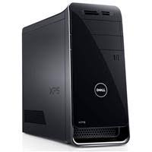
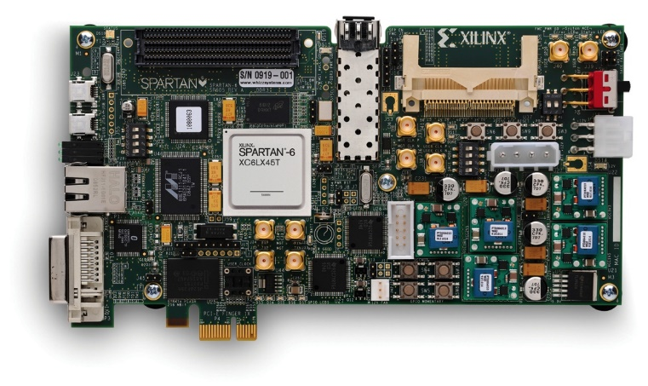
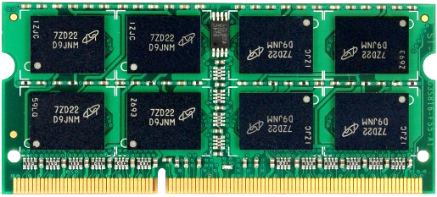
Experimental Methodology
Tool that enables us to freely issue DRAM commands
  Existing systems: Commands are generated and controlled by HW
Custom FPGA-based infrastructure
PCIe
DDR3
PC
FPGA
DIMM
C++ programs to specify commands
Generate
command sequence

Slide 13
Experiments
Swept each timing parameter to read data
  Time step of 2.5ns (FPGA cycle time)
Quantified timing errors: bit flips when using reduced latency
Tested 240 DDR3 DRAM chips from three vendors
  30 DIMMs
  Manufacturing dates: 2011 – 2013
  Capacity: 1GB
  Ambient temperature: 20ºC

Slide 14
Outline
Motivation and Goals
DRAM Background
Experimental Methodology
Characterization Results
  Activation latency
  Precharge latency
Mechanism: Flexible-Latency DRAM
Conclusion

Slide 15

Activation Latency: Key Observation
Observation: ACT errors are isolated in the cells read in the first cache line
1
1
1
1
Not fully
activated
1
1
1
Row Buffer
?
?
Second read w/
sufficient activation time
0
First read after ACT
1
tRCD
X
Command
ACTIVATE
READ
READ
Actual ACT Time

Slide 16
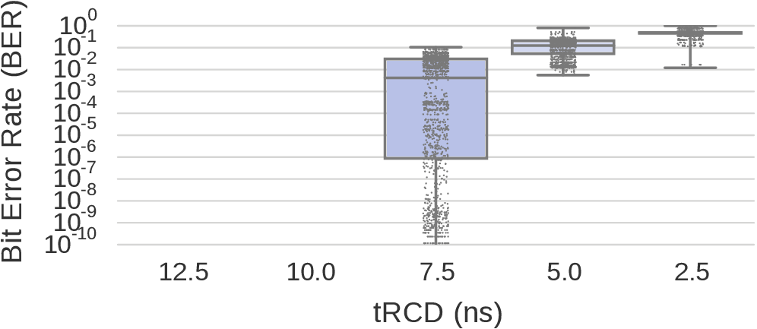
Variation in Activation Errors
Results from 7500 rounds over 240 chips
No ACT Errors
Max
Many errors
Rife w/ errors
Quartiles
Very few errors
Min
13.1ns
standard
Modern DRAM chips exhibit
significant variation in activation latency
Different characteristics across DIMMs

Slide 17
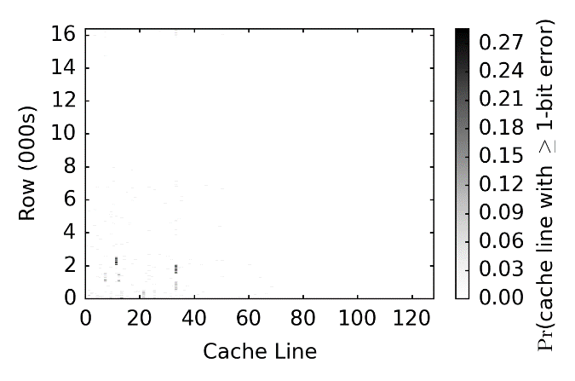
Spatial Locality of Activation Errors
One DIMM @ tRCD=7.5ns
Activation errors are concentrated
at certain columns of cells

Slide 18
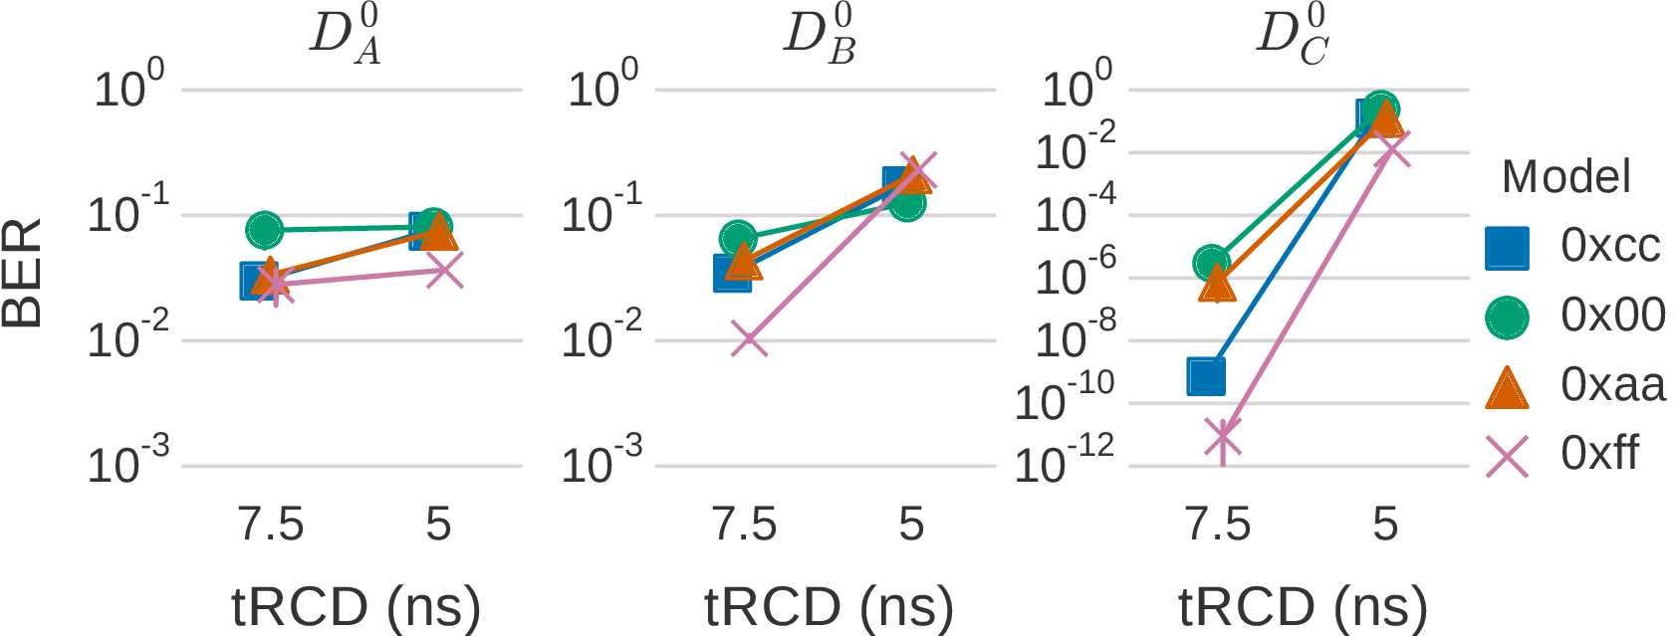
Strong Pattern Dependence
DIMM A
DIMM B
DIMM C
> 4 orders
of magnitude
Row buffer design is biased towards 1 over 0 [Lim+, ISSCC’12]
Activation errors have a strong dependence
on the stored data patterns

Slide 19
Precharge Latency: Key Observation
Observation: PRE errors occur in multiple cache lines in the row activated after a precharge
1
1
1
1
Not fully
precharged
0
0
0
0
1
0
0
1
1
Row Buffer
1
Incorrectly sensed data
tRP
Command
PRECHARGE
ACTIVATE
Actual PRE Time

Slide 20
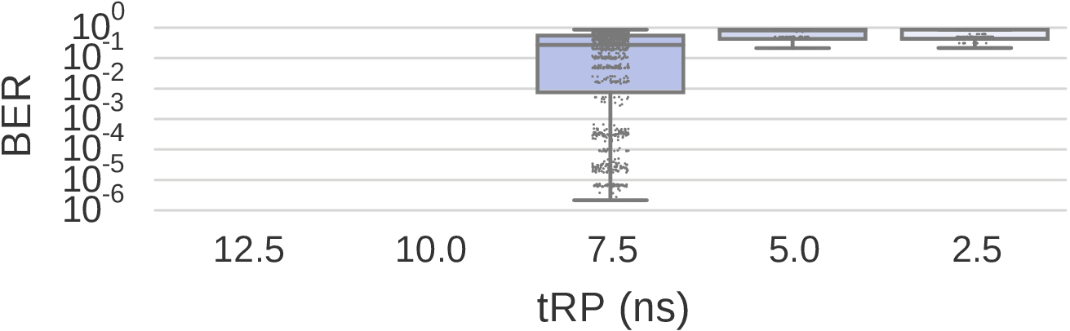
Variation in Precharge Errors
Results from 4000 rounds over 240 chips
No PRE Errors
Many errors
Rife w/ errors
Few errors
13.1ns
standard
Different characteristics across DIMMs
Modern DRAM chips exhibit
significant variation in precharge latency

Slide 21
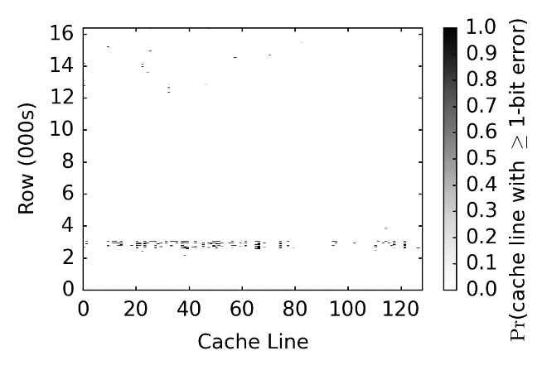
Spatial Locality of Precharge Errors
One DIMM @ tRP=7.5ns
Precharge errors are concentrated
at certain rows of cells

Slide 22
Outline
Motivation and Goals
DRAM Background
Experimental Methodology
Characterization Results
Mechanism: Flexible-Latency DRAM
Conclusion

Slide 23
Mechanism to Reduce DRAM Latency
Observations
  DRAM timing errors are concentrated on certain regions
  All cells operate without errors at 10ns tRCD and tRP
Flexible-LatencY (FLY) DRAM
  A software-transparent design that reduces latency
Key idea:
  1) Divide memory into regions of different latencies
  2) Memory controller: Use lower latency for regions without slow cells; higher latency for other regions

Slide 24
FLY-DRAM Evaluation Methodology
Cycle-level simulator: Ramulator [CAL’15]
https://github.com/CMU-SAFARI/ramulator
8-core system with DDR3 memory
Benchmarks: SPEC2006, TPC, STREAM, random
  40 8-core workloads
Performance metric: Weighted Speedup (WS)

Slide 25
FLY-DRAM Configurations
tRCD
99%
93%
12%
Profiles of 3 real DIMMs
tRP
99%
74%
13%

Slide 26
Results
19.7%
19.5%
17.6%
13.3%
FLY-DRAM improves performance
by exploiting latency variation in DRAM

Slide 27
Other Results in the Paper
Error-correcting codes (ECC)
  Effective at correcting activation errors
Restoration latency
  Significant margin to complete without errors
Effect of temperature
  Difference is not statistically significant to draw conclusion

Slide 28
Conclusion
First to experimentally demonstrate and analyze
latency variation behavior within real DRAM chips
Show across 240 DRAM chips that:
  All cells work below standard latency
  Some regions of cells work even faster, but slow cells in other regions start to fail
  Error rate is data-dependent
FLY-DRAM reduces latency by using low latency for regions without slow cells and high latency for others
  13%/17%/19% speedup based on profiles of 3 real DIMMs
https://github.com/CMU-SAFARI/DRAM-Latency-Variation-Study

Slide 29
Understanding Latency Variation in Modern DRAM Chips
Experimental Characterization, Analysis, and Optimization
Kevin Chang
Abhijith Kashyap, Hasan Hassan, Saugata Ghose, Kevin Hsieh,
Donghyuk Lee, Tianshi Li, Gennady Pekhimenko, Samira Khan, Onur Mutlu

Slide 30
Backup Slides

Slide 31
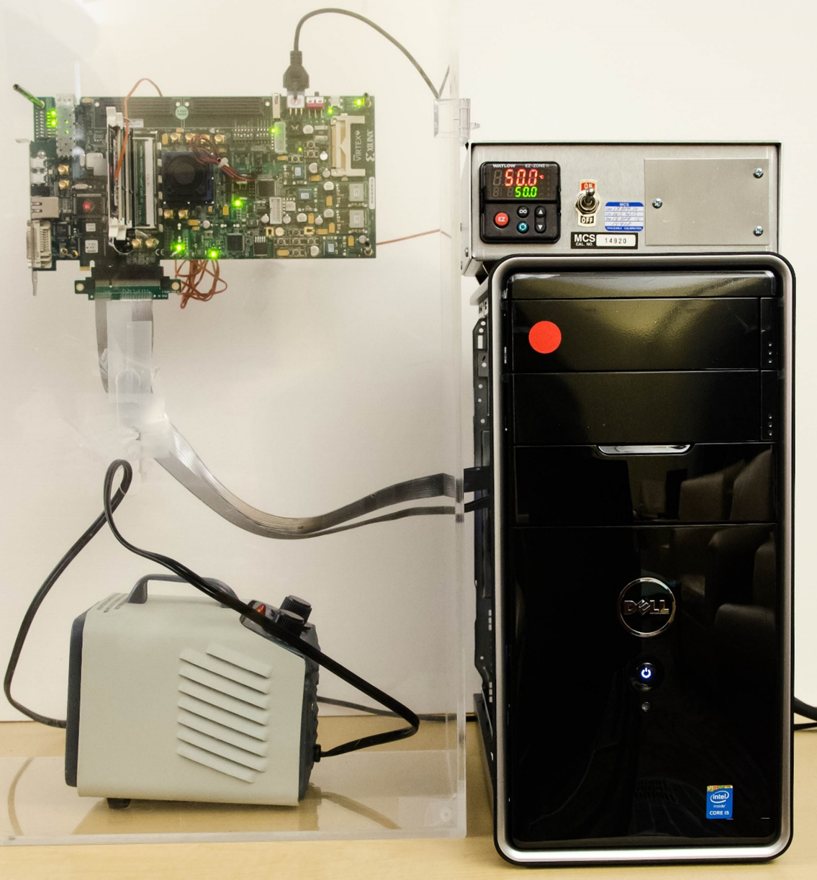
Infrastructure
Temperature
Controller
FPGA
DIMM
Heater

Slide 32
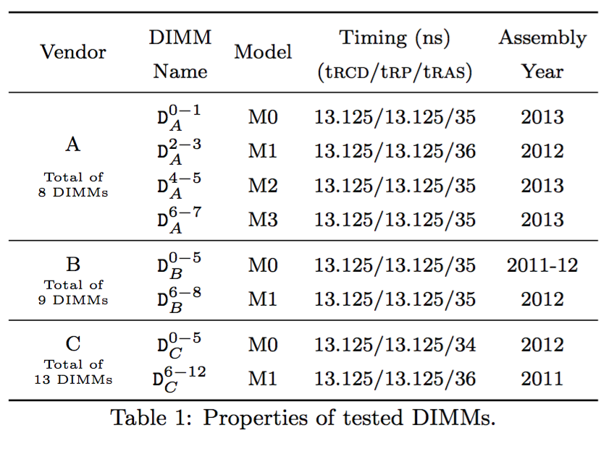
DRAM DIMMs

Slide 33
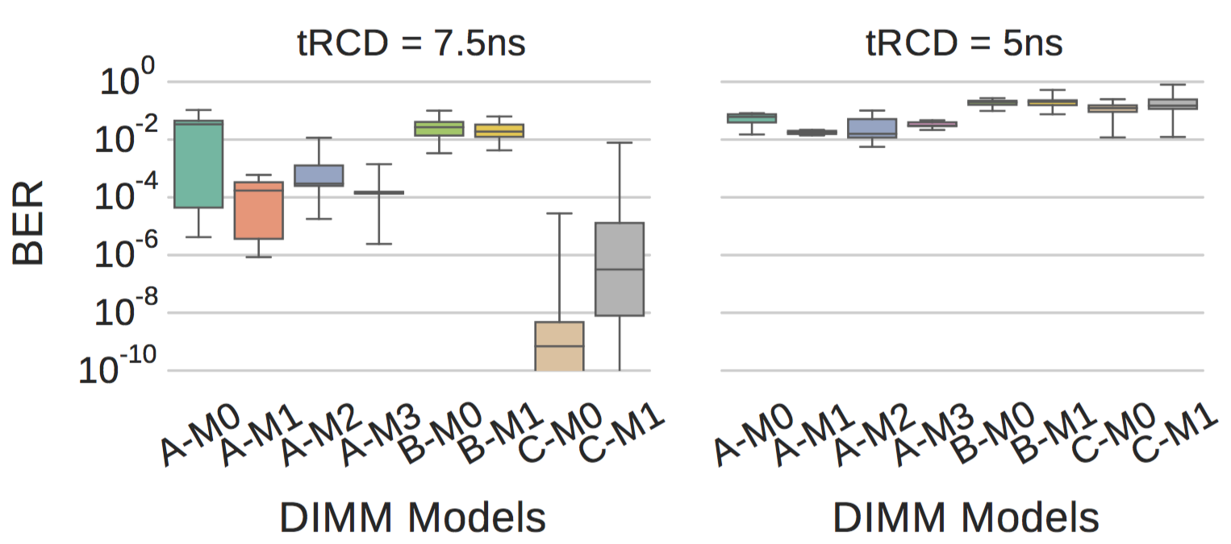
Activation Latency Variation by DRAM Models

Slide 34
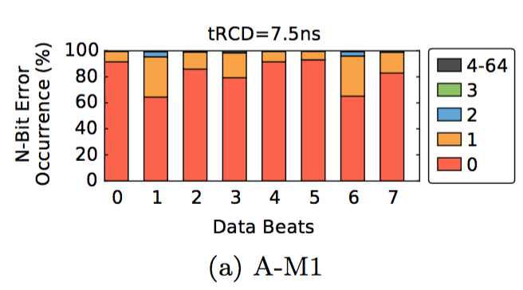
Activation Errors in Data Bursts

Slide 35
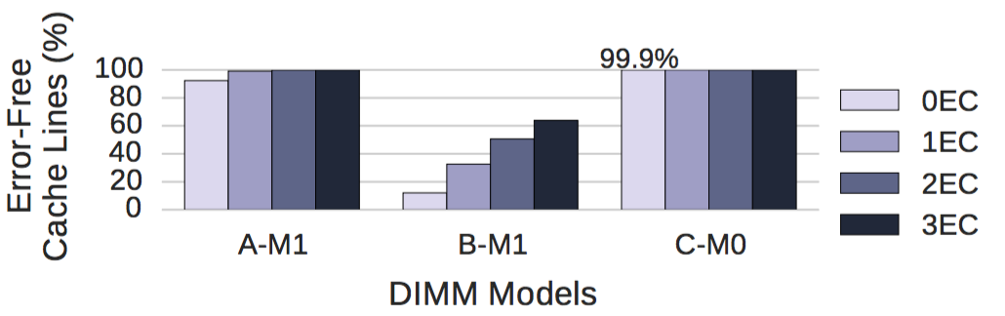
Effect of ECC on Activation Errors

Slide 36
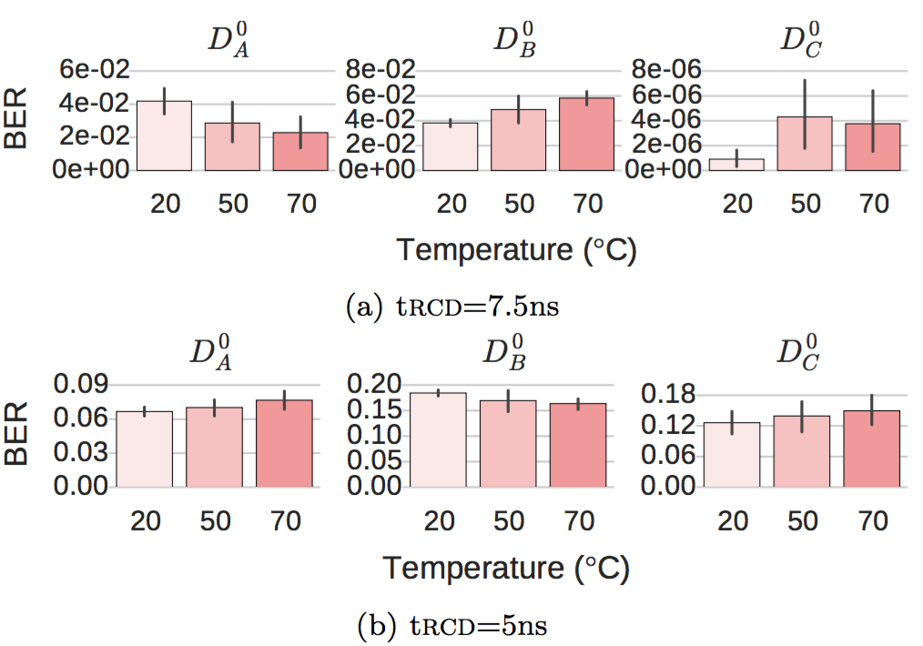
Activation Errors by Temperature

Slide 37
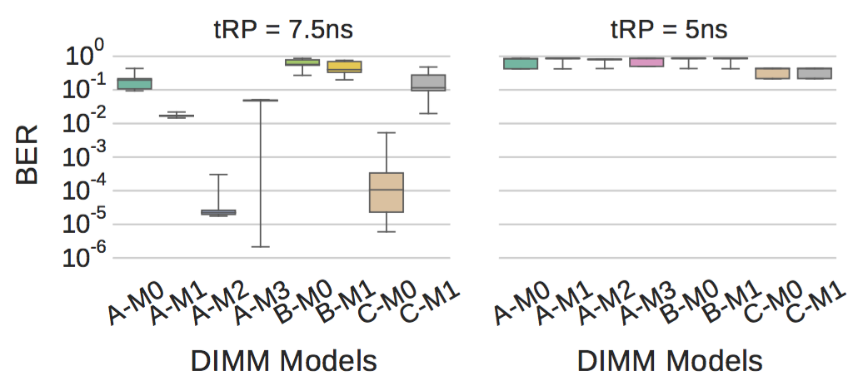
Precharge Latency Variation by DRAM Models

