Slide 1



Improving NAND Flash Memory Lifetime with
Write-hotness Aware Retention Management
WARM
Yixin Luo, Yu Cai, Saugata Ghose, Jongmoo Choi*, Onur Mutlu
Carnegie Mellon University, *Dankook University

Slide 2
Executive Summary
Flash memory can achieve 50x endurance improvement by relaxing retention time using refresh [Cai+ ICCD ’12]
Problem: Refresh consumes the majority of endurance improvement
Goal: Reduce refresh overhead to increase flash memory lifetime
Key Observation: Refresh is unnecessary for write-hot data
Key Ideas of Write-hotness Aware Retention Management (WARM)
  Physically partition write-hot pages and write-cold pages within the flash drive
  Apply different policies (garbage collection, wear-leveling, refresh) to each group
Key Results
  WARM w/o refresh improves lifetime by 3.24x
  WARM w/ adaptive refresh improves lifetime by 12.9x (1.21x over refresh only)
Notes:
As you know, flash memory has limited write endurance.

Slide 3
Outline
Problem and Goal
Key Observations
WARM: Write-hotness Aware Retention Management
Results
Conclusion

Slide 4
Outline
Problem and Goal
Key Observations
WARM: Write-hotness Aware Retention Management
Results
Conclusion

Slide 5
Retention Time Relaxation for Flash Memory
Flash memory has limited write endurance
  Retention time significantly affects endurance
  The duration for which flash memory correctly holds data
Typical flash retention guarantee
Requires refresh to reach this
[Cai+ ICCD ’12]

Slide 6
NAND Flash Refresh
Flash Correct and Refresh (FCR), Adaptive Rate FCR (ARFCR)
[Cai+ ICCD ‘12]
3000
150000
Nominal endurance
Extended endurance
Unusable endurance (consumed by refresh)
Problem: Flash refresh operations reduce extended lifetime
Goal: Reduce refresh overhead, improve flash lifetime
Notes:
Prior work proposes Flash correct and refresh FCR which applies periodic refresh operations to extend flash endurance.
Adaptive rate FCR is another technique that adaptively change the refresh rate to wear-out levels.

Slide 7
Outline
Problem and Goal
Key Observations
WARM: Write-hotness Aware Retention Management
Results
Conclusion

Slide 8
Observation 1: Refresh Overhead is High
Notes:
Evaluated 16 real workload traces to find % of

Slide 9
Observation 2: Write-Hot Pages Can Skip Refresh
Update
Retention Effect
Write-Hot Page
Write-Hot Page
Invalid Page
Write-Cold Page
Write-Cold Page
Write-Cold Page
Invalid Page
Write-Cold Page
Write-Hot Page
Write-Cold Page
Invalid Page
Write-Hot Page
Write-Hot Page
Write-Hot Page
Skip Refresh
Need Refresh

Slide 10

Conventional Write-Hotness Oblivious Management
Flash Memory
Hot Page 1
Erase
Hot Page 1
Read
Page 0
Page 256
……
Page M
Cold Page 2
Hot Page 4
Write
Page 1
Page 257
Page M+1
Hot Page 1
Cold Page 2
Page 2
Page 258
Page M+2
……
……
……
Cold Page 3
Cold Page 3
Hot Page 4
Cold Page 4
Cold Page 5
Hot Page 4
Page 255
Page 511
Page M+255
Unable to relax retention time for blocks with write-hot and cold pages
Flash Controller

Slide 11
Key Idea: Write-Hotness Aware Management
Flash Memory
Hot Page 1
Page 0
Page 256
……
Page M
Cold Page 2
Hot Page 4
Page 1
Page 257
Hot Page 1
Page M+1
Hot Page 1
Cold Page 3
Page 2
Page 258
Page M+2
Hot Page 4
Cold Page 5
……
……
……
Hot Page 4
Hot Page 1
Hot Page 4
Hot Page 1
Page 255
Page 511
Page M+255
Can relax retention time for blocks with write-hot pages only
Flash Controller

Slide 12
Outline
Problem and Goal
Key Observations
WARM: Write-hotness Aware Retention Management
Results
Conclusion

Slide 13
WARM Overview
Design Goal:
  Relax retention time w/o refresh for write-hot data only
WARM: Write-hotness Aware Retention Management
  Write-hot/write-cold data partitioning algorithm
  Write-hotness aware flash policies
    Partition write-hot and write-cold data into separate blocks
    Skip refreshes for write-hot blocks
    More efficient garbage collection and wear-leveling

Slide 14
Write-Hot/Write-Cold Data Partitioning Algorithm
Cold Virtual Queue
①
TAIL
……
HEAD
Cold Data
1. Initially, all data is cold and is stored in the cold virtual queue.
Notes:
Dynamically partitions write-hot and write-cold data into separate queues, allowing WARM to quickly adapt to workload behavior.

Slide 15
Write-Hot/Write-Cold Data Partitioning Algorithm
Cold Virtual Queue
①
TAIL
……
HEAD
Cold Data
②
2. On a write operation, the data is pushed to the tail of the cold virtual queue.

Slide 16
Write-Hot/Write-Cold Data Partitioning Algorithm
Cold Virtual Queue
①
TAIL
……
HEAD
Cold Data
②
Recently-written data is at the tail of cold virtual queue.

Slide 17
Write-Hot/Write-Cold Data Partitioning Algorithm
Hot Virtual Queue
Cold Virtual Queue
④
TAIL
①
TAIL
……
HEAD
Hot Data
Cold Data
②
③
Hot Window
Cooldown Window
3, 4. On a write hit in the cooldown window,
the data is promoted to the hot virtual queue.

Slide 18
Write-Hot/Write-Cold Data Partitioning Algorithm
Hot Virtual Queue
Cold Virtual Queue
④
TAIL
HEAD
①
TAIL
……
HEAD
Hot Data
Cold Data
②
③
Hot Window
Cooldown Window
Data is sorted by write-hotness in the hot virtual queue.

Slide 19
Write-Hot/Write-Cold Data Partitioning Algorithm
Hot Virtual Queue
Cold Virtual Queue
④
TAIL
HEAD
①
TAIL
……
HEAD
Hot Data
Cold Data
⑤
②
③
Hot Window
Cooldown Window
5. On a write hit in hot virtual queue, the data is pushed to the tail.

Slide 20
Write-Hot/Write-Cold Data Partitioning Algorithm
Hot Virtual Queue
Cold Virtual Queue
④
TAIL
HEAD
⑥
①
TAIL
……
HEAD
Hot Data
Cold Data
⑤
②
③
Hot Window
Cooldown Window
6. Unmodified hot data will be demoted to the cold virtual queue.

Slide 21
Conventional Flash Management Policies
Flash Translation Layer (FTL)
  Map data to erased blocks
  Translate logical page number to physical page number
Garbage Collection
  Triggered before erasing a victim block
  Remap all valid data on the victim block
Wear-leveling
  Triggered to balance wear-level among blocks

Slide 22
Write-Hotness Aware Flash Policies
Flash Drive
Hot Block Pool
Cold Block Pool
Block 0
Block 0
Block 1
Block 1
Block 2
Block 2
Block 3
Block 3
Block 4
Block 4
Block 5
Block 5
Block 6
Block 6
Block 7
Block 7
Block 8
Block 8
Block 9
Block 9
Block 10
Block 10
Block 11
Block 11
Write-hot data → naturally relaxed retention time
Program in block order
Garbage collect in block order
All blocks naturally wear-leveled
Write-cold data → lower write frequency, less wear-out
Conventional garbage collection
Conventional wear-leveling algorithm

Slide 23
Dynamically Sizing the Hot and Cold Block Pools
All blocks are divided between the hot and cold block pools
Find the maximum hot pool size
Reduce hot virtual queue size to maximize cold pool lifetime
Size the cooldown window to minimize ping-ponging of data between the two pools
Notes:
Guarantees data in the hot block pool is hot enough to skip refresh
Cold pool lifetime usually limits overall lifetime
Ping ponging hurts flash lifetime

Slide 24
Outline
Problem and Goal
Key Observations
WARM: Write-hotness Aware Retention Management
Results
Conclusion

Slide 25
Methodology
DiskSim 4.0 + SSD model
Parameter | Value
Page read to register latency | 25 μs
Page write from register latency | 200 μs
Block erase latency | 1.5 ms
Data bus latency | 50 μs
Page/block size | 8 KB/1 MB
Die/package size | 8 GB/64 GB
Total capacity | 256 GB
Over-provisioning | 15%
Endurance for 3-year retention time | 3,000 PEC
Endurance for 3-day retention time | 150,000 PEC

Slide 26
WARM Configurations
WARM-Only
  Relax retention time in hot block pool only
  No refresh needed
WARM+FCR
  First apply WARM-Only
  Then also relax retention time in cold block pool
  Refresh cold blocks every 3 days
WARM+ARFCR
  Relax retention time in both hot and cold block pools
  Adaptively increase the refresh frequency over time
Notes:
Add color

Slide 27
Flash Lifetime Improvements
WARM+ARFCR
21%
WARM+FCR
30%
12.9x
WARM-Only
3.24x
Baseline
WARM-Only
FCR
WARM+FCR
ARFCR
WARM+ARFCR

Slide 28
WARM-Only Endurance Improvement
3.58x
Notes:
One reason for WARM’s lifetime improvement is endurance improvement.

Slide 29
WARM+FCR Refresh Operation Reduction
Notes:
WARM also reduces unnecessary refresh operations in extended lifetime.

Slide 30
WARM Performance Impact
Worst Case:
< 6%
Avg. Case:
< 2%
Notes:
Talk about partition -> garbage collection efficiency is lower in some cases

Slide 31
Other Results in the Paper
Breakdown of write frequency into host writes, garbage collection writes, refresh writes in the hot and cold block pools
  WARM reduces refresh writes significantly while having low garbage collection overhead
Sensitivity to different capacity over-provisioning amounts
  WARM improves flash lifetime more as over-provisioning increases
Sensitivity to different refresh intervals
  WARM improves flash lifetime more as refresh frequency increases

Slide 32
Outline
Problem and Goal
Key Observations
WARM: Write-hotness Aware Retention Management
Results
Conclusion

Slide 33
Conclusion
Flash memory can achieve 50x endurance improvement by relaxing retention time using refresh [Cai+ ICCD ’12]
Problem: Refresh consumes the majority of endurance improvement
Goal: Reduce refresh overhead to increase flash memory lifetime
Key Observation: Refresh is unnecessary for write-hot data
Key Ideas of Write-hotness Aware Retention Management (WARM)
  Physically partition write-hot pages and write-cold pages within the flash drive
  Apply different policies (garbage collection, wear-leveling, refresh) to each group
Key Results
  WARM w/o refresh improves lifetime by 3.24x
  WARM w/ adaptive refresh improves lifetime by 12.9x (1.21x over refresh only)

Slide 34
Other Work by SAFARI on Flash Memory
J. Meza, Q. Wu, S. Kumar, and O. Mutlu. A Large-Scale Study of Flash Memory Errors in the Field, SIGMETRICS 2015.
Y. Cai, Y. Luo, S. Ghose, E. F. Haratsch, K. Mai, O. Mutlu. Read Disturb Errors in MLC NAND Flash Memory: Characterization and Mitigation, DSN 2015.
Y. Cai, Y. Luo, E. F. Haratsch, K. Mai, O. Mutlu. Data Retention in MLC NAND Flash Memory: Characterization, Optimization and Recovery, HPCA 2015.
Y. Cai, G. Yalcin, O. Mutlu, E. F. Haratsch, O. Unsal, A. Cristal, K. Mai. Neighbor-Cell Assisted Error Correction for MLC NAND Flash Memories, SIGMETRICS 2014.
Y. Cai, O. Mutlu, E. F. Haratsch, K. Mai. Program Interference in MLC NAND Flash Memory: Characterization, Modeling, and Mitigation, ICCD 2013.
Y. Cai, G. Yalcin, O. Mutlu, E. F. Haratsch, A. Cristal, O. Unsal, K. Mai. Error Analysis and Retention-Aware Error Management for NAND Flash Memory, Intel Technology Jrnl. (ITJ), Vol. 17, No. 1, May 2013.
Y. Cai, E. F. Haratsch, O. Mutlu, K. Mai. Threshold Voltage Distribution in MLC NAND Flash Memory: Characterization, Analysis and Modeling, DATE 2013.
Y. Cai, G. Yalcin, O. Mutlu, E. F. Haratsch, A. Cristal, O. Unsal, K. Mai. Flash Correct-and-Refresh: Retention-Aware Error Management for Increased Flash Memory Lifetime, ICCD 2012.
Y. Cai, E. F. Haratsch, O. Mutlu, K. Mai. Error Patterns in MLC NAND Flash Memory: Measurement, Characterization, and Analysis, DATE 2012.

Slide 35
Improving NAND Flash Memory Lifetime with
Write-hotness Aware Retention Management
WARM
Yixin Luo, Yu Cai, Saugata Ghose, Jongmoo Choi*, Onur Mutlu
Carnegie Mellon University, *Dankook University

Slide 36
Backup Slides

Slide 37
Related Work: Retention Time Relaxation
Perform periodic refresh on data to relax retention time [Cai+ ICCD ’12, Cai+ ITJ ’13, Liu+ DAC ’13, Pan+ HPCA ’12]
  Fixed-frequency refresh (e.g., FCR)
  Adaptive refresh (e.g., ARFCR): incrementally increase refresh freq.
  Incurs a high overhead, since block-level erase/rewrite required
  WARM can work alongside periodic refresh
Refresh using rewriting codes [Li+ ISIT ’14]
  Avoids block-level erasure
  Adds complex encoding/decoding circuitry into flash memory

Slide 38
Related Work: Hot/Cold Data Separation in FTLs
Mechanisms with statically-sized windows/bins for partitioning
  Multi-level hash tables to improve FTL latency [Lee+ TCE ’09, Wu+ ICCAD ’06]
  Sorted tree for wear-leveling [Chang SAC ’07]
  Log buffer migration for garbage collection [Lee+ OSR ’08]
  Multiple static queues for garbage collection [Chang+ RTAS ’02, Chiang SPE ’99, Jung CSA ’13]
  Static window sizing bad for WARM
    Number of write-hot pages changes over time
    Undersized: reduced benefits
    Oversized: data loss of cold pages incorrectly in hot page window

Slide 39
Related Work: Hot/Cold Data Separation in FTLs
Estimating page update frequency for dynamic partitioning
  Using most recent re-reference distance for garbage collection [Stoica VLDB ’13] or for write buffer locality [Wu+ MSST ’10]
  Using multiple Bloom filters for garbage collection [Park MSST ’11]
  Prone to false positives: increased migration for WARM
  Reverse translation to logical page no. consumes high overhead
Placing write-hot data in worn-out pages [Huang+ EuroSys ’14]
  Assumes SSD w/o refresh
  Benefits limited by number of worn-out pages in SSD
  Hot data pool size cannot be dynamically adjusted

Slide 40
Related Work: Non-FTL Hot/Cold Data Separation
These works all use multiple statically-sized queues
  Reference counting for garbage collection [Joao+ ISCA ’09]
  Cache replacement algorithms [Johnson+ VLDB ’94, Megiddo+ FAST ’03, Zhou+ ATC ’01]
Static window sizing bad for WARM
  Number of write-hot pages changes over time
  Undersized: reduced benefits
  Oversized: data loss of cold pages incorrectly in hot page window

Slide 41
References
[Cai+ ICCD ’12] Y. Cai, G. Yalcin, O. Mutlu, E. F. Haratsch, A. Cristal, O. Unsal, K. Mai. Flash Correct-and-Refresh: Retention-Aware Error Management for Increased Flash Memory Lifetime, ICCD 2012.
[Cai+ ITJ ’13] Y. Cai, G. Yalcin, O. Mutlu, E. F. Haratsch, A. Cristal, O. Unsal, K. Mai. Error Analysis and Retention-Aware Error Management for NAND Flash Memory, Intel Technology Jrnl. (ITJ), Vol. 17, No. 1, May 2013.
[Chang SAC ’07] L.-P. Chang. On Efficient Wear Leveling for Large-Scale Flash-Memory Storage Systems, SAC 2007.
[Chang+ RTAS ’02] L.-P. Chang, T.-W. Kuo. An Adaptive Striping Architecture for Flash Memory Storage Systems of Embedded Systems, RTAS 2002.
[Chiang SPE ’99] M.-L. Chiang, P. C. H. Lee, R.-C. Chang. Using Data Clustering to Improve Cleaning Performance for Flash Memory, Software: Practice & Experience (SPE), 1999.
[Huang+ EuroSys ’14] P. Huang, G. Wu, X. He, W. Xiao. An Aggressive Worn-out Flash Block Management Scheme to Alleviate SSD Performance Degradation, EuroSys 2014.
[Joao+ ISCA ’09] J. A. Joao, O. Mutlu, Y. N. Patt. Flexible Reference-Counting-Based Hardware Acceleration for Garbage Collection, ISCA 2009.
[Johnson+ VLDB ’94] T. Johnson, D. Shasha. 2Q: A Low Overhead High Performance Buffer Management Replacement Algorithm, VLDB 1994.
[Jung CSA ’13] T. Jung, Y. Lee, J. Woo, I. Shin. Double Hot/Cold Clustering for Solid State Drives, CSA 2013.

Slide 42
References
[Lee+ OSR ’08] S. Lee, D. Shin, Y.-J. Kim, J. Kim. LAST: Locality-Aware Sector Translation for NAND Flash Memory-Based Storage Systems, ACM SIGOPS Operating Systems Review (OSR), 2008.
[Lee+ TCE ’09] H.-S. Lee, H.-S. Yun, D.-H. Lee. HFTL: Hybrid Flash Translation Layer Based on Hot Data Identification for Flash Memory, IEEE Trans. Consumer Electronics (TCE), 2009.
[Li+ ISIT ’14] Y. Li, A. Jiang, J. Bruck. Error Correction and Partial Information Rewriting for Flash Memories, ISIT 2014.
[Liu+ DAC ’13] R.-S. Liu, C.-L. Yang, C.-H. Li, G.-Y. Chen. DuraCache: A Durable SSD Cache Using MLC NAND Flash, DAC 2013.
[Megiddo+ FAST ’03] N. Megiddo, D. S. Modha. ARC: A Self-Tuning, Low Overhead Replacement Cache, FAST 2003.
[Pan+ HPCA ’12] Y. Pan, G. Dong, Q. Wu, T. Zhang. Quasi-Nonvolatile SSD: Trading Flash Memory Nonvolatility to Improve Storage System Performance for Enterprise Applications, HPCA 2012.
[Park MSST ’11] D. Park, D. H. Du. Hot Data Identification for Flash-Based Storage Systems Using Multiple Bloom Filters, MSST 2011.
[Stoica VLDB ’13] R. Stoica and A. Ailamaki. Improving Flash Write Performance by Using Update Frequency, VLDB 2013.
[Wu+ ICCAD ’06] C.-H. Wu, T.-W. Kuo. An Adaptive Two-Level Management for the Flash Translation Layer in Embedded Systems, ICCAD 2006.
[Wu+ MSST ’10] G. Wu, B. Eckart, X. He. BPAC: An Adaptive Write Buffer Management Scheme for Flash-based Solid State Drives, MSST 2010.
[Zhou+ ATC ’01] Y. Zhou, J. Philbin, K. Li. The Multi-Queue Replacement Algorithm for Second Level Buffer Caches, USENIX ATC 2001.

Slide 43
Workloads Studied
Synthetic Workloads
Trace | Source | Length | Description | Trace | Source | Length | Description
iozone | IOzone | 16 min | File system benchmark | postmark | Postmark | 8.3 min | File system benchmark
Real-World Workloads
Trace | Source | Length | Description | Trace | Source | Length | Description
financial | UMass | 1 day | Online transaction processing | rsrch | MSR | 7 days | Research projects
homes | FIU | 21 days | Research group activities | src | MSR | 7 days | Source control
web-vm | FIU | 21 days | Web mail proxy server | stg | MSR | 7 days | Web staging
hm | MSR | 7 days | Hardware monitoring | ts | MSR | 7 days | Terminal server
prn | MSR | 7 days | Print server | usr | MSR | 7 days | User home directories
proj | MSR | 7 days | Project directories | wdev | MSR | 7 days | Test web server
prxy | MSR | 7 days | Firewall/web proxy | web | MSR | 7 days | Web/SQL server

Slide 44
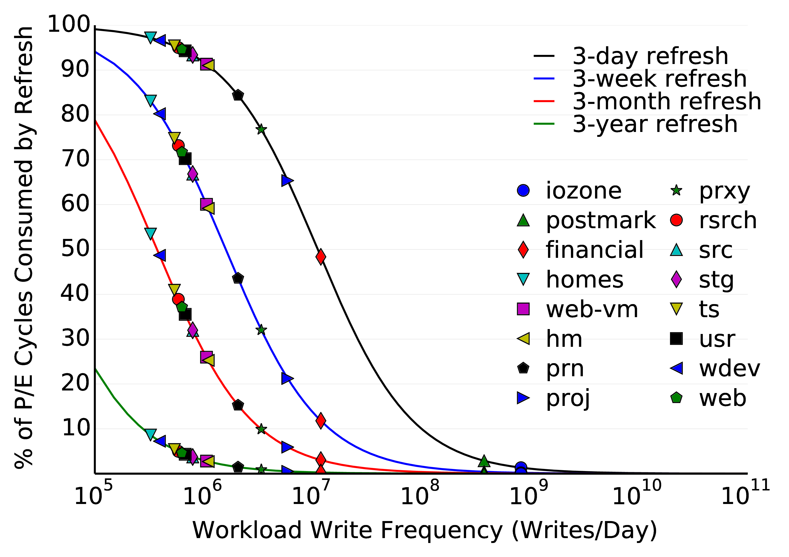
Refresh Overhead vs. Write Frequency

Slide 45
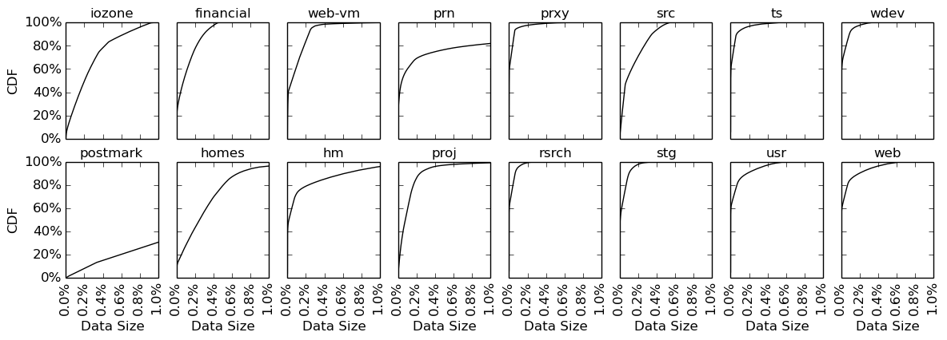
Highly-Skewed Distribution of Write Activity
Small amount of write-hot data generates large fraction of writes.

Slide 46
WARM-Only vs. Baseline

Slide 47
WARM+FCR vs. FCR-Only

Slide 48
WARM+ARFCR vs. ARFCR-Only

Slide 49
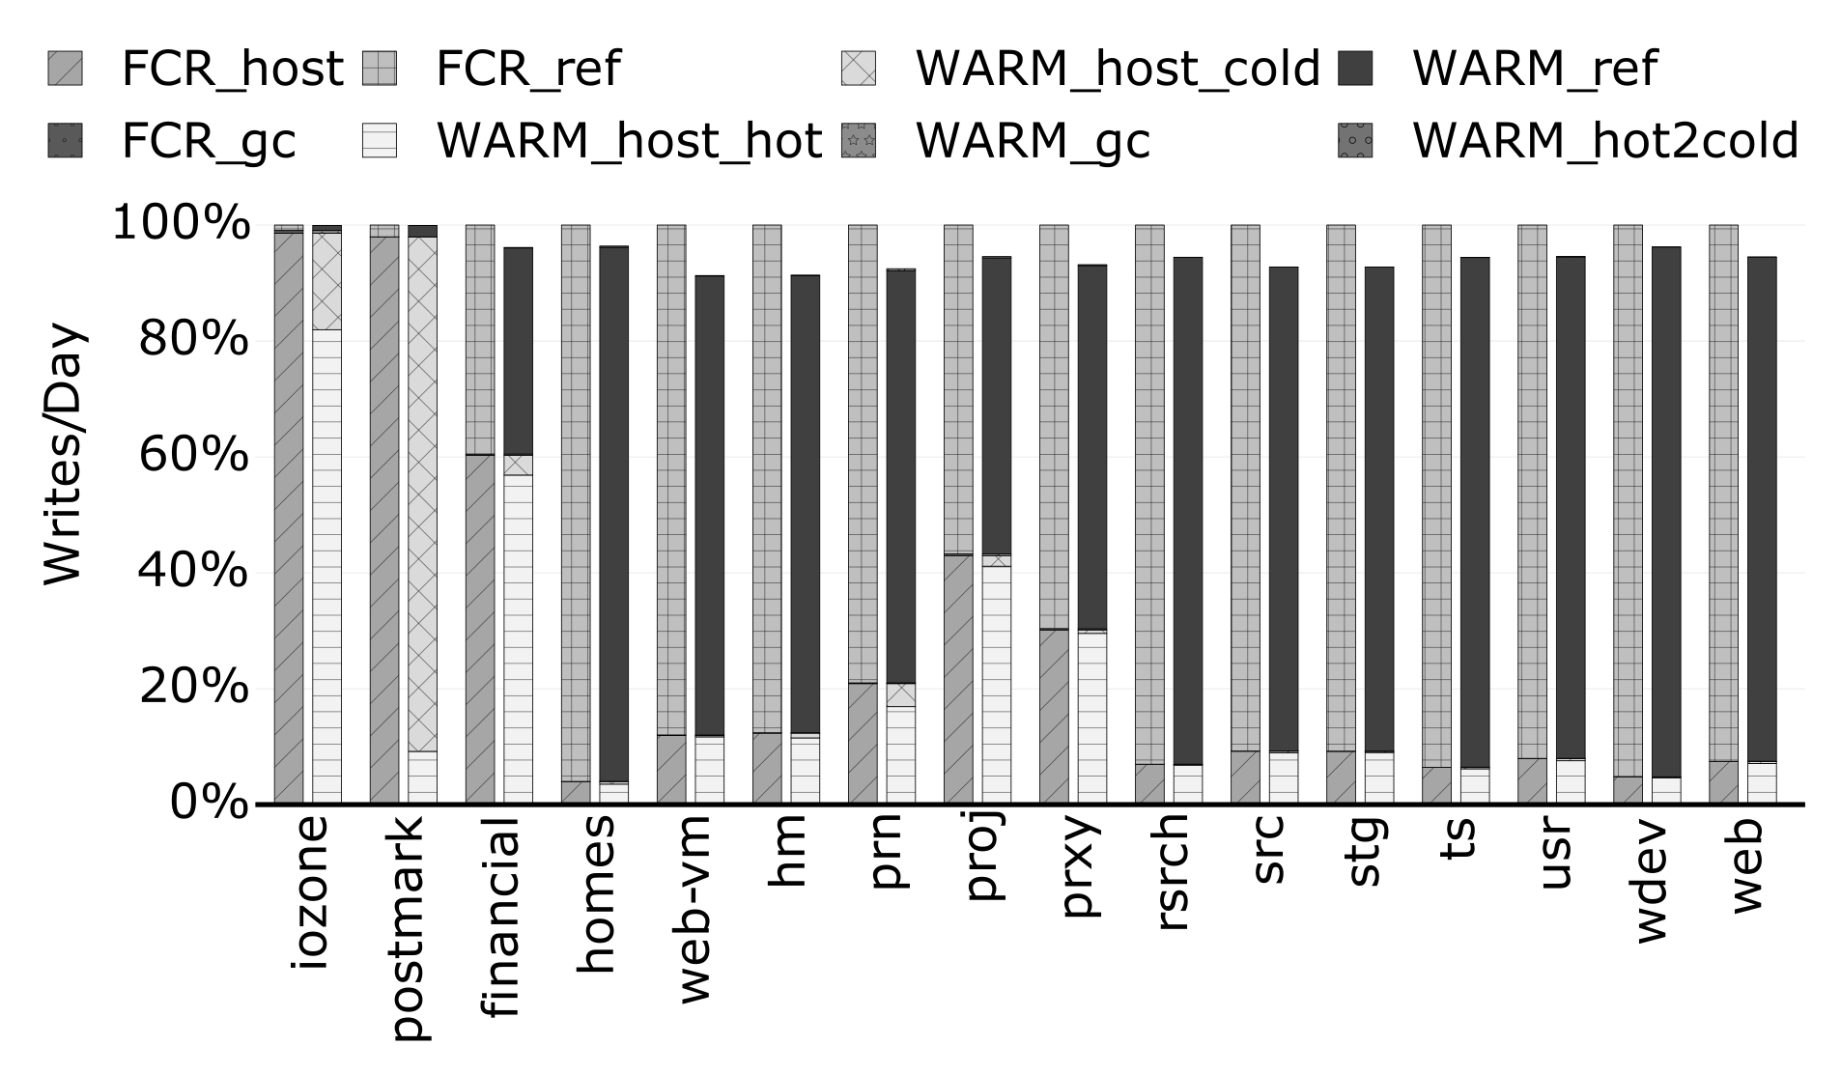
Breakdown of Writes

Slide 50
Sensitivity to Capacity Over-Provisioning

Slide 51
Sensitivity to Refresh Frequency

Slide 52
Lifetime Improvement from WARM

Slide 53
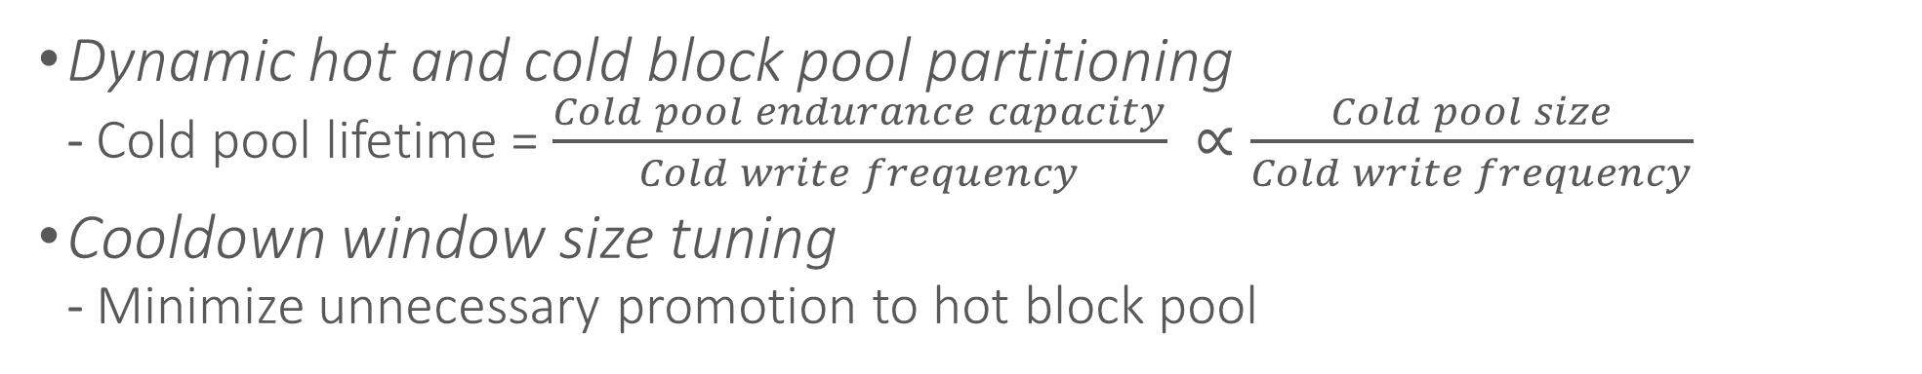
WARM Flash Management Policies
Flash Drive
Hot Block Pool
Cold Block Pool
Block 0
Block 0
Block 1
Block 1
Block 2
Block 2
Block 3
Block 3
Block 4
Block 4
Block 5
Block 5
Block 6
Block 6
Block 7
Block 7
Block 8
Block 8
Block 9
Block 9
Block 10
Block 10
Block 11
Block 11
TAIL
HEAD
Cooldown window
Dynamic hot and cold block pool partitioning
  Cold pool lifetime = $\frac{Cold pool endurance capacity}{Cold write frequency} ∝\frac{Cold pool size}{Cold write frequency}$
Cooldown window size tuning
  Minimize unnecessary promotion to hot block pool

Slide 54
Revisit WARM Design Goals
Write-hot/write-cold data partition algorithm
Goal 1: Partition write-hot and write-cold data ✓
Goal 2: Quickly adapt to workload behavior ✓
Flash management policies
Goal 3: Apply different management policies to improve flash lifetime ✓
  Skip refreshes in hot block pool
  Increase garbage collection efficiency
Goal 4: Low implementation and performance overhead ✓
  4 counters and ~1KB storage overhead

