Slide 1




Zorua: A Holistic Approach to Resource Virtualization in GPUs
Session 2A
Monday, 5:20 PM
Nandita Vijaykumar
Kevin Hsieh, Gennady Pekhimenko, Samira Khan,
Ashish Shrestha, Saugata Ghose, Adwait Jog, Phillip B. Gibbons, Onur Mutlu

Slide 2
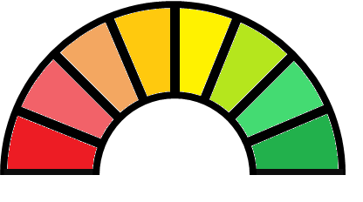
High Performance

Slide 3
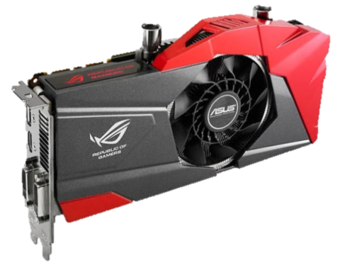
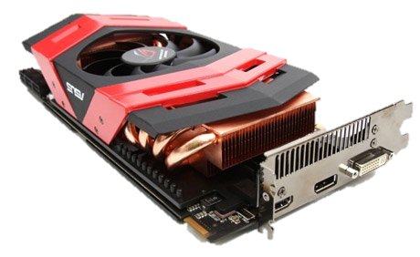
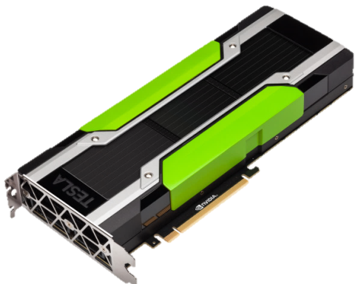
High Performance
GPUs

Slide 4
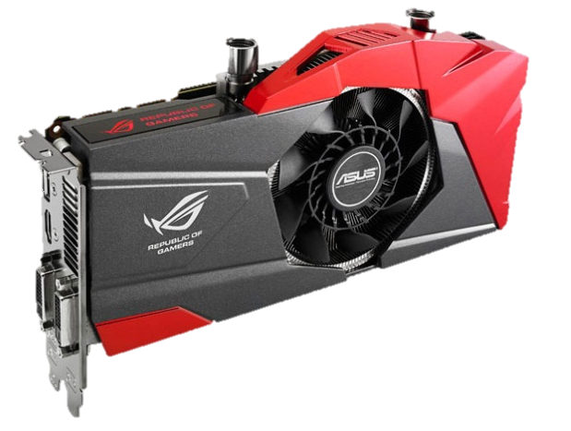
__global__ void CUDAkernel2DCT(float *dst, float *src, int I){
int OffsThreadInRow = threadIdx.y * B + threadIdx.x;
for(unsigned int i = 0; i < B; i++)
bl_ptr[i * X] = src[i * I];
__syncthreads();
CUDAsubroutineInplaceDCTvector(…);
__syncthreads();
CUDAsubroutineInplaceDCTvector(…);
for(unsigned int i = 0; i < B; i++)
dst[i *I] = bl_ptr[i * X]; }

Slide 5
__global__ void CUDAkernel2DCT(float *dst, float *src, int I){
int OffsThreadInRow = threadIdx.y * B + threadIdx.x;
for(unsigned int i = 0; i < B; i++)
bl_ptr[i * X] = src[i * I];
__syncthreads();
CUDAsubroutineInplaceDCTvector(…);
__syncthreads();
CUDAsubroutineInplaceDCTvector(…);
for(unsigned int i = 0; i < B; i++)
dst[i *I] = bl_ptr[i * X]; }
Low Performance!

Slide 6
The programmer has to statically allocate
3 major resources:

Slide 7
The programmer has to statically allocate
3 major resources:
Registers
R

Slide 8
The programmer has to statically allocate
3 major resources:
Registers
Scratchpad Memory
R
S

Slide 9
The programmer has to statically allocate
3 major resources:
Registers
Scratchpad Memory
Thread Slots
R
S
T

Slide 10
The programmer has to statically allocate
3 major resources:
Registers
Scratchpad Memory
Thread Slots
R
S
T
Imperfect Allocation ⇨ Low Performance

Slide 11
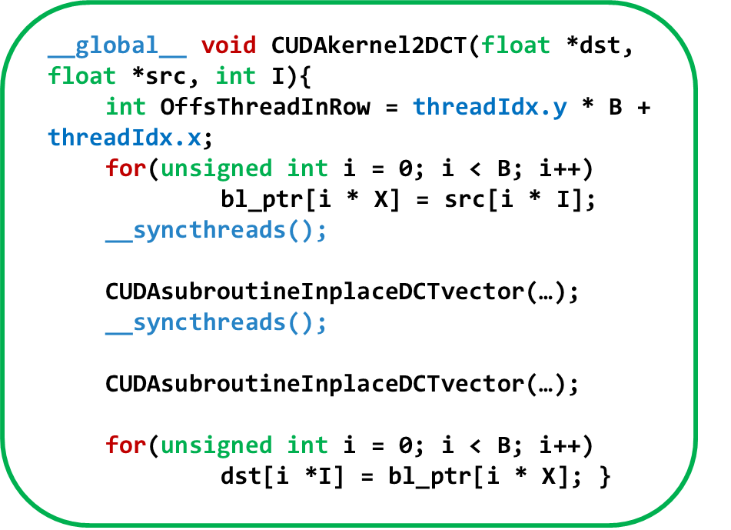

Tune Code
R
S
T
FIX: Usage of Registers, Scratchpad and Thread Slots

Slide 12
High Performance
R
S
T
Problem: Programming Effort

Slide 13
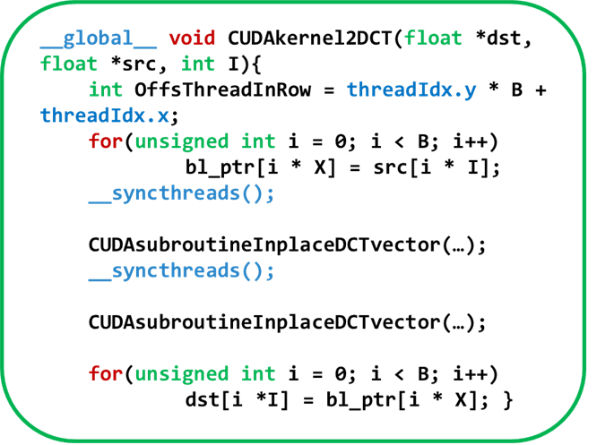
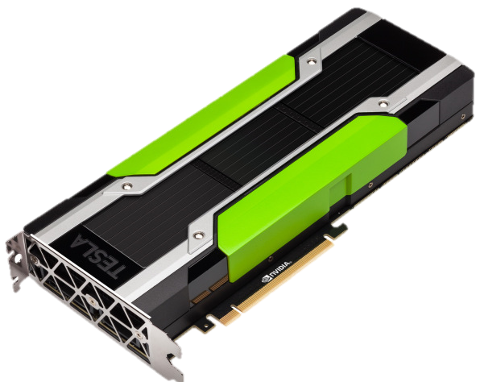
GPU 1
GPU 2
R
S
T
R
S
T

Slide 14
Low
Performance!
Problem: Performance Portability

Slide 15
Programmer-specified resource allocation leads to 3 key issues with:
Programming ease
Performance portability
Performance for optimized code

Slide 16
Our Approach
Decouple
Programmer-specified resource usage
Allocation in the hardware

Slide 17
Zorua:
A Framework to Virtualize
On-chip Resources in GPUs

Slide 18

Zorua: A Holistic Approach to Resource Virtualization in GPUs
Session 2A
Monday, 5:20 PM
Nandita Vijaykumar
Kevin Hsieh, Gennady Pekhimenko, Samira Khan,
Ashish Shrestha, Saugata Ghose, Adwait Jog, Phillip B. Gibbons, Onur Mutlu

