Slide 1


Zwift : A Programming Framework for High Performance Text Analytics on Compressed Data
ICS-2018
June 12-15, Beijing
Feng Zhang †⋄, Jidong Zhai ⋄, Xipeng Shen #, Onur Mutlu ⋆, Wenguang Chen ⋄
†Renmin University of China
⋄Tsinghua University
#North Carolina State University
⋆ETH Zürich

Slide 2
Motivation
Data management evolution in history.
Database System
Data warehouse
Big data System
MySQL
SQL Server
DB2
Data Warehousing
Mining
Complex structures
MapReduce
Hadoop
Spark
Every data, 2.5 quintillion bytes of data created – 90% data in the world today has been created in the last two years alone[1].
What if the data are too big
that exceed storage capacity?
QUESTION:
[1] What is Big Data?
https://www-01.ibm.com/software/data/bigdata/what-is-big-data.html

Slide 3
Motivation
Challenge 1:
  SPACE: Large Space Requirement
Challenge 2:
  TIME: Long Processing Time
Observation:
  Using Hash Table to check redundant content
REUSE
Whether we can perform
analytics directly on compressed data?

Slide 4
Motivation
Our Idea:
  Text analytics directly on compressed data (TADOC)
Input:
Rules:
R0:
R1
a
R2
R2
edge
a b a a b c a b d a b c a b d
R0 → R1 a R2 R2
R1 → a b
R2 → R1 c R1 d
R2:
R1
c
R1
d
R1:
a
b
(a) Original data
(b) Grammar-based compression
(c) DAG Representation
Feng Zhang, Jidong Zhai, Xipeng Shen, and Onur Mutlu. Potential of A Method for Text Analytics Directly on Compressed Data. Technical Report TR-2017-4, NCSU, 2017.

Slide 5
Motivation
How text analytics directly on compressed data (TADOC) recovers data?
R0:
R1
a
R2
R2
Output:
R2:
R1
c
R1
d
R1:
a
b

Slide 6
Motivation
How text analytics directly on compressed data (TADOC) recovers data?
R0:
R1
a
R2
R2
Output:
a b
R2:
R1
c
R1
d
R1:
a
b

Slide 7
Motivation
How text analytics directly on compressed data (TADOC) recovers data?
R0:
R1
a
R2
R2
Output:
a b a
R2:
R1
c
R1
d
R1:
a
b

Slide 8
Motivation
How text analytics directly on compressed data (TADOC) recovers data?
R0:
R1
a
R2
R2
Output:
a b a
R2:
R1
c
R1
d
R1:
a
b

Slide 9
Motivation
How text analytics directly on compressed data (TADOC) recovers data?
R0:
R1
a
R2
R2
Output:
a b a
R2:
R1
c
R1
d
R1:
a
b

Slide 10
Motivation
How text analytics directly on compressed data (TADOC) recovers data?
R0:
R1
a
R2
R2
Output:
a b a a b
R2:
R1
c
R1
d
R1:
a
b

Slide 11
Motivation
How text analytics directly on compressed data (TADOC) recovers data?
R0:
R1
a
R2
R2
Output:
a b a a b c
R2:
R1
c
R1
d
R1:
a
b

Slide 12
Motivation
How text analytics directly on compressed data (TADOC) recovers data?
R0:
R1
a
R2
R2
Output:
a b a a b c a b
R2:
R1
c
R1
d
R1:
a
b

Slide 13
Motivation
How text analytics directly on compressed data (TADOC) recovers data?
R0:
R1
a
R2
R2
Output:
a b a a b c a b d
R2:
R1
c
R1
d
R1:
a
b

Slide 14
Motivation
How text analytics directly on compressed data (TADOC) recovers data?
R0:
R1
a
R2
R2
Output:
a b a a b c a b d a b c a b d
R2:
R1
c
R1
d
R1:
a
b

Slide 15
Motivation
Text analytics directly on compressed data (TADOC), why it is good?
In format.
R0:
R1
a
R2
R2
Appear more than once, but only store once!
R2:
R1
c
R1
d
Challenge 1:
  Space
R1:
a
b
Appear more than once, but only compute once!
Challenge 2:
  Time

Slide 16
What’s more?
Even BETTER!

Slide 17
Motivation
Text analytics directly on compressed data (TADOC), why it is good?
In Process:
R0:
R1
x2
a
x1
R0:
R1
a
R2
R2
R0:
R1
a
R2
R2
R2
x1
2
2
R2:
R1
c
R1
d
1
1
R2:
R1
c
R1
d
R2:
R1
x2
c
x1
d
x1
2
R1:
a
b
2
R1:
a
b
R1:
a
x1
Further saves storage space and computation time.
Some applications do not need to keep the sequence.
i
In each rule, we may remove sequence info too.
b
x1
weight

Slide 18
Outline
We are here!
Introduction
  Motivation & Example
  Programming Challenges
  Solution
Zwift Implementation
  Language Overview
  Language Features
Results
  Benchmarks
  Performance
  Storage Savings & Productivity
Conclusion
Use word count for illustration
Not easy to generalize this technique
A conceptual framework and a high level solution
How we implement our idea
Exhibition of the Zwift from several perspectives

Slide 19
Example
<element, frequency>
word
count
6
1
a
0
i
Step #
b
0
5
c
2
0
Word Count
i
Weight
2
d
0
Calculation;
R0 -> R1, R0 -> R2.
1
Weight of R0: 1
Local word table in R0: <a,1>
Local rule table in R0:
<R1,1>, <R2, 2>
R0:
R1
a
R2
R2
Weight of R2: 2
Local word table in R2: <c,1>, <d,1>
Local rule table in R2: <R1, 2>
2
1
R2:
R1
c
R1
d
4
Calculation; R2 -> R1.
2
Calculation: (4+1).
3
Weight of R1: 5
Local word table in R1: <a,1>, <b,1>
R1:
a
b
Results integration.
4
Notes:
1. R0 propagates the frequency of R1 (which is 1) to R1, and the frequency of R2 (which is 2) to R2.
2. R2 calculates its weight (which is 2), and propagates the frequency of R1 multiplied by R2’s weight to R1.
3. R1 calculates its weight, which is 5 (4+1).
4. We integrate the local word table in each node multiplied by its weight as the final result.

Slide 20
Example
i
Step #
Word Count
i
Weight
R0 propagates the frequency of R1 (which is 1) to R1, and the frequency of R2 (which is 2) to R2.
1
Weight of R0: 1
Local word table in R0: <a,1>
Local rule table in R0: <R1,1>, <R2, 2>
R0:
R1
a
R2
R2
2
1
R2:
R1
c
R1
d
4
R1 calculates its weight, which is 5 (4+1).
3
R2 calculates its weight (which
is 2), and propagates the frequency
of R1 multiplied by R2’s weight to R1.
2
Weight of R1: 5
Local word table in R1: <a,1>, <b,1>
R1:
a
b
Weight of R2: 2
Local word table in R2: <c,1>, <d,1>
Local rule table in R2: <R1, 2>
We integrate the local word table in each node multiplied by its weight as the final result.
4

Slide 21
Programming Challenges
Problem dimension
i
Step #
1
Weight of R0: 1
Local table in R0: <a,1>
i
Weight
R0:
R1
R1
R2
a
2
How to keep file information?
When to remove sequence information?
Implementation dimension
1
R1:
R2
c
R2
d
4
2
Weight of R1: 2
Local table in R1: <c,1>, <d,1>
R2:
a
b
Dataset dimension
3
Weight of R2: 5
Local table in R2: <a,1>, <b,1>
We integrate the local table in each node multiplied by its weight as the final result.
4
Notes:
Problem dimension: Different analytics problems have different requirements and complexities.
Implementation dimension: There are multiple ways to implement TADOC for a given data analytics problem.
Dataset dimension: The attributes of input datasets may sometimes substantially affect the overhead and benefits of a TADOC implementation.

Slide 22
Programming Challenges
i
Step #
Problem dimension
<w,i>
Word table
<a,6>, <b,5>
<c,2>, <d,2>
CFG relation
Information propagation
3
<a, 2×2 + 1 +1> = <a, 6>
<b, 2×2 + 1> = <b, 5>
<c, 1×2 > = <c, 2>
<d, 1×2 > = <d, 2>
R0:
R1
R1
R2
a
Implementation dimension
Which one is better?
2
<a,2>, <b,2>
<c,1>, <d,1>
R1:
R2
c
R2
d
<a, 1×2> = <a, 2>
<b, 1×2> = <b, 2>
<c, 1>
<d, 1>
Dataset dimension
1
R2:
a
b
<a,1>, <b,1>

Slide 23
Programming Challenges
Problem dimension
Traversal Order
or
or
?
Implementation dimension
Dataset dimension
The best traversal order may depend on input.

Slide 24

Solution
A conceptual framework, a six-element tuple (G, V, F, $⋁$,D, $∧$)
  A graph G, DAG representation
R0:
R1
a
R2
R2
R2:
R1
c
R1
d
G, how to represent it.
R1:
a
b
Notes:
A graph G, which is the DAG representation of the compression results on a dataset.

Slide 25

Solution
A conceptual framework, a six-element tuple (G, V, F, $⋁$,D, $∧$)
  A domain of values V, possible values as the outputs
R0:
R1
a
R2
R2
R2:
R1
c
R1
d
V, what do we want to get from G?
R1:
a
b
Notes:
A domain of values V, which defines the possible values as the outputs of the document analytics of interest.

Slide 26

Solution
A conceptual framework, a six-element tuple (G, V, F, $⋁$,D, $∧$)
  A domain of values F, possible values to be propagated
R0:
R1
a
R2
R2
2
1
R2:
R1
c
R1
d
4
F, what to propagate?
R1:
a
b
Notes:
A domain of values F, which defines the possible values to be propagated across G.

Slide 27

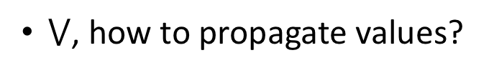
Solution
A conceptual framework, a six-element tuple (G, V, F, $⋁$,D, $∧$)
  A meet operator $⋁$, how to transform values
1
Calculation;
R0 -> R1, R0 -> R2.
R0:
R1
a
R2
R2
$⋁$, how to propagate values?
2
1
R2:
R1
c
R1
d
3
4
Calculation: (4+1).
Calculation; R2 -> R1.
2
R1:
a
b
Notes:
A meet operator $⋁$, which defines how to transform values in F at one step of the traversal of G.

Slide 28
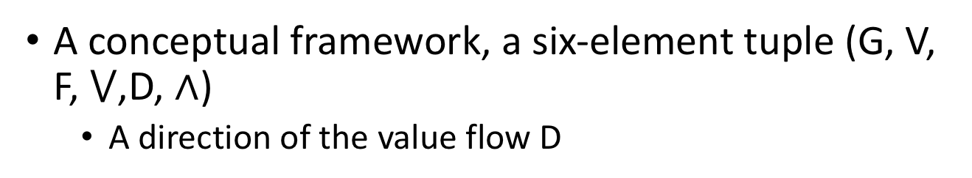
Solution
A conceptual framework, a six-element tuple (G, V, F, $⋁$,D, $∧$)
  A direction of the value flow D
R0:
R1
a
R2
R2
D, what direction?
R2:
R1
c
R1
d
R1:
a
b
Notes:
A direction of the value flow D, which is FORWARD (parents before children) or BACKWARD (children after parents) or DEPTHFIRST (in the order of the original files).

Slide 29
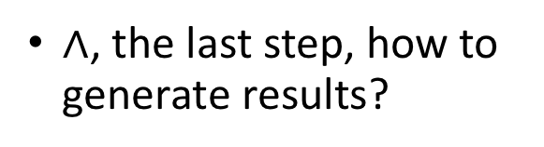
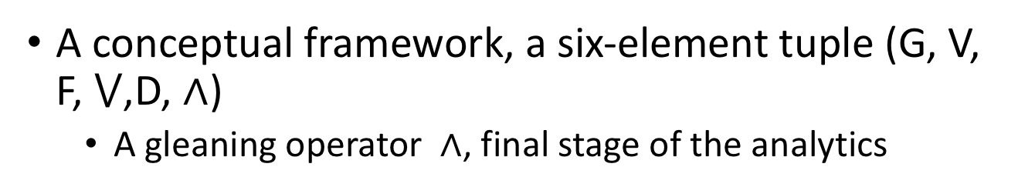
Solution
A conceptual framework, a six-element tuple (G, V, F, $⋁$,D, $∧$)
  A gleaning operator $∧$, final stage of the analytics
1
R0:
R1
a
R2
R2
2
$∧$, the last step, how to generate results?
1
R2:
R1
c
R1
d
4
2
3
R1:
a
b
Results integration.
4
Notes:
A gleaning operator $∧$, which defines how to transform values in V in the final stage of the analytics.

Slide 30

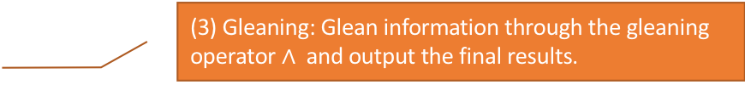
Solution
High-level algorithm for TADOC:
(1) Loading: Load the grammar, build G (or its variants), and initialize the data structures local to each node or global to the algorithm.
Compressed data (DAG)
(2) Propagation: Propagate information with the meet operator $⋁$ while traversing G in direction D.
Memory
DAG traversal
(3) Gleaning: Glean information through the gleaning operator $∧$and output the final results.
Results
Notes:
(1) Loading: Load the grammar, build G (or its variants), and initialize the data structures local to each node or global to the algorithm.
(2) Propagation: Propagate information with the meet operator $⋁$ while traversing G in direction D.
(3) Gleaning: Glean information through the gleaning operator $∧$and output the final results.

Slide 31
Contribution
How to generalize the idea of TADOC
Zwift, the first programming framework for TADOC
  The Zwift Language
  A compiler and runtime
  A utility library

Slide 32
Outline
Introduction
  Motivation & Example
  Programming Challenges
  Solution
Zwift Implementation
  Language Overview
  Language Features
Results
  Benchmarks
  Performance
  Storage Savings & Productivity
Conclusion

Slide 33
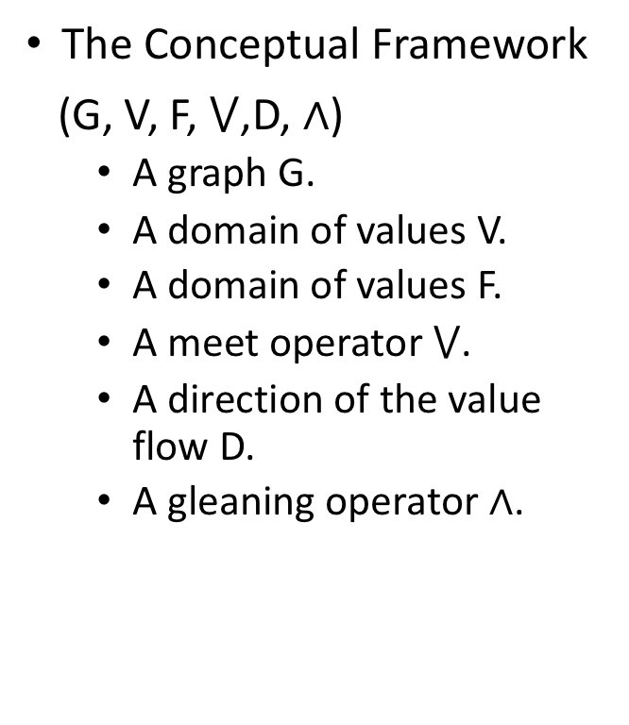
The Zwift Language
Zwift DSL template.
The Conceptual Framework
(G, V, F, $⋁$,D, $∧$)
  A graph G.
  A domain of values V.
  A domain of values F.
  A meet operator $⋁$.
  A direction of the value flow D.
  A gleaning operator $∧$.
01 ELEMENT = LETTER/WORD/SENTENCE
02 USING_FILE = true/false
03 NodeStructure = {
04 //data structures in each node
05 }
06 Init = {
07 //initializations for each node in ZwiftDAG
08 }
09 Direction = FORWARD/BACKWARD/DEPTHFIRST
10 Action = {
11 //actions taken at each node during a traversal
12 }
13 Result = {
14 // result structure
15 }
16 FinalStage = {
17 // final operations to produce the results
18 }

Slide 34
Language Features
Edge Merging
  Edge merging merges multiple edges between two nodes into one, and the weight of the edge may be used to indicate the number of original edges in the Zwift code.
Node Coarsening
  Node coarsening reduces the size of the graph, and at the same time, reduces the number of substrings spanning across nodes.
Two-Level Bit Vector
  Level Two contains a number of N -bit vectors (where N is a configurable parameter). Level One contains a pointer array and a level-1 bit vector.

Slide 35
Language Features
Coarse-Grained Parallelism
  The parallelism is at the data level. The coarse-grained method also simplifies the conversion from sequential code to parallel and distributed versions of the code.
Version Selection
  Zwift allows programmers to easily run the different versions on some representative inputs.
Double Compression
  Double compression performs further compression (e.g., using Gzip) of the compressed results from Sequitur.

Slide 36
Outline
Introduction
  Motivation & Example
  Programming Challenges
  Solution
Zwift Implementation
  Language Overview
  Language Features
Results
  Benchmarks
  Performance
  Storage Savings & Productivity
Conclusion

Slide 37
Benchmarks
Six benchmarks
  Word Count, Inverted Index, Sequence Count, Ranked Inverted Index, Sort, Term Vector
Five datasets
  580 MB ~ 300 GB
Two platforms
  Single node
  Spark cluster (10 nodes on Amazon EC2)

Slide 38
Benchmarks
processing time
(a) Manual-direct (baseline)
original files
processing
result
preprocessing time
processing time
original files
Gzip
compression
Gunzip
processing
result
(b) Manual-gzip
preprocessing time
processing time
original files
Double
compression
Gunzip
processing
result
(c) Manual-opt
preprocessing time
processing time
original files
Double
compression
Gunzip
processing
result
(d) Zwift

Slide 39
Performance
Execution time benefits of speedup over manual-direct.
  Zwift yields 2X speedup, on average, over manual-direct.
  Zwift and manual-opt show similar performance, which indicates that Zwift successfully unleashes most power of TADOC.
Notes:
We'd like to clarify the relations between manual-opt and Zwift. Both versions apply our proposed TADOC techniques to text analytics; manual-opt does it manually while Zwift does it (and some adaptive optimizations) automatically. Comparing them to the default benchmarks shows the benefits of our proposed TADOC techniques; we hence used the default benchmarks as the baseline.
Zwift and manual-opt show similar performance (Fig 4), which indicates that Zwift successfully unleashes most power of TADOC.

Slide 40
Storage Savings
Zwift reduces storage usage by 90.8%, even more than manual-gzip does.

Slide 41
Productivity
On average, the Zwift code is 84.3% shorter than the equivalent C++ code.

Slide 42
Conclusion
Zwift is an effective framework for TADOC.
  It reduces storage usage by 90.8%
  It reduces execution time by 41.0%
Zwift significantly improves programming productivity.
Notes:
Zwift is an effective framework for general-purpose text analytics directly on compressed data.
Zwift significantly improves programming productivity, while effectively unleashing the power of text analytics directly on compressed data.
Zwift produces code that reduces storage usage by 90.8% and execution time by 41.0% on six text analytics problems.

Slide 43
Thanks!
Any questions?

